Slide 1
UniCoV
Surveillance to detect
SARS-CoV-2
Ministers Briefing
13-October-21
Using New Technologies in Testing for Respiratory Viruses
The UCC approach
Mobile Apps
Point of Care Testing
COVID-19 Advisory Group 17th January 2022
Dr Michael Byrne
Dr. John MacSharry

Slide 2
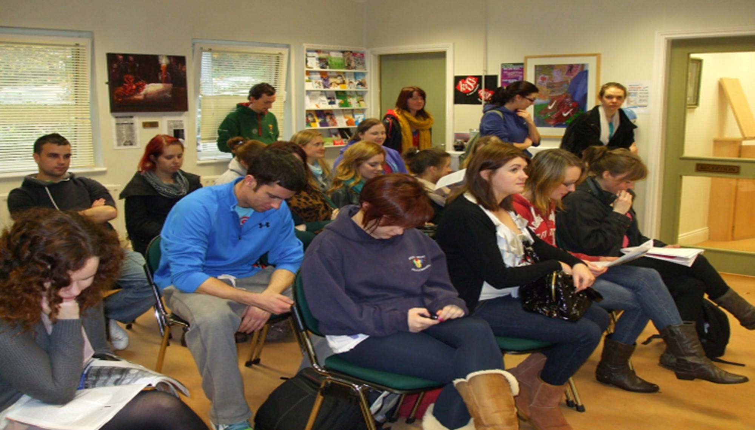
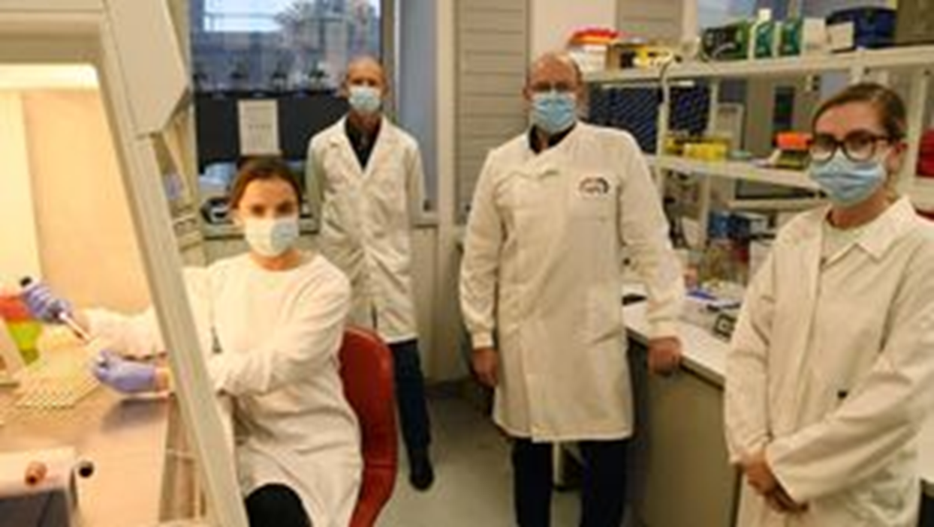
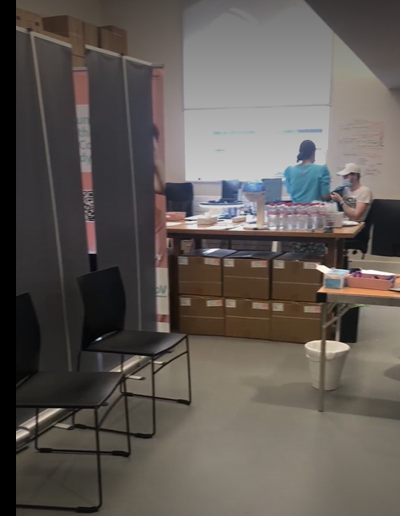
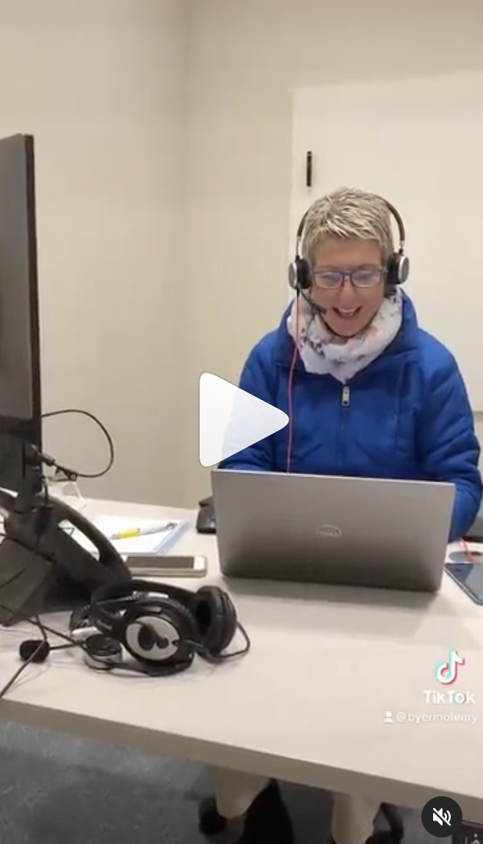
Student Health Centre Student Health Department University College Cork
Microbiology Laboratory School of Microbiology University College Cork
UniCoV COVID Central The Hub University College Cork

Slide 3
UniCoV
Using New Technologies in Testing for Respiratory Viruses
The UCC approach
Surveillance to detect
SARS-CoV-2
Ministers Briefing
13-October-21
Why we used (new) technology: mobile app(s) during C-19
How we used (new) technology: mobile app(s) during C-19
How we used app technology with new testing technology C-19: UniCoV
How we are using new testing technology on other respiratory viruses

Slide 4
UniCoV
Using New Technologies in Testing for Respiratory Viruses
The UCC approach
Surveillance to detect
SARS-CoV-2
Ministers Briefing
13-October-21
Why we used mobile app technology:
July 2020: Clinical Placements contingent on reporting C-19
UCC Student Health prior experience of IT/IS app-based solutions
UCC Student Health support case-finding and to provide close-loop care
Potential for upscaling to whole UCC community to support return

Slide 5
UniCoV
Using New Technologies in Testing for Respiratory Viruses
The UCC approach
Why did we develop COVID-19 apps?
Surveillance to detect
SARS-CoV-2
Ministers Briefing
13-October-21
Needed a solution that could do the following:
Daily Symptom Screen/Infectious Risk Screen: Control Access "Pass"
Daily Report: to School and Placement setting
Advise Participant Notify Student Health Closed Loop (Refer & Care)
Needed a solution which would be:
Available: off the shelf or rapidly developed and responsive to evolving needs
Secure: GDPR Compliant: HEI Security Compliant
Easy to use, using familiar technology, reasonable cost

Slide 6
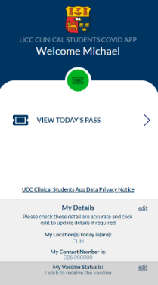
Using New Technologies in Testing for Respiratory Viruses
The UCC approach
UniCoV
Surveillance to detect
SARS-CoV-2
Ministers Briefing
13-October-21

Slide 7
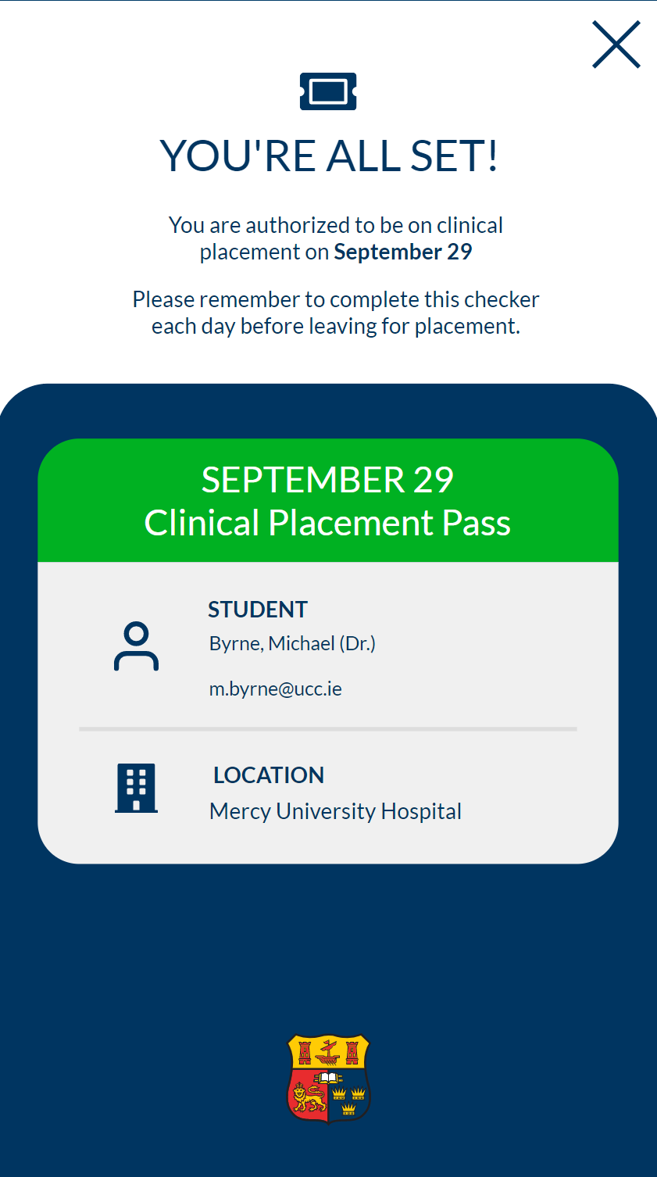
Day-Pass Issued
If the student has answered the questions to indicate they are not an Infectious Risk and they have none of the Symptoms listed they will be taken to the Day-Pass Issued Page.
The Date of Issue is clearly shown, with the student’s name visible and the student’s placement location.
The student is reminded of the obligation to complete the Clinical Placement APP every day prior to placement.
The student has this Day-Pass available to them on their phone in the APP and can show it to any of the placement supervisors if challenged to do so on any day.

Slide 8
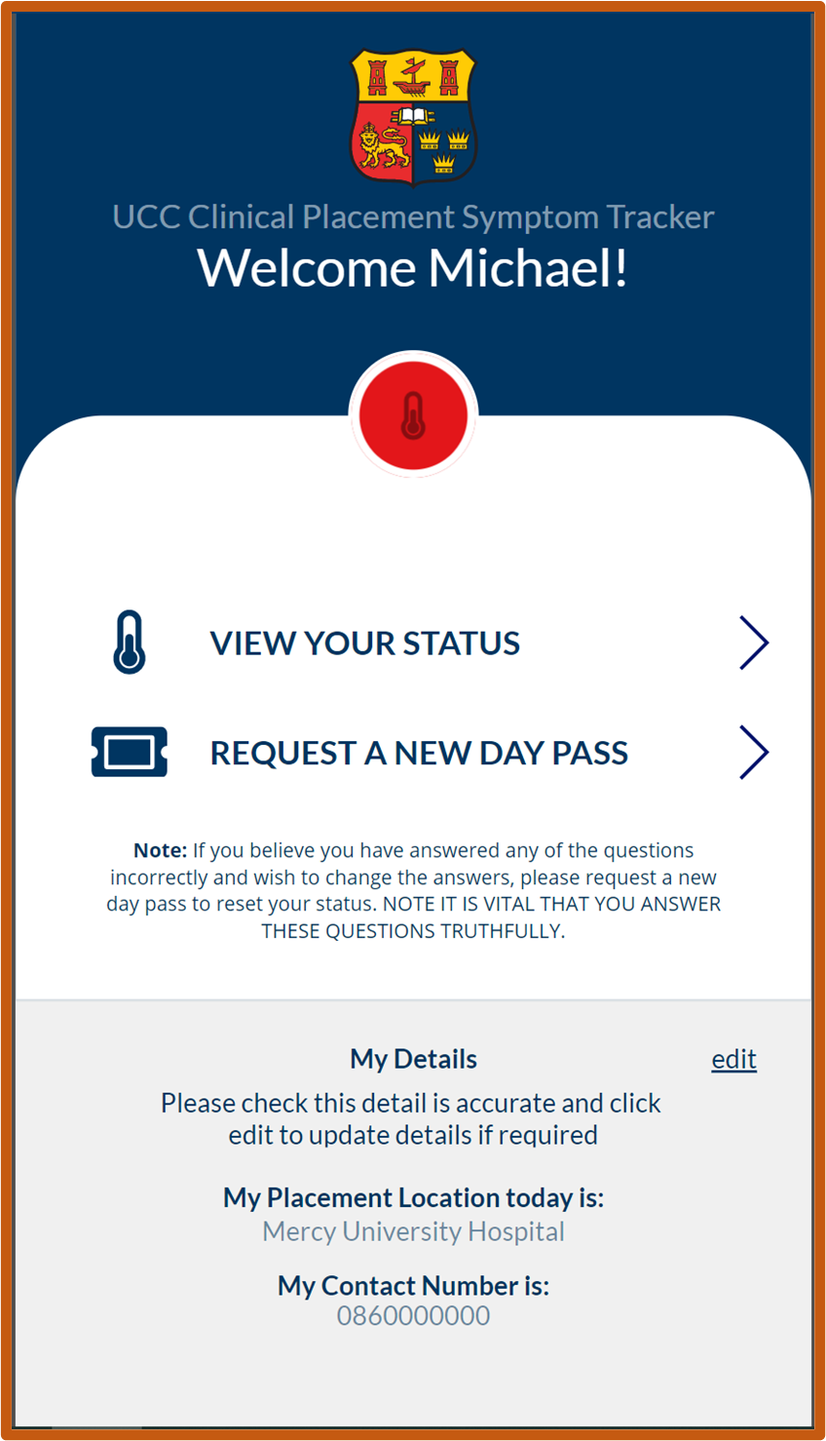
Placement App Home Page
The Student requests a new Day Pass for Clinical Placement by clicking here
The app allows the student to edit the answers they have submitted if they have made an error
The Student enters their details on first use.
These are edited and changed when the student:
moves to a different placement location
changes their mobile number

Slide 9
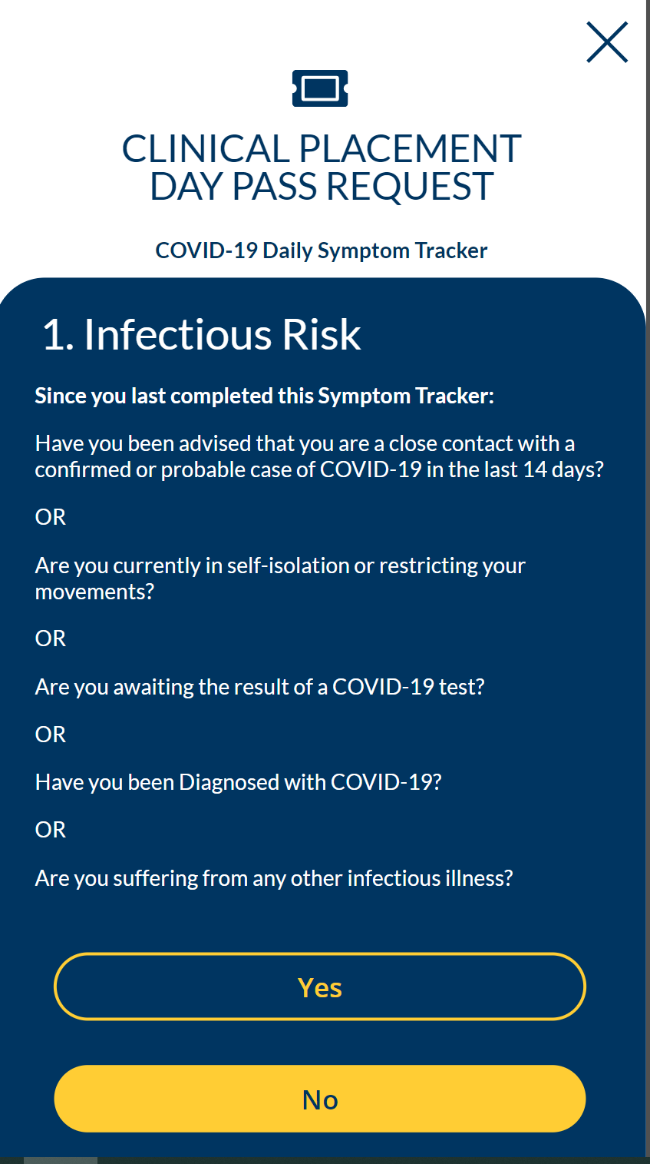
Infectious Risk Page
The Infectious Risk Page asks the student a series of questions to determine if they know themselves to be suffering or possibly suffering from an Infectious Illness including COVID-19
The student can select Yes or No.
Selecting Yes takes the student to the following page:

Slide 10
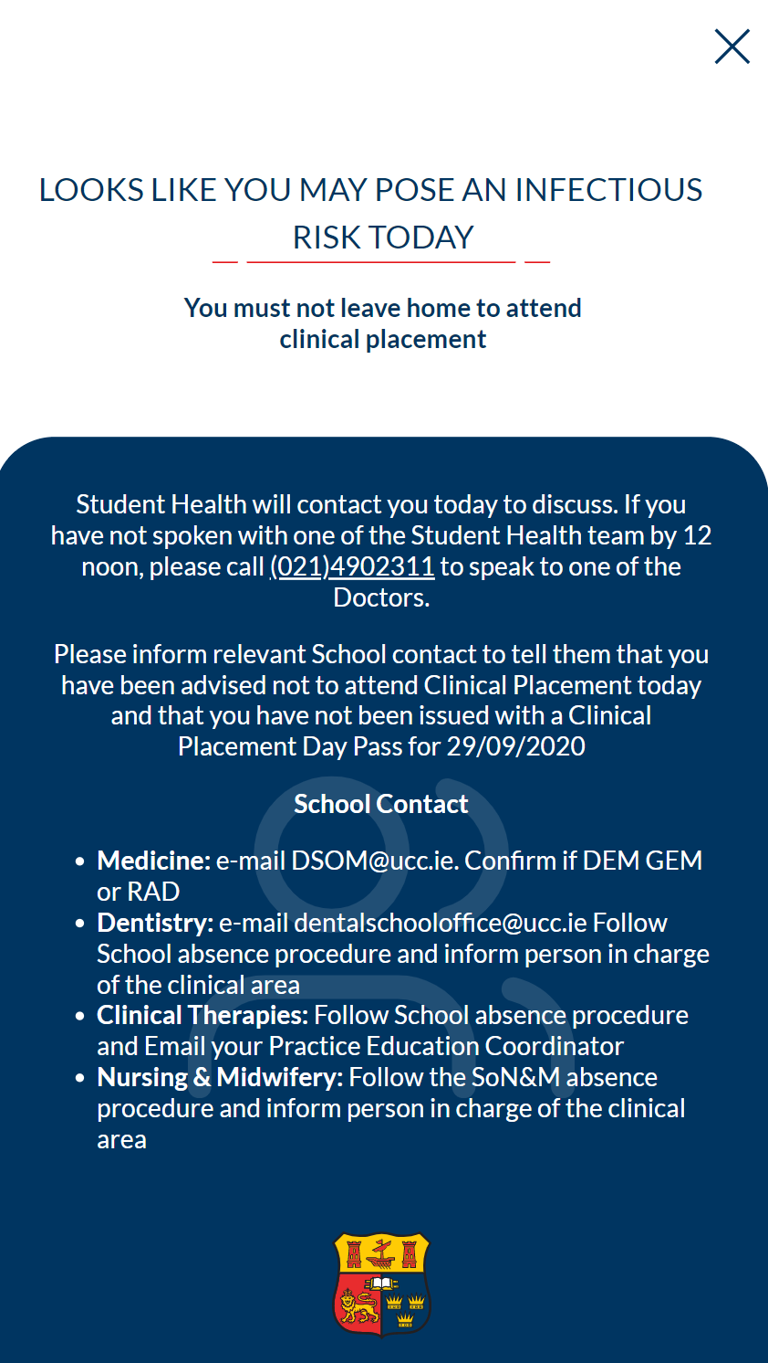
Infectious Risk Confirmed Yes Page
The student is instructed that they must not leave home or attend placement, as they may pose an infectious risk.
The student is advised that they will be contacted by UCC Student Health and if not contacted by 12 noon instructs them to take responsibly to ring Student Health number.
The student is also instructed to contact their relevant School contact and to follow absence procedures
The student clicks the X at the top right of the App and moves to the next page:

Slide 11
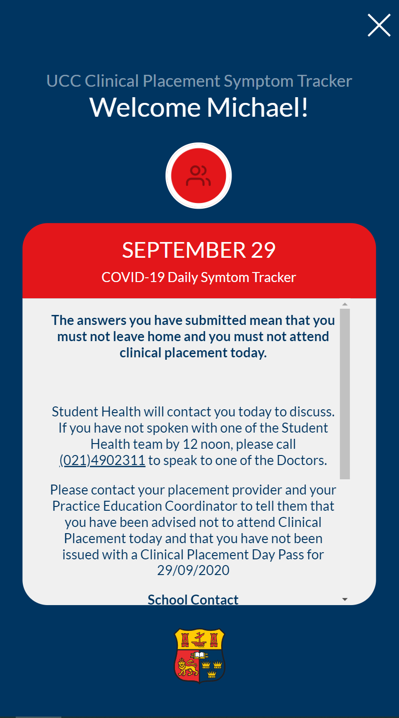
Infectious Risk Confirmed Yes Day Pass Not Issued Page
The student is advised that for that particular date displayed in Red Banner that they must not attend placement .
The student is also instructed to contact their relevant School contact and to follow absence procedures
The student clicks the X at the top right of the App and moves to the Home Page:

Slide 12
Placement App Home Page
The app Home Page allows the student to View Their Status which in this case will takes them to the Infectious Risk Confirmed Yes: Day Pass Not Issued Page
The student can request a new day pass if they wish to change their answers because they have selected an answer in error
If the student selects a different answer at the Infectious Risk Page as follows:

Slide 13
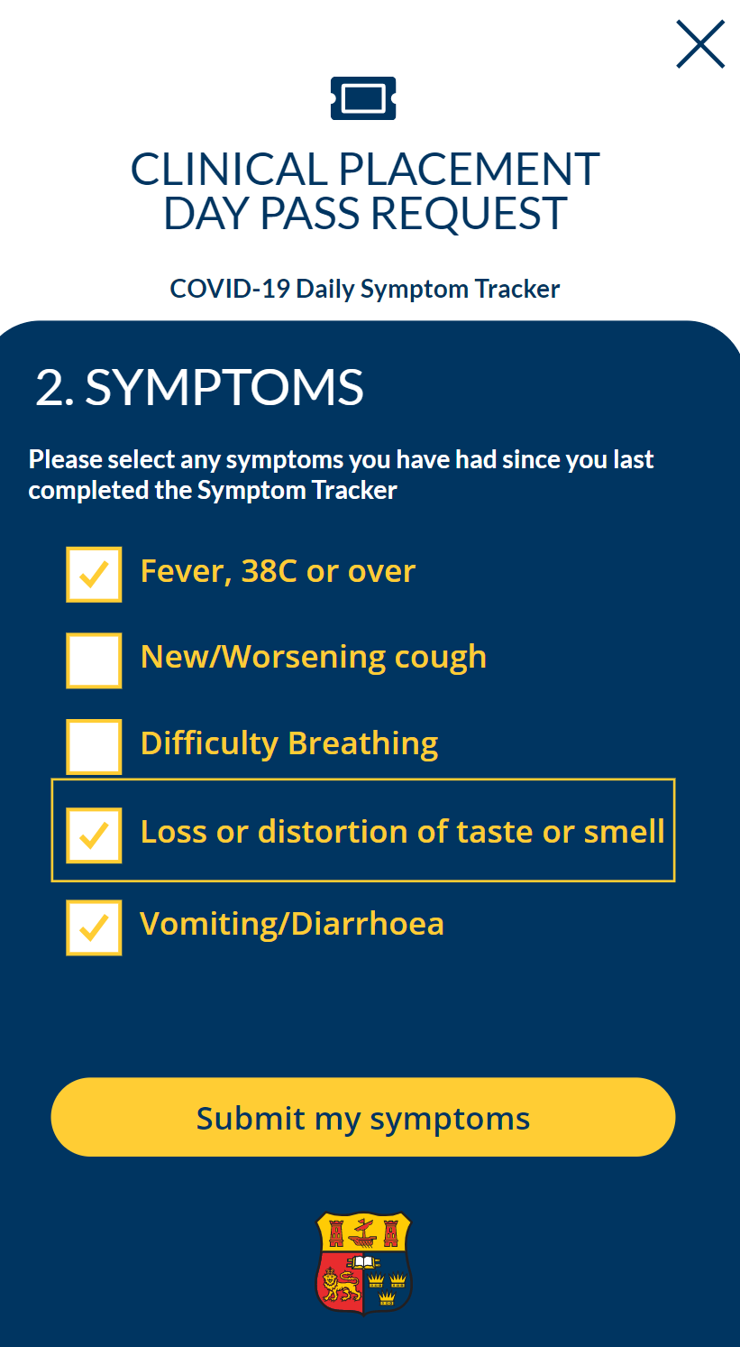
Symptoms Page
The Symptoms Page includes the 4 cardinal symptoms of COVID-19 as well as a symptom of Vomiting and Diarrhoea to uncover those students who may have symptoms of COVID-19 or Gastroenteritis, the most common infectious illness, either of which preclude a student attending on-site on placement.
The student can select none, or any one, or all of the symptoms and a tick appears in the relevant box when selected.
If the student has selected one or more of the symptoms, the Submit my symptoms button appears.
Students who select Submit my symptoms are taken to the next page:

Slide 14
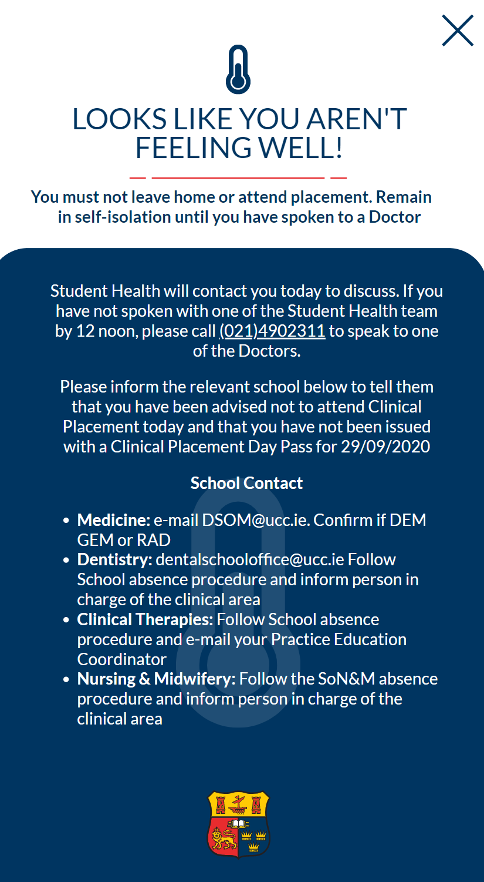
Symptoms Confirmed Yes Day Pass Not Issued Page
The student is advised that as it looks like they are not feeling well that they must not leave home or attend placement and they must remain in self-isolation .
They are also instructed that they will be contacted by Student Health or to contact Student Health by 12 noon.
The student is also instructed to contact their relevant School contact and to follow absence procedures
The student clicks the X at the top right of the App and moves to the Next Page:

Slide 15
Systems Confirmed Yes Day Pass Not Issued Page
The student is advised that for that particular date displayed in Red Banner that they must not attend placement.
The student is also instructed to contact their relevant School contact and to follow absence procedures
The student clicks the X at the top right of the App and moves to the Home Page:

Slide 16
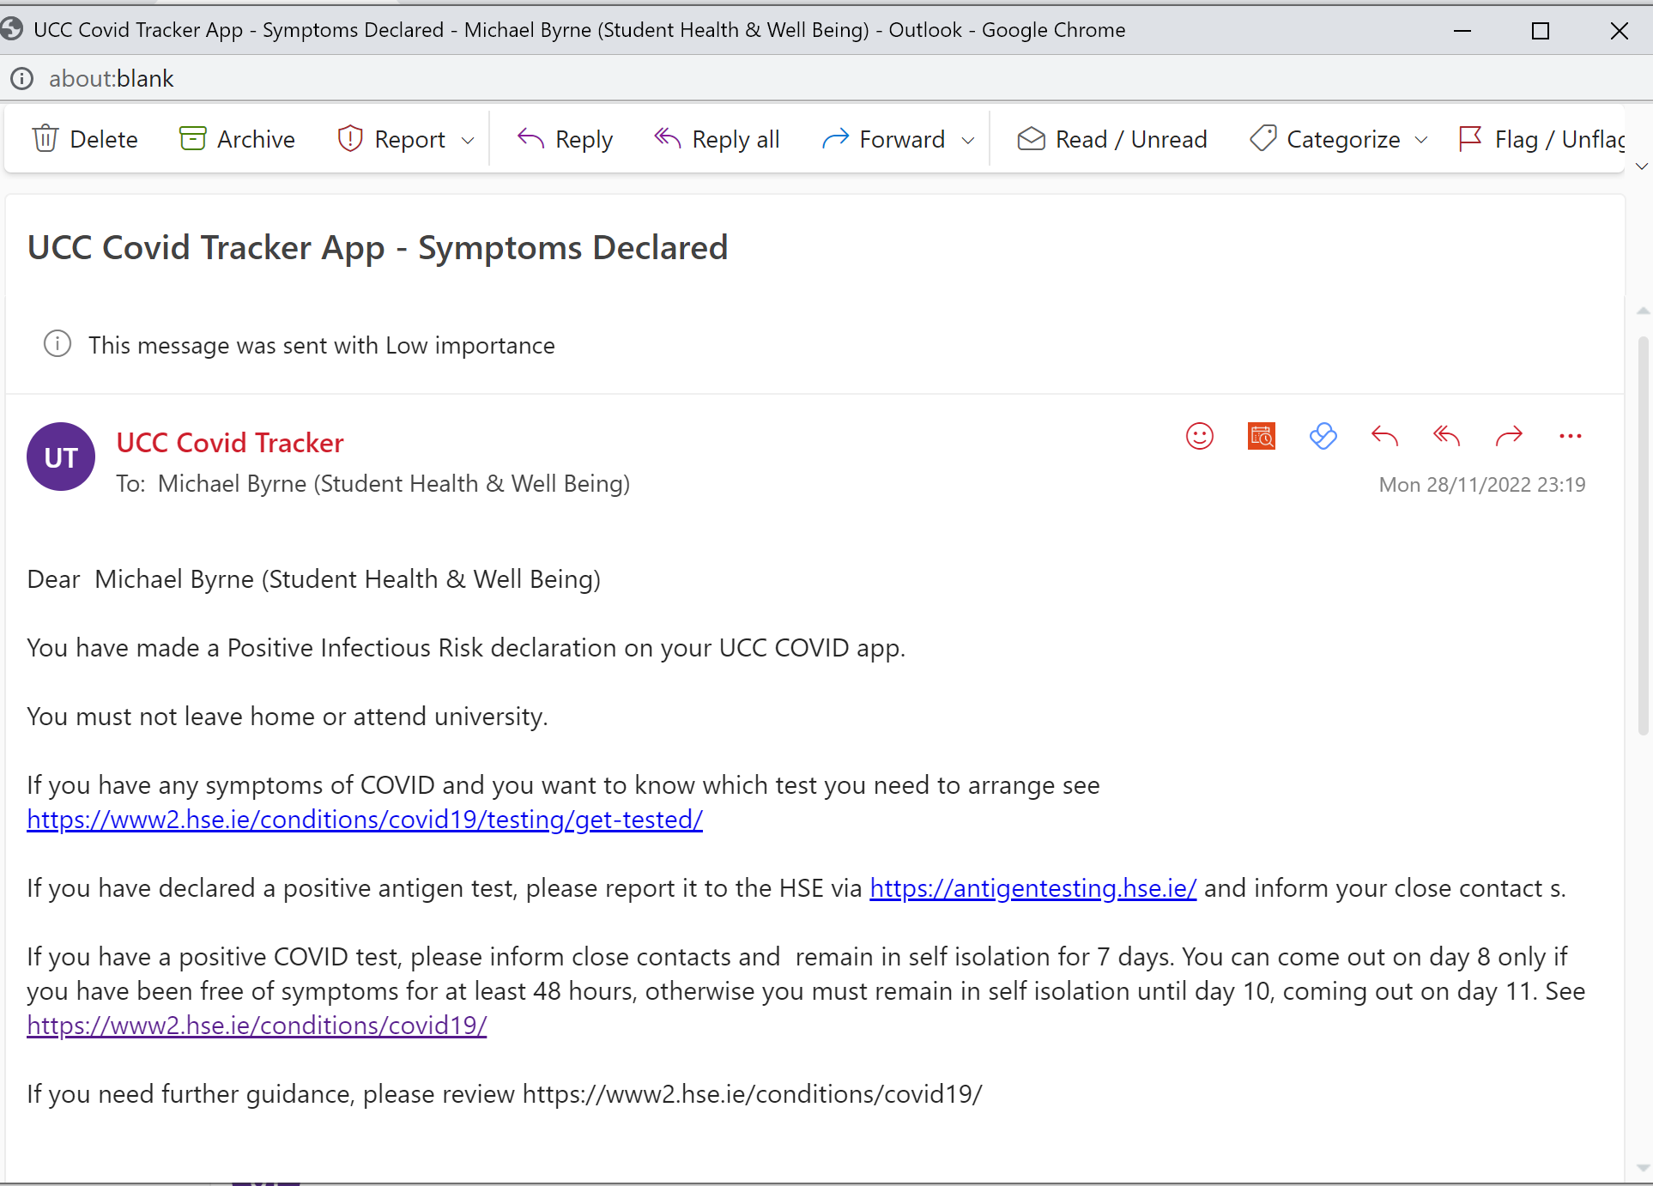
UniCoV
TITLE
PATIENT E-MAIL INBOX ADVISE AND DIRECCTIONS
Surveillance to detect
SARS-CoV-2
Ministers Briefing
13-October-21

Slide 17
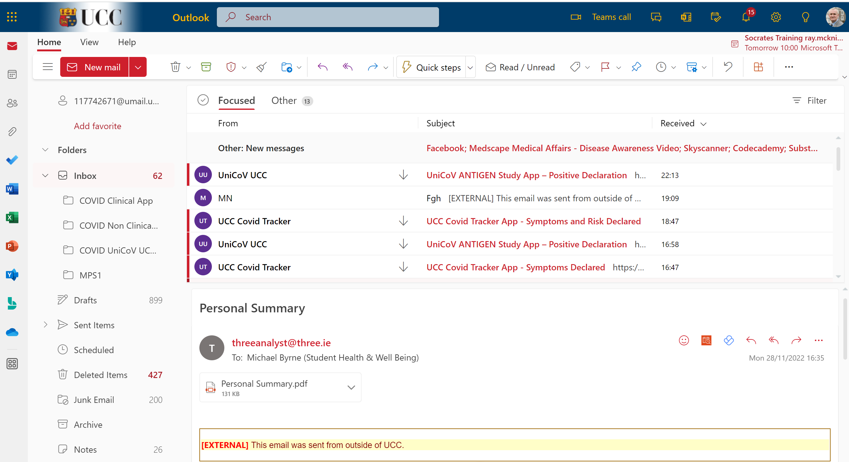
Rapid Development and Deployment Of The UniCoV Mobile App: The Practitioner Perspective
UniCoV
CLINICIAN E-MAIL INBOX NOTIFICATION
Surveillance to detect
SARS-CoV-2
Ministers Briefing
13-October-21

Slide 18
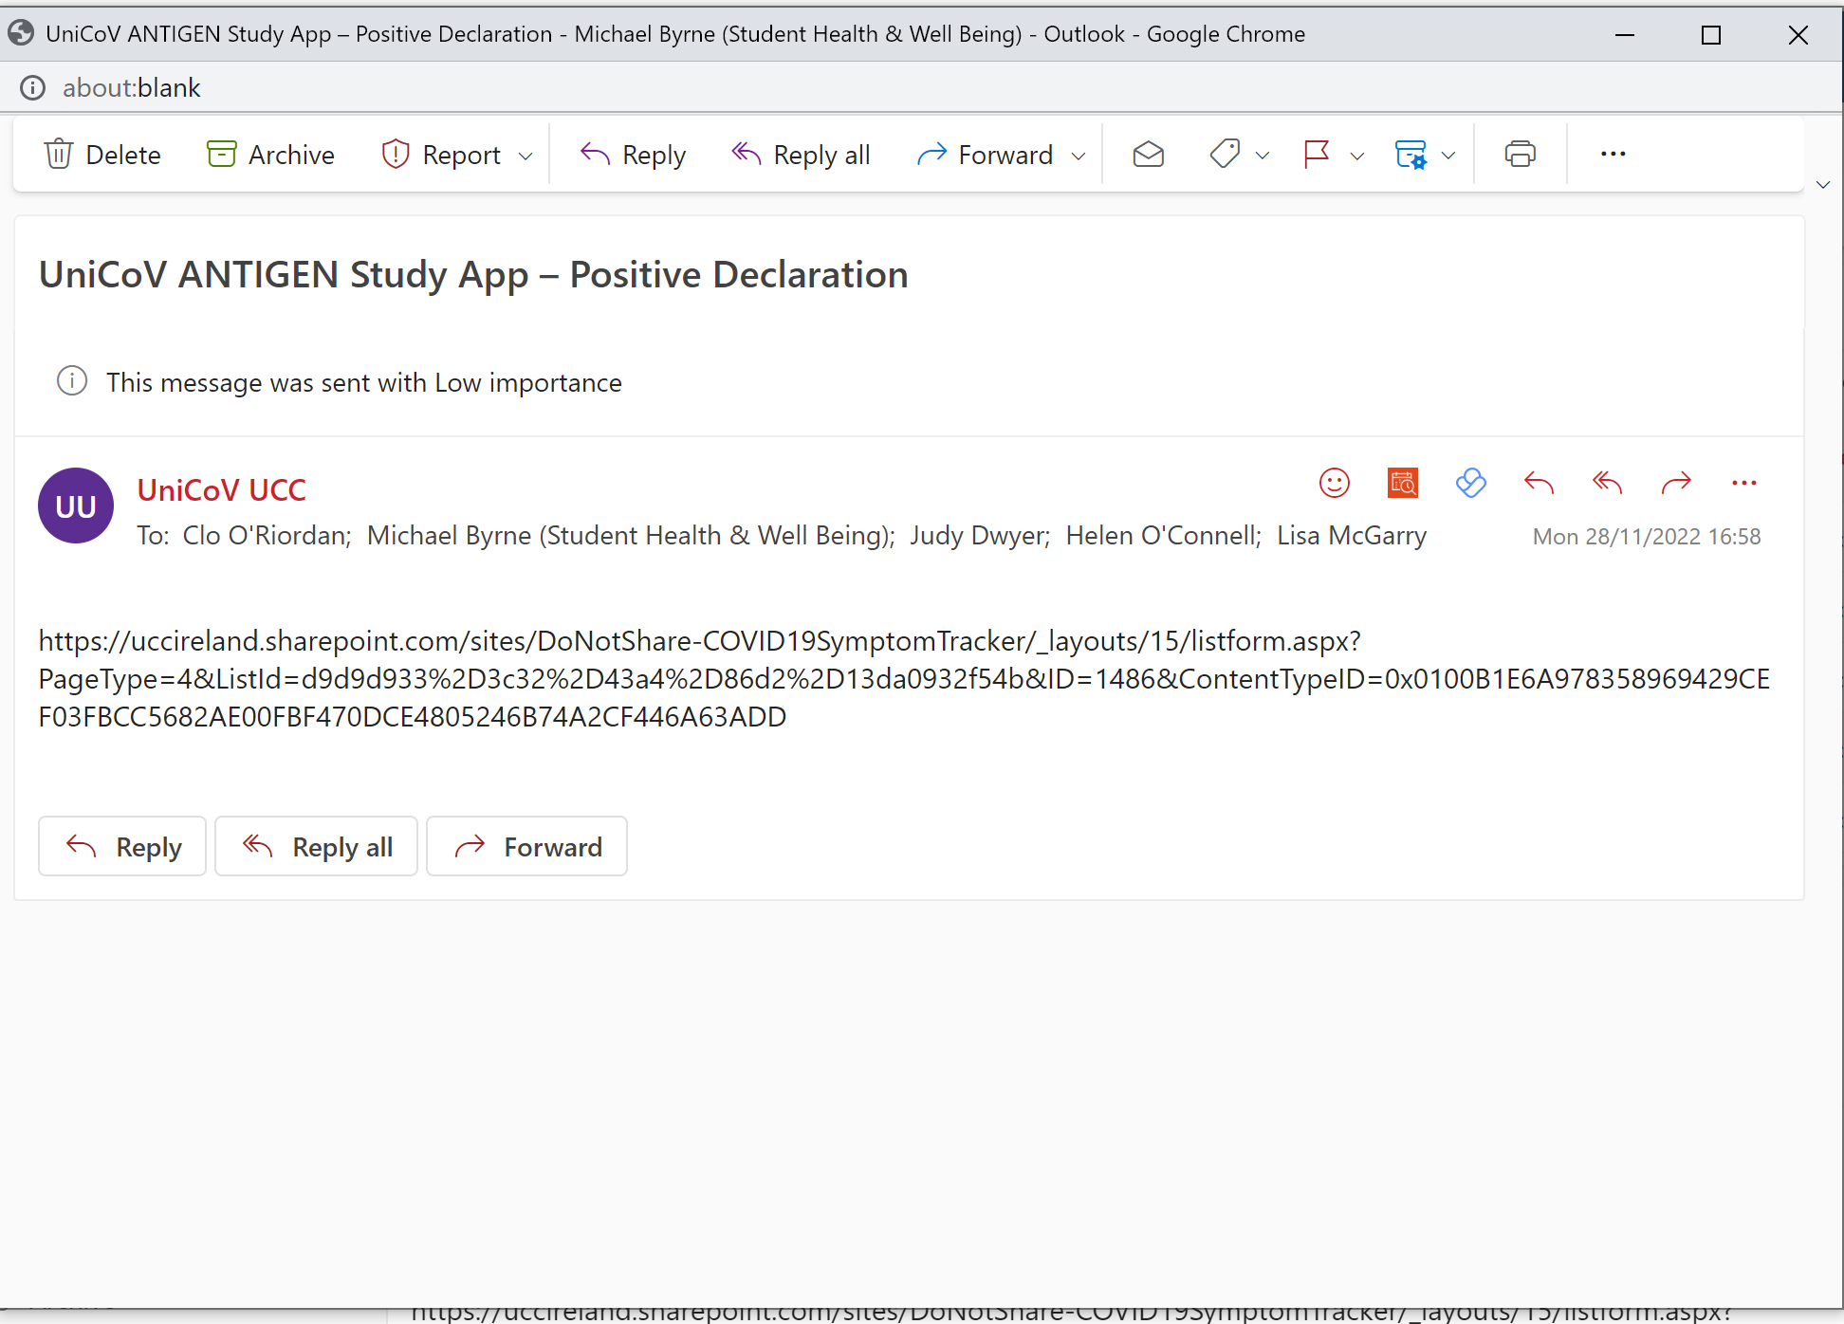
UniCoV
TITLE
Surveillance to detect
SARS-CoV-2
Ministers Briefing
13-October-21
CLINICIAN E-MAIL INBOX LINK TO DECLARATION DETAILS

Slide 19
UniCoV
Using New Technologies in Testing for Respiratory Viruses
The UCC approach
Surveillance to detect
SARS-CoV-2
Ministers Briefing
13-October-21
How we used new technology: Mobile apps(s)
July 2020 - January 2021 One app: Clinical Students only
January 2021: A second app deployed for all non-clinical students and staff

Slide 20
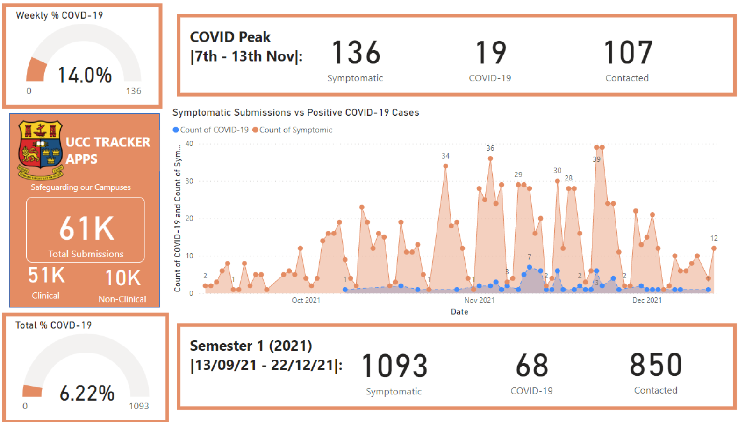

Slide 21
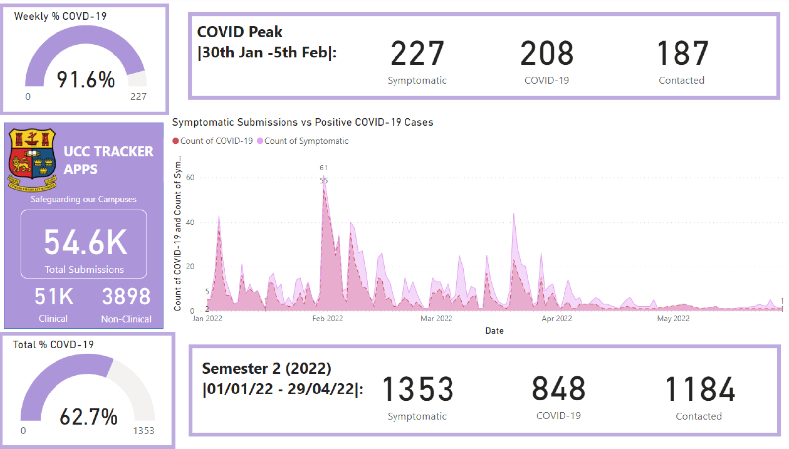

Slide 22
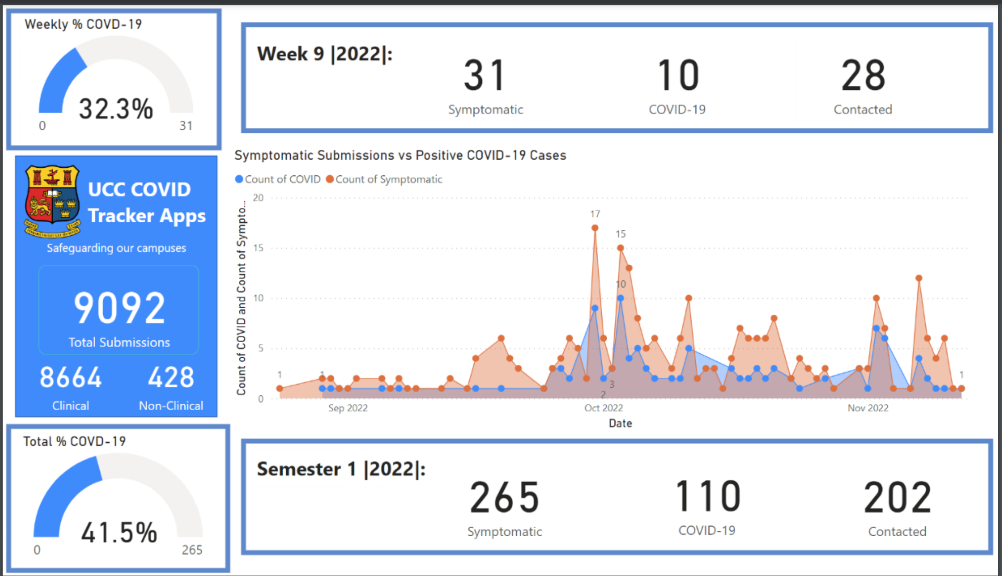

Slide 23
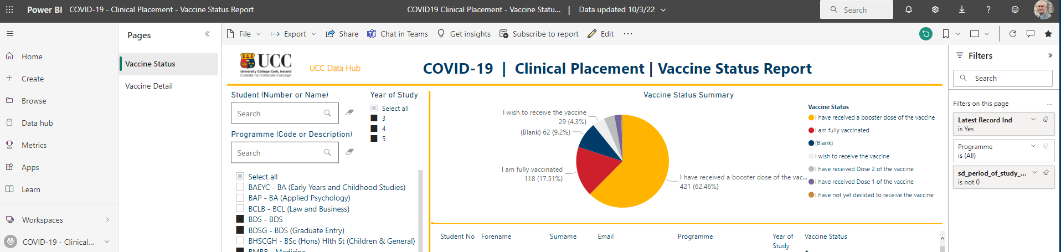
Using New Technologies in Testing for Respiratory Viruses
Reporting Tool -The UCC approach

Slide 24
UniCoV
Using New Technologies in Testing for Respiratory Viruses
The UCC approach
Surveillance to detect
SARS-CoV-2
Ministers Briefing
13-October-21
How we used new technology: Mobile apps(s) and New Testing C-19
July 2020 - January 2021 One app: Clinical Students only
January 2021: A second app deployed for all non-clinical students and staff
July 2021: New app technology with New testing technology C-19: UniCoV

Slide 25
UniCoV
Surveillance to detect
SARS-CoV-2
Ministers Briefing
13-October-21
Rapid Testing for SARS-CoV-2 –
LFAT or PCR ?

Slide 26
Using New Technologies in Testing for Respiratory Viruses
The UCC approach
UniCoV
Surveillance to detect
SARS-CoV-2
Ministers Briefing
13-October-21
UniCoV research study comparing serial testing strategies using AT and PCR in 4 HEIs
Needed a solution that could serve to:
Advise: Participants & Notify Student Health – Closed Loop Refer & Care
Recruit: Induct and Onboard: Obtain Consent: Demographic Detail: Imm Hx
Record: Twice Weekly Sympt Screen: LFAT result: Upload Image: Saliva Tube Barcode
Report: Result of Study Saliva PCR to Patient – Overall Results of UniCoV for each HEI
The solution/tool would be:
Available: off the shelf or rapidly developed and responsive to evolving needs
Secure: GDPR Compliant: HEI Security Compliant
Deployable: 4 sites: Acceptable to Participants: Easily used by UniCoV Teams

Slide 27
Using New Technologies in Testing for Respiratory Viruses
The UCC approach
The UniCoV App
UniCoV
Surveillance to detect
SARS-CoV-2
Ministers Briefing
13-October-21

Slide 28
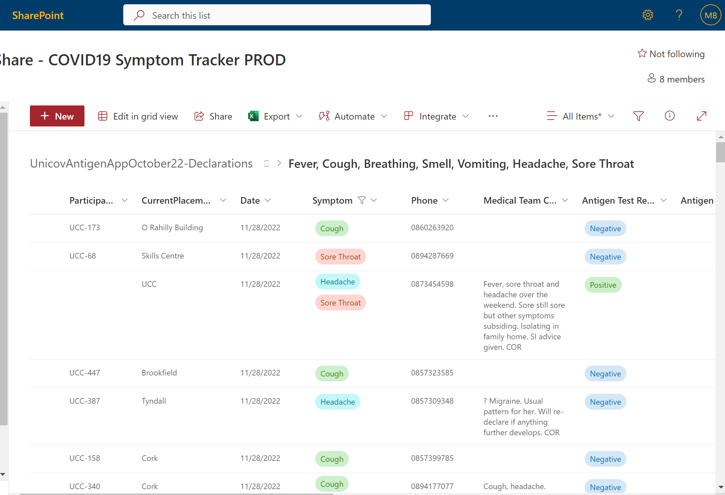
Rapid Development and Deployment Of The UniCoV Mobile App: The Practitioner Perspective
UniCoV
Surveillance to detect
SARS-CoV-2
Ministers Briefing
13-October-21

Slide 29
UniCoV
Using New Technologies in Testing for Respiratory Viruses
The UCC approach
Surveillance to detect
SARS-CoV-2
Ministers Briefing
13-October-21
How we used new technology: Mobile apps(s) and New Testing: Resp Viruses
July 2020 - January 2021 One app: Clinical Students only
January 2021: A second app deployed for all non-clinical students and staff
July 2021: New app technology with New testing technology C-19: UniCoV
November 2022: App technology with New testing technology: C-19 Infl A/B: RSV: Adenovirus : Multiplex Point of Care Testing

Slide 30
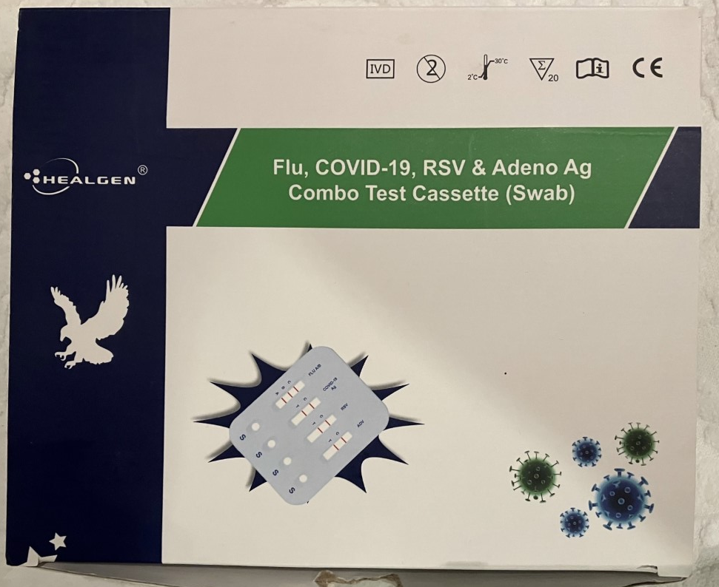
Using New Technologies in Testing for Respiratory Viruses
The UCC approach
Other Viruses
Includes C -19, RSV, Infl A/B, Adenovirus
Not licenced for Self-Test Yet
Patients who declare on COVID- app as symptomatic and C-19 Negative are invited to attend for swab
Early stages- Positive reaction from Clinicians and Patients

Slide 31
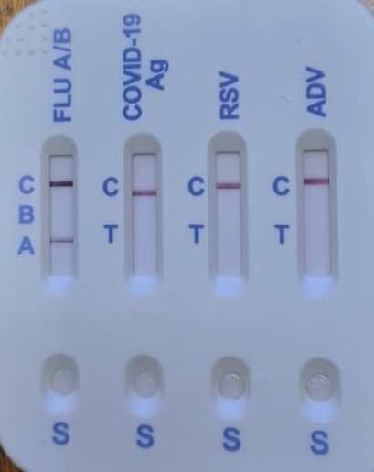
Using New Technologies in Testing for Respiratory Viruses
The UCC approach
Other Viruses
Influenza A Positive

Slide 32
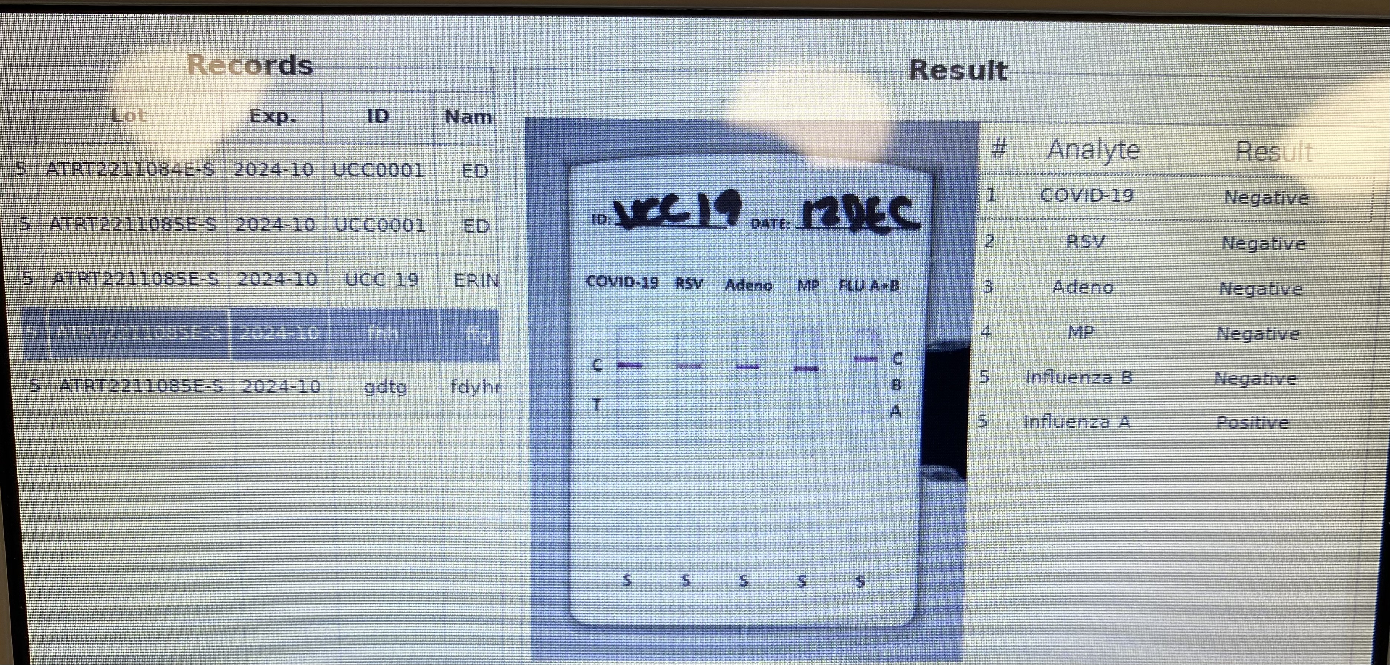
Using New Technologies in Testing for Respiratory Viruses
The UCC approach
Other Viruses
Influenza A Positive
using visual test reader with printer attached

Slide 33
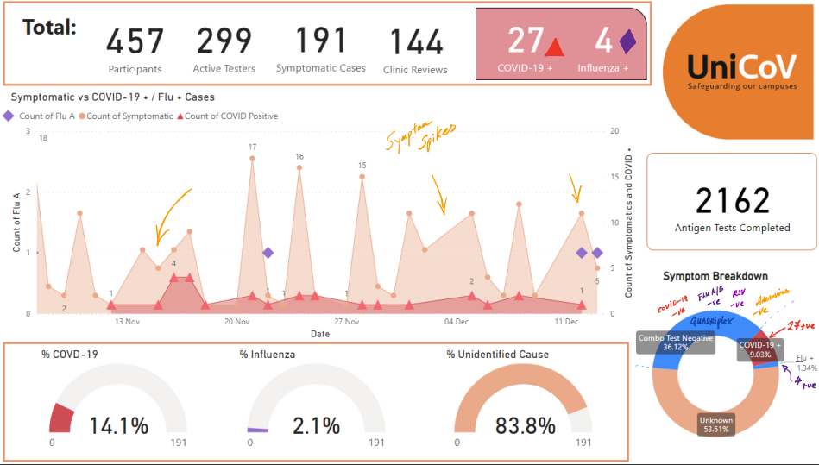
Using New Technologies in Testing for Respiratory Viruses
The UCC approach
Other Viruses
191 Symptomatic
27 C-19 +ve on C-19 LFAT
68 negative Multiplex
4 Positive Multiplex; Inf A

Slide 34
UniCoV
Surveillance to detect
SARS-CoV-2
Ministers Briefing
13-October-21
Using New Technologies in Testing for Respiratory Viruses
The UCC approach
Go Raibh Maith Agaibh Go Léir
COVID-19 Advisory Group 17th January 2022
Dr Michael Byrne
Dr. John MacSharry

Slide 35
Using New Technologies in Testing for Respiratory Viruses The UCC approach
Who Made This Happen?
UCC President John O Halloran and ULT
UCC SU-President Asha Woodhouse
UCC Student Health and the UniCoV Team
Clo O’Riordan
Helen O'Connell, Lisa McGarry , Eolann Dinneen,
Anne Bermingham, John O’Leary
UniCoV-UCC:
Professor Mary Horgan, Dr John MacSharry
UniCoV-National:
Prof Breda Smyth, Prof Paddy Mallon, Prof Aideen Long, Prof Charlie Spillane
Students and Staff Participants
IT: Rory O’Toole, Kevin Harrington, Reece Campbell, Conor Kelly, Daryl McCann, ERGO
Clinical Care: UCC Student Health Department
Lab
Joanna Szafran, Sophie Broderick, Leah McPhillips, Conor Egan,
Muireann Hickey, Matt Power, Dr John O'Callaghan, Dr Niall O’Leary
UCC Academy Project Management

