Slide 1
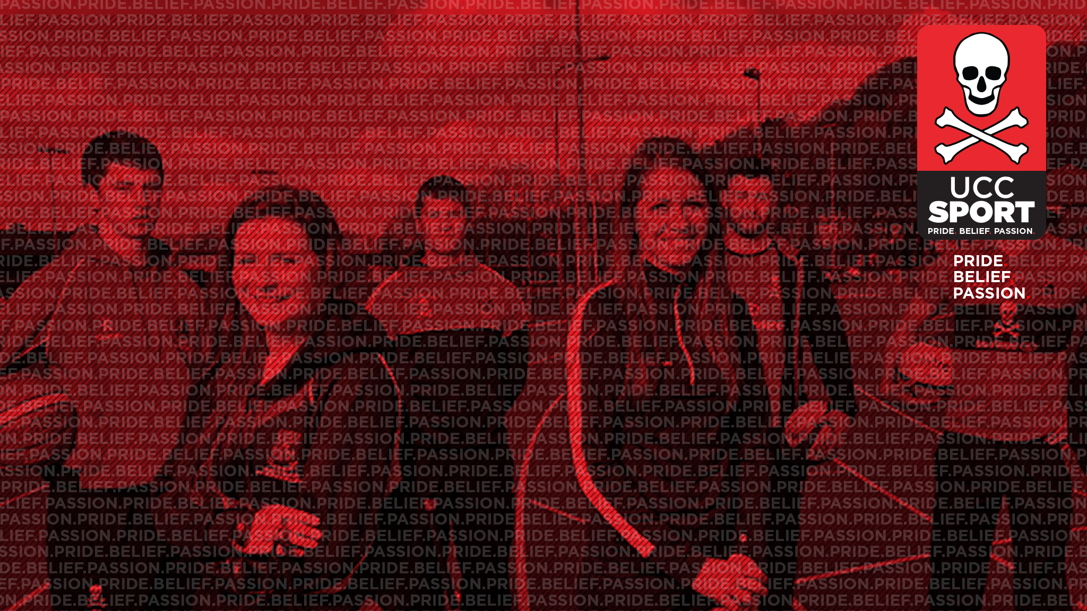
UCC SPORT
PERFORMANCE PROGRAMME
UCC Sport Performance.ie

Slide 2

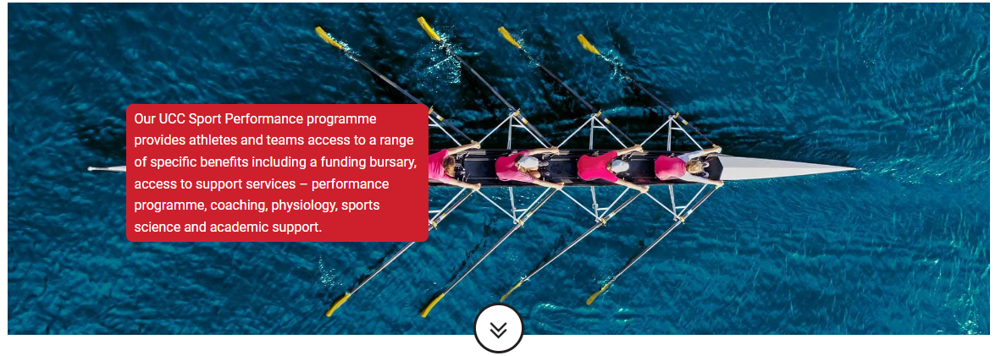
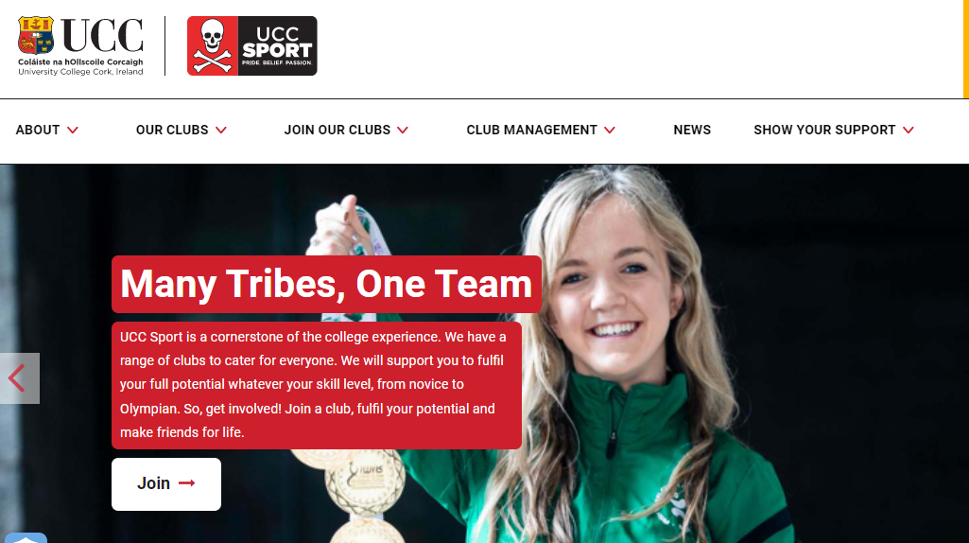

UCC SPORT PERFORMANCE PROGRAMME
PURPOSE
The purpose of UCC Sport performance programme is to support UCC athletes develop and perform to their full potential. Our priority is to ensure a focus on student athlete welfare and that sport in UCC is an enjoyable and positive experience.
The performance programme is aimed at our sports scholarship students our leading teams and athletes performing at top level sport in UCC and at regional, national and international levels.
We have an incredible range of athletes who are committed to performing in sport and academically. They are supported by our dedicated team of Sports Development Officers, coaches and professional staff.
Our performance programme is based around 4 key pillars:
Performance management + support
Sports programme
Strength & Conditioning (S&C), Sport Physiology and Sports Medicine Support
Academic and Life skills Support.
VISION AND GOALS
VISON | GOALS | OUTCOMES
Supporting UCC students reach and develop their full potential in performance sport, with a focus on their welfare and wellbeing. | UCC students enjoying, developing and performing in their sport. UCC students completing their academic programmes. UCC teams and individuals competing and achieving success in 3rd level and national competitions. UCC student athletes achieving highest representative honours. | UCC Player athlete welfare support and satisfaction. Results in performance competitions. UCC Performance Athletes on top level squads (3rd level – county – HP international and 3rd level. Performance Athletes progressing through academic programmes. Delivery of quality services and support.
PRIDE. BELIEF. PASSION. UCC Sport Performance.ie
#FindYourTeam

Slide 3
UCC SPORT PERFORMANCE PROGRAMME
PERFORMANCE MANAGEMENT + SUPPORT
Plan, manage and deliver our performance strategy, sports scholarship, academic to UCC athletes and teams.
Support UCC Sport performance teams and individuals, develop prepare and perform to their full potential.
Track, assess and promote results and achievements in our performance sports, teams, and athletes.
Management and co-ordination of sports medicine, sports physiology, and physio services.
Develop and work with external agencies, sports, and partners.
SPORTS PROGRAMME
Implementation of core sport competition and training programmes for GAA Senior Teams: Camogie, Gaelic, Hurling + LGFA; Women's Hockey 1st team, Rowing senior squad, Men's Rugby 1st team and U20; Soccer men and women 1st teams.
Individual sport scholarship athletes training and competition support.
Participation in competitions and events.
Support for attending representative training and international competitions.
Working with Student Sport Ireland, NGBs for World Student Games, World Championships and performance programmes
STRENGTH + CONDITIONING (S+C); SPORTS PHYSIOLOGY + MEDICINE
Design and delivery of a top class strength and conditioning programme at the elite squad gym in partnership with the S+C team in the Mardyke Arena.
Access to UCC sports physiology programme for consultation services, appropriate physiology testing, design of relevant prehab and rehab services at the UCC Sport HPL in the Mardyke Arena.
Working with UCC Sports Medicine team to deliver excellent medical, diagnostic, cardiac testing, concussion management, care and advice.
Rehabilitation services with UPMC clinic and other physiotherapy services and clinicians.
ACADEMIC AND LIFESKILLS
Provision of academic flexibility and support to support student athletes achieve their academic goals.
ASAS accreditation and recognition from Sport Ireland and SSI.
Access to life skills services including planning, time management, counselling, nutrition and personal development support and workshops.
PRIDE. BELIEF. PASSION. UCC Sport Performance.ie
#FindYourTeam

Slide 4
KEY INFORMATION + STUDENT ATHLETE SERVICES
PERFORMANCE MANAGEMENT + SUPPORT
UCC Sports Scholarship students to complete contracts and their Athlete Performance Plan APP by 30th September.
UCC Sports Scholarship students to complete induction process for scholarship and teams; attend designated workshop and Lifestyle support services; complete concussion, physiological, cardiac testing, screening and other programmes as required.
Further support and information – contact b.young@ucc.ie
UCC Sport Performance Programme
SPORTS PROGRAMME
UCC student athletes work with Club Team and club coaches for specific sports information and support.
Athlete's can access a wide range of UCC Services
UCC Support Tree Services
STRENGTH + CONDITIONING SPORTS PHYSIOLOGY + MEDICINE
Coach and athletes plan S+ C programme process with Damien O Donoghue dodonoghue@ucc.ie.
All designated squad members to complete TeamBuildr profile.
Complete Cardiac Screening – contact UCC Medicine J.Dwyer@ucc.ie
UCC Sport Scholarship students to consult with Trevor Woods on physiology needs and support at the UCC HPL t.woods@ucc.ie
Report Sports Injuries:
https://submit.link/3iu
ACADEMIC AND LIFESKILLS
Athletes to complete Academic Support Form for access to academic support and exam flexibility (at least 2 weeks in advance of exam or assignment date).
Contact UCC Sport c.odonovan@ucc.ie; for direct support and information asap if and when academic support issues.
Sports Scholarship students to attend induction, workshops and life skills support services as required. These will be scheduled with you.
PRIDE. BELIEF. PASSION. UCC Sport Performance.ie

Slide 5
MEET THE TEAM
PERFORMANCE MANAGEMENT + SUPPORT
Morgan Buckley
Head of UCC Sport
Tomasz Mrowca
UCC Clubs Executive President
Betty Young
SEA UCC Sport
Peter Calnan
SEA UCC Sport
Michele Power
UCC Quercus Programme
Elaine O Mahony
UCC Quercus Programme
SPORTS PROGRAMME
Sharon Hutchinson
UCC Hockey
John Grainger
UCC GAA
Jack Casey + Tomas O Leary
UCC Rugby
Greg Yelverton
UCC Soccer
UCC Coaches and Volunteers in UCC performance sports and individual sports
STRENGTH + CONDITIONING SPORTS PHYSIOLOGY + MEDICINE
Damien O Donoghue
Mardyke Arena S+C Staff
Trevor Woods
UCC Sport Physiologist
Dr Judy Dwyer
UCC Medical
Brid McEvoy
UCC Physiotherapist
Joe Normoyle
UPMC Physiotherapist
Evan Lynch
Nutritionist
Staff and clinicians in each unit.
ACADEMIC AND LIFESKILLS
Christine O Donovan
Deputy Head of UCC Sport
Canice Kennedy
Performance Sports Psychologist
PRIDE. BELIEF. PASSION. UCC Sport Performance.ie

Slide 6




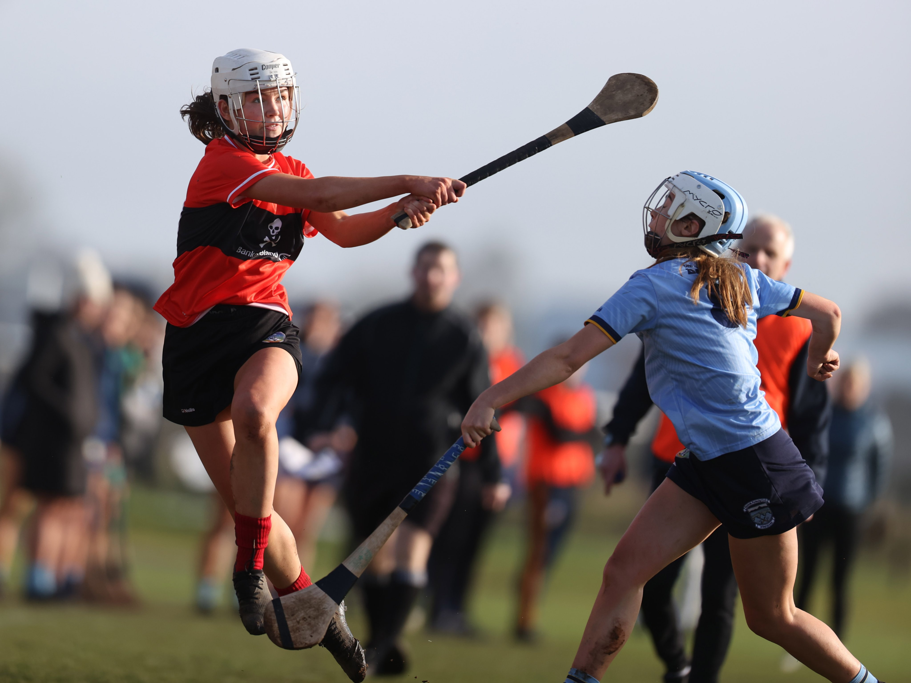

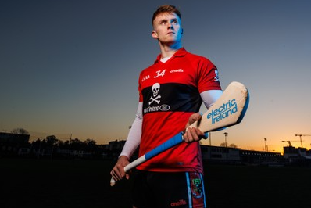

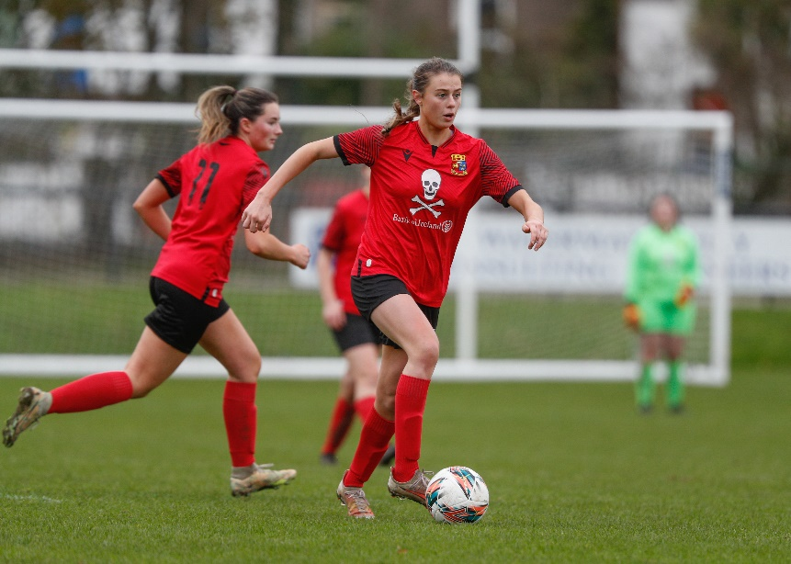



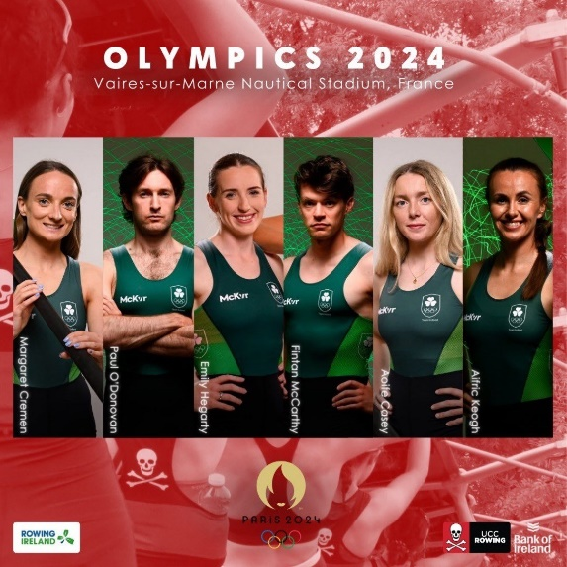
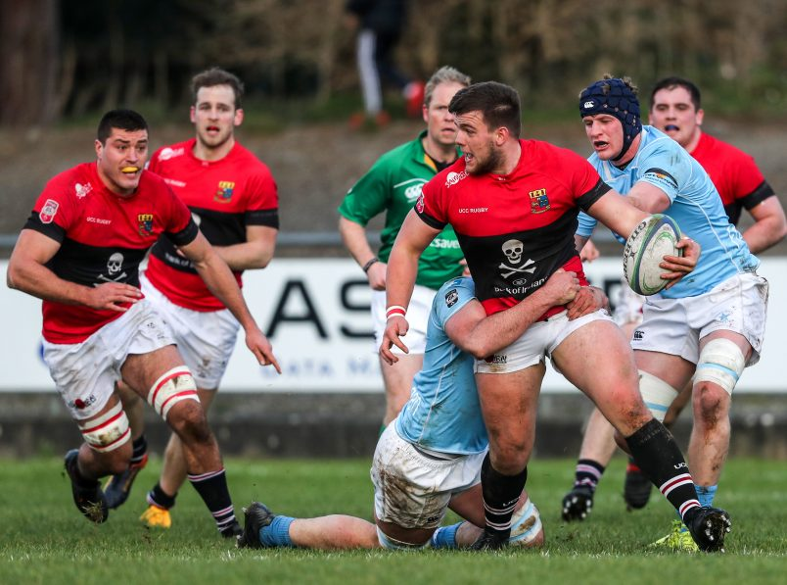

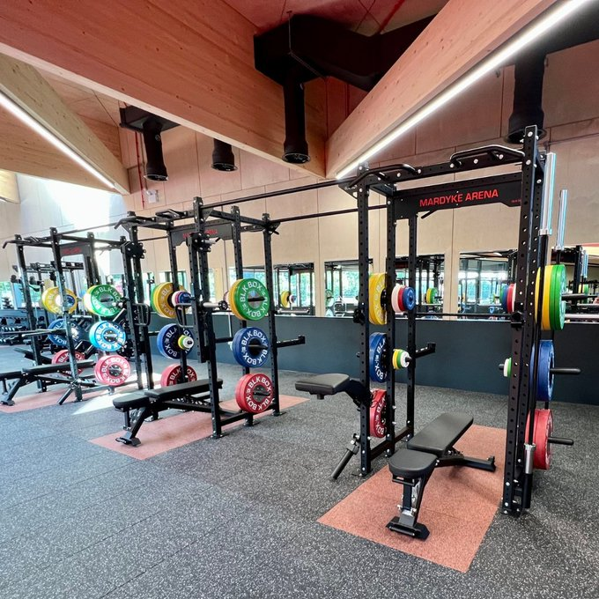

UCC SPORT PERFORMANCE PROGRAMME
PRIDE. BELIEF. PASSION. UCC Sport Performance.ie

Slide 7
UCC SPORT PERFORMANCE PROGRAMME: SPORTS MEDICINE
Dr Judy Dwyer

Slide 8
UCC SPORT PERFORMANCE PROGRAMME: IMPACT CONCUSSION
UPMC
Note from John
“Free Online Baseline Concussion testing to all UCC Sport athletes. See instructions and code attached for UCC Sport. It might be best for Joe to issue this to each coach etc. I think it should be supported by an information webinar etc around concussion and how to recognise the symptoms and how it can impact people”.
Can you follow up with Joe to see how best to coordinate this – we will look to promote with our relevant performance athletes and squads.
The idea of running a seminar and education on this is worth exploring
thanks
Morgan

Slide 9
UCC SPORT PERFORMANCE PROGRAMME: SPORTS PSYCHOLOGY
Sports Psychology - Canice Kennedy
This Psychology & Social structure will differ by student, their progression through their courses and by the sport that they play but UCC Sport recognises that they can assist in this process by providing some services to the sport scholarship recipients to assist them in dealing with the academic, sporting and social challenges. These services are likely to include time management, nutrition, sleep, goal setting and sport psychology assistance and could be provided by a combination of group seminars and individual consultations.
The primary objectives of the support will be:-
Support the mental preparation and performance of students
Enable students to manage academic and athletic responsibilities
Develop core mental fitness skills: confidence, commitment, control, and concentration
Foster mental resilience to cope with transitions and setbacks
I propose a programme that includes a number of group sessions and individual consultations with the athletes & players.

Slide 10
UCC SPORT PERFORMANCE PROGRAMME: SPORTS PSYCHOLOGY
Session 1 Induction
September An Introduction to the Scholarship Program
The role of the Sports Office
The services provided
Time Management
Goal Setting
The role of the sport psychologist
Session 2 Well-Being
September The importance of the balanced athlete
Diet & Hydration
The importance of sleep
Managing sporting & academic timetables
Session 3 Mental Fitness 1
October The role of sport psychology in the preparation phase
Explaining the 3 Stages of Performance – preparation, performance and evaluation
Perfecting pre-performance mental preparation
Dealing with pre-performance anxiety
Role of confidence in sport
Session 4 Mental Fitness 2
October The challenge of consistency in performance
Building mental toughness for performance
Developing performance level focus
Perfecting competition confidence
The role of post-performance evaluation
Each session will last about 45 minutes with time afterwards for questions & answers. Presentation notes will be provided to all participants. I suggest that each session is run at 2 different times to accommodate academic and training schedules.
Individual Consultations
I believe that individual sport psychology sessions should be offered as part of the Sport Psychology support. These sessions may be required for any number of reasons including injury, dealing with poor performance or non selection, struggling to balance college & sporting life or the psychological factors that impact performance (confidence, commitment, control or concentration). If free individual sessions are offered then I suspect that all recipients will take up the offer so I suggest that the athlete / player should be expected to make a contribution to the cost.
Cost
The cost of a group session will be €300 and the cost of an individual session will be €60.
Canice Kennedy
14th June 2025

Slide 11
UCC SPORT PERFORMANCE PROGRAMME: SPORTS NUTRITION
Sports Nutrition
Evan Lynch
Email: evan@southeastnutritionclinic.com
Mobile: 085 708 5625
Address: 2nd floor, 11 Peter Street, Clonmel, Co.Tipperary, E91F662.
I offer the following consultation packages:
- One appointment: €165
- Three appointments: €450
- Five appointments: €700
As we briefly spoke about after the workshop, I have a set up in place with DCU Athletics. I would be interested in setting up a similar setting with UCC athletes, and could cater to any/all scholarship athletes, of course, if this can be set up, I would be able to offer high concession rates with the expectation of a reasonable volume of appointment slots.

