Slide 1
Digital Passport Session

Slide 2
Digital Passport Workshop Schedule
TIME | ACTIVITY
9:00-9:15 | Introductions
9:15-11:15
11:15-11:30
11:30-1:00
1:00-1:30
1:30-2:15
2.15-3:15

Slide 3
Today’s topic: Time Management

Slide 4
Session Overview
Understand what Time management/Scheduling is and can do for the individual
Ways to Implement good Time management/Scheduling for an individual

Slide 5
Goals of Time Management
To feel in control of your time
To integrate your academic life with your real life
To get all assignments done and still have time for fun
To get rid of time wasters and enjoy being more relaxed

Slide 6
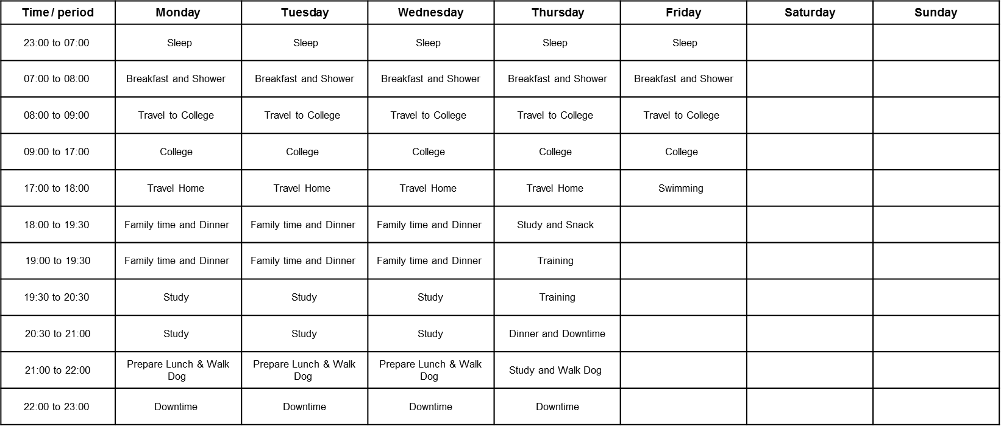
Weekly Schedule

Slide 7
Time | Monday |  | Tuesday |  | Wednesday |  | Thursday |  | Friday |  | Saturday |  | Sunday
 | Planned | Done | Planned | Done | Planned | Done | Planned | Done | Planned | Done | Planned | Done | Planned | Done
07:00 | Breakfast and Shower |  | Breakfast and Shower |  | Breakfast and Shower |  | Breakfast and Shower |  | Breakfast and Shower
08:00 | Travel to College |  | Travel to College |  | Travel to College |  | Travel to College |  | Travel to College
09:00 | Lecture A |  | Lecture A |  | Lecture A |  | Lecture A |  | Lecture A
10:00
11:00 | Lecture B |  | Lecture B |  | Lecture B |  | Lecture B |  | Lecture B
12:00
13:00 | Lunch |  | Lunch |  | Lunch |  | Lunch |  | Lunch
14:00 | Tutorial |  | Tutorial |  | Demonstration |  | Tutorial |  | Demonstration
15:00
16:00
17:00 | Travel Home |  | Travel Home |  | Travel Home |  | Travel Home |  | Travel Home
18:00 | Family Time and Dinner |  | Family Time and Dinner |  | Family Time and Dinner |  | Meeting up with Friends |  | Family Time and Dinner
19:00
20:00 | Study |  | Study |  | Study |  |  |  | Study
21:00 | Workout |  | Workout |  | Workout |  | Family Time |  | Swimming
22:00 | Prepare Lunch |  | Prepare Lunch |  | Prepare Lunch |  | Prepare Lunch
23:00 | Downtime |  | Downtime |  | Downtime |  | Downtime |  | Downtime
23:00-7:00 | Sleep |  | Sleep |  | Sleep |  | Sleep |  | Sleep
Your Weekly Schedule

Slide 8
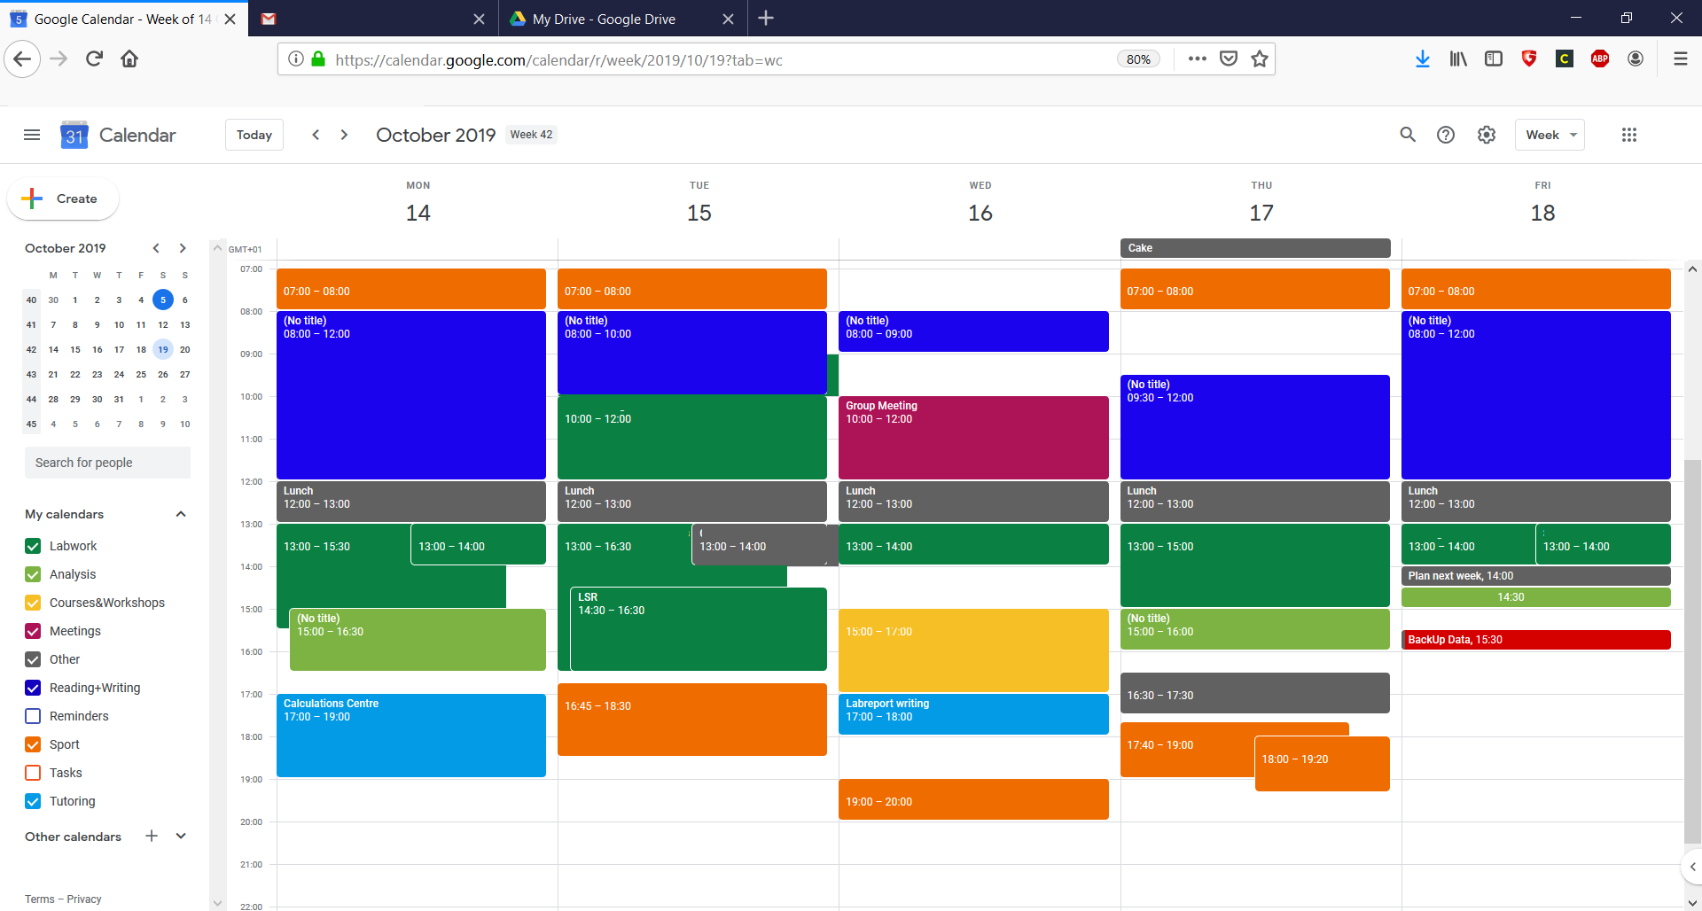
Time Blocking
You can also include the weekends, or get a monthly overview; add in as many different “calendar” (categories) as you need!

Slide 9
Time Management: Check List
Requirements, priorities and responsibilities
Choice
Honesty/Realism
Sustainability
Enjoyability
Well roundedness
Big picture thinking
Cull/Review
Discipline vs procrastination

Slide 10
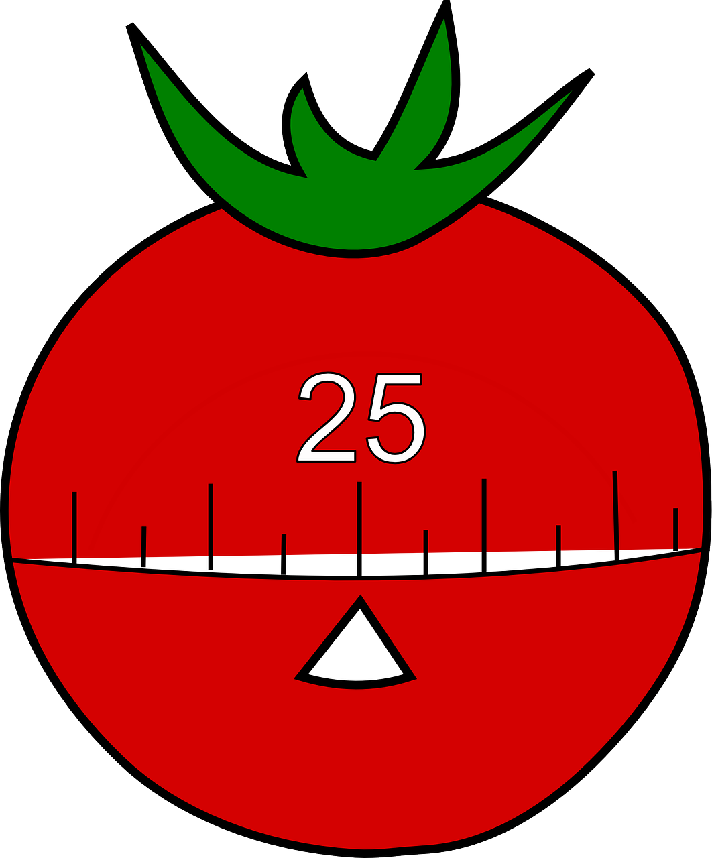
Pomodoro Technique
There are 6 steps in the original technique:
Pick the task you want to accomplish
Set your timer (traditionally 25 minutes)
Work on the task for the set time
Stop working when the timer rings & add a ✅ on a piece of paper
After 1-3 checkmarks, take a short break (3–5 minutes)
After 4 “pomodoros”, take a longer break (15–30 minutes)
Then: Reset your checkmark count to zero, then go to step 1!
You can adapt the time span
as needed for your work!

Slide 11
Time Management & Lectures
Be on time!
Have your preferred pen & paper/computer ready to take notes
Know what your learning outcomes and objectives are
Check Canvas and your student account emails for any important information
Make sure all your (unanswered) questions are answered
Remember: You have access to your lecturer during office hours

Slide 12
Key Points to Remember
Time Management is for YOU & you can do (almost) everything with it as long as it works for you
→ No one is judging!
It will take a few trials until you find the right schedule for your life
Try different methods or create your own “Zombie” method!

Slide 13
Resources & Planning Options
Bullet Journaling:
https://bulletjournal.com/
Lots of YouTube videos
Time Blocking
Reading: https://blog.rescuetime.com/time-blocking-101/
Video: https://www.youtube.com/watch?v=_MFFzIxHy9k
TIP: Have a look around for paper planners, maybe one has the right layout for you?

Slide 14
Demonstration

Slide 15
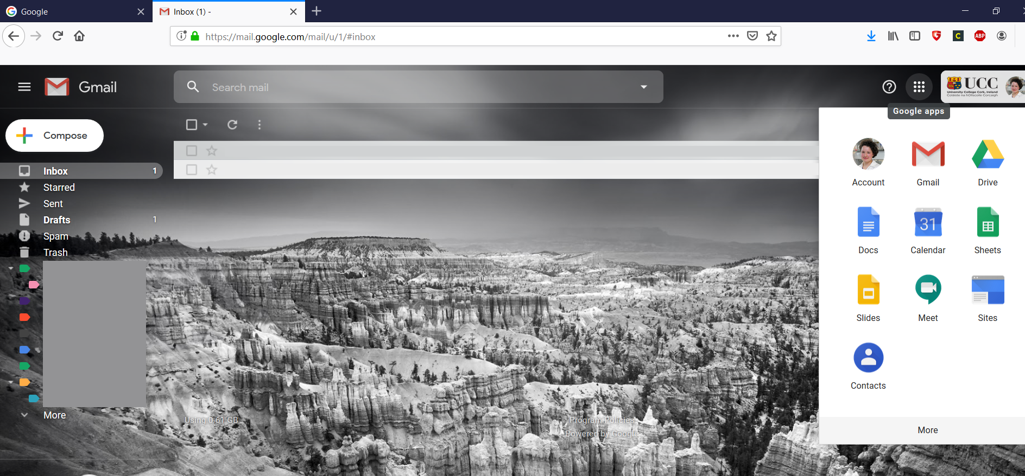
Access your Umail & Calendar

Slide 16
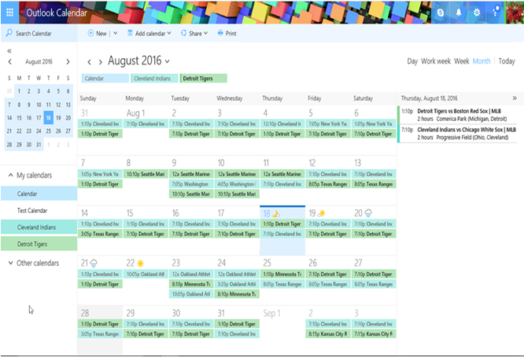
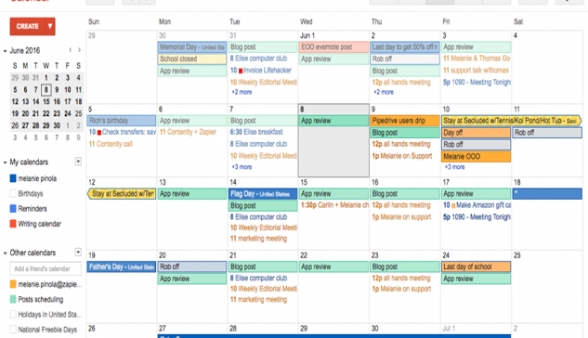
Google Calendar
Outlook Calendar
You can sync all your online calendars! (Umail is basically Gmail)

Slide 17
Any Questions?

Slide 18
Contact the Skills Centre for a Presentation Practice or if you need other help with your academic communication!
Email: skillscentre@ucc.ie

