Slide 1
Cyber Security Awareness
Patrick O’Toole | Cyber Security Analyst | ITSecurity@ucc.ie

Slide 2

Welcome!
Learning outcomes
Protect your accounts
Staying safe online
Identifying scams and phishing attempts
What to do if you fall victim to a cybercrime

Slide 3
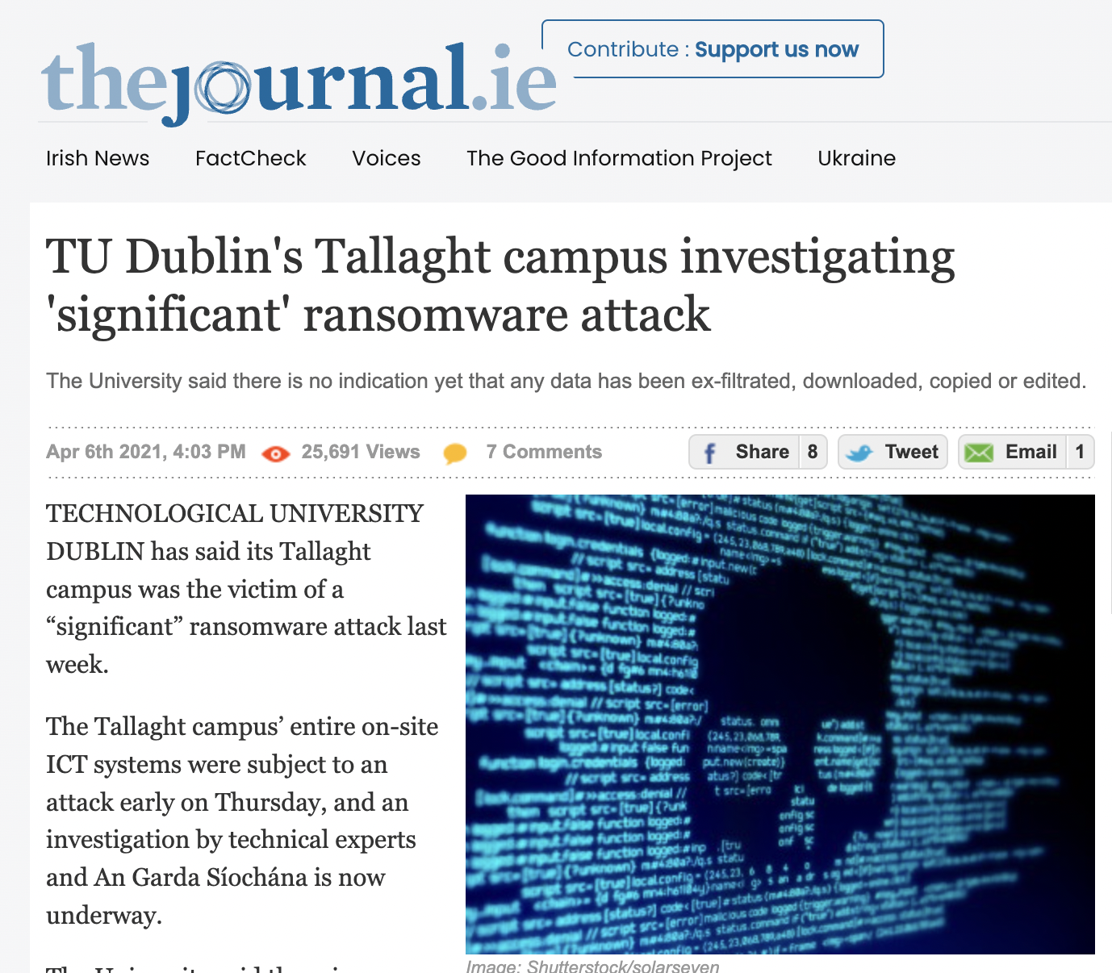
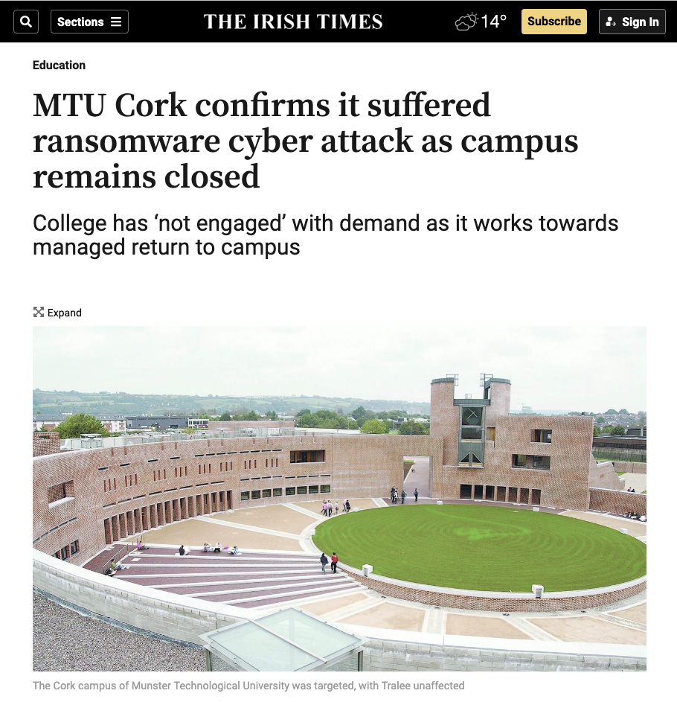
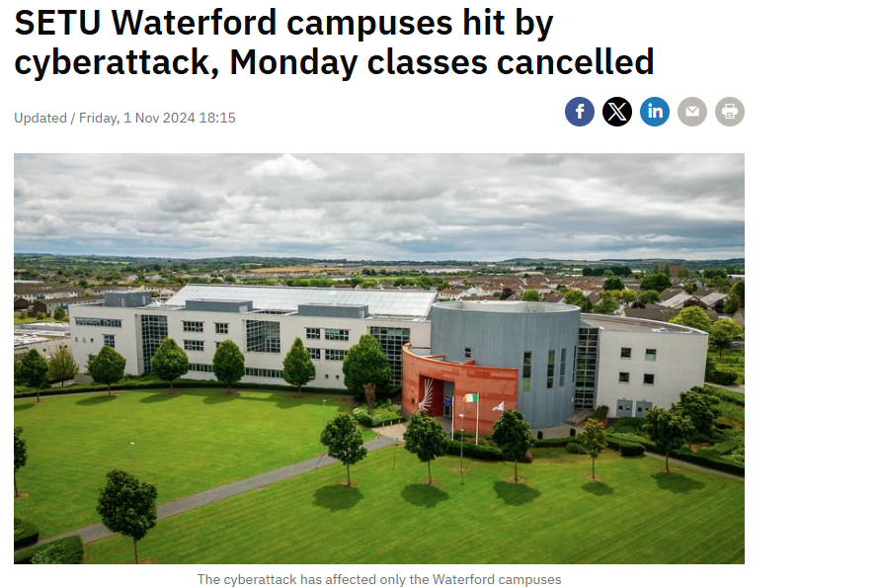
Cyber Attacks on Irish HEIs
Notes:
TU Dublin experienced a ransomware attack in 2021, causing significant disruptions
MTU ransomware attack in 2023 cost more than 4 million euros and caused significant down time and disruption
SETU suffered a cyber attack in 2024, with access to internet and emails cut off, this was caught early and there was no evidence of ransomware activation or data exfiltration
Global Average cost of a cyber attack is 3.8 million euros

Slide 4
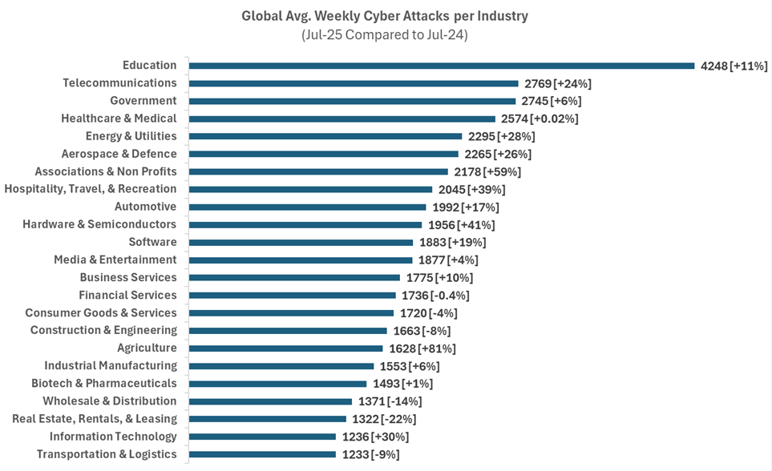
Cyber Attack by Industry
Source: https://blog.checkpoint.com/research/global-cyber-threats-july-snapshot-of-an-accelerating-crisis/
Notes:
Core threats are phishing and ransomware

Slide 5

Cyber Threats in UCC
Email Threats 4/1/26 – 11/1/26:
84 emails containing malware detected
87,819 spam emails received
25,069 phishing email sent to UCC email addresses
Blocked attack techniques:
89,500 detections blocked in the last 4 weeks (15/12/25 -14/01/26)

Slide 6
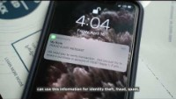

Slide 7
Strong Passwords
Have you used your UCC password for any other accounts?
Is it less than 16 characters long?
Have you ever shared your password with anyone?
Have you ever sent your password by email or Teams message?

Slide 8
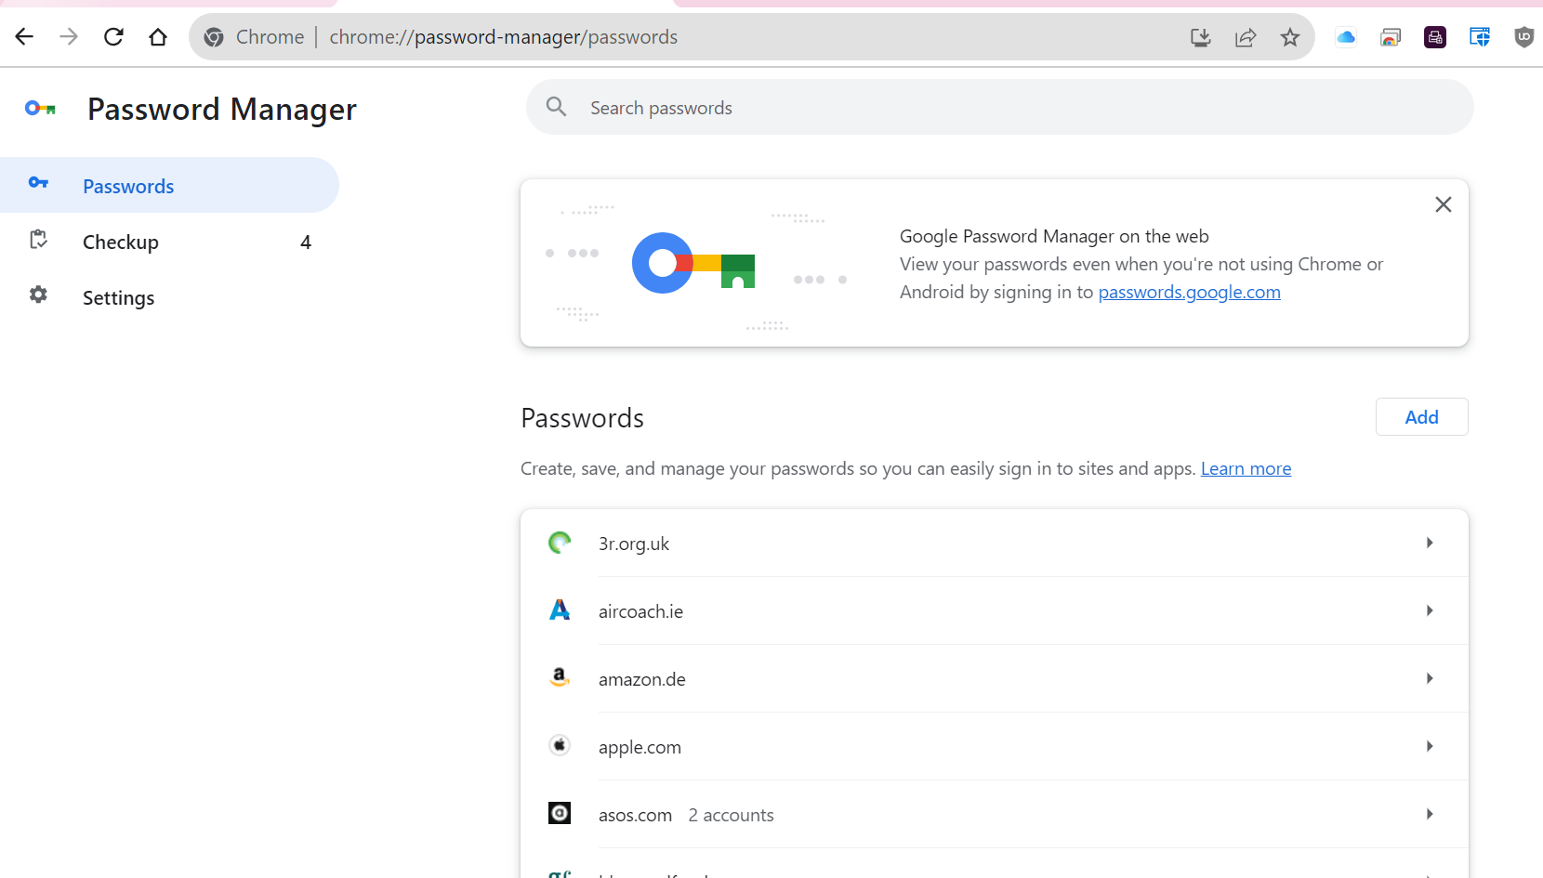
Password Manager
Unique passwords are important!
Google Account Password Manager
Edge Password Manager
Mac Passwords App

Slide 9

Top Password Stats
What do you think is the world’s most common password in 2025?
Answer: 123456 (used over 21 million times)
Is this a strong password?
Answer: Definitely not!
Source: https://nordpass.com/most-common-passwords-list/

Slide 10

Top Password Stats
What percentage of security breaches involved weak, reused, or stolen passwords?
Answer: over 80%
Source: https://us.norton.com/blog/privacy/password-statistics

Slide 11

Top Password Stats
What percentage of people who have had their password hacked were using a password of 8 or less characters?
Answer: 61%
Source: https://www.security.org/resources/online-password-strategies/

Slide 12
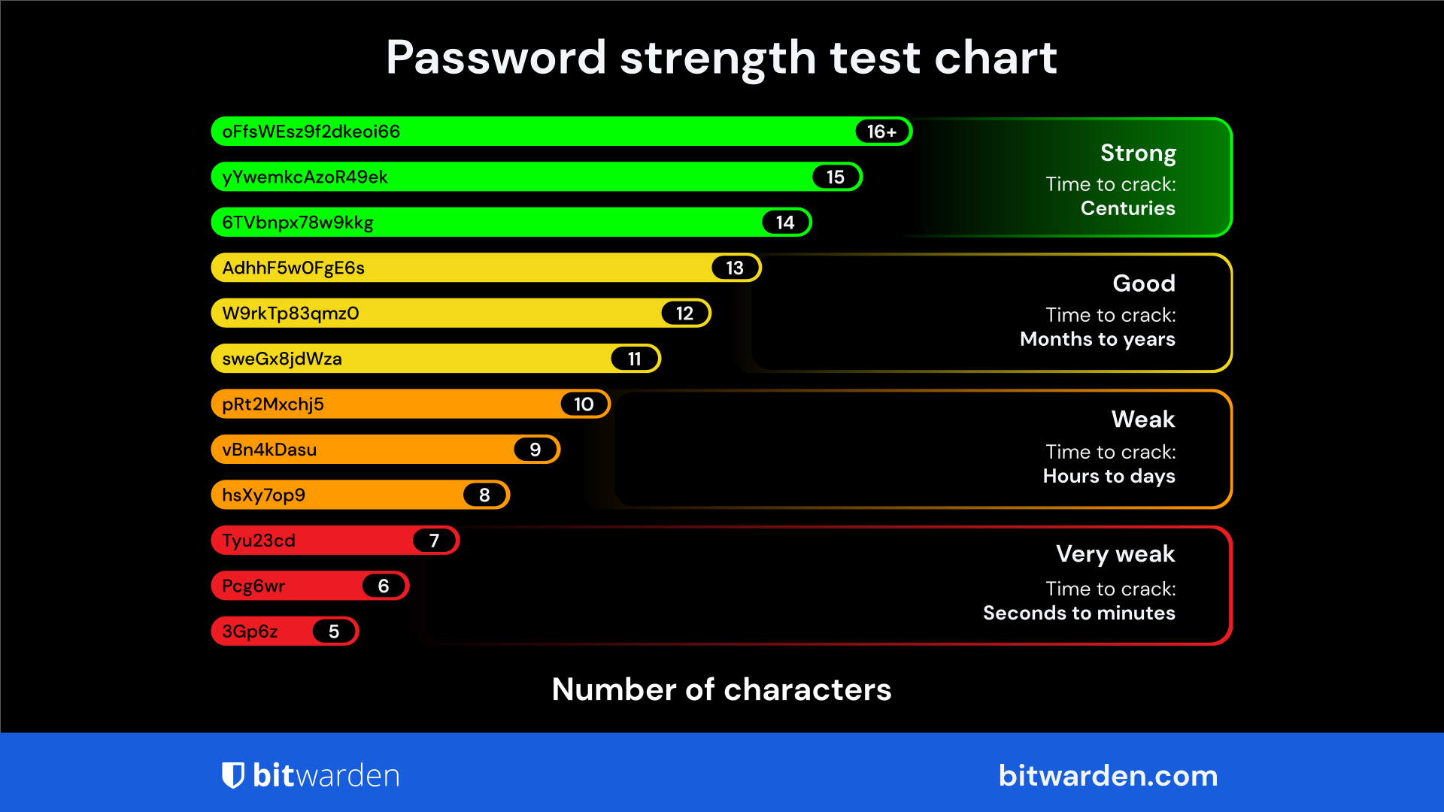

Slide 13

Password Suggestions
The “three random words” approach
Ex: AppleNemoBiro147#
Source: https://www.ncsc.gov.uk/blog-post/the-logic-behind-three-random-words
Notes:
This method works as it provides a length of the password that can be deemed as strong,
the password is novel with no just one word but three together.
it is more usable then complex sets of random digits and numbers.

Slide 14
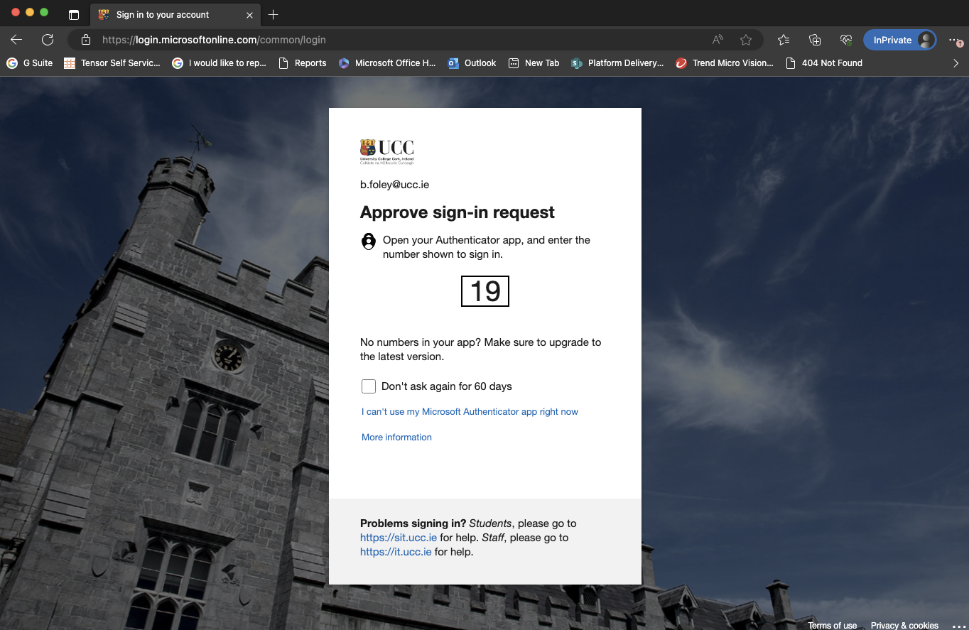
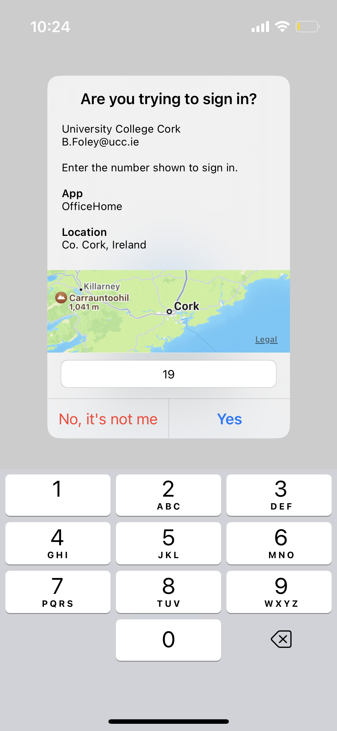

MFA Authentication
Notes:
Required on all staff account in UCC
Enhances Security adding an extra layer of protection
Helps protect personal and organizational information

Slide 15

Social Engineering
The human is the most targeted element in cyber attacks
Less than 3% of people correctly identify all phishing emails
>90% of all compromises can be traced back to a phishing for credentials
Notes:
In a recent phishing simulation conducted in October, 12% of users sent the phishing email clicked on the link

Slide 16
Check/Validate sender
Be wary of “urgent” or threatening emails
Trust your instincts
Don’t open attachments from unknown senders
Don’t click on links from unknown senders
Phishing Awareness

Slide 17
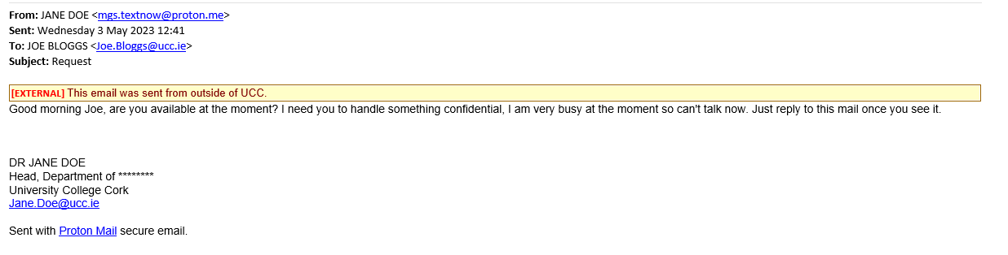
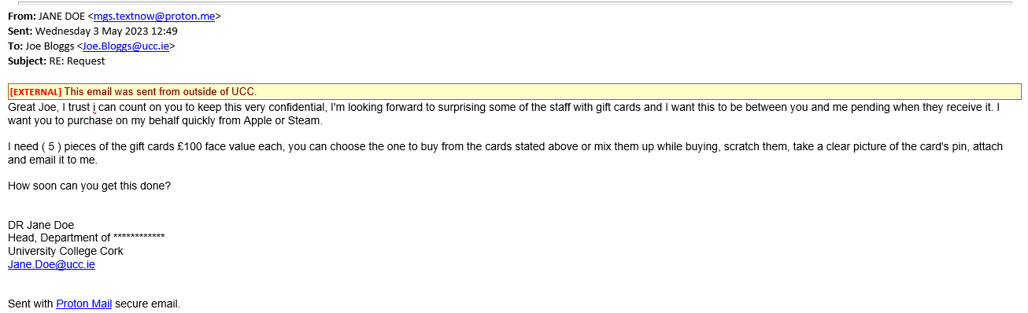

Slide 18
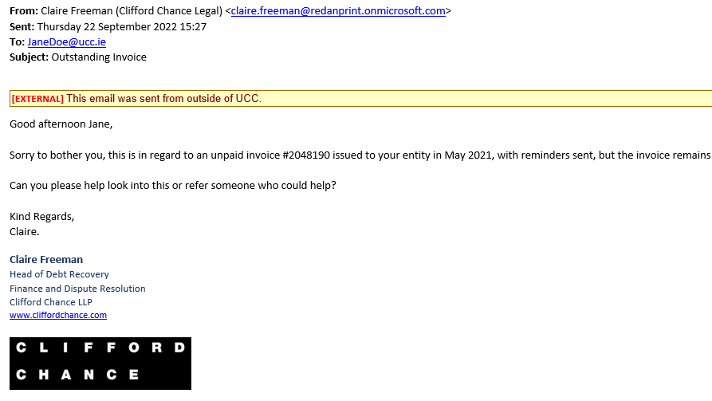

Slide 19

Phished Successfully?
If you have provided any financial information, contact your bank & local Garda Station immediately
Reset your password
Enable MFA
Contact IT Support

Slide 20

Other Phishing/Scam Types
SMS (Text)
WhatsApp
Phone calls
Social media

Slide 21
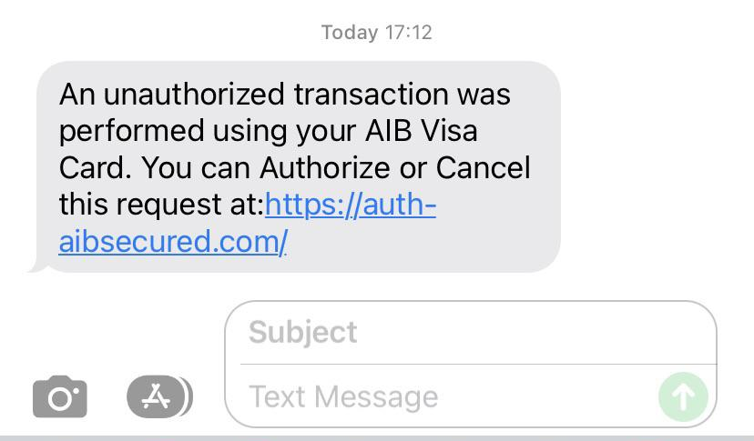
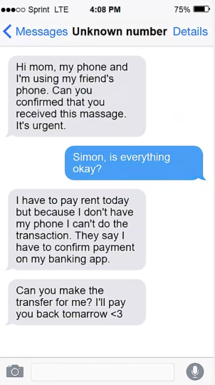
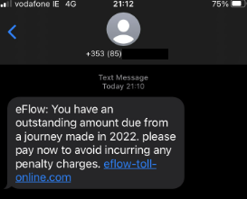
SMS (Text)
Notes:
Hi mum/dad text continue to grow and in the UK victims have lost 220,000 pounds to this scam between 2023-2025
Most prevalent text scams are from delivery companies, toll-road payment scams, and fake bank alerts
If you receive these types of texts, contact the sender through official channels if you are unsure if it is a scam.

Slide 22
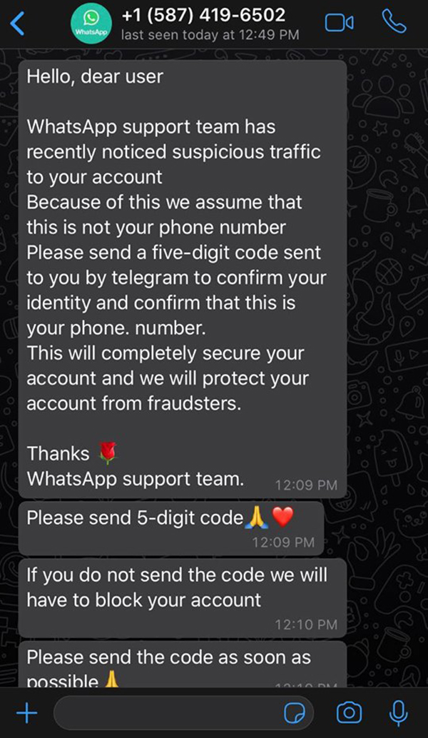
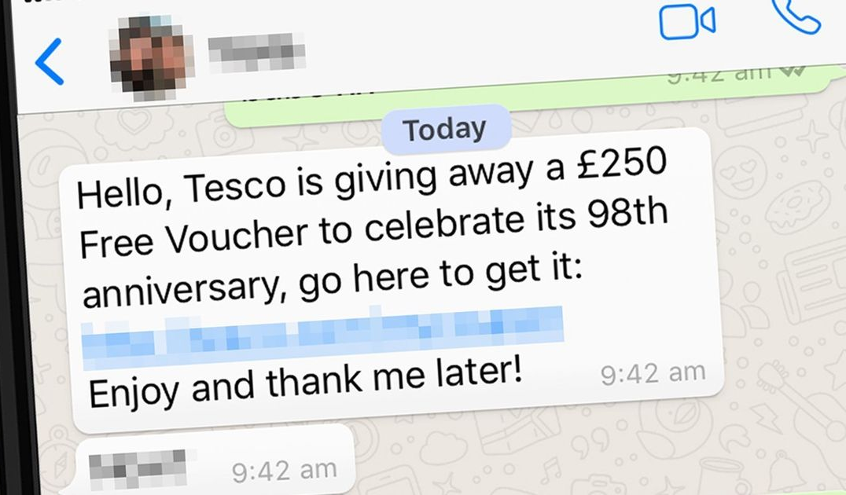
WhatsApp
Notes:
Common scams on WhatsApp include impersonation, job, romance, give aways and fake support scams
Meta removed nearly 7 million scam-related accounts from WhatsApp in the first half of 2025

Slide 23
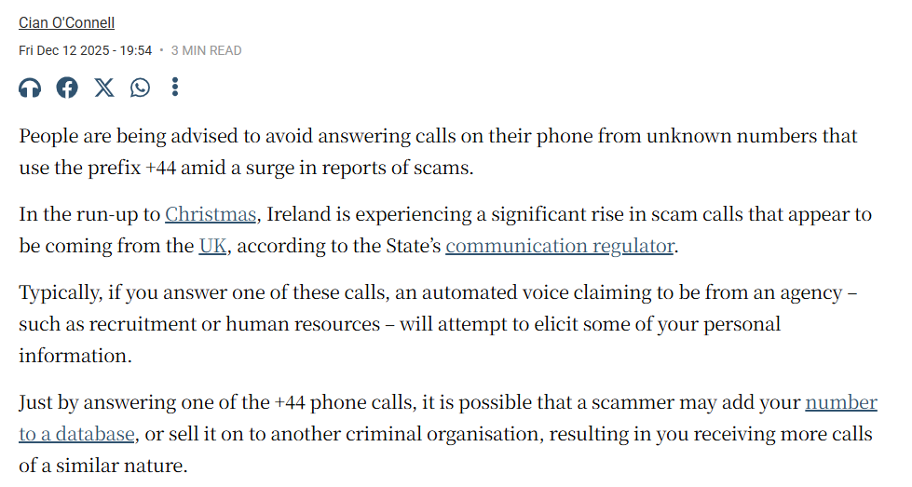
Phone Scam
Common from UK (+44) & Belgium (+32)
Do NOT engage with suspicious calls
iPhone (iOS 26) now offers call screening
If unsure, hang up and call the company using an official number
Source: https://www.irishtimes.com/crime-law/2025/12/12/phone-users-advised-not-to-answer-44-calls-from-unknown-numbers-amid-blitz-of-scams/

Slide 24
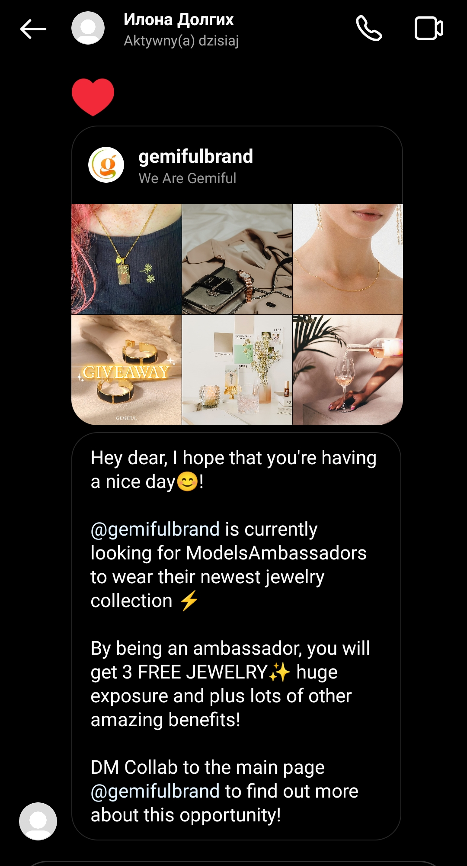
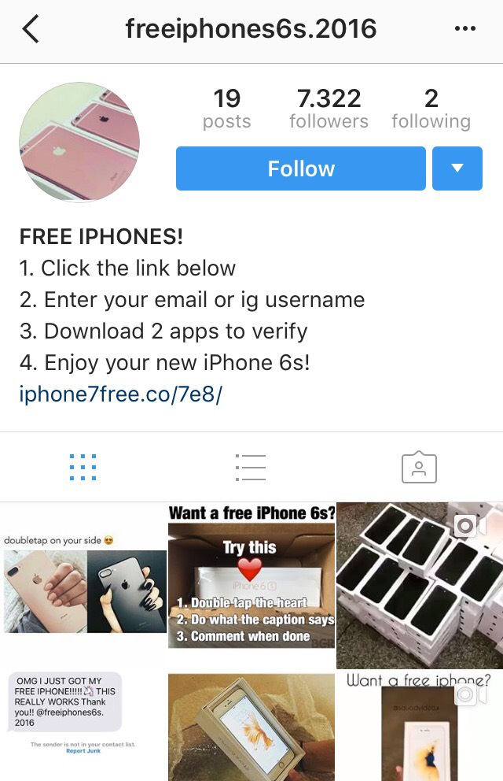
Social Media
Notes:
Again fake giveaways and impersonation scams are big on social media
Also be aware of marketplace scams where people are selling products that sound to good to be true

Slide 25
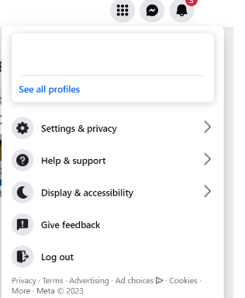
Social Media Privacy Settings:
Protect your digital information – review your social media privacy settings
Share information responsibly

Slide 26
In Summary
Use strong passwords
Enable Multi-Factor Authentication everywhere
Think before you click (on links and attachments)
Be wary of “urgent” calls, emails, texts…

Slide 27
Thank you for listening!
Questions?

