Slide 1

AI and Large Language Models: Opportunities and Risks
Exploring benefits and challenges of powerful AI systems
Notes:
AI-generated content may be incorrect. ---

Slide 2
Introduction to AI and LLMs
Notes:
Understanding Artificial Intelligence, How Large Language Models Work

Slide 3

Understanding Artificial Intelligence
Definition and Scope of AI
AI systems perform tasks requiring human intelligence such as reasoning, learning, and problem-solving.
Large Language Models Explained
LLMs are AI trained on large text data to predict and generate human-like language patterns.
Capabilities and Examples
LLMs excel at summarizing, answering questions, and generating creative content with probabilistic outputs.
Understanding AI Limitations
AI outputs are probabilistic and can be inaccurate, requiring cautious use especially by new users.
Notes:
Artificial Intelligence (AI) refers to computer systems designed to perform tasks that typically require human intelligence, such as reasoning, learning, and problem-solving. AI encompasses various subfields, including machine learning, natural language processing, and computer vision. Large Language Models (LLMs) are a specific type of AI trained on vast amounts of text data to understand and generate human-like language. They do not think or reason like humans; instead, they predict words and phrases based on patterns learned from data. Examples include ChatGPT, Microsoft Copilot, and Google Gemini. These models excel at tasks such as summarizing documents, answering questions, and generating creative content. However, it is important to note that their outputs are probabilistic and can sometimes be inaccurate. Understanding this distinction helps users appreciate both the power and limitations of AI tools.

Slide 4

How Large Language Models Work
Next Word Prediction
LLMs predict the next word in a sequence using statistical patterns from extensive datasets.
Transformer Architecture
Transformers process context to generate coherent text by analyzing relationships within data sequences.
Training on Massive Texts
Models are trained on billions of words from diverse sources to mimic human language fluency.
Limitations and Hallucinations
LLMs can generate convincing but incorrect information, requiring users to verify outputs carefully.
Notes:
Large Language Models operate by predicting the next word in a sequence based on statistical patterns derived from massive datasets. They use deep learning architectures, particularly transformer models, which allow them to process context and generate coherent text. These models are trained on billions of words from books, articles, and websites(not necessarily with the owners consent!), enabling them to mimic human language fluency. However, they do not possess true understanding or reasoning capabilities; their responses are generated from learned correlations rather than factual verification. This means they can produce convincing but incorrect information, known as hallucinations. For example, an LLM might fabricate a citation or invent details about historical events. While they are powerful tools for drafting content, summarizing research, and answering questions, users must verify outputs against trusted sources. A LLM will never answer I do not know.

Slide 5
Practical Applications
Notes:
Everyday Uses of AI

Slide 6

Everyday Uses of AI
Learning and Research Aid
AI can summarize academic papers and simplify complex theories, supporting effective learning and research.
Writing and Creativity Support
AI helps draft emails, presentations, memoirs, and creative writing, enhancing productivity and expression.
Travel and Wellness Assistance
AI provides travel itineraries and general health information, facilitating planning and wellness inquiries.
Notes:
AI offers numerous practical benefits. For learning and research, LLMs can summarize lengthy academic papers, explain complex theories in simple terms, and provide quick overviews of unfamiliar topics. Writing assistance is another major advantage: AI can help draft emails, prepare presentations, or even assist in writing memoirs and creative works. Travel planning becomes easier with AI-generated itineraries, destination suggestions, and packing checklists.(note – these come from travel blogs and sites that often reply on ad revenue to exist, if AI takes their traffic they are likely to stop updating, in time it is likely the data offered by AI will be out dated or solely from government tourist boards)
Health and wellness inquiries can be addressed through general information, though professional advice should always be sought for medical decisions. Creative projects such as poetry, short stories, or photo captions can be enhanced using AI tools, fostering engagement and enjoyment. These applications demonstrate how AI can enrich daily life, offering convenience and intellectual stimulation. However, users should approach these tools as aids rather than authoritative sources, ensuring that outputs are verified and aligned with personal needs.

Slide 7
Risks and Limitations of AI
Notes:
Hallucinations and Bias

Slide 8
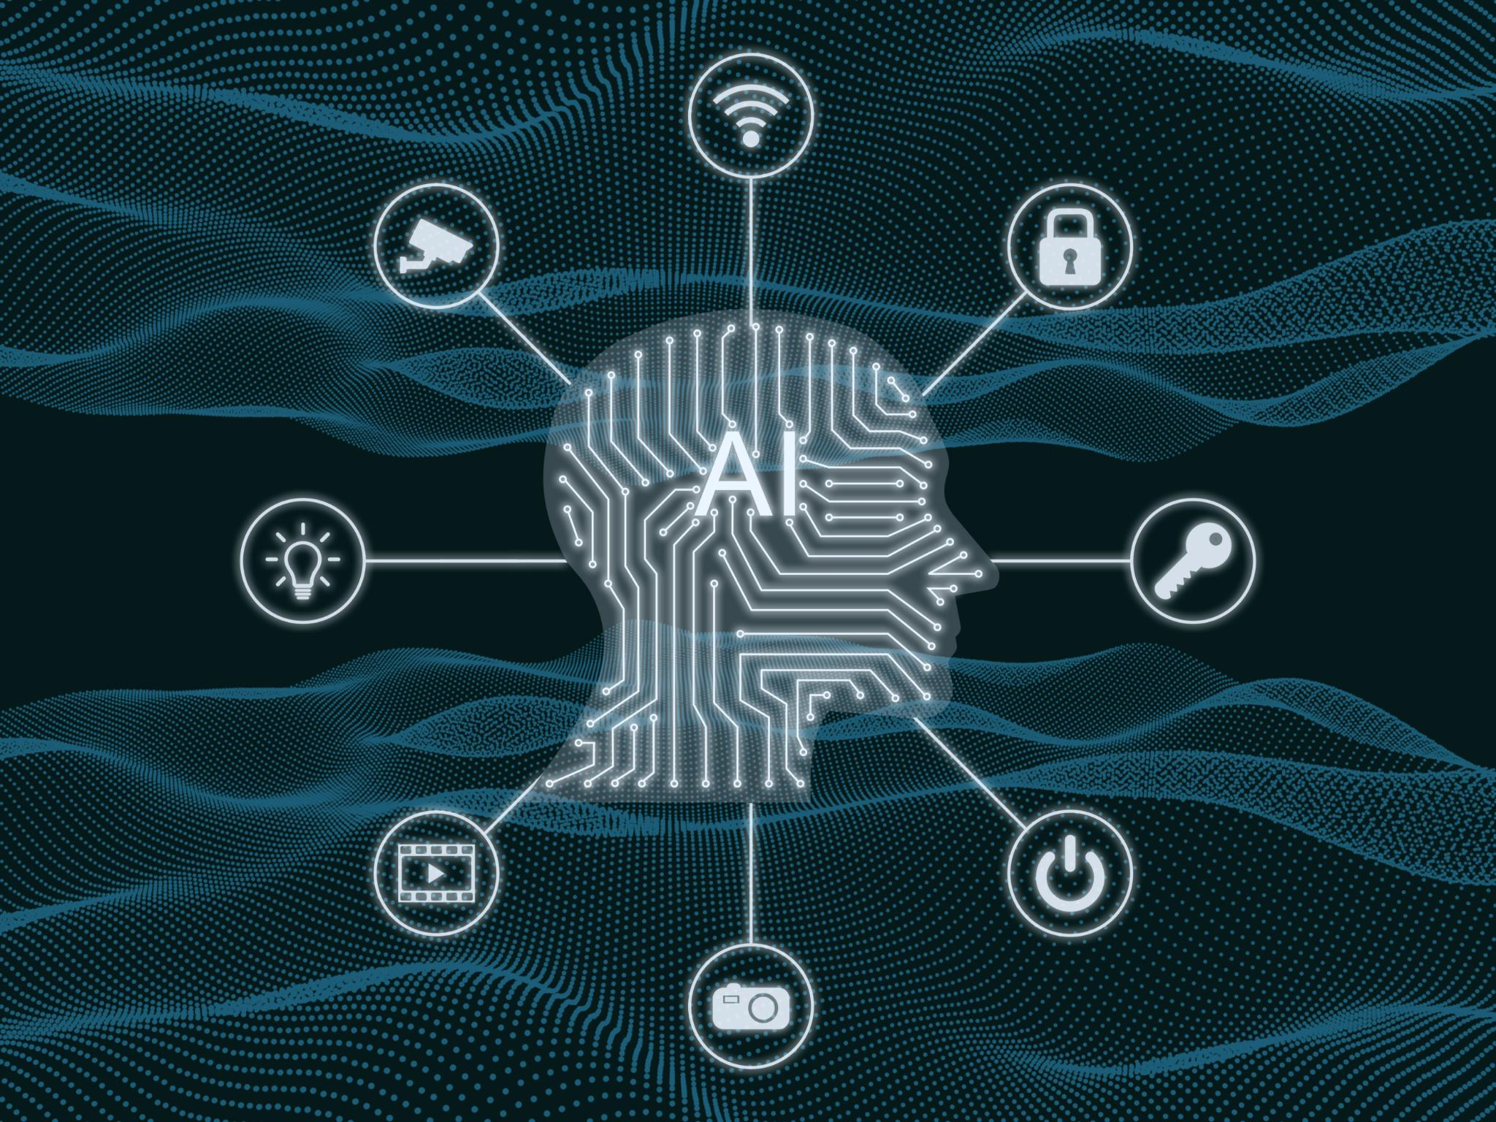
Hallucinations and Bias
LLM Hallucinations
LLMs can generate false or fabricated information confidently due to pattern-based text prediction without fact verification.
Bias in AI Models
Bias reflects in AI outputs as models learn from biased training data, leading to skewed or inappropriate results.
Privacy Risks
Sharing sensitive data with AI may lead to data storage and further use in training, posing privacy concerns.
Critical Thinking Importance
Over-reliance on AI can reduce critical thinking; users should always verify AI output with reliable sources.
Notes:
One of the most significant risks of using LLMs is hallucination, where the model generates incorrect or fabricated information with high confidence. For example, it might invent a historical event or provide a false citation. This occurs because LLMs predict text based on patterns rather than verifying facts. Remember, it will never say I do not know! Bias is another concern, as models reflect the biases present in their training data, which can lead to skewed or inappropriate outputs. Until the world is free from bias AI will be biased.
Privacy risks arise when users share sensitive information with AI systems, as data may be stored or used for further training. Over-reliance on AI can also diminish critical thinking skills, as users may accept outputs without question. Understanding these limitations is crucial for safe and effective use. We should treat AI as a helpful tool, not an infallible authority, and always cross-check information with reliable sources.

Slide 9
AI and Misinformation
Notes:
Fake Images and Videos

Slide 10

Fake Images and Videos
Rise of Deepfake Technology
AI enables creation of realistic fake images and videos, increasing risks of misinformation and fraud.
Risks and Impacts
Deepfakes are used in political propaganda, scams, and identity theft, causing reputational harm.
Detection and Awareness
Recognize signs like unnatural facial movements and verify content with trusted tools to avoid deception.
Notes:
AI has made it easier to create highly convincing fake images and videos, commonly known as deepfakes. These can depict individuals saying or doing things they never did, posing serious risks for misinformation, fraud, and reputational harm. Deepfakes have been used in political propaganda, scams, and even identity theft.
For you, this means encountering content online that appears authentic but is entirely fabricated. Recognizing this threat is essential for maintaining digital literacy. Warning signs include unnatural facial movements, inconsistent lighting, or distorted backgrounds. However, as technology improves, these indicators become harder to spot. Therefore, verifying content through trusted sources and using reverse image search tools is critical. Awareness of deepfakes empowers individuals to navigate the digital landscape safely and avoid falling victim to deception.

Slide 11

Deep Fake Example
Pope in a Puffer Jacket Guardian article from 2023
In the news today
‘Add blood, forced smile’: how Grok’s nudification tool went viral | AI (artificial intelligence) | The Guardian

Slide 12
Staying Safe and Future Outlook
Notes:
Detection and Safety Tips

Slide 13

Detection and Safety Tips
Verify Information Sources
Always cross-check facts with credible sources like academic journals and reputable news outlets to ensure accuracy.
Protect Personal Privacy
Avoid sharing sensitive, personal, or UCC, information with AI tools as privacy cannot be fully guaranteed in digital systems.
Authenticate Visual Content
Use reverse image search and metadata analysis to verify suspicious images or videos and detect misinformation.
Maintain Healthy Skepticism
Approach content with caution, especially if it appears too good to be true. Use trusted fact-checking resources.
Notes:
To stay safe when using AI tools, adopt a cautious and informed approach. Always cross-check facts with reliable sources such as academic publications or reputable news outlets. Avoid sharing personal or sensitive information with AI systems, as privacy cannot be guaranteed. When encountering suspicious images or videos, use reverse image search or metadata analysis to verify authenticity. Trusted fact-checking websites can also help identify misinformation. Additionally, maintain a healthy skepticism toward content that seems too good to be true. By following these practices, retired staff can enjoy the benefits of AI while minimizing risks. Looking ahead, AI will continue to evolve, offering new opportunities in education, healthcare, and creative fields. However, ethical challenges such as bias, misinformation, and privacy will persist. Staying informed and vigilant ensures that users remain empowered in an increasingly AI-driven world.

Slide 14

Questions?

