Slide 2
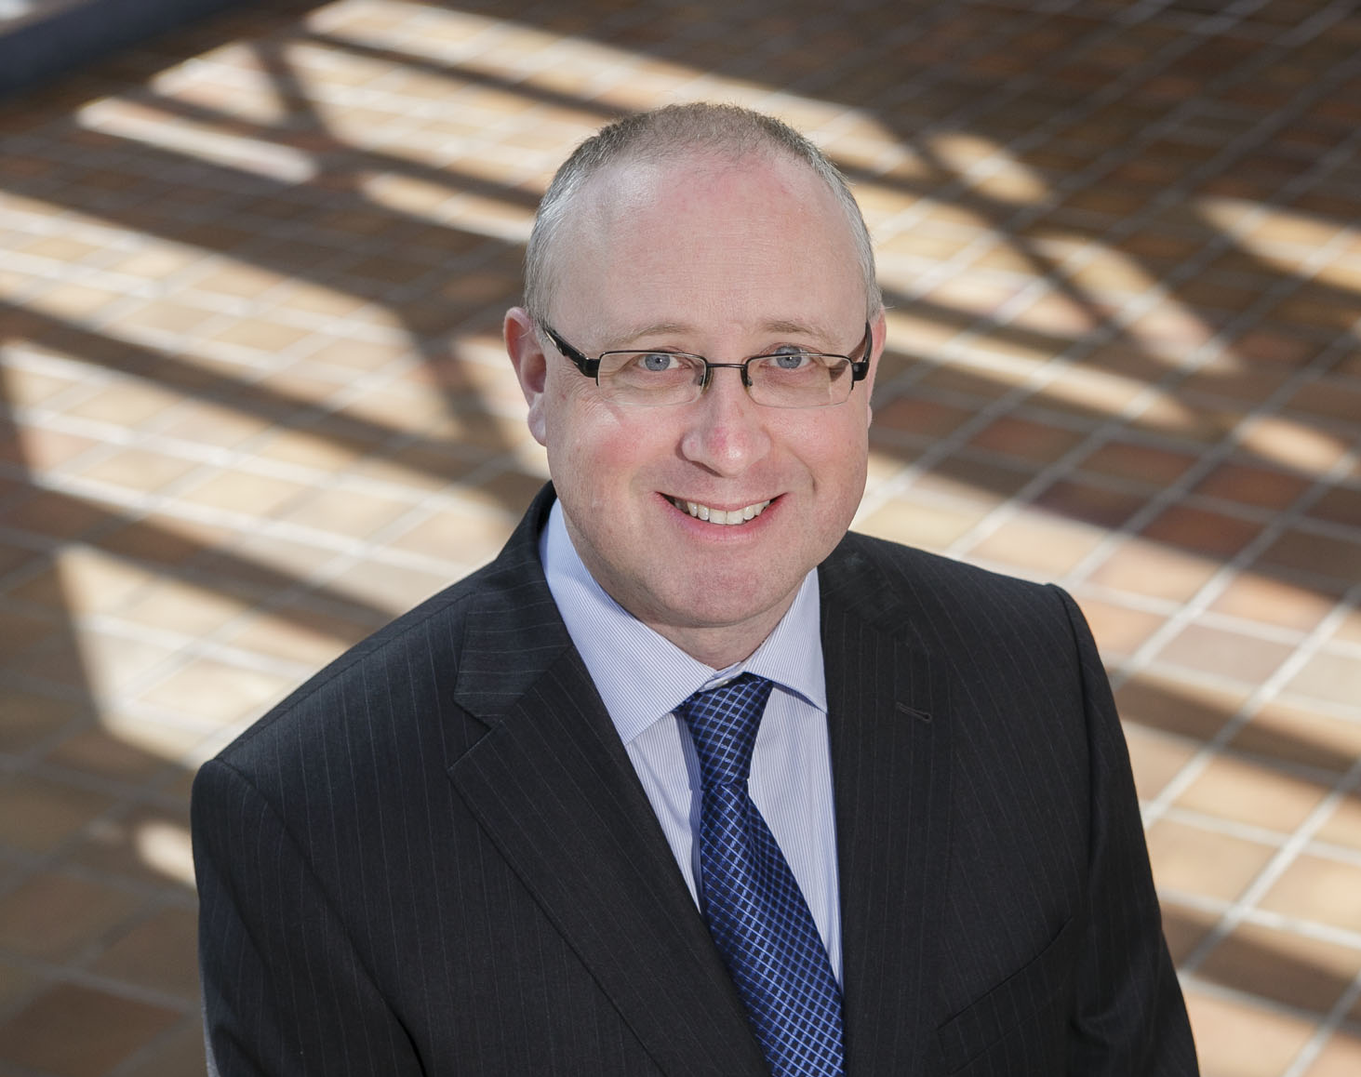
Introductory Remarks
Professor Paul McSweeney
Vice President for Learning and Teaching

Slide 3
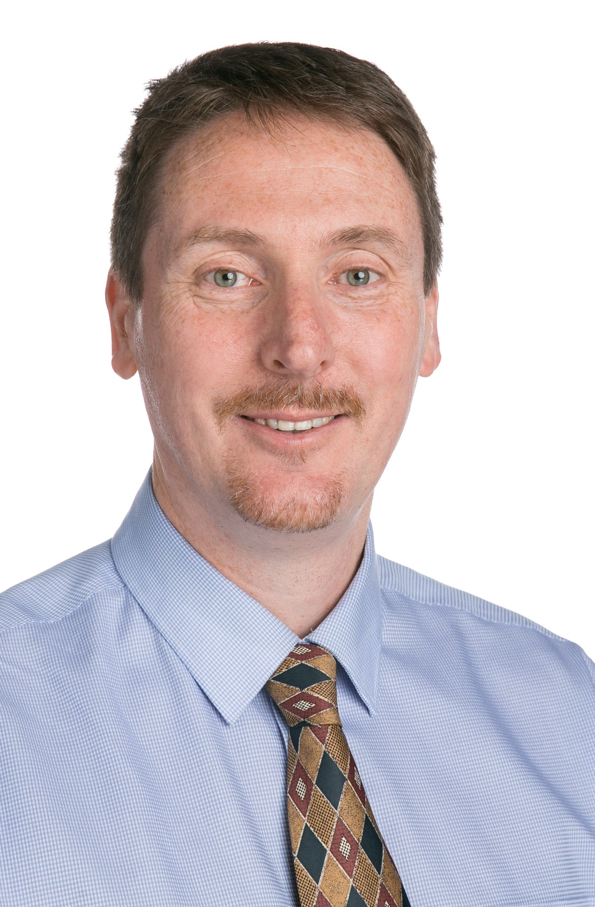
Mentimeter
Tom O’Mara
Head of Digital Education
OVPLT

Slide 4
Questions?

