Slide 1
Session 2. Common PDF Issues
PDF Series
September 2022
Notes:
Thanks everyone for joining. As I said in the chat there, this session is being recorded so there's about 15 to 20 minutes of presenting in this session and then we'll take some questions and answers after. So joining me on the call is James Northridge, the Inclusive UCC project manager and Conor and Grace from our intern project are on the call today as well, or should be joining soon, and they can take some questions in the chat if needed.
For those of you who were here last week, there's a tiny bit of overlap, tiny bit at the start. And there'll also be a bit of overlap with next week. So while we're talking about PDFs here, a lot of these issues come back to the original Word document. So it's about remediating things like tables and headings. And I'll go through that list with you in a moment. So a lot of the time I'll be going back to Word, but we will reference how these issues are caught with PDFs in Blackboard Ally.

Slide 2
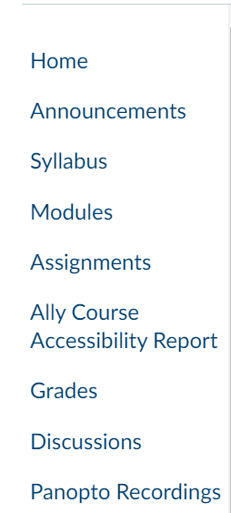
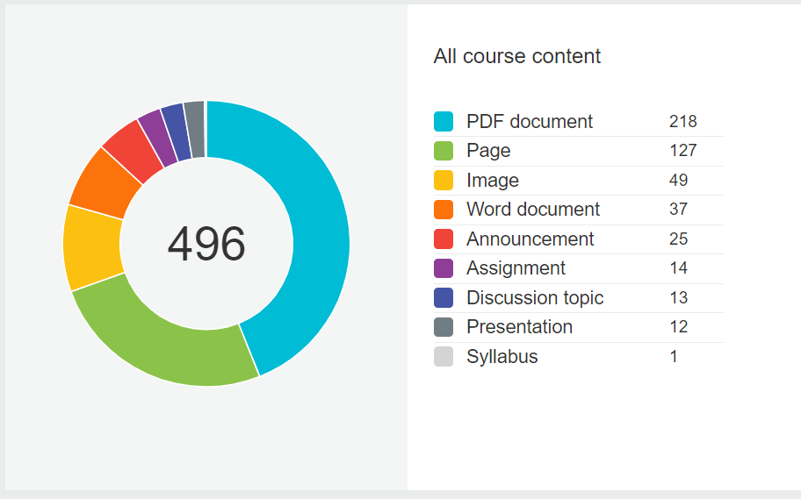
Context of this Session
Notes:
So just two slides from last week again, the context of this session is that we're rolling out a software after Christmas this year called Blackboard Ally, which integrates with Canvas and it will appear in your menu on Canvas here.
This is a screenshot from courses that we enabled it on over the summer when we ran our first pilot. So you won't see this in your menu yet, we're still piloting this software at the minute. This is an example of one of the reports that it shows and PDF documents, as you can see, are one of the top kind of problematic documents.

Slide 3
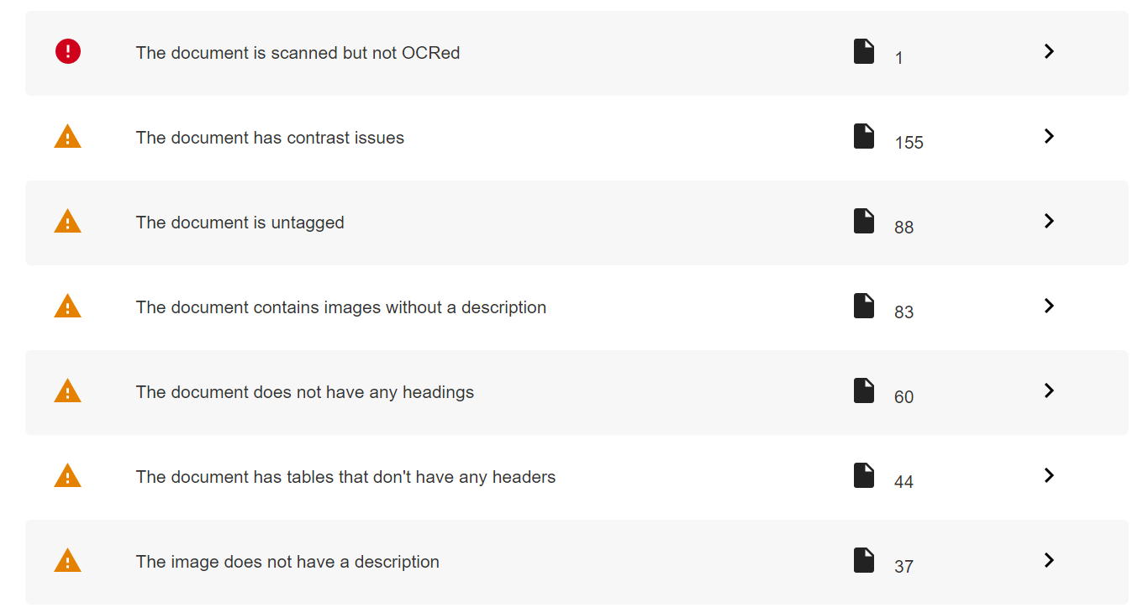
Context of this Session (2)
Notes:
This is a number of the issues that might show up with the PDF and we will be going through all of these today. So Contrast Issues, Untagged, Images without a Description, Headings and Table Headers. So most of those come back to the original Word document. We will look at how to convert your PDF to Word to remediate them. Except for Tagged here, which is specific to it being a PDF.

Slide 4
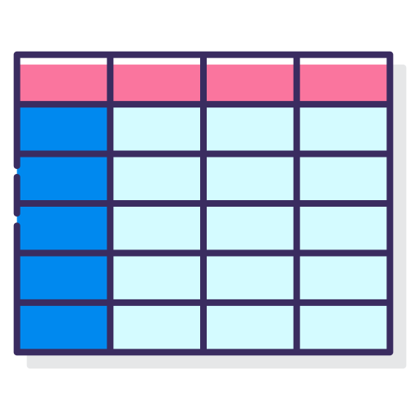
The Five Ts
Tables
Tags
Tiered Headings
Text Contrast
Text for Images
Notes:
So the things are looking at today, I've summed them up as the five Ts. That's not an official term. That was just to make it kind of memorable for today.
So we're going to look at Tables, Tags, Tiered Headings, Text Contrast and Text for Images. So as I mentioned, Tags are the only PDF specific one. The rest come back to your document and next week we'll be looking at setting up your Word document from scratch and doing all these things. So next week will be a bit more detailed and hands-on. Today we're just giving an overview of what would be caught and by Ally when that Accessibility Check is run on your course.

Slide 5
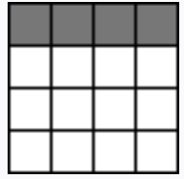
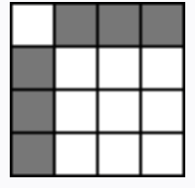
Tables
Headers
Data tables are used to organize data with a logical relationship in grids. Accessible tables need HTML markup that indicates header cells and data cells and defines their relationship. Assistive technologies use this information to provide context to users.
People using screen readers can have the row and column headers read aloud as they navigate through the table. Screen readers speak one cell at a time and reference the associated header cells, so the reader doesn’t lose context.
Reference: https://www.w3.org/WAI/tutorials/tables/
Notes:
So Tables are the first one and the first issue with Tables is Headers. So data tables are used to organise data with the logical relationship in grids. Accessible tables need HTML markup that indicates header cells and data cells and defines their relationship. Assistive technologies use this information to provide context to users.
You don't need to worry about being able to do HTML. We'll look at that in a minute, of how you can do this in Word. Because as you know Word doesn't use HTML. But this is just a bit of context for you about what's going on in the background to let the screen readers know the context.
So people using screen readers can have the Row and Column Headers read aloud as they navigate through the Table. Screen readers speak one cell at a time and reference the associated Header cells so the reader doesn't lose context. So you can see in this example that the first row has been set as a Header. And in this one the first row and the first column, are set as a Header. So it's really just saying to the screen reader “These are your categories. These are the main headings of the table.”

Slide 6
Tables (2)
Headers
If you can Tab smoothly through the table, cell by cell and row by row, a screen reader should have no trouble with it.
Designated header rows make it easier for a screen reader to navigate your table, and some screen readers will call out the name of a row or column before reading the data.
Use the Table Design tab to designate a row or column as a Header.
Notes:
If you can tab smoothly through the table cell by cell and row by row, a screen reader should have no trouble with it. And I'll share these notes with you after the session as well. If you'd like a a refresher on them.
So designated Header rows make it easier for a screen reader to navigate your table and some screen readers will call out the name of a row or heading column before reading the data.
You use the table Design tab to now to designate a row or column as a Header. So when you click on your table in Word and go to the Design tab, you can set a Header Row or a Header Column or both. Word is limited in that the maximum you can do is one Header Row and one Header Column. You can't have multiple Header Rows or multiple Header Columns, and we look at that in a minute what to do in that situation, if you've a very complicated table.
And again we mention screen readers a lot, but this just makes layout a bit easier for everyone. A lot of this is based around screen readers, a lot of this guidance. But when you come out of it again, it helps a range of things.

Slide 7
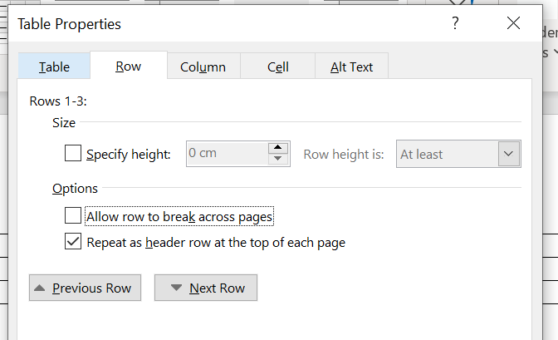
Tables (3)
Headers
Under Table Properties, check Repeat as header row at the top of each page.
Also, be sure Allow row to break across pages is unchecked.
Notes:
So this is just a bit of a detail that we look again at again next week when we're setting up our Tables. But you check “Repeat as Header Row” at the top of each page in the Table Properties and uncheck “Allow Row to Break Across Pages.” So that kind of helps you with your accessibility review of setting up that table.

Slide 8
Tables (4)
Merged/Split Cells
Screen readers make sense of information in a linear way. They read tables from top to bottom, left to right.
Using merged or split cells in your table confuses the reading order and can make your information difficult to follow.
Instead, consider breaking down your information into multiple simple tables (with no merged or split cells) or rethink how you are presenting the information.
 |  | 2020 |  | 2019
 |  | Appearances | Wins | Appearances | Wins
Red Team | Sue | 15 | 4 | 12 | 5
 | Bob | 12 | 3 | 13 | 6
Blue Team | Harry | 13 | 4 | 10 | 4
 | Beth | 18 | 2 | 16 | 3
Notes:
The next issue with Tables is Merged and Split Cells so you can see here we've Merged Cells and Split Cells here. And that confuses the screen reader. So screen readers makes sense of information in a linear way. They read Tables from top to bottom, left to right. Using Merged or Split Cells in your Table confuses the reading order and can make your information difficult to follow. Instead, consider breaking down your information into multiple simple tables with no Merged or Split Cells, or rethink how you were presenting the information.
In this example here, if we were following that guidance, we'd do one table for the Red Team and another table for the Blue team. If it's very complicated information you might reconsider creating bulleted lists or an image with some Alt Text or something, if it's getting too complicated.
To show you what we mean by the Accessibility Review, when I go to my Review tab here in PowerPoint, (this is the same in any Word document), you'll have a Review tab and this Check Accessibility icon.
And you can see that it's caught the Table issue because I've purposely done one inaccessible table here. It has caught the one on my first page and it's caught this one. What you can do is, you can use this dropdown arrow, I won't go through it now, but you can use this dropdown arrow and it will tell you what's the issue. It will tell you whether it's Merged cells or Split cells and you can keep on reformatting that table until it's passing your Accessibility Check. So that's how you know that your table is navigable by the screen reader.

Slide 9
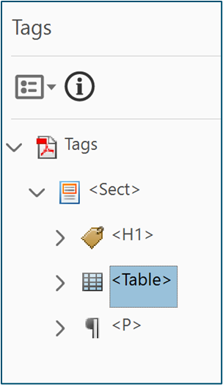
Tags
Tags are an invisible layer of formatting that create a logical reading order for a screen reader.
They are applied to content such as Tables, Figures, Artifacts and Lists.
Each tag identifies the type of content and stores some attributes about it.
They also arrange the document content into a hierarchical architecture (or a “tag tree”).
Reference: Accessible Document Solutions: An Introduction to PDF Tags
Notes:
The next thing is Tags and you might not have heard of this term before. It's not something that would be in a lot of our terminology, we haven't really needed to know about it before. Tags are invisible layer of formatting that create a logical reading order for a screen reader. They are applied to content such as Tables, Figures, Artifacts and Lists. Each tag identifies the type of content and stores some attributes about it. They also arrange the document content into hierarchical architecture called A Tag Tree.
This is an example here. Basically, it will go through your document and it's telling the screen reader “Here we have a Heading. Next we have a Paragraph. Next we have an Image. Next we have a Table.” This screenshot is taken from Adobe. If you're using the licensed version of Adobe, you can check for this. If not, you don't need to be able to check for this because what I'll show you in a minute.
So this is an untagged document. And you can see here is my Tagged one. You can see here all these tags are telling the screen reader if there’s a Paragraph. If I go to a page with an image here, if I scroll down a bit, you see it's denoted them as a Figure. So that's what a Tagged document is. But if you're not using the licensed version of Acrobat, Blackboard Ally will tell you.
I've uploaded that same document to my Ally Test Area and you can see there’s a little red score saying there's low accessibility with the PDF. So this is the original one. This is the one with no tags. This is the one I got on EBSCO. And you can see that, when I click into Ally, it tells me that the PDF is untagged. So what do you do about this? What do you do when your PDF isn't tagged?

Slide 10
Tags (2)
You do not need advanced editing skills to apply these changes.
SensusAccess UCC will generate tags for you.
Notes:
So you don't need advanced editing skills to apply these changes. In session four we are looking at how to edit and fix up your Tag Tree, and that's just for anybody who's interested and wants to know a bit about that. But for now - SensusAccess UCC, which is available on the library website, will create those tags for you. So as your target format, you just put “Tagged PDF”.
Demonstration – SensusAccess
Go to Libguides.ucc.ie
Select the ‘Supporting Learning’ tab
Select SensusAccess
Select the ‘Convert Files Now’ button
Source = File
Step 1. Upload your Document
Choose your File
Press Upload
Step 2. Select Output Format
For this demo, we’re using ‘Accessibility Conversion’
Step 3 - Specify accessibility conversion options
Under ‘Target Format’ we can choose ‘Tagged PDF’
Step 4. Enter email address and submit request
Enter your UCC email address. This will take a couple of minutes to come through.
So when I pop this back up on Ally, it will know that it's tagged and it will be approved for accessibility then. So that's all you need to do with tags. Pop them through SensusAccess, generate the tags, and your document will then be accessible.
As I said, we're looking at tags more closely in the fourth session and that's for users of Acrobat.

Slide 11
Tiered Headings
Screen reader users can navigate a page according to its headings, listen to a list of all headings, and skip to a desired heading to begin reading at that point.
One of the most common accessibility mistakes is making text bold when a heading is needed. Though the text may look like a heading, the underlying code is not set correctly, and screen reader users will not benefit.
Select the appropriate heading rank in your hierarchy. Do not select heading levels based on their appearance.
Reference: Yale University 'Usability and Web Accessibility'
Notes:
Tiered Headings is the next one. Screen reader users can navigate a page according to its Headings, listen to a list of all Headings, and skip to a desired Heading, to begin reading that point. I'll show you a video of a screen reader doing that in a minute. So one of the most common accessibility mistakes is making text bold, when a Heading is needed. Though the text may look like a Heading, the underlying code is not set correctly, and screen reader users will not benefit. Select the appropriate heading rank in your hierarchy. Do not select heading levels based on their appearance.
In Word Styles there is a hierarchy. So if you use a Heading One for your main point, the sub point must be a Heading Two and a sub point to that again would be a Heading Three. You're going down the hierarchy to let the screen reader know. And again this isn't just for screen readers, any sighted users as well - it makes the document really clear and really well formatted for them.

Slide 12
Tiered Headings (2)
Reference: YouTube.com 'Screen Reader User's Experience and MS Word"
Notes:
To see how this can leave a screen reader behind, I've a short video for you here.
Video narration “Now I will use the H key and I'll be able to move from 1 heading to the next. [Screen reader] ‘Heading 3 William of Okham. Heading 2 List of major medieval philosophers. Page 4, Heading 2 Review of medieval period. Heading 2 Links For more information’.”
Video narration “In the inaccessible document, on the other hand, I have to use the up and down arrow keys to navigate to a certain part of the text. Also, I do not hear any information that indicates that I have arrived at a major heading. [Screen reader] ‘There are no elements in this document. No more headings found.’”
You can see in that example the screen reader user would need to read everything. They need to go through the whole document, so they're instantly at a disadvantage to the sighted user who can scan and say “well I just want to jump to this part.” And you saw there that the screen reading software, when you're using the stylized headings, they can quickly read through the list and decide then if they want to jump through the document to another part. So that's why we we're encouraging the tiered headings.

Slide 13
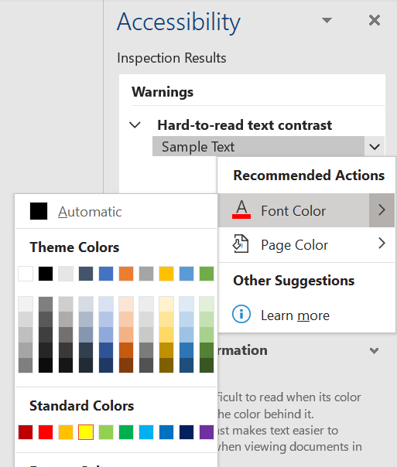
Text Contrast
It is important that the contrast between foreground and background colours on text and images is not too high or too low.
Otherwise, it is difficult to read for users with literacy or vision difficulties.
Notes:
The second last one then in our five Ts is Text Contrast. It is important that the contrast between foreground and background colors on text and images is not too high or too low. Otherwise, it is difficult for users with literacy or vision difficulties. You can see here we've really bright yellow sample text and the Accessibility Checker in Word (the same one we looked at earlier under the Review tab) is recommending what colours to use instead. So it lets you pick a new colour and it will tell you whether the contrast is more accessible and it will fix that issue for you.

Slide 14
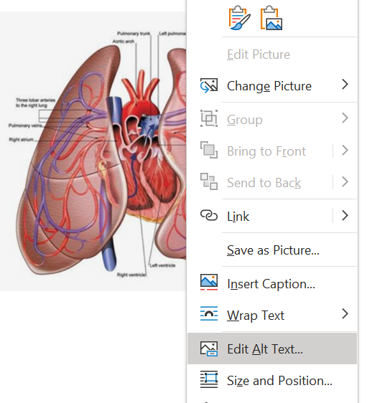
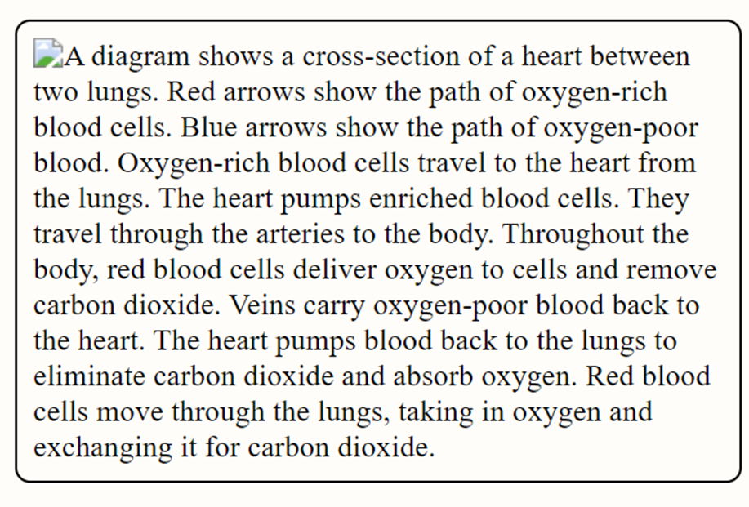
Text for Images
Known as Alternative Text (Alt Text).
This is the written copy that appears in place of an image.
Useful for those who use screenreaders or those with low bandwidth.
Notes:
The last point then, in what happens with our PDFs that aren't accessible, is Text for Images. This is also known as alternative text or Alt Text. It's the written copy that appears in place of an image, and it's useful for those who use screen readers, or even those at low bandwidth and many other issues. But that's just an example. To add Alt Text on an image, right click and select Edit Alt Text.
And you can see here an example of a description. So it's describing the lungs, what the picture looks like, and then also the process that's happening in the picture. So you can see if somebody with low bandwidth would get that written copy as well. And it's really, really useful.

Slide 15
What to do when the PDF isn't your own?
Notes:
You're probably wondering “ok, all of that comes back to a Word document. That's great, but what do I do with a document where I don't have that original Word document? I've got my PDF from EBSCO” (as you saw me doing there when I was tagging it).
If you've put a PDF through Ally and it's saying “you've Contrast Issues, you've Heading issues, you've Table issues, all of that.” What you can do is use SensusAccess to convert it to a Word document. When SensusAccess gives you back that Word document, then you can format your Headings and the five things that I mentioned there. (The four things, I suppose, the tagging is separate and you might do that at the end.)

Slide 16
What to do when the PDF isn't your own? (2)
Section 104 of Copyright and Related Acts, 2000
A designated body may:
make a copy of a work for the purpose of modifying that copy to meet the special needs of a person who has a physical or mental disability, and
supply that modified copy to that person, without infringing the copyright in that work.
Notes:
In terms of copyright then, when the PDF isn't your own (and we've gone back to OCLA about this) under Section 104 of the Copyright and Related Acts “A designated body, which would include university, may make a copy of a work for the purposes of modifying that copy to meet the special needs of a person who has a physical or mental disability. And supply that modified copy to that person without infringing the copyright in that work.”
So you're not changing their content, you're not rewording anything, you're simply reformatting the document so that a student with the disability can read it a bit better. I've hyperlinked that act for you there, for when I send around the notes. Obviously, you can't sell the document, or release it to the public, that would be infringing on copyright.
And if you leave a note on the Canvas page to say “this has been edited for the purposes of a student with a disability” then again, you're covering that as well.

Slide 17
Thanks for Listening
Contact Us
First Floor, The Hub, Main Campus, UCC
inclusive@ucc.ie
www.ucc.ie/en/inclusive/
Notes:
So thanks everyone and that's the 50 minutes of presenting over. We're happy to talk through some of that with you now. We are Inclusive UCC. We're based in The Hub and this is our e-mail address if you'd like to contact us some more. We also have our website, it’s under the Registrar's Office website.
As I mentioned, the next two sessions in the series are happening next week and the week after so ‘starting that document in Word’ a little bit of overlap with today. But we'll be just doing, it's more of a hands-on session. And then the last session is for users of an Acrobat license who would like to really get into the technical bit with those tags and things. So thanks everyone for listening and we'll take some questions.
Questions Q1. “How long do those conversions take?”
A1. “Yeah, that's really good question. A couple of minutes. I didn't open my e-mail today. I had one done already, but usually 5-10 minutes is the longest I've ever seen it taking.
Q2. “I have on Canvas a lot of readings, a lot of articles for my student. Does that mean that I need to tag them all? or what does it mean for me in terms of, you know, to make them all accessible? Because if this is the case, then there's an awful lot of work for me. If all of this material needs to be accessible the way you showed us.”
A2. “Yeah, you're right. There is a bit of work on it and it can take a bit of time. And so we'd say, you know, do it gradually over time and if you can. It's going to be hard to know about the Tags and that's a good question. It's going to be hard to know until you get that report from Ally after Christmas. You could in the meantime be running some PDFs through SensusAccess, through that tagged thing. But unless you've the Acrobat license, or Ally, it's going to be hard to know. So some of them might come with Tags and some of them don't. So we're really in these sessions just preparing you and with some of the terminology and for what will be coming when Ally is switched on. Maybe start with the most used ones.”
Q3. “Yeah, I was just wondering about accessibility for PowerPoint slides that aren't PDF's. Is there a separate issue or are there certain principles that would apply that are the same?”
A3. “And yeah, and that's a great question as well. So all the principles we looked at would apply except for the Tags. The Tags are the only PDF-specific one. If you're dealing with PowerPoint, it's the headings, the tables, the contrast and the alt text, they all apply to PowerPoint, yeah.
And the session next week on word it will be parallel. Really. Anything we you learn in that session will apply to PowerPoint.”

