Slide 1
Digital Wellbeing
Susan O’Mahony
Staff Wellbeing & Development Advisor

Slide 2
Learning Outcomes
Understand Digital Wellbeing
Reflect on your Digital Wellbeing and Understand how to Disconnect from work at UCC
Provide tools to help promote Digital Wellbeing

Slide 3

Digital Wellbeing
'Digital wellbeing’ refers to the impact of technologies and digital services on our mental, emotional, social and physical health.
This Photo by Unknown Author is licensed under CC BY-SA-NC

Slide 4
Digital Wellbeing Definition
"The capacity to look after personal health, safety, relationships and work life balance in digital settings: to use digital tools in pursuit of personal goals and to participate in social and community activities: to act safely and responsibly in digital environments, to negotiate and resolve conflict: to manage digital workload, overload and distraction: to act with concern for the human and natural environment when using digital tools"
(Shah, 2021)

Slide 5

Digital Technology:
There are benefits and risks with digital participation in relation to health and wellbeing outcomes
What benefits and risks have you noticed with digital technology?

Slide 6

Harmful effects of Technology
Heightened attention-deficit symptoms
Impaired emotional and social intelligence
Technology addiction
Social Isolation
Impaired Brain Development
Disrupted Sleep

Slide 7

Digital Wellbeing is about finding balance between our online and offline life
This Photo by Unknown Author is licensed under CC BY-NC-ND

Slide 8

Digital Wellbeing at UCC
New Right To Disconnect Policy under development
New Digital GP
Digital Wellbeing Platform
Digital and in person EAP service

Slide 9

Overview of the Right To Disconnect Code
Code applies to all employees in all types of employment
Purpose is to provide practical guidance and best practice
Complement rights and obligations under existing employment legislation
Onus of management of working time on employer while individual responsibility on the part of employee required in the context of existing legislation.
This Photo by Unknown Author is licensed under CC BY-SA-NC

Slide 10

What are your Rights Under the Code?
The right of an employee to not routinely perform work outside normal working hours
The right to not be penalised for refusing to attend to work matters outside of normal working hours.
The duty to respect another person’s right to disconnect (e.g., by not routinely emailing or calling outside normal working hours.
This Photo by Unknown Author is licensed under CC BY-SA-NC

Slide 11

What are Employees Obligations?
Manage their own work time
Take reasonable care to protect their safety, health and welfare and that of their co-workers
Cooperate with mechanisms to record work time
Notify employer if statutory breaks not availed outlining reasons why
Be conscious of own work pattern and take remedial action if necessary
This Photo by Unknown Author is licensed under CC BY-NC

Slide 12
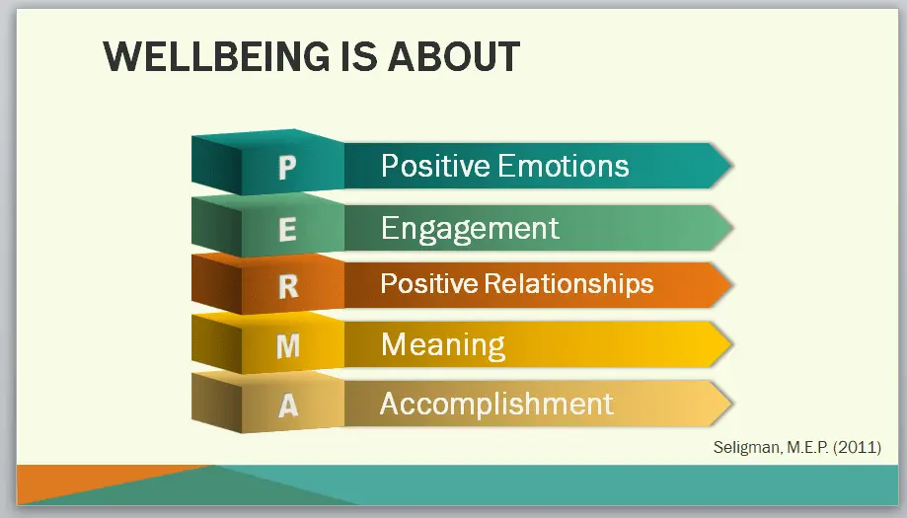
Digital Wellbeing

Slide 13

Digital Wellbeing: Positive Emotions
When you think about your own relationship with , as it were, with digital technologies, are they positive or negative?
Are you experiencing stress and anxiety because of digital technologies? If so, what can you do to reduce the negative emotions?
This Photo by Unknown Author is licensed under CC BY-NC

Slide 14

Digital Wellbeing: Engagement
By engagement and digital wellness, when using these technologies are you getting into the flow of your work or becoming easily distracted?
Or are the technologies giving you the chance to chat friends and helping you to go with the flow, to relax, and find some quality time?
This Photo by Unknown Author is licensed under CC BY

Slide 15

Digital Wellbeing: Relationships
Is digital technology having a positive or negative impact on your relationships
Are you present with your family or friends?
Have you noticed that you get “ Self Interrupted”

Slide 16

Digital wellbeing: Meaning
Does your use of these digital technologies help you achieve greater meaning?
How does technology help you achieve your goals at work?
This Photo by Unknown Author is licensed under CC BY-SA-NC

Slide 17

Digital Wellbeing Accomplishment
Does the time you spend with digital technologies time that leads you towards accomplishing something worthwhile?
Can you recall recent accomplishments achieved because of digital technology?

Slide 18

Tools to Help Disconnect from work
Use E-Signature to set boundaries
“Please note that this email may have reached you outside of normal business hours – if it does, I do not expect an immediate response”
Select time and date to send an email during working hours found under delay email in options tab
Turn off Work Notifications on your phone and laptop and Schedule Breaks for physical activity
Agree times of meetings during working hours
Attend Right to Disconnect Training
Use Digital Wellbeing on devices to track your wellbeing
Introduce evidence- based practices such as mindfulness to disconnect
This Photo by Unknown Author is licensed under CC BY-SA

Slide 19

Digital Wellbeing Reflection
What’s going well?
What do you need to do more of?
What do you need to stop doing?
What do you need to start doing?

Slide 20
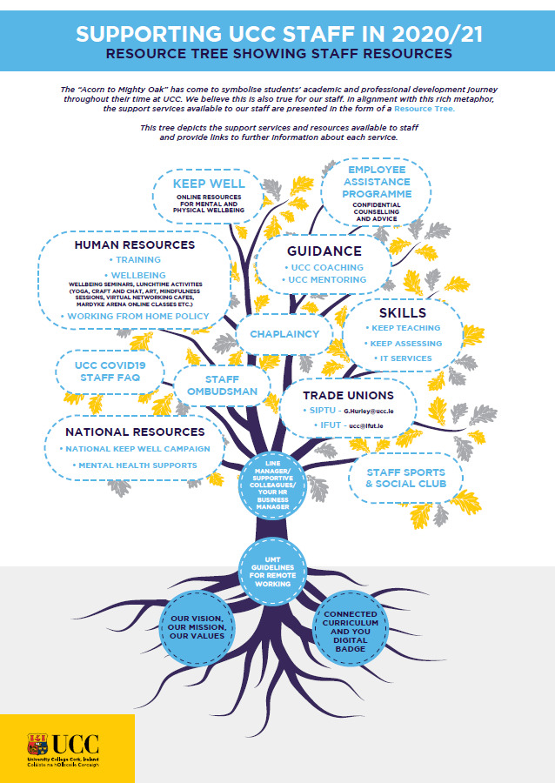
Where can I go for help?

Slide 21

Workshop Learning
What will you do differently as a result of attending this workshop?

