Slide 1
Skills Based CV’s
Turning your experience into clear evidence of the skills employers need
Carol O’Dwyer
People & Culture- Research
25th September 2026

Slide 2
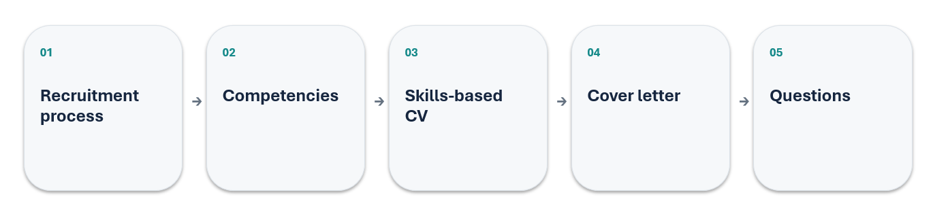
Welcome!
Today we will cover
The through-line: read the role → identify the evidence → present it clearly.

Slide 3
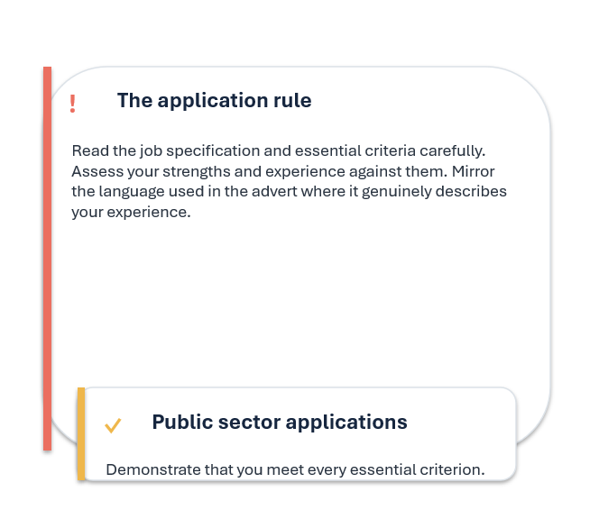
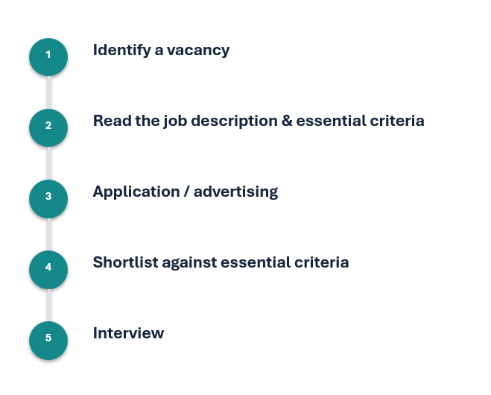
How the process works

Slide 4
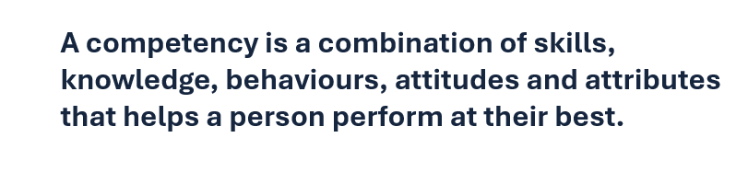
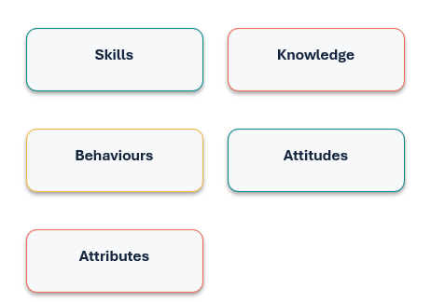
What is a competency?
Competencies help with
• Performing tasks
• Accomplishing goals
• Succeeding in a particular role
Your task: identify the competencies you already have — then choose evidence that proves them.

Slide 5
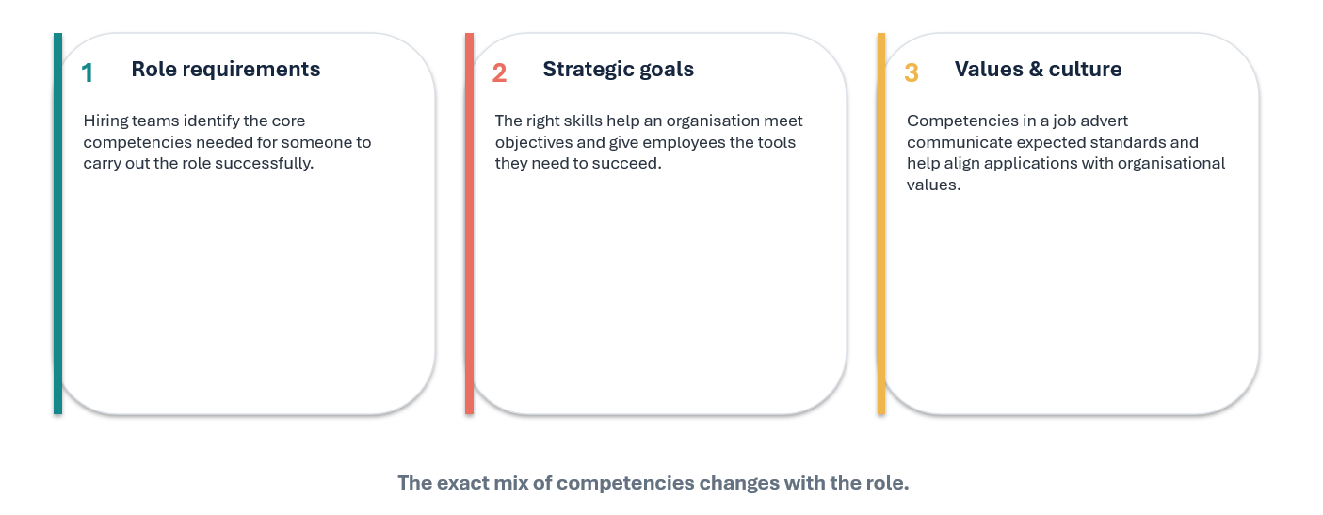
Why competencies matter to organisations

Slide 6
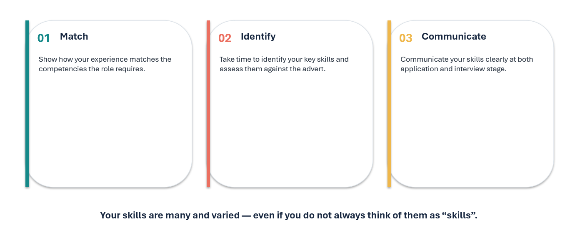
Why competencies matter to job seekers

Slide 7
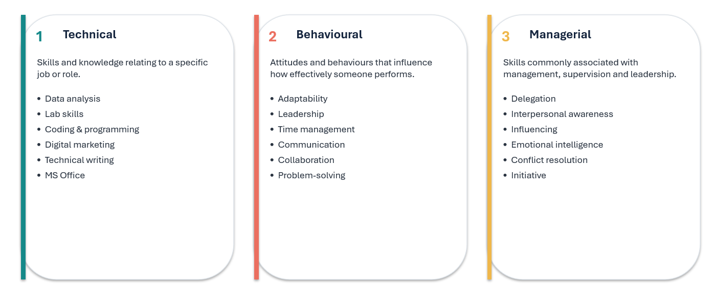
Three useful competency categories

Slide 8
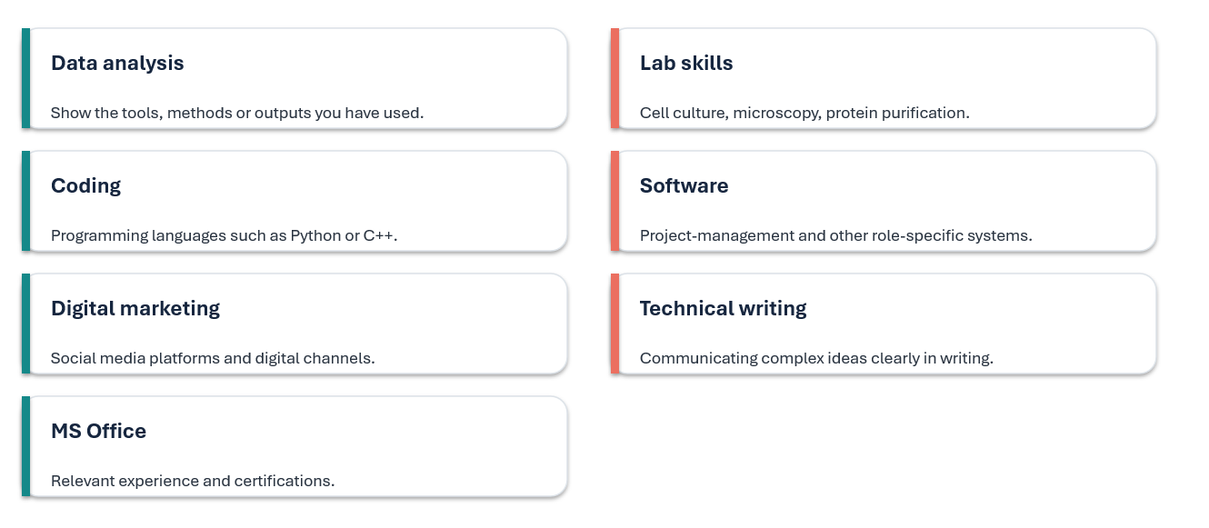
Technical competencies: make them specific

Slide 9
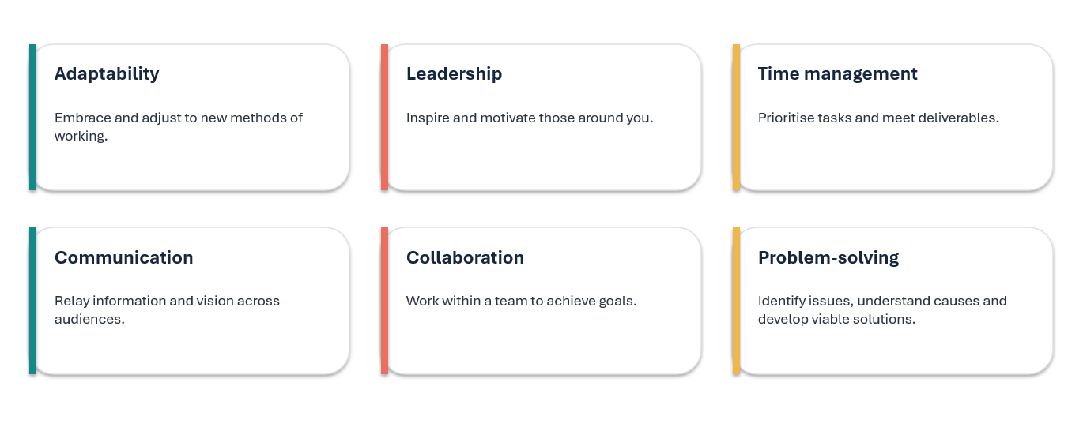
Behavioural competencies: show the behaviour

Slide 10
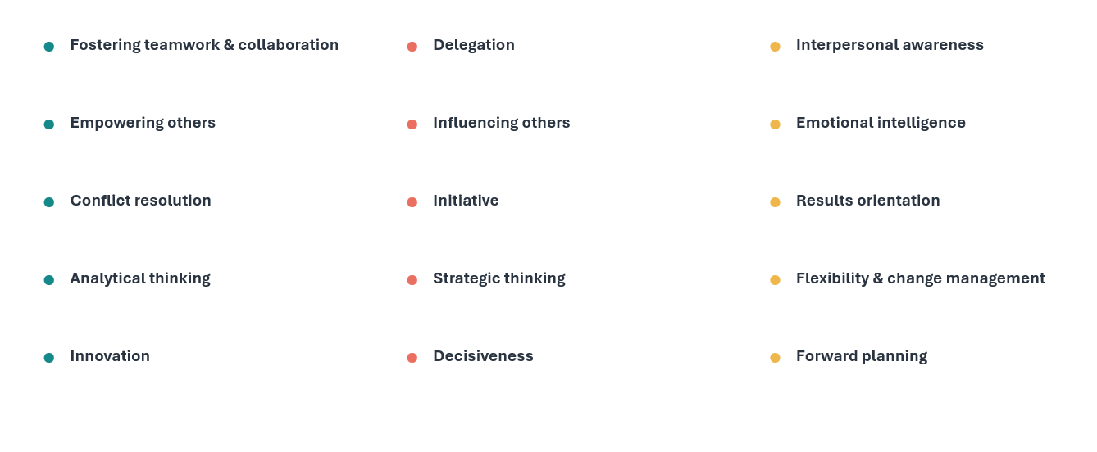
Managerial competencies: the wider leadership toolkit

Slide 11
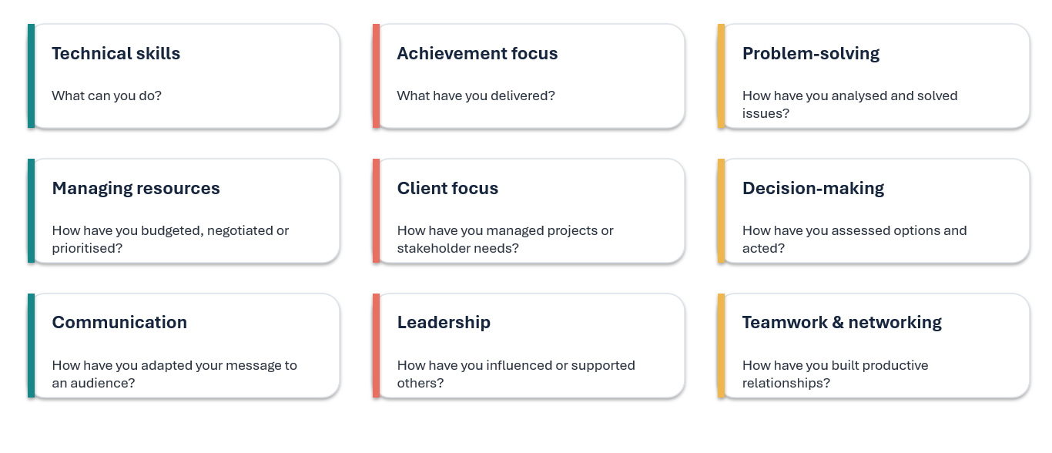
Examples: translate labels into evidence

Slide 12
Skills, Skills, Skills
Technical
Skills
☐ Programming
☐ Data Analysis
☐ Laboratory Techniques
☐ CAD Software
☐ Statistical Analysis
☐ Machine Learning
☐ Scientific Writing
☐ Simulation & Modelling
Transferable Skills
☐ Communication
☐ Teamwork
☐ Leadership
☐ Problem Solving
☐ Time Management
☐ Organisation
☐ Critical Thinking
☐ Adaptability
Research Skills
☐ Literature Reviews
☐ Experimental Design
☐ Data Collection
☐ Report Writing
☐ Presentation Skills
☐ Technical Documentation

Slide 13
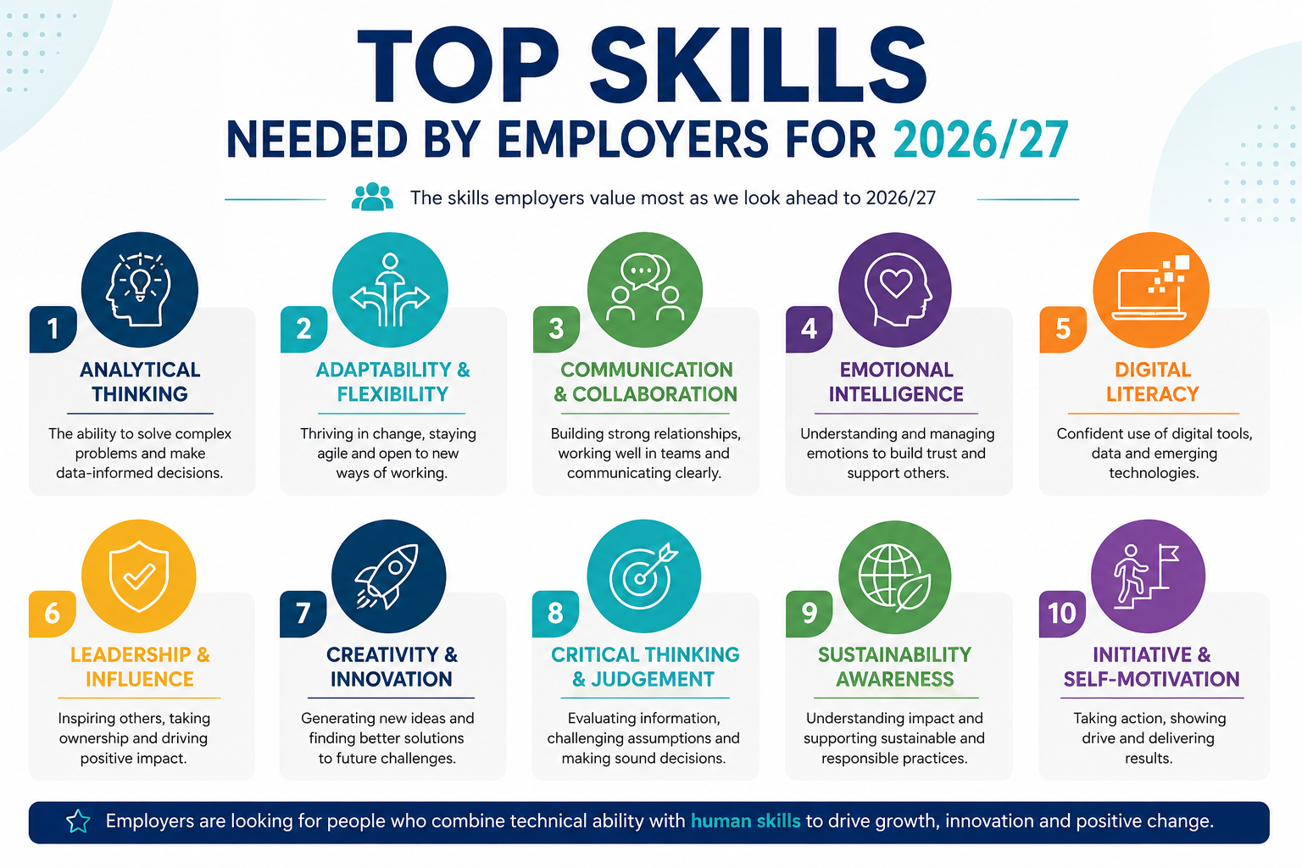

Slide 14
What Is a CV?
A CV is:
A marketing document
Evidence of your potential
A tailored summary of your skills and experiences
Employers want:
Problem solvers
Communicators
Team players
Technical capability
Evidence of initiative

Slide 15


Activity
Notes:
📊 Strong achievements — “Increased sales by 25%”
🎯 Tailored to the job — skills clearly match the role
🧠 Relevant skills — not just a long list
🏆 Evidence of impact — shows what you achieved, not just what you did
🎨 Clear & professional design — easy to scan
💡 Something memorable — a project, award, portfolio or unique experience

Slide 16
Types of CVs
Chronological CV
Focus on work history
Skills-Based CV
Best for:
Best for experienced applicants
Students
Career changers
Limited work experience

Slide 17
Skills Based CV-
What does it look like?
Two to three sentences that summarise your work history
Include areas of expertise - your skills and qualifications
Create a section titled, "Professional Competencies," under which you include five to six professional competencies.
Add a list of your previous employers and your position with each, including the dates of employment.
State your education, professional training or academic credentials. Include the area of study or degree program.

Slide 18
How to Tailor Your CV
Step 1:
Read the job description carefully
Step 2:
Highlight:
Skills
Software
Competencies
Keywords
Step 3:
Mirror the language naturally

Slide 19
Why Tailoring Matters​
Employers use ATS (Applicant Tracking Systems)​
ATS scans for:​
Keywords ​
Clear headings​​
Recognisable formatting​
Consistency​
Technical skills ​
Relevant experience ​
Generic CVs are less effective
An Applicant Tracking System is software used by employers to manage applications.​
Recruiters use ATS because manually reading every CV would take too much time.​

Slide 20
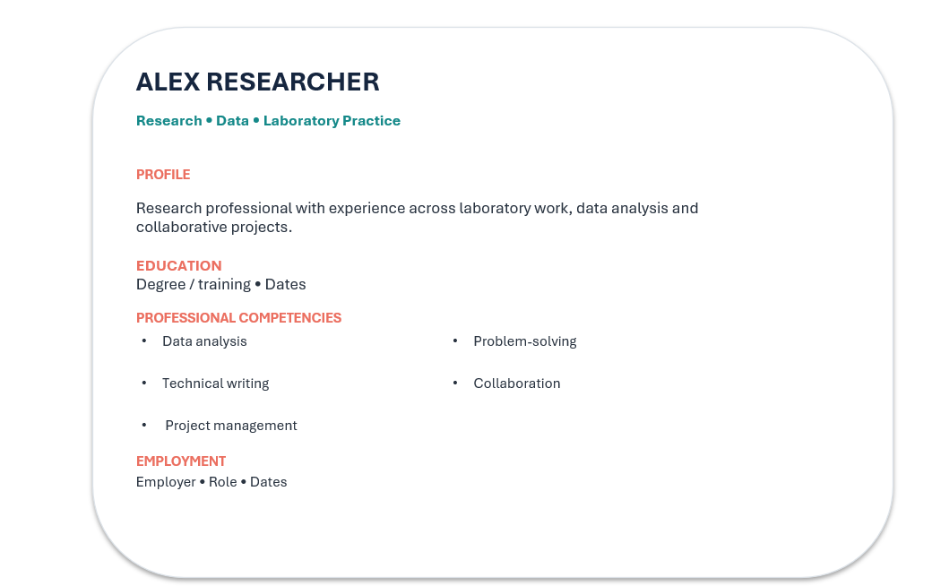
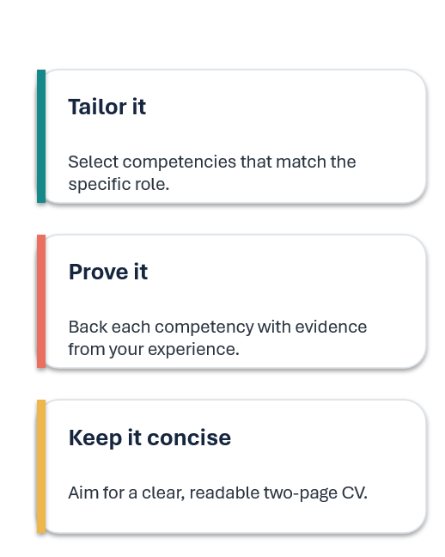
A simple researcher CV blueprint

Slide 21
Example of a Generic Skills Based Researcher CV

Slide 22
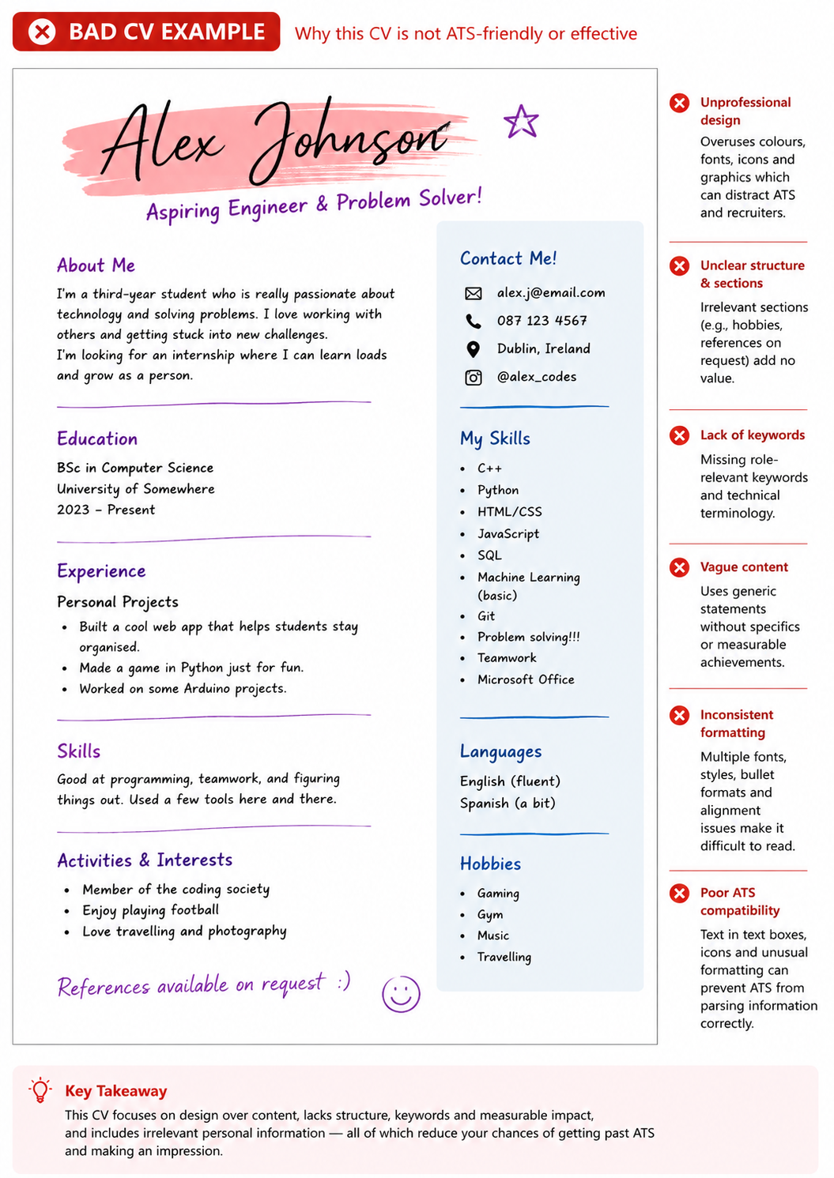
Notes:
For STEM roles especially, employers typically value:
Clarity
Professionalism
Readability
Technical evidence
A clean and structured layout usually performs better than a visually crowded one.”
No Measurable Achievements
Lack of Relevant Keywords

Slide 23
Weak vs Strong Skills Statements
Describe skills with evidence, action & measurable impact!
Key Tip
A strong skill statement should explain:
WHAT you did + HOW you did it + RESULT/IMPACT
Formula:
Action Verb + Task + Outcome

Slide 24
Weak vs Strong Statements
Strong CV statements:
Show evidence of your skills
Explain what you actually did
Demonstrate impact or results
Sound more professional and credible
Why Strong Skill Statements Matter?

Slide 25
Weak vs Strong Skills Statements
Weak Statement
Strong Statement
Good at teamwork
Strong communication skills
Experience with coding
Worked in a laboratory
Good problem solver
Did group projects
Collaborated with a 4-person engineering team to design and test a low-cost water filtration prototype
Presented research findings to 50+ students and staff using clear data visualisations
Developed Python scripts to automate data analysis, reducing processing time by 30%
Conducted microbiology experiments following laboratory safety and documentation protocols
Identified faults in a robotics project and implemented design improvements to increase accuracy
Collaborated in a 4-person engineering team to design a low-cost water filtration prototype

Slide 26
Use Action Verbs
Strong Action Verbs
Analysed
Designed
Programmed
Investigated
Developed
Optimised
Simulated
Modelled
Presented
Implemented
Led

Slide 27
Formula for Strong Bullet Points
Action + Task + Result
Example:
Developed a Python script to automate data cleaning, reducing processing time by 40%.

Slide 28

STAR Method
Situation
Task
Action
Result
Use STAR to:
Build bullet points
Explain projects
Prepare for interviews

Slide 29
STAR Method
S — Situation
What was the context or challenge?
T — Task
What were you responsible for?
A — Action
What did you do?
Example:
Our engineering team needed to reduce production waste during a design project.
Example:
I was responsible for analysing material usage data.
Example:
I developed an Excel tracking model to identify inefficiencies and recommend improvements.
R — Result
What was the outcome?
Example:
Reduced estimated material waste by 15% during prototype development.

Slide 30
Translate Transferable Skills Into Industry Language
Academic Skill | Industry Translation
Conducted original research | Led end-to-end research projects / Owned project lifecycle
Wrote and defended thesis/dissertation | Produced high-level deliverables under deadline
Ran experiments / collected data | Data analysis / Led research initiatives / Executed testing protocols
Taught courses / mentored students | Training / Coaching / Team leadership
Gave conference talks | Public speaking / Stakeholder communication
Managed lab / project | Project management / Cross-functional collaboration
Conducted literature reviews | Market research / Competitive analysis
Analysed qualitative/quantitative data | Data analysis / Business intelligence

Slide 31
Top CV Mistakes
AVOID
Walls of text
Spelling errors
Generic statements
Poor formatting

Slide 32
Formatting Tips
Keep it:
Recommended Fonts
1–2 pages
Consistent
Easy to scan
Professional font
Clear headings
Bullet-point focused
Calibri
Arial
Aptos

Slide 33

AI and CV Writing
AI can help with:
  Grammar
  Brainstorming
  Bullet-point improvement
But:
  Keep it authentic
  Avoid overly generic language
  Verify technical accuracy

Slide 34

Mini CV Audit
If you have a CV review it!
Check for
  Clear skills?
  Evidence of impact?
  Tailored?
  Easy to read?
  Strong action verbs?

Slide 35
“I Don’t Have Experience”
You probably do.
Use:
Lab work
Coursework
Hackathons
Group projects
Volunteering
Clubs & societies
Research assignments
Personal projects

Slide 36
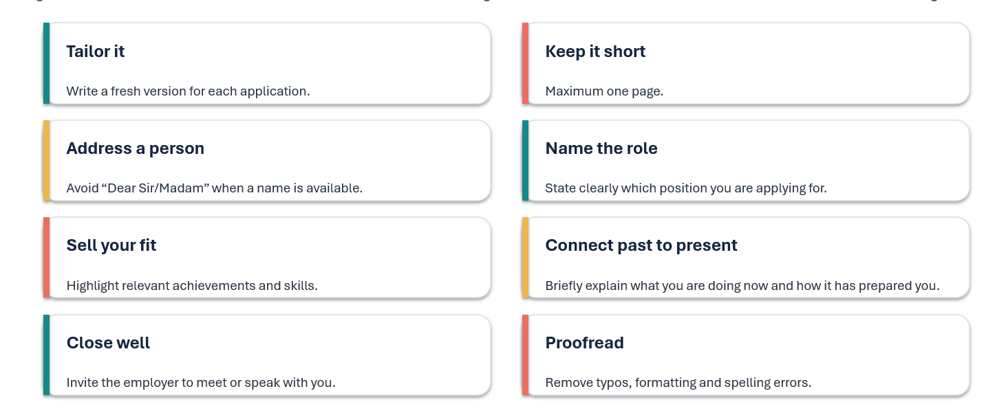
Make the letter work with the CV

Slide 37
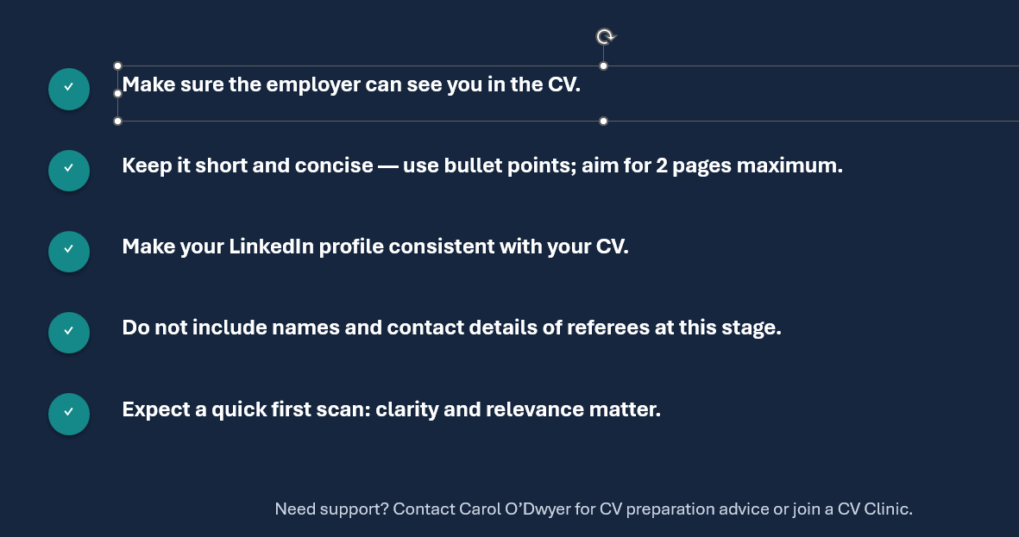
Remember!!

Slide 38
Key Takeaways
Remember:
  Skills matter
  Evidence matters more
  Tailoring is essential
  Projects count as experience
  Clear formatting improves readability
Notes:
Recommended Tools

Slide 39
Thank You!
Any Questions?

