Slide 1
The Post Doc Hub Leading a Research Team Dr Anne Gannon 29th September 2023

Slide 2
Session Objectives
To explore what leadership is
To identify what make leaders effective
To review a relevant leadership framework
To reflect and start to develop some new insights into enhancing your own leadership style and approach
To consider and plan for your ongoing leadership development

Slide 3
What is Leadership?
Leadership can be defined as the process of understanding people's motivations and leveraging them to achieve a common goal (CIPD)
Leadership is a process of giving purpose (meaningful direction) to collective effort and causing willing effort to be expended to achieve purpose.” (Jacobs & Jaques, 1990)

Slide 4
What do definitions of leadership have in common?
Different definitions of leadership all agree on three essential elements:
Self: leaders have self-awareness and effectively express their personal qualities.
Other people: leaders influence, motivate, and inspire stakeholders.
The job: leaders define, clarify, and revise tasks to be achieved.

Slide 5
The Practice of Leadership
From working with and observing leaders in action, what is effective leadership from your own experiences?
Consider
What makes a leader effective?
What do effective leaders do and how do they do it?
What do others look for in a leader?

Slide 6
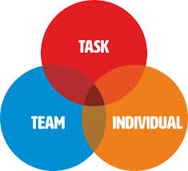
ACTION CENTRED LEADERSHIP (Adair)
Team Needs Task Needs
Encouraging teamwork Setting objectives/goal
Communication and co-ordination Defining the task
Culture and values Planning the task
Allocating resources
Co-ordinating activities to achieve the task
Setting standards and evaluating results
Individual Needs
Fairness, respect and consistency
Guidance and skills development
Connection, support and communication
Motivation, engagement and development

Slide 7
The Adair Action Centred Leadership Model
This model highlights the core actions of effective leadership:
Task: the actions that you take to achieve a goal.
Team: your actions at the group level, to encourage effective teamwork and group cohesion.
Individual: actions that address each team member's unique needs.
For Adair, the task, team and individual needs overlap as follows:
Achieving the task builds the team and satisfies the individuals
If the team needs are not met - if the team lacks cohesiveness - then performance of the task is impaired and individual satisfaction is reduced
If individual needs are not met the team will lack cohesiveness and performance of the task will be impaired
However, the leader may need to vary the degree of emphasis given to each of the three components in response to the situation at any point in time.
Adair firmly believed that leadership can be taught, that it does not depend on a person's traits and that it is a transferable skill

Slide 8
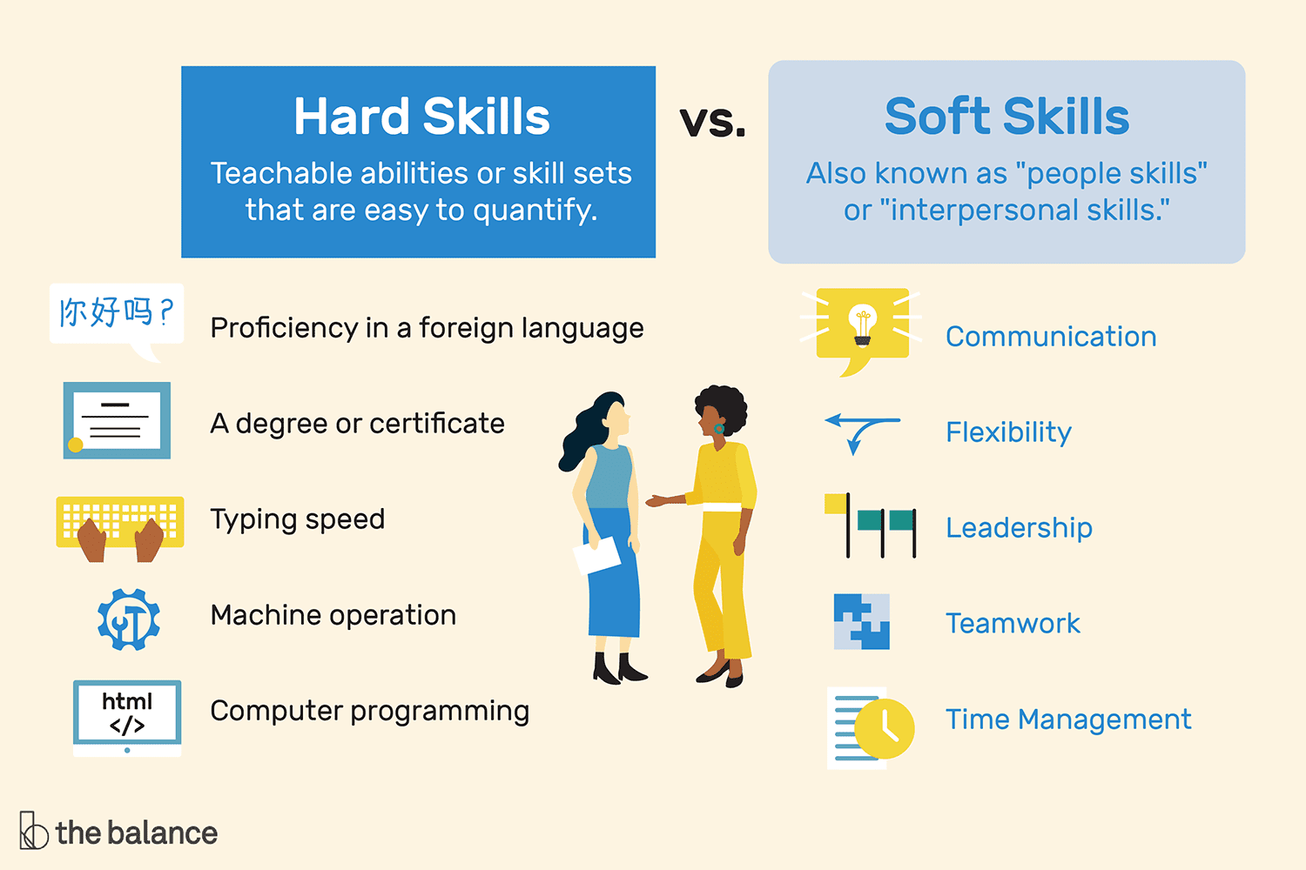
Hard Skills & Soft Skills

Slide 9
Reflecting on soft skills
Interpersonal Skills
Public Speaking
Why are soft skills important in leadership?
What do soft skills enable in leading a research team effectively?
Soft Skills
Communication Skills
Leadership
Stress Management
Conflict Management
Time Management
Decision Making

Slide 10
The top skills for the future
Notes:
The World Economic Forum’s Future of Jobs 2020 report identified the top 15 soft-skills which employers see as rising in prominence in the lead up to 2025

Slide 11
Evidence based leadership
According to McKinsey* analysis of academic literature and the results of a survey of 200,000 people in 81 organisations worldwide there are 4 types of behaviour that account for 89% of leadership effectiveness:
Being supportive
Operating with a strong results orientation
Seeking different perspectives
Solving problems effectively
What does this research tell us about the skills we need to have to be effective as leaders?
* https://www.mckinsey.com/featured-insights/mckinsey-explainers/what-is-leadership?cid=eml-web
Notes:
What is leadership? https://www.mckinsey.com/featured-insights/mckinsey-explainers/what-is-leadership?cid=eml-web

Slide 12
What do followers look for in their leaders?
Authenticity
Followers want leaders who are extremely good at what they do, but who have not lost sight of where they have come from, or who they are.
Significance
Followers tend to respond to leaders who make them feel like their contributions matter.
Community
Followers also look for their leaders to create a sense of common purpose at work, and a desire within the group to relate and interact with each other.
Excitement
What followers really want is to get a buzz and feeling of excitement from their leader.
Goffee and Jones, 'The Art of Followership', European Business Forum (Summer 2006), p 24.

Slide 13
Leadership and soft skills
It is our individual responsibility as a Leader to consider how our style can impact others and to work actively to develop an environment which is productive and comfortable for each individual and the collective team
Leadership is an ALL day EVERY DAY activity. It is evidenced in our approach to our own work and how we behave and communicate towards others. Leadership is really about what you do – not who you are
Others?

Slide 14
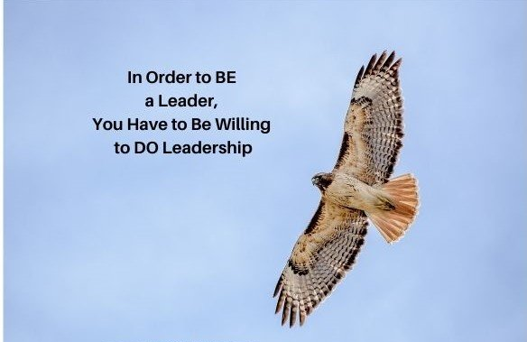
A final word on Leadership….

Slide 15
How to actively develop your leadership skills
Reflect and identify the skills that you need to lead effectively and create an action plan to develop these
Ask for feedback from work colleagues and your manager
Take opportunities to lead – in work, volunteering etc. and reflect and learn from this experience
Take ownership for your own training and development and actively engage in training, coaching and mentoring opportunities

Slide 16
Session Learning
What will you do differently as a result of attending this session?

