Slide 1

Career Planning for Researchers
Sourcing and Accessing non academic jobs
Mary McCarthy UCC Career Services

Slide 2
OVERVIEW – TOUCHPOINTS
10 Steps to employment
The PhD Professional –Identifying Skills
Finding a direction and sector that suits you
Non academic jobs for PhDs - 10 most common careers
Additional Information to review
Online Presence, Networking -Where to look – Where are jobs advertised- “unearthing jobs – the hidden market of jobs
-Preparing your personal Profile
Building connections and networks
- Identifying opportunities

Slide 3
Career Planning
Things you can do now
..

Slide 4

key to finding a career outside academia
Explore your interests, skills, and experiences
Be open to different career paths.
Develop and expand and explore your Network
Seek out mentorship and career guidance

Slide 5
You are in the driving seat
Step 1
Create the best CV possible – have it reviewed, change for each opportunity
You need one detailed generic CV
You will edit and TARGET for each application
Helpful Tools
https://www.ucc.ie/en/media/support/careers/CVGuideforPhDandPostdoctoralResearchers.pdf ( CV Guide)
CareerSet link

Slide 6
..
Step 2
Build Career Intelligence - Know Yourself , relevant organisations , Roles and professional work sectors
Know yourself
Review and reflect on interests, innate strengths/ attributes, skills and values
Research Organisations and Roles of interest-
Build Career Intelligence
Note the skillset/competencies and experiences required –
Note the close matches and the skills gaps

Slide 7
Step 4
Be inspired and informed by PhDs /PosDocs who have successfully transitioned to nonacademic careers who have gone before you
–Make connections and network –
Learn from others about their career journey ( conduct Informational Interviews)
Helpful resource
UCC Linkedin Alumni Networking Guide and apply to your search
Step 5
Create your PROFILE and BUILD A NETWORK
Make your self known to potential employers and professionals-
Develop your online presence –
Create, build and expand your network of contacts
Helpful resource
- LinkedIn Profiling workbook( email attachment)

Slide 8
..
Step 6
Be Aware of current growth sectors
Helpful resources
http://www.skillsireland.ie/
Labour Market trends links attached
Step 7
Be Interview Ready – Have an Elevator Speech prepared- Know your Competencies and Skills- Be Able to demonstrate them with STAR Technique
Helpful resource
Shortlistme
https://www.ucc.ie/en/careers/areyouacurrentstudent/applicationstoolkit/prepareforyourinterview/shortlistmetool/
Step 8
Contact Recruitment agencies ,register / job posts/ opportunities ,conduct weekly online jobs research . Identify organisations/companies of interest and relevance
Helpful resource

Slide 9
..
Step 9
Be adaptable and open minded- Embrace the Unexpected - Consider a nonlinear Career path to get started –Career development is a journey not a one -off job offer
Step 10
Add to your skills portfolio, acquire micro credentials through online short learning courses
Popular courses
Project Management, Data Analytics, Python………

Slide 10
Helpful Career Navigation resources
Hallowell Career Orientation ( email attachment )
Schein’s Career Anchors (email attachment )
Career Mindset Exercise ( email attachment )
LinkedIn Profile workbook ( email attachment)
Take Psychometric Profiling Assessments – Profiling for Success - https://www.ucc.ie/en/careers/areyouacurrentstudent/advice/profilingforsuccess/
Personality Types indicator ( 16 personalities)
Values
Interests
Cappfinity Strengths Profiling
https://www.strengthsprofile.com/en-GB/Products/Free
Identify 3 realised strengths, 3 unrealised strengths, 2 learned behaviours

Slide 11
CareerSet
A useful Digital CV Review Tool
Learn how to target your CV to specific reguirements
..

Slide 12
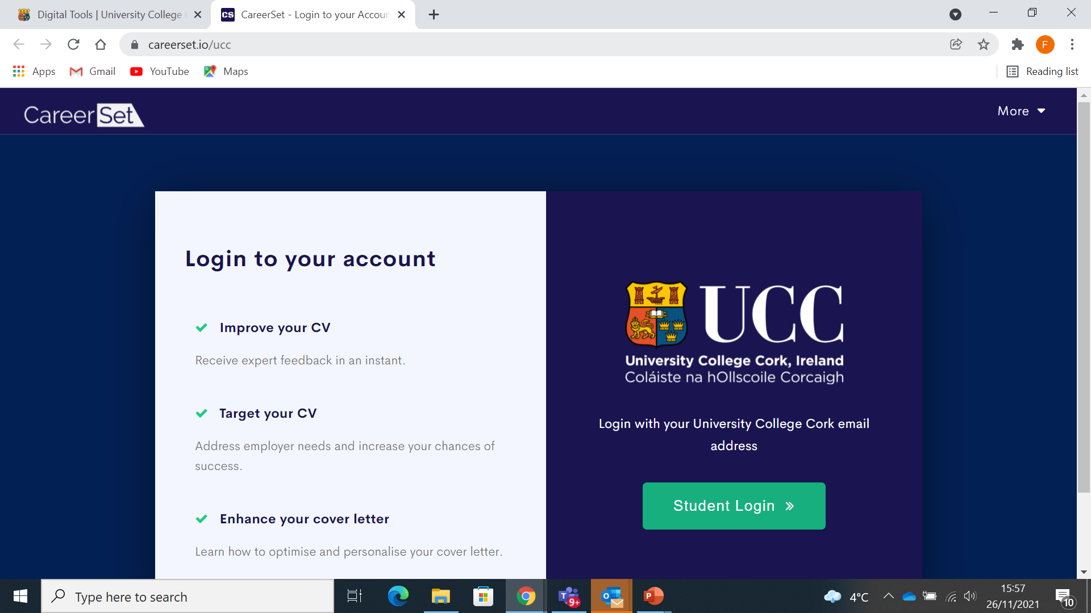

Slide 13
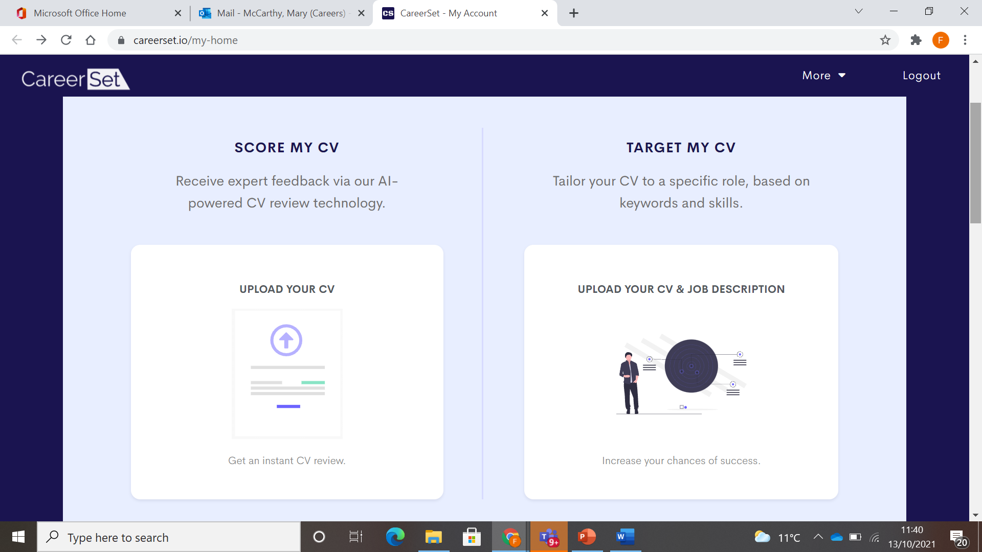

Slide 14
..
Identifying and communicating your skills

Slide 15
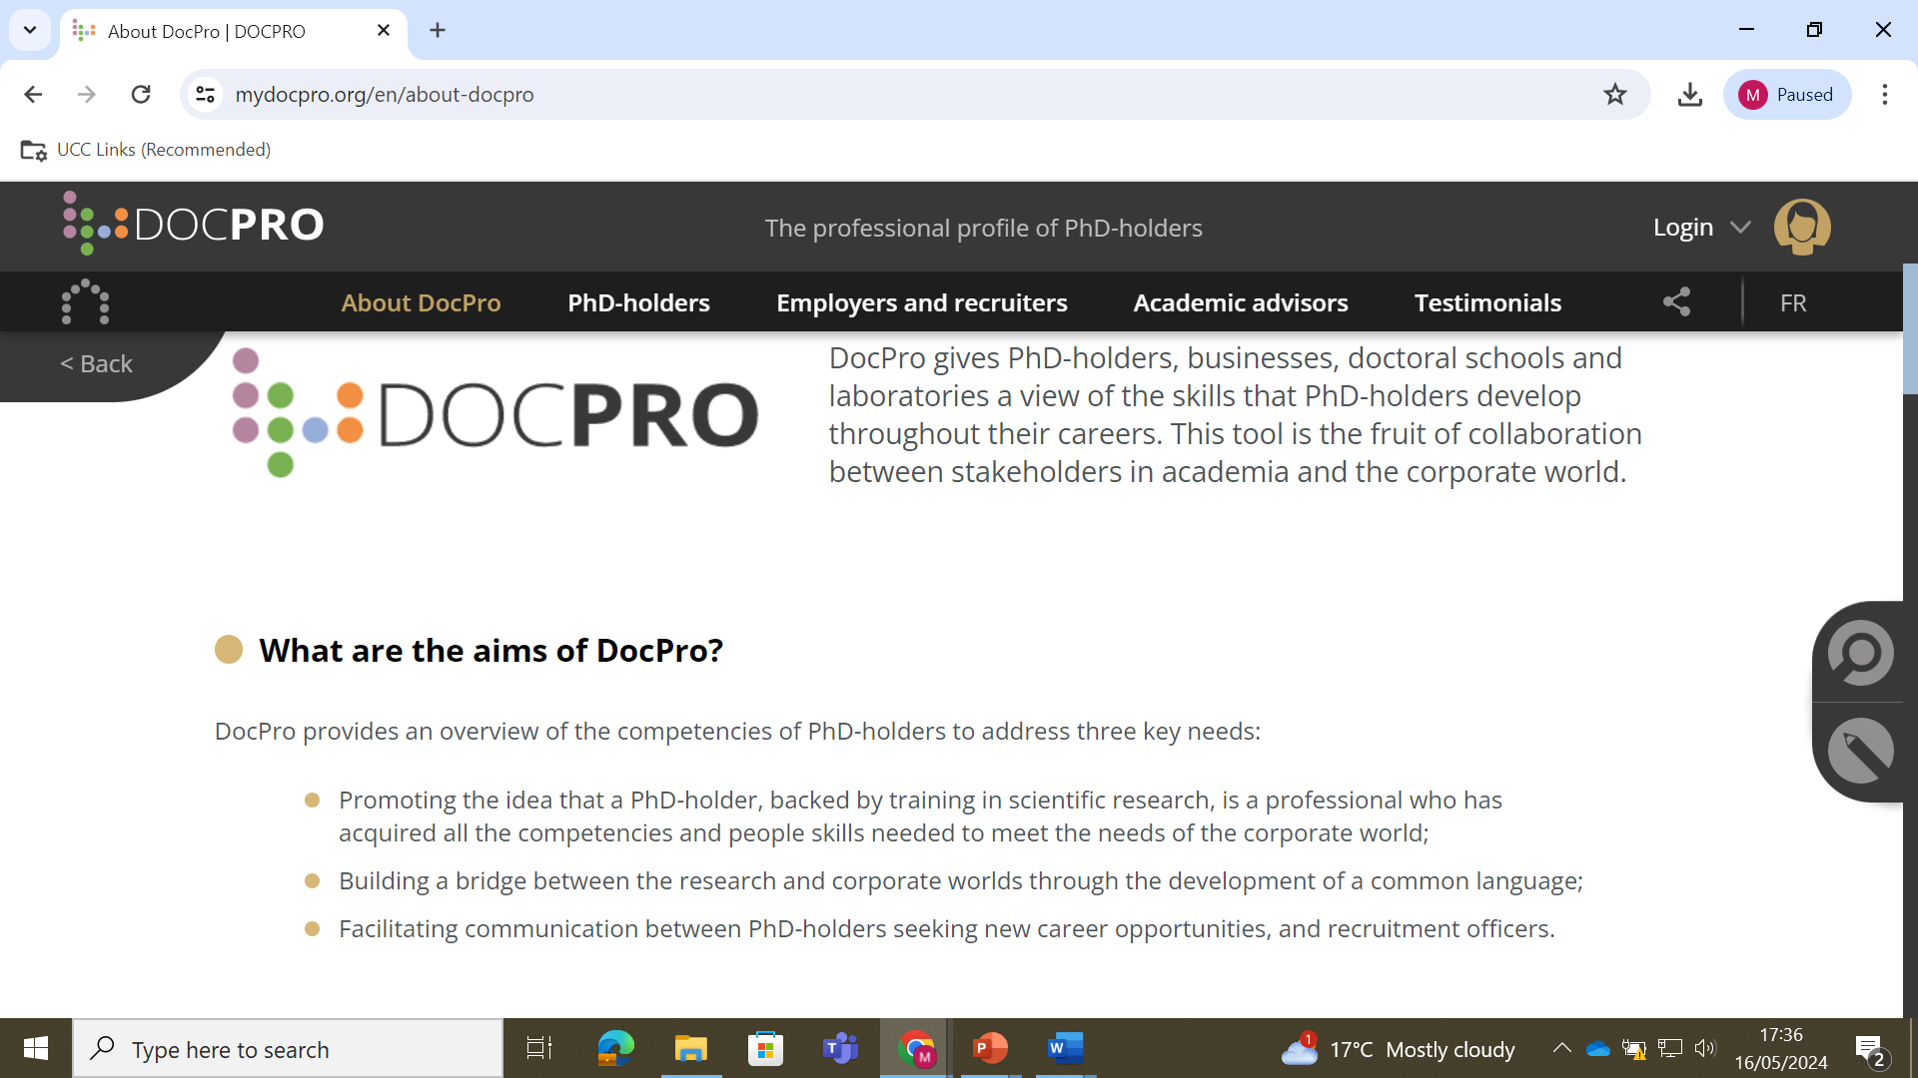

Slide 16
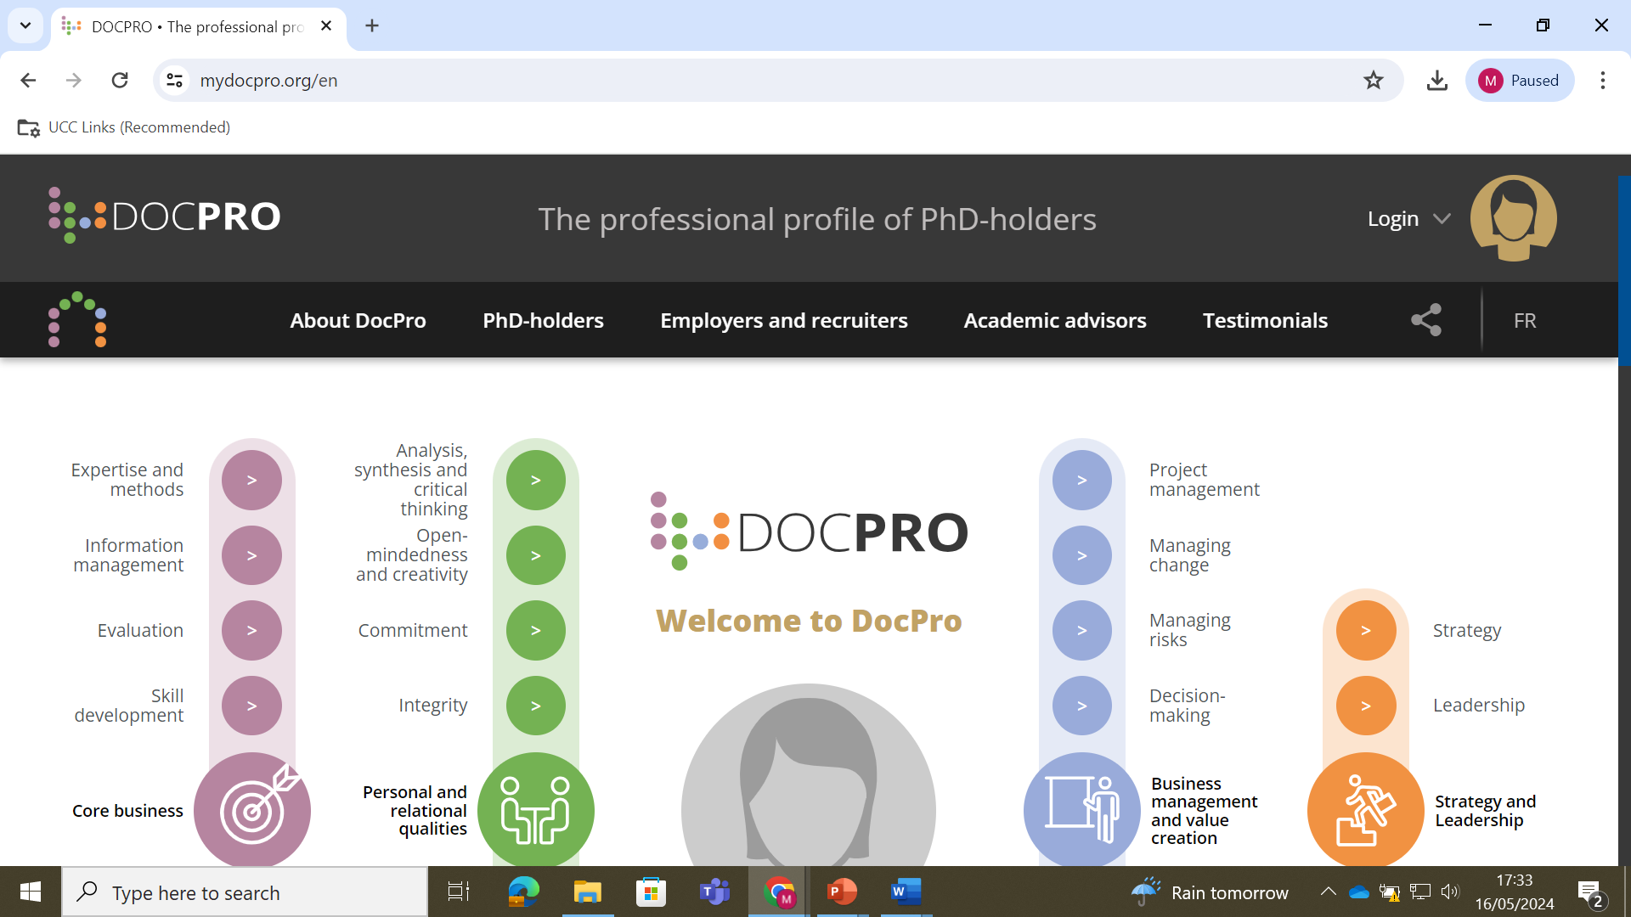

Slide 17
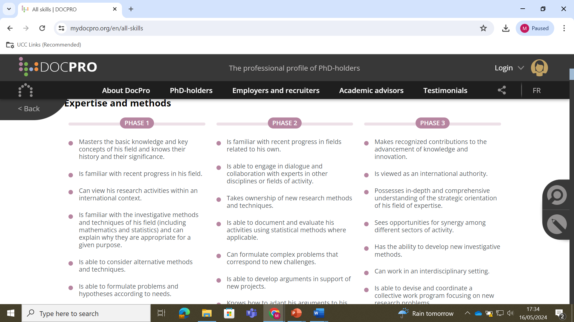

Slide 18
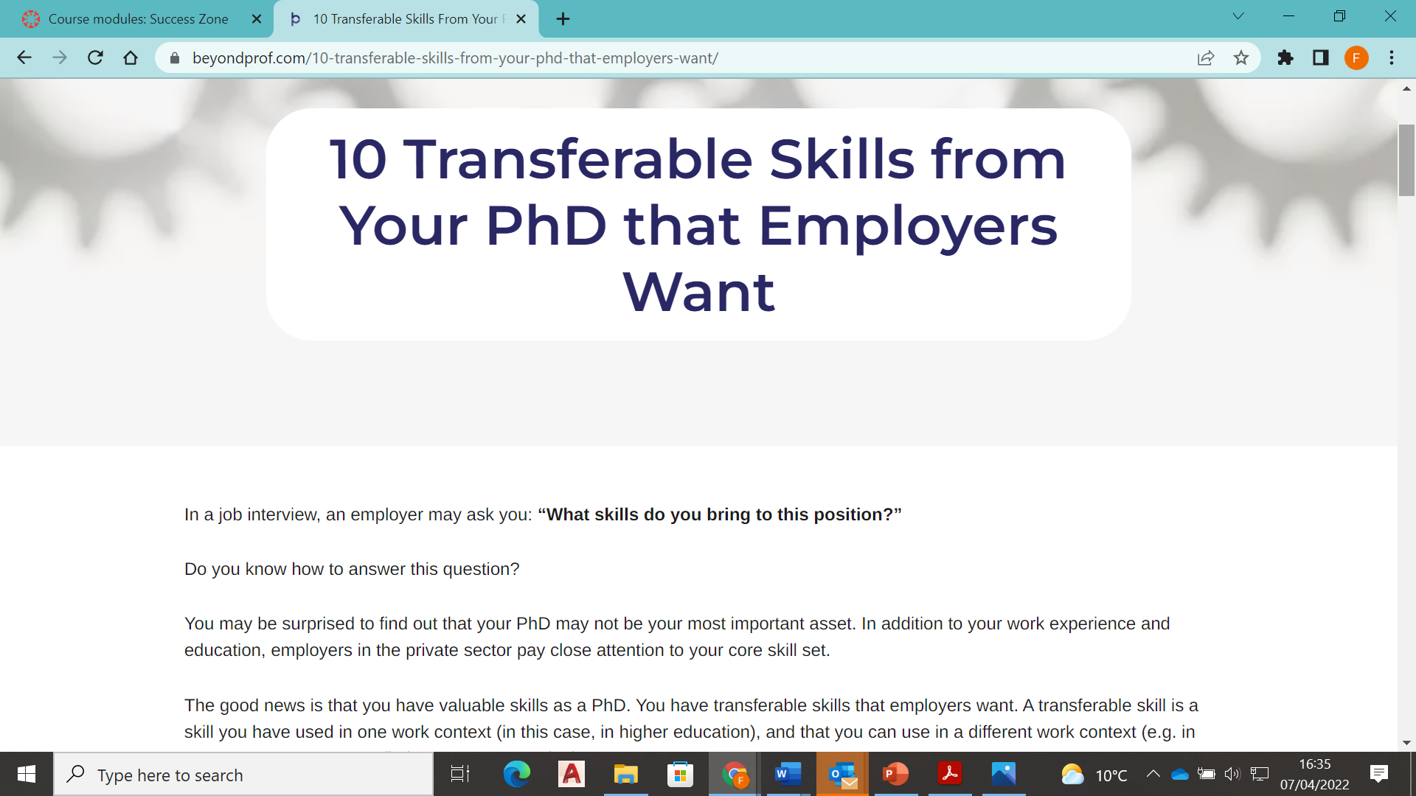
https://beyondprof.com/10-transferable-skills-from-your-phd-that-employers-want/

Slide 19
PhD Skills -Your Skillset
Written Communication
Years of practice writing papers, your thesis, conference abstracts, journal manuscripts, and of course your dissertation.
Research and Data Analysis *******
Research skills are valuable even in many fields outside of academia.
You are able to determine the best approach to a question, find relevant data, design a way to analyze it, understand a large amount of data, and then synthesize your findings. You even know how to use research to persuade others and defend your conclusions.
Communication - Presenting
PhDS get more public speaking opportunities than most. Through conference talks, poster presentations, and teaching, you will learn Ability to present complex information and ideas in accessible, understandable ways.
Project Management *************
A PhD is an exercise in project management. You to design a project, make a realistic timeline, overcome setbacks, and manage stakeholders. You also have to manage long-term projects at the same time as short-term goals

Slide 20
Skills gained from a PhD
Critical Thinking
You are mind is trained to approach problems systematically, see the links between ideas, evaluate arguments, and analyse information to come up with your own conclusions. Every sector and industry can benefit from someone who knows “how to think”.
Collaboration
Your Phd is your project-Post doc Research is collaborative you have to negotiate, work with others on a regular / day to day basis.
The ability and willingness to work effectively in teams, build positive relationships often across multiple disciplines is a premium requirement and asset across all sectors.

Slide 21
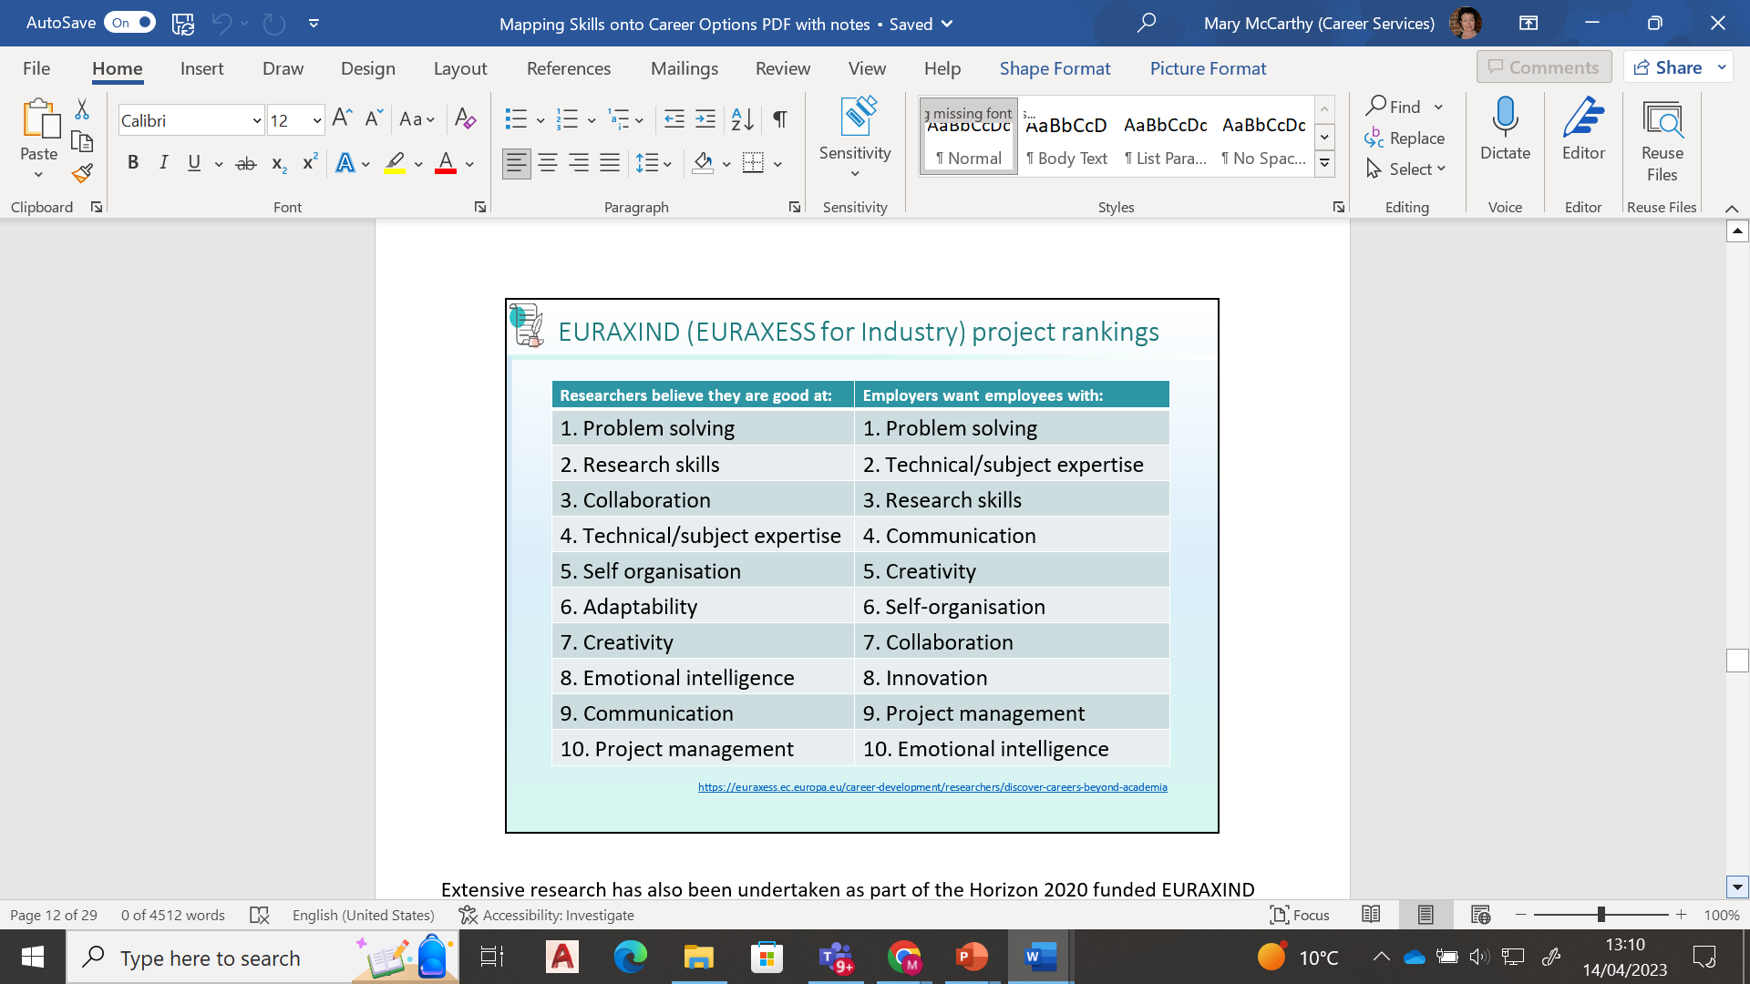

Slide 22
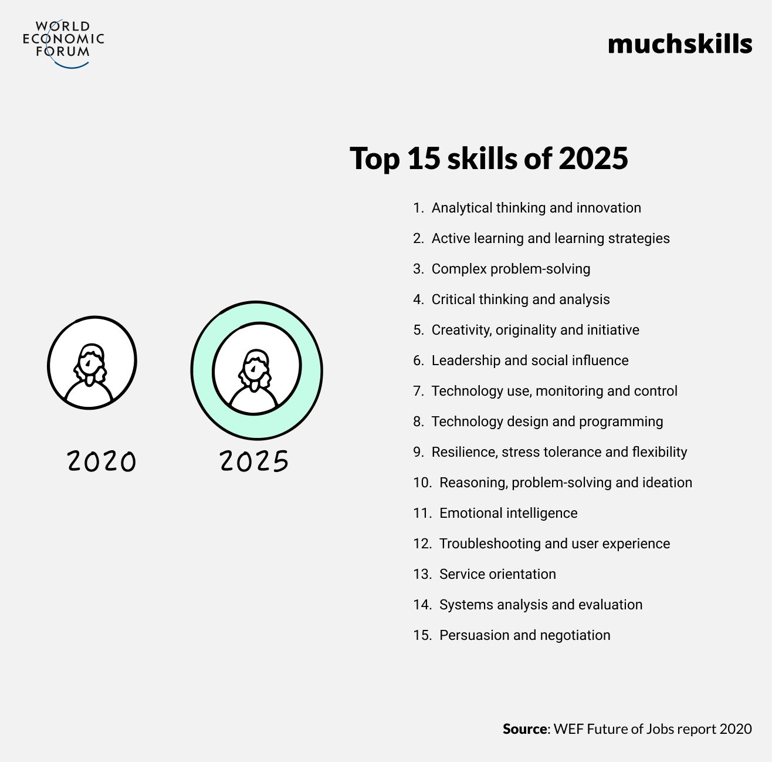

Slide 23
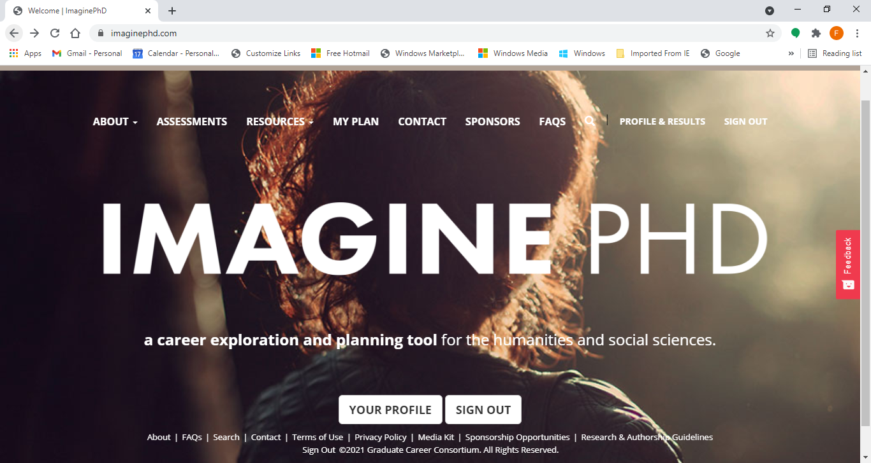

Slide 24
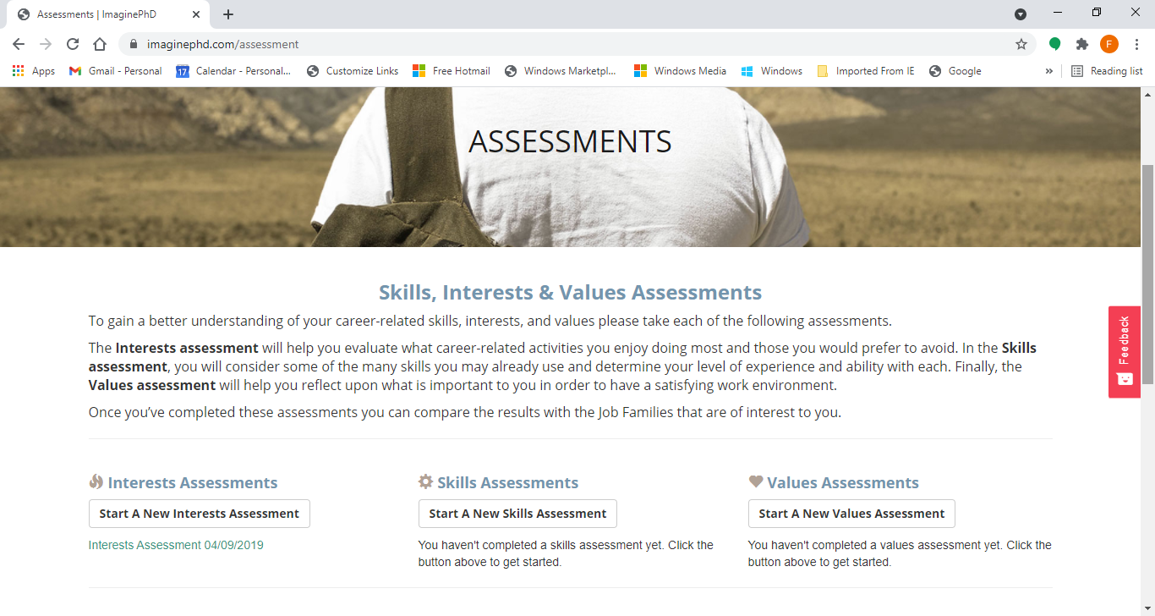

Slide 25
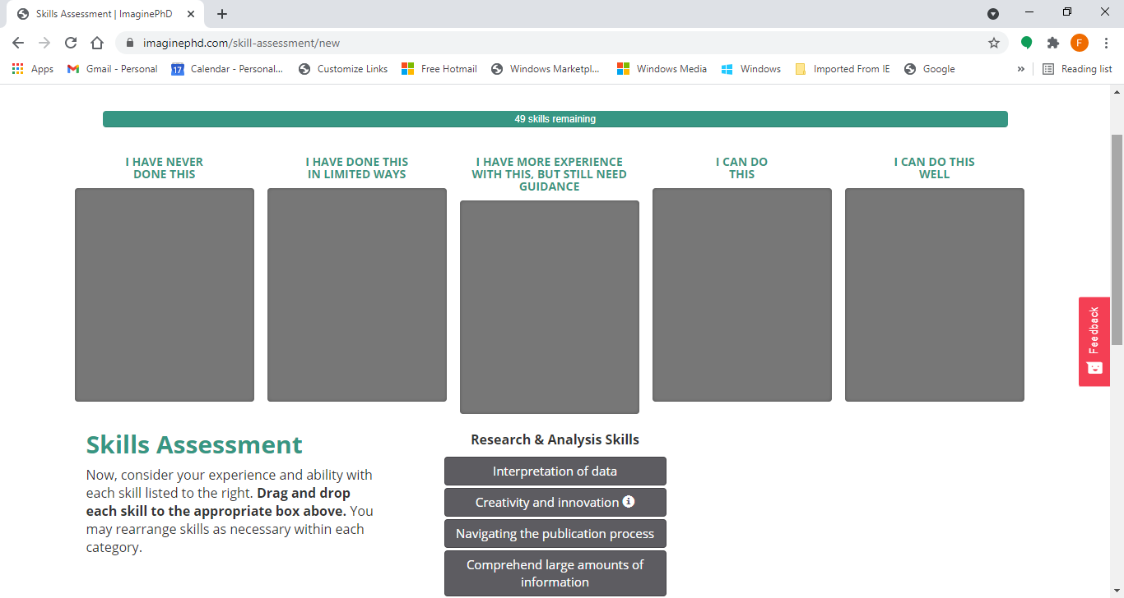

Slide 26
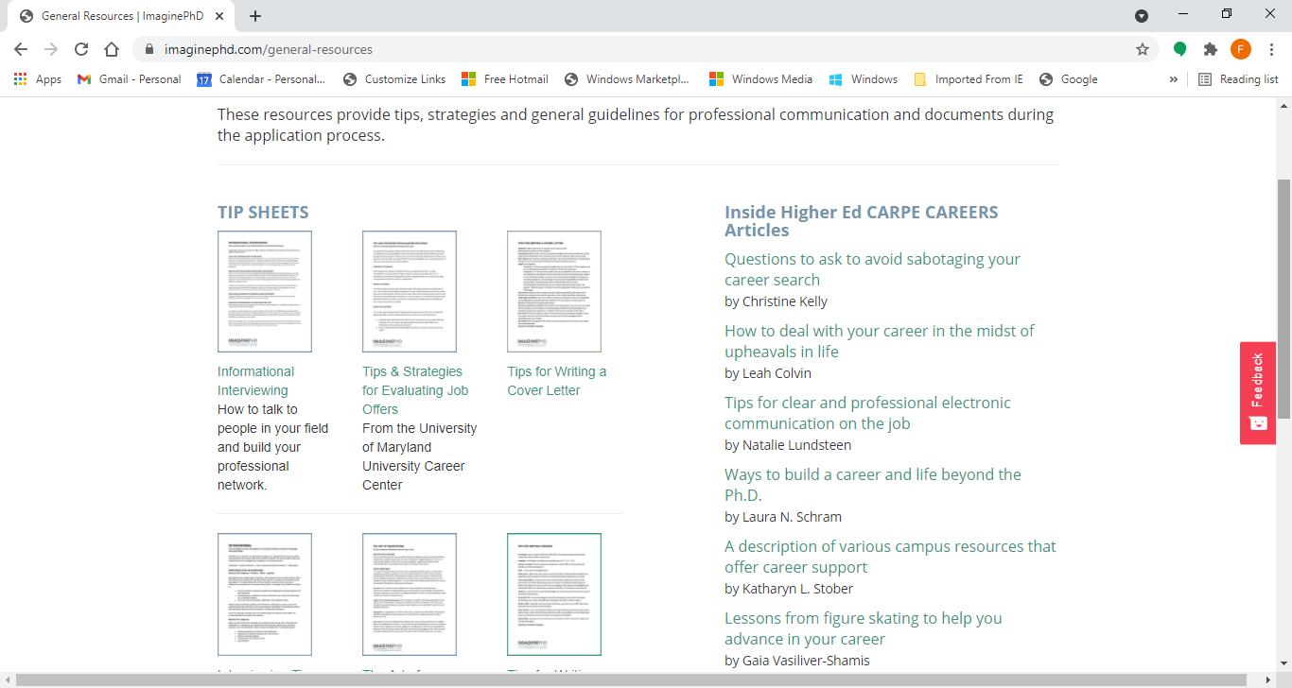

Slide 27
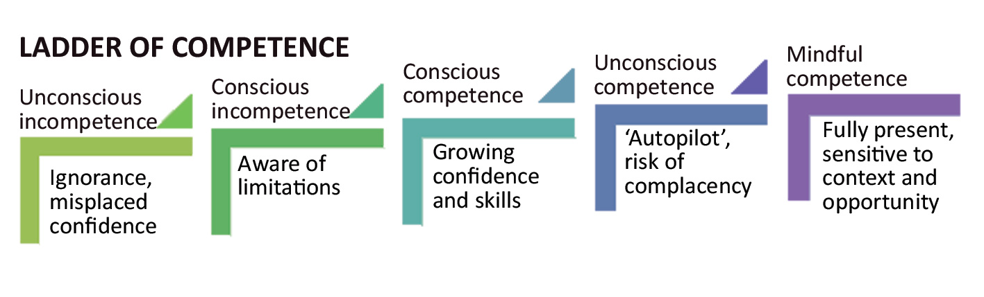
How Skills develop

Slide 28

Career Planning
Can you define your skills?
Can you define your strengths so that you could promote these to an employer?
Can you define your values (what’s important?)
Can you identify areas for your own personal and career development?
Tools -Skills Audit- SCOT ANALYSIS-

Slide 29
SCOT ANALYSIS
Strengths (Internal) What do I do well? What are the things that I am naturally good at doing? What Skills and knowledge have I developed from my academic experience? | Challenges (Internal) What am not happy with? What might stand in my way ? What can I improve on?
Opportunities (External Environment) Who can help me? What Information resources are helpful ? What can help me? | Threats and Obstacles (External Environment) Are there challenges/ obstacles ? How can I resolve to these?
Notes:
Take 7-8 minutes minutes to complete the SCOT Analysis in as much detail as possible

Slide 30
.
Navigating your career

Slide 31
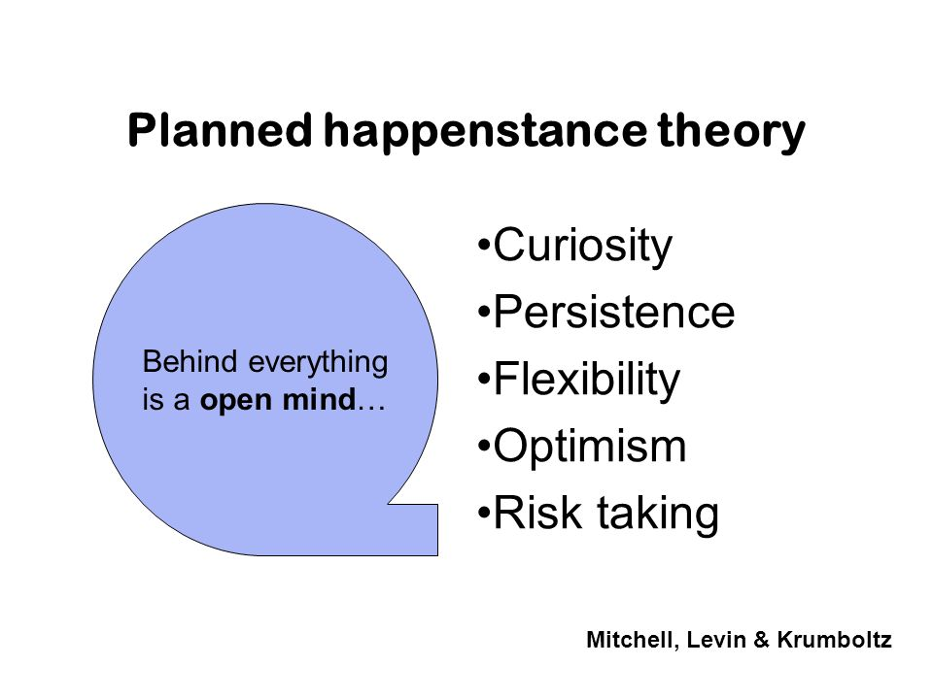
The Role of Happenstance in careers
Curiosity invites you to explore learning opportunities
Persistence helps you to deal with obstacles/challenges
Flexibility equips you to adapt to changing circumstances and events
Optimism equips you to maximise benefits from unplanned events
Risk-taking permits you to be willing to step into new experiences and uncertainty

Slide 32
The Art of Action
Thinking
How can I be more responsive and seize opportunities ?
What can I do to be more proactive and move forward ?
Are they're novel ways of creating my own career path /opportunities ?
How am I going to continue to learn, network and develop new skills
How will I stay responsive to changing needs ?
Notes:
End with this slide

Slide 33



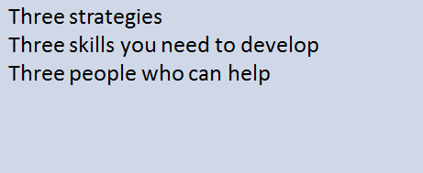
CAREER PLANNING involves…….

Slide 34

Brainstorm
Identify 5 priorities for you in a career
Identify your top 3 skills
3 minutes written exercise

Slide 35

Finding a direction and sector that suits you
Helpful things to consider
Helpful questions to ask when considering entirely new career sectors
What interests me ?
What do I regularly read and keep informed about ?
Are there sectors that link with personal interests ?
What are the growth sectors ?
How do they link to my skills?
Tools
Personality Types Indicator
Hallowell Job Fit ( attached)

Slide 36
Ascending Motto: Climb as high as you can Method: Gain promotion and advancement Desires: Money, status, responsibility, power Dreads: Getting stuck at a level below my potential Question: How quickly can I get there? | Growing Motto: Become a more rounded person Method: Take on roles that allow development Desires: Self actualisation, wisdom, competence Dreads: Staying the same person Question: How will this change me?
Securing Motto: Stay safe Method: Manage risks, hedge your bets Desires: Stability, employability, continuity Dreads: Losing my job, changing my lifestyle Question: How can I keep things going? | Relating Motto: Be somewhere you belong Method: Focus on nurturing important relationships Desires: Community, family, being valued Dreads: Being isolated, not fitting in, conflict Question: Who do I connect with?
Learning Motto: Follow your passion Method: Find opportunities to pursue your interests Desires: Education, subject focus, new ideas Dreads: Rehashing the same knowledge Question: How can I explore this topic further? | Exploring Motto: Keep trying new things Method: Always looking for intriguing new opportunities Desires: Variety, new challenges, the unexpected Dreads: Getting stuck repeating the same old actions Question: Where could this take me next?
Notes:
What types do you identify most with ? Select 4 that are the strongest influencers on your experience of Career

Slide 37
Choosing Motto: Be in control Method: Take charge whenever you can Desires: Autonomy, independence, decision making Dreads: Having to answer to someone else Question: How can I do it my way? | Auditioning Motto: My time will come Method: Get your talents noticed by someone Desires: Recognition, nurturing, reward Dreads: Being overlooked Question: Who will give me my big chance?
Investing Motto: It will be worth it in the end Method: Work hard to lay a foundation for the future Desires: Building resources, enabling the dream Dreads: Not making it by wasting time Question: What will it take to get there? | Fulfilling Motto: Live up to your promise Method: Accept challenging goals and push yourself Desires: Achievement, being worthy, fulfilling duty Dreads: Giving up on the mission Question: How can I achieve my purpose?
Defining Motto: What you do is who you are Method: Seek clearly defined roles Desires: Sense of identity, status, respect Dreads: Undermining or devaluing of role Question: What does it say about me? | Expressing Motto: Articulate your individuality Method: Pursue opportunities allowing self-expression Desires: Being creative, being oneself, being authentic Dreads: Having to conform Question: Can I be myself?

Slide 38
How are your thoughts influencing your career?
Select the 2 strongest Career approaches that influence your experience and approach to your Career.
Select the most influencing 2 career mottos and 2 desires.
Write them out.
How do your influencing career mottos and desires support your personal and professional career development ?
Do they impact it in a positive way ? Do they stand in your way ?
Do they need re-evaluation?
Take 5 minutes to reflect and write.

Slide 39
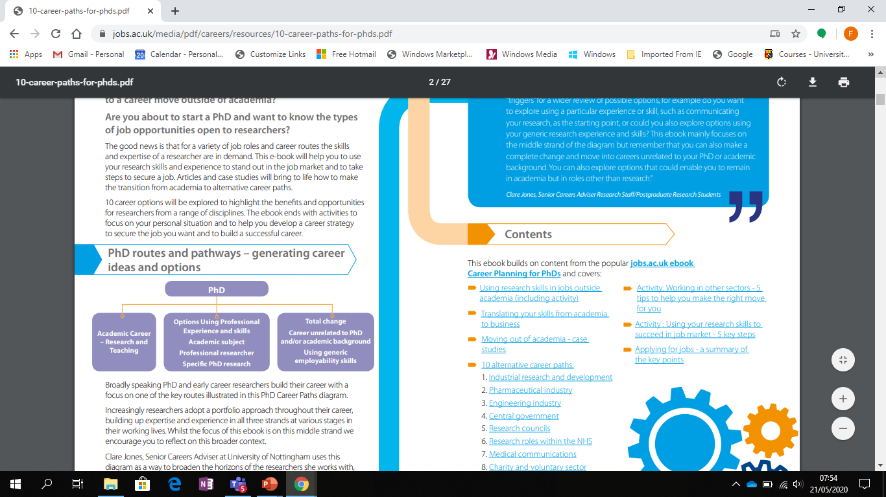
Non academic jobs for PhDs - 10 most common careers https://career-advice.jobs.ac.uk/phd-studentship/10-career-paths-for-phds/******** ( Useful Career Resource Guide )

Slide 40


Where do PhDs go?
HEA Graduate Outcomes Survey
CSO Higher Education Outcomes
https://www.cso.ie/en/csolatestnews/presspages/2018/highereducationoutcomes-graduatesof2010-2014/
http://hea.ie/assets/uploads/2019/02/HEA-Graduate-Outcomes-Survey.pdf

Slide 41
Non-Academic Career routes
Industry: Many industries hire PhDs for research and development positions. These can include pharmaceuticals, biotechnology, engineering, and technology companies, among others.
Government: Many government agencies, such as the National Institutes of Health, the National Science Foundation, and the Department of Energy, hire PhDs for research and policy positions.
Consulting: Consulting firms often hire PhDs as subject matter experts in fields such as healthcare, finance, and technology.
Science communication: PhDs can work as science journalists, writers, editors, and communicators, helping to translate complex scientific concepts for the general public.
Non-profit and advocacy organisations: Many non-profit and advocacy organisations require research and policy expertise, making them a potential career option for PhDs.
Entrepreneurship: Some PhDs choose to start their own businesses, either as consultants or by creating their own products or services.
Education: PhDs can work as educators in non-academic settings, such as in museums, science centres, or educational software companies. They can also opt to become active in the lower education levels such as secondary school. ( European Data )

Slide 42
Two-thirds of PhD graduates find employment in Ireland (HEA Survey )
61% PhDs are in science, technology, engineering and maths (STEM) subjects, with a total of 61pc of all students studying STEM.
21% Natural sciences, mathematics and statistics (NMS) make up of all PhD students, while health and welfare make up
19% Engineering, construction and manufacturing (ECM) count for 14% ECM of all PhD students.
12% Social sciences, journalism, Arts and Humanities.
67% end up in employment in Ireland after their studies.

Slide 43
HEA Employment Survey
65% of PhD graduates work in non-market services: defined as ‘health services, civil and public services, education, and social services’.
40% of PhD graduates work in higher education
100%of all agriculture, forestry, fisheries and veterinary students end up in employment in Ireland
72% of NMS students are in employment,
21% of Arts and Humanities PhD graduates were on the hunt for a job.
STEM graduates 30% of Engineering Construction Management graduates and 28% of Natural Sciences Maths Statistics graduates are employed by manufacturing industries.
36% (ECM)and 37%(NMS) are employed in non-market services.

Slide 44
Non-Academic Career routes of PhDs in Ireland
National Policy /Public Sector Organisations *
ESRI
EPA
Public Jobs- Civil Service
-Enterprise Ireland
-Industrial Development Agency
-Inter trade Ireland
-Irish Research council
-Public procurement of Innovation
-Quality Standards Organization
-HIQA
Higher Education Administration
Consultancy *
Nonproﬁts- NGO
Financial and Business Advisory Services
Secondary School Teaching
Publishing
E Learning
Cultural and Historical Organisations
Start ups - enterprises

Slide 45
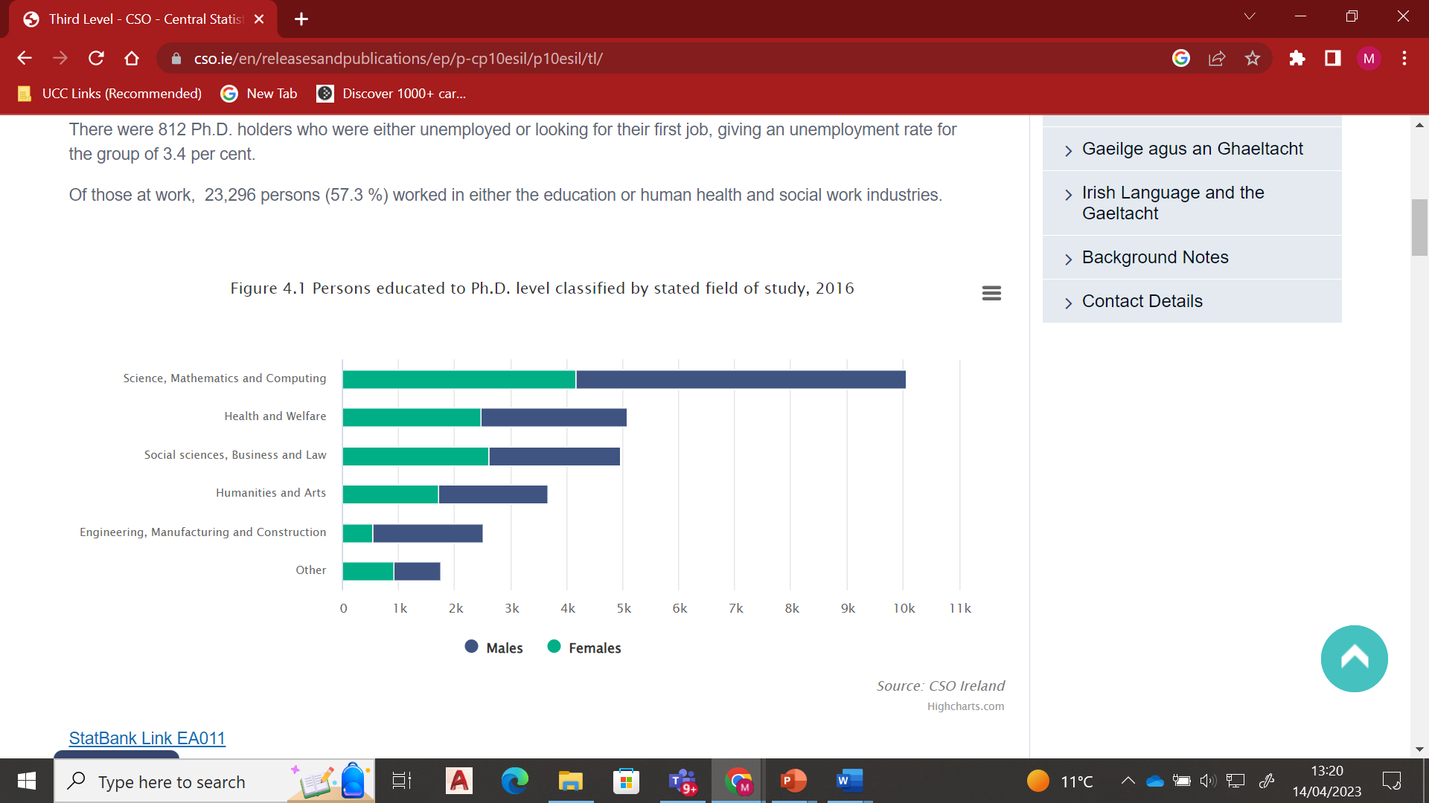
CSO Data- Career Destinations of PhDs in Ireland https://www.cso.ie/en/releasesandpublications/ep/p-cp10esil/p10esil/tl/

Slide 46
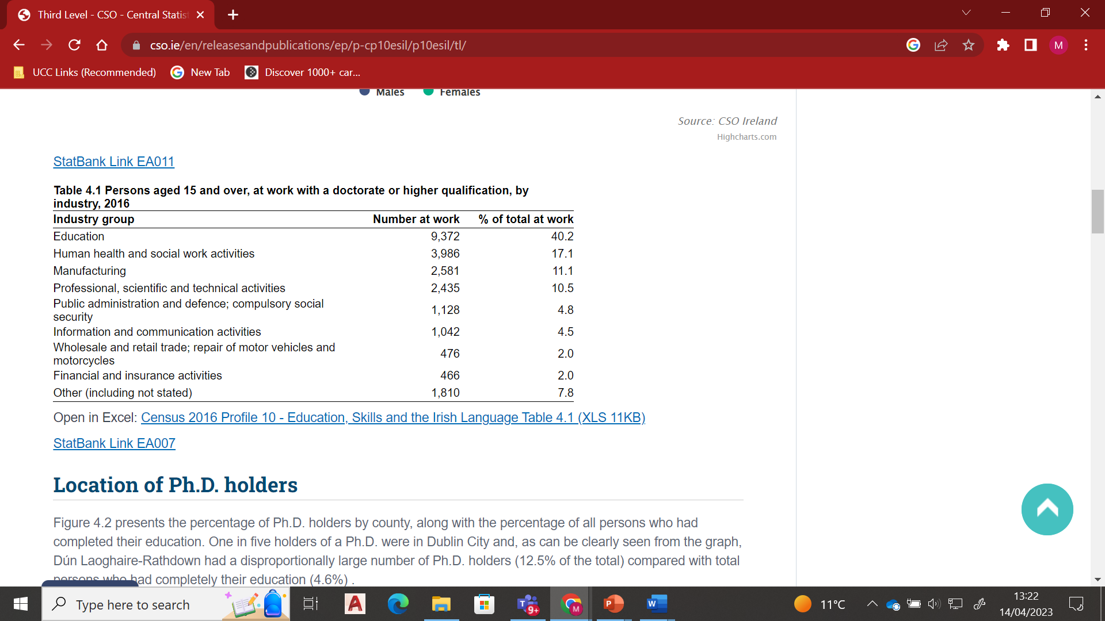

Slide 47
Growth areas
Big Data
Data security/ Cyber security
Finance- Financial Technology
ICT –Digital Technologies
AI
Life Sciences- Bio Pharma-Bio Tech
Sustainable Business practices/Sustainable production
Environmental protection/ conservation
Consultancy
Renewables
Supply Chain Logistics
https://www.bartrawealthadvisors.com/ireland-job-market-which-professional-sectors-are-in-high-demand/

Slide 48
Consulting at a glance -What they look for
Problem Solving and Analysis - Thinking/ Learning/Cognition
The nature of consulting projects is to solve a problem the client is facing- solution and strategy must be built on sound analysis
You demonstrate strong intellectual abilities to solve complex problems
Personal impact.
You demonstrate a track record of dedication and commitment to achieving high standards and outcomes in most projects you undertook in the past.
You have had a strong personal impact on most projects and group tasks you are part of.
Entrepreneurial drive.
This means you should have a track record of launching new initiatives. You are not satisfied with doing things the traditional way and like innovating.

Slide 49
What they look for
Emotional Intelligence ( An ability to build positive , sustainable relationships )
-Highly regarded in consulting for multiple reasons.
-The work is client facing and so being able to build strong working relationships is important, senior partners and directors need to be confident that you are ‘safe’ to put in front of a client.
-You will often work on small teams (3 or 4 people) and potentially work away with that team meaning you not only work together but socialise together.
Leadership potential and ability
This means you've shown you can influence / motivate and lead groups of people in the past either in a work /extracurricular context

Slide 50
Accenture
We’re looking for people with intellectual curiosity and an entrepreneurial spirit, who can build relationships, lead others and who aren’t afraid to question the norm.
Set yourself apart by demonstrating the following skills and attributes:
Effective communication
Relationship building
Problem solving
Creativity
High learning agility
Adaptability
Taking initiative
Results-focused

Slide 51
McKinsey
We hire exceptional people from many different educational and professional backgrounds who are eager to learn and share their knowledge with others.
We look for people who excel at problem solving, show great potential for leadership and have a record of achievement at university, at work and in their personal lives.
Personal Impact
Working with clients on their toughest issues requires the involvement and support of many individuals. Interacting effectively with people, sometimes in challenging situations, is key to creating positive, enduring change.
Entrepreneurial Drive
Overcoming obstacles and achieving goals requires an innovative mindset, an openness to new approaches, and a continuous quest for learning and growth.

Slide 52

Consulting Careers –Everything you need to know
https://lincoln.ie/what-to-expect-from-consulting-in-ireland/
https://www.pwc.ie/services/consulting/strategy.html
https://www.cmc-global.org/content/institute-management-consultants-and-advisers-ireland
List of consulting firms in Dublin
https://www.consultingcase101.com/list-of-consulting-firms-in-dublin-ireland/
https://www.mckinsey.com/ie
https://www.linkedin.com/jobs/strategy-consulting-jobs/?originalSubdomain=ie
https://www.consultancy.uk/firms
https://www.insidecareers.co.uk/professions/management-consultancy/
https://www.consulting.com/types-of-consulting-careers
https://www.consulting.com/types-of-consulting-careers (6.5 min video)
https://info.lse.ac.uk/current-students/careers/resources/employment-sectors/consultancy

Slide 53
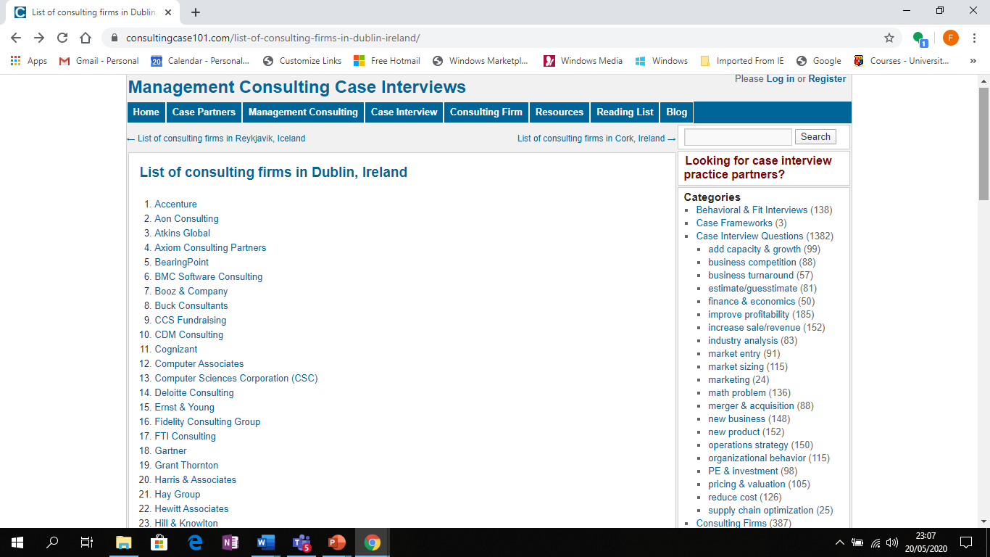

Slide 54
Buildyour “ Career Intelligence “ research the amazing world of work, sectors , jobs and possibilities – Be Inspired
Recovering Academic
https://podcasts.apple.com/ie/podcast/recovering-academic/id1146802786
Beyond the Lab
https://podcasts.apple.com/ie/podcast/vanderbilt-beyond-the-lab-podcast/id1329787147
PhD in Progress Your Education Your Life Your Career
https://podcasts.apple.com/ie/podcast/phd-in-progress-podcast-education-career-life/id858594298
The Career Farm - Grow your own Career
https://podcasts.apple.com/ie/podcast/the-career-farm-grow-your-own-career-with-jane-barrett/id929948746
10 Good Minutes Career Advice from Young professionals
https://podcasts.apple.com/ie/podcast/10gm-career-advice/id297143488
Squiggly Careers
https://podcasts.apple.com/ie/podcast/squiggly-careers/id1202842065
Career Decisions
https://podcasts.apple.com/ie/podcast/career-decisions/id1484099776
PhD Career Stories
https://podcasts.apple.com/ie/podcast/phd-career-stories/id1150156933
Cheeky Scientist Radio
https://podcasts.apple.com/ie/podcast/cheeky-scientist-radio/id1183346190

Slide 55
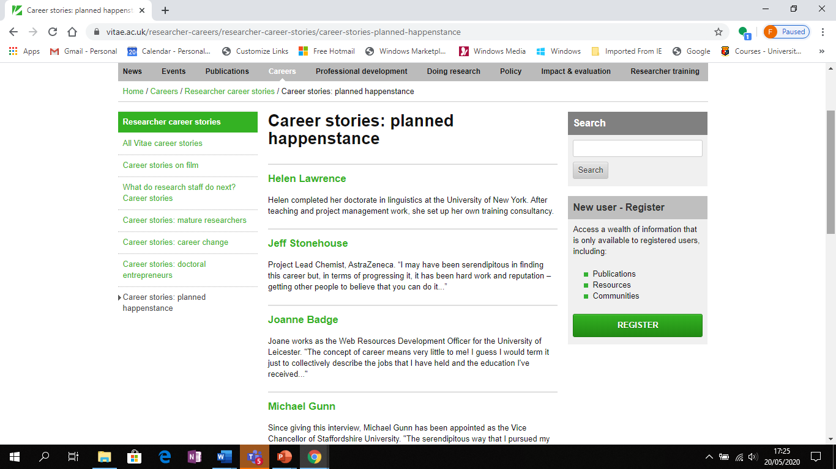
PhD Career Stories
https://www.vitae.ac.uk/researcher-careers/researcher-career-stories/career-stories-planned-happenstance

Slide 56
C Career Narratives
https://www.tcd.ie/Careers/events/careers-beyond-academia.php
https://theauditorium.blog/2024/01/03/pathfinder-career-narratives-20-research-development-manager/

Slide 57
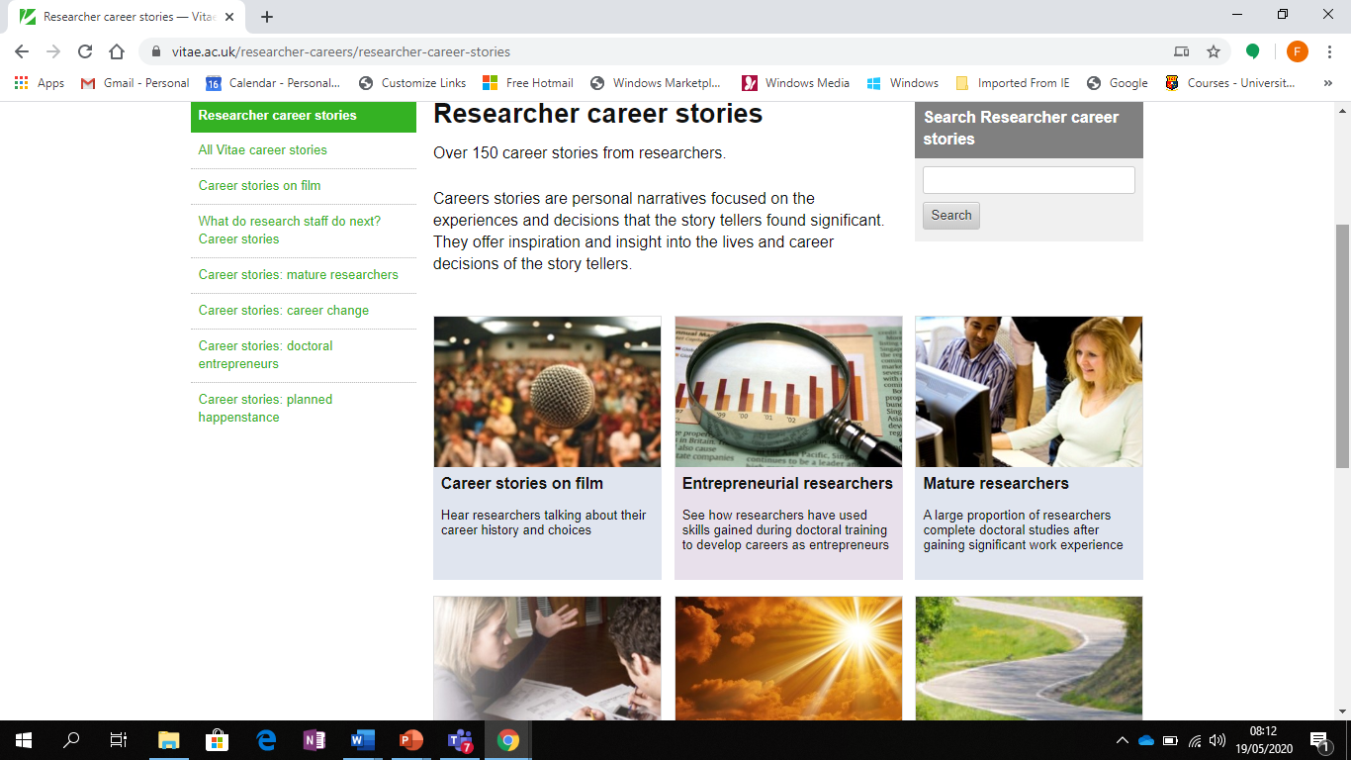

Slide 58
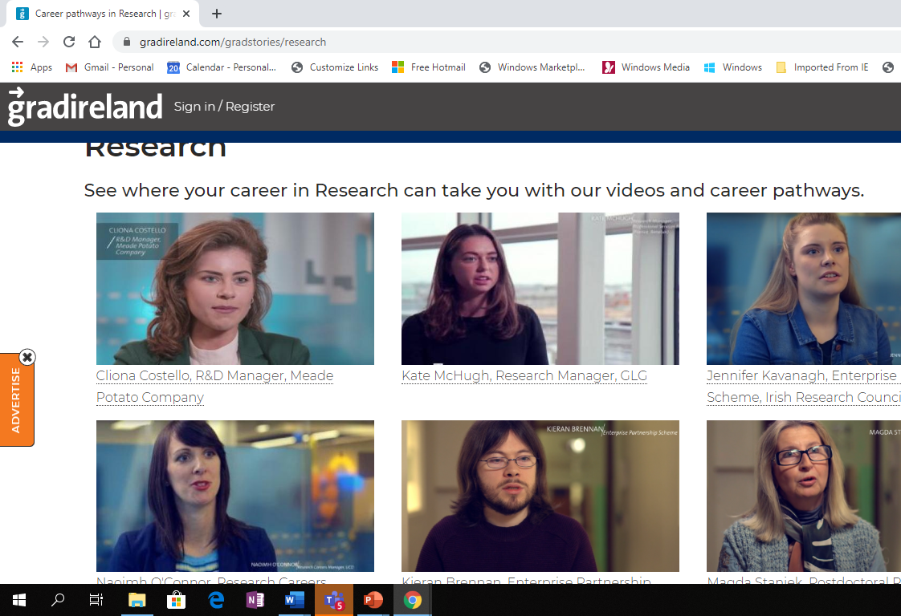
https://gradireland.com/gradstories/research

Slide 59
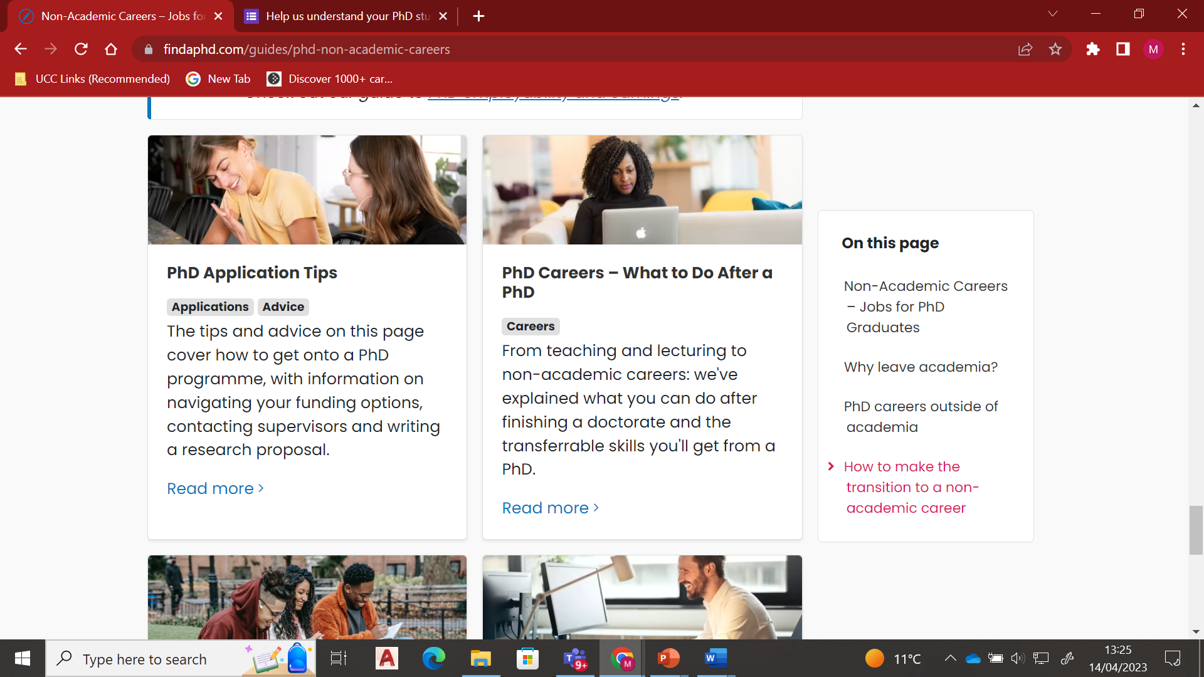
https://www.findaphd.com/guides/phd-non-academic-careers

Slide 60
Where to look – Where are jobs advertised- “unearthing jobs – the hidden market of jobs
LinkedIn ********
Recruitment Agencies
Referrals
Networking

Slide 61
Creative Job Searching
Creative Job Searching is systematic approach to finding a job
It’s a pro-active approach rather than a re-active approach
Incorporating elements :
  Researching information on: occupations/employers/job opportunities
  Developing a network of contacts, through work shadowing, volunteering, work experience, networking events, employer engagement events etc.
  Maximising your online profile to encourage recruiters and employers to recruit you.
  Making focused speculative applications to employers to Access the “Hidden Jobs Market”
Notes:
Reactive – applying for advertised jobs
Proactive – can complimete reactive job searching
Research is important.
Networking helps you access people and opportunities – work shadowing/volunteering etct.
Maximising your online profie – your brand you are putting out there. How you can attract recruiters as well you using it to network
Speculative jobs market.
Things being suggested are some ways to supplement that you can chose from – decide whats right for you. What can I time for. Its up to you to make a plan.
They are just suggestions at this point. No expectation do them all and possible a way to start an action plan.

Slide 62
“Hidden Jobs Market”
Research shows that up to 70% of jobs are not advertised
Why?
  Costs money
  Attracts too many applications
  CVs on file already
Open
Jobs Market
Hidden Jobs Market
Notes:
62
The 'Iceberg' Principle illustrates the hidden job market. The proportions will alter depending on the sector but advertised vacancies make up a small proportion of opportunities and the boundaries of the hidden job market are indefinite:
Proportions of the triangle will vary depending on the sector

Slide 63

3 Elements of Networking
  Strategic:
  WHO needs to be in my network?
  Tactical:
  HOW will I integrate the right people?
  Online:
  HOW can I network online?
Notes:
Strategic – you don’t want to connect with everyone – target who you want to engage with. Use your time wisely. Who is most important
Tactical – How will you do it.

Slide 64

Strategic Networking (Who)
Who needs to be in your network?
What does your Networking look like now?
How would you like your Network to Look?
Notes:
Who do you need to add to your network. Like anything, its about planning.
Join some online organisations and target those who are relevant and make sense to you. Job relevant contacts – see next slide

Slide 65
Networking
Building Relationships with Potential job relevant contacts
Who are Job Relevant Connections?
Referees
Company Representatives
Alumni working in target sectors /roles
Professionals in your field
Recruitment Consultants
Peers, Friends, Family, Colleagues
Notes:
Makes notes of events
Connect with them with a nice note
Connect with people who are past alumni that you would like to aspire to. Get advice and tips how to secure a role.
Professionals in your field – Build your connections, just like other social media, you will get visibility to news in that area and there is opportunity for you to contribute.

Slide 66
Networking Tactics
Join groups and networks both online and offline
Join or Engage with relevant professional industry and business networks
Attend events, participate and be visible
Interview people in careers of interest
Research and send speculative applications
Create a positive relevant online presence
At events:
Research the speakers and list of attendees
Prepare an Elevator Pitch (90 second introduction)
Prepare questions to ask
Connect online after the event
Notes:
Education, experience, unique selling points, where you want to go. Needs to be rehearsed. What are you pitching.

Slide 67
Do Informational Interviews with professionals of interest
A new professional relationship in a career area of interest
Information on roles and careers you didn’t know existed
An opportunity to meet people who may forward you job leads in the future
First hand relevant information about working in a particular industry, field or profession
The culture and atmosphere in an organisation
Tips and insider knowledge on how to prepare and land your first career position

Slide 68
Tactical Networking Checklist 1
Name of Top 50 Target Connection | When will you contact them? | By which method? | What mutual contact will help open the door?
1. Name/Title
2. Name/Title
3. Name/Title
4. Name/Title
5. Name/Title

Slide 69
Tactical Networking Checklist 2
Professional and Industry Networks or Societies or Associations | Professional and Industry Events | Voluntary Roles in Charities, Clubs or Professional Societies | Professional Working in Your Dream Role, Company or Sector
Name 3 networks you will join: 1. 2. 3. | Name 3 events you will attend: 1. 2. 3. | Name 3 voluntary roles you will apply for: 1. 2. 3. | Name 3 people that you will contact for an informational interview: 1. 2. 3.

Slide 70

Optimise Your Online Networking
Develop your profile – essential before you start networking
Understand the platforms – the audience, tone, etiquette of
Grow your connections – your access to other connections depends on this.
Join an online community/group – great way to interact with people in a specialist area.
Notes:
VO: How do you make the most of your online networking and really optimise your efforts? We’ve already mentioned the importance of developing your profile.
It’s also important to really get to know and understand the different social media platforms, their audience, their purpose and the etiquette required for the tone of the platform. While Instagram is for more creative expression and a unique insight into what motivates you, LinkedIn is a very professional platform, so the tone in what you post or comment on is quite different.
Once you have developed your profile it’s important to start growing your connections, particularly for LinkedIn this is essential. What you can see in your news feed and the profiles that are visible to you depend on your number of connections.
There is also great value in joining online communities and groups. You can find dedicated websites for special interest groups or on social media websites like Facebook and LinkedIn. Many of these communities offer things like forums, podcasts or even offline events. Once you’ve been accepted in a group become a valuable member. Don’t simply read what’s going on, you need to get involved with the discussion.

Slide 71

Optimise Your Online Networking contd.
Be active - comment, like, interact and contribute.
It’s not all one-way - give more than you receive, share an article.
Be professional – you’re not interacting with your friends on Facebook, it’s professional interaction not personal.
Notes:
VO: How else can you optimise your online networking?
It’s really important to be active on these platforms, you need to comment on posts and share articles, interact with people and where possible contribute to the discussion.
It’s not all one way, it’s important to offer something of value, such as a link to a relevant article, likes on a post, don’t just ask for recommendations or information. The general rule with online networking is to give more than you receive.
It’s also really important to be professional and polite when you are interacting online, don’t use slang or text writing, use professional communication. Don’t make the mistake of interacting how you would on Facebook on LinkedIn, FB is for more personal interactions, birthdays, family photos etc. LinkedIn is more professional.

Slide 72
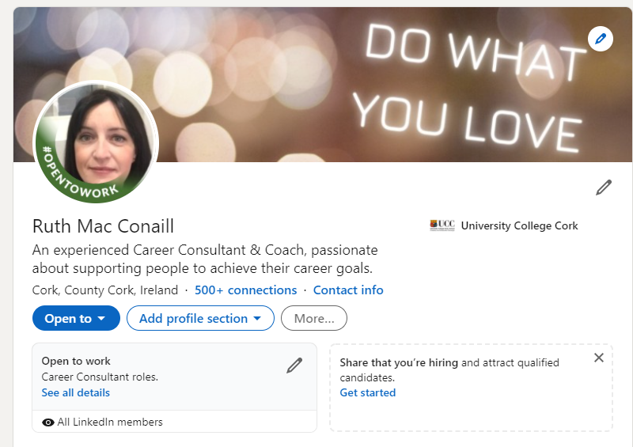
Optimise Your LinkedIn Profile – for Recruiters
Photo, background banner, headline
Open to work – photo filter and recruiter section
Summary/About section – keywords
Look at others in the industry
Connect
Engage
Publish
Perfect your profile

Slide 73
PhD Jobs - a week in the life at a glance
LinkedIn -588 Phd Jobs in Ireland (28 new) (Ireland
14000+ Phd jobs in European Union (664 new))
Indeed-25+ PhD Graduate Jobs, Employment 16 May 2024 - Indeed
Indeed 30 funded PhD jobs

Slide 74
..
https://www.universityvacancies.com/
https://www.nijobs.com/Phd-Jobs
https://www.publicjobs.ie/en/graduate-opportunities
https://www.irishjobs.ie/
https://ie.indeed.com/PhD-Ireland-
https://www.careerjet.ie/phd-graduate-jobs.html

Slide 75
LinkedIn Groups
Each Group has:
  Members – i.e. potential contacts for YOU
  Discussion Board
  Promotions
  Job Vacancies
Contribute to Discussions – be SEEN online by industry players
Ask for advice

Slide 76
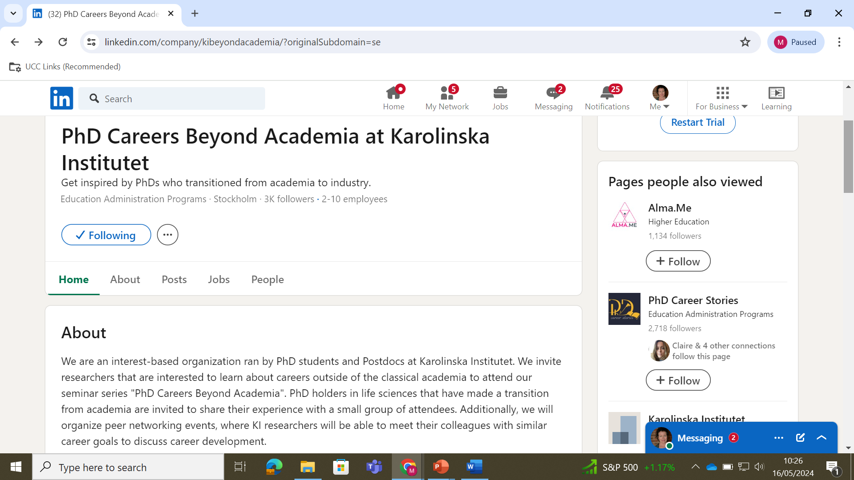

Slide 77
Useful follow up resources
PhD Careers outside of Academia
https://www.jobs.ac.uk/media/pdf/ca
https://www.jobs.ac.uk/media/pdf/careers/resources/10-career-paths-for-phds.pdf
https://career-advice.jobs.ac.uk/resources/jobs-ac-uk-live-qa-alternative-career-pathways-after-your-phd
https://www.findaphd.com/advice/doing/phd-non-academic-careers.aspx
https://www.linkedin.com/pulse/most-direct-path-huge-job-offers-3-foundations-phds-hankel-ph-d-/
https://www.linkedin.com/company/kibeyondacademia/
https://academicpositions.com/career-advice/the-7-essential-transferable-skills-all-phds-have
https://www.themuse.com/advice/3-things-phd-need-to-know-get-job-outside-academia ***
https://www.enago.com/academy/you-have-a-phd-what-next/

Slide 78
Useful follow up resources
https://versatilephd.com/phd-career-finder/
https://www.imaginephd.com/
https://www.insidehighered.com/blogs/gradhacker/exploring-alternative-academic-careers
https://www.vitae.ac.uk/researcher-careers/researcher-career-stories
https://www.academictransfer.com/en/blog/six-career-paths-for-phd-graduates/

Slide 79
Useful follow up resources
https://www.linkedin.com/jobs/phd-jobs/?currentJobId=3922224611&originalSubdomain=ie
https://ie.indeed.com/q-phd-graduate-jobs.html?vjk=826b6317072dadc4
https://www.careerjet.ie/phd-graduate-jobs
https://www.jobs.ie/jobs/phd
https://arqus-alliance.eu/research/phd-portal/careers-beyond-academia/
https://www.mydocpro.org/en Europe
https://eu-recruit.com/jobs/stem-phds-masters/ Europe STEM
https://brighterbox.com/blog/article/post-phd-job-hunting-outside-academia UK
https://minerva-recruitment.com/ uk
https://www.bestinireland.com/best-recruitment-agency-ireland/

