Slide 1
PEER SUPPORT NETWORKS /
ACTION LEARNING SETS
Mary Horgan, Friday 16th January

Slide 2
Why are we here?
Peer Support Networks – what are they & what are they not?
Composition
Process - How do they work?
The Benefits
How would you go about establishing one?
Experiences from Bronagh Clarke – member of School Managers Peer Support Network
Next week
Notes:
Importance of creating supportive research cultures
The realities of modern research:
Increasing pressures and expectations
Competition for funding and publications
Isolation, especially for early-career researchers
Challenges of balancing research, teaching and administrative duties
Importance of creating supportive research cultures

Slide 3
Peer Support Networks – what are they?
“A group of people who perform similar functions and share a concern or a passion for something they do and learn how to do it better as they interact regularly” Wenger-Trayner
“A way of learning from our actions and what happens around us by:
taking time to question,
understand and reflect,
gain insight,
consider how to act in the future” Weinstein, 1999

Slide 4
Peer Support Networks
They are not:
Formal Work Group
Project Team
Informal Network
Training initiative
They are:
Group of people who share experiences, knowledge, encouragement and practical support,
Where membership is voluntary,
Generally self-organised,
Who identify priorities/workplace challenges/shared roadblocks they wish to discuss, explore & decide on concrete actions.
Build reflective, collaborative and peer centred learning habits.

Slide 5
Composition
Composition will be informed by your ‘raison d’être’
Post doctoral groups
Early career
Shared disciplines
Cross disciplinary groups
Peer coaching groups
Identify funding opportunities
Generate new ideas
Share resources
Navigate career pathways
Build professional networks
Facilitate knowledge exchange around specific discipline

Slide 6
Benefits
Professional Sharing knowledge and expertise Developing new skills Solving research challenges faster Accessing opportunities and funding information Building collaborations Expanding professional networks | Career Increased visibility Learning from others' career journeys Developing leadership skills Greater confidence in decision-making

Slide 7
Wellbeing Benefits
Reduced isolation Increased sense of belonging Emotional support during setbacks Improved resilience Better work-life balance through shared experiences

Slide 8
Principles
Confidentiality
Openness
Remain fully present
Equal Status
Do not give advice or solutions (ALS)
Allow time to think
Participate fully & giving others opportunity to participate
Trust
Notes:
SLIDE 3 - “A way of learning from our actions and what happens around us by:
taking time to question,
understand and reflect,
gain insight,
consider how to act in the future” Weinstein, 1999

Slide 9
Action Learning Sets - The Process
The Presenter: one member presents specific work challenge or opportunity
The Questioning: Others now ask open-ended, probing questions to help presenter clarify root cause of challenge. NO ADVICE GIVEN
The Reflection: Presenter observes as group discusses issue & they offer different perspectives.
Action Planning: Presenter synthesises feedback, commits to concrete actions to implement before next meeting
Next Meeting: Share impact of actions & any challenges as a result.

Slide 10
Some Questions – Presenter
Think of a task/issue on the theme discussed today that you face at work.
Describe it to the group briefly but be specific.
In describing your task/issue, the following questions may help you.
What am I trying to do?
How am I feeling about it?
What is challenging me?
What can I currently do about it?
Who knows what I’m trying to do?
Who can help or support me?

Slide 11
The Group
1. Questions of understanding
Why is this important?
2. Questions to explore below the surface?
Can you explain?
How do you know?
Can you give an example
3. Questions to explore options and prompt action
What do you think would happen if…?
What would doing nothing look like?
What are your options?
What are you going to do next?
What are you trying to achieve?

Slide 12
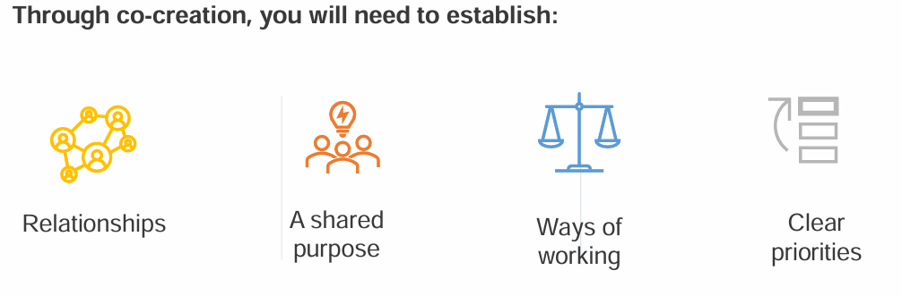
Be clear on your purpose
(First Meeting)
Rest on psychological safety, confidentiality, equal status and a discipline of asking powerful questions rather than offering premature solutions.
Notes:
Ways of working – regularity, dates in diary in advance, agenda, share chairing, minute taking??,
Common pitfalls:
Lack of clear purpose
Irregular participation
Over-reliance on one individual

Slide 13
First Meeting
Purpose – ‘The Why’
Regularity / Schedule
Ways of workings
- Agenda
- Share chairing
Share note taking
Ground rules – how you will work together
Confidentiality

Slide 14
DR BRONAGH CLARKE
School of Pharmacy, School Manager
‘School Managers Peer Support Network’

Slide 15

NEXT STEPS
PURPOSE?
Members?
Would they be interested? Issue call for ‘Expressions of Interest’ amongst target group
How to contact target group? All Research Staff email / School Managers, Department, School, Units will have specific email distribution lists
First Meeting (slide 12) – our ‘why’, rules of working, rotating chair, agenda (?)

Slide 16
Research excellence is not achieved in isolation.
Strong peer support networks help researchers collaborate more effectively, navigate challenges with confidence, and build rewarding and sustainable academic careers.

Slide 17
Next Session
RESEARCH DATA MANAGEMENT
Friday, 6th November 2026
11:00 – 12:00
Aoife Coffey, Boole Library

Slide 18
Thank You
Any Questions?

Slide 19
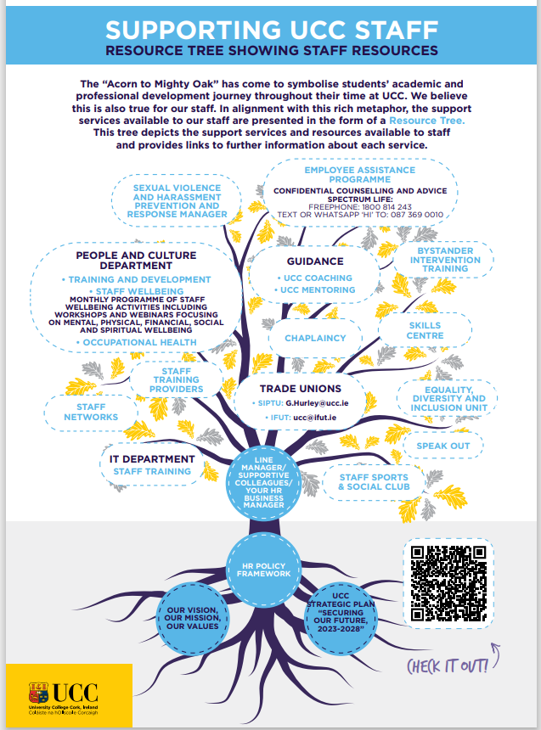

Slide 20

