Slide 1
MENTORING FOR RESEARCHERS
Paolo Saporito & Mary Horgan
19 April 2024

Slide 2
Let’s get the most out of this morning
Email: Switch it off & be present
Microphone: When not speaking, please keep it on mute
Camera: If possible, do have your camera on
Participate: Just use the ‘raise hand’ function if you have a question or wish to comment & click to take it down afterwards. The more interactive, the better!
Confidentiality: Everything we discuss is confidential

Slide 3

Briefing Objectives
Part 1
Clarify what mentoring is
Examine purpose & benefits of mentoring
Review roles of mentee & mentor
Confidentiality
Part 2
Examine how working with a mentor can support you to navigate and advance your research career
Consider your personal objectives for mentoring, and the type of mentor you want to work with
Describe the characteristics of an effective mentor, and good mentoring practice

Slide 4
What does mentoring mean to you?
Structured process where experienced individual (mentor) helps another person (mentee) to develop his/her goals & skills through time limited, confidential one to one conversations
Supportive relationship - role of the mentor to help, advise & provide information & guidance to mentee.
May work in similar areas or share similar experiences
Relationship based upon mutual trust & respect
No line management relationship between mentee & mentor

Slide 5
Principles
Mentee led
Goal oriented (concrete goals)
Environment of openness, trust & mutual support
Both parties respectful of each other’s time, experience & difference
Partnership approach
No hidden agendas & non judgemental
Confidential process

Slide 6
Mentoring vs. Training
Training
Directive - focussed on meeting set learning outcomes and skills gaps
Mentoring
Directive guidance & advice based on experience

Slide 7
‘Expectations’
Mentors:
‘Expectations of your mentee’
Mentees:
‘Expectations of your mentor’

Slide 8
Role of Mentee
Actively engage with mentoring process & appointed mentor
Drive the process - take responsibility for managing mentoring relationship including meeting commitments, arranging meetings etc.
Set clear objectives and goals & realistic expectations around delivering on development needs
Communicate directly, honestly & openly, be curious, pose questions, share ideas
Be willing to listen & take on board constructive feedback & advice
Retain responsibility for own learning

Slide 9
Role of Mentor
Provide guidance & support in addressing identified development needs
Act as sounding board, providing encouragement & source of knowledge, stimulating insight
Create new perspectives & different ways of thinking
A figure with whom mentees can discuss their aspirations and concerns; who will listen; provide constructive feedback, challenge as appropriate
See positives in mentee that they may be unaware of
Support & encourage mentee to take positive action
Help mentee to understand how things operate in UCC including the unspoken norms & values
Introduce mentee to peers & colleagues as relevant to assist them become familiar with & integrate into the wider University
Mentor has no responsibility for actions & decisions of mentee

Slide 10

Confidentiality
What does confidentiality mean to you and your mentor/mentee?
In what circumstances would confidentiality need to be broken and how would this happen?

Slide 11
1st Meeting - Some suggestions
‘Coffee & Chemistry’ & then…..
Getting to know each other
Discuss & clarify expectations & goals
Boundaries – what is in & out
Confidentiality
In between contact?
Post meeting follow up?
Mentee led process

Slide 12
Mentoring and Research
Mentoring conversations are not limited to a mentoring programme and can take place with a range of supporting players, and in a range of different ways
Everybody needs a Mentor…but its horses for courses (= what is suitable for one person or situation might be unsuitable for another)

Slide 13
Mentoring and Research
Informal mentoring
PI or Supervisor (back in a minute)
Peer networks and communities
- Insights into research careers
- Updates on discipline developments in institutions relevant to your research area
- Support, critical feedback
- Also available through professional bodies and societies
“Institutional” mentor
- Norms or working cultures within your department/school/college/university
- Awareness of key contacts (i.e. HR, Finance, Research Office)
- Usually pairing managed by institution
- Confidential space if outside of own department

Slide 14
Mentoring and Research
Informal mentoring
Research Career Development Professionals (i.e. HR Research, Careers Services)
- Support in career and skill development
- Directions to relevant training (including FORMAL mentoring programmes)
- Knowledge of your rights, roles and responsibilities as a researcher (employment/contract side)
Research Officers
- Guidance and feedback on funding strategies
- Knowledge of your rights, roles and responsibilities as a researcher (research side)
- Fit/eligibility for funding calls

Slide 15

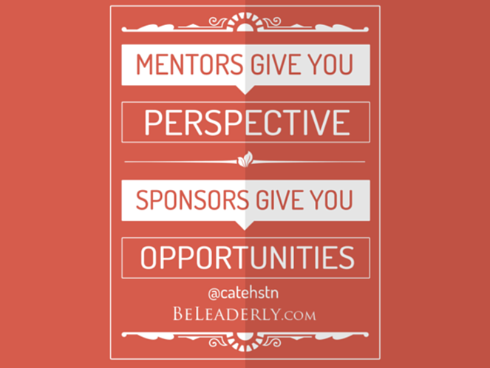
Mentoring and Research
Informal mentoring
Sponsors
- Specific role in career development → career advocate acting on your behalf
- Use their reputation to help you
- Give you access to opportunities and resources

Slide 16
Mentoring and Research
Informal mentoring
Sponsors (examples)
- Link to research fellowships (i.e. John Smith Foundation, charitable organisations)
- Talent Development Programmes
- Prestigious PI in your field

Slide 17
Mentoring and Research
Career Gains
Increased confidence and self-awareness
Knowledge of role responsibilities and future career options
Setting goals
Contacts with networks
Organisational tools and techniques
Publication plans
Work/life balance strategies
Improved workplace relationships

Slide 18
Mentoring and Supervision
The Supervisor/PI as an informal mentor
Pros:
Professional advice
Access to career opportunities (i.e. funding)
Advice on skill and idea development
Cons:
Hierarchical relationship (i.e. line manager)
Stakeholder in your research progress and success = guidance influenced by their interest

Slide 19
Mentoring and Supervision
Supervising and mentoring are two different practices.
Supervision (or line management)
It is a legal requirement
It involves directing actions and overseeing tasks
Setting KPIs, assessing, evaluating
Goal: accomplish organizational or educational objectives
Outcomes are required, not necessarily desired
Mentoring
It is a voluntary, mentee-led initiative
No assessment or evaluation, only constructive feedback
Goal: discuss objectives set by the mentee
Outcomes are desired and willingly pursued, not required

Slide 20
Mentoring and Supervision
Vitae Researcher Development Framework

Slide 21
Mentoring and Supervision
Vitae Researcher Development Framework
Phase 2

Slide 22
Mentoring and Supervision
Vitae Researcher Development Framework
Phase 3, 4 and 5

Slide 23
Over to you….
1. Are you interested in having a mentor?
What goals/objectives would you like a mentor to offer support & guidance on?
Have you a mentor in mind?
2. Interested in being a mentor to a researcher?
Brief outline of your experience & areas you could assist with.
Contact marykate.oregan@ucc.ie or maryniamh.horgan@ucc.ie to progress or discuss further.

Slide 24
Questions and Answers

Slide 25
