Slide 1
Research Data Management
Dr. Aoife Coffey, Research Data Coordinator,
Research & Digital Services, UCC Library
researchdata@ucc.ie

Slide 2
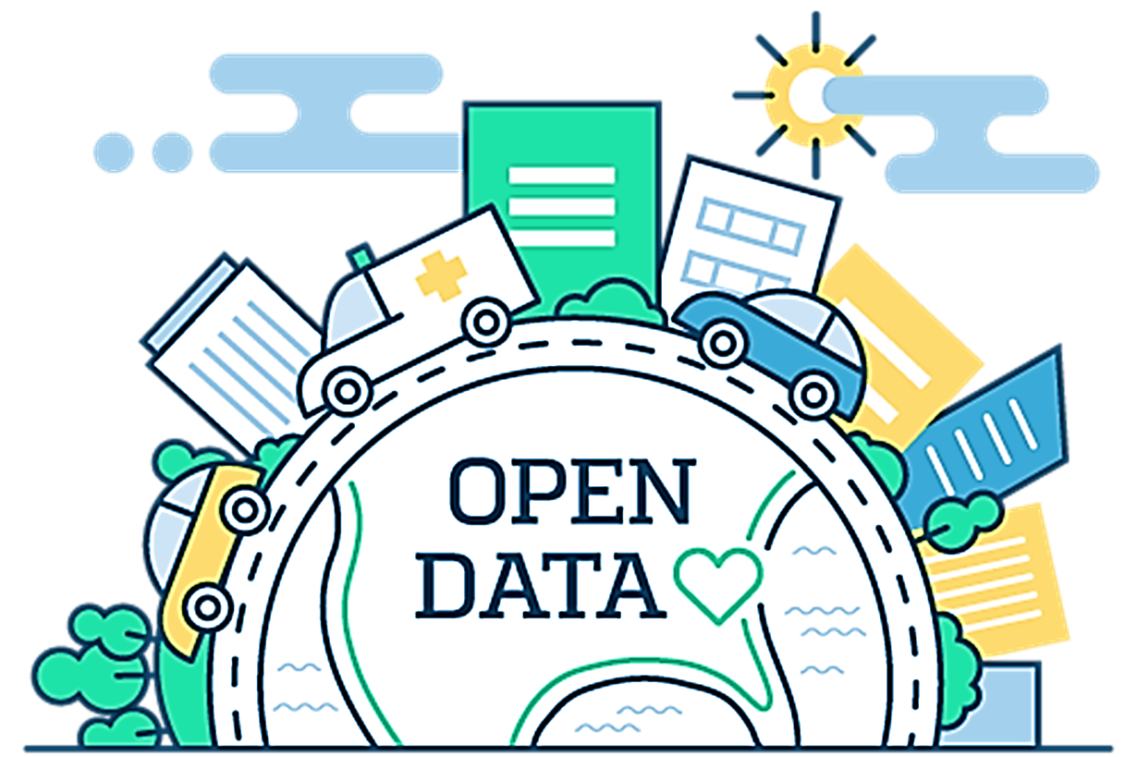
Open Research Data
Refers to the data underpinning scientific research results with no restrictions on its access
Accountability
Transparency
Reproducibility
Building on exiting data
Revisiting existing data
Better and stronger collaborations
Value for public money

Slide 3
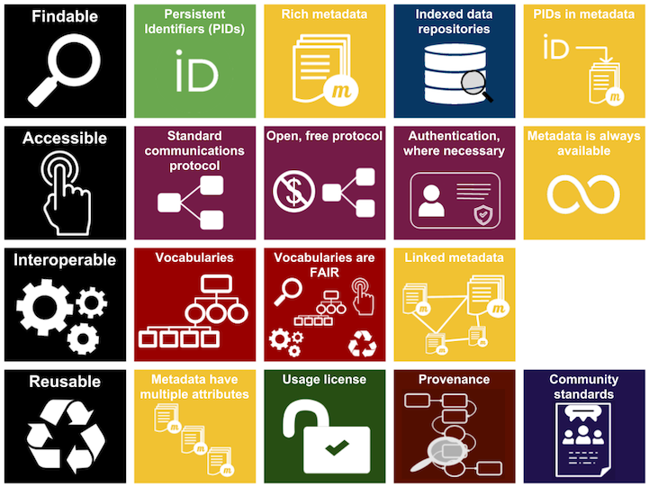
FAIR Principles
Metadata
Persistent Identifiers
Licensing
Repositories
https://libguides.ucc.ie/researchdataservice/fair
https://www.nature.com/articles/sdata201618
https://www.go-fair.org/fair-principles/
https://www.ands.org.au/working-with-data/fairdata/training

Slide 4
National and International Context
National Funders
NORF
Impact 2030
Research Integrity
Publishers
Open Data Directive
EU Funders
European Open Science Cloud
Research Integrity
Publishers
COARA –Coalition for Advancing Research Assessment

Slide 5
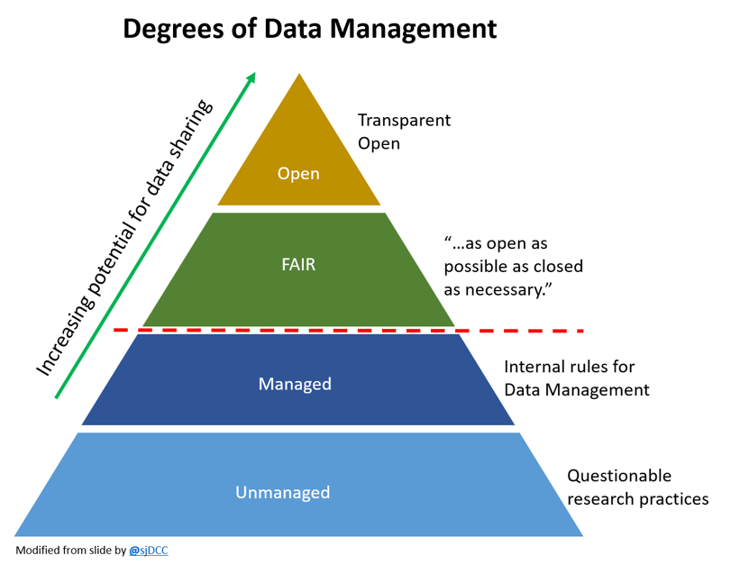
How do you make data FAIR?

Slide 6
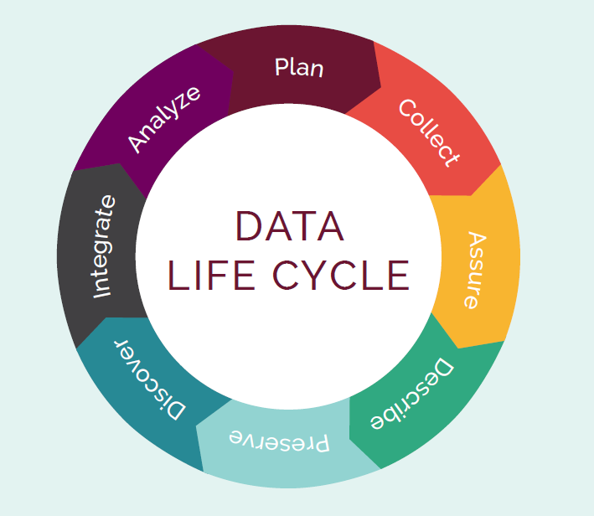
What is data management?
It is the active management of research data during they lifecycle of a project and also includes decisions about treatment of the data post-project
It involves organization, storage, preservation and potential sharing of the data
It’s an integral part of good research practice

Slide 7
Why do you need a data management plan?
Essential part of project management
Establishes clear workflows and guidelines surrounding data management
Sets out transparent data practices
Ensures compliance with legislation
Plan and allocate resources and cost
Plan infrastructure to support data
Day to day you can find and understand your data when you need to use it
There is continuity if project staff leave, or new researchers join
You can avoid unnecessary duplication e.g., re-collecting or re-working data
The data underlying publications are maintained, allowing for validation of results
The data can become another output from a project

Slide 8
Structure of Data Management Plans
1. Data Collection
2. Documentation, metadata and data quality
3. Ethics and Legal Compliance
4. Storage and Back-up during research
5. Data Sharing and Long-term Preservation
6. Resources and Responsibilities
https://doi.org/10.5281/zenodo.4915861
Practical Guide to the International Alignment of Research Data Management - Extended Edition - Science Europe
Notes:
SO this is what a DMP looks like, everything in green is what you should be doing already…. Only the yellow bits are directly related to FAIR.

Slide 9
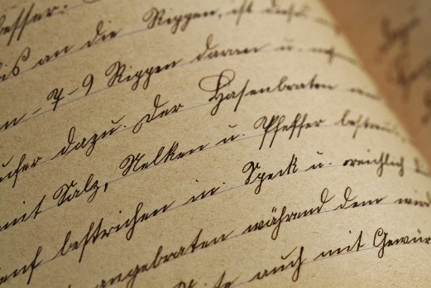
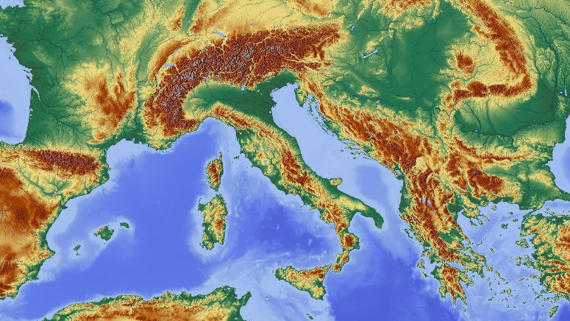
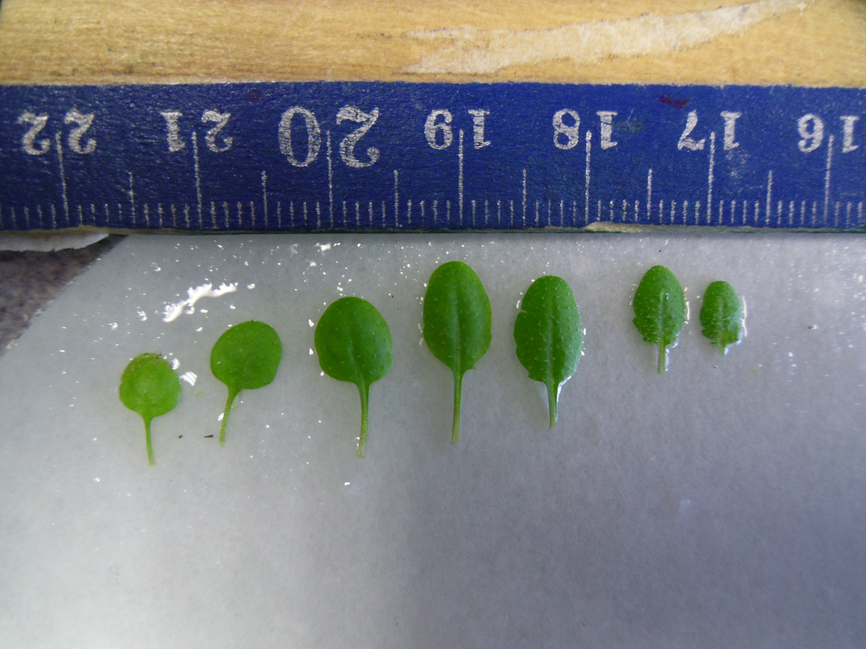
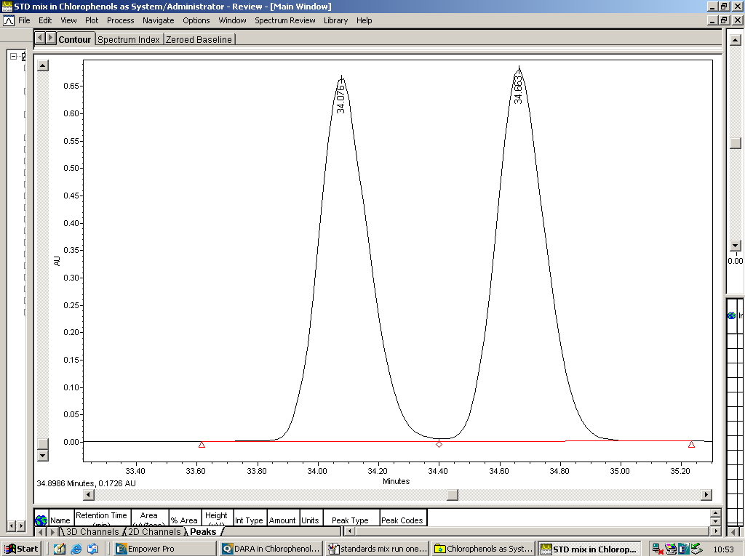
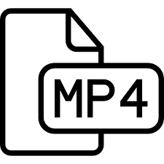
1. Data Collection
What is the type, format and volume of data?
How will data be collected or created?
Secondary
Primary
Qualitative
Quantitative
https://openi.nlm.nih.gov/detailedresult.php?img=PMC3742216_ijms-14-13763f2&req=4
https://www.cellsignal.com/contents/resources-protocols/changes-to-recommended-western-blotting-protocols/western-variation
http://chem.ch.huji.ac.il/nmr/whatisnmr/whatisnmr.html

Slide 10
This means it can include;
- datasets
- databases
- images
- musical compositions
- guidelines
- protocols
- websites
- apps
-designs
- bibliographies
- code
- software
- presentations
- performances
- music
- podcasts
- video
…...........etc. etc. Ect.
What is Research Data?
“……….information generated, collected or observed during a research project.
It is evidence used to support research conclusions and will go on to form part of the scholarly record.

Slide 11
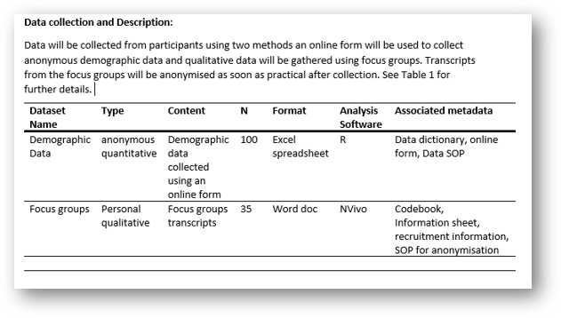
​​​ | dataset​​ | Collection method​​ | type​​​ | format​​​ | location ​and access​​ | software required​​​
1​​​ | Fieldtrial 1 (FT1)​​​ | Small scale fieldtrial. Lettuce grown using 3 UV filters​​​ | Flavonoids,​​​ Plant growth parameters​​​ | Excel,images ​​ | FT1 Master File (hyperlinkto file location)​​​ Only project member have access​​ | Excell, SPSS, ImageJ ​​​
2​​​ | ​​Field trial 2(FT2)​ | Arabodopsis Ecotype Trial. Using 3 UV filters​ | ​​Flavonoids, ​ Plant growthparameters, ​ Fluorescence ​ | ​​Excel ​ Images​ Fv/Fm​ | FT3 Master File (hyperlink to filelocation) ​ Project member and 4th year project student have access ​ | Excell, SPSS, ImageJ​

Slide 12
2. Documentation and Metadata and Data Quality
Metadata is data about data………
it describes and gives information about other data
A metadata standard
is a collection of defined data elements, characteristics or attributes which must be provided to comply with a general/ community or discipline defined set of criteria.
these requirements are intended to establish a common understanding of the meaning of the data
for every element the name and semantic meaning is defined, this is a controlled vocabulary
examples of controlled vocabularies are; dictionaries, sematic networks, ontologies, taxonomies
Types of Metadata
Discovery/Descriptive Metadata
- authors
-funders
-keywords
-abstract
Substantive/Contextual Metadata
-bibliography/citations
-standards used
-file formats
-data dictionary
-analysis scripts
-links to other metadata

Slide 13
2. Documentation and Metadata and Data Quality
Dataset level:
what is this thing, who made it, when, how...?
Internal arrangement/aggregation:
what files, folders, database tables, components make up this thing, what are they, who made them, how do I open them, how do they relate to each other, how does their naming and arrangement encode meaning?
mg, kg, cm, C⁰/F⁰, %, FV/FM, GPS, shape, colour
Variable-level:
where is the label for this variable, what does the label mean, what units were used, what are the acceptable values, how do these variables relate to each other?
Notes:
Semantic and Syntactic Interoperability …..Metadata
So what does all of that really mean, lets look at the different levels of metadata you need to provide for interoperability
So syntactic interoperability and semantic interoperability and intrinsically linked…. One covers the functional compatibility of the systems and one is about the agreed definitions, meanings behind the data so a controlled vocabulary or maybe simply a defined vocabulary.
At a dataset level you need to the overarching metadata? You need to describe the internal file structure and how each file relates to each other.
Then your need to describe the data itself down to the units and correct ranges for those units
And as I said before there are different ways of doing this

Slide 14
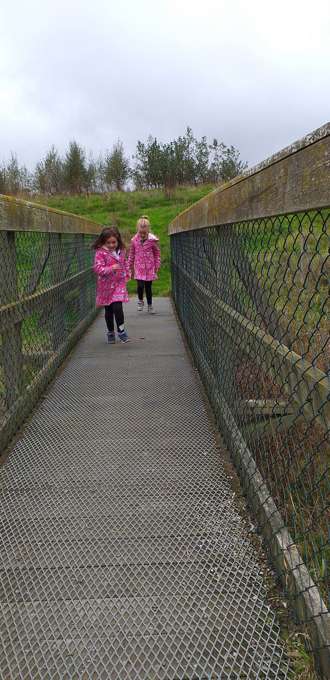
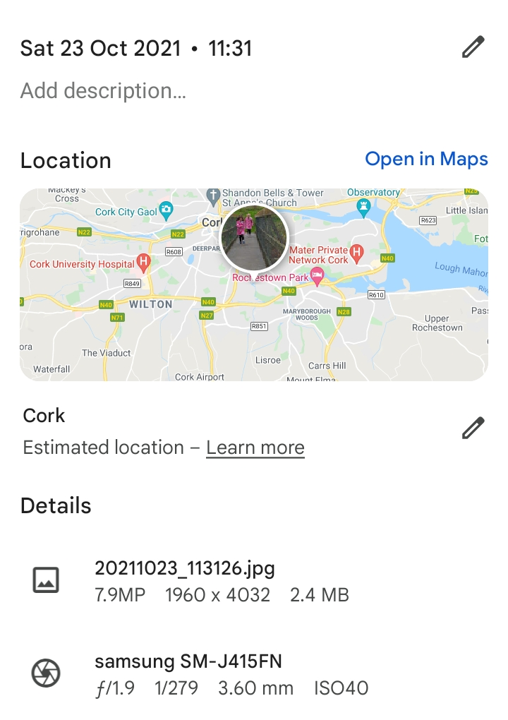
Data
Metadata
Notes:
7.9megapixels
1960x4032 pixels
2.4MB
F/1.9 F-stop – the aperture of the lens
1/279 shutter speed
3.6mm focal length
ISO40 sensitivity of the sensor

Slide 15
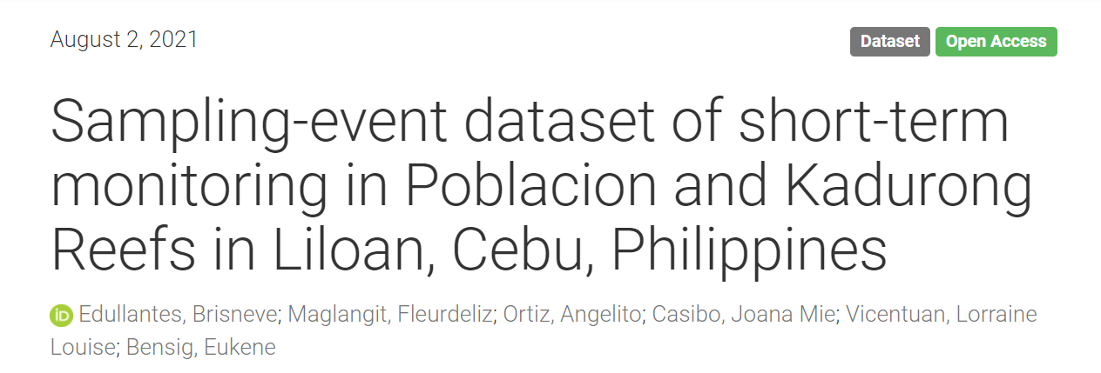
https://dwc.tdwg.org/terms/
https://doi.org/10.5281/zenodo.5154859

Slide 16
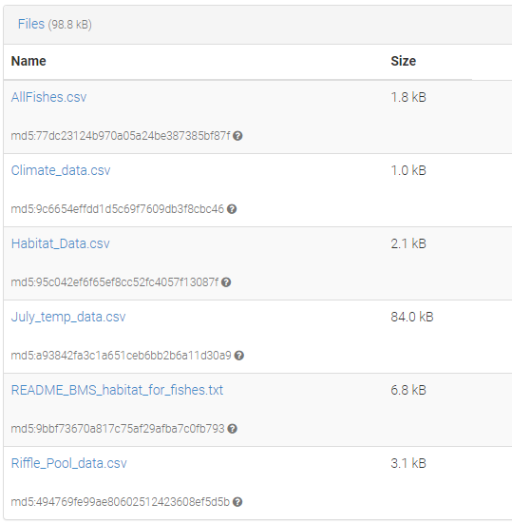
Example that doesn't use a metadata standard
Albertson, Lindsey. (2022). Influence of beaver mimicry restoration on habitat availability for fishes, including Arctic grayling (Thymallus arcticus) [Data set]. https://doi.org/10.5061/dryad.47d7wm3fq
https://zenodo.org/record/5839189#.YeANoP7P2Uk
Even without a metadata standard you can have reusable and reproducible data if you provide the right contextual information, metadata and documentation.
This can include things like;
- readme.txt files
- data dictionaries
- protocols
- analysis scripts
- codebooks
…....etc. etc.

Slide 17
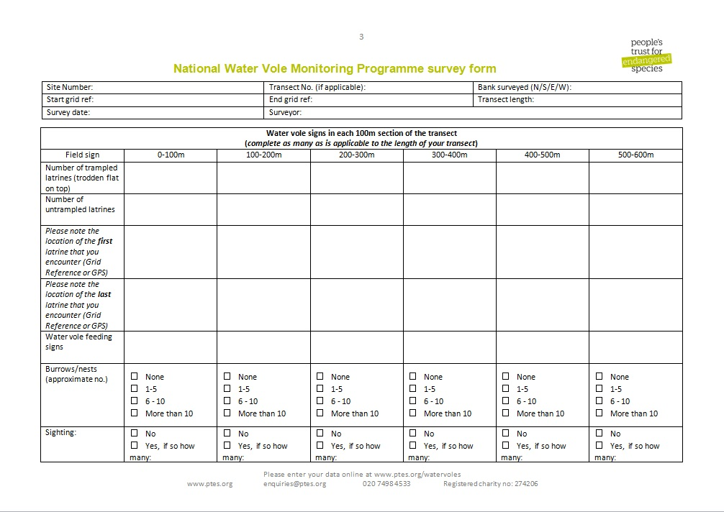
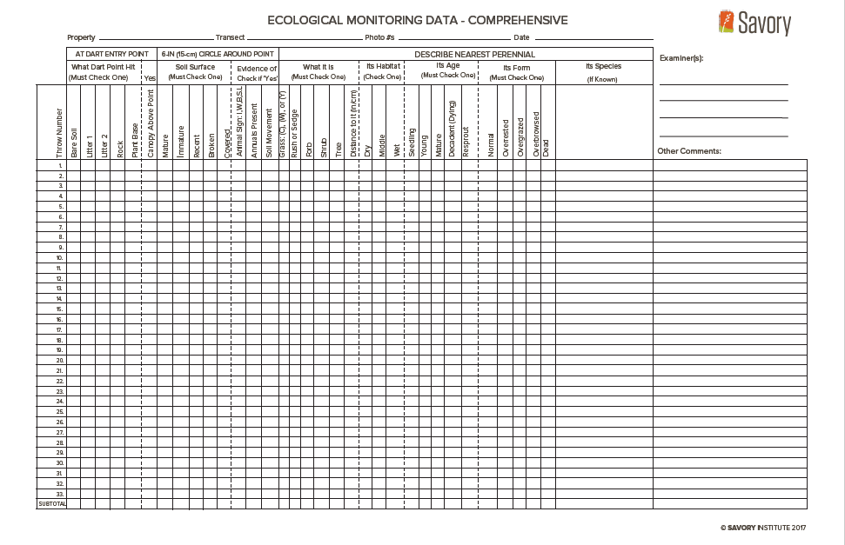

Slide 18
What data quality control measures do you use?
Defined SOPs for treatment of your data
Documenting the calibration of instruments
Standardise data capture, data entry or recording methods
Naming conventions
Version control
Read only raw data files
Data entry validation techniques (spreadsheets)
Methods for transcription
Peer review of data.
…….there are probably others specific to your discipline

Slide 19
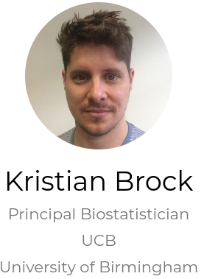
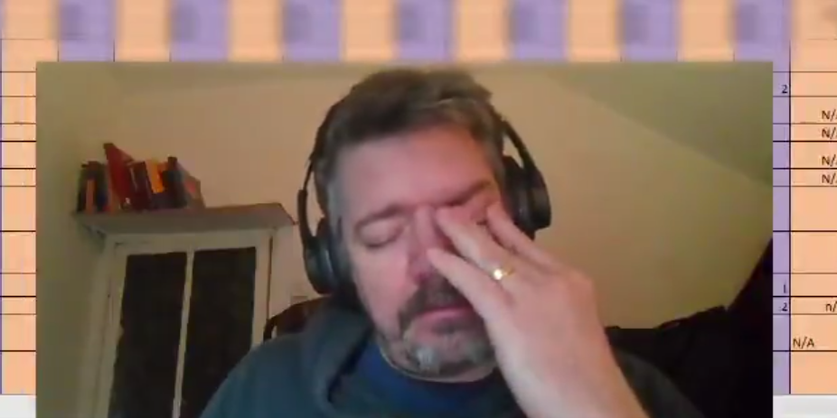
Spreadsheet Design………..be aware of the limitations of excel and take steps to prevent them
Be Consistent
Decide on naming conventions
Use ISO standards
Have rules for empty cells
One piece of data per cell
Make it a rectangle
Subjects in rows
Variables in columns
Create a data dictionary
Backup
Version Control
Use data validation
Include a ReadMe file
No calculation in raw data files
Don’t use formatting as data
Don’t have figures in raw data files
Don’t use merged cells
Don’t hide columns
Don’t use special characters
Don’t have more than one header row
Don’t include temporary or dummy variables not of use to researchers
https://www.kristianbrock.com/post/send-me-data/
https://twitter.com/i/status/1323619993263755264
https://www.youtube.com/watch?v=Ry2xjTBtNFE&t=6s
https://doi.org/10.1080/00031305.2017.1375989
Notes:
So these are the kind of rules that you need to be clear about when using spreadsheets ……

Slide 20
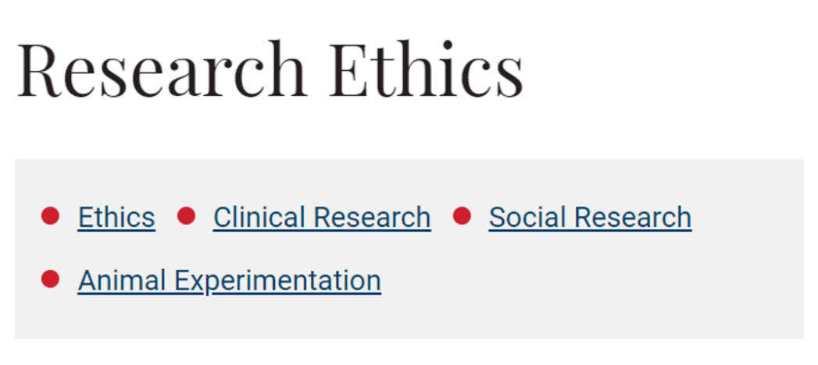
Do you have a data sharing agreement?
3. Ethics and Legal Compliance
Are you using secondary data?
How will you manage ethical issues and codes of conduct?
How will you manage copyright and Intellectual Property Rights (IPR) issues?
Who ‘owns’ your data?
Origin and provenance
Intellectual Property
Copyright
The DMP should outline how you are going to ensure compliance with any legal or ethical requirements associated with your data.

Slide 21
4. Storage and backup [DURING]
Automate your backups
How will data be stored and backed up during the research?
How will you take care of data security and personal data protection?
How will you manage access and security?
https://www.ucc.ie/en/it/storage/
Active Data Storage Decision Tree
Instructions for the storage of Electronic Research Data
https://www.nature.com/articles/d41586-019-01040-w

Slide 22
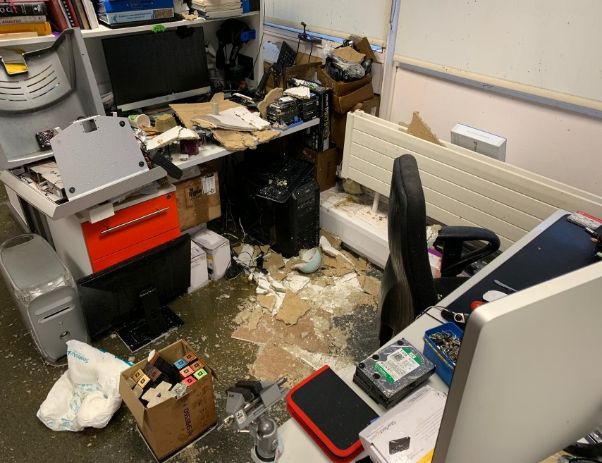
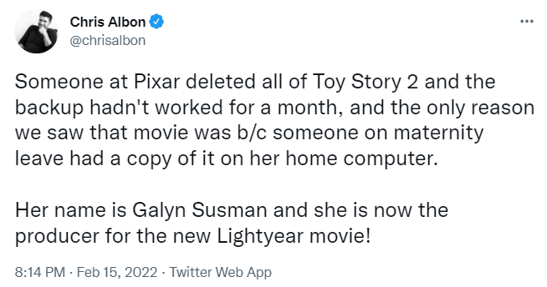
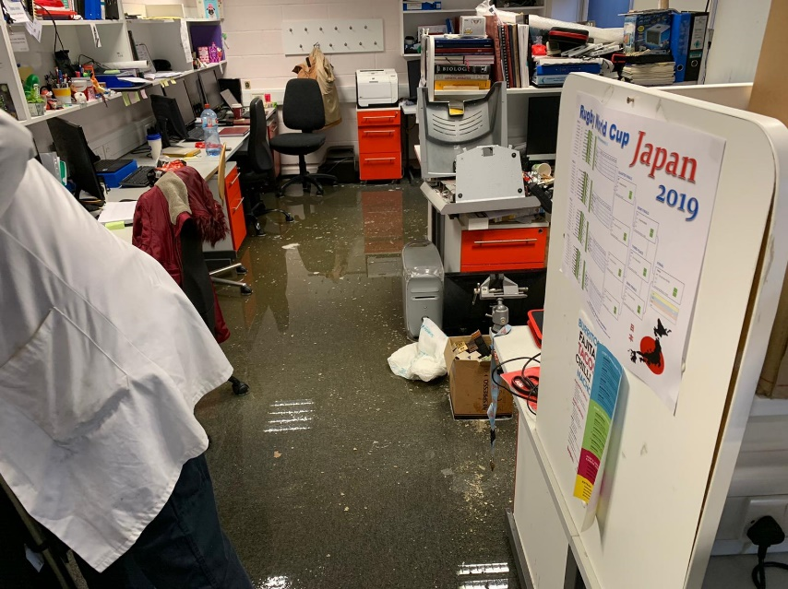
APC- Burst Radiator
https://www.independent.co.uk/arts-entertainment/films/news/lightyear-toy-story-deleted-galyn-susman-b2016221.html?utm_content=Echobox&utm_medium=Social&utm_campaign=Main&utm_source=Twitter#Echobox=1645004983

Slide 23
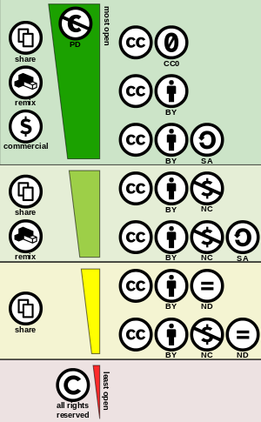
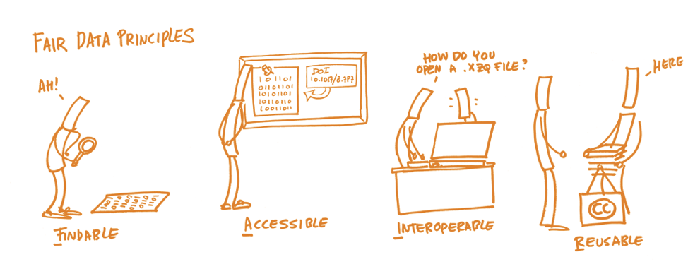
5. Data Sharing and Long-Term Preservation
“…….collect once use many times”
https://creativecommons.org/
https://libguides.ucc.ie/researchdataservice/fair
https://www.nature.com/articles/sdata201618

Slide 24
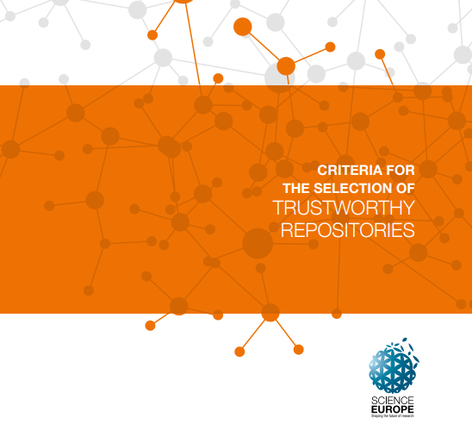
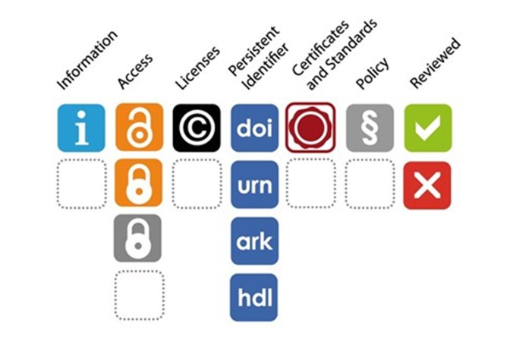
Leveraging repositories to FAIRify your data
https://dataverse.harvard.edu/
https://www.scienceeurope.org/our-resources/practical-guide-to-the-international-alignment-of-research-data-management/
https://osf.io/
https://www.softwareheritage.org/
https://www.dri.ie/
https://fairsharing.org/
https://zenodo.org/
https://figshare.com/
https://www.maynoothuniversity.ie/iqda
https://www.ucd.ie/issda/
https://www.ebi.ac.uk/
https://www.ncbi.nlm.nih.gov/

Slide 25
If data cannot be made available, why? ​
​
Reasons why you can’t share your data
Copyright
Secondary data
Sensitivity -Commercial (embargo)
-Re-identification of anonymised data
4. No consent
5. Endangered species locations/habitat
….but even in projects where the primary raw data cannot be shared there nearly always other outputs which can be shared.
Metadata
Aggregate data
Analysis code
SOPs

Slide 26
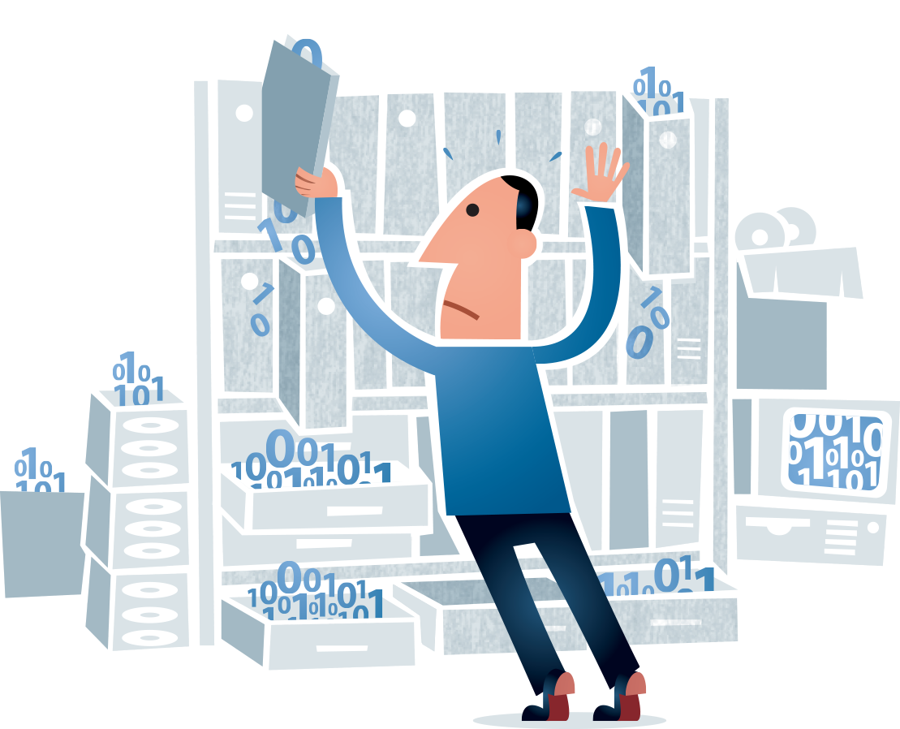
6. Responsibilities and Resources
Who will be responsible of data management?
What resources will you require to deliver your plan?
https://www.southatlanticlcc.org/wp-content/uploads/2017/10/data-management-psb.png

Slide 27
Research Data Service
PaPOR TRaIL free course on Open Research - Link
Canvas Research Essentials Enroll
Website Research Data Service
One to one appointment booking Book Now
Data Management Plan Review
Advice on active data management
Advice on FAIR principles, data sharing and long-term preservation
Scheduled and tailored training in data management and FAIR
Digital Badge in the Responsible Conduct of Research

