Slide 1
FINANCE – Office of Research Grants and Contracts
Preparing Your Budget
Kevin Goggin, Research Support Officer

Slide 2
Agenda – Session 1
Contents:
1. Compliance! Compliance! Compliance!
2. Pay Costs
3. Equipment Costs
4. Other Costs
5. Direct Costs versus Indirect Costs
6. VAT
7. Q & A

Slide 3
Agenda
Contents:
1. Compliance! Compliance! Compliance!
2. Pay Costs
3. Equipment Costs
4. Other Costs
5. Direct Costs versus Indirect Costs
6. VAT
7. Q & A

Slide 4
1. Compliance! Compliance! Compliance! Compliance with…..
Funding Body Rules & Guidelines:

Slide 5
1. Compliance! Compliance! Compliance! Importance of Call Documentation
Read the Call Documentation’s Eligible Cost rules
Interpret and understand:
What direct costs can be claimed
How are direct costs are calculated
Is there an allowance to claim indirect costs / overheads
What amount / % of costs are reimbursed / Is match funding required?

Slide 6
1. Compliance! Compliance! Compliance! General Cost Eligibility Rules - Will vary by funder /call
Costs must be actually incurred by the beneficiary
They must be incurred during the period of the project as set out in the grant agreement (exceptions may apply to costs relating to final report)
The must be declared under the budget categories as set out in the grant agreement
They must be incurred in connection with the action description and be necessary for its implementation.
They must be identifiable and verifiable and compliant with accounting standards

Slide 7
1. Compliance! Compliance! Compliance! General Cost Eligibility Rules
They must comply with the national laws relating to taxes, labour and social security
The must be reasonable and justified and compliant with UCC Procurement guidelines.

Slide 8
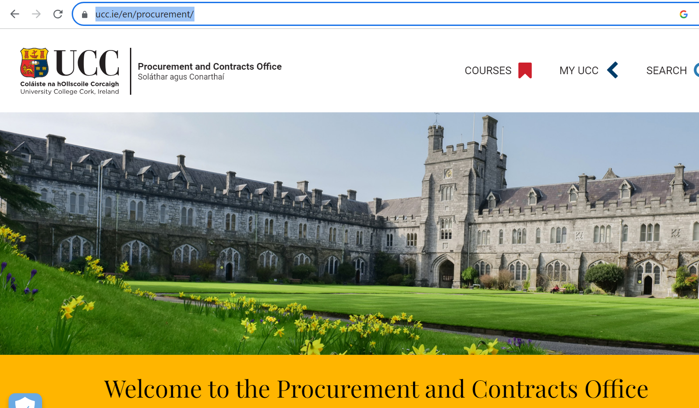
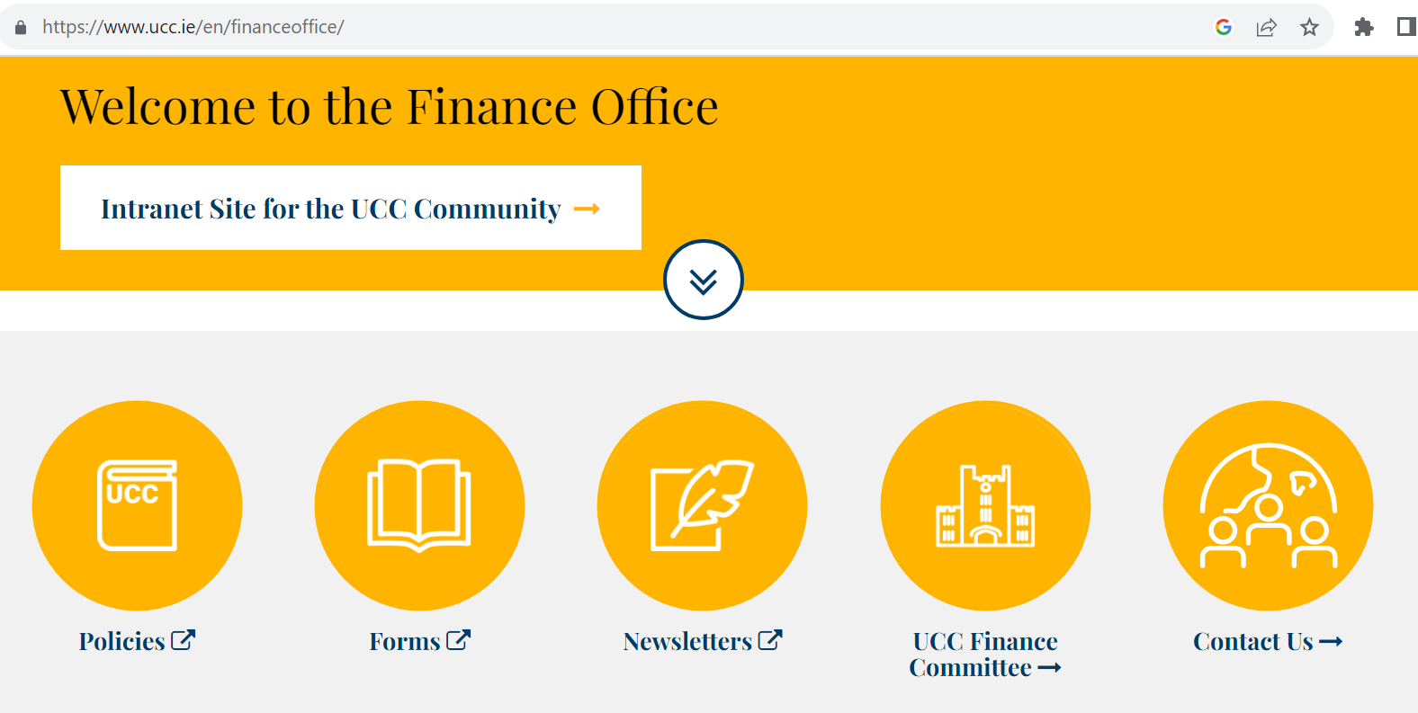
1. Compliance! Compliance! Compliance! Compliance with…..
UCC Policies & Procedures:
UCC Procurement Policies & Procedures:
https://www.ucc.ie/en/procurement/
UCC Finance Office Policies & Procedures:
https://www.ucc.ie/en/financeoffice/

Slide 9
1. Compliance! Compliance! Compliance! Compliance with…..
Local regulatory compliance –Taxation and all Legal compliance:

Slide 10
1. Compliance! Compliance! Compliance! Compliance with…..
UCC Research Procedures:
“UCC Research” are always the main point of contact
Submit your budget for review no later than 5 working days pre-submission of application

Slide 11
Agenda
Contents:
1. Compliance! Compliance! Compliance!
2. Pay Costs
3. Equipment Costs
4. Other Costs
5. Direct Costs versus Indirect Costs
6. VAT
7. Q & A

Slide 12
2. PAY Costs
QUESTION?
UCC hired a staff member with an annual salary of €24,000 on the 01-JAN-2023. What will be the total pay cost of that employee be to UCC for the 12 month period to 31-DEC-2023?
€24,000
€32,222

Slide 13
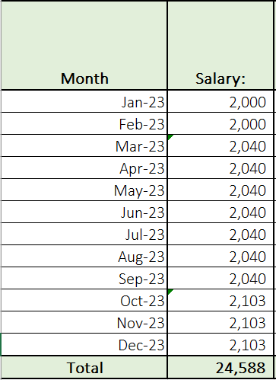
2. PAY Costs Salary Calculation

Slide 14
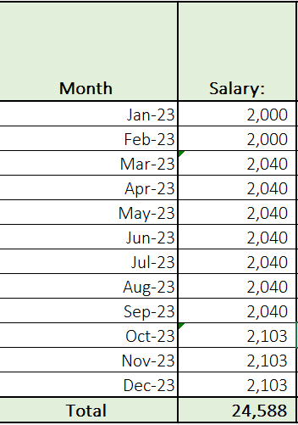
2. PAY Costs Incremental Employer Pay Costs

Slide 15
2. PAY Costs Multi Year Forecasts
When considering multi-year forecasts what needs to be considered?
Know salary scale adjustments
Unknown salary scale adjustments
Annual pay scale movements
QUESTION?
UCC are currently preparing a budget for a new Horizon Europe project of 5 year duration? The project will require the recruitment of a Research Assistant to work full time on the project. The projects is expected to commence on 01-Jan-2024. How much should we forecast for the Research Assistant Pay costs?

Slide 16
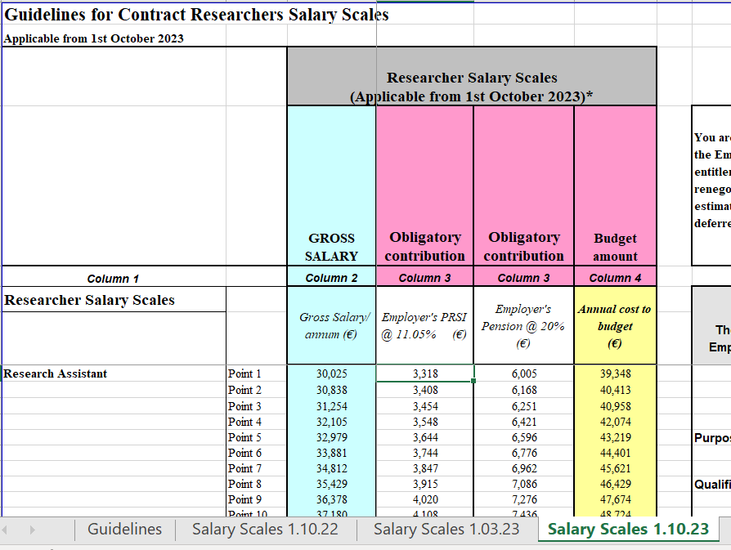
2. PAY Costs Multi Year Forecasts
As staff member will commence post 01-JAN-2024 then the relevant scales from the UCC / IUA website should be used
The IUA website features current and future agreed pay scales

Slide 17
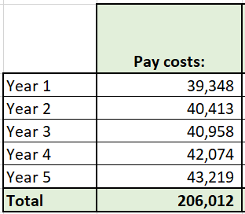
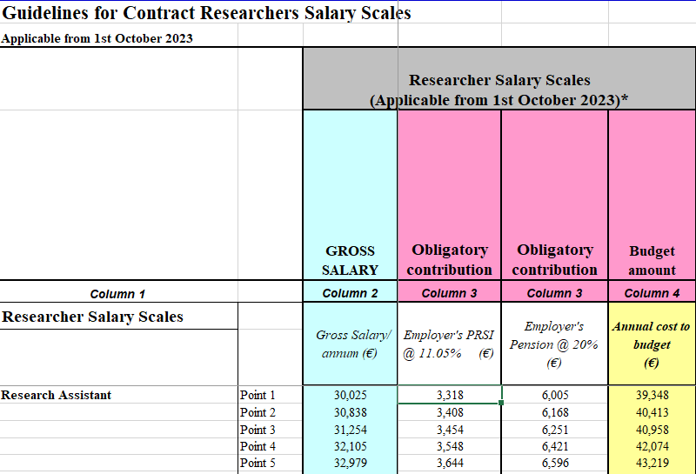
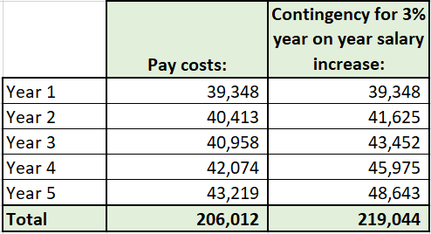
2. PAY Costs Multi Year Forecasts
In the interest of prudence pay cost forecasts, where eligible, should include a 3% year on year inflationary pay increase.
The staff member will move up one point on the salary scale on each anniversary of the employment commencement date!

Slide 18
2. PAY Costs Useful Links
UCC Salary Scales (Research & Non Research):
https://www.ucc.ie/en/hr/salaryscales/
IUA -University Research Salary Scales/Guidelines (Reflecting known future increases):
https://www.iua.ie/for-researchers/researcher-salary-scales-career-framework/
DCU Pay Cost Forecasting tool:
https://salarycalculator.adaptcentre.ie/

Slide 19
Agenda
Contents:
1. Compliance! Compliance! Compliance!
2. Pay Costs
3. Equipment Costs
4. Other Costs
5. Direct Costs versus Indirect Costs
6. VAT
7. Q & A

Slide 20
3. Equipment Costs Depreciation versus Invoicing / Cash Flow
UCC purchase a piece of laboratory equipment for €20,000 on 01-JAN-2023? How much will be recorded as expenditure in UCC’s financial statements for the period to 30-DEC-2023?
€20,000
€4,000

Slide 21
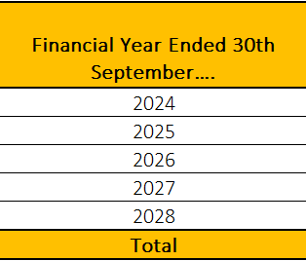
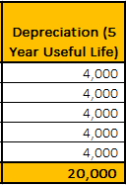
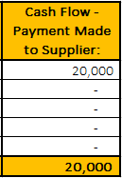
3. Equipment Costs Depreciation versus Invoicing / Cash Flow
Annual Depreciation: Cost of Asset (€20,000) divided by Useful Life of Assets (5 years)
Cash Flow Impact: The supplier of the assets is paid (€20,0000) in full in the year of acquisition of the asset
NOTE: Depreciation method applies to some funding agencies, e.g. EU, EPA & SEAI. Other funding agencies may have Depreciation / Equipment cost claim rules, e.g. Allow to claim full purchase price of equipment, so budgets & claims would have to be calculated accordingly.

Slide 22
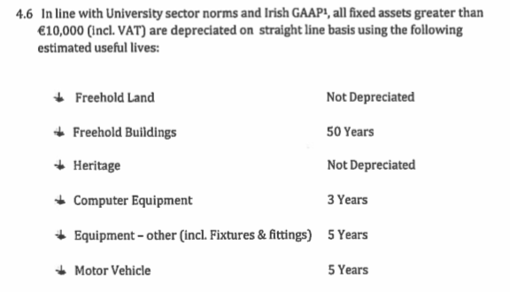
3. Equipment Costs
Extract from “UCC Fixed Asset Policy & Procedures”:

Slide 23
3. Equipment Costs EU Horizon Europe Example - Budget
UCC are participating in an EU Horizon Europe funded project
The project requires purchase of non-IT equipment costing €20,000
The project will commence on 01-JAN-2023 and will be of a 5 year duration
The budget assumes that the equipment required for the project will be acquired on the first day of the project
The equipment was actually delivered to UCC with an accompanying invoice on 01-OCT-2023

Slide 24
3. Equipment Costs EU Horizon Europe Example - Budget
€3,000 has be funded from alternative source, e.g. project overheads / departmental budget

Slide 25
3. Equipment Costs When to acquire an asset?
Key Message:
To maximise funds when claims are based on Depreciation, be sure to purchase equipment as early as possible in the project life.

Slide 26
3. Equipment Costs Useful Links
UCC Fixed Asset Policy & Procedures:
https://www.ucc.ie/en/media/support/financeoffice/otherdocuments/FixedAssetPolicyProcedures2021.doc

Slide 27
Agenda
Contents:
1. Compliance! Compliance! Compliance!
2. Pay Costs
3. Equipment Costs
4. Other Costs
5. Direct Costs versus Indirect Costs
6. VAT
7. Q & A

Slide 28
4. Other Costs
Ensure that costs of all direct resources required are included in the budget, including but not limited to:
Subcontracting
Travel & Expenses
Forecast values in compliance with the UCC policy, https://uccireland.sharepoint.com/sites/accounts-payable-ucc/SitePages/Travel-%26-Expenses-Policy.aspx
Consumables, including IT equipment <€10,000
Dissemination, Publication & Open Access Costs
Audit Fees
E.g. In Horizon Europe a certificate on the financial statements is required when the EU contribution to a project >= €430,000

Slide 29
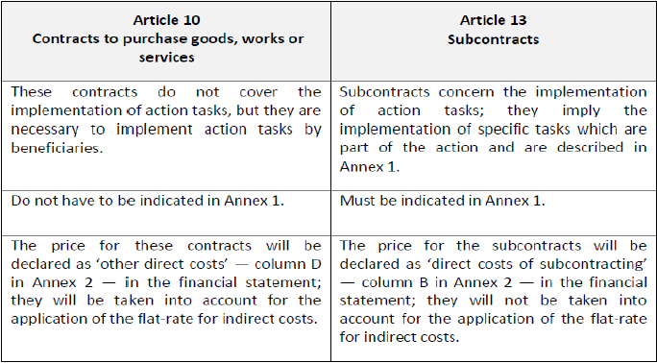
4. Other Costs Subcontracts vs. Contracts to purchase goods, works & services

Slide 30
Subcontracts
Subcontracting – EU Guidance:
A project action task that will be completed by a third party who:
Works independently. The contract is based on business conditions, subcontractors are not directly supervised by the beneficiary, no access to IPR.
Must be mentioned, estimated and justified in the application. If not, cost can be rejected.
Subcontractors must be bound by certain requirements of the EC (e.g. subcontractors may also be audited!)
Must be appointed in compliance with UCC Procurement policies and procedures.
Addition of subcontractors after a grant agreement has been signed requires a grant amendment.

Slide 31
Agenda
Contents:
1. Compliance! Compliance! Compliance!
2. Pay Costs
3. Equipment Costs
4. Other Costs
5. Direct Costs versus Indirect Costs
6. VAT
7. Q & A

Slide 32
5. Direct Costs versus Indirect Costs What are they?
"Indirect costs" are costs which are necessary for implementing the project, but are not "directly" linked to it (because their share in the project cannot be exactly established).
Examples thereof are:
Office of the Vice President for Research
Computing
Energy
Cleaning
Insurance
Space
Minor works
Post
Grounds
Human Resources
Finance
Library
Security
Secretarial
In Research Projects these costs can be recovered, where applicable/ allowable, via an “Overheads” charge

Slide 33
5. Budgeting for Indirect Costs Questions for Consideration
Key question:
How much “Overheads” (Indirect Costs) should I include in my budget / can I charge to a funding agency?

Slide 34
5. Direct Costs versus Indirect Costs Questions for Consideration
How much “Overheads” (Indirect Costs) should I include in my budget / can I charge to a funding agency?
This will be determined by:
The rules determining what % can be earned and what are eligible costs to which this % can be applied, where applicable, as set out by the relevant funding authority, e.g. Horizon Europe = Normally 25% of “eligible” costs.
UCC Research Overheads Rates Policy (https://www.ucc.ie/en/media/research/researchatucc/documents/OverheadRatesPolicy.FINAL(1).pdf)
Parameters for determining overhead rate (30% to 100%):
Foreground IP Ownership
Partner – Enterprise type / size
Partner Licensing Terms
Desk Based versus Lab Based Research

Slide 35
Agenda
Contents:
1. Compliance! Compliance! Compliance!
2. Pay Costs
3. Equipment Costs
4. Other Costs
5. Direct Costs versus Indirect Costs
6. VAT
7. Q & A

Slide 36
6. VAT (Value Added Tax) When are Research services Vatable?
Activities not regarded as exempt educational activities

Slide 37
6. VAT (Value Added Tax)
How does VAT impact on the finances of my research project?
VAT is mainly a concern in Industry funded research activities
VAT must be charged on research income.
Expenses incurred in the project will be net of VAT
VAT is mainly a concern in Industry funded research activities

Slide 38
6. VAT (Value Added Tax)
Revenue Guidelines on VAT for University Research Activities:
https://www.revenue.ie/en/tax-professionals/tdm/value-added-tax/part03-taxable-transactions-goods-ica-services/Services/services-third-level-educational-bodies-research.pdf

Slide 39
Agenda
Contents:
1. Compliance! Compliance! Compliance!
2. Pay Costs
3. Equipment Costs
4. Other Costs
5. Direct Costs versus Indirect Costs
6. VAT
7. Q & A

Slide 40
BACK UP SLIDES

Slide 41
FINANCE – Office of Research Grants and Contracts
Research Support……”Who, What, Where, When?”
Kevin Goggin, Research Support Officer

Slide 42
Who and where?
Main Finance Office, North Wing
Name | Role / Funding Body
Caitriona Doyle | Research Accountant (Interim)
Hugh Keane | Deputy Research Accountant (Interim)
Joanne O’Sullivan | Assistant Deputy Research Accountant – Financial Support & Grant Administration EU H2020 / HE, Enterprise Ireland Overhead
Kevin Goggin | Research Support Officer – EU & HE Budget applications
Margaret O’Connell | Research Support Officer – EU & HE Budget claims
Caitriona O’Leary | Financial Support & Grant Administration – Marine Institute, SEAI, CFF
Lillian Guerin | Financial Support & Grant Administration – IRC / HRB
Erica Constant | Financial Support & Grant Administration – EPA, Wellcome Trust, Cancer Research

Slide 43
Who and where?
Main Finance Office, North Wing
Name | Role / Funding Body
Maria Buckley | Research Bank Accounts, Journal transfers
Catherine Donovan | Financial Support & Grant Administration – Enterprise Ireland, Teagasc, HEA
Maeve Nagle | Grant Administration
Alice O’Leary | Research Employment Contracts
Mary Aherne | Research Income, Invoicing & Debtors, VAT
Rachel Murphy Coughlan | Research expenses and hourly payroll
Ger Aherne | Grant administration

Slide 44
Who and where?
Kane Building Annex - SFI
Name | Role / Funding Body
Tim O’Mahony | SFI Accountant (Interim)
Roisin Campbell | SFI Centres Support Officer
Conor Dowd | Financial Support & Grant Administration – SFI
Rozy Gay | Financial Support & Grant Administration – SFI
https://uccireland.sharepoint.com/sites/finance-office-intranet/SitePages/Finance-Office-Contact-List.aspx?csf=1&web=1&e=cRe8sR&cid=76a83bac-c389-4b6b-9b27-aaa7b66320b4
Most up to date information is available on UCC Finance sharepoint site

Slide 45
What?
Completion
Management of closing balances and research account closure
Application
Budget preparation and review
Award
Contract review, account administration & treasury
Administration & Compliance
Claims management & Budgetary / financial compliance.

Slide 46
What? : Application
Assist with budget preparation
Review of proposed budgets prior to submission, reviewing for:
Compliance
Completeness
Accuracy
Taxation status
Application

Slide 47
What? : Award
Financial review of legal agreement, e.g. Consortium Agreements, Sub-contract agreements
Opening of research accounts (R-codes)
Determine Overhead Distribution allocation %
Set up project treasury processes
Award

Slide 48
What? : Administration & Compliance
Prepare research financial claims / invoices
Allocate earned overheads
Review / approve research expense claims
Review / approve funding for research employment contracts
Audit management / Liaison with external auditors
Control research debtors and allocation of research income
Management Reporting /Address internal & external ad hoc queries and requests
Administration & Compliance

Slide 49
What? : Completion
Prepare final research financial claims / invoices
Accounting for any surplus / deficits on completed projects
Closure of research accounts
Completion

Slide 50
When?
Proposal / Application stage, with RSS co-ordination:
To request budget templates
To seek guidance on budget preparation
For review of budgets prior to submission….but no later than 5 days prior to the application deadline
Claim / Invoice stage
Requesting of budget reallocations
Preparing research finance related information requests

Slide 51
Who and where?
Main Finance Office, North Wing
Name | Role / Funding Body
Mary Cusack | Research Accountant
Caitriona Doyle | Deputy Research Accountant
Joanne O’Sullivan (On leave) | Financial reports & grant administration - EU; Enterprise Ireland annual overhead queries; General research queries. (Currently on Leave - contact Erica Constant)
Kevin Goggin | Budget & Application Review, Horizon Europe & Others
Margaret O’Connell | Horizon Europe and Horizon Europe Reporting - Financial Reporting Support for Horizon 2020 and Horizon Europe projects; Financial reports & grant administration - EU
Caitriona O’Leary | Financial reports & grant administration - EU, Marine Institute; General research queries
Lillian Guerin | Health Research Board, Irish Research Council

Slide 52
Who and where?
Main Finance Office, North Wing
Name | Role / Funding Body
Erica Constant | Financial reports & grant administration - EPA, EU, Interreg, Wellcome Trust, Cancer Research Ireland; General research queries
Maria Buckley | Allocating research income; Research bank account; Debtors; Journal processing; General research queries
Catherine Donovan | Financial reports & grant administration - HEA, EI and Teagasc; Other general research queries
Maeve Nagle | Grant administration; Opening non-SFI research accounts (Currently on Leave)
Alice O’Leary | Research employment contracts, amendments, renewals etc. Post Proposal forms; Once-off Payment Authorisation forms; Ad hoc payroll requests
Mary Aherne | Allocating research income; Research bank account; Debtors; Research VAT queries; VIES Revenue return

Slide 53
Who and where?
Main Finance Office, North Wing
Name | Role / Funding Body
Rachel Murphy Coughlan | Research expense claim & travel advances; Once-off Payment Authorisation forms; Ad hoc research payroll requests
Geraldine Ahern | Grant administration; General research queries

Slide 54
Who and where?
Kane Building Annex - SFI
Name | Role / Funding Body
Hugh Keane | SFI Accountant
Tim O’Mahony | SFI Reporting
Roisin Campbell | SFI Centres
Conor Dowd | SFI Reporting
Rozy Gay | SFI Reporting

Slide 55
What?
Completion
Management of closing balances and research account closure
Application
Budget preparation and review
Award
Contract review, account administration & treasury
Administration & Compliance
Claims management & Budgetary / financial compliance.

Slide 56
What? : Application
Assist with budget preparation
Review of proposed budgets prior to submission, reviewing for:
Compliance
Completeness
Accuracy
Taxation status
Application

Slide 57
What? : Award
Financial review of legal agreement, e.g. Consortium Agreements, Sub-contract agreements
Opening of research accounts (R-codes)
Determine Overhead Distribution allocation %
Set up project treasury processes
Award

Slide 58
What? : Administration & Compliance
Prepare research financial claims / invoices
Allocate earned overheads
Review / approve research expense claims
Review / approve funding for research employment contracts
Audit management / Liaison with external auditors
Control research debtors and allocation of research income
Management Reporting /Address internal & external ad hoc queries and requests
Administration & Compliance

Slide 59
What? : Completion
Prepare final research financial claims / invoices
Accounting for any surplus / deficits on completed projects
Closure of research accounts
Completion

Slide 60
When?
Proposal / Application stage, with RSS co-ordination:
To request budget templates
To seek guidance on budget preparation
For review of budgets prior to submission….but no later than 5 days prior to the application deadline
Claim / Invoice stage
Requesting of budget reallocations
Preparing research finance related information requests

Slide 61
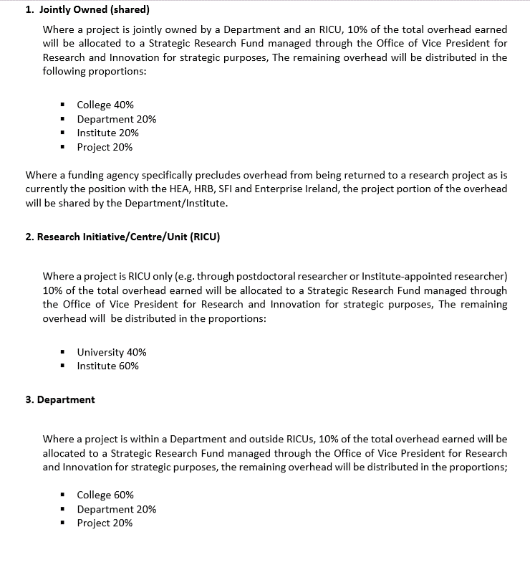
5. Direct Costs versus Indirect Costs Questions for Consideration
Where will the “Overheads” income be recognised?
This will be determined by:
UCC Contract Research Overhead Distribution Policy:
https://www.ucc.ie/en/media/support/financeoffice/orgc/Contract_Research_Overhead_Distribution_Policy_Oct2014.pdf

