Slide 1
Inner Critic & Imposter Syndrome
Mary Horgan
Friday 10th November 2023
Notes:
What is imposter syndrome and how can you combat it? - Elizabeth Cox (4 mins.)

Slide 2
Lets get the most out of this morning
Email: Switch it off & be present
Microphone: When not speaking, please keep it on mute
Camera: If possible, do have your camera on
Participate: Just use the ‘raise hand’ function if you have a question or wish to comment & click to take it down afterwards. The more interactive, the better!
Confidentiality: Everything we discuss is confidential

Slide 3
Workshop Objectives
What is Imposter Syndrome?
Some symptoms
Role of Self-Belief
Growth V. Fixed Mind-set
Triggers
Strategies to deal with it

Slide 4
Can you answer YES to below?
Have you lied or fabricated your
  previous exam results or qualifications?
  experience?
  abilities?
An Imposter = Person who pretends to be somebody else in order to trick people
Oxford English Dictionary

Slide 5
Any sound familiar?
You won’t let go the email/paper/dissertation, you need to keep fixing, redrafting, re-reading it….
You are dreading a forthcoming presentation. What if you cannot answer a question or just go blank?
You see a job advertised you would love but do not apply. ‘Wouldn’t get it, too many others far better’.
You have just been promoted. You are now terrified. What if you are “found out” as being incompetent?
5. Others….?

Slide 6
What is Imposter Syndrome?
“That feeling of being a fraud despite evidence that you are not.” Hugh Kearns
Up to 70% of people have suffered from the imposter feelings at some point. Forbes, 2014
** Between 30-50% of people = consistent imposter syndrome that affect what they think, feel & do. **
Usually associated with high performers.
Affects each of us differently

Slide 7
Some common symptoms
Regular/constant feelings of self-doubt
Fear of failure (consciously or unconsciously)
Continual over-preparation for tasks
Discount praise
Feeling like a fraud
Feeling like you need to be the very best

Slide 8
Critical Role of Self-Beliefs
Our beliefs control our bodies, our minds, and thus our lives...
(Bruce Lipton, Biology of Belief)
Opponent in our head is much stronger than the opponent opposite.
“How are my attitudes and beliefs serving me? Positively or negatively?“

Slide 9
Critical Role of Self-Beliefs (2)
“Greatest revolution of our generation = the discovery that human beings, by changing the inner attitudes of their minds, can change the outer aspects of their lives.”
William James (Philosopher)
** It takes practice but you can teach yourself to think more accurately. **
Challenge your assumptions, your black and white thinking, your mental filters and your tendencies to jump to conclusions.

Slide 10
Growth v Fixed Mind-set

Slide 11
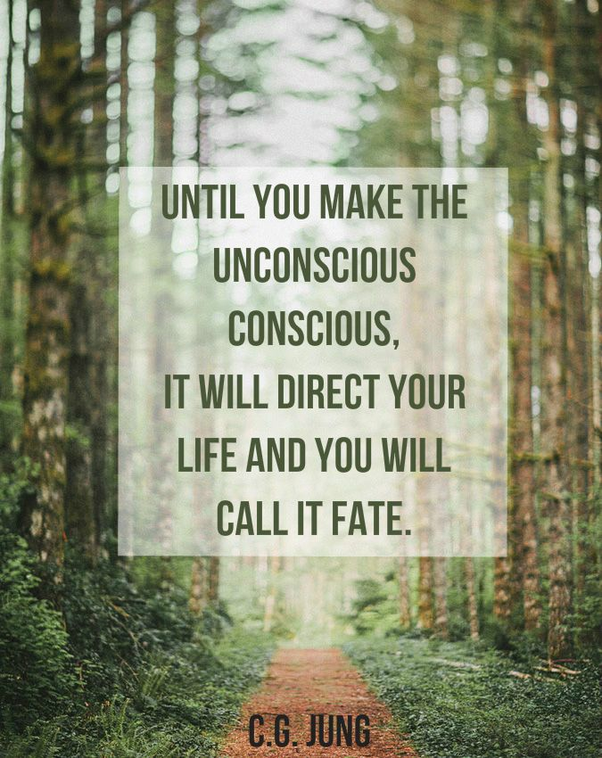
Self-Awareness
Be aware of it. Recognise when your inner critic kicks in and choose to shut it down. Focus on facts, rather than fears. Look back at positives, list your strengths, accept compliments
Personality preferences influence our behaviour.
They don’t dictate them.

Slide 12
Use of Language

Slide 13
How is your language creating your world?
It is hard to get up in the morning.
I just can’t stop smoking.
I made four mistakes in that MCQ.
I should have mentioned ‘x & y’ in the interview.
I would never have managed to do that on my own.
How are you speaking to yourself?

Slide 14
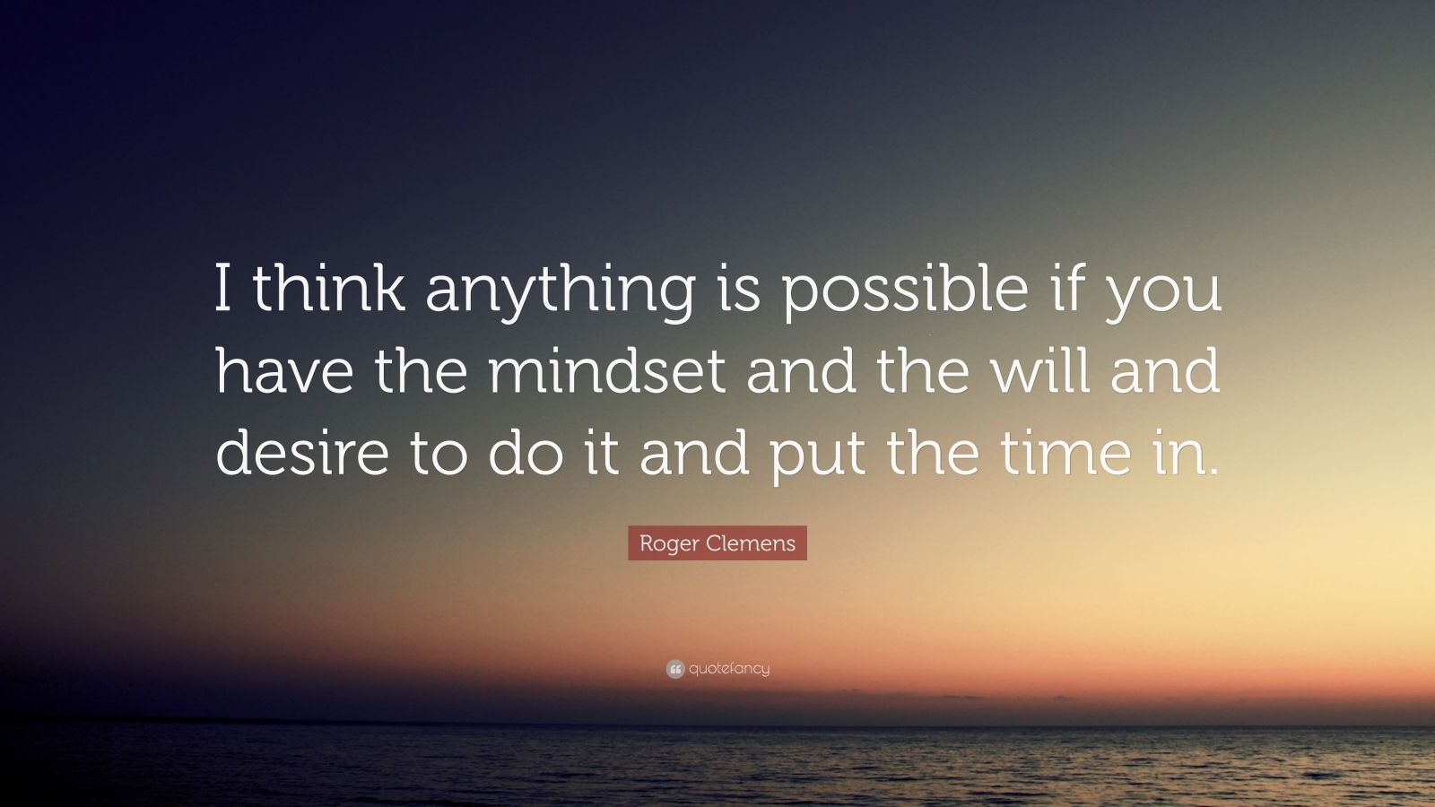
The ‘As if’ Frame
Act “as if” you were.....What would it be like?”
Act as though something were already true - the positive outcome has already been achieved and the senses experience it.
What would you be thinking, doing and believing differently?
“We see the world not as it is, but as we are." William Shakespeare

Slide 15
Identify your triggers
Do I self-sabotage?
Perfectionism (high achievers)
Giving your best is not the same as ‘being the best’
Perfectionism is the enemy of the good or just ‘good enough’
Procrastination
Overcommit

Slide 16
Some Strategies (1)
Identify your triggers
Be objective / set realistic goals & standards
Be prepared to make mistakes
Watch your language - Is it positive or negative, fact or fiction?
Keep a written note of positive feedback, achievements.
Be brave – what is the worst that can happen? F.A.I.L
Focus on your BREATH – calms nervous system

Slide 17
Some Strategies (2)
Recalibrate who you compare yourself to
Look for support from people outside your circle
If you’re performing, remind yourself of it
Adjust your definition of competence
Focus on your strengths
Accept your accomplishments
** Ask yourself – might COACHING help? **

Slide 18
To conclude….
Acknowledge your feelings as a first step
Break your thinking pattern & reframe your beliefs about your accomplishments & how others see them
Watch your language
Remind yourself of your achievements
Focus on your strengths

Slide 19
Resources
The Time Ferriss Show (14 July ‘21) -
Anne Lamott on Taming your Inner Critic
All in the Mind BBC 4 (7 January ’20) – Imposter Syndrome (10:22 – 17:48 mins.)
All in the Mind ABC (February 2022) – Controlling the chatter in your head
Mike Cannon-Brookes Ted Talk (21 Dec. ‘19) - How you can use Imposter Syndrome to your benefit
Melody Wilding, HBR (May 2021) Stop being so hard on yourself
Sherrie Haynie, Forbes (November 2020), Why knowing your personality type is critical to a growth-mindset
Margie Warrell, ‘Afraid of Being 'Found Out?' How to Overcome Impostor Syndrome’ at: forbes.com (3 April 2014).

Slide 20
A key takeaway for you?

Slide 21
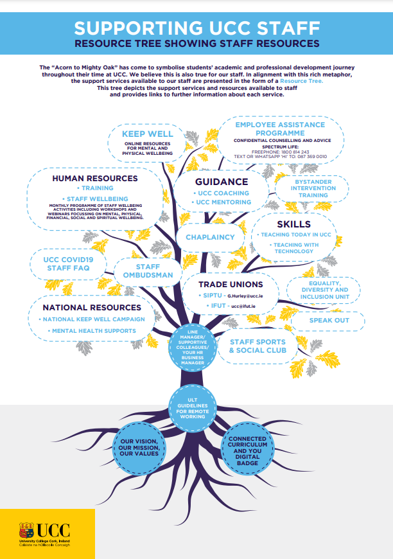

Slide 22
Meet the Team
Anne Gannon
Staff Wellbeing & Development Manager
Grace Conway
Staff Development Co-Ordinator
Susan O’Mahony
Staff Wellbeing & Development Advisor
Anna McKenna
Senior Executive Assistant
Mary Horgan
Staff Development Advisor

Slide 23

Connect With Us
View our Staff Wellbeing and Development Roadshow which took place in September 2023
Staff Wellbeing & Development Roadshow
traininganddevelopment@ucc.ie
staffwellbeing@ucc.ie
@UCCWellDev

Slide 24

