Slide 1

Research Data Management
Dr. Aoife Coffey, Research Data Coordinator,
Research & Digital Services, UCC Library
aoife.coffey@ucc.ie

Slide 2
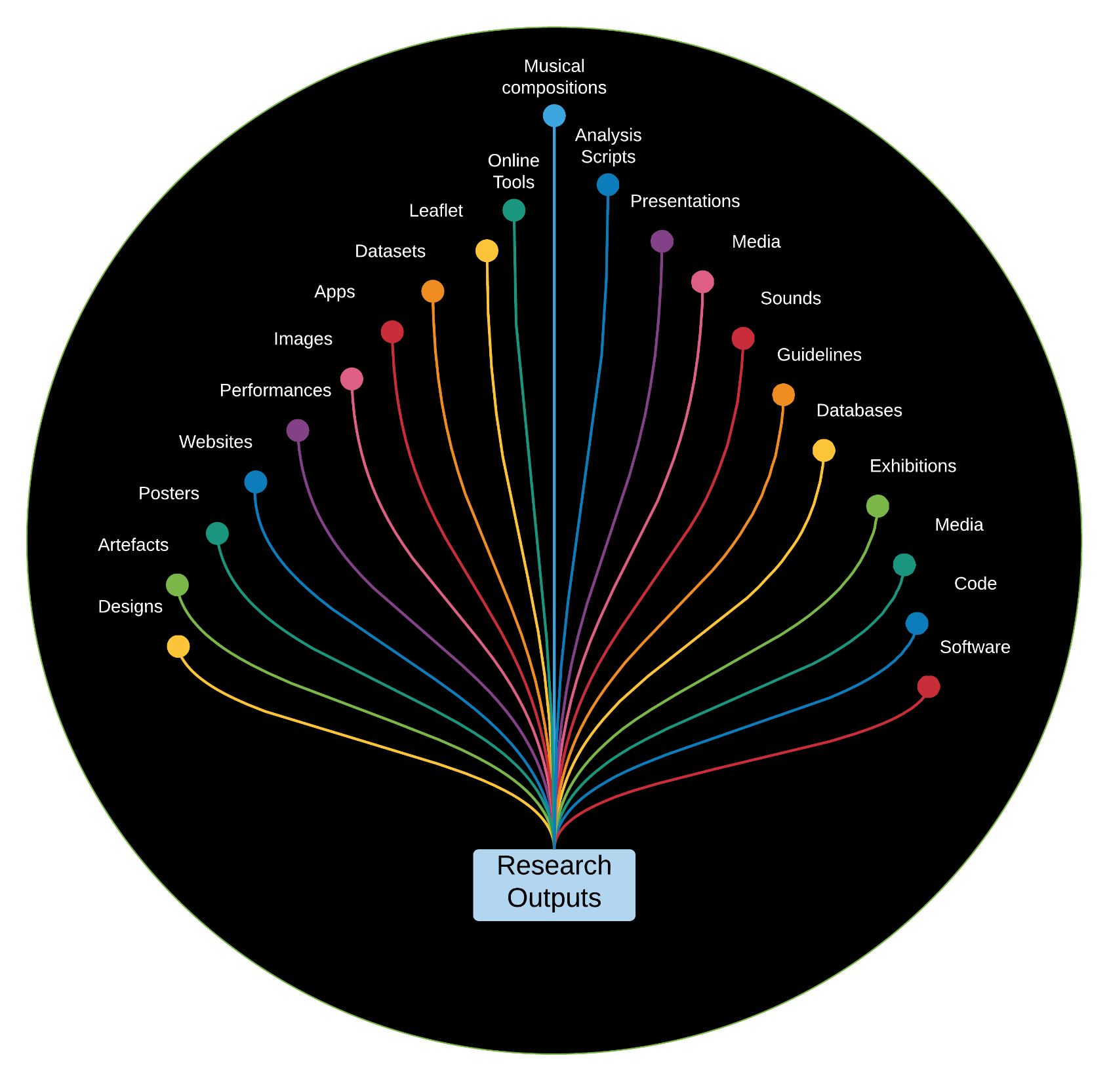
What is Research Data?
“……….information generated, collected or observed during a research project.
It is evidence used to support research conclusions and will go on to form part of the scholarly record.

Slide 3
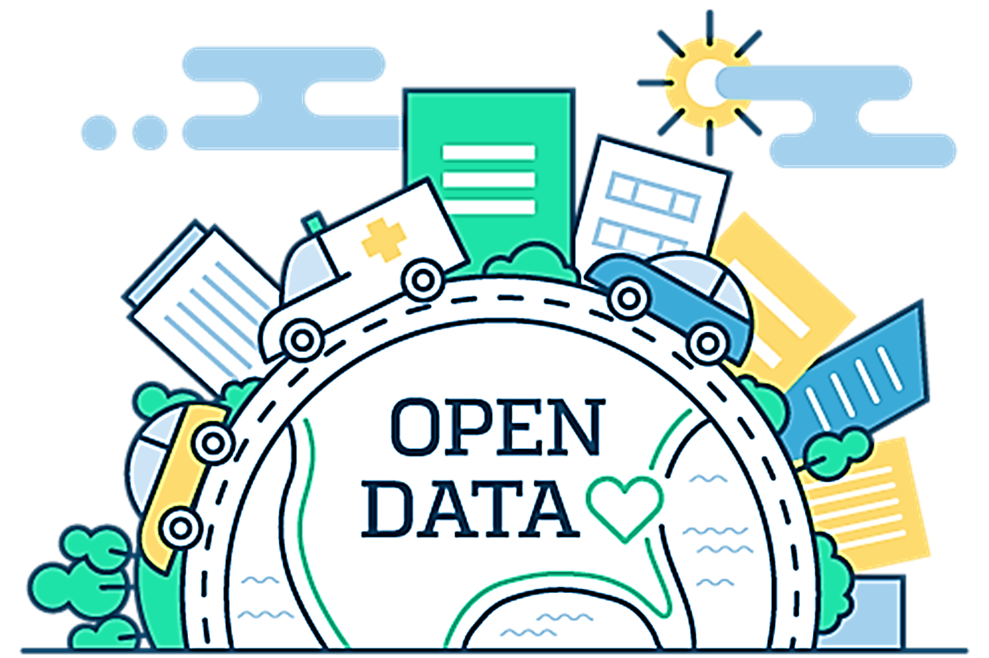
Open Research Data
Refers to the data underpinning scientific research results with no restrictions on its access
  Accountability
  Transparency
  Reproducibility
  Building on exiting data
  Revisiting existing data
  Better and stronger collaborations
  Value for public money

Slide 4




Make it FAIR
F + A + I = R
Findable
Accessible
Interoperable
Reusable
(… also
Reproducible, Replicable)
"as open as possible but as closed as necessary."
DOI:10.1038/sdata.2016.18

Slide 5
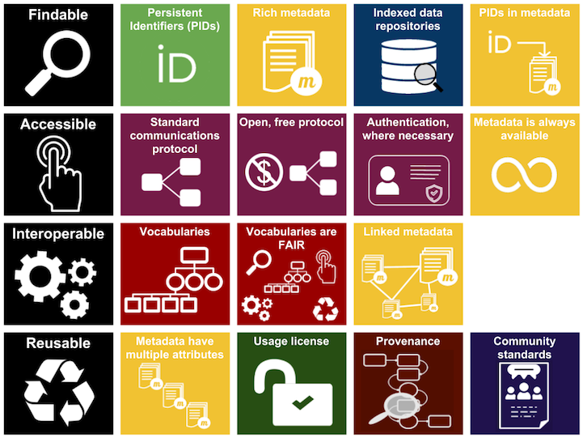
FAIR Principles
Metadata
Persistent Identifiers
Licensing
Repositories
https://libguides.ucc.ie/researchdataservice/fair
https://www.nature.com/articles/sdata201618
https://www.go-fair.org/fair-principles/
https://www.ands.org.au/working-with-data/fairdata/training

Slide 6













FAIR
DATA

Slide 7
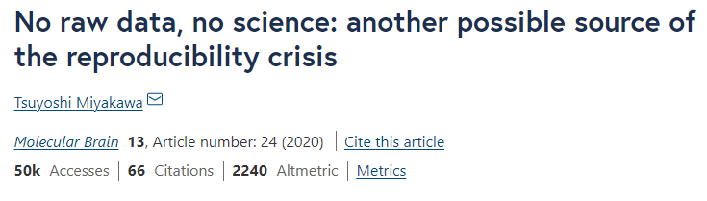
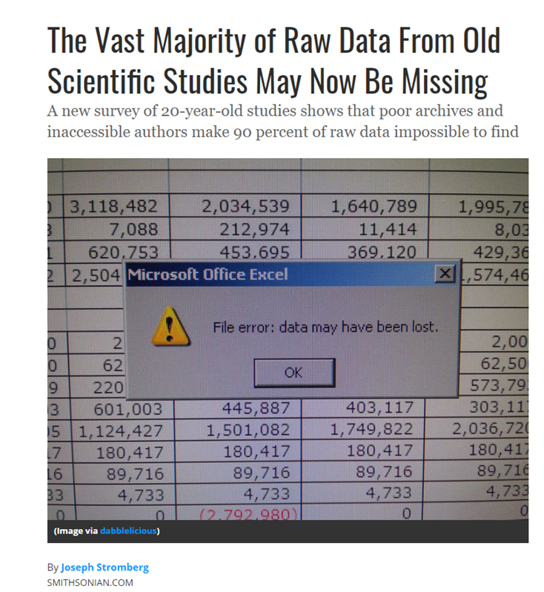
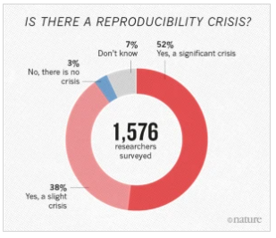
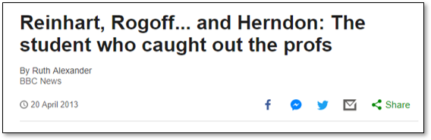
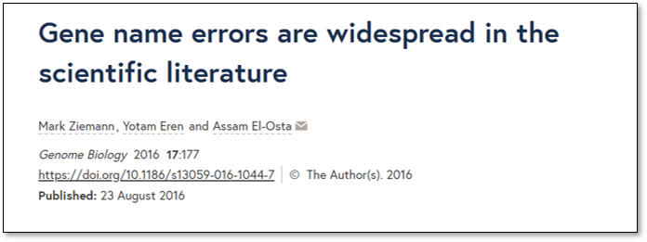
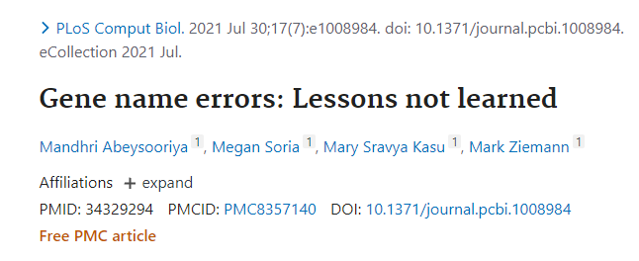
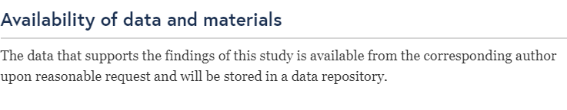
Why do we need Open Research Data and the FAIR Principles?
Baker, M. 1,500 scientists lift the lid on reproducibility. Nature 533, 452–454 (2016). https://doi.org/10.1038/533452a
Miyakawa, T. No raw data, no science: another possible source of the reproducibility crisis. Mol Brain 13, 24 (2020). https://doi.org/10.1186/s13041-020-0552-2
https://www.smithsonianmag.com/science-nature/the-vast-majority-of-raw-data-from-old-scientific-studies-may-now-be-missing-180948067/
https://genomebiology.biomedcentral.com/articles/10.1186/s13059-016-1044-7 https://doi.org/10.1371/journal.pcbi.1008984 https://en.wikipedia.org/wiki/Growth_in_a_Time_of_Debt
Notes:
I think that we need to acknowledge that we have not been the best caretakers of our own data in the past. This has unfortunately led to problems with the scholarly record. There are gaps, missing pieces, mistakes and then knock on and consequent effects of these gaps, missing bits and mistakes.
For example, Amgen, a US biotech company, attempted to replicate 53 high-impact cancer research studies and were reportedly able to replicate only six. psychologist Brian Nosek, and lots of others redid 100 studies in psychological science from three high-ranking psychology journals . 97 of the original studies had significant effects, but out those 97, only 36% of the replications yielded significant findings (p value below 0.05). Failure to reproduce is not just an issue for one discipline it is something that needs to be addressed across the research landscape. There are examples from across a wide range of disciplines from economics to ecology. And the reasons why studies fail to replicate or reproduce are complex but today we are going to look at ways to combat one of the reasons. The availability and reusability of the under lying data.

Slide 8
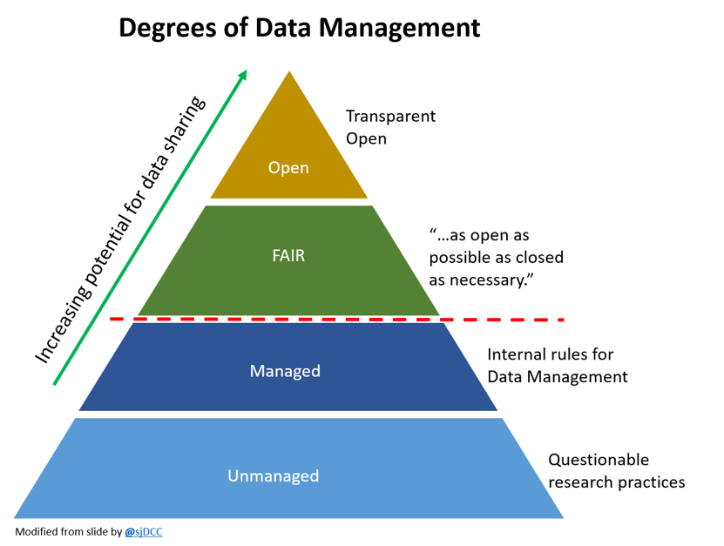

Slide 9
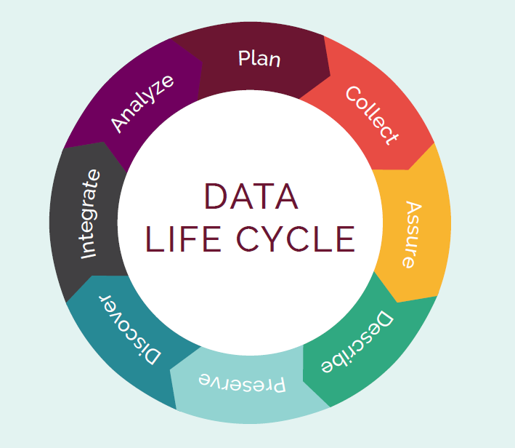
What is data management?
It is the active management of research data during they lifecycle of a project and also includes decisions about treatment of the data post-project
It involves organization, storage, preservation and potential sharing of the data
It’s an integral part of good research practice

Slide 10
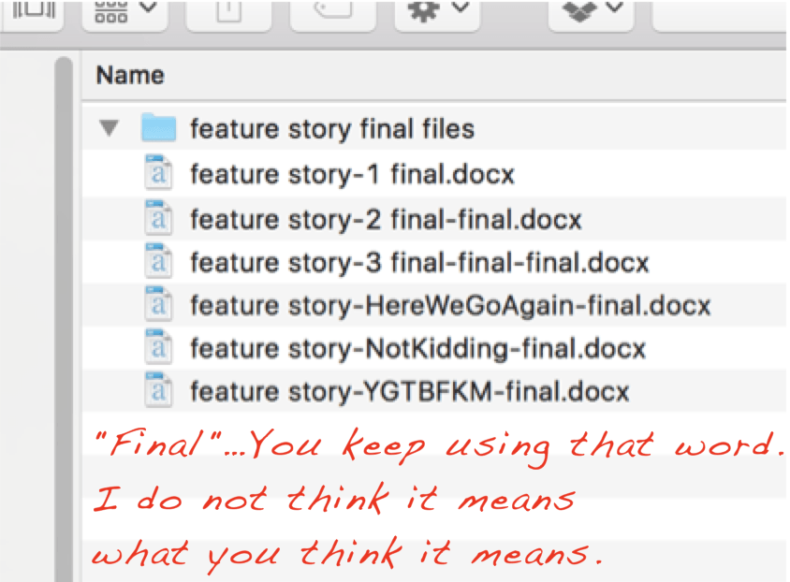
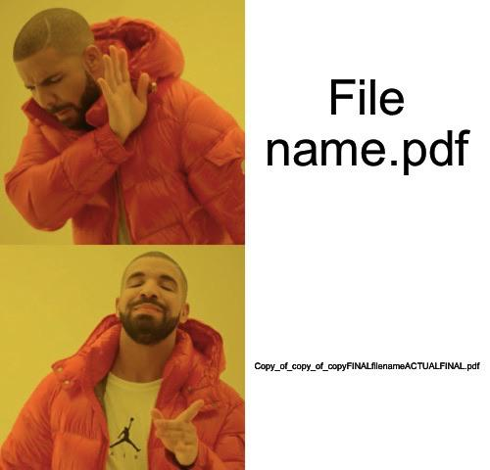
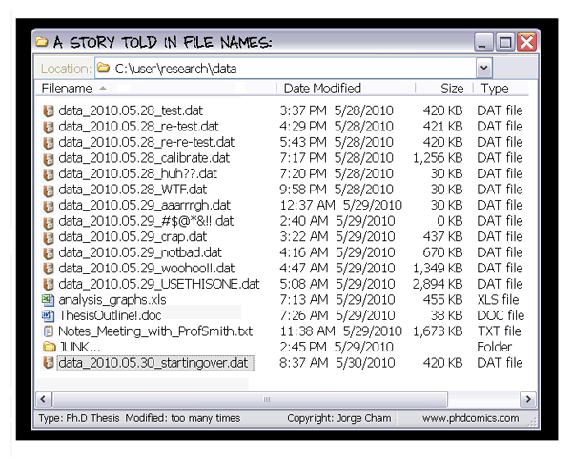
Why do you need a data management plan?
https://www.reddit.com/user/Ex_Reddit_Lurker/

Slide 11
Why do you need a data management plan?
Essential part of project management
Establishes clear workflows and guidelines surrounding data management
Sets out transparent data practices
Plan and allocate resources and cost
Plan infrastructure to support data
Day to day you can find and understand your data when you need to use it
There is continuity if project staff leave, or new researchers join
You can avoid unnecessary duplication e.g., re-collecting or re-working data
The data underlying publications are maintained, allowing for validation of results
The data can become another output from a project

Slide 12

Structure of Data Management Plans
1. Data Collection
2. Documentation, metadata and data quality
3. Ethics and Legal Compliance
4. Storage and Back-up during research
5. Data Sharing and Long-term Preservation
6. Resources and Responsibilities
https://doi.org/10.5281/zenodo.4915861
Practical Guide to the International Alignment of Research Data Management - Extended Edition - Science Europe
Notes:
SO this is what a DMP looks like, everything in green is what you should be doing already…. Only the yellow bits are directly related to FAIR.

Slide 13
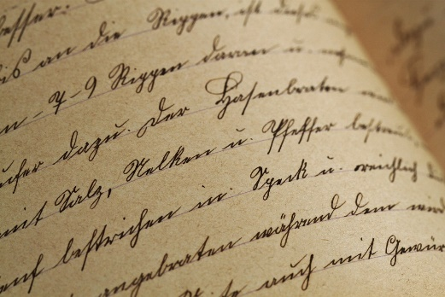
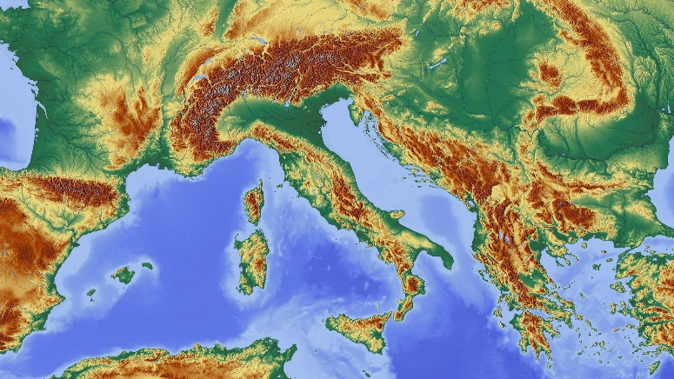




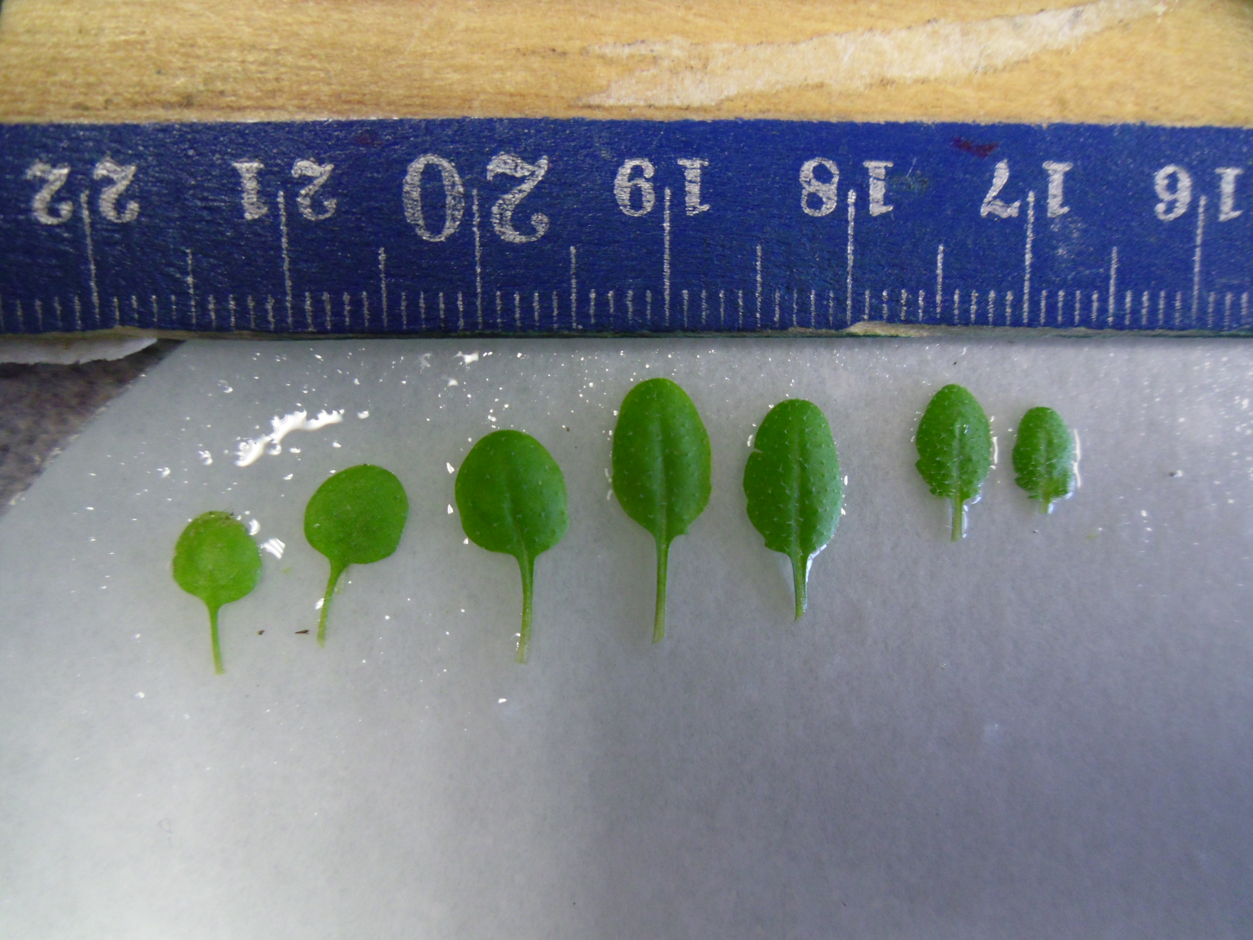



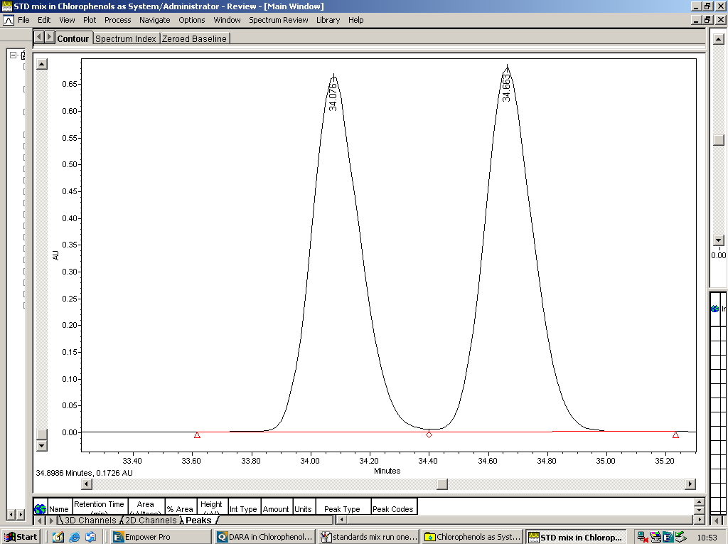
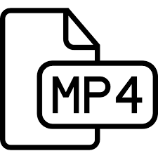

1. Data Collection
What is the type, format and volume of data?
How will data be collected or created?
Secondary
Primary
Qualitative
Quantitative
https://openi.nlm.nih.gov/detailedresult.php?img=PMC3742216_ijms-14-13763f2&req=4
https://www.cellsignal.com/contents/resources-protocols/changes-to-recommended-western-blotting-protocols/western-variation
http://chem.ch.huji.ac.il/nmr/whatisnmr/whatisnmr.html

Slide 14
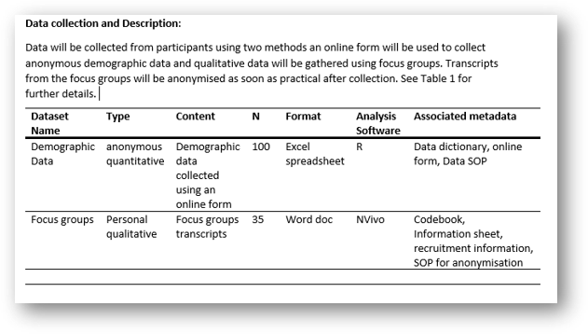
​​​ | dataset​​ | Collection method​​ | type​​​ | format​​​ | location ​and access​​ | software required​​​
1​​​ | Fieldtrial 1 (FT1)​​​ | Small scale fieldtrial. Lettuce grown using 3 UV filters​​​ | Flavonoids,​​​ Plant growth parameters​​​ | Excel,images ​​ | FT1 Master File (hyperlinkto file location)​​​ Only project member have access​​ | Excell, SPSS, ImageJ ​​​
2​​​ | ​​Field trial 2(FT2)​ | Arabodopsis Ecotype Trial. Using 3 UV filters​ | ​​Flavonoids, ​ Plant growthparameters, ​ Fluorescence ​ | ​​Excel ​ Images​ Fv/Fm​ | FT3 Master File (hyperlink to filelocation) ​ Project member and 4th year project student have access ​ | Excell, SPSS, ImageJ​

Slide 15
2. Documentation and Metadata and Data Quality
What is Metadata?
Metadata is data about data………
it describes and gives information about other data
A metadata standard
is a collection of defined data elements, characteristics or attributes which must be provided to comply with a general/ community or discipline defined set of criteria.
these requirements are intended to establish a common understanding of the meaning of the data
for every element the name and semantic meaning is defined, this is a controlled vocabulary
examples of controlled vocabularies are; dictionaries, sematic networks, ontologies, taxonomies
Types of Metadata
Discovery/Descriptive Metadata
- authors
-funders
-keywords
-abstract
Substantive/Contextual Metadata
-bibliography/citations
-standards used
-file formats
-data dictionary
-analysis scripts
-links to other metadata

Slide 16

2. Documentation and Metadata and Data Quality
Dataset level:
what is this thing, who made it, when, how...?
Internal arrangement/aggregation:
what files, folders, database tables, components make up this thing, what are they, who made them, how do I open them, how do they relate to each other, how does their naming and arrangement encode meaning?
mg, kg, cm, C⁰/F⁰, %, FV/FM, GPS, shape, colour
Variable-level:
where is the label for this variable, what does the label mean, what units were used, what are the acceptable values, how do these variables relate to each other?
Notes:
Semantic and Syntactic Interoperability …..Metadata
So what does all of that really mean, lets look at the different levels of metadata you need to provide for interoperability
So syntactic interoperability and semantic interoperability and intrinsically linked…. One covers the functional compatibility of the systems and one is about the agreed definitions, meanings behind the data so a controlled vocabulary or maybe simply a defined vocabulary.
At a dataset level you need to the overarching metadata? You need to describe the internal file structure and how each file relates to each other.
Then your need to describe the data itself down to the units and correct ranges for those units
And as I said before there are different ways of doing this

Slide 17
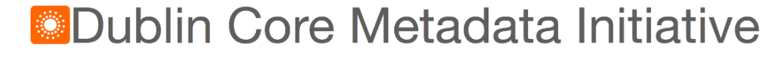
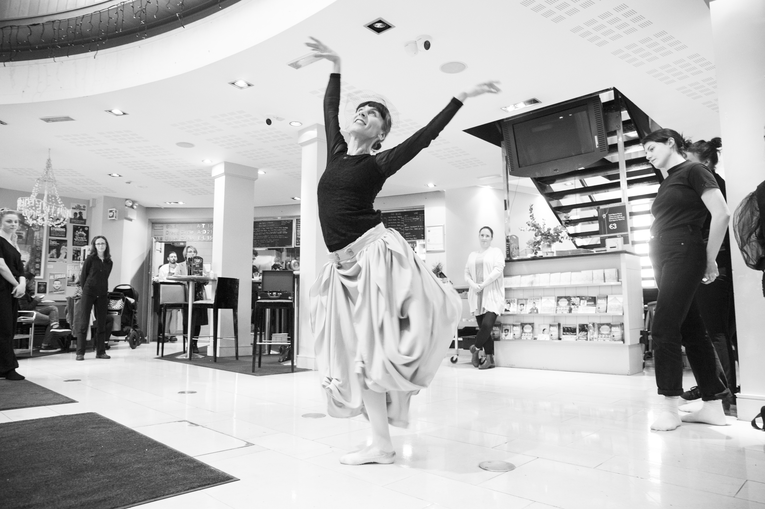
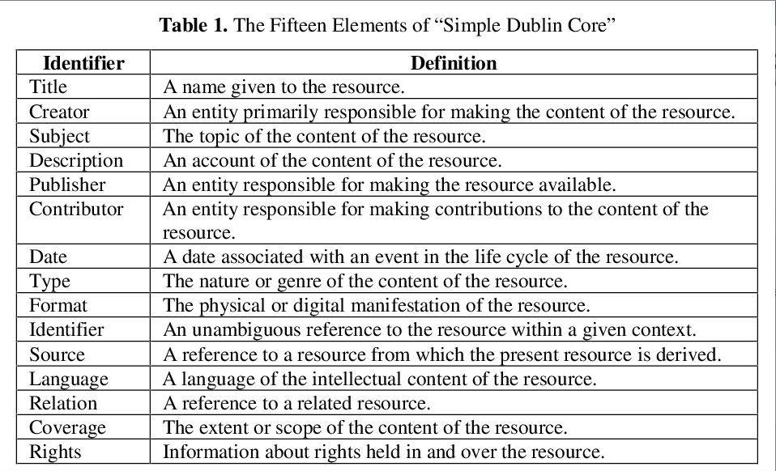
Sugimoto S., Baker T., Weibel S.L. (2002) Dublin Core: Process and Principles. In: Lim E.P. et al. (eds) Digital Libraries: People, Knowledge, and Technology. ICADL 2002. Lecture Notes in Computer Science, vol 2555. Springer, Berlin, Heidelberg. https://doi.org/10.1007/3-540-36227-4_3
Arts and Culture in Education Research Repository. (2019) UCC University College Cork UCC School of Film, Music and Theatre Arts and Culture in Education Collection, Digital Repository of Ireland [Distributor], Arts and Culture in Education Research Repository [Depositing Institution], https://doi.org/10.7486/DRI.vd678j83q-15

Slide 18
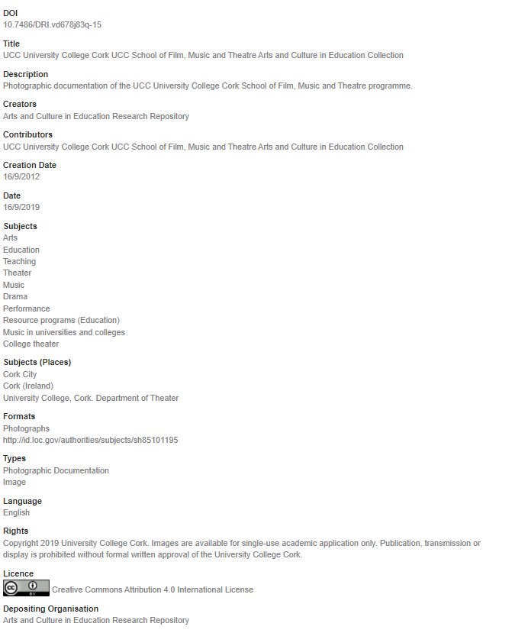

Slide 19
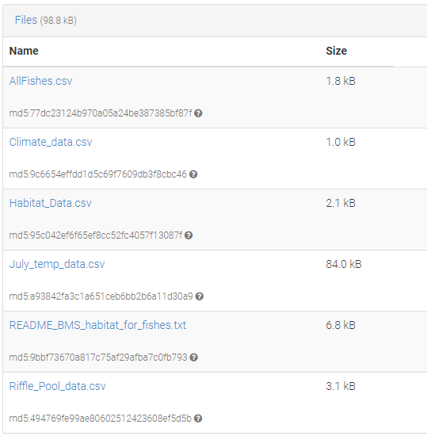
Example that doesn't use a metadata standard
Albertson, Lindsey. (2022). Influence of beaver mimicry restoration on habitat availability for fishes, including Arctic grayling (Thymallus arcticus) [Data set]. https://doi.org/10.5061/dryad.47d7wm3fq
https://zenodo.org/record/5839189#.YeANoP7P2Uk
Even without a metadata standard you can have reusable and reproducible data if you provide the right contextual information, metadata and documentation.
This can include things like;
- readme.txt files
- data dictionaries
- protocols
- analysis scripts
- codebooks
…....etc. etc.

Slide 20
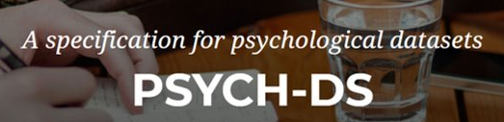
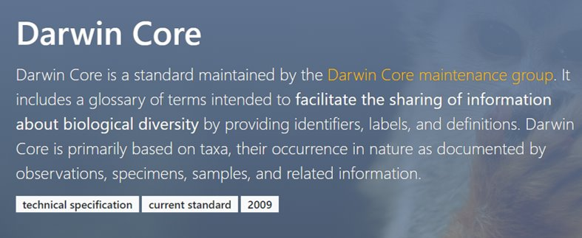

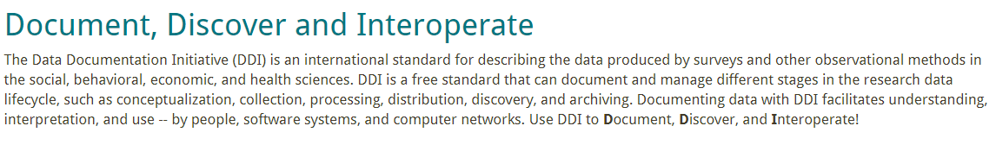


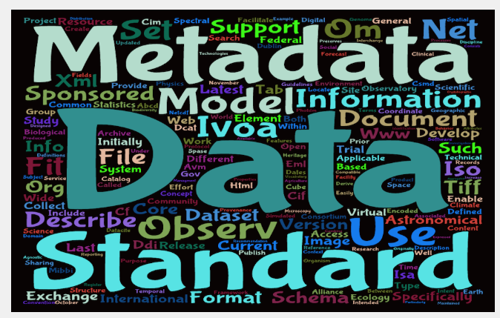

https://psych-ds.github.io/
https://rd-alliance.github.io/metadata-directory/standards/ddi-data-documentation-initiative.html
https://en.wikipedia.org/wiki/SNOMED_CT
https://rd-alliance.github.io/metadata-directory/standards/EAD.html
https://www.ebi.ac.uk/chebi/aboutChebiForward.do#
https://rd-alliance.github.io/metadata-directory/

Slide 21
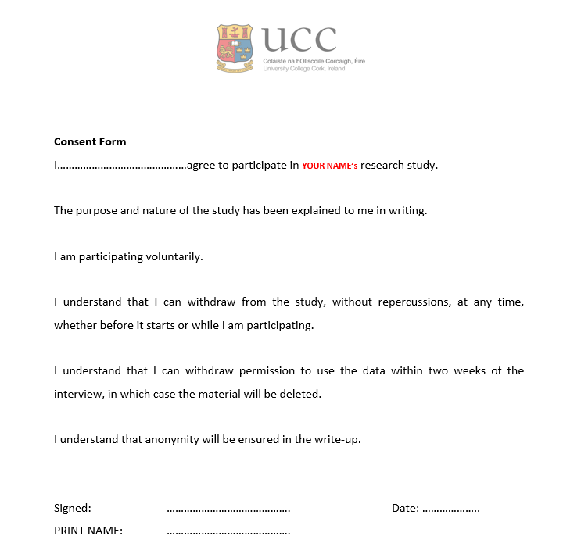
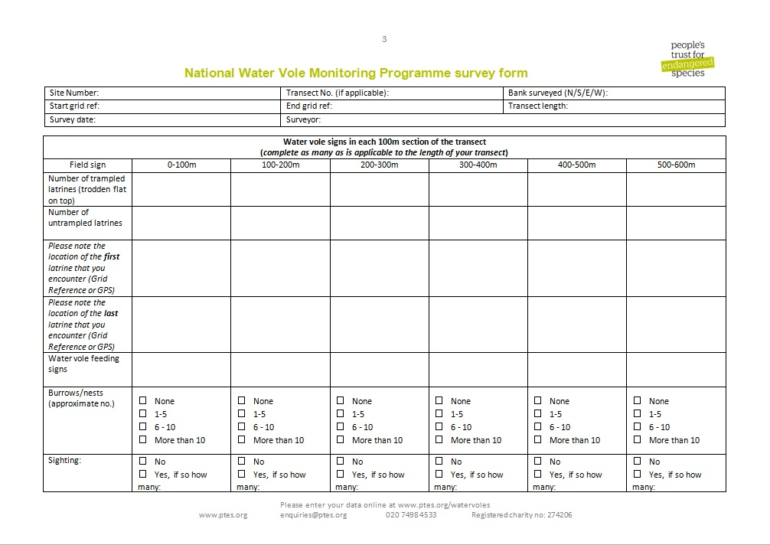
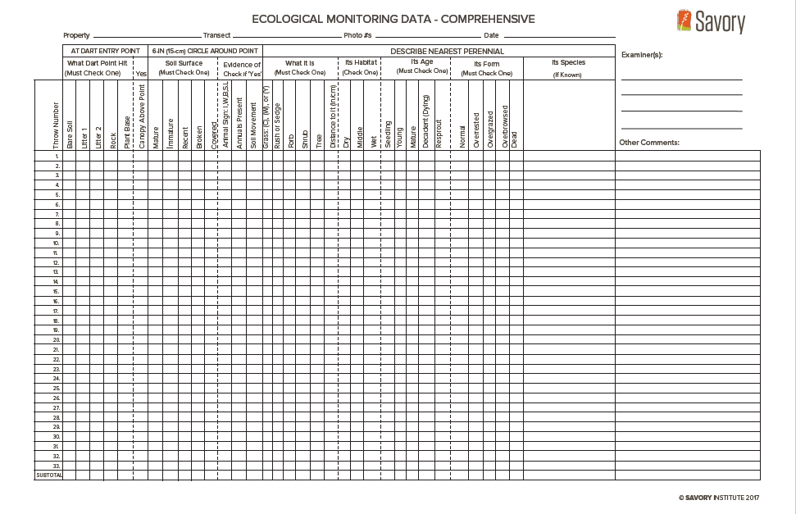

Slide 22
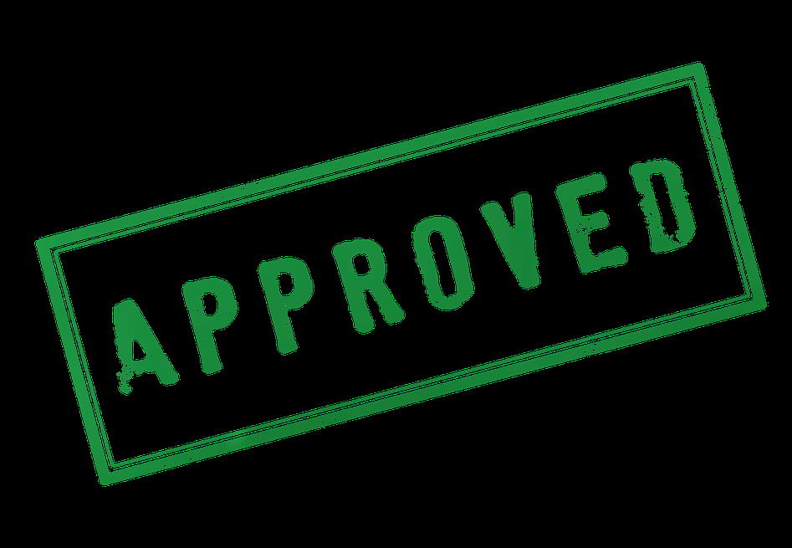
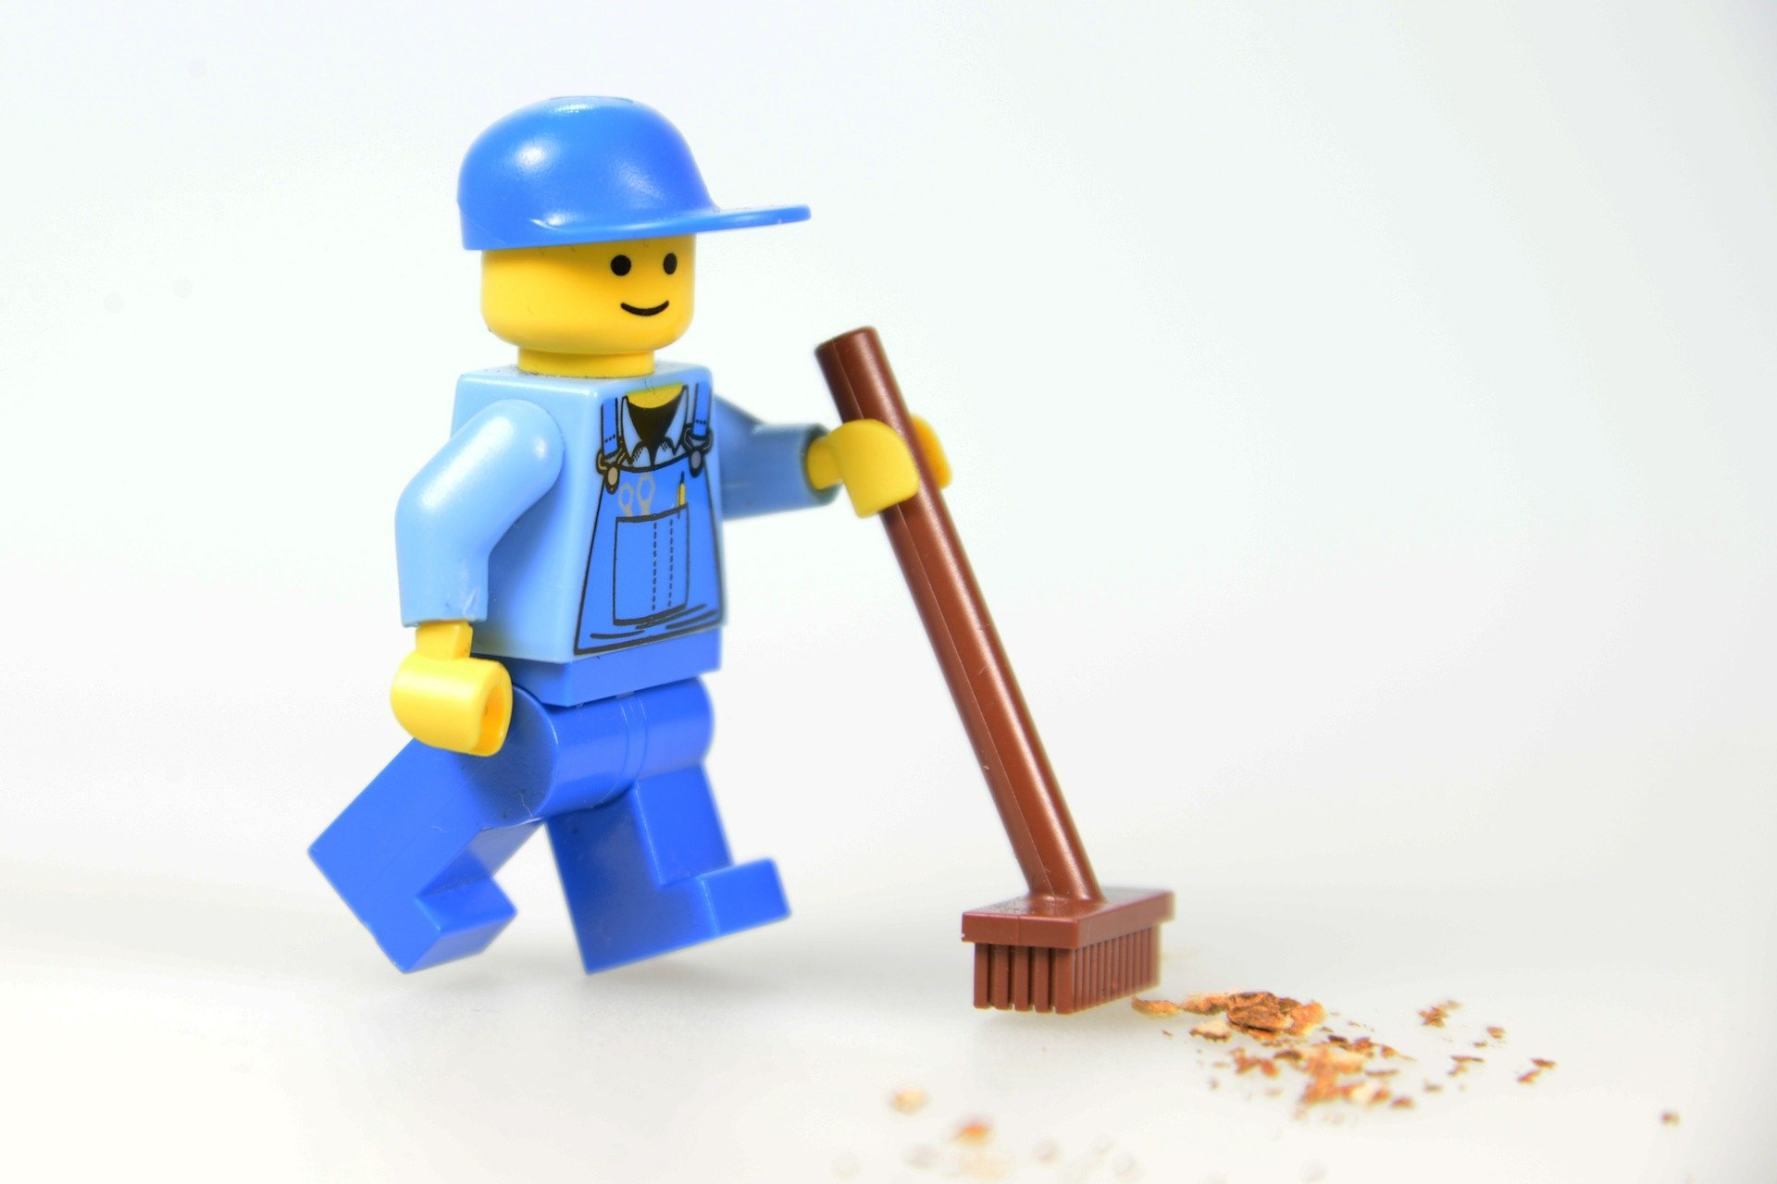
Why control data quality?
Research Integrity
You can be confident of your results and analysis
Less time spent ‘cleaning’ the data
More likely that your data will be re-used
What data quality control measures do you use?
Defined SOPs for treatment of your data
Naming conventions
Version control
Read only raw data files
Spreadsheet validation
…….etc.

Slide 23
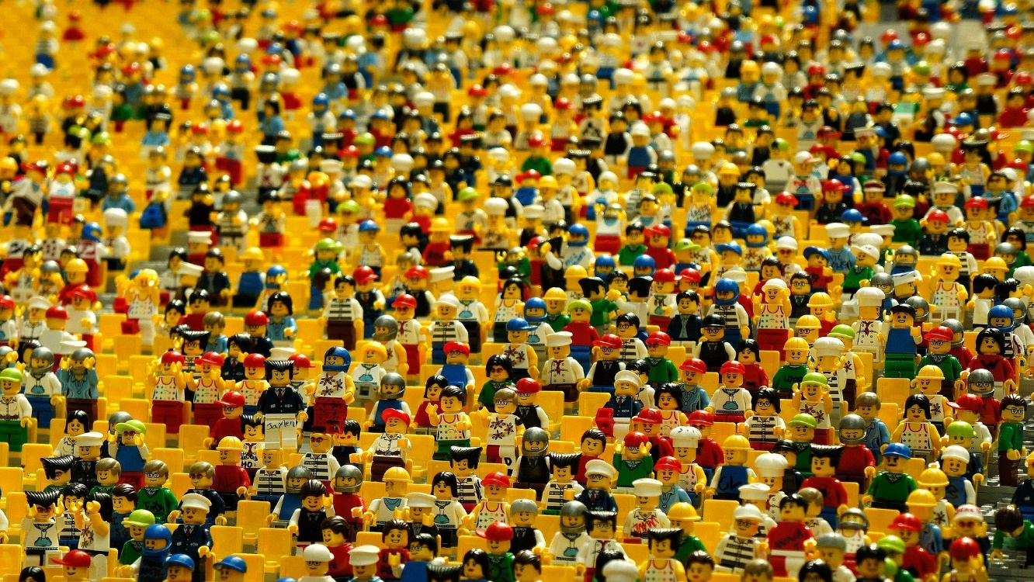
Naming Conventions
Be Consistent
Descriptive
Consensus......on collaborative projects
Chronological Order YYYYMMDD or YYMMDD
Short names
Don’t use special characters....@#?~£$€&
Use leading zeros 0001, 0002 ……..1001
Don’t use spaces …file_name, file-name, filename or FileName
Include a README.txt file to explain and describe your naming convention

Slide 24
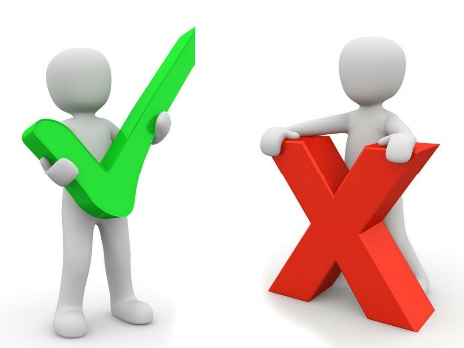

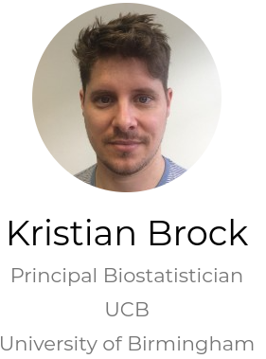
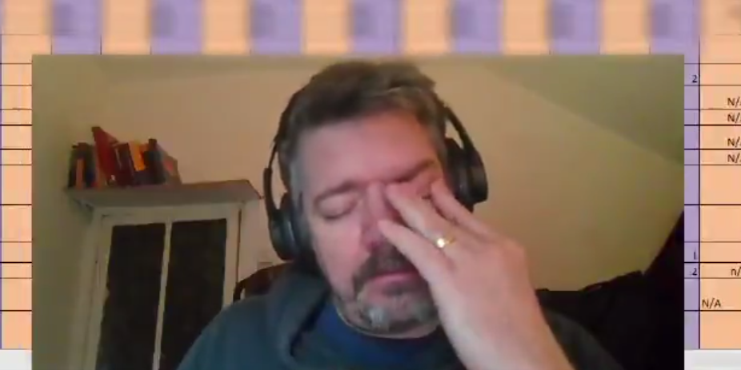
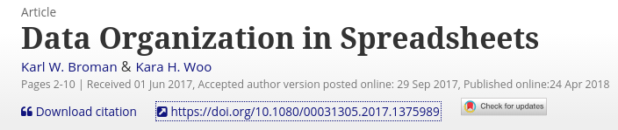
Spreadsheet Design………..be aware of the limitations of excel and take steps to prevent them
Be Consistent
Decide on naming conventions
Use ISO standards
Have rules for empty cells
One piece of data per cell
Make it a rectangle
Subjects in rows
Variables in columns
Create a data dictionary
Backup
Version Control
Use data validation
Include a ReadMe file
No calculation in raw data files
Don’t use formatting as data
Don’t have figures in raw data files
Don’t use merged cells
Don’t hide columns
Don’t use special characters
Don’t have more than one header row
Don’t include temporary or dummy variables not of use to researchers
https://www.kristianbrock.com/post/send-me-data/
https://twitter.com/i/status/1323619993263755264
https://www.youtube.com/watch?v=Ry2xjTBtNFE&t=6s
https://doi.org/10.1080/00031305.2017.1375989
Notes:
So these are the kind of rules that you need to be clear about when using spreadsheets ……

Slide 25





4. Storage and backup [DURING]
Automate your backups
How will data be stored and backed up during the research?
How will you take care of data security and personal data protection?
How will you manage access and security?
https://www.ucc.ie/en/it/storage/
https://www.nature.com/articles/d41586-019-01040-w

Slide 26
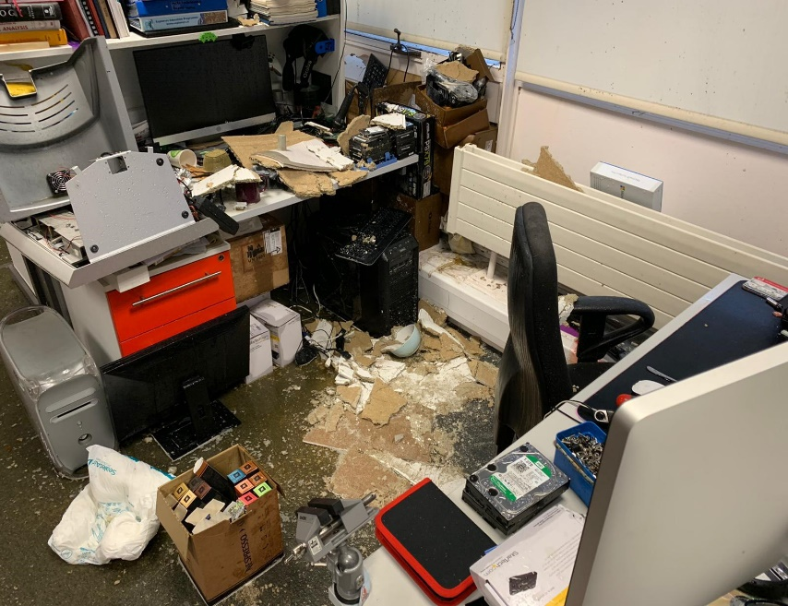
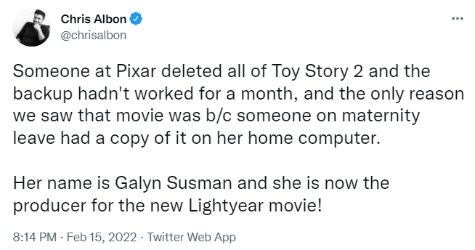
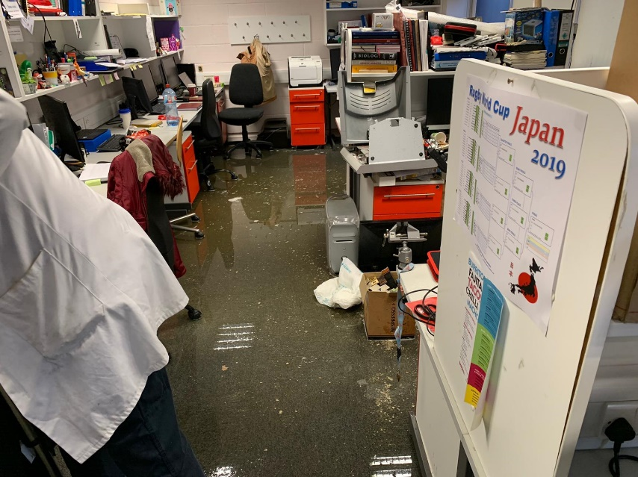
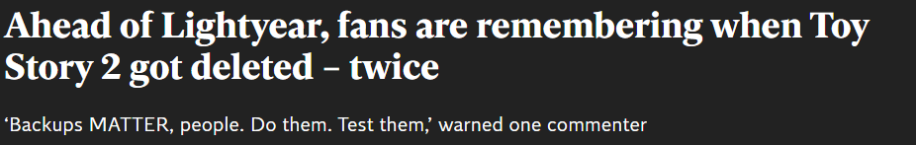
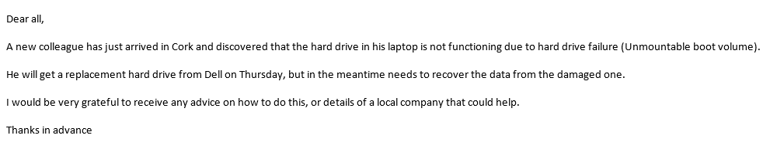
APC- Burst Radiator
https://www.independent.co.uk/arts-entertainment/films/news/lightyear-toy-story-deleted-galyn-susman-b2016221.html?utm_content=Echobox&utm_medium=Social&utm_campaign=Main&utm_source=Twitter#Echobox=1645004983

Slide 27
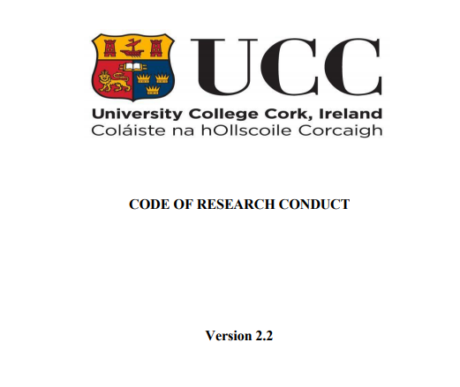
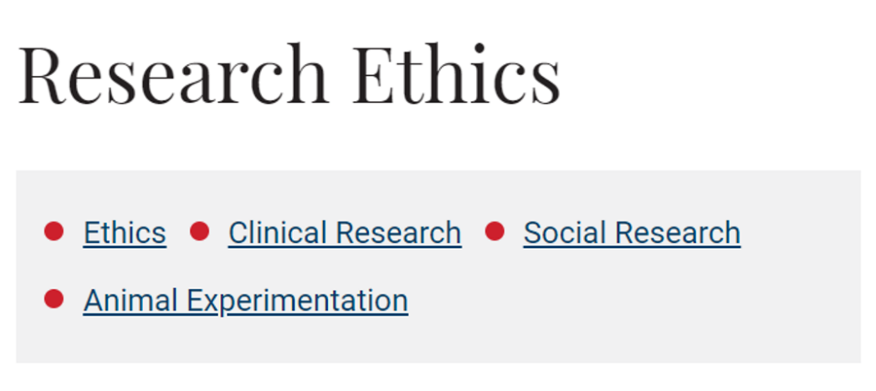

3. Ethics and Legal Compliance
Do you have a data sharing agreement?
Are you using secondary data?
How will you manage ethical issues and codes of conduct?
How will you manage copyright and Intellectual Property Rights (IPR) issues?
Who ‘owns’ your data?
GDPR !
Copyright

Slide 28
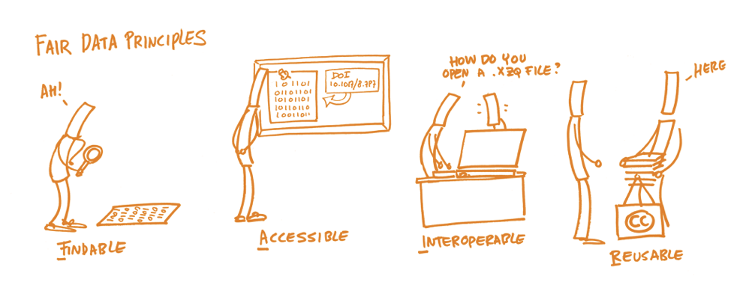
5. Data Sharing and Long-Term Preservation
“…….collect once use many times”
https://libguides.ucc.ie/researchdataservice/fair
https://www.nature.com/articles/sdata201618

Slide 29
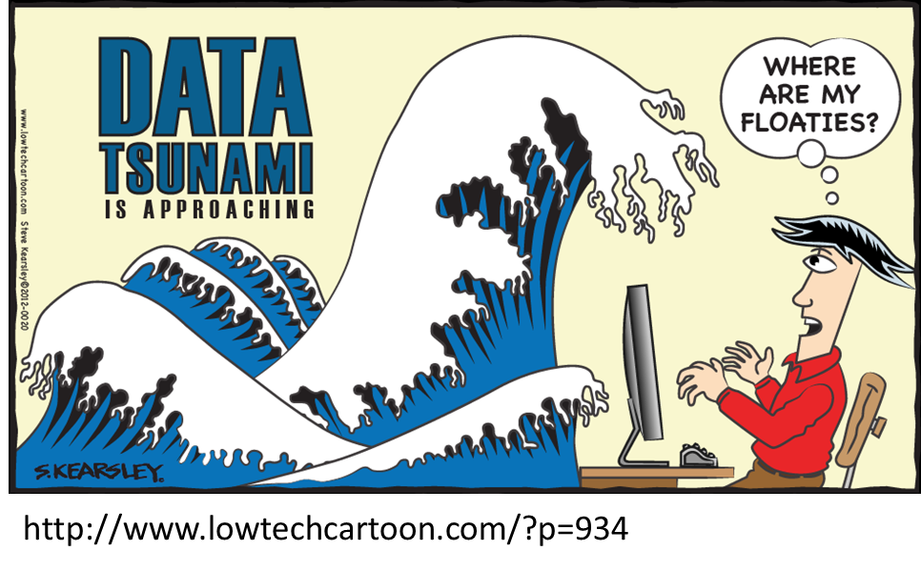
5. Data Sharing and Long-term Preservation
What data? All data?
H2020
“……..underlying data”
“………any other data”
Which data should be retained, shared and/or preserved?
What is the long-term preservation plan for the dataset?

Slide 30

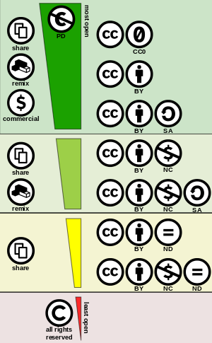


5. Data sharing and Long-term Preservation
How and when will you share data (licences, security, possible embargo reasons)?
Will you make sure unique and persistent identifier is in use (e.g. DOI)?
https://www.gnu.org/licenses/license-list#SoftwareLicenses
https://creativecommons.org/
https://opensource.org/licenses

Slide 31













Repositories
https://fairsharing.org/
https://zenodo.org/
https://www.scienceeurope.org/our-resources/practical-guide-to-the-international-alignment-of-research-data-management/
https://dataverse.harvard.edu/
https://figshare.com/
https://www.dri.ie/
https://www.ucd.ie/issda/
https://www.ncbi.nlm.nih.gov/
https://osf.io/
https://www.maynoothuniversity.ie/iqda
https://www.ebi.ac.uk/
https://www.softwareheritage.org/

Slide 32
If data cannot be made available, why? ​
​
Reasons why you can’t share your data
Copyright
Secondary data
Sensitivity -Commercial (embargo)
-Re-identification of anonymised data
4. No consent
5. Endangered species locations/habitat
….but even in projects where the primary raw data cannot be shared there nearly always other outputs which can be shared.
Metadata
Aggregate data
Analysis code
SOPs

Slide 33

6. Responsibilities and Resources
Who will be responsible of data management?
What resources will you require to deliver your plan?
https://www.southatlanticlcc.org/wp-content/uploads/2017/10/data-management-psb.png

Slide 34

Summary
Identify what data you have or will generate
Draft and implement a realistic data management plan including details of;
  Data description, collection or re-use of existing data
  Documentation and data quality
  Storage and Backup (During)
  Legal and Ethical Requirements, Codes of Conduct
  Data sharing and long-term preservation
  Responsibilities and Resources
  A data management plan is a living document, continue to update and develop it as your work and project progresses
  You don’t need a DMP to have FAIR data but it makes it a whole lot easier if you do have a DMP.

Slide 35




Any Questions
?
?
UCC Library Learning Resources Canvas page
https://ucc.instructure.com/courses/55
Research Data Service
https://libguides.ucc.ie/researchdataservice
?
?

