Slide 1
UCC Staff Wellbeing Supports
Susan O’Mahony
Staff Wellbeing & Development Advisor

Slide 2
Overview of Session
Brief Introduction to Wellbeing at UCC
Overview of supports available
Employee Assistance Service
4. UCC Staff Support Tree

Slide 3

Introduction to wellbeing at UCC
Strong university leadership commitment to Staff Wellbeing & Development
Dedicated Staff Wellbeing & Development Team
1st university in Ireland to be awarded the IBEC Keepwell Standard in 2018
A member of The UK Healthy Universities Network
Invited by Advance HE to contribute to wellbeing symposium in February 2021

Slide 4
Meet the Team
Anne Gannon
Staff Wellbeing & Development Manager
Grace Conway
Staff Development Co-Ordinator
Susan O’Mahony
Staff Wellbeing & Development Advisor
Anna McKenna
Senior Executive Assistant
Mary Horgan
Staff Development Advisor

Slide 5

What is Wellbeing?
Wellbeing is present when a person realises their potential, is resilient in dealing with the normal stresses of life, takes care of their physical wellbeing and has a sense of purpose and belonging to the wider community. It is a fluid way of being and needs nurturing through life.
WHO, 2004
This Photo by Unknown Author is licensed under CC BY-SA

Slide 6

How do you look after your wellbeing?
This Photo by Unknown Author is licensed under CC BY-SA-NC

Slide 7
UCC Wellbeing adopts a
Holistic Approach
Mental
Physical
Financial
Social
Spiritual

Slide 8
Overview of Wellbeing Supports
Orientation for all staff
Individual wellbeing sessions for managers
Monthly programmes of Wellbeing activities from UCC experts to support nutrition, sleep, resilience
Team Interventions
Support from Peers within the UCC Community
Wellbeing workshops
Right to Disconnect
Physical activity Mardyke
Digital Gym
Coaching via the UCC Internal Coaching network

Slide 9



An Employees’ guide to the
Employee Assistance Service
Notes:
Good morning My name is Anne-Marie and I am your dedicated AM here at Spectrum Life. Today I am going to take you through a 30min presentation which will give an overview of the Spectrum Life services available to your employees. If you have questions along the way please pop them into the chat function or I can take them at the end.
First of all a bit about Spectrum Life. We are an Irish HQd company supporting over 1,500 organisations across Ireland and the UK. We are healthcare and wellbeing company focused on providing best in class mental health and wellbeing supports as our primary mission.

Slide 10




What Do You Have Access To with EAP Service?
Employee Assistance Programme (EAP)
Unlimited 24/7, 365 in the moment support, with referral to scheduled counselling, where clinically appropriate to do so.
Wellbeing Platform & App
A customised, digital platform delivering expert content on mental wellbeing, fitness and nutrition, in addition to a step counter and a calorie tracker.
For example, through the Platform, you will be able to access various Mental Health elearning courses that educates, informs and empowers you in various aspects of mental wellbeing.
Online CBT
Access to clinically led online Cognitive Behavioural Therapy pathways to expand access, drive engagement and increase recovery.

Slide 11

Accessing the EAP Spectrum Life
Accessible 24/7, 365 days a year
Available to all UCC staff/their partners/adult children
It is a completely free and confidential service
Free Phone: 1800 814 243
  Text ‘Hi’ to 087 369 0010 for SMS & WhatsApp Support (standard rates apply)
  Email: eap@spectrum.life
  You can Live Chat or Request a Call Back on the wellbeing portal and phone app
    Register: https://UCC.spectrum.life/login?org=JwvaQS9w
    Use organisation code: JwvaQS9w

Slide 12

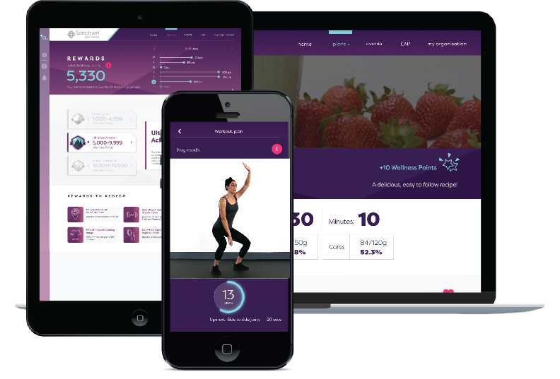

Your Wellbeing Platform and App!
What Do You Have Access To?
Access the EAS directly through the wellbeing portal (desktop) and app (phone/tablet)
  Supplying: Freephone number, text and WhatsApp number, Live chat function, request a call back function and email address.
Step and calorie counter.
Mental wellbeing, fitness and nutrition resources.
E-learning modules.
Informative blog articles on all aspects of wellbeing.
On demand webinars.
Build up wellness points for discounts on wellness brands.
Book and attend wellbeing events.
Download the app on:
Notes:
First page talks about the EAS and signposting to the contact numbers or pathways. It will be customised for your organisation once you come onboard

Slide 13
EAP Problems Reported
Depression, anxiety, stress
Grief & bereavement
Relationships & marital problems
Work stress & work life balance issues
Interpersonal work conflict
Parenting problems

Slide 14
How to support wellbeing
Take the lead in wellbeing and communicate expectations
Be a wellbeing role model by looking after your wellbeing
Know how to recognise the signs of stress, burnout and anxiety
Seek support for staff members who are experiencing anxiety and work overload
Encourage open dialogue around stress, anxiety and mental wellbeing
Communicate wellbeing programme and encourage staff to attend wellness webinars and workshops
Consider a local champion promoting wellbeing
Provide opportunities to discuss wellbeing at team meetings

Slide 15
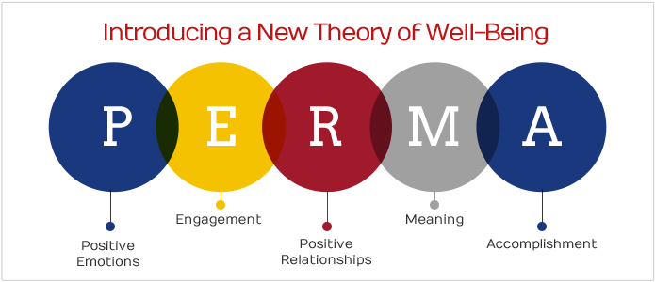
PERMA: Martin Seligman
This Photo by Unknown Author is licensed under CC BY

Slide 16

Increasing Wellbeing
Positive Emotions: 3 good things exercise
Engagement: Learning to use your bests strengths
Relationships: Improving relationships through improved empathy, compassion and communication skills
Video
Meaning : Considering your values, goals and purpose in life.
Accomplishment: Achieving through self-discipline and grit – savouring your accomplishments
This Photo by Unknown Author is licensed under CC BY-SA-NC

Slide 17
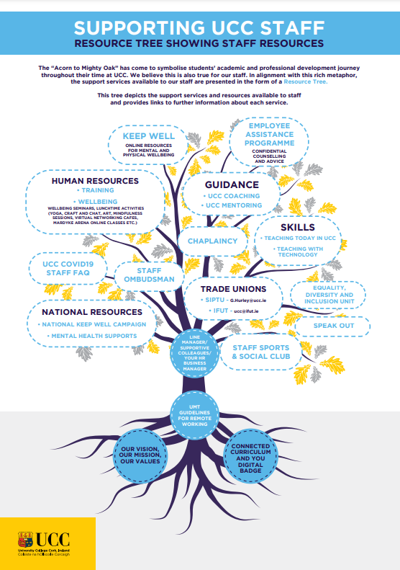

Slide 18

Staff Wellbeing & Development
Matters
Any questions?
Email susanomahony@ucc.ie
Thank you

Slide 19
Further Resources
http://self-compassion.org/ (Dr. Kristin Neff)
https://self-compassion.org/self-compassion-test/
http://actionforhappiness.org/
http://franticworld.com/ (Mark Williams)
http://oxfordmindfulness.org/
PositivityRatio.com-Home
https://self-compassion.org/self-compassion-test/

