Slide 1

UCC Research
UCC’s Research Support, Policy & Strategy Function
David O’Connell PhD
Director of Research Support & Policy
D.OConnell@ucc.ie

Slide 2
Research Funding Landscape – UCC Performance (Overall Income)
€/M
€/M

Slide 3
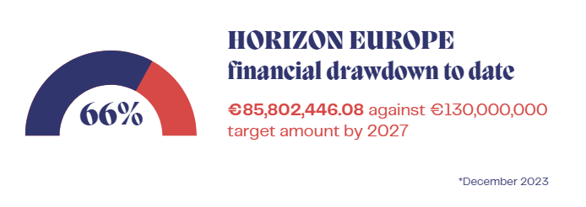

Horizon Europe – UCC Funding Drawdown versus Institutional Target
As of December 2023:
117 Horizon Europe awards
40 awards as Coordinator and 77 as Partner
Financial Drawdown — €85.8 Million
66% of UCC’s institutional target for the Horizon Europe programme — €130 million over 7 years

Slide 4
Citation Impact Score* – National Comparison
HEI | THE Citation Impact Score (2023)*
UCC | 83.7
TCD | 79.4
RCSI | 76.9
UCD | 73.9
NUIM | 71.7
NUIM | 71.2
DCU | 63.2
UL | 50.8
TUD | 33.1
*Times Higher Education (THE) World University Ranking (2023)

Slide 5

Office of the Vice President for Research & Innovation (OVPRI)
Three constituent Offices: UCC Research, UCC Innovation & BSU
Support the UCC research community and our collaborators
Agility in anticipating opportunities, influencing policy, and strategically
positioning UCC for the future
Proactive engagement with all external stakeholders
Inter-institutional cooperation: Regional – National - International
Raising the UCC research brand nationally and internationally
Securing Our Future - UCC Strategic Plan (2023–2028) – available at: https://www.ucc.ie/en/president/strategy2028/
Notes:
Partnership with VP Ext affairs

Slide 6
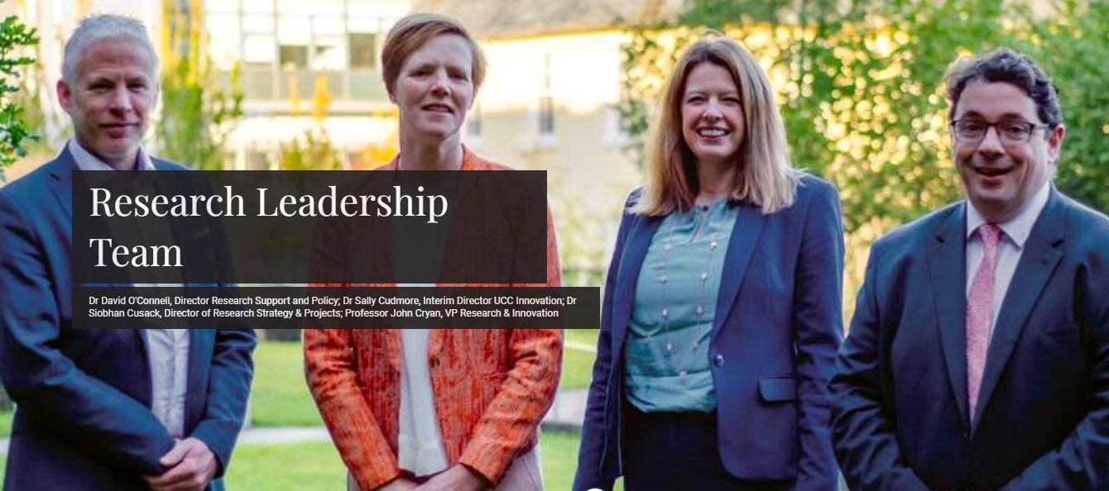
Office of the Vice President for Research & Innovation (OVPRI)
Notes:
Partnership with VP Ext affairs

Slide 7
  What we do..
  Services delivered by UCC Research
    Pre-Award: Development & Operations
    Post-Award: Operations
    Research Policy Development & Implementation
    Research Strategy Development & Implementation
    Research Systems & Reporting
    Impact & Engaged Research
    Communications & Outreach

Slide 8
Services Supporting UCC’s Research Community
Development | Operations | Strategy & Policy
Research Funding Opportunities: Intelligence & Communication Proposal Development & Support Proposal Review, Sign-off & Submission Support Training & Mentoring Programmes Managing Sponsor Expectations Coordinate & Assist in Research Reporting and Information Requirements (Institutional & External) Organization and Presenting at Workshops & Information Sessions Funding Agency Liaison College Research Committee Liaison and Support Research Publicity and Promotion Report Preparation | Pre- & Post-Award Administrative Point of Contact: Coordination, Compliance Checks and Institutional Sign-off Central Admin Office Liaison/Single Point of Contact Administrative Contact for Funding Agencies Contract & Proposal Database Maintenance Proposal Support (incl. Costing and Sign-offs) Event Organization Operational Advice & Support to UCC Research Development Team Funding/Event Information Communication [e-Newsletter, Website] IRIS Helpdesk/Support & Development Website Development/Maintenance KPI/Metric/Research Information Reports Management of Post-Award Review Process | Development & Implementation of R&I Strategy and Policy Development & Implementation of Research Training, Education and Development for Researcher Community (with HR Research) Institutional & Strategic Funding Calls and Reporting Institutional Research Performance (Metrics/Reporting) External Stakeholder Liaison Prime-UCC liaison Consultancy Management Site Visit Organization & Support Supporting Research Collaborations Strategic Research Stimulation Activities Research Publicity, Promotion & Communications (including Annual Research Awards Programme and Research View magazine)
Contract Review

Slide 9

Applying for Funding
Contact UCC Research at the earliest opportunity
Identify potential funding sources
  Submit application in plenty of time!
All funding applications must be signed off by
UCC Research
Submit draft application & budget to UCC Research
a minimum 5 working days in advance
of call deadline

Slide 10
Congratulations on your Award – What Next?
Goal: Get a research account opened and get the project underway
A. All research contracts/agreements must be reviewed before they can be signed and a research account opened.
B. The following documentation should be made available to the relevant Research Support Administrator (RSA):
  Submitted Application
  Contract Assessment Form (Appendix C):This document must be signed you (and any co-PIs), your Head of Unit, and the relevant Head of College
  Contract documentation from the Funding Agency
  Patient-focussed Questionnaire (PFQ)
The RSA will work with the relevant University Offices to coordinate the review of your contract/agreement
All forms available on Support section of the UCC Research website

Slide 11
UCC Research: Coordination of Application/Contract Review
‘Single Point of Contact’ Model
Finance Office
OCLA
UCC Research
HR
UCC Innovation
Sponsorship Office

Slide 12
Research Skills Training Programme 2024
Title | Date | Speaker(s)
The Evaluation of Funding Proposals under Horizon Europe: Perspectives from Evaluators | Feb 29th | Martin O'Connell, Sarah O'Connell & Paolo Saporito
Preparing Your Budget | March 14th | Kevin Goggin
Pathways to Impact | March 28th | Sean Lucey & Ashleigh Byrne
Communicating Research | April 11th | Trevor Carey, UCC Academy
Research Metrics and Researcher Profiles | April 18th | Hardy Schwamm
Cultivating Interdisciplinarity Pathways in Your Research Career | April 25th | Paul Bolger
The Entrepreneurial Mindset and Practice | May 9th | Fiona Edwards Murphy
F.A.I.R. Data Management | May 16th | Aoife Coffey
Open Research | May 23rd | David O’Connell & Donna Ó Doibhlin
Summer Break
Consortium Management | September 5th | Rebecca Buckley & Justin Holmes
Navigating UCC when Managing a Research Grant: Contracts and Finance | September 19th | Fiona O'Shea & Kevin Goggin
GDPR & IT Security | October 3rd | Catrina Solan & Barry Foley
Clinical Research | October 17th | Erin Crowley
Research Culture & Engaged Research | October 31st | Martin Galvin
Research Integrity & Ethics | November 14th | Irene Kavanagh, Kevin Murphy, Christian Waeber & David Kerins
Research for Policy | November 28th | Hannah Daly
Citizen Science | December 5th | Daniela Iacopino
For further information about the programme, please contact Paolo Saporito (psaporito@ucc.ie).

Slide 13
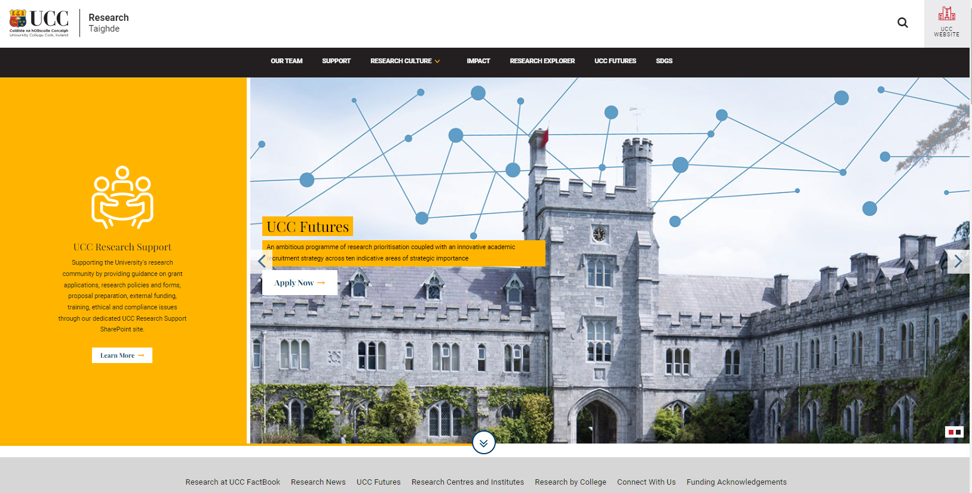
https://www.ucc.ie/en/research/

Slide 14
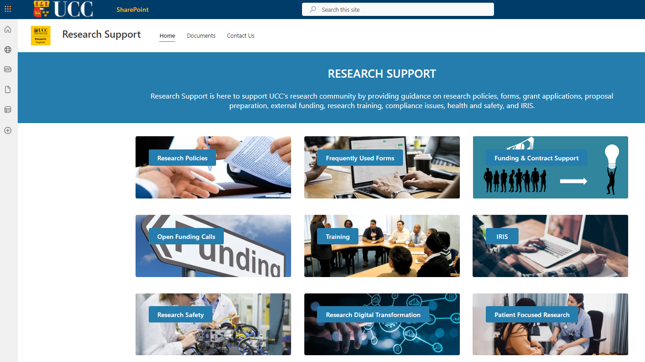
https://uccireland.sharepoint.com/sites/ResearchSupport

Slide 15


Slide 16
PI Forum
Share common issues
Research strategy, policy and processes
Platform
New staff
Support for networking and dissemination
Developments on the national and international research environment
Break down barriers

Slide 17
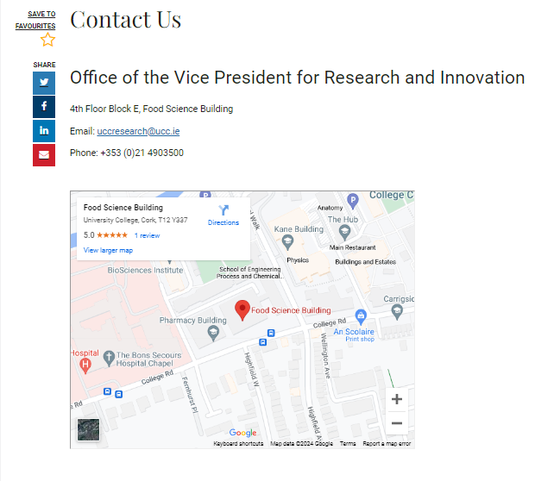
https://www.ucc.ie/en/researchandinnovation/contactus/

