Slide 1
Digital Wellbeing
Susan O’Mahony
Staff Wellbeing & Development Advisor

Slide 2
Learning Outcomes
Understand Digital Wellbeing
Reflect on your Digital Wellbeing
Provide tools to help promote Digital Wellbeing

Slide 3
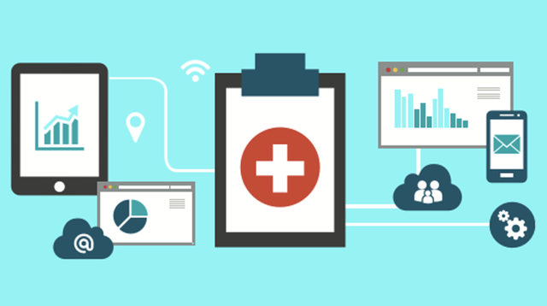
Digital Wellbeing
'Digital wellbeing’ refers to the impact of technologies and digital services on our mental, emotional and physical health.
This Photo by Unknown Author is licensed under CC BY-SA-NC

Slide 4

Digital Technology:
Total hours worked increased by approximately 30% including a rise of 18% in working after normal business hours. Average output did not significantly change, therefore productivity fell by 20%

Slide 5
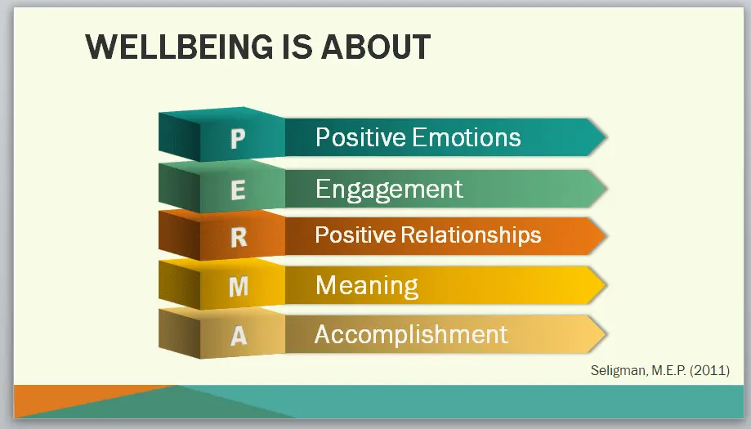
Digital Wellbeing

Slide 6
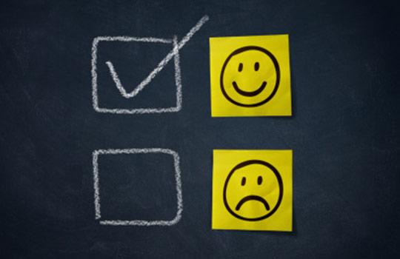
Digital Wellbeing: Positive Emotions
When you think about your own relationship with , as it were, with digital technologies, are they positive or negative?
Are you experiencing stress and anxiety because of digital technologies? If so, what can you do to reduce the negative emotions?
This Photo by Unknown Author is licensed under CC BY-NC

Slide 7

Digital Wellbeing: Engagement
By engagement and digital wellness, when using these technologies are you getting into the flow?
Or are the technologies giving you the chance to chat friends and helping you to go with the flow, to relax, and find some quality time?
This Photo by Unknown Author is licensed under CC BY

Slide 8
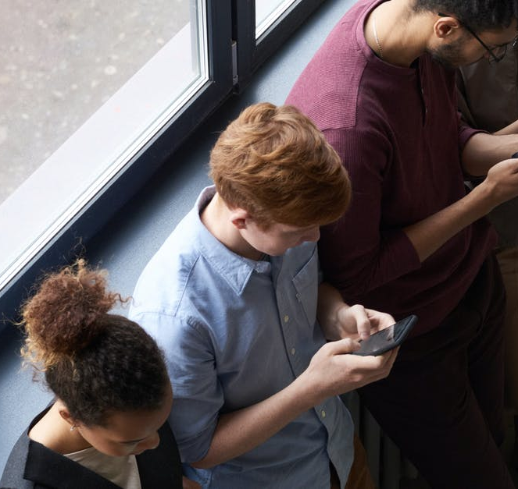
Digital Wellbeing: Relationships
Is digital technology having a positive or negative impact on your relationships
Are you present with your family or friends
Have you noticed that you get
“ Self Interrupted”

Slide 9
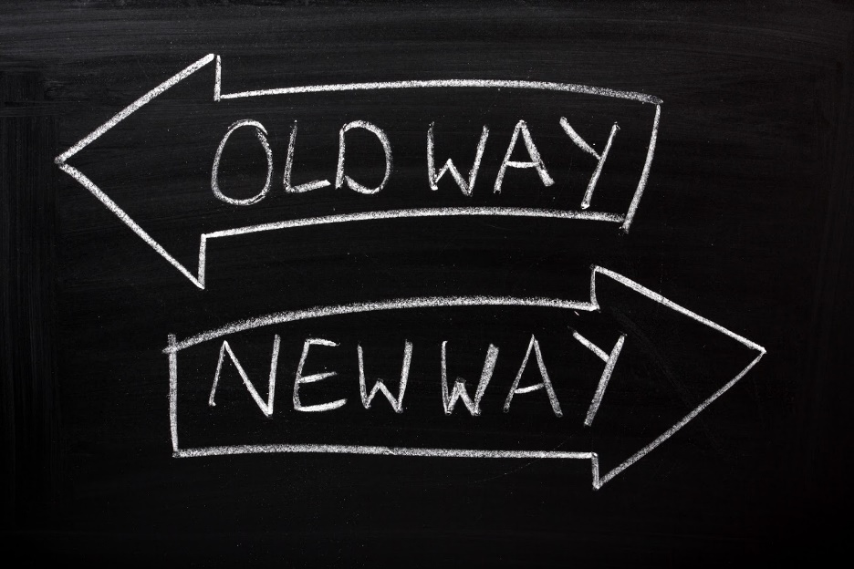
Digital wellbeing: Meaning
Does your use of these digital technologies help you achieve greater meaning?
How does technology help you achieve your goals at work?
This Photo by Unknown Author is licensed under CC BY-SA-NC

Slide 10

Digital Wellbeing Accomplishment
Does the time you spend with digital technologies time that leads you towards accomplishing something worthwhile?
Can you recall recent accomplishments achieved because of digital technology

Slide 11

Why Disconnect from Technology
Colleagues expected to respond to after hours communications reported higher levels of :
Psychological distress
Emotional Exhaustion
Poor Physical Health
University of South Australia 2021
2,200 Academic & Professional Staff from 40 universities
This Photo by Unknown Author is licensed under CC BY

Slide 12
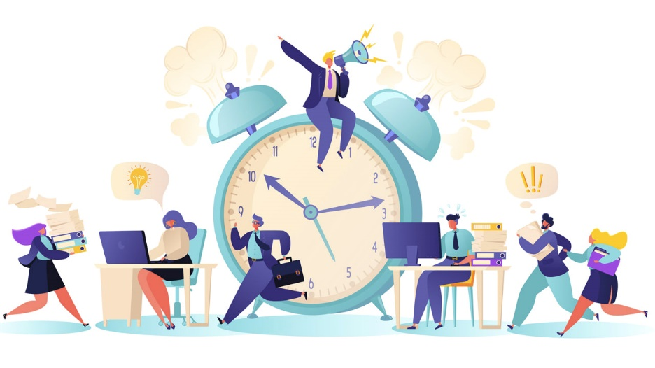
Impact of working longer hours
Impacts your mental & physical recovery from work
Working longer hours may increase risk of heart attack & stroke (WHO)
Constant state of hypervigilance impacting metabolism & immunity
Less time for social interaction, physical exercise & relationships
This Photo by Unknown Author is licensed under CC BY-SA-NC

Slide 13

How often we switch task?
2004
3 mins and 5 seconds
2016
40 seconds
University of California and Irvine
This Photo by Unknown Author is licensed under CC BY-SA-NC

Slide 14

Impact of Psychological Detachment
More productive
More engaged on the job
More convivial with colleagues
This Photo by Unknown Author is licensed under CC BY-SA-NC

Slide 15
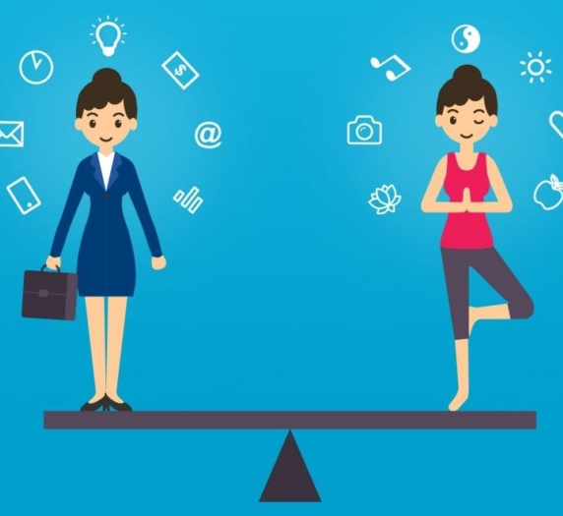
Balance online and offline life
This Photo by Unknown Author is licensed under CC BY-NC-ND

Slide 16

Reflection
What’s going well?
What do you need to do more of?
What do you need to stop doing?
What do you need to start doing?

Slide 17

Top Tips to Manage E-mail
Avoid emails first thing in the morning
Turn off Notifications
Plan Focus time for work
Plan Time to respond to emails
Discuss team email culture
This Photo by Unknown Author is licensed under CC BY

Slide 18

Further Digital Tools
Digital Wellness Institute
F.Lux Reduce Blue lighting
Managing your Teams notifications
https://support.microsoft.com/en-us/office/manage-notifications-in-teams-1cc31834-5fe5-412b-8edb-43fecc78413d
Canvas Notifications
https://community.canvaslms.com/t5/Instructor-Guide/How-do-I-manage-my-Canvas-notification-settings-as-an-instructor/ta-p/1222
Communications Policy
For students e.g. 48-hour response time
Set Teams Quiet Time
Weekends/evenings
This Photo by Unknown Author is licensed under CC BY-SA

Slide 19
Other tools
Use Time management tools
Apple
Android

Slide 20

Tools to Disconnect from work
Use E-Signature
“Please note that this email may have reached you outside of normal business hours – if it does, I do not expect an immediate response”
Select time and date to send an email during working hours found under delay email in options tab
Turn off Work Notifications on your phone and laptop and Schedule Breaks
Agree times of meetings during working hours
This Photo by Unknown Author is licensed under CC BY-SA

Slide 21
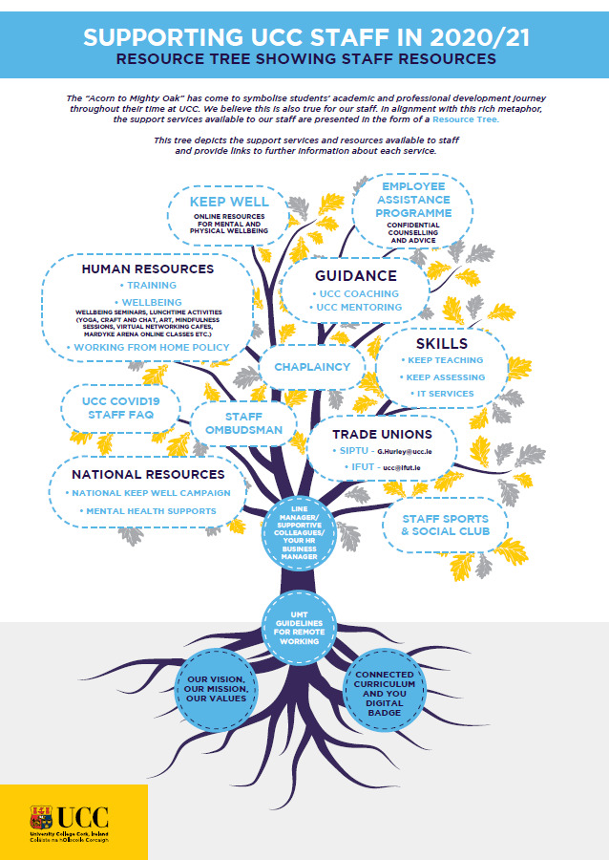
Where can I go for help?

Slide 22

Workshop Learning
What will you do differently as a result of attending this workshop?

