Slide 1
UCC Library Research Services
Online Researchers Orientation Spring 2024

Slide 2
Welcome and Hello
UCC Library offers a range of resources, spaces and services to meet the needs of the research community.
It is a building full of friendly and knowledgeable staff only too eager to help you on your research journey.
It is a great place to study, to research, to write or to take a break from what is a hectic campus.
General Queries or if you are not sure who to ask;
Check the Ask Us FAQs or live chat on the Library website or email library@ucc.ie
Open access publishing queries: donna.odoibhlin@ucc.ie or libraryapcs@ucc.ie
Research Data Service: researchdata@ucc.ie

Slide 3
Research Services
01
CORA the Cork Open Research Archive is UCC's institutional repository of research publications including theses, journal articles and conference papers. Donna Ó Doibhlin, the Scholarly Communications Librarian and the CORA Team provide expert support, training and advice on all aspects of the publishing landscape, with a focus on open access.
Open Access at UCC webpage
CORA website
Contact Research Services
CORA: cora@ucc.ie
Scholarly Comms Librarian: donna.odoibhlin@ucc.ie
Research Data Service: researchdata@ucc.ie
Research Data Coordinator: aoife.coffey@ucc.ie
02
Research Data Service provides advice and training for all aspects of data management from grant application stage to post-project. We can help with drafting and implementing your data management plan and deciphering the requirements of FAIR and Open Data.
Research Data Service webpage
Enrol in Research Essentials @ UCC Library

Slide 4
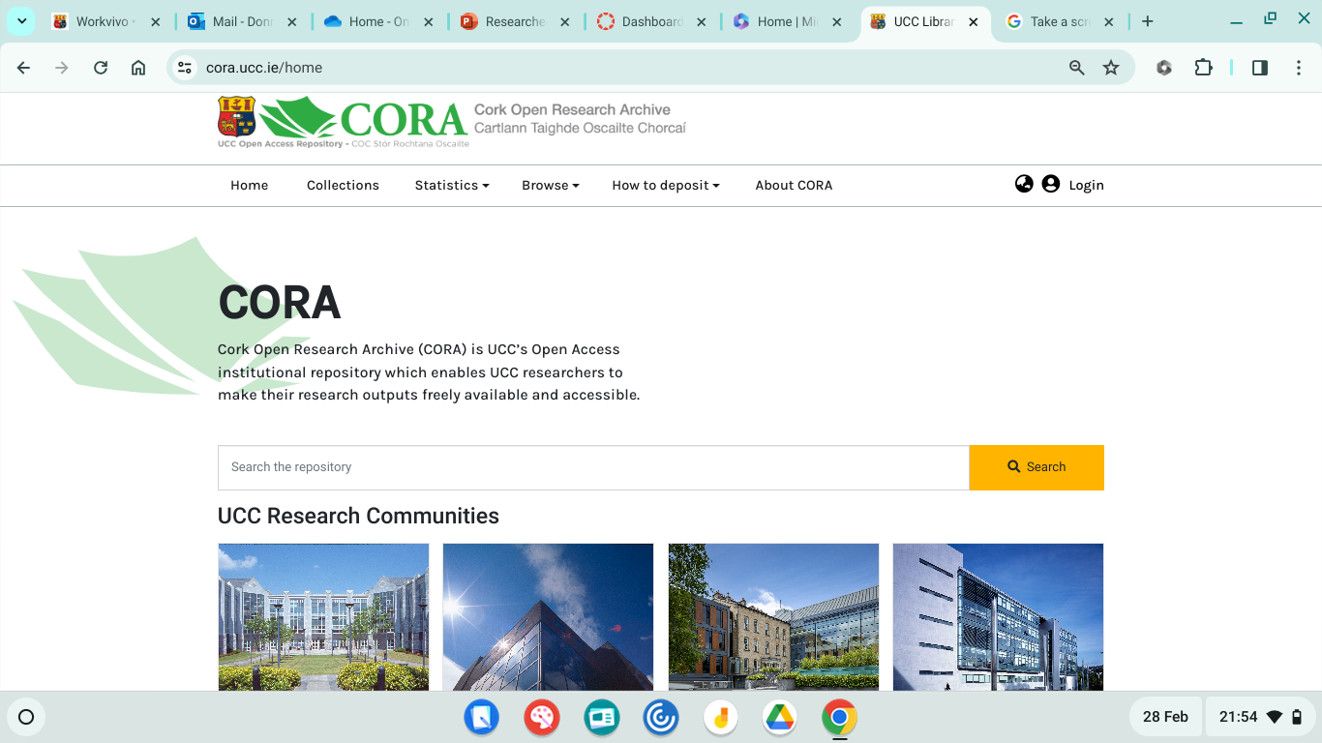
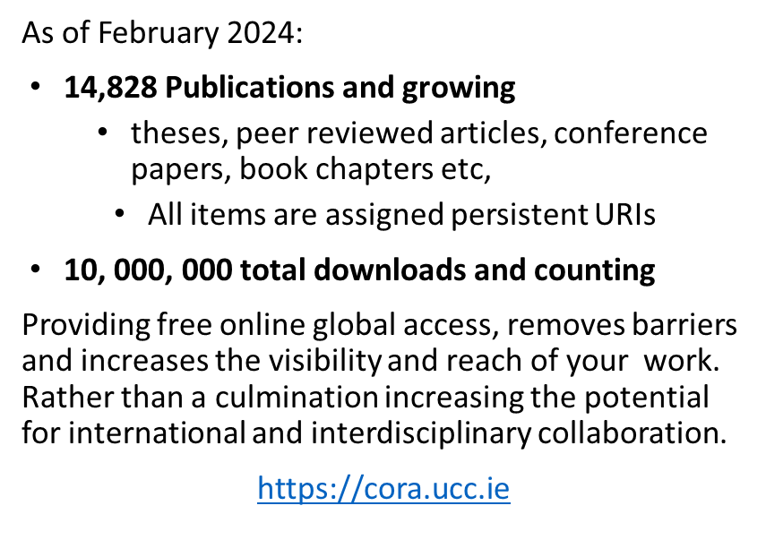
CORA: UCC’s Open Access Repository
CORA@ucc.ie
Notes:
A spotlight on UCC’s research output. Fully open access.

Slide 5
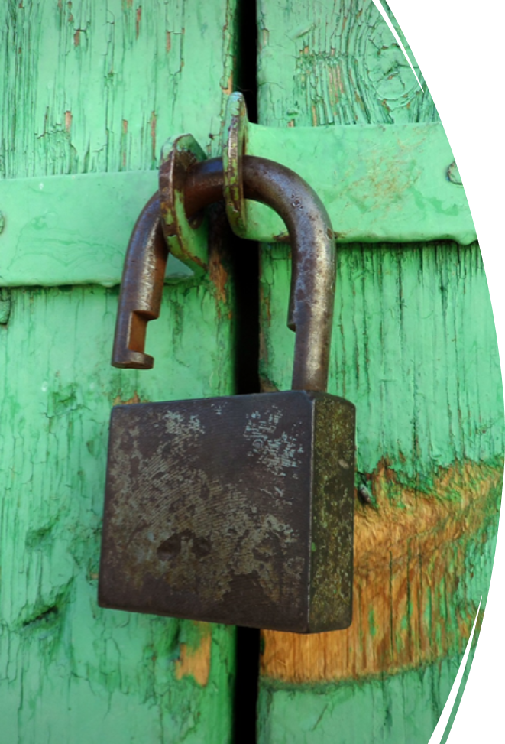
What is open access?
Open access is a broad international movement that seeks to grant free and open online access to academic information, such as publications and data.
A publication is defined 'open access' when there are no financial, legal or technical barriers to accessing it - that is to say when anyone can read, download, copy, distribute, print, search for and search within the information, or use it in education or in any other way within the legal agreements.
https://www.openaccess.nl/en/what-is-open-access

Slide 6
Policy shift
Plan S Signatories: Committing to a vision of Science without publication paywalls. Plan S requires that scientific publications that result from research funded by public grants must be published in compliant Open Access journals or platforms.
Notes:
Several policy papers have been published recently by scientific government bodies in Ireland and Europe with the aim of making research, especially that which stems from public funding, freely available to anyone with access to the internet.
European bodies and research organisations have signed several agreements to demand that published research findings and papers transition from behind paywalls, to open access online..
Many funding bodies have signed up to Plan-S which is tightly focused on transition of OA for publications, and of with SFI is a signatory, as are the IRC and HRB.
With HORIZON EUROPES ADOPTION OF PLAN S – THIS HAS CHANGED HOW RESEARCH MUST BE CONDUCTED AND SHARED
SFI / IRC / WELCOME ARE ALL signatories

Slide 7
Plan S: What’s different?
Immediate access/Zero embargo
Rights Retention by author/institution required & content licensed under CC-BY
‘Hybrid OA’ not eligible for funding (except through TA/TJ)
Full OA Journal/Platform
Transformative Agreement/Journal (until 2024)
Repository with zero embargo
(Rights Retention)
Notes:
Immediate access/Zero embargo
Rights Retention by author/institution required & content licensed under CC-BY
‘Hybrid OA’ not eligible for funding (except through TA/TJ)

Slide 8
Funder Open Access Policies
NORF ​
National Framework on the Transition to an Open Research Environment​
"All Irish scholarly publications resulting from publicly funded research will be openly available by default from 2020 onwards and will be accessible on an ongoing basis." ​
​
Coalition S ​
Plan S​
“With effect from 2021, all scholarly publications on the results from research funded by public or private grants provided by national, regional and international research councils and funding bodies, must be published in Open Access Journals, on Open Access Platforms, or made immediately available through Open Access Repositories without embargo”​
​
SFI ​
National Framework on the Transition to an Open Research Environment​
SFI now requires all peer-reviewed articles and conference proceedings submitted for publication after 1st January 2021 to be made openly accessible immediately from the date of publication. This requirement also applies to other funding agencies that have endorsed cOAlition S / Plan S e.g. Wellcome Trust. Coalition S
Notes:
The research services team are able to advise on funder requirements. Much more information on our Open Access libguide.

Slide 9
So, when you have your paper ready to publish – you have choices . . and obligations
Where?
Will it meet my funder requirements?
What type of CC licence should I apply?
Notes:
All

Slide 10
Funder mandates - https://v2.sherpa.ac.uk/juliet/
Does journal offer funder compliant publishing route? - https://journalcheckertool.org/ or https://v2.sherpa.ac.uk/romeo/
Is there an IReL publishing deal that would cover an APC? - https://irel.ie/open-access/ or https://libguides.ucc.ie/OAatucc/publishyourresearch
Is green open access enough, or do I need to pay for gold open access? Check the Plan S Journal Checker Tool
Do I need to apply a rights retention licence/which one? https://creativecommons.org/about/cclicenses/
Some pre-submission things to consider . .

Slide 11
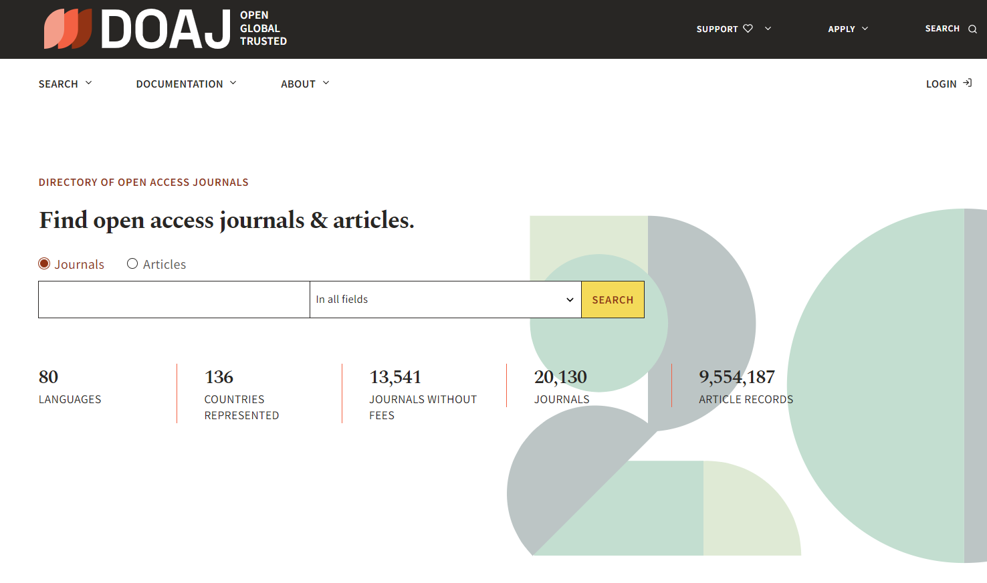
Notes:
Search here to find OA journals, their aim and scope, instructions for potential authors, peer review, rights retention and associated costs, where applicable.
DOAJ is a unique and extensive index of diverse open access journals from around the world, driven by a growing community, committed to ensuring quality content is freely available online for everyone.
DOAJ's mission is to increase the visibility, accessibility, reputation, usage and impact of quality, peer-reviewed, open access scholarly research journals globally, regardless of discipline, geography or language.

Slide 12
Routes to open access for UCC researchers:
Green OA:
Self-archiving a postprint (AAM) in UCC’s Open Access Repository – CORA - in addition to traditional publication in subscription access journal authors deposit a draft copy of their articles (postprint) in an institutional repository e.g. CORA. This may involve a temporary embargo on accessing the full text of article.
Gold OA:​
Articles are made openly accessible by the publisher, often for a fee, known as an article processing charge (APC) which covers publication costs​ (between €100 - €4k per paper)
Diamond/Platinum OA:​
Articles are made openly accessible by the publisher, but no fee is charged to the author. Instead, publication costs are covered by institutions, funders, societies etc. For example: HRB Open Research​, The Boolean, Scenario, The Open Library of Humanities journal, etc.
Notes:
So, to ensure our funded researchers are compliant with their OA obligations we have to give them options.
There options are basically as follows: Green / Gold / Diamond
Green - A postprint (AAM) is a digital draft of a research journal article after it has been peer reviewed and accepted for publication, but before it has been typeset and formatted by the journal. Publishers may demand an embargo is applied on releasing the full text for a period of time.
Self-archiving a postprint (AAM) in UCC’s Open Access Repository – CORA - in addition to traditional publication in subscription access journal authors deposit a draft copy of their articles (postprint) in an institutional repository e.g. CORA. This may involve a temporary embargo on accessing the full text of article.

Slide 13
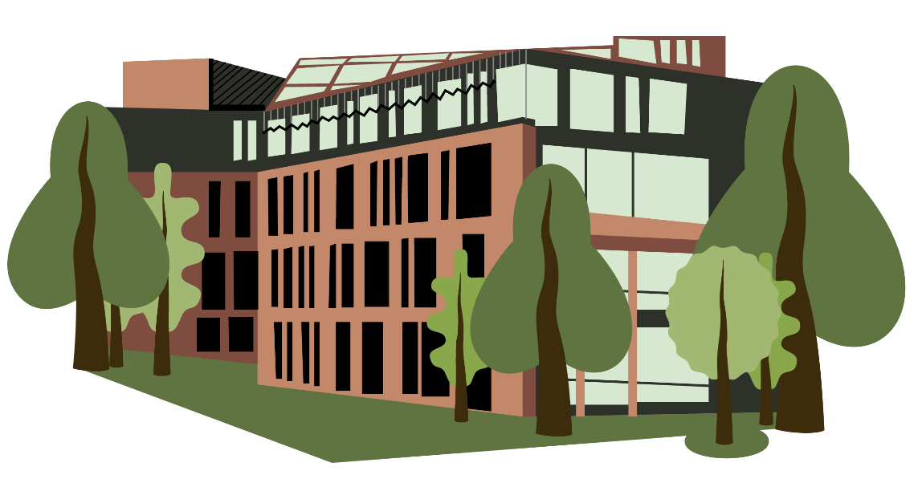
Contact us: cora@ucc.ie
How we can help:
Open Access: CORA is University College Cork's online, open access institutional repository, giving free open access to UCC’s research publications, inc. journal articles, book chapters, conference papers, theses.
UCC Theses: CORA is the central repository for electronic copies of UCC postgraduate research theses.
CORA supports Green Open Access publishing. This Green route involves no costs to researchers and enables you to deposit the final manuscript version of your papers in the CORA repository, where they will be archived and published open access.
CORA offers advice on current Open Access Agreements: These allow corresponding authors to publish gold open access on publication, at no extra APC cost, with participating publishers (quotas apply).
Submitting your paper/book chapter to CORA (UCC’s Open Access Repository) fulfils the requirements of UCC’s Open Access to Publications Policy (2016)
Resources:
CORA: https://libguides.ucc.ie/OAatucc/cora
Theses: https://libguides.ucc.ie/theses
Open Access Agreements: https://libguides.ucc.ie/OAagreements

Slide 14
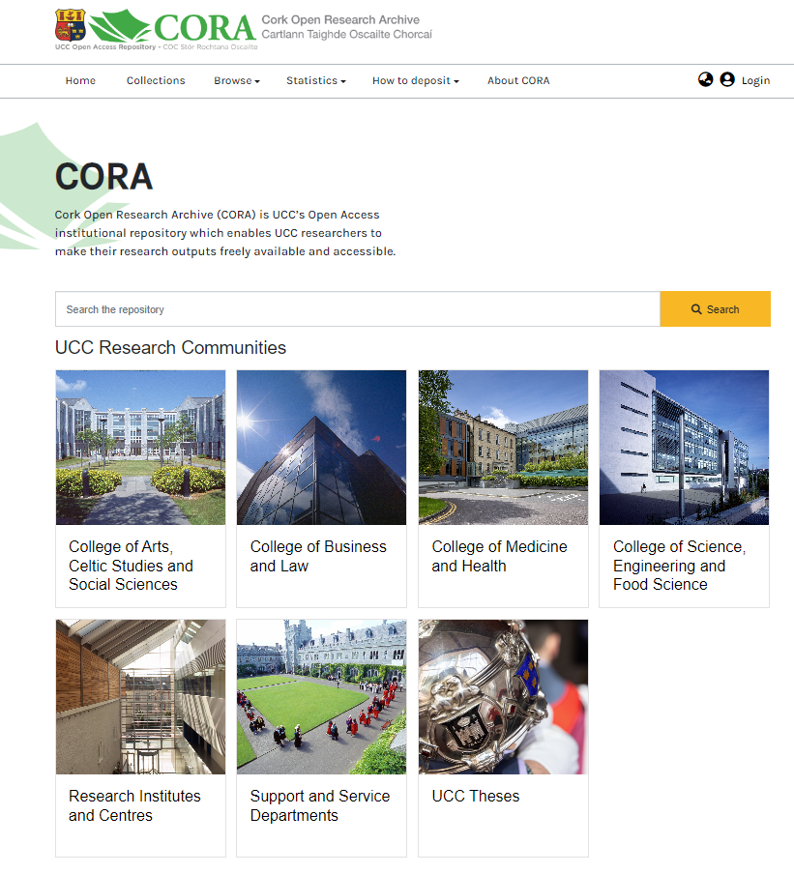
Contact us: cora@ucc.ie
How to add papers to CORA:
Send the AAM, Authors Accepted Manuscript of your publications via e-mail to cora@ucc.ie
Upload publications through your IRIS profile: IRIS FAQs
PhD students submit their doctoral etheses through CORA
Resources:
CORA: https://libguides.ucc.ie/OAatucc/cora
Theses: https://libguides.ucc.ie/theses
Open Access Agreements: https://libguides.ucc.ie/OAagreements

Slide 15
What about ‘Embargoes’?
A publication embargo is a temporary delay to full text availability in the institutional repository. The associated metadata is fully visible and discoverable, with links to the published article.
The length of these embargoes varies, with an average of 12 months. However, some publishers have no embargo at all on their self-archiving policy and allow accepted manuscripts to be made available at the time of article acceptance or at publication.
You can find out if your journal applies an embargo using the Sherpa Romeo tool:
https://v2.sherpa.ac.uk/romeo/
Sherpa Romeo is an online resource that aggregates and analyses publisher open access policies from around the world and provides summaries of publisher copyright and open access archiving policies on a journal-by-journal basis.
The CORA team check publication embargoes as part of their processing workflow. Publication embargoes will be applied by the team.
Notes:
Some publishers apply embargoes on the full text availability of articles deposited in Institutional Repositories . . .hence sometimes we need to pay Article Publishing Charges to make papers immediately open access.

Slide 16
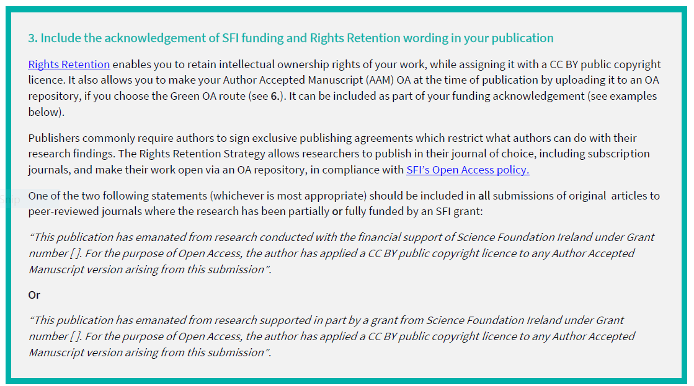
What about Embargoes and Funder Compliance?
Some funders require CC BY and no embargo. SFI e.g. advise authors to include the acknowledgement of SFI funding and Rights Retention wording in your work.
Read SFI Open Access Policy here:
https://www.sfi.ie/funding/sfi-policies-and-guidance/open-research/

Slide 17
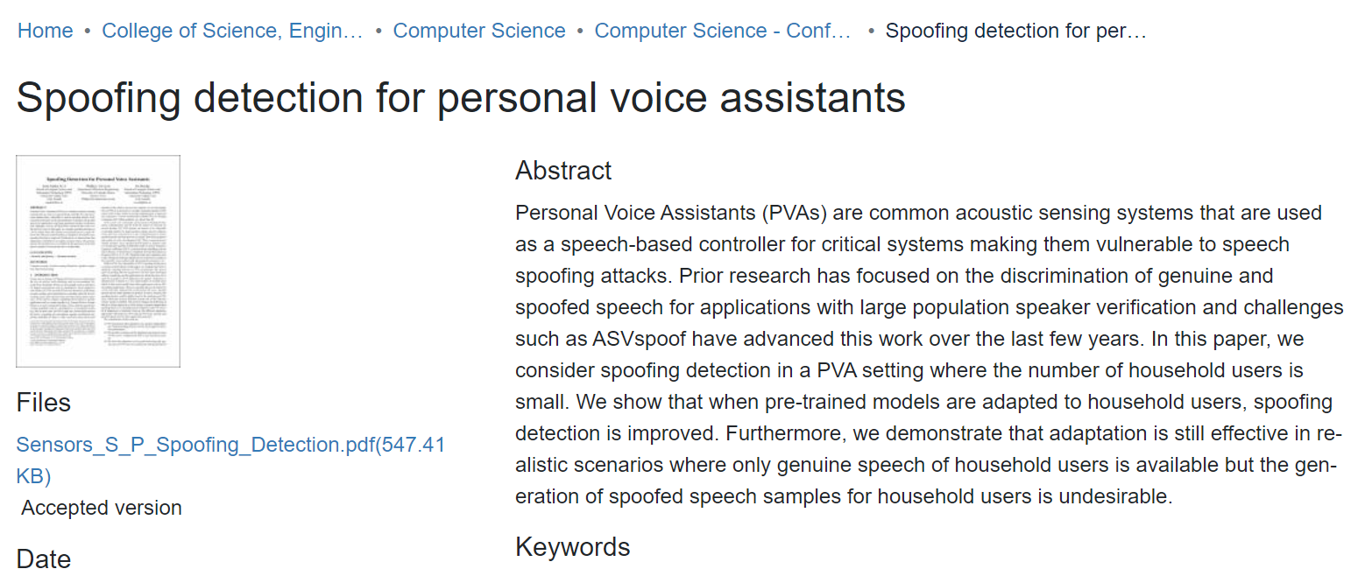
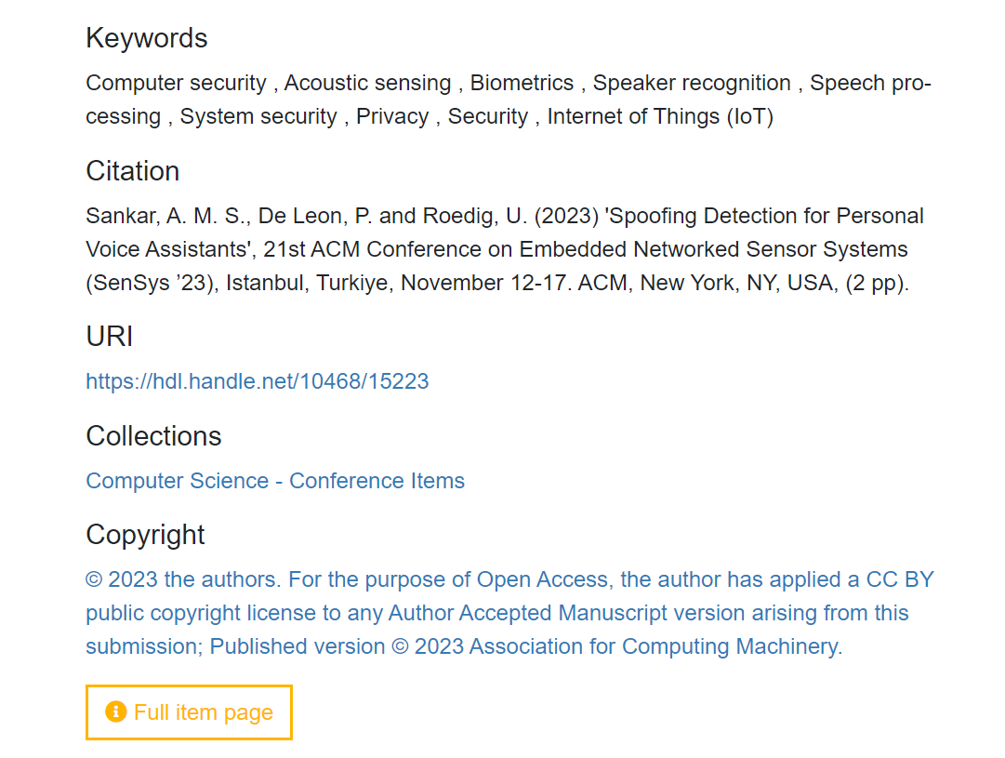
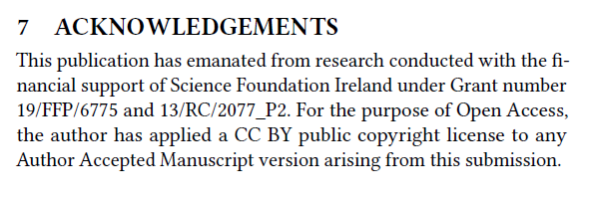
Example of a paper with a Rights Retention Statement Sankar, A. M. S., De Leon, P. and Roedig, U. (2023) 'Spoofing Detection for Personal Voice Assistants', 21st ACM Conference on Embedded Networked Sensor Systems (SenSys ’23), Istanbul, Turkiye, November 12-17. ACM, New York, NY, USA, (2 pp). CORA Handle/Persistent URI: https://hdl.handle.net/10468/15223 Rights Retention Statement

Slide 18
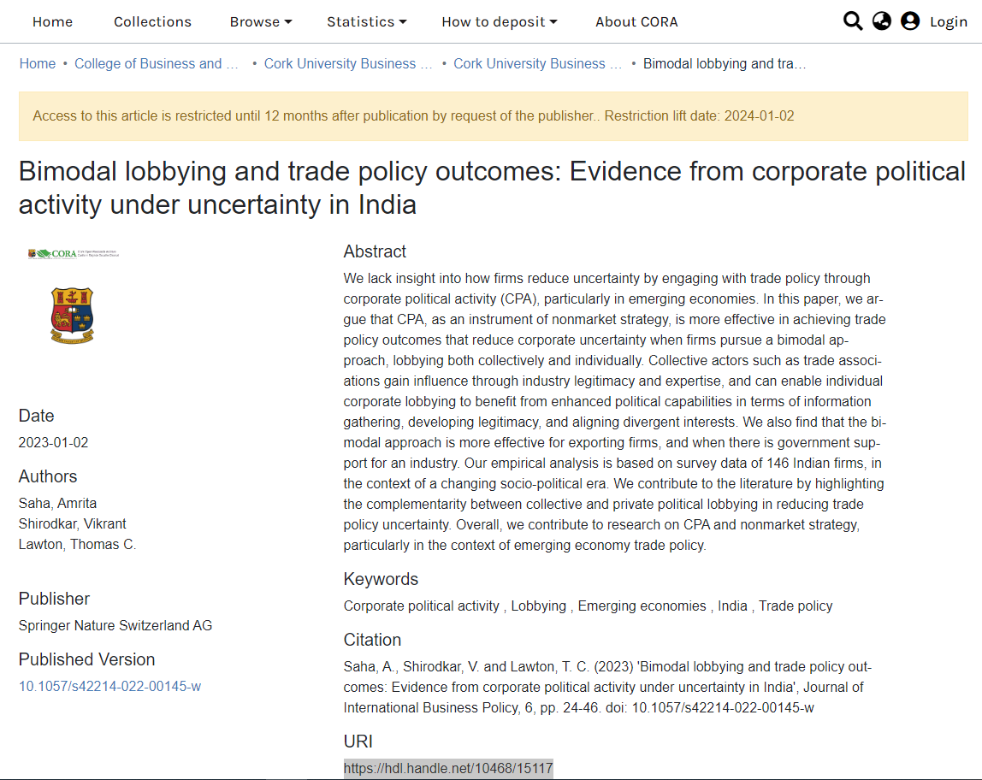
Example of an embargoed paper Saha, A., Shirodkar, V. and Lawton, T. C. (2023) 'Bimodal lobbying and trade policy outcomes: Evidence from corporate political activity under uncertainty in India', Journal of International Business Policy, 6, pp. 24-46. doi: 10.1057/s42214-022-00145-w CORA Handle/Persistent URI: https://hdl.handle.net/10468/15117 Embargoed for 12 months after publication. Embargo will lift automatically. Meanwhile the metadata, abstract, keywords etc are discoverable. The record links to the published version.

Slide 19
Example of Author Accepted manuscript archived on CORA Kehoe, L., et al (2020) 'Modelling the impact of mandatory folic acid fortification of bread or flour in Ireland on the risk of occurrence of NTD-affected pregnancies in women of childbearing age and on risk of masking vitamin B12 deficiency in older adults', European Journal of Nutrition, 59, 2631-2639. doi: 10.1007/s00394-019-02111-4 CORA Handle/Persistent URI: https://hdl.handle.net/10468/15136
Author's Accepted Version
Published Version

Slide 20
College of SEFs

Slide 21
Theses Collection

Slide 22
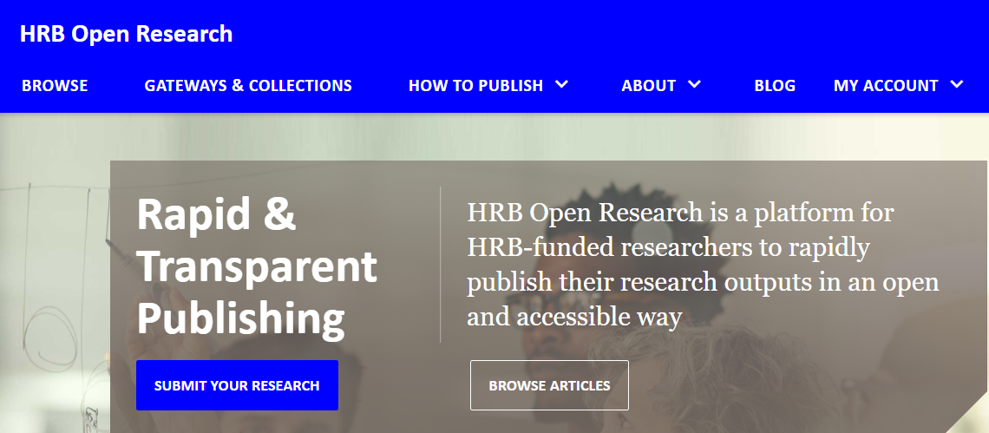
Funder Publishing Platforms
Notes:
Another good option is to publish in one of the funder OA publishing platforms – HRB Open research for HRB funded projects, Wellcome and Open Research Europe for research outputs from those funding streams.

Slide 23
Gold Open Access
Accessible immediately at the point of publication
Author may have to pay article processing charges (APCs) once an article has been accepted for publication
Author retains copyright and readers are granted reuse rights
Publisher managed
Notes:
UCC as a member of the IReL consortium have access to an annual allocation See: https://irel.ie/open-access/ of pre-paid APCs – contact the CORA Team to ascertain if there is funding available to support publishing your papers open access immediately.
The CORA team oversee the APC process in UCC, encouraging researchers to avail of APCs where available

Slide 24
IReL Transformative Agreements –
funding Open Access publishing for UCC authors
UCC, via IReL have secured several 'Transformative Agreements' with publishers that typically allow corresponding authors from eligible institutions to publish their articles open access immediately on publication. These Article Publishing Charges (APCs) have been prepaid for a large number of articles with a wide range of publishers.
To confirm if your proposed journal is eligible for a funded APC please check the link below: https://libguides.ucc.ie/OAagreements or email libraryapcs@ucc.ie.
To avail of funded APCs UCC authors must meet the following criteria, when their article is accepted for publication:
You must be listed as the corresponding author.
You must include ‘University College Cork’ in your affiliation details.
You should use your UCC email address: @ucc.ie , @tyndall.ie.
See also: https://irel.ie/open-access/
Notes:
To avail of funded APCs UCC authors must meet the following criteria, when their article is accepted for publication:
You must be listed as the corresponding author.
You must include ‘University College Cork’ in your affiliation details.
You should use your UCC email address: @ucc.ie
Funding is limited and a number of agreements ran out of APCs in the summer 2022, however a new tranche of funding was released in January 2023 so there should be APCs available for the first few months, anyway. Please email libraryapcs@ucc.ie to confirm if there are before submitting to a journal or check the libguide above.

Slide 25
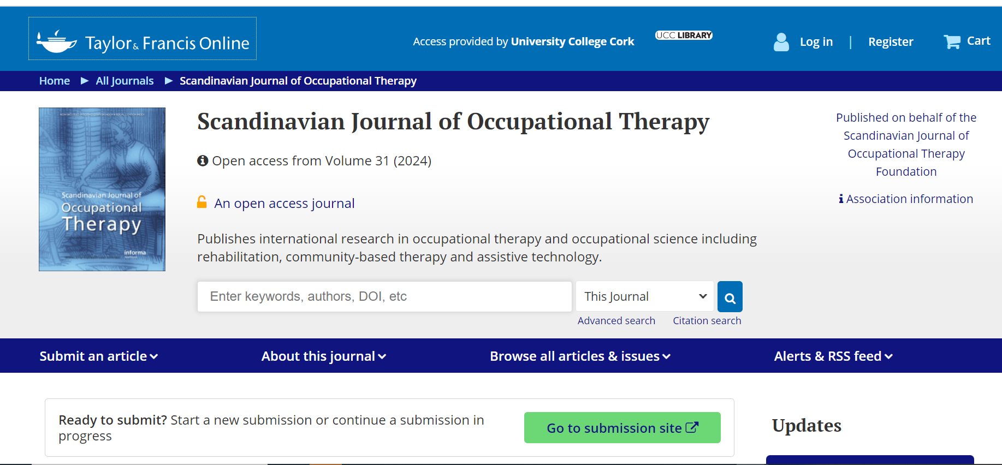
Watch out for Gold Open Access Journals!
Don’t depend on an IReL APC, you may not get one!
If you are publishing in a hybrid journal you have the option of publishing behind a paywall and making your work available under the Green route: archiving the Accepted Version in a repository like CORA.
If you are publishing in a Gold APC journal, and there are no IReL APCs left, you have to find an alternative funding source. The APC is mandatory in a gold fully open access journal. Beware!

Slide 26
Diamond OA in UCC:​
UCC Library Services support Diamond Open Access publishing though OJS – eg The Boolean, Scenario and Alphaville Journal
We also support diamond OA publishing though membership of The Open Library of Humanities journal
Notes:
The CORA Team and Library systems staff have worked together to facilitate Diamond Open access journals.
Immediate Open Access publication by the journal or book publisher without payment of a fee. Copyright may be retained by the author and permission barriers to share, or reuse are generally removed.
UCC Library Services support Diamond Open Access publishing though OJS – eg The Boolean and Scenario.
The Open Library of Humanities (OLH) is a charitable organisation dedicated to publishing open access scholarship without author article processing charges (APCs). It is funded by an international consortium of libraries who have joined OLH in its mission to make scholarly publishing fairer, more accessible, and rigorously preserved for the digital future. Its partner libraries include those of the seven Irish universities, including UCC
All of its academic articles are subject to rigorous peer review and the scholarship that OLH publishes showcases some of the most dynamic research taking place in the humanities disciplines today – from classics, modern languages and cultures, philosophy, theology and history, to political theory, sociology, anthropology, film and new media studies, and digital humanities.
OLH’s mission is to support and extend open access to scholarship in the humanities – for free, for everyone, for ever.

Slide 27
PG6009-Graduate Information Literacy
Research Resource Discovery​
Comprehensive search & review of the literature, including using research databases, internet resources, social web tools​
​
Research Resources & Academic Integrity​
Critically evaluating information resources in terms of authority & value; considering ethical issues, and using reference software to manage research information​
​
Open Research & Dissemination​
Research Data Management: How to draft a data management plan, FAIR principles​
Publishing & Disseminating: scholarly communication process; various routes to publication, especially Open Access & self-archiving
Target Audience: PhD & Research Masters ​
Duration: 20 hours Credit Weighting: 5 credits ​
​
Usually run twice a year ​
email: ​
LibraryLearningTeaching@ucc.ie

Slide 28
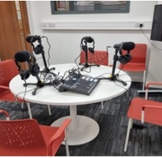
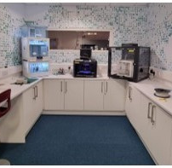
Digital Scholarship Studio
The Digital Scholarship Studio is a technology-rich space which enables new modes of knowledge building. Develop your digital literacy and integrate digital tools into your learning, teaching, and research through our:
Digital Makerspace: 3D printing, 3D scanning, and mold making
Breakout room for multi-person podcasting or for project planning and consultations for digital scholarship projects
High-spec bookable computers preloaded with specialist software ​
Equipment loans and specialist peripherals​
Guidance and advice & workshops and training ​
Other spaces include the newly upgraded Library Studio and the Virtual Reality Lounge. ​
These spaces and services are supported by Declan, Dave, Martin, William, and Stephanie who are on hand to help, Monday to Friday from 9am to 5pm. On Tuesdays, we offer extended hours until 7pm. ​
Have any questions or want to learn more?
Get in touch at librarydigitalexperiences@ucc.ie

Slide 29
Special Collections & Archives
Special Collections & Archives are repositories for primary source material and the secondary sources that support such primary sources. Whole collections or items from the collections can be used in student learning, teaching, research and outreach. ​
​
All items in Special Collections & Archives must be viewed in the section in Q-1, Boole Library and most must be requested in advance. Check our website for further information on how to locate and request. ​
​
Items include photographs & photograph albums; audio and audio-visual recordings; ​paper-based records: manuscripts, letters, diaries, bound volumes (ledgers, scrapbooks); ​maps from landed estate collections; and artworks, books, pamphlets and journals, maps, ​graphic materials, born-digital and digitised collections.​
​Services​
Access to 176 collections​
Specialist knowledge​
Use for teaching, learning, research & outreach opportunities.
Contact Us​;
Special Collections and Archives Website
General queries; specialcollectionsarchives@ucc.ie
T: 021 490 2282​
​Special Collections Librarian: Elaine Harrington e.harrington@ucc.ie ​
Archivists: Emma Horgan emma.horgan@ucc.ie Emer Twomey emer.twomey@ucc.ie ​

Slide 30
Accessing Other Libraries
SCONUL Access: Borrowing rights in participating libraries in the UK and Ireland
ALCID: Access to other university libraries and their collections in Ireland
More information

Slide 31
Our Socials
@ucclibrary
@UCCLibrary
@cora_ucc.ie
@UniversityCollegeCorkLibrary
Boole Bites

Slide 32
Thank you for listening!
- Donna (on behalf of the library Research Services Team)

