Slide 1
The Post Doc Hub Leading a Research Team Dr Anne Gannon 1st October 2021

Slide 2
Session Objectives
To explore what leadership is
To identify what make leaders effective
To reflect and develop some insight into enhancing your own leadership style and approach
To consider and plan for your ongoing leadership development

Slide 3
What is Leadership?
Leadership is a process of social influence, which maximises the efforts of others, towards achievement of a goal
(Kruse, K.2013)
Leadership is the ability to influence others, with or without authority
(DeLisle,P. 2019)
Leadership is a process of giving purpose (meaningful direction) to collective effort, and causing willing effort to be expended to achieve purpose.” (Jacobs & Jaques, 1990)

Slide 4
The Practice of Leadership
From working with and observing leaders in action, what is effective leadership from your own experiences?
Consider
What makes a leader effective?
What do effective leaders do and how do they do it?
What do others look for in a leader?

Slide 5
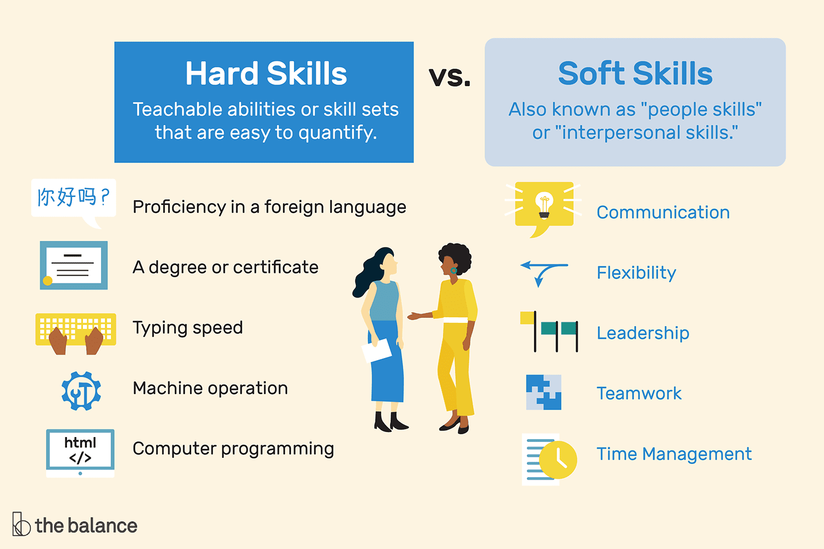
Hard Skills & Soft Skills

Slide 6
Leading by example
85% of job success comes from having well-developed soft skills & people skills.
15% of job success comes from technical skills & knowledge (hard skills)
(Harvard University, the Carnegie Foundation & Stanford Research Centre)

Slide 7
What is Leadership?
……the accomplishment of a goal through the direction of human assistants.
The leader may not possess or display power; force or the threat of harm may never enter into their dealings They may not be popular- nor a colourful person; Their unique achievement is a human and social one which stems from his understanding of his fellow workers and the relationship of their individual goals to the group goal
(E.C.H Prentice, HBR, 2004)
Notes:
https://hbr.org/2004/01/understanding-leadership

Slide 8
What is leadership?
Leadership – it starts with you.
(P.Drucker)
Leadership is about who you are
Leadership is about how you act
Leadership is about what you do
Leadership is about how you work with others
(Kotter, 2012)

Slide 9
Emotional Intelligence (EQi) and Leadership
Emotional intelligence is defined as the ability to understand and manage your own emotions, as well as recognise and influence the emotions of those around you.
More than a decade ago, Daniel Goleman highlighted the importance of emotional intelligence in leadership,
“The most effective leaders are all alike in one crucial way: They all have a high degree of what has come to be known as emotional intelligence. It’s not that IQ and technical skills are irrelevant. They do matter, but...they are the entry-level requirements for executive positions.”

Slide 10
What is emotional intelligence?
5 Elements comprising
Self-awareness.
Self-regulation.
Motivation.
Empathy.
Social skills.
(Daniel Goleman, 2009)

Slide 11
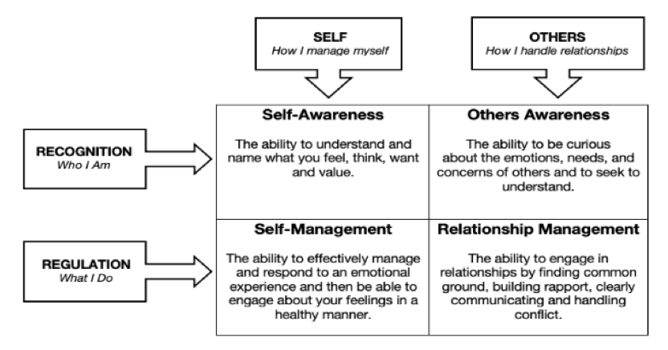
Exploring EQi

Slide 12
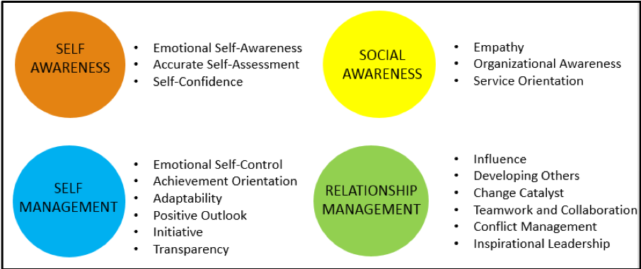
Leadership Competencies

Slide 13
Leadership Styles In Practice
 | Modus operandi of the leader | Style in a Phrase | Underlying EI Competencies | When this style works best
DIRECTIVE / COERCIVE | Demands immediate compliance | “Do what I tell you, now!” | Drive to achieve, initiative , self-control | In a crisis, to kick start a turnaround, or with a problem
AUTHORITATIVE / VISIONARY | Mobilises people toward a vision | “Come with me.” | Self-confidence, empathy, change catalyst | When changes require a new vision, or when a clear direction is needed.
AFFILIATIVE | Creates harmony and builds emotional bonds | “People come first” | Empathy, building relationships, communication | To heal rifts in a team, motivate people during stressful times.
Notes:
ANNE

Slide 14
Leadership Styles In Practice
Leadership Style | Modus operandi of the leader | Style in a Phrase | Underlying EI Competencies | When this style works best
PARTICIPATIVE / DEMOCRATIC / COLLABORATIVE | Forges consensus through participation | “What do you think?” | Collaboration, team leadership, communication | To build buy-in or consensus, to get input from valued employees
PACE-SETTING | Sets high standards for performance | “Do as I do.” | Conscientiousness, drive to achieve, competent team | To get quick results from a highly-motivated and competent team.
COACHING | Develops people for the future | “Try this” | Developing others, empathy, self-awareness | To help an employee improve performance or develop long-term strengths
Notes:
ANNE

Slide 15
Learnings about Leadership and EQi
When the leader succeeds, it will be because they have learned two basic lessons: people are complex, and people are different. (W.C.H Prentice, HBR, 2004)
There are pros and cons to every style​
Remember, regardless of your role - it takes two to tango!​ seek to be both respectful and adaptable
It is your responsibility to consider how your style can impact others and work actively to develop an environment which is conductive to good morale

Slide 16
What do followers look for in their leaders?
Authenticity
Followers want leaders who are extremely good at what they do, but who have not lost sight of where they have come from, or who they are.
Significance
Followers tend to respond to leaders who make them feel like their contributions matter.
Community
Followers also look for their leaders to create a sense of common purpose at work, and a desire within the group to relate and interact with each other.
Excitement
What followers really want is to get a buzz and feeling of excitement from their leader.
Goffee and Jones, 'The Art of Followership', European Business Forum (Summer 2006), p 24.

Slide 17
The 3 C’s of Remote Leadership (Wingard, J. Forbes, 2020)
Clarity – around goals, roles, expectations, boundaries and communication
Communication – without micro-managing
Connection – create and maintain trust and engagement

Slide 18
How to actively develop your leadership skills
Reflect and identify the skills that you need to lead effectively and create an action plan to develop these
Ask for feedback from work colleagues and your manager
Take opportunities to lead – in work, volunteering etc. and reflect and learn from this experience
Take ownership for your own training and development

Slide 19
Session Learning
What will you do differently as a result of attending this webinar?

