Slide 1
Navigating the Research Recruitment Process
Carol O’Dwyer
HR Research Advisor
People & Culture

Slide 2
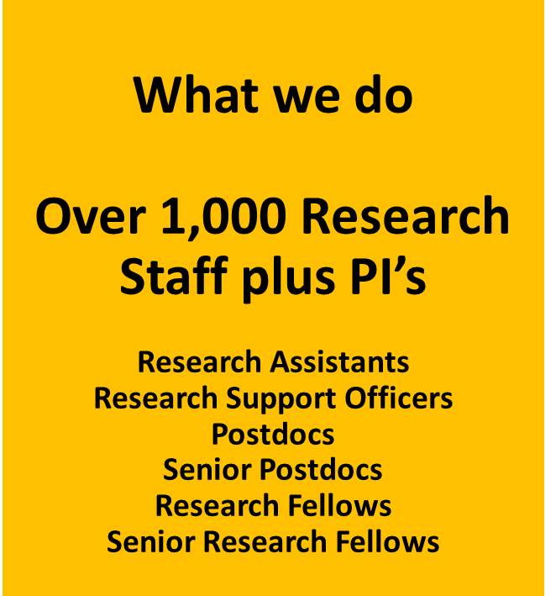
Overview of Research Recruitment
Personal & Professional Development
Career Management Structure
Recruitment
Contract Management
Salary Administration

Slide 3



Policies
Employment and Career Management Structure for Researchers (aka Employment Framework)
Framework – Research Posts
  Research Assistants
  Research Support Officers
  Postdocs
  Senior Postdocs
  Research Fellow
Regulation – Senior Research Posts
  Senior Research Posts
Open
Transparent
Merit-based
Recruitment
2013 2021 2025

Slide 4
Open, Transparent, and Merit-Based Recruitment
(OTM-R)
Open
All job opportunities are publicly advertised and easily accessible.
Transparent
The recruitment criteria, process, and timelines are clearly defined.
Merit
Candidates are assessed objectively against established criteria such as scientific excellence, skills, and experience.
Clear information is provided on the position, required qualifications, and selection process.
International and interdisciplinary applications are welcomed.
Applicants are informed about the selection stages and receive feedback after evaluation.
Decision-making is documented and traceable.
Bias is minimised through structured evaluation and, where possible, diverse selection panels.
Career breaks or non-traditional career paths are fairly considered.

Slide 5
Open, Transparent, and Merit-Based Recruitment
(OTM-R)
Goals and Benefits
Key Practices
Public posting of vacancies on recognised platforms (e.g., EURAXESS).
Use of standardised evaluation rubrics and interview protocols.
Transparent communication and feedback to candidates.
Monitoring and continuous improvement of recruitment practices.
Attract the best talent globally.
Strengthen research quality and innovation.
Foster equity, diversity, and inclusion in research institutions.
Build trust and accountability in research recruitment.

Slide 6
Career Stages
Overview of research posts and contracts.docx
Research Assistant
Entry Level
Senior Postdoctoral Researcher
Advanced Development Stage
Postdoctoral Researcher
Early-Stage Professional Training
Research Fellow
Independent researcher with own funding

Slide 7
Policies, Recruitment & Contract Management
Recruitment Process
Transparent Hiring (OTM-R)
Shortlisting & Interview
Overseen by PIs and People & Culture Research*
Contracts
Fixed-term with clear training and progression pathways.
No unpaid extensions post-contract
Support Structures
Defined roles/responsibilities for PIs, HR, Heads of Schools
Comprehensive onboarding for new and international staff
Development
Induction for researchers and implementation of development plan with PI

Slide 8
Research Recruitment Process-6 Steps
1. Pre- Advertising
Vacant post is identified​
2.Advertising
Submit an advertisement to P&C (via the Advertisement Template​
3.Shortlist
Managed by PI and one other qualified person​
Submit to P&C Research a completed Post Proposal Form (PF4)​
Approval by Head of School and Research Accounts Office required
Ad posted on UCC Vacancies , Euraxess,University Vacancies for one week minimum​
Applications submitted via ESS​
Applicants shortlisted based on the essential criteria listed in the ad​
2 to 4 weeks notice for interview
4.Interview
Interview dates arranged by the PI​
Online or in-person​
Retain records for feedback at local level​
PI to obtain references (two minimum)
6.Record Keeping
A personal file will be kept of the new employee
Feedback, interview questions and scoring will be kept on record and provided if requested​
5.Offer
Informal Offer can come form PI/Hiring Dept
Formal Offer to come from HR upon New Recommendation for Appointment Form submission AND
Approval from Research Accounts

Slide 9
Research Recruitment Process
Pre-Advertsising
Advertising
Vacant post is identified​
Submit a completed PF4 July 2026 to P&C Research(hrresearchqueries@ucc.ie)
Approval by Head of School and Research Accounts Office required
Submit a completed Advertisement Template​ to P&C ​Research (hrresearchqueries@ucc.ie)
Ad posted on UCC Vacancies , Euraxess, University Vacancies for one week minimum​
Applications submitted via ESS​

Slide 10
Research Recruitment Process
Shortlist
Examples of email wording:
Managed by PI and one other qualified person​
Applicants shortlisted based on the essential criteria listed in the ad​
2 to 4 weeks notice for interview
Email to unsuccessful candidates at shortlisting Not Successful at shortlisting
Invitation for interview Invitation for Interview
Reserve Candidates after shortlisting Reserve Candidates at Shortlisting

Slide 11
Research Recruitment Process
Interview
Examples of email wording
Interview dates arranged by the PI​
Online(Teams) or in-person​
Retain records for feedback at local level​
PI to obtain references (two minimum)
Advise unsuccessful candidates of the outcome
Advise successful candidate they have been recommended for appointment and that they will be contacted by HR regarding a formal offer of appointment
Reference Request email: Reference Request email example
Email to unsuccessful candidates following interview Non Successful Candidates following interview email
Email to reserve candidates following interview Reserve Candidates Post Interview

Slide 12
Research Recruitment Process
Offer
Record Keeping
Informal Offer can come form PI/Hiring Dept
Formal Offer to come from HR upon NewRecommendation-for-appointment-to-research-postNew(1).docx submission AND
Approval from Research Accounts
Discussions on salary should not take place until the recommended salary has been fully approved in accordance with University Policy on Research Salary Guidelines.
A personal file will be kept of the new employee
Feedback, interview questions and scoring will be kept on record and provided if requested​

Slide 13
Research Support Officers & Senior Research Coordinators
With effect from 8th July 2026, all new Research Support Officer and Senior Research Coordinator posts must be advertised using the appropriate University salary grades (Research, Administrative or Technical).
New Research Support Officers and Senior Research Coordinator positions should no longer be advertised using personal rates and will instead be advertised against a specified grade in line with the duties and responsibilities of the role.
Link to Salary Scales: SalaryScales01June2026.pdf
Scales inclusive of Cost to Grant
Admin Scales Cost to Grant Admin Scales Cost to Grant RSO & SRC June 2026
Technical Scales Cost to Grant Technical Scales Cost to Grant June 2026
Clinical Nurse Manager B Cost to Grant Clinical Nurse Manager B June 2026 Cost to Grant
For further information or assistance please contact hrresearchqueries@ucc.ie

Slide 14
Regulation (Senior Research Posts)
For the purposes of this regulation Senior Research posts are defined as posts at the level of:​
Centre/Unit Director​
Senior Research Fellow ​
Senior Research Manager ​
Senior Research Coordinator​
*To be eligible to fall under regulations, salary must be above the threshold of €81,700per annum.

Slide 15
Regulation (Senior Research Posts)
When recruiting for Senior Research Posts the University Regulations will apply​
Objective: Attract and appoint high-calibre researchers to roles such as Senior Research Fellow, Research Manager, etc.
Key Principles:​
Fairness & transparency in hiring​
Equality, diversity, and non-discrimination (in line with Irish legislation)​
Structured, rigorous process led by trained panels​
Other Regulations | University College Cork

Slide 16
Regulation (Senior Research Posts)
For Senior Research posts, where the salary is above €77,600 please forward a completed and signed PF4to HR ResearchQueries (hrresearchqueries@ucc.ie )in the first instance. ​​
Approval will be sought from Vice President for Research and Innovation and, HR Business Manager Research to proceed.​
In the meantime, you will be asked to provide a list of Selection Committee members including an external assessor and the job ad as per regular research posts

Slide 17
Regulation (Senior Research Posts)
Selection Committee Composition
Committee Structure & Pre-Interview Responsibilities
Chair (external to recruiting unit)​
Principal Investigator​
Academic Heads​
External Assessor​
HR Representative
Draft job advertisement, selection criteria & info pack​
Ensure gender balance ​
Conflict-of-interest checks​
Plan search strategy and shortlist based on essential/desirable criteria​
Organise Interviews

Slide 18
HR Participation and Support
A HR representative attends shortlisting meetings
The HR Rep attends at the start and end of the interview process
The HR Rep briefs the Selection Committee on policy, procedures, relevant legislation, scoring and question format
Both the HR Rep and the Post Administrator are available throughout the course of the process in a support and advisory role

Slide 19
Conflict of Interest
All those involved in the recruitment of research staff are reminded of the University’s Policy on Conflict of Interest in relation to Recruitment and Promotions. ​
In the event that a PI or selection board member has a family or social connection to a candidate for a research position the PI should contact People & Culture Research for guidance​
​
Please familiarise yourself with the Code of Conflict of Interest in Relation to Recruitment and Promotions.

Slide 20
Short Term Appointments
Where the term of the research funded project is less than 6 months, the PI can with the authorisation of the Head of School/College/Centre/Unit and Research Accounts, offer a nonstandard contract under the following circumstances:​
(i) where a specific skill set is required for less than 6 months​
(ii) where a contact is issued for a replacement for a post doc who has resigned during the project​
(iii) where a contract is issued to cover leave of less than 6 months.​
There is no advertising requirement for contracts of less than 6 months duration.​
Short Term appointments can be issued for a maximum of 6 months and will under no circumstances be extended.

Slide 21
Short Term Appointments
To initiate a short term research appointment you must:
Submit a completed Short Term Research Appointment form to hrresearchqueries@ucc.ie
Also submit a CV for the appointable candidate

Slide 22
Meet the Research Team
Mary O’Regan
HR Business Manager marykate.oregan@ucc.ie
Carol O'Dwyer
HR Research Advisor carol.odwyer@ucc.ie
Niamh Buckley
Senior Executive Assistant
Niamh.buckley@ucc.ie
Laura McSweeney
HR Coordinator
l.mcsweeney@ucc.ie
Luca Cavallo
Research Support Officer
LCavallo@ucc.ie
Nayonika Sen
Research Support Officer
NayonikaSen@ucc.ie

Slide 23
Who Should I Contact?
Advertising
Contracts, Contract termination or extension, Payroll
Niamh Buckley (CACSSS,SEFS)
Nayonika Sen(General Enquiries)
Carol O'Dwyer
Luca Cavallo
Laura McSweeney(COMH,APC,COBL)
Secondments, Visiting Staff, Training
HR Business Manager Research
Mary Kate O'Regan

Slide 24
Useful Links
People and Culture Research | University College Cork
UCC onboarding for new staff
Updated Employment and Career Management Structure for Research Staff2019
HR Excellence in Research | University College Cork

