Slide 1

Research Data Management
Dr. Aoife Coffey, Research Data Coordinator,
Research & Digital Services, UCC Library
aoife.coffey@ucc.ie

Slide 2
Open Research
Open Methodology
Open Science or Open Research describes an on-going movement with evolving principles and practices which aim to transform the way research is performed, researchers collaborate, knowledge is shared and science is organised by facilitating more transparency, openness, networking and collaboration.
Open Access
Open Data
Citizen Science
Open Evaluation

Slide 3
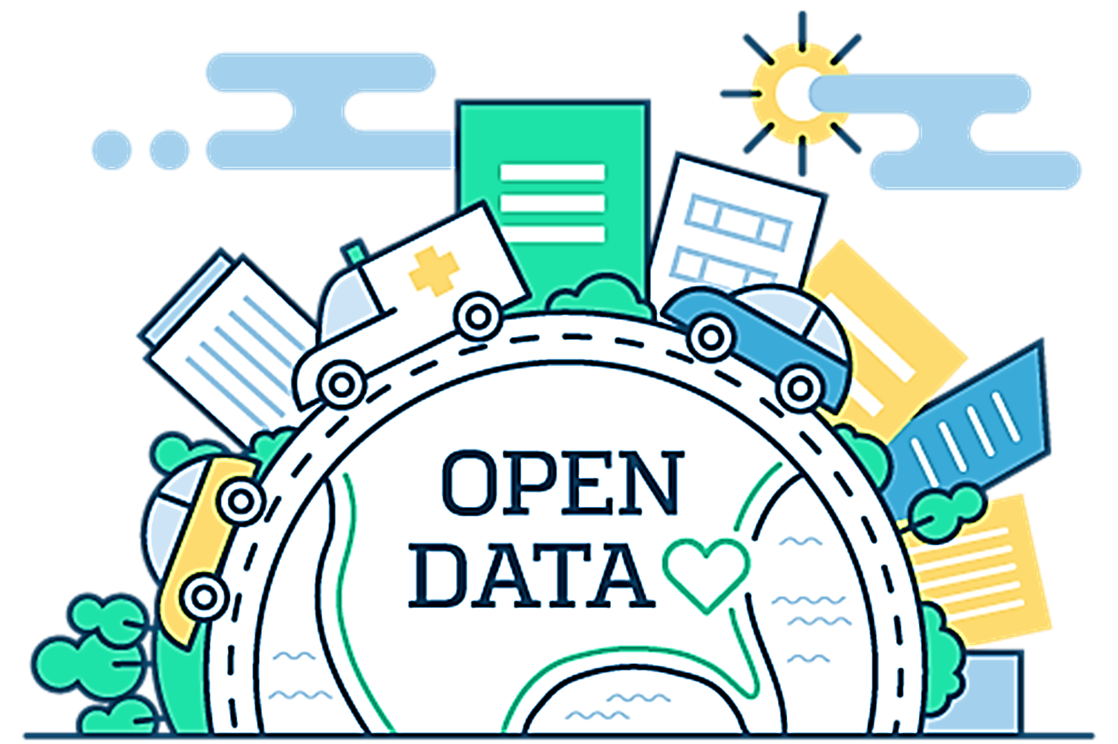
Open research data
Refers to the data underpinning scientific research results with no restrictions on its access
  Accountability
  Transparency
  Reproducibility
  Building on exiting data
  Revisiting existing data
  Better and stronger collaborations
  Value for public money

Slide 4




Make it FAIR
F + A + I = R
Findable
Accessible
Interoperable
Reusable
(… also
Reproducible, Replicable)
"as open as possible but as closed as necessary."
DOI:10.1038/sdata.2016.18

Slide 5
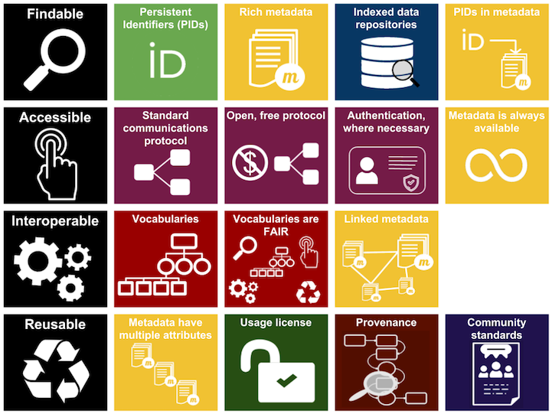
FAIR Principles
Persistent Identifiers
Metadata
Licensing
Repositories
https://libguides.ucc.ie/researchdataservice/fair
https://www.nature.com/articles/sdata201618
https://www.go-fair.org/fair-principles/
https://www.ands.org.au/working-with-data/fairdata/training

Slide 6















Why you should care about FAIR?

Slide 7
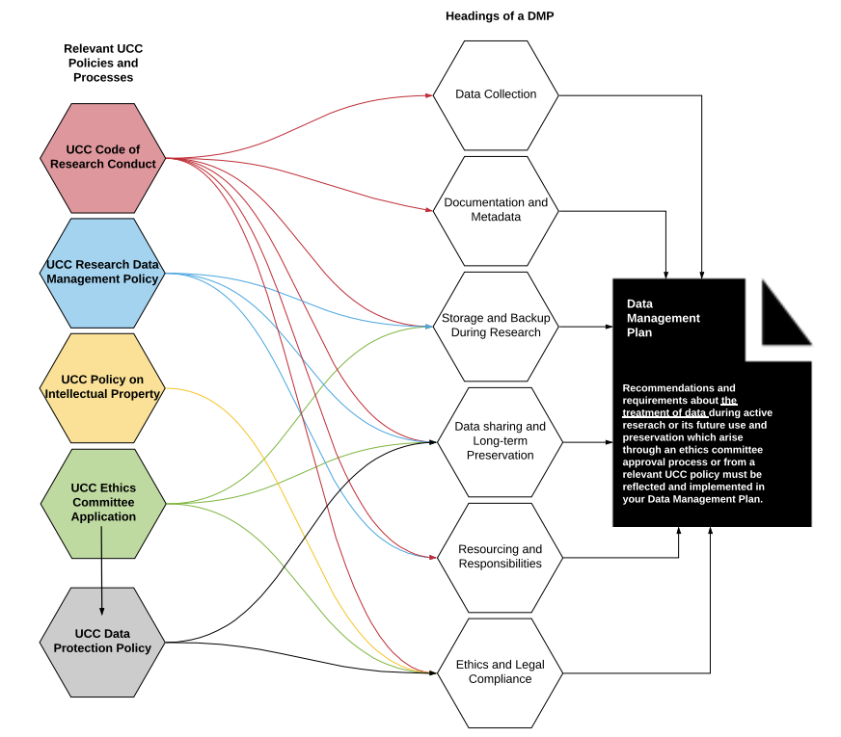
Mapping of UCC Policies and Processes to the headings of a Data Management Plan (DMP)

Slide 8
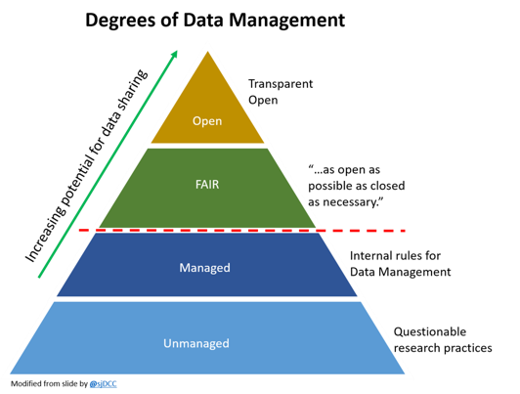

Slide 9
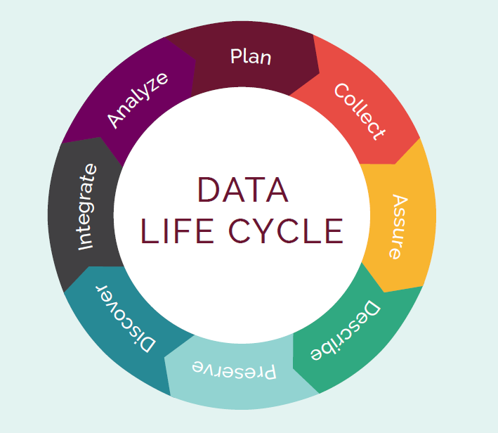
What is data management?
It is the active management of research data during they lifecycle of a project and also includes decisions about treatment of the data post-project
It involves organization, storage, preservation and potential sharing of the data
A Data Management Plan operationalises a data management strategy.
A DMP is a living document and should be updated throughout the projects lifecycle

Slide 10

Structure of Data Management Plans
1. Data Collection
2. Documentation, metadata and data quality
3. Ethics and Legal Compliance
4. Storage and Back-up during research
5. Data Sharing and Long-term Preservation
6. Resources and Responsibilities
http://www.scienceeurope.org/wp-content/uploads/2018/01/SE_Guidance_Document_RDMPs.pdf
http://survey.scienceeurope.org/upload/surveys/724948/files/RDM_Consultation_Letter_Annexes.pdf
http://www.dcc.ac.uk/sites/default/files/documents/resource/DMP/DMP_Checklist_2013.pdf

Slide 11
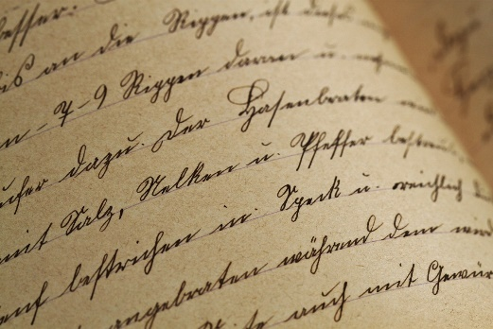
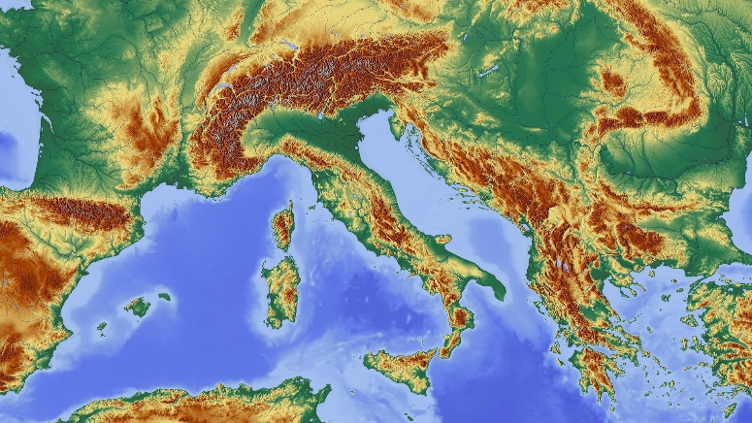



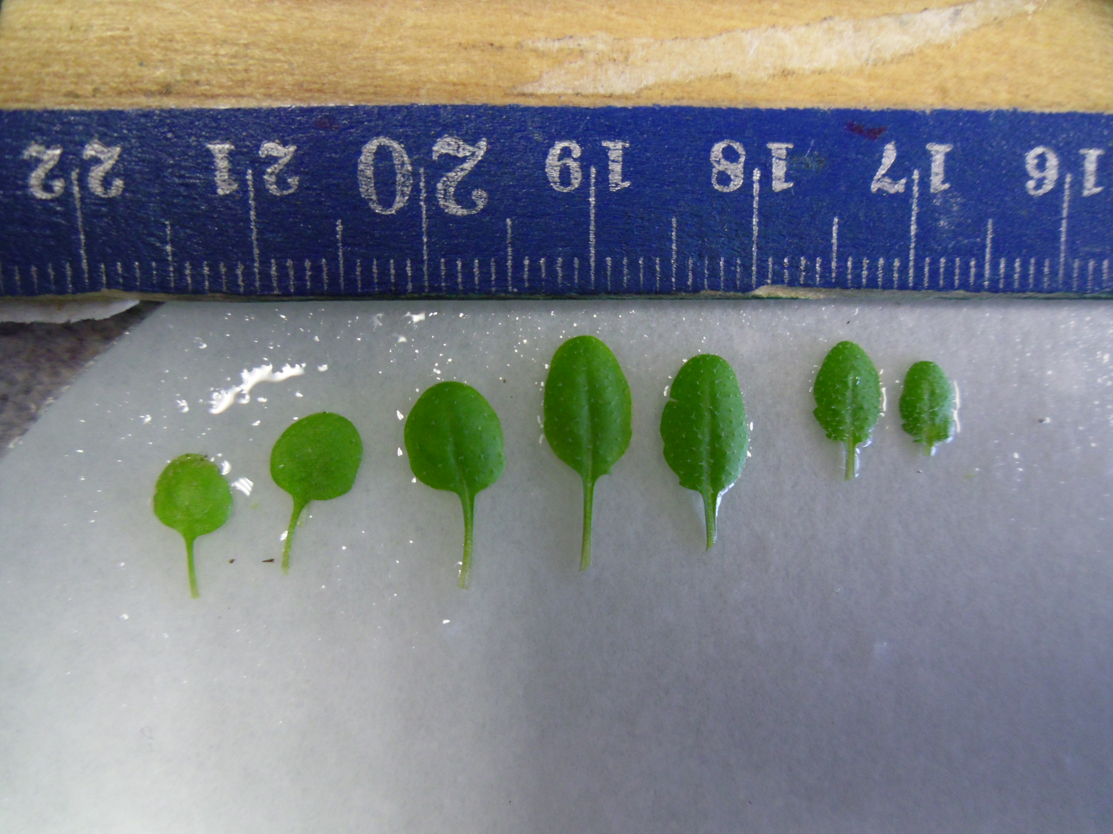




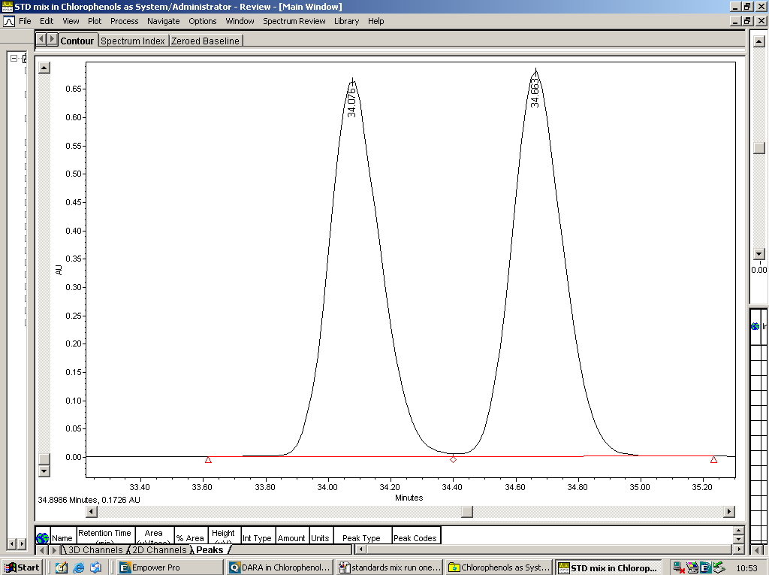
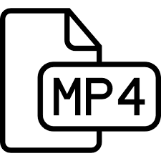



1. Data Collection
1. Data Collection
What is the type, format and volume of data?
How will data be collected or created?
What is the type, format and volume of data?
How will data be collected or created?
Secondary
Secondary
Primary
Primary
Qualitative
Qualitative
Quantitative
Quantitative
SELECT ?name ?person
WHERE {
?person a dbo:Actor .
?person dbo:birthPlace :Ireland .
?person foaf:name ?name .
}
https://openi.nlm.nih.gov/detailedresult.php?img=PMC3742216_ijms-14-13763f2&req=4
https://www.cellsignal.com/contents/resources-protocols/changes-to-recommended-western-blotting-protocols/western-variation
http://chem.ch.huji.ac.il/nmr/whatisnmr/whatisnmr.html
https://openi.nlm.nih.gov/detailedresult.php?img=PMC3742216_ijms-14-13763f2&req=4
https://www.cellsignal.com/contents/resources-protocols/changes-to-recommended-western-blotting-protocols/western-variation
http://chem.ch.huji.ac.il/nmr/whatisnmr/whatisnmr.html

Slide 12
​​​ | dataset​​ | Collection method​​ | type​​​ | format​​​ | location ​and access​​ | software required​​​
1​​​ | Field trial 1 (FT1)​​​ | Small scale field trial. Lettuce grown using 3 UV filters​​​ | Flavonoids,​​​ Plant growth parameters​​​ | Excel spreadsheet, images ​​ | FT1 Master File (hyperlink to file location)​​​ Only project member have access​​ | Excell, SPSS, ImageJ ​​​
2​​​ | ​​​ | ​​​ | ​​​ | ​​​ | ​​​ | ​​​

Slide 13

2. Documentation and Metadata and Data Quality
FAIR
Dataset level:
what is this thing, who made it, when, how...?
Internal arrangement/aggregation:
what files, folders, database tables, components make up this thing, what are they, who made them, how do I open them, how do they relate to each other, how does their naming and arrangement encode meaning?
mg, kg, cm, C⁰/F⁰, %, FV/FM, GPS, shape, colour
Variable-level:
where is the label for this variable, what does the label mean, what units were used, what are the acceptable values, how do these variables relate to each other?

Slide 14
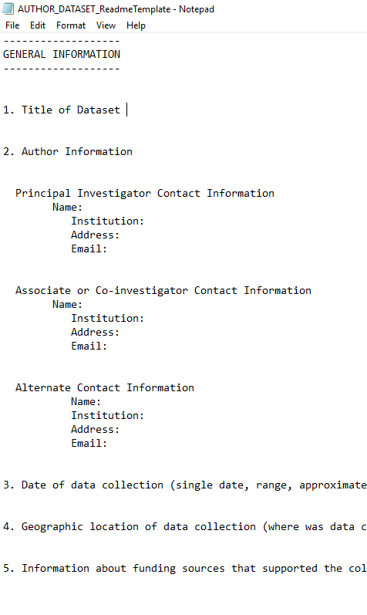
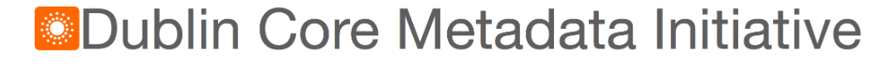
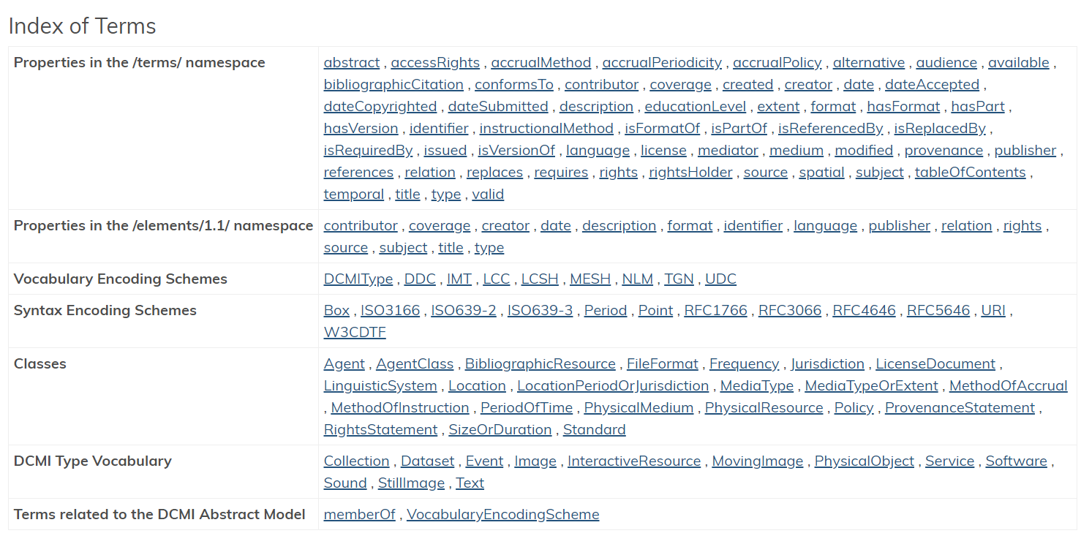

Slide 15
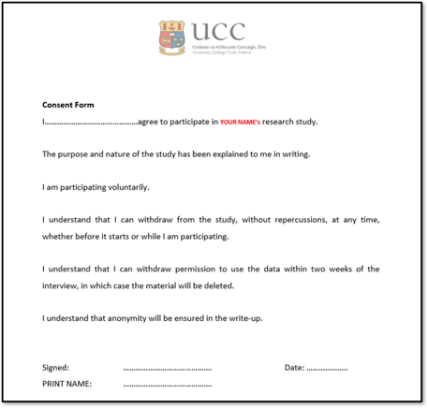
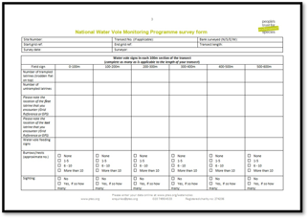
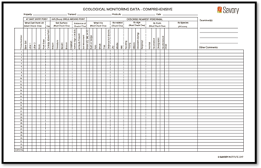

Slide 16
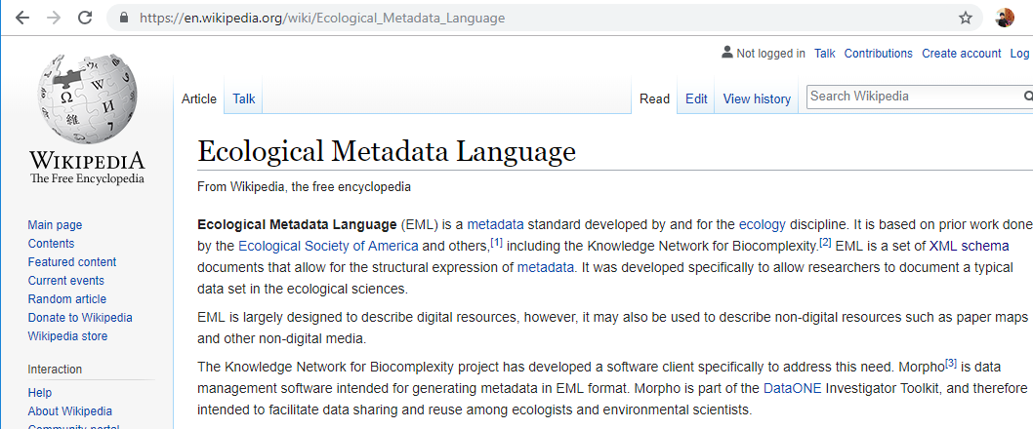


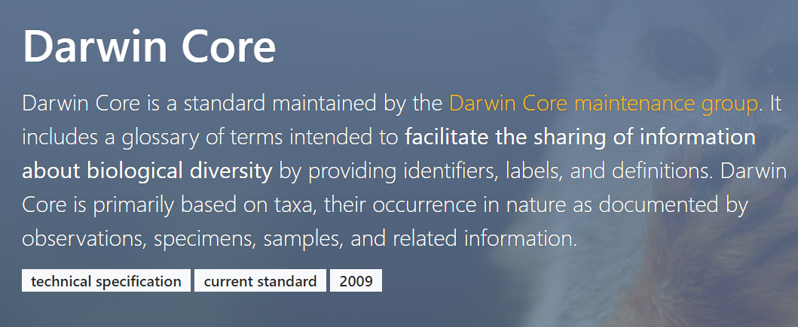

Slide 17
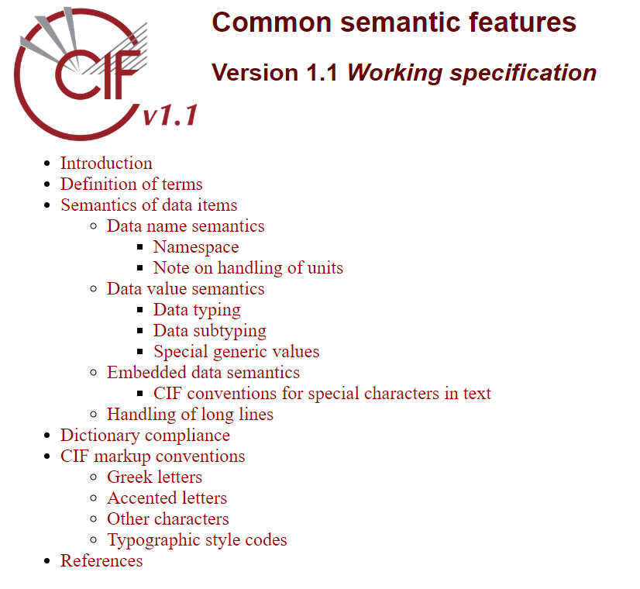



Specialist metadata standards examples
The Crystallographic Information File
Medical Subject Headings

Slide 18
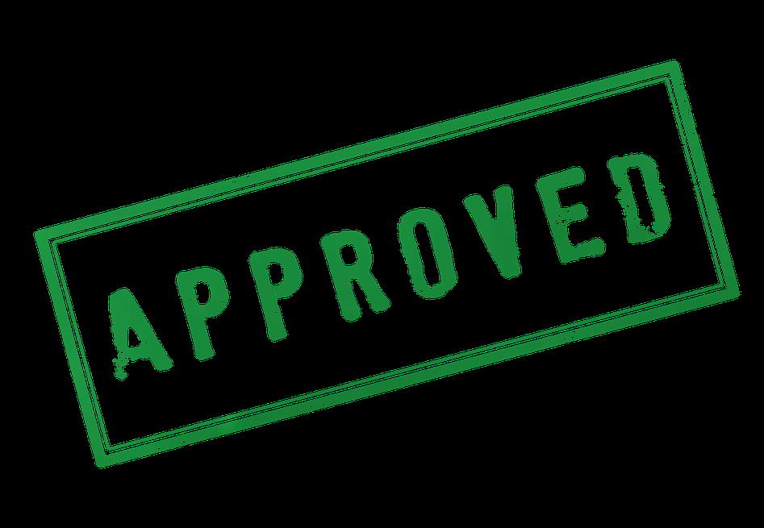

Why control data quality?
Research Integrity
You can be confident of your results and analysis
Less time spent ‘cleaning’ the data
More likely that your data will be re-used
What data quality control measures do you use?
Defined SOPs for treatment of your data
Naming conventions
Version control
Read only raw data files
Spreadsheet validation
…….etc.

Slide 19
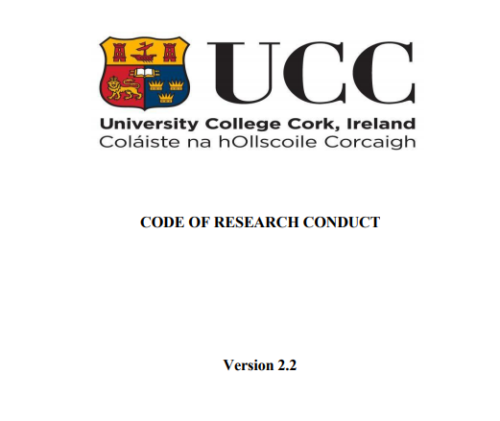
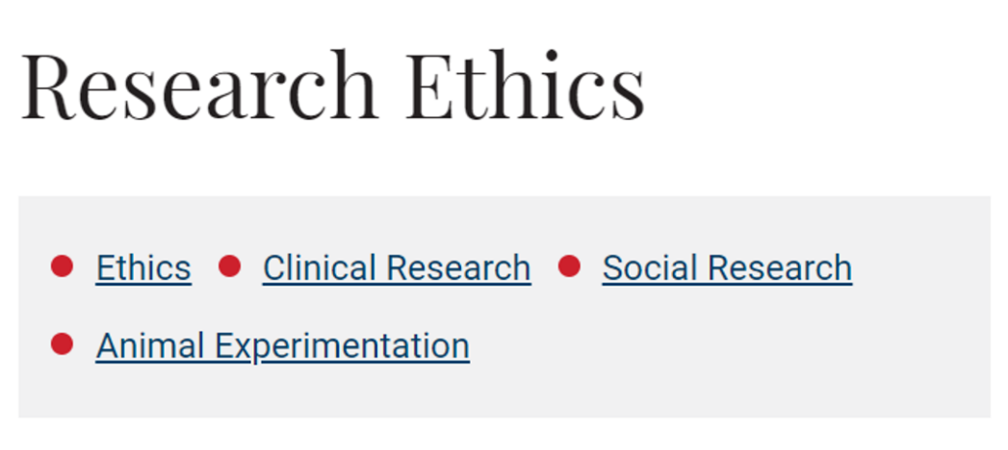

Do you have a data sharing agreement?
3. Ethics and Legal Compliance
Are you using secondary data?
FAIR
How will you manage ethical issues and codes of conduct?
How will you manage copyright and Intellectual Property Rights (IPR) issues?
Who ‘owns’ your data?
GDPR !

Slide 20






4. Storage and backup [DURING ACTIVE RESEARCH]
Automate your backups
How will data be stored and backed up during the research?
How will you take care of data security and personal data protection?
How will you manage access and security?
https://www.ucc.ie/en/it/storage/

Slide 21
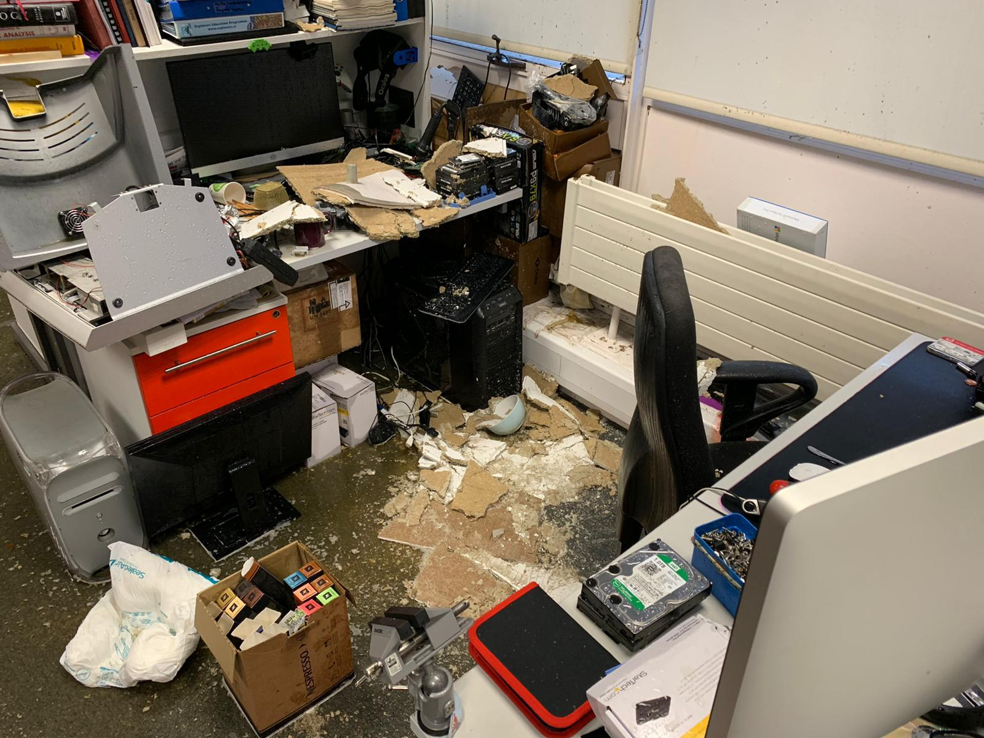
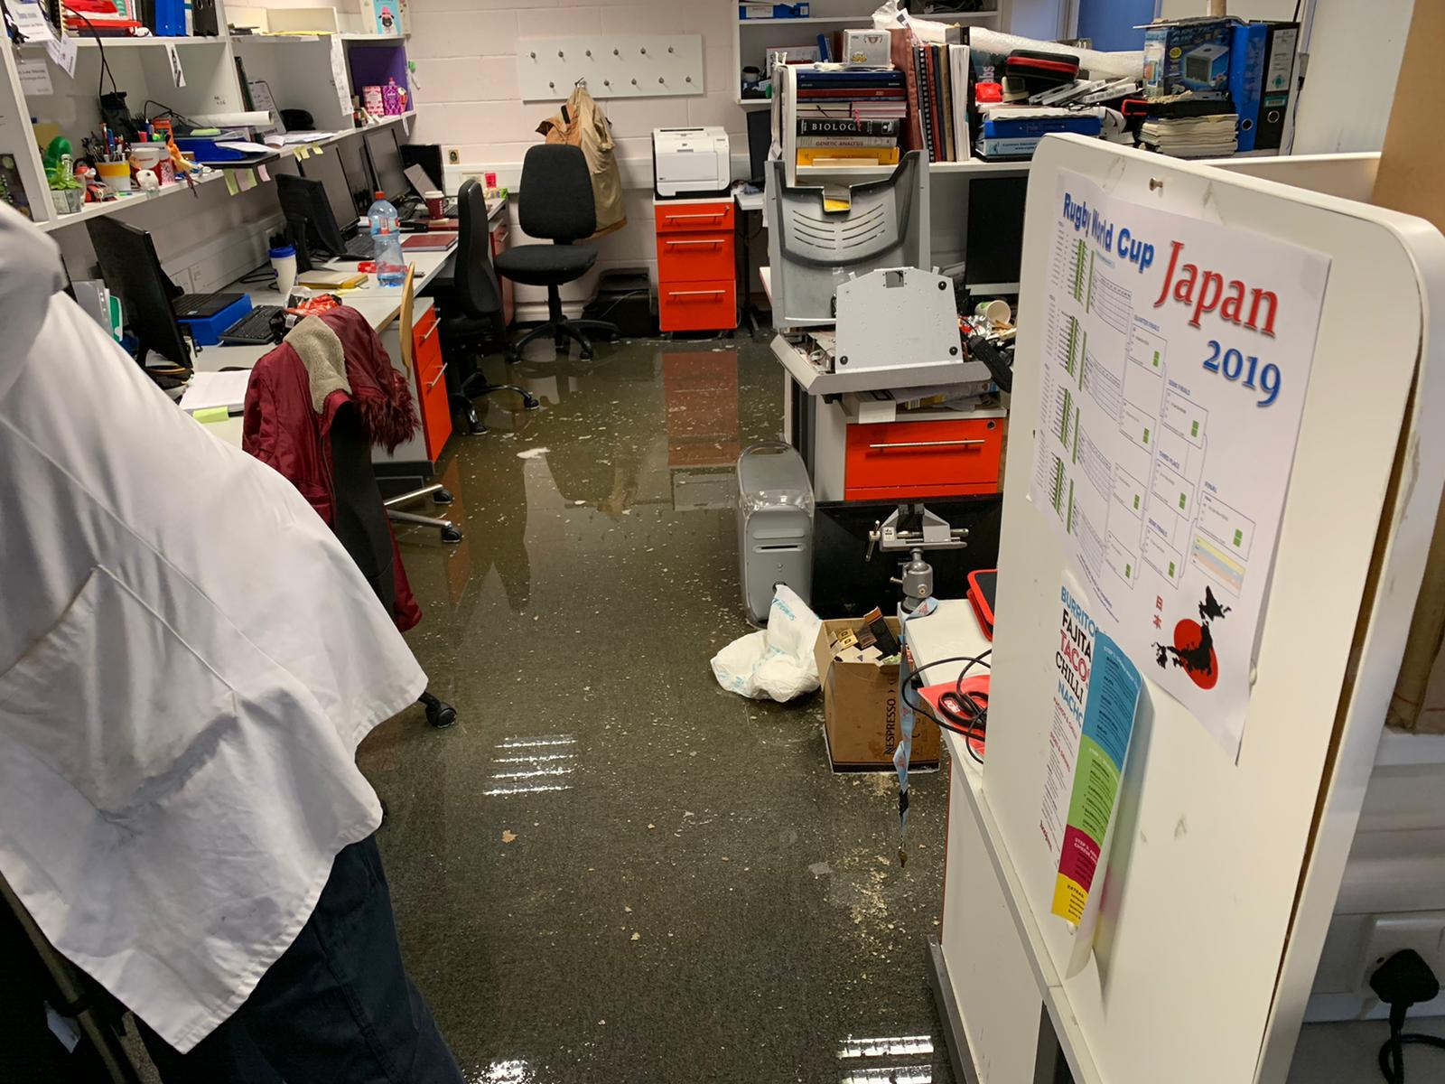
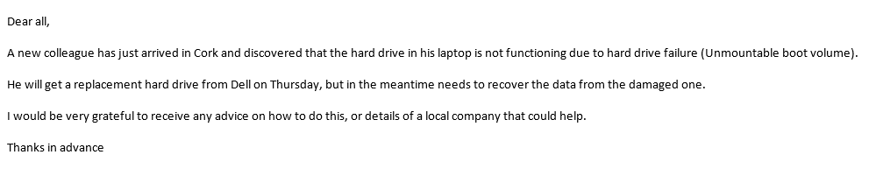
APC- Burst Radiator

Slide 22
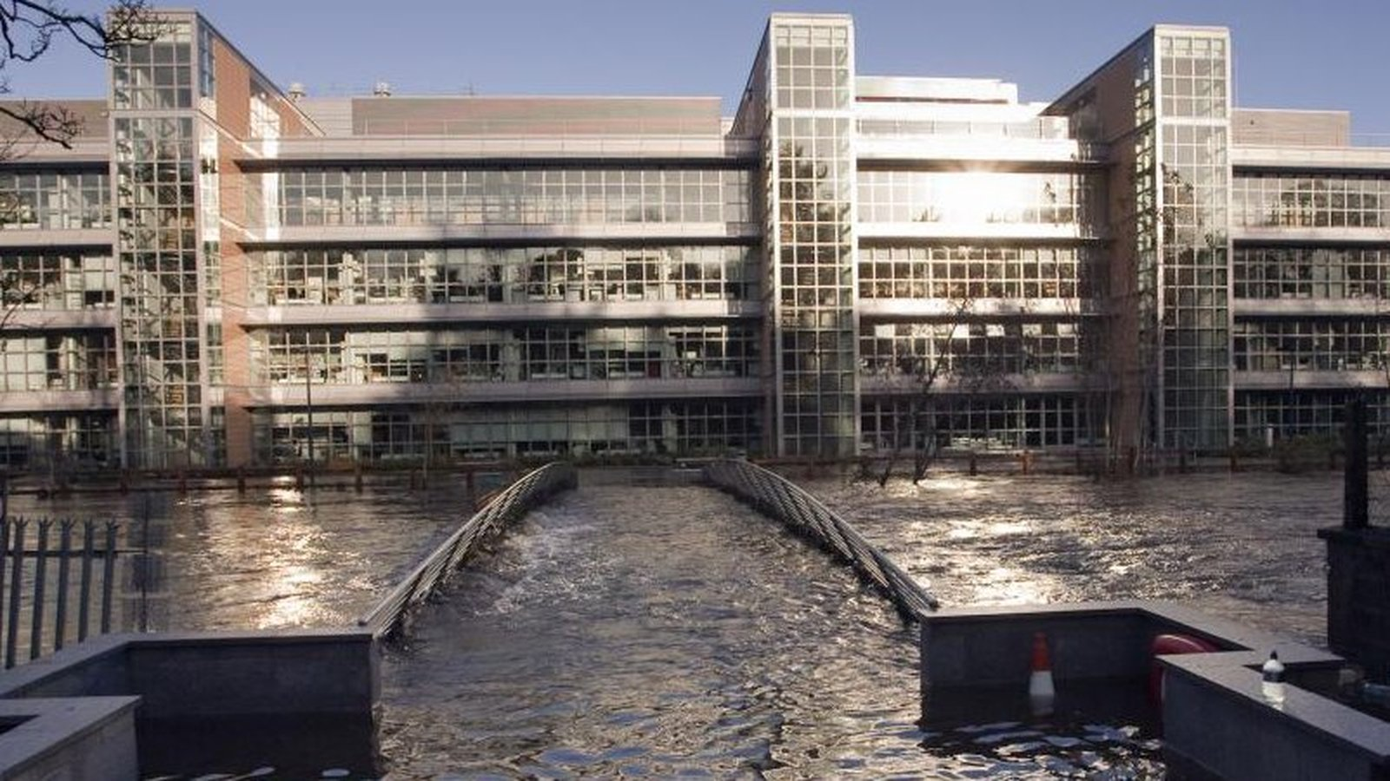
4. Storage and backup [DURING]

Slide 23
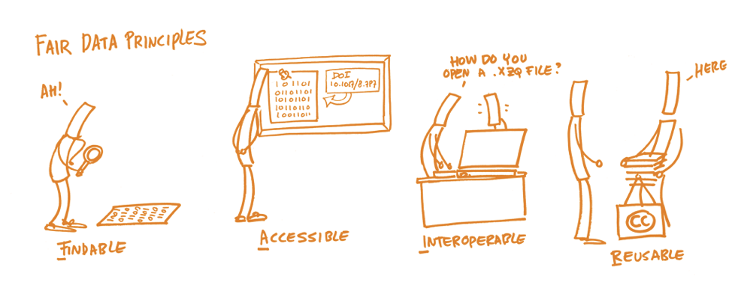

FAIR
5. Data Sharing and Long-Term Preservation
“…….collect once use many times”
https://libguides.ucc.ie/researchdataservice/fair
https://www.nature.com/articles/sdata201618

Slide 24

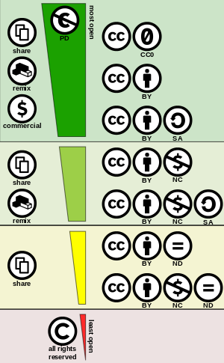




FAIR
5. Data sharing and Long-term Preservation
How and when will you share data (licences, security, possible embargo reasons)?
Will you make sure unique and persistent identifier is in use (e.g. DOI)?
https://zenodo.org/
https://fairsharing.org/
https://figshare.com/
https://creativecommons.org/

Slide 25
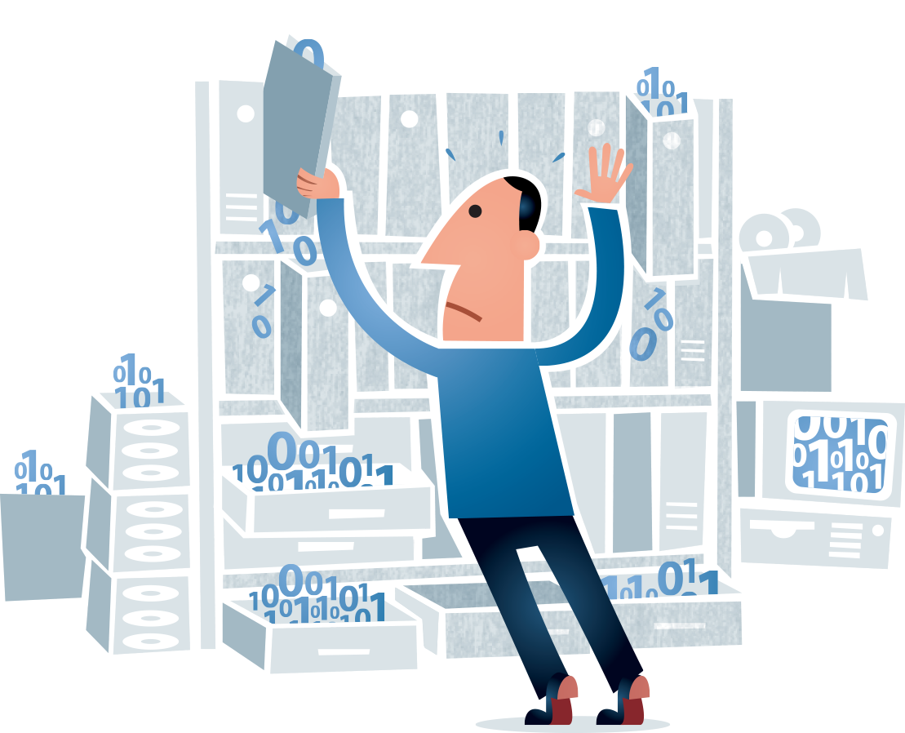
6. Responsibilities and Resources
Who will be responsible of data management?
What resources will you require to deliver your plan?
https://www.southatlanticlcc.org/wp-content/uploads/2017/10/data-management-psb.png

Slide 26
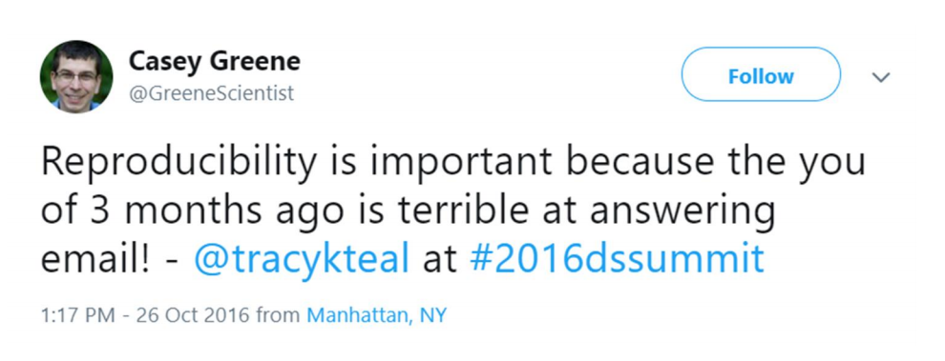
Why do you need a data management plan?
Data Management

Slide 27
Why do you need a data management plan?
Essential part of project management
Establishes clear workflows and guidelines surrounding data management
Sets out transparent data practices
Plan and allocate resources and cost
Plan infrastructure to support data
Day to day you can find and understand your data when you need to use it
There is continuity if project staff leave or new researchers join
You can avoid unnecessary duplication e.g. re-collecting or re-working data
The data underlying publications are maintained, allowing for validation of results
The data can become another output from a project

Slide 28
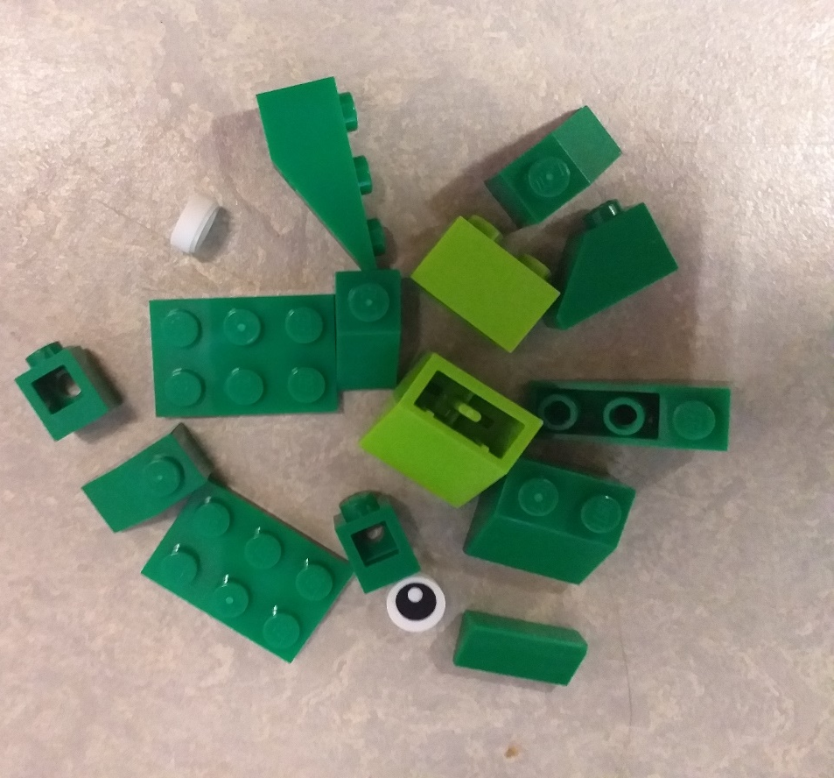
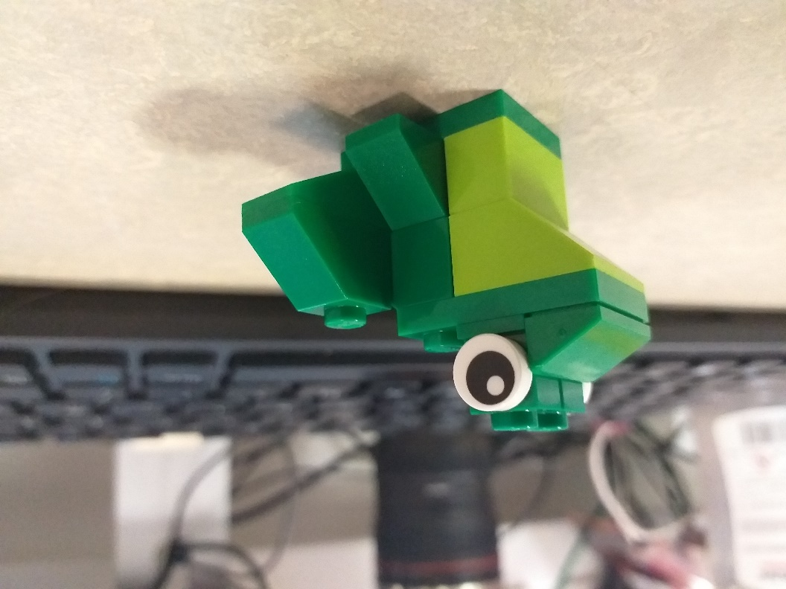
Component Parts
Published Findings

Slide 29

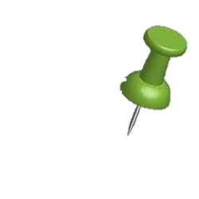




?
?
?
?
Any Questions

Slide 30


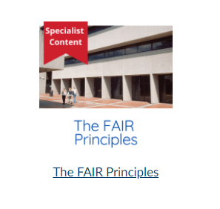
Research Data Service
One to one appointment booking
https://outlook.office365.com/owa/calendar/ResearchDataService1@uccireland.onmicrosoft.com/bookings/
Data Management Plan Review
Advice on active data management
Advice on FAIR principles, data sharing and long-term preservation
Scheduled and tailored training in data management and FAIR
Digital Badge in the Responsible Conduct of Research
Canvas Library Learning Resource https://ucc.instructure.com/courses/55
Website https://libguides.ucc.ie/researchdataservice/home

