Slide 1
Grant Writing
Niamh Mundow EU Research Officer, UCC Research, OVPRI

Slide 2
Funders

Slide 3
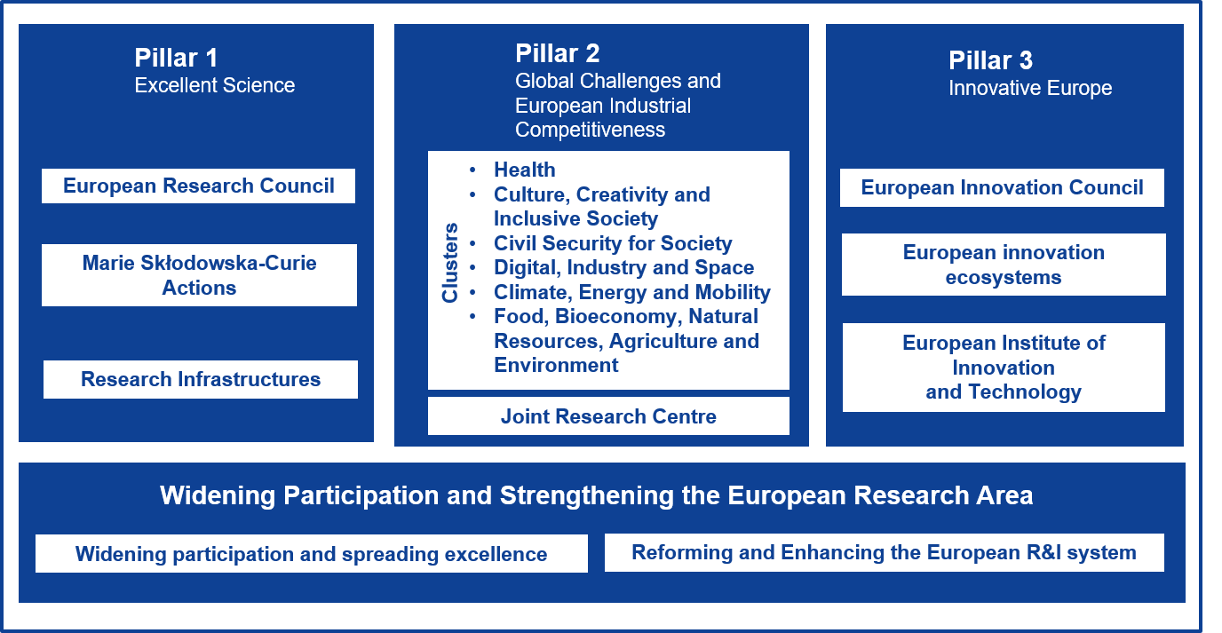
Horizon Europe

Slide 4
Excellent Science
Groundbreaking
Impact
On Science / field of research
High Risk / high gain
Starting Grant, Consolidator
n.uibreithuinaigh@ucc.ie
euresearch@ucc.ie

Slide 5
Any discipline
Impact
On your career
Mobility
Excellent science
MSCA Post Doctoral fellowships
MSCA-PF@ucc.ie

Slide 6
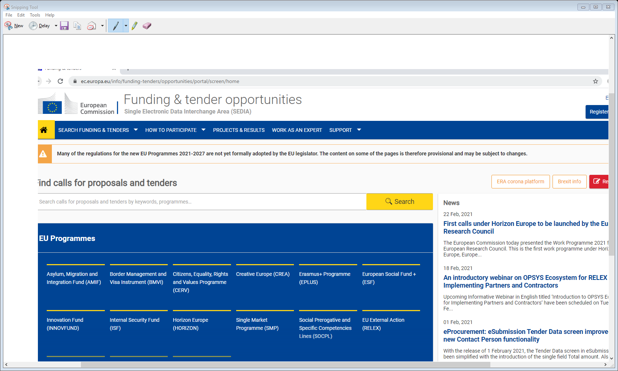
Portal
Read the Work Programme
The Guidance Document
Download the templates, with headers and questions to be addressed
MSCA guide for supervisors
Data management plan

Slide 7
Part A – Application
Part B - proposal
Excellence Weighting: 50%
1.1 Quality and pertinence of the R&I objectives and the extent to which they are ambitions/ beyond state of the art
1.2 Soundness of proposed methodology – including interdisciplinary approaches, gender, diversity, quality of open science, engagement of civil society
1.3 Quality of the supervision, training and two way transfer of knowledge between the researcher and the host
1.4 Quality and appropriateness of researchers existing experience in relation to the proposed project
MSCA Post Doctoral fellowships
B1 10 page limit
Formatting: A4, Times Roman, Font 11
Tables Font 8 – illustrating proposal, not providing core information

Slide 8
Part B - proposal
Impact Weighting – 30%
2.1 Credibility of measures to enhance career perspectives and employability of researcher and contribution to skills development
2.2 Suitability and quality of the measures to maximise expected outcomes and impact as set out in the dissemination and exploitation plan, including communication activities
2.3 The magnitude and importance of the projects contribution to the expected and scientific, societal and economic impacts
MSCA Post Doctoral fellowships
Each heading has subheadings NB these are not suggestions, these are required

Slide 9
Part B - proposal
Quality and efficiency of implementation – weighting 20%
3.1 Quality and efficiency of the work plan, assessment or risks and appropriateness of the effot assigned to work packages (nb gantt chart)
3.2 Quality and capacity of host institutions and participating organisations including hosting arrangements
MSCA Post Doctoral fellowships
Consider placements / secondments

Slide 10
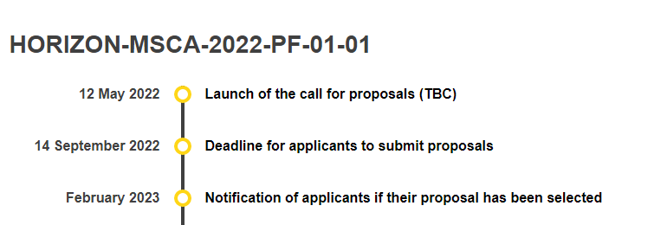
B2
CV / Track record
Publications
Presentations
Conferences
Research expeditions organised by PI
Funding so far
uploaded separately
MSCA Post Doctoral fellowships
MSCA-PF@ucc.ie

Slide 11
Horizon Europe

Slide 12
Global Challenges
Cluster 6: Food, Bioeconomy, Natural Resources, Agriculture, Environment
https://ec.europa.eu/info/research-and-innovation/funding/funding-opportunities/funding-programmes-and-open-calls/horizon-europe/cluster-6-food-bioeconomy-natural-resources-agriculture-and-environment_en

Slide 13
What new knowledge are you generating?
Will this make Europe a leader in Science?
Why hasn’t this been done before?
Are you the best person for this?
Is this knowledge already available?
Partnering in a consortium
Who are the other partners
Are they using an idea they had that matches a call or trying to fit their idea into a call
How long have they known this call was coming
What is the research question and is this in the abstract
What policy is underlying in the call / who wrote the call

Slide 14
TIP
The best way to access successful and unsuccessful applications is by registering as an expert

Slide 15
Understand Funding landscape
Network / Mentor
Time
Eligibility / CV
Templates
UCC Research
EI supports
Portal

Slide 16
https://www.ucc.ie/en/research/support

