Slide 1

Welcome to UCC Innovation
2024 Orientation for Researchers
UCC Innovation - Creating impact from your research through commercial engagement
Commercial Awareness and Knowledge Transfer

Slide 2

About Us
Getting UCC's ideas and expertise to the
commercial arena to
  benefit society,
  impact on the economy
  provide a return to the university to further advance its research mission
National Leader in Licenses, Industry Research Income
ISO9001:2015 Accredited Processes
Active “New Ventures” establishment and development programme

Slide 3

Research and innovation make a real and positive impact across society, the economy and the environment, both domestically and internationally.
Enterprises, particularly SMEs, start, succeed and transform through innovation, knowledge exchange, research commercialisation and access to highly skilled people.
Research excellence is enabled by a world class, accessible environment supported by a clear Strategy architecture and institutional landscape.
Research and innovation contribute to a shared island and an innovative Europe through strong North-South, European and global R&I collaborations.
Investment in research and innovation is increasing, with investment rising to at least 2.5% of the domestic economy before end 2030.
Research talent is supported at all career stages, and excellence and impact are rewarded

Slide 4

Goal One:
Research and Innovation
Deliver impactful research and innovation that addresses global grand challenges in signature areas of excellence through the UCC Futures framework, resulting in a distinctive research reputation.
Implement the UCC Futures framework, informed by smart specialisation and the UN SDGs.
Improve strategic hiring, retention and development of our people at all career stages, supported by a research ecosystem and career framework.
Increase PhD enrolment numbers, enhance the research student experience, and embed research and innovation into our curriculum.
Transform UCC’s research culture through the implementation of engaged research and open research, underpinned by academic integrity, and ethical and responsible practice.
Create an innovation culture and entrepreneurial campus, underpinned by an ethos of creativity and discovery.

Slide 5

UCC Innovation
Ideas
Technology Commercialisation
New Ventures
Expertise
Business Engagement and Consulting

Slide 6
What we do
New Ventures
Relationship opportunity
UCC Consulting
Technology Commercialisation
Incubation
Start Up Programmes
Spinout Formation
Identify
Protect
Market
Transfer
Negotiate Terms
Billing & Invoicing

Slide 7
The Team
Director of Innovation
Sally Cudmore
Executive Assistants
Marie Healy/Anne McSweeney
Technology Commercialisation
Kevin Dalton
Karen McCarthy
Anthony Morrissey
Emer O’Shea
Sharon Sheahan
New Ventures
Micheál Collins Spinout Manager
Myriam Cronin Incubation: incl
Sprint Programme
Eamon Curtin Ignite Programme
Damien Mulley Start Up Manager
Maeve Murphy Comm Prog Exec
Business Engagement & Consulting
Ruth Hargrove Administrator
Rachel O’Leary Head
Central Operational Support
David Corkery Head of Ops
Paddy Martin Solicitor
Sarah Nolan Communication
Chris McCahill Data & IP
Julianne Quinlan Finance
Thiffany Silva Legal Support

Slide 8





Benefiting Society & Economy - 2024
€125 m Research Expenditures
65
Invention Disclosures
31
Spinouts Still Operational as of FY2021
Research & Development
Invention
3 Spinouts
5 start ups
Formed
Public Use & Economic Growth
Technology Transfer Life Cycle
2024
Technology
Transfer Life Cycle 2021
Evaluation
Product Development
IP Protection
5
New Products Created
Licensing
Marketing
10
New Patent Applications Filed
33 Licenses & Options Executed
25 Consultancy relationships
8 Patents Issued

Slide 9
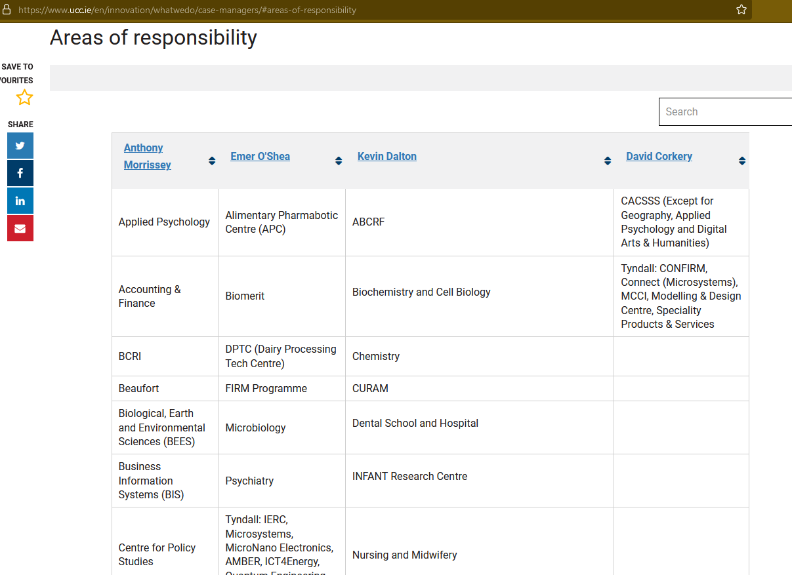

Slide 10





THE JOURNEY OF A UCC IDEA
1. What is the problem you can solve?
2. What are the competitor solutions?
3. Market feedback
4. Develop idea/ solution.
5. Team strategy and planning
YOUR Research
YOUR Initial
Commercialisation idea
Building a commercial opportunity
Commercialisation
Product Development
Market launch
Supported by UCC Innovation
Led by UCC
Led by Commercial Champion

Slide 11

HOW WE CAN HELP
c
Learning
Digital Badge in IP and Innovation
SPRINT Strategies for Business Development
SPRINT Market discovery and Customer validation
IP
IP protection
IP Marketing
c
Funding
EI Feasibility Funding
EI Commercialisation Funding
Developing a Commercial Team
c
Mentorship
Workshops
Other supports
Entrepreneurs-in-Residence
Investment
Expert Clinics

Slide 12
Technology Commercialisation Process
Identify
Evaluate
Protect
Market
Deal
Relationship
Internal marketing
Researcher meeting
IDF Prep
IDF submission
Customer Readiness Level (CRL)
Technology Readiness Level (TRL)
Business Readiness Level BRL)
IPR Level (IPRL)
Team Readiness Level (TMRL)
Funding Readiness Level (FRL)
Write profile
Promote
Online
In print
Phone
Valuation
Term sheet
Template agreements
Sign off
Annual royalty report
Technology "forward due diligence"
Research collaboration
Royalty audit
Patent
Copyright
Know-How
Priority
PCT
Nationalise

Slide 13






Company Formation
IP
Money
New Venture
Team
Addressable Market

Slide 14

Consultancy
Focus on Expertise
Not developing new knowledge
Currently policy focus on academic staff only

Slide 15
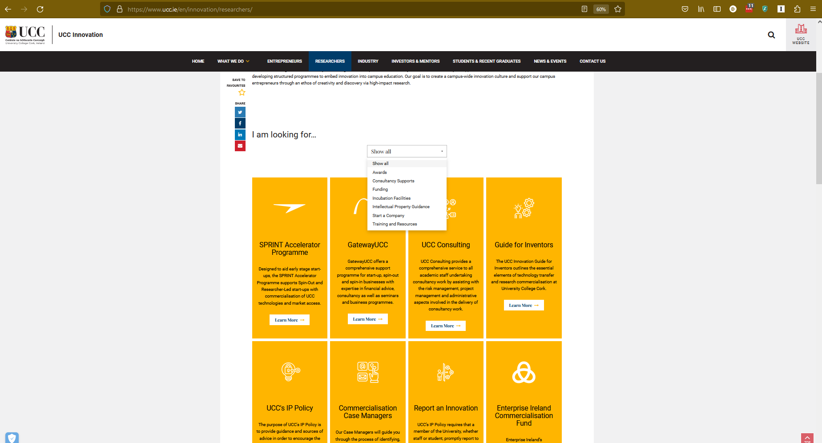
Contact Us

Slide 16
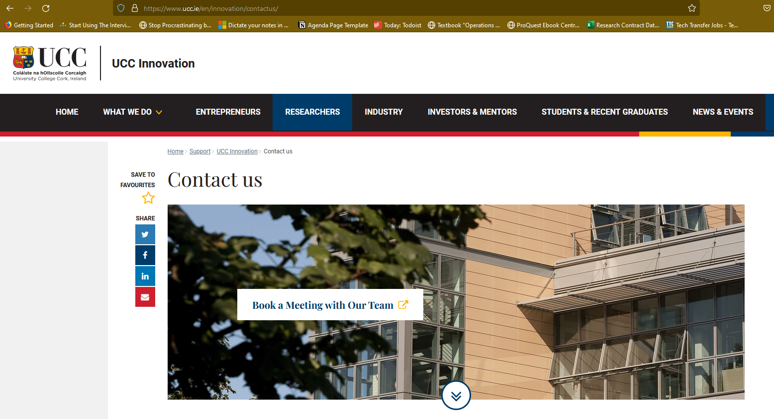
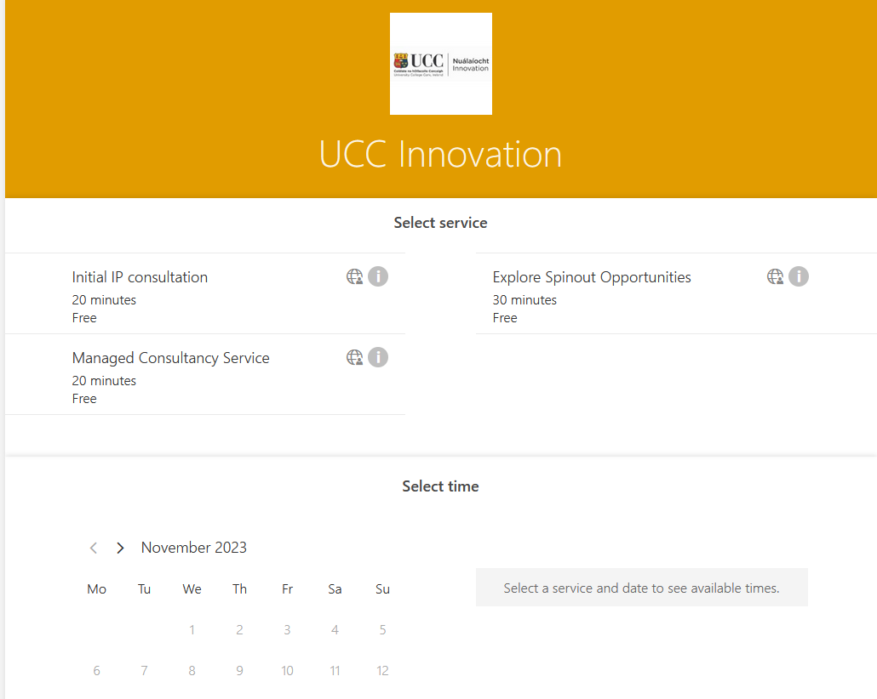
Contact Us

Slide 17

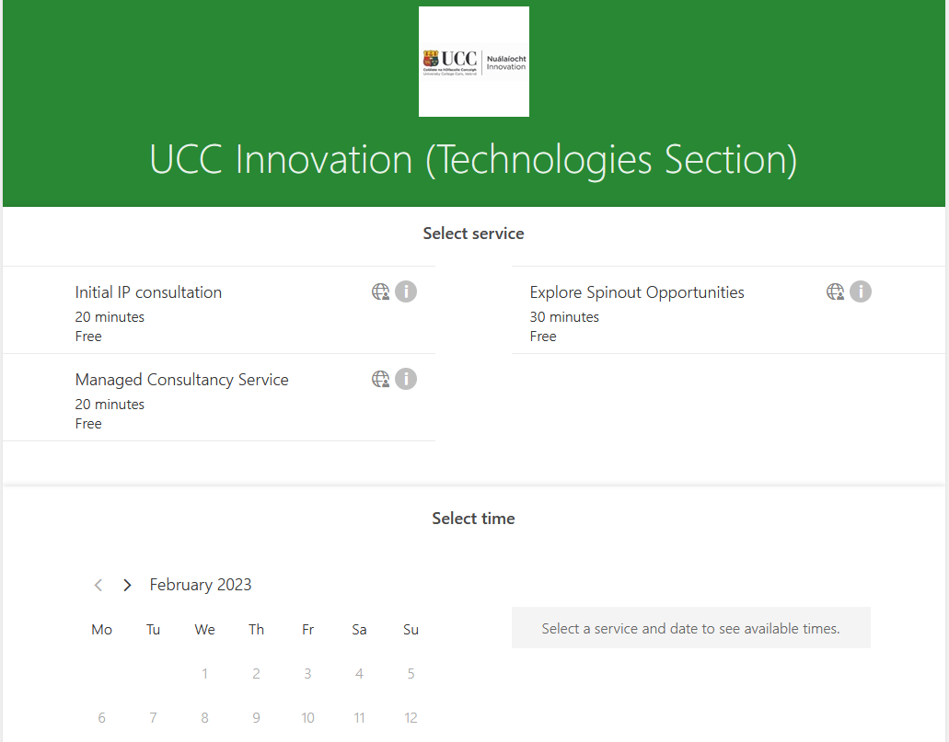
Contact Us
www.ucc.ie/en/innovation
uccinnovation@ucc.ie
+353-21-4205880 (team members)
Linkedin
Twitter
Book a Meeting

