Slide 1


An Employees’ guide to the
Employee Assistance Programme

Slide 2




What Do You Have Access To?
Employee Assistance Programme (EAP)
Up to 6 counselling sessions where required, and access to supports across legal, financial and much more.
Wellbeing Platform & App
A customised, digital platform delivering expert content on mental wellbeing, fitness and nutrition, in addition to a step counter and a calorie tracker.
For example, through the Platform, you will be able to access various Mental Health elearning courses that educates, informs and empowers you in various aspects of mental wellbeing.
Online CBT
Access to clinically led online Cognitive Behavioural Therapy pathways to expand access, drive engagement and increase recovery.

Slide 3

Accessing the EAP
Accessible 24/7, 365 days a year
It is a completely free and 100% confidential service
Free Phone: 1800 814 243
  Text ‘Hi’ to 087 369 0010 for SMS & WhatsApp Support
  Email: eap@spectrum.life
  You can Live Chat or Request a Call Back on the wellbeing portal and phone app
    Register here: https://UCC.spectrum.life/login?org=JwvaQS9w
    Use organisation code: JwvaQS9w

Slide 4


Will My Employer Know I Have Contacted the EAP?
The EAP service is a completely free & 100% confidential service. Your name and personal information will never be shared with your employer.
Who Can Contact the EAP?
The EAP is available employees, in addition to their family members who are a spouse, civil partner or dependent, where the family member can be described as a person over the age of 18 and residing at the family home.
What Information Does A Person Need to Provide on the Initial Contact?
All that we require on the initial telephone is to reference the company you work for and some high level information to confirm you are eligible to use the service.

Slide 5



What can the EAP help with?
The EAP counselling service can help with a wide variety of personal or work related issues you and your family might be facing…
  Stress
  Anxiety
  Low mood
  Marital or relationship problems
  Family problems
  Loss & grief
  Substance abuse issues
Financial worries
Questions on a legal matter
Help with career planning
Confidence issues
Consumer queries
Worries about physical health
Advice on practical, day to day issues
…and much, much more

Slide 6


Who Will You Speak with on the Initial Contact?
Fully qualified and experienced counsellors, who can offer immediate support.
Each individual is dealt with by one of our counsellors who will become a person’s dedicated Case Manager from start to finish.
On the initial contact, the Case Manager will collect a person’s contact details, discuss the issue they are facing and complete a quick assessment, taking approximately 30 minutes. This is also known as a triage process.
The Case Manager will then match the person with the most appropriate service available.

Slide 7
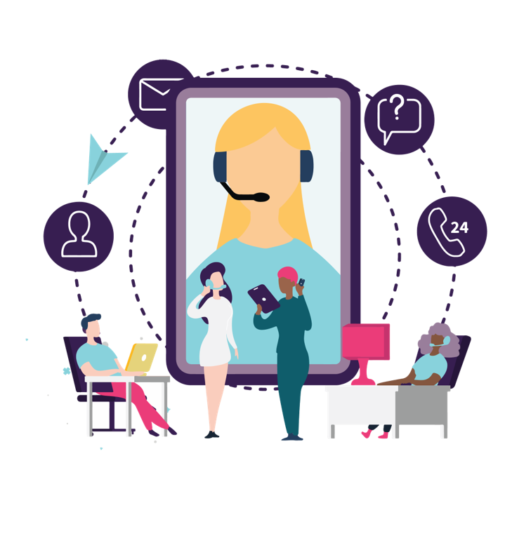
EAP Short Term Counselling
How does it work?
Where appropriate, person may be referred to counselling through the EAP following the triage process with the Case Manager.
When a person is referred to counselling through the EAP, they will be provided with up to 6 sessions of counselling, where appropriate.
Our expansive team is spread throughout the Island of Ireland, so a person may be matched with a counsellor within 30km of their home or work place, where appropriate. This may now be online due to COVID-19.
Our counsellors have a wide range of clinical specialities, meaning a person can be matched with someone experienced in dealing with their specific issue.
After being referred, a person’s appointment will be confirmed within 24 hours and scheduled within 5 days of initial contact.
Our team of counsellors speak more than a dozen different languages. Therefore, we can deliver the counselling services in multiple languages.* (See notes)
Notes:
* The initial contact via freephone, text, SMS, live chat and email will be in English.

Slide 8
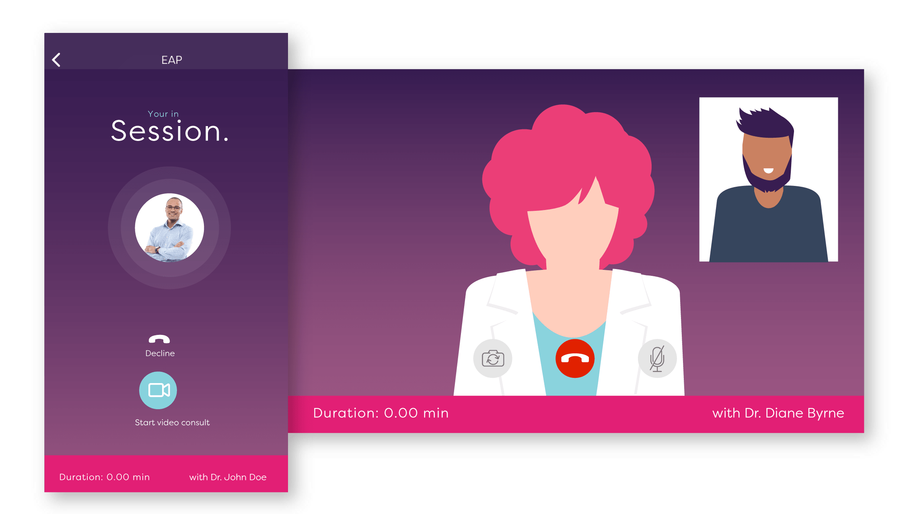
What if Face to Face Counselling is Not Possible?
There are a number of different options if face to face counselling does not suit. For example, it may not possible due to COVID-19.
In addition to telephone counselling, our video, SMS, WhatsApp, email and live chat counselling services are fully secure, meeting the highest standard of sensitive data protection.
This service is highly convenient and easily accessible.
No matter the location, a person can be linked up with a counsellor who has clinical expertise in handling the person’s specific issue.

Slide 9

Areas Of Support Beyond Mental Wellbeing
The EAP can support a person in other areas, such as:
  Financial advice
  Legal advice
  Life coaching
  Mediation information
  Consumer advice
  Advice from allied health professionals including physiotherapists, dieticians and more
  Advice on childcare and eldercare
For all of the above, the Case Manager can refer a person on for one free 30 minute telephone consultation with a relevant trained and experienced expert* (see notes).
Notes:
*A person can avail of one 30 minute consultation per year per issue. They may avail of multiple 30 minute consultations on different topics, where the topics are unrelated.

Slide 10

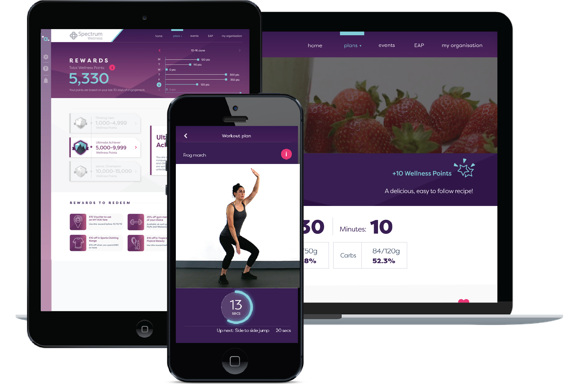

Your Wellbeing Platform and App!
What Do You Have Access To?
Access the EAP directly through the wellbeing portal (desktop) and app (phone/tablet)
  Supplying: Freephone number, text and WhatsApp number, Live chat function, request a call back function and email address.
Step and calorie counter.
Mental wellbeing, fitness and nutrition resources.
E-learning modules.
Informative blog articles on all aspects of wellbeing.
On demand webinars.
Build up wellness points for discounts on wellness brands.
Book and attend wellbeing events.
Download the app on:

Slide 11



Reach out to your EAP today for advice:
Freephone IRE: 1800 814 243
WhatsApp/SMS: Text ‘Hi’ to 087 369 0010

