Slide 1
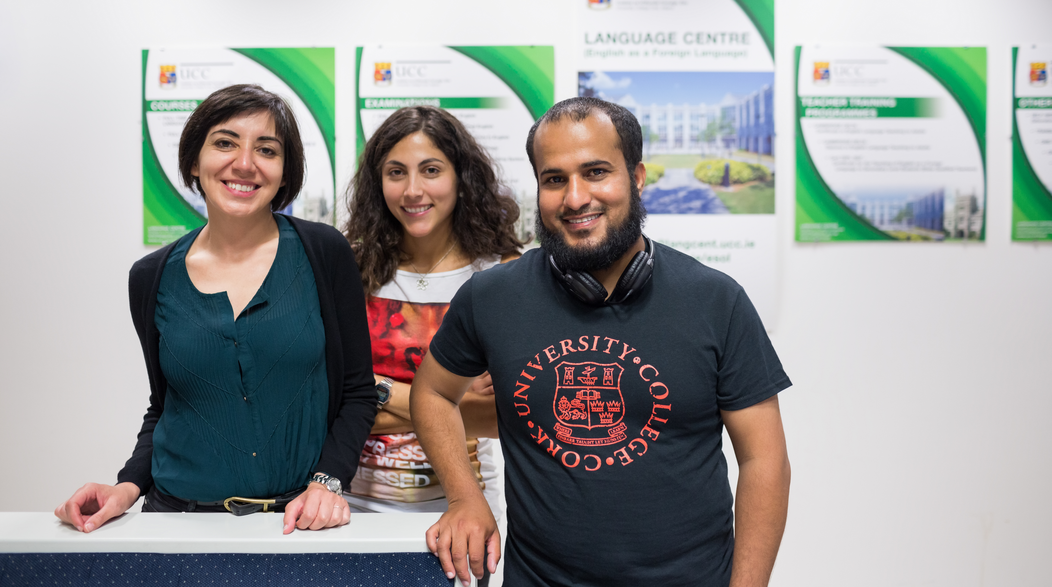
English language, academic skills and teacher development services
Handbook for staff

Slide 2
Contents
Introduction to the Centre
Page 4. Services for students
For applicants
For new students
For students on programme
Discounts on commercial courses
Page 7. Collaborative projects with schools and partners
Embedded disciplinary support
Special pathways
Special modules
Bespoke collaborative programmes for partners
Page 8. Services for staff
Language learning and acquisition expertise
Training workshops
Teacher education
Discounts on professional courses
Page 9. Contact details

Slide 3
The Language Centre is on a mission to help those who learn, teach and communicate using the English language in UCC
If you work with international students, speakers of English as a second language, are international faculty yourself, or you are interested in communication and academic discourse, then you will find something here that will assist you in your work.
The Centre is part of the Office of the Vice President for Learning and Teaching and is situated in the O’Rahilly Building. Established in 1994, it operates with a dual purpose: to provide commercially-driven courses as well as services to UCC staff and students working in the international space. Some of these services are free of charge and some have a fee attached. The Centre collaborates in various ways across all four colleges and provides assessment expertise to the admission functions.
The University Language Centre is a specialist centre with teaching practitioners working in the discipline of TESOL (Teaching English to Speakers of Other Languages). This includes the sub-specialisms of EAP (English for Academic Purposes), EFL (English a Foreign Language for adults) and ESP (English for specialist or vocational purposes), as well as teacher education.

Slide 4
Services for students
For degree applicants We provide two direct routes on to degree programmes which can help you meet your recruitment targets and provide assurance that your students start their programmes with strong academic and language skills
Pre-sessionals are designed to raise students’ English to the required admission level for their UG or PG degree. As a fully approved admission route, successful students progress to full offer without the need for an additional English language test. These programmes also help train the students for UCC academic culture and develop the skills required for successful participation on their degrees. Available to those in receipt of a conditional offer. Fees apply | The International Master’s Pathway is an approved admission route for applicants who do not yet meet the academic or language levels required for admission to their chosen master’s programme. Suitable for applicants who fall one class below target in their undergraduate degree and/or one band IELTS equivalence in language skills. Master’s programmes can opt in to this and are involved in the selection of students. Open for applications from September 2022 for academic year 2023-24. Fee applies
Services for individual students

Slide 5
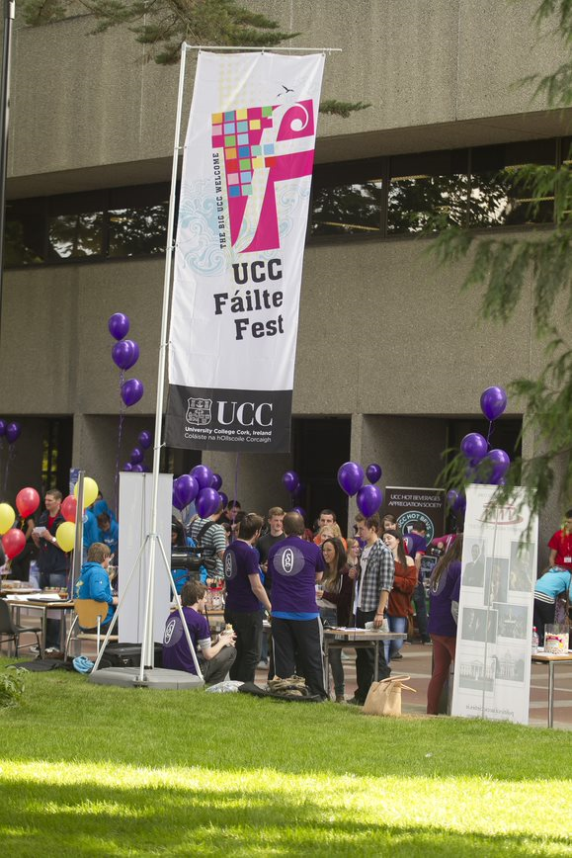
For new students We help prospective and new students to prepare and acclimatise to study at UCC
Short induction courses designed to give students a running start to their degrees can be delivered prior to semester one or customised to meet the needs of particular cohorts once on programme. Fees charged to departments | For all incoming students, ‘Learn English B2 & Beginner’s Irish‘, launched on Canvas Catalog as part of the UNIC language modules project. Self-access, online module designed to support staff and student mobility prior to departure for Ireland. Free of charge

Slide 6
For students on programme For many students, this may be the first time they have worked extensively in academic English, and the academic conventions and culture of Ireland may present unexpected challenges. Our courses and workshops are designed to support them alongside their degrees.
Core and elective credit modules in academic and disciplinary English. Free of charge, unless module is built for specific programmes | Digital badges in academic speaking and listening, and reading and writing. Free of charge
We provide special courses for students admitted under admissions caveats.
Undergraduate dual degree students admitted under recommendation 4. of UG Admissions Review December 2019 at IELTS 6.0 (5.5): Undergraduate English programme (UGE). Fee charged to student or department | Postgraduate research students admitted under caveat in recommendation 3.b of PG Admissions Review December 2021 at 0.5 IELTS band below in one skill: Postgraduate English programme (PGE) – Three hours per week, semester one and two. Fee charged to student or department
A 10% discount is available to UCC students and staff on all commercial part-time English language courses.
Typical academic programme modules include
Academic discourse and skills modules Critical Thinking Academic Conventions Collaborative & Dialogic Learning Autonomous Learning Intercultural Communication Presentations | Language systems modules Grammar Vocabulary Phonology Discourse | Language skills modules Reading Writing Speaking Listening
Assessment modules Initial, formative and summative assessment aligned to learning outcomes and benchmarked to the CEFR language levels (ie A0-C2, in common with IELTS and other exams)

Slide 7
Collaborative projects with partners
The Centre works with schools and colleges to create programmes and modules to meet the specific needs of their students, as can be seen in the examples below. With UCC partners
School of Nursing embedded disciplinary support & credit module | School of Law Level 7 special award pathway in Law and Legal English | School of Law Pre-diploma preparation in China – Hainan University. Academic writing 101 | CUBS Bespoke Interculturality modules for the postgraduate cohort
With external partners
Academic English programme for Beijing Technical University engineering students | Semester abroad programme for Tokyo University of Foreign Studies

Slide 8
Services for staff
Language Training workshops
Verbal communication for the international workforce Aoife Ní Mhurchú, CPD lead Free of charge | Understanding language levels in incoming students Kerry Platts, Admissions lead Free of charge
Teacher education
Teaching English to adults Cambridge Certificate in English Language Teaching to Adults (CELTA) Fee applies | Teaching using English (English as a medium of instruction) Teacher Development Courses Fees apply | Refresh your skills with weekend Pedagogy Workshops Fees apply
Bespoke services In addition to our offer to staff of 10% discount on commercial courses, we provide a tailored service to colleagues and teams needing intensive and highly targeted coaching to support the development of their communication skills in the workplace, Professional English Suite Fees apply

Slide 9
Key Contacts
Please do get in touch
Sally Orren Academic Head
General and academic programmes
Brendan Ó Sé Academic Head
Development and professional programmes, teacher training
Kerry Platts Academic Coordinator
Pre-sessionals, assessments and credit modules
Julie Butters Academic Coordinator
Pre-master's pathways and credit modules
Email academicenquiries@ucc.ie
Website https://www.ucc.ie/en/esol/

