Slide 1


Slide 2
Showcasing Today
ACE
Centre for Digital Education
Centre for the Integration of research, teaching & learning
Library
Disability Support, Access UCC
IT Services
Language Centre
5 MINUTE BREAK
Web Content Team
Office of Media & Communications
UCC Skills Centre
11. Office of Corporate & Legal Affairs
12. HR Research
13. Staff Wellbeing & Development
Notes:
.

Slide 3
Lifelong Learning in ACE, learner-centric, responsive, and inclusive, leaving no one behind

Slide 4

Part-time Programmes
School of Nursing and Midwifery, UCC
120+ Part-time Courses
Delivered with the 4 colleges in UCC
Levels 5-9
Online and in-person
OUR MISSION
Examples
Building Workplace Resilience in Self and Others, Certificate in CPD Microcredential
Environment, Sustainability and Climate, Certificate*, Diploma
Personal and Management Coaching, Postgraduate Diploma
Personal and Management Coaching, MSc
Mindfulness Based Practice and Research, Postgraduate Diploma
(Bio)Pharma Processing, Postgraduate Diploma
Further, Adult and Community Education, Postgraduate Diploma

Slide 5
Short Courses
Spring (Dec- Jan/Feb) | Autumn (Aug-Sep)
Online and in-person | 6-10 weeks long
25-30 personal and professional interest courses
Creative Writing, Genealogy, Beekeeping, Permaculture, Wine Studies
School of Nursing and Midwifery, UCC
OUR MISSION
Staff Discount – 15%
Email shortcourses@ucc.ie to get discount
See all courses here: https://ace.open.ucc.ie/
Deadline for registration is this evening
Mpardy@ucc.ie

Slide 6
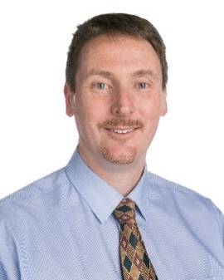
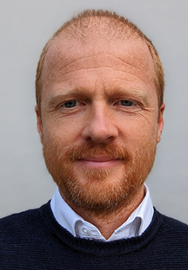
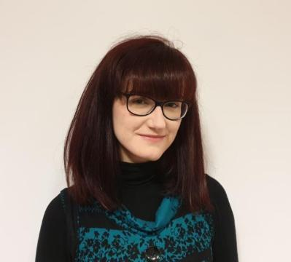
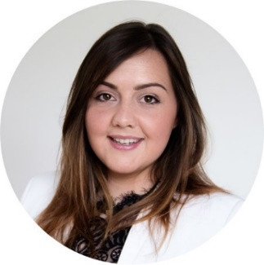
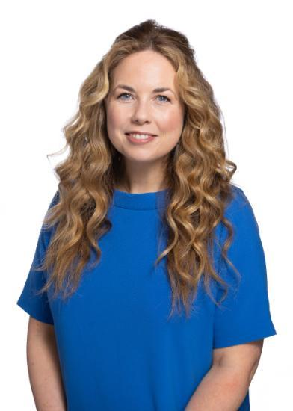
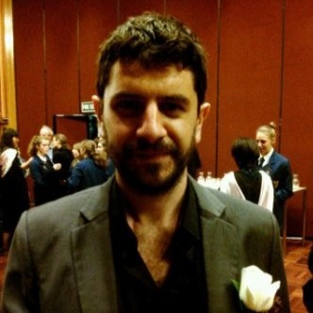

THE CENTRE FOR DIGITAL EDUCATION - CDE….
Tom O’Mara, Head of Digital Education
Eugene Campbell, Digital Education Support Assistant
Ríanna Peck, Instructional Designer
Michelle Donovan, Instructional Designer
Vacant Post, Instructional Designer
Clíodhna O’Callaghan, Digital Education Officer
Fergal Harrington, Digital Education Officer

Slide 7




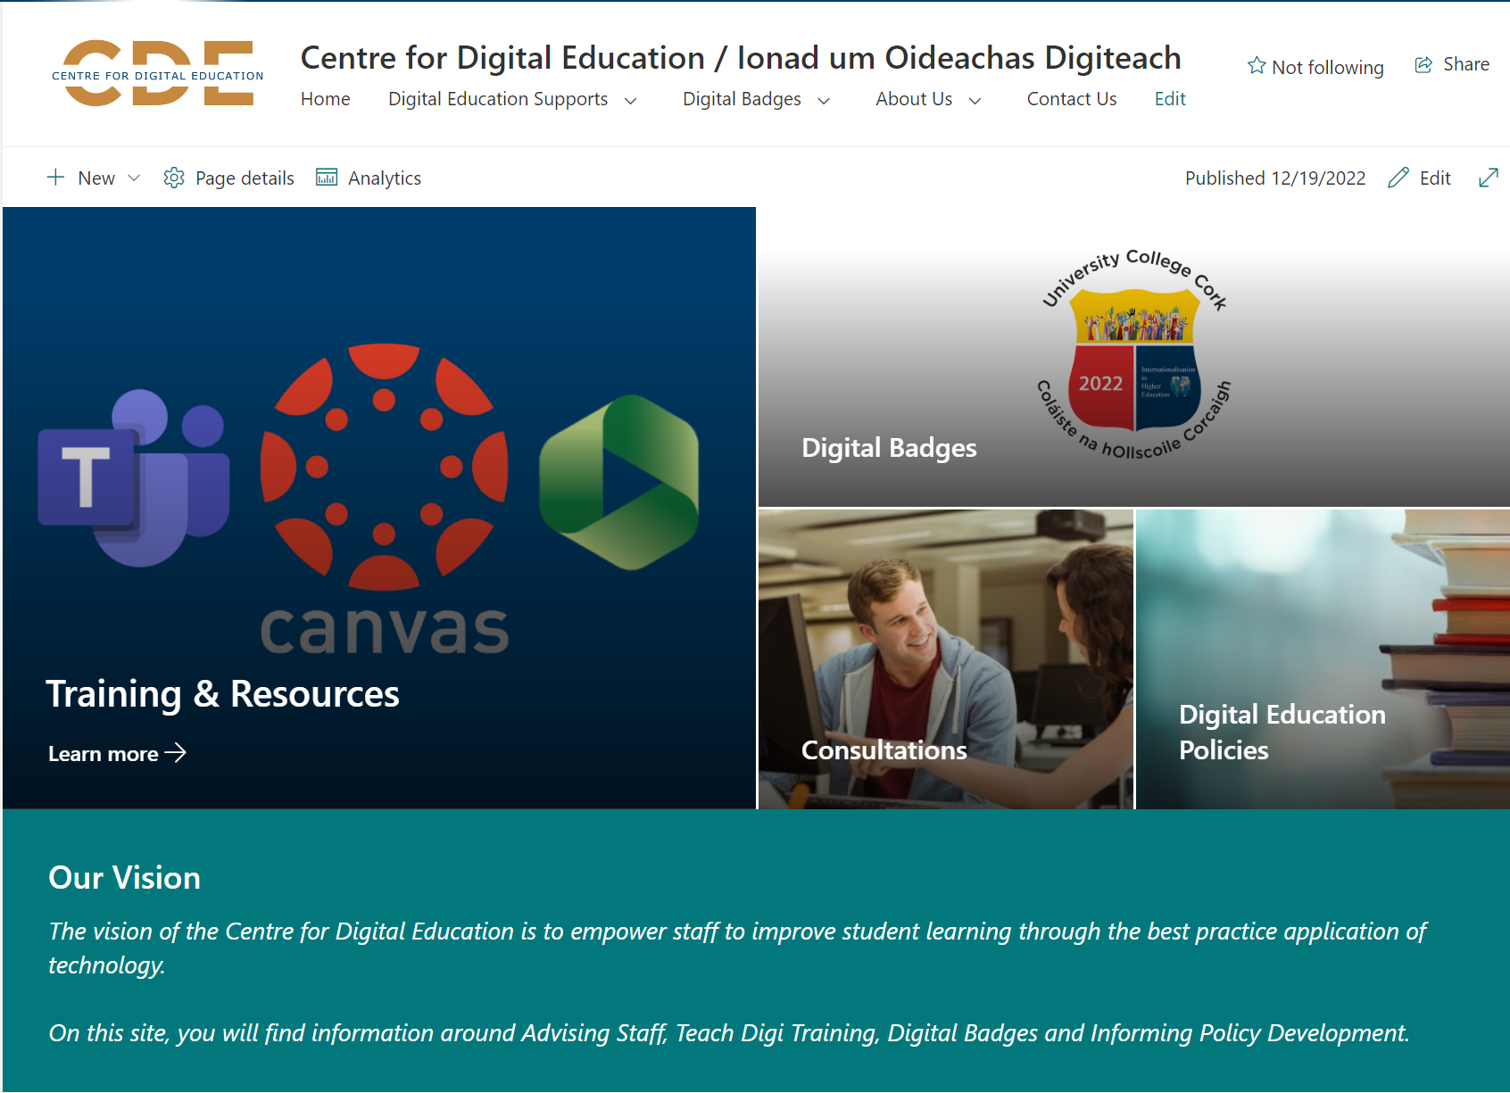




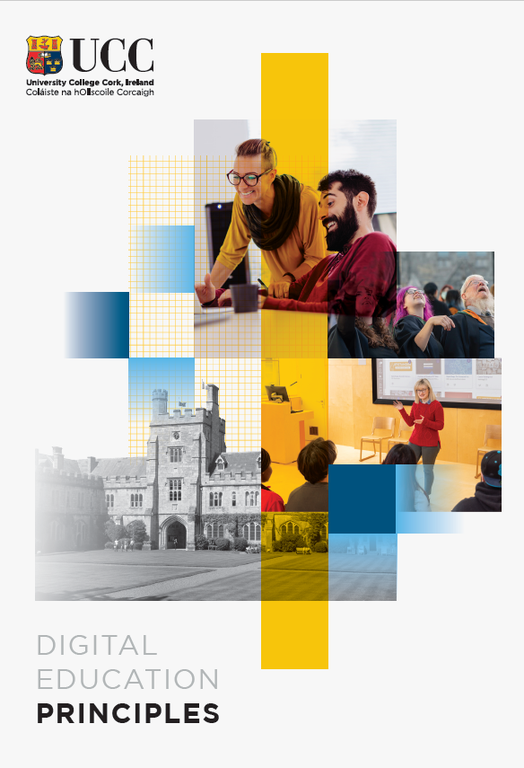


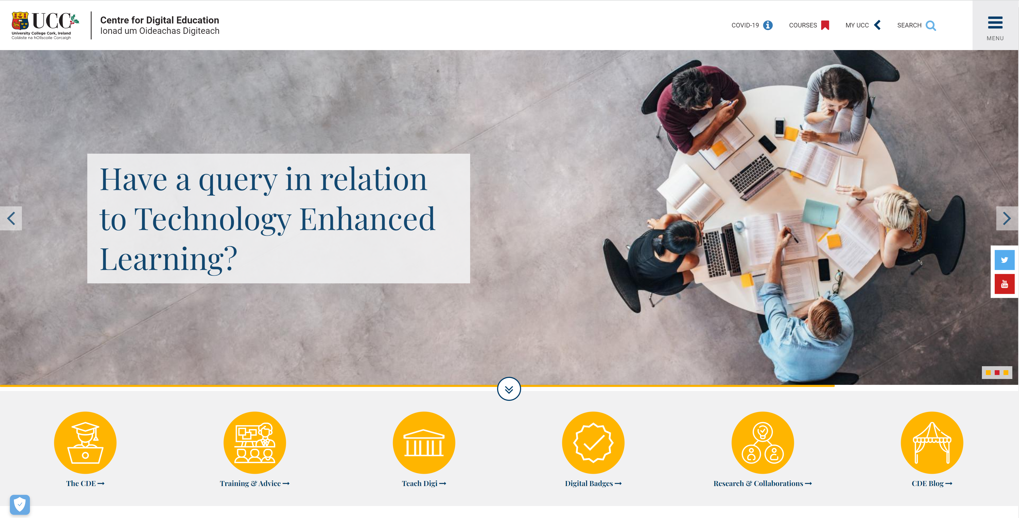

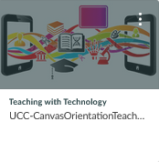
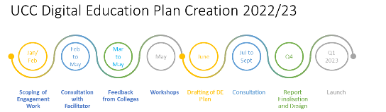
CDE - Empowering staff to improve student learning through the best application of technology.
Advising Staff, Training, Informing Policy Development, Evaluating of Emerging Educational Technology, Outreach and National and International Collaboration.
We will achieve this by Advising Staff, Training, Informing Policy Development, Evaluating of Emerging Educational Technology, Outreach and National and International Collaboration.
Securing our Future - Strategic Approach 2.5 - Provide a digitally enabled learning and teaching experience, equitable to all, which incorporates Universal Design principles.
Developed and Implementing: UCC's first Digital Education Plan
Established: Digital Education Software and Supports request form
Recorded: Ag Caint podcasts (Enhancing Digital Teaching and Learning project)
Collaboration: Inclusive UCC, CIRTL, DAC, AVMS, Library, Skills Centre, Inclusive UCC
Managing implementation of Live Audience Engagement Software
102 different Digital Badges have been issued to 5,721 earners across 516 issuing events
Consultations – new programme applications, digital badges, Canvas/Panopto/etc queries
Canvas, Panopto, M365 for Teaching training events
Notes:
UCC promotes digital education approaches to enhance pedagogy-informed, largely campus-based learning, teaching and assessment experiences.
UCC encourages the use of digital education tools and resources to support the delivery of student-centred, equitable education, incorporating Universal Design Principles.
UCC encourages the adoption of appropriate digital education approaches to address learning and teaching challenges posed by new technologies.
UCC supports the enhancement of students’ digital literacy.
Upcoming and ongoing projects:
OVPLT Talks
Digital Assessment
Learning Taxonomy
DE Software – polling, video, plagiarism
TwT Update
Training events in collab with CIRTL, Inclusive UCC, Library and IT
DE Resourcing Map
Lecture Recording Automation report

Slide 8


Centre for the Integration of Research, Teaching & Learning (CIRTL) sir-tel

Slide 9
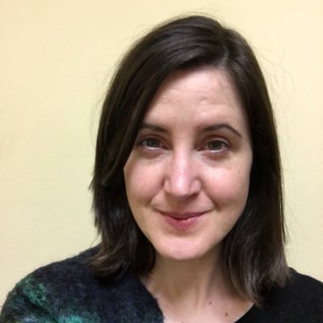
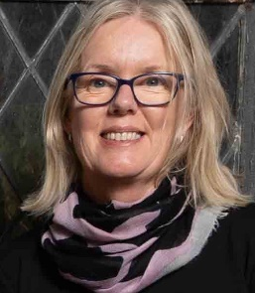



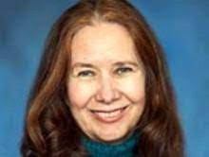
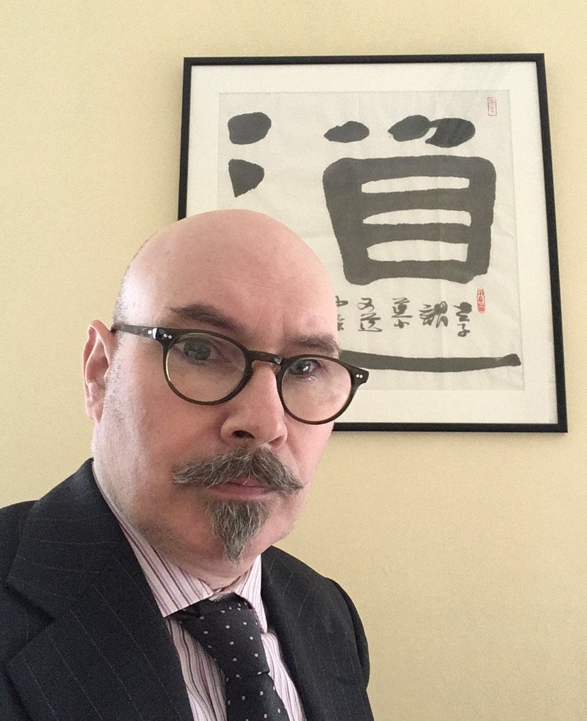
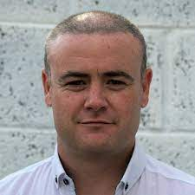

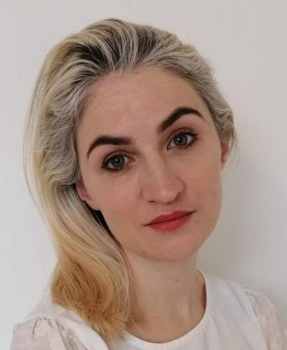
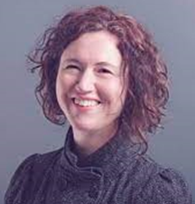
CIRTL’s Team
www.ucc.ie/en/cirtl/meetourteam
Patricia Murphy Executive Assistant
Laura Lee Learning Enhancement Project Manager
Catherine O’Mahony
CIRTL Director
Ruth Hally Community Engaged Learning Officer
Anna Santucci Senior Lecturer
Bonnie Mullinix Research Fellow
James Cronin College Lecturer
Owen Jump
College Lecturer
Sarah Thelen
College Lecturer
Katy Dineen
College Lecturer
Briony Supple
Senior Lecturer (Seconded to School of Education)

Slide 10

PG Cert in Teaching & Learning
www.ucc.ie/en/ckb02/
Free for all UCC staff
Open to all staff who support student learning
Part of Probation & Establishment process for Academic staff
PG Cert in Professional Practice & Leadership
www.ucc.ie/en/pcplhe/
Discount fee for UCC staff
Open to all staff in professional services or academic leadership roles
Certificate in CPD in Digital Education
www.ucc.ie/en/ace-ccpdde/
Discount fee for UCC staff
Offered in both semesters

Slide 11
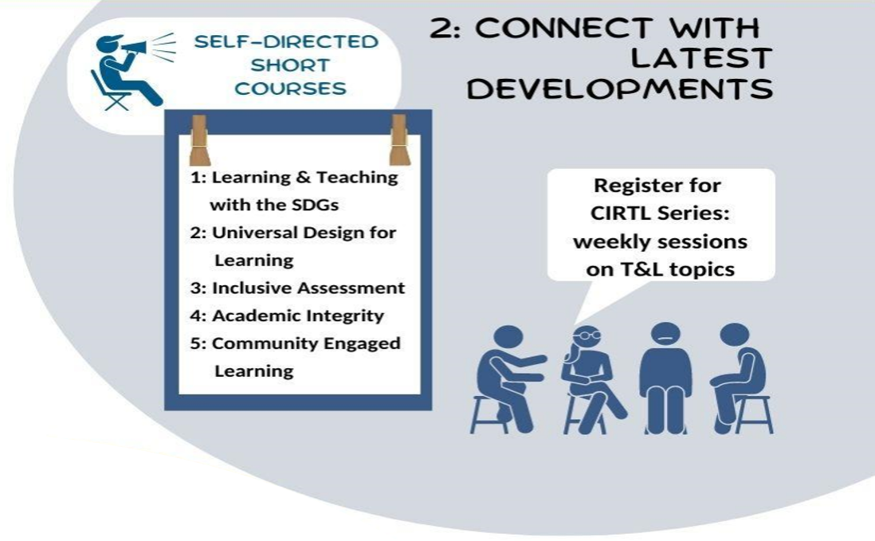

Self-Directed Short Courses
www.ucc.ie/en/cirtl/professional-development/badge/
Free for all UCC staff
Gain digital badge if complete
Varied topics and shorter time commitment
Many are self-directed with no specific start date
Enquiries to cirtl@ucc.ie

Slide 12




Digital Badge: 18-20 hours Variety of topics
Register for PG Cert in T&L Sept-Mar 2024 Fully-online
Attend EAIR Conference Aug 21-23 2024 https://the-eair.org/

Slide 13
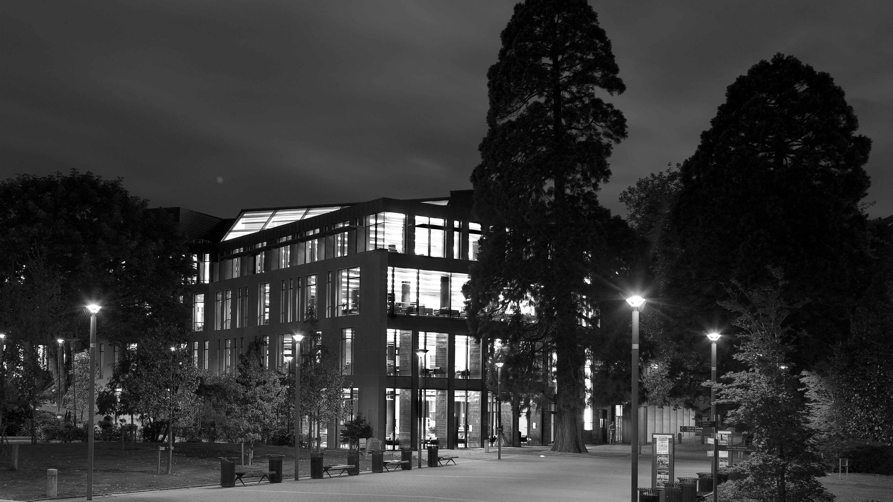

UCC Library
Staff Training Opportunities
Alan Carbery – Head of Academic Services

Slide 14


Who we are
UCC Library offers a range of resources, spaces and services to meet the teaching, learning and research needs of the University.
​
It is a service full of friendly and knowledgeable staff only too eager to help you on your journey.
We offer many one-to-one and group training opportunities and supports.
If you need support for your teaching activities, your own learning, or research, please connect with us.

Slide 15
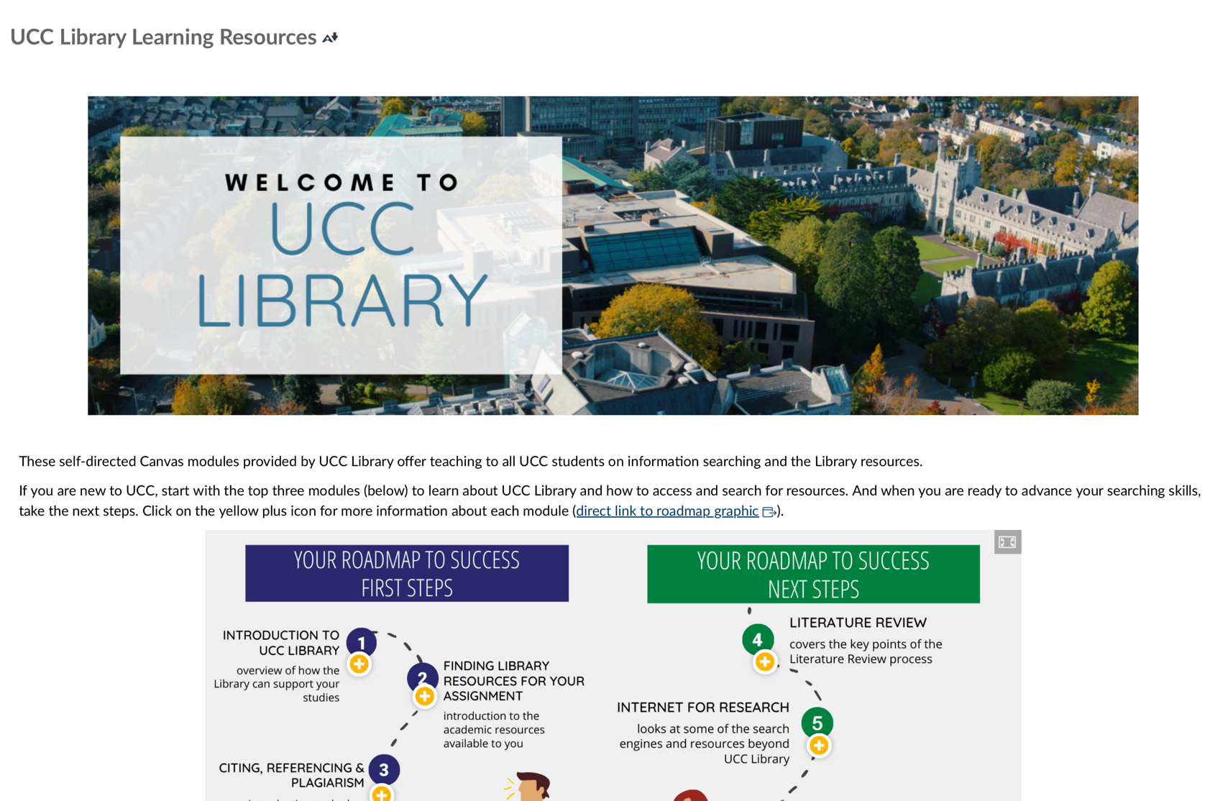
Staff Training – Some Highlights
Self-Direct Canvas Learning Course
Self-enrolled, self-directed Canvas course available to all staff and students with modules on:
Introduction to UCC Library, Finding Library Resources
Evaluating Information, Citing, Referencing & Plagiarism
Referencing Software
Tracking Influential Papers & Authors, & lots more.
Self-enroll to the UCC Library Learning Resources Canvas Course
Open Workshop Sessions
Regular workshop sessions, delivered in-person & online, to help you get hands-on support and guidance on finding top-quality information sources, build you information literacy skills, citing referencing & plagiarism, and many more.
Sessions advertised through the Library Website.

Slide 16


Staff Training – Some Highlights
Develop your Creative & Digital Skills
Join us in the newly-opened Digital Scholarship Studio to develop your creative and digital skills. Sessions on offer this Spring include:
Introduction to Adobe Illustrator; InDesign, Lightroom
Video Editing using Adobe Premier Pro
Learn the basics of digitizing A/V formats (cassettes, vinyl, CDs)
Learning more about the Digital Scholarship Studio & our offerings
Discover Unique & Distinct Collections
Throughout Jan – May, view items from our Special Collections & Archives based on specific themes, including:
Art, Figures in Culture, Graphic-format and Sea & Shore
Hear from our expert staff about our collections.
More info.

Slide 17


Staff Training – Some Highlights
Build your research skills with Research Essentials
Develop awareness of the tools, techniques and knowledge to support your research activities through our series of 7 workshops. Topics include
Research Data Management and FAIR Data
Open Access Publishing
Advanced Search Techniques for Systematic Reviews
Academic Poster Design & Podcasting for Researchers
Find our more about UCC Library’s Research Essentials Programme
PG6009 – Graduate Information Literacy Skills
A UCC 5-credit module for PhD and Research Masters Students to develop their information literacy skills to find, evaluate, manage and use information for their studies.
Delivered each Semester over three days.
More info.

Slide 18
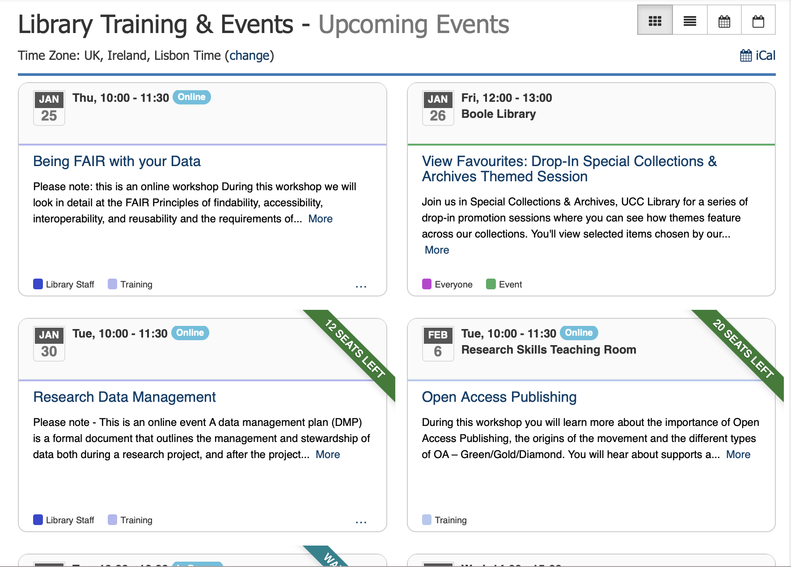
UCC Library Training & Events Calendar
Sign-up for a range of workshops, programmes and events, both in-person and online.
All our Events and Training Programmes are available through the Library homepage
We are continually developing new workshops and training opportunities.
Questions?
library@ucc.ie

Slide 19

Disability Support Access UCC January 29th 2024

Slide 20
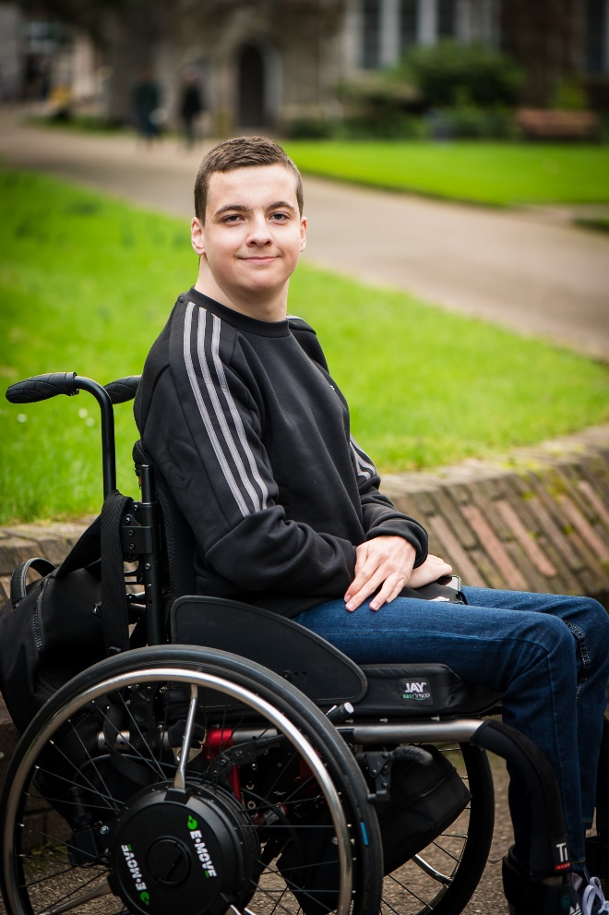

Slide 21
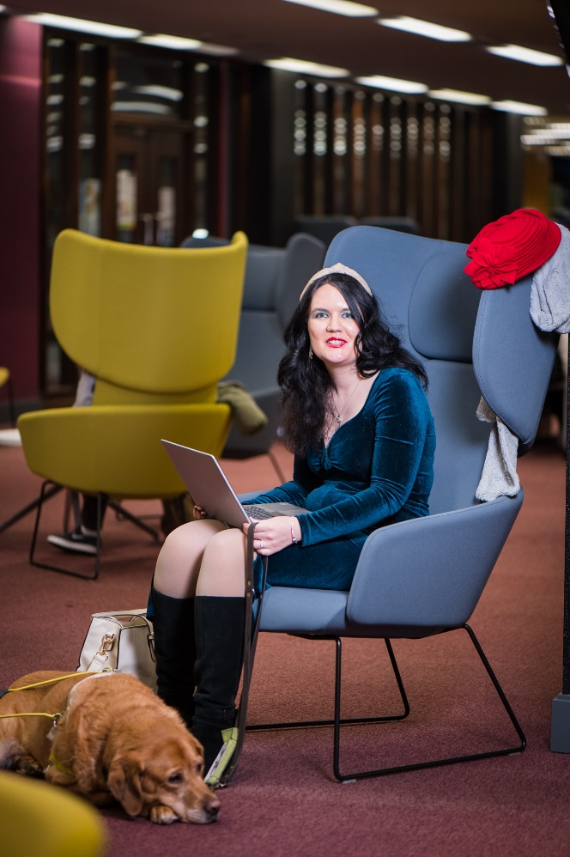
Disability Support, Access UCC
Who we are.
How we support student and staff.

Slide 22
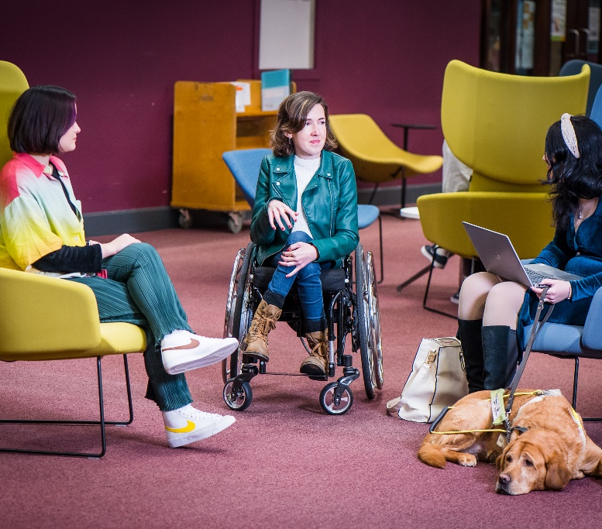
Reasonable Accommodation Policy
To ensure that students with disabilities/learning differences/significant ongoing health conditions may access a holistic learning experience on an equal footing to all members of the UCC community.
This policy provides a framework for the provision of Reasonable Accommodations for students with disabilities/ learning differences/significant ongoing health conditions who have registered with Disability Support in UCC.
Standard & Non-standard

Slide 23

Disability Awareness
Autism
ADHD
Blind / Vision Impairment
Deaf / Hard of Hearing
Mental Health
Physical Disability
Significant Ongoing Illness
Specific Learning Difficulty – Dyslexia, Dyspraxia
What other training is needed ?

Slide 24
Contact
Disability Support dssinfo@ucc.ie
Linda Doran l.doran@ucc.ie

Slide 25


IT Services, Training we provide to UCC Staff
Marian Twomey
Digital Advisory Centre, IT Services

Slide 26

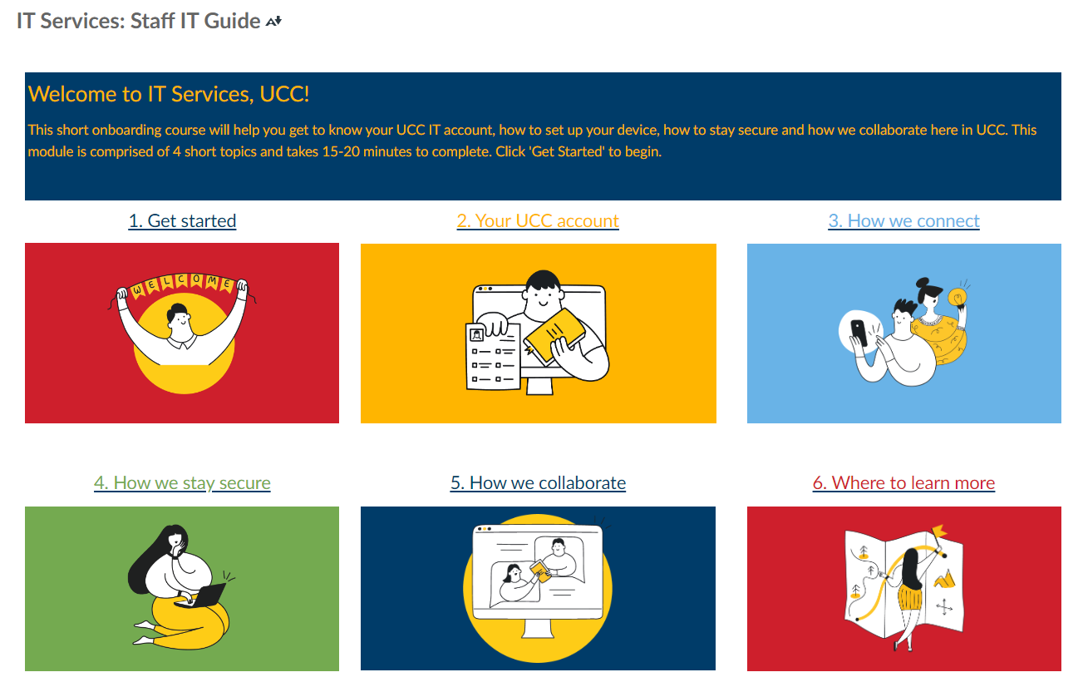
IT Services Staff IT Guide
The Staff IT Guide was created by IT Services. This on-line course is available to all staff via Canvas and is designed to be self paced.
To promote awareness of this course - new staff receive a “New Staff Onboarding Email” which is automated based on account creation.

Slide 27

Digital Advisory Centre IT Services
The Digital Advisory Centre (DAC) was set up in 2022 to assist staff to make the most of technology so they can offer an enhanced service to staff & students of UCC and the wider community. The following are just some of the things we offer to empower staff in a digital workplace:
M365 and more for a Digital Workplace Digital Badge
DAC Learn Live Sessions
Monthly Tips & Tricks published in WorkVivo
Monthly Microsoft Updates for Advanced Users
M365 Fundamentals Digital Badge
UCC Microsoft Learning Pathways

Slide 28
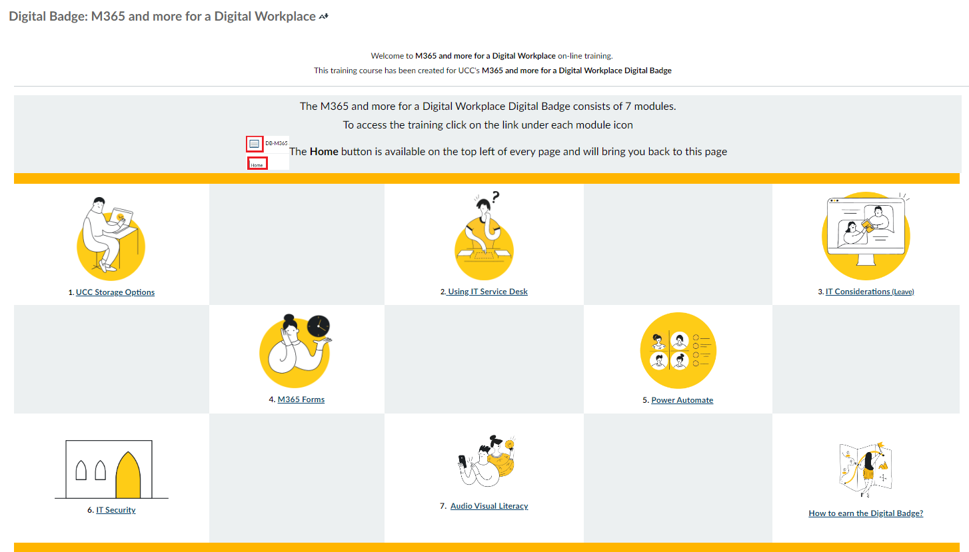

M365 and more for a Digital Workplace Digital Badge
Launched in Sep 2023, the M365 and more for a Digital Workplace on-line course was created by the Digital Advisory Centre It is available to all staff via Canvas and has the option to attain a Digital Badge.

Slide 29

IT Security IT Services
IT Security in conjunction with HEAnet deliver online cyber security awareness sessions. IT Security training is mandatory for all staff.
Each October IT Security actively engage with staff for Cyber Security Month. Several events take place during cyber security month to promote awareness.
The M365 and more for a Digital Workplace and the IT Services Staff IT Guide both contain an IT Security module.
Mandatory IT Security Training
Tailored Awareness Training
Cyber Security Month
Staff IT GUIDE

Slide 30


Useful Links
Digital Advisory Centre Learning Resources
IT Tips and Tricks
IT Services WorkVivo Space
IT Security – Cybersecurity Awareness training
IT Services Portal

Slide 31
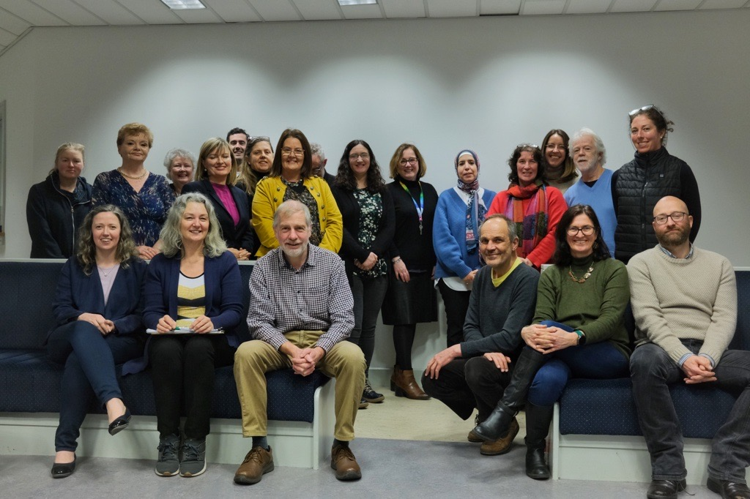


Staff Workshops 2024
See: Courses for UCC Staff | University College Cork

Slide 32


Inclusive Communication for ​
Global Workplace & Learning Environment
Overview:
This 90-minute session aims to provide participants with practical skills and a heightened awareness of effective spoken language use in linguistically and culturally diverse work and learning environments. The interactive format ensures engagement and application of concepts in real-world scenarios.
Workshop Objectives:
1.Reflect on spoken communication challenges faced in the workplace
2. Identify features of spoken language that affect clarity
3. Discuss strategies to ensure adaptability and flexibility towards diverse listeners
4. Discuss strategies to prevent and repair communication breakdowns

Slide 33



Understanding English Language Levels for
university entrance
Overview:
In this 90-minute interactive workshop, admissions teams, lecturers and all staff working with international students will gain an understanding of the English language admission requirement levels and the IELTS exam.
Workshop Objectives:
1. Understand what is meant by "English language level" with reference to the Common European Framework of Reference for Languages and how this is reflected in UCC students’ use of English
2. Receive an overview of the content and context of the English language exams for UCC entrance (IELTS)
3. Understand how the scoring system in international English exams such as IELTS specifically relates to students’ writing ability
4. Increase awareness of the challenges that students face when taking exams such as IELTS for university entrance
5. Have an opportunity to ask questions regarding English language qualifications for students

Slide 34

Embedding Academic Discourse Development
into your Discipline
Overview:
This session aims to empower educators with the knowledge and tools needed to make academic discourse accessible, breakdown complexity in class, and systematically integrate discourse development into their teaching programs. Participants will leave with practical strategies to enhance the learning experience for all students.
Workshop Objectives:
In this session, the takeaways will be:
1. the importance of making disciplinary academic discourse visible and accessible to all students.
2. how to break down academic discourse and types of activities that can be done in class.
3. how to embed academic discourse development into your programme.

Slide 35
See: Courses for UCC Staff | University College Cork
Link to apply for a place here.

Slide 36
UCC Website Training
Monday, 29 January 2024

Slide 37

Who we are
Web Content Team
Maurice Ryder, Head of Web Content
Cal Doyle, Web Content Editor
We oversee the website and the content that lives on it

Slide 38

Website Training
CMS Training
This is training on how to use the content management system (CMS)
The CMS is the platform that supports the website and its content
The training is online, on Canvas
Currently being revamped
https://ucc.instructure.com/enroll/WB38NL

Slide 39

Website Training
Webshots
This is a series of learning sessions, monthly
We look at content best practice, from writing to imagery to accessibility to search engine optimisation
https://uccireland.sharepoint.com/sites/digitalestatecomms/SitePages/Webshots.aspx

Slide 40

Give us a shout!
We’re here to help!
If you’ve any questions or queries just holler at us, erm, nicely:
decomms@ucc.ie
Thank you!

Slide 41
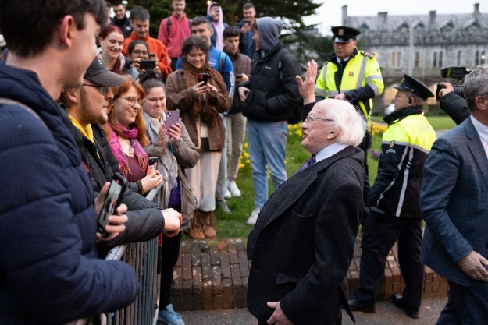

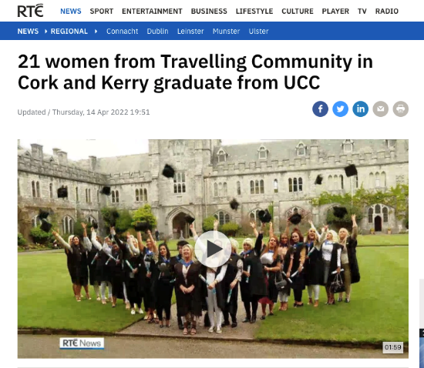
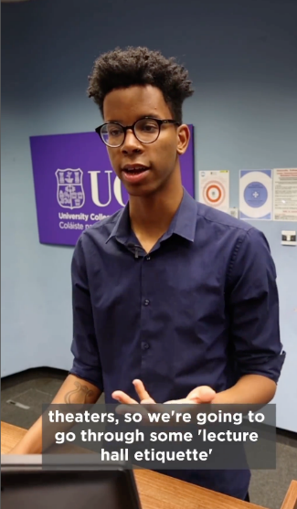
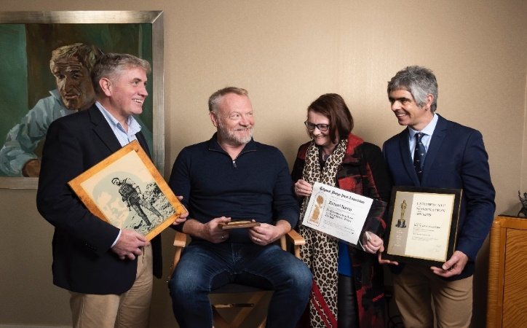
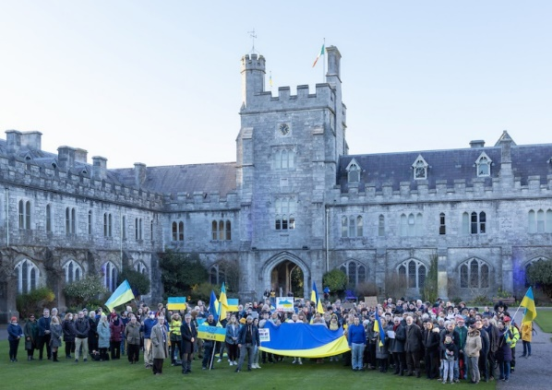
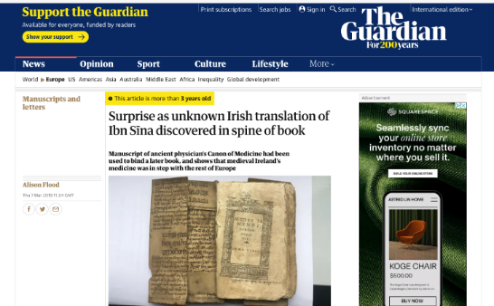
Office of Media & Communications

Slide 42

Who are we
Eoin Hahessy – Director, Media & Communications
Joe Leogue – Media & Comms Officer

Slide 43
What we do
Media Relations
Stakeholder communications & Public Affairs
Research campaigns
Internal communications
Social media management
Media Training & workshops
Crisis Communications
UCCTV
Expert Alerts

Slide 44

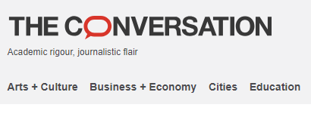
Media training….
How to write for the media
How to give to an interview
Opinion editorials
RTE Brainstorm workshops /
The Conversation workshops

Slide 45

We help make your day easier
Workvivo: The digital heart of UCC
An events calendar that shows what is going across the university
An app launcher with Agresso, ESS,Teams, Outlook all in one place
Place to share news and thank colleagues
SEFS, IT, OVPLT all using it for their newsletters
2,200+ regular users.

Slide 46
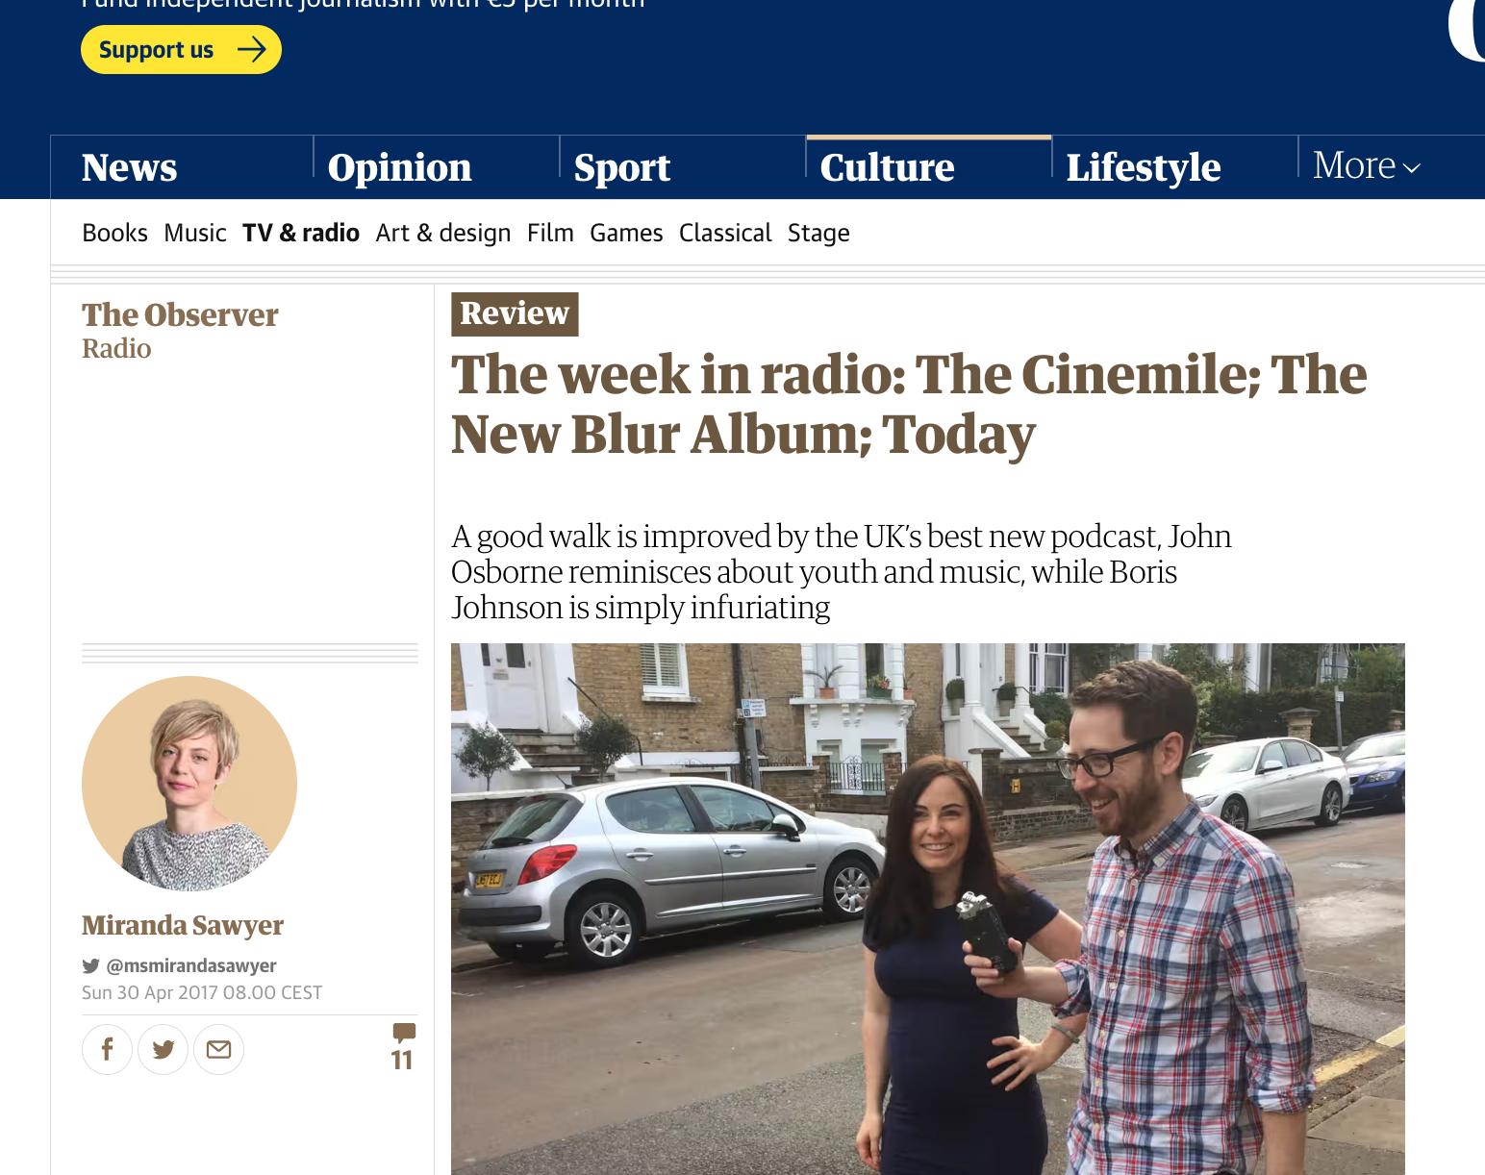
We host workshops on…
Please not another emoji…best practice in social media
Really…another podcast
Did video really kill the radio star?
No it is not worth spending all that money on a newsletter

Slide 47
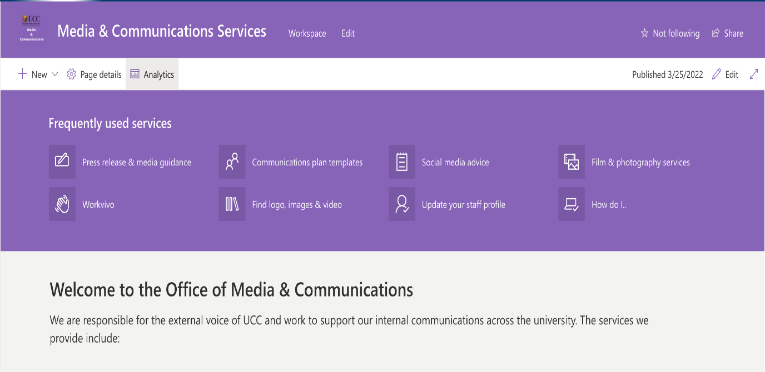
Thank you
https://uccireland.sharepoint.com/sites/MediaCommunicationsServices

Slide 48
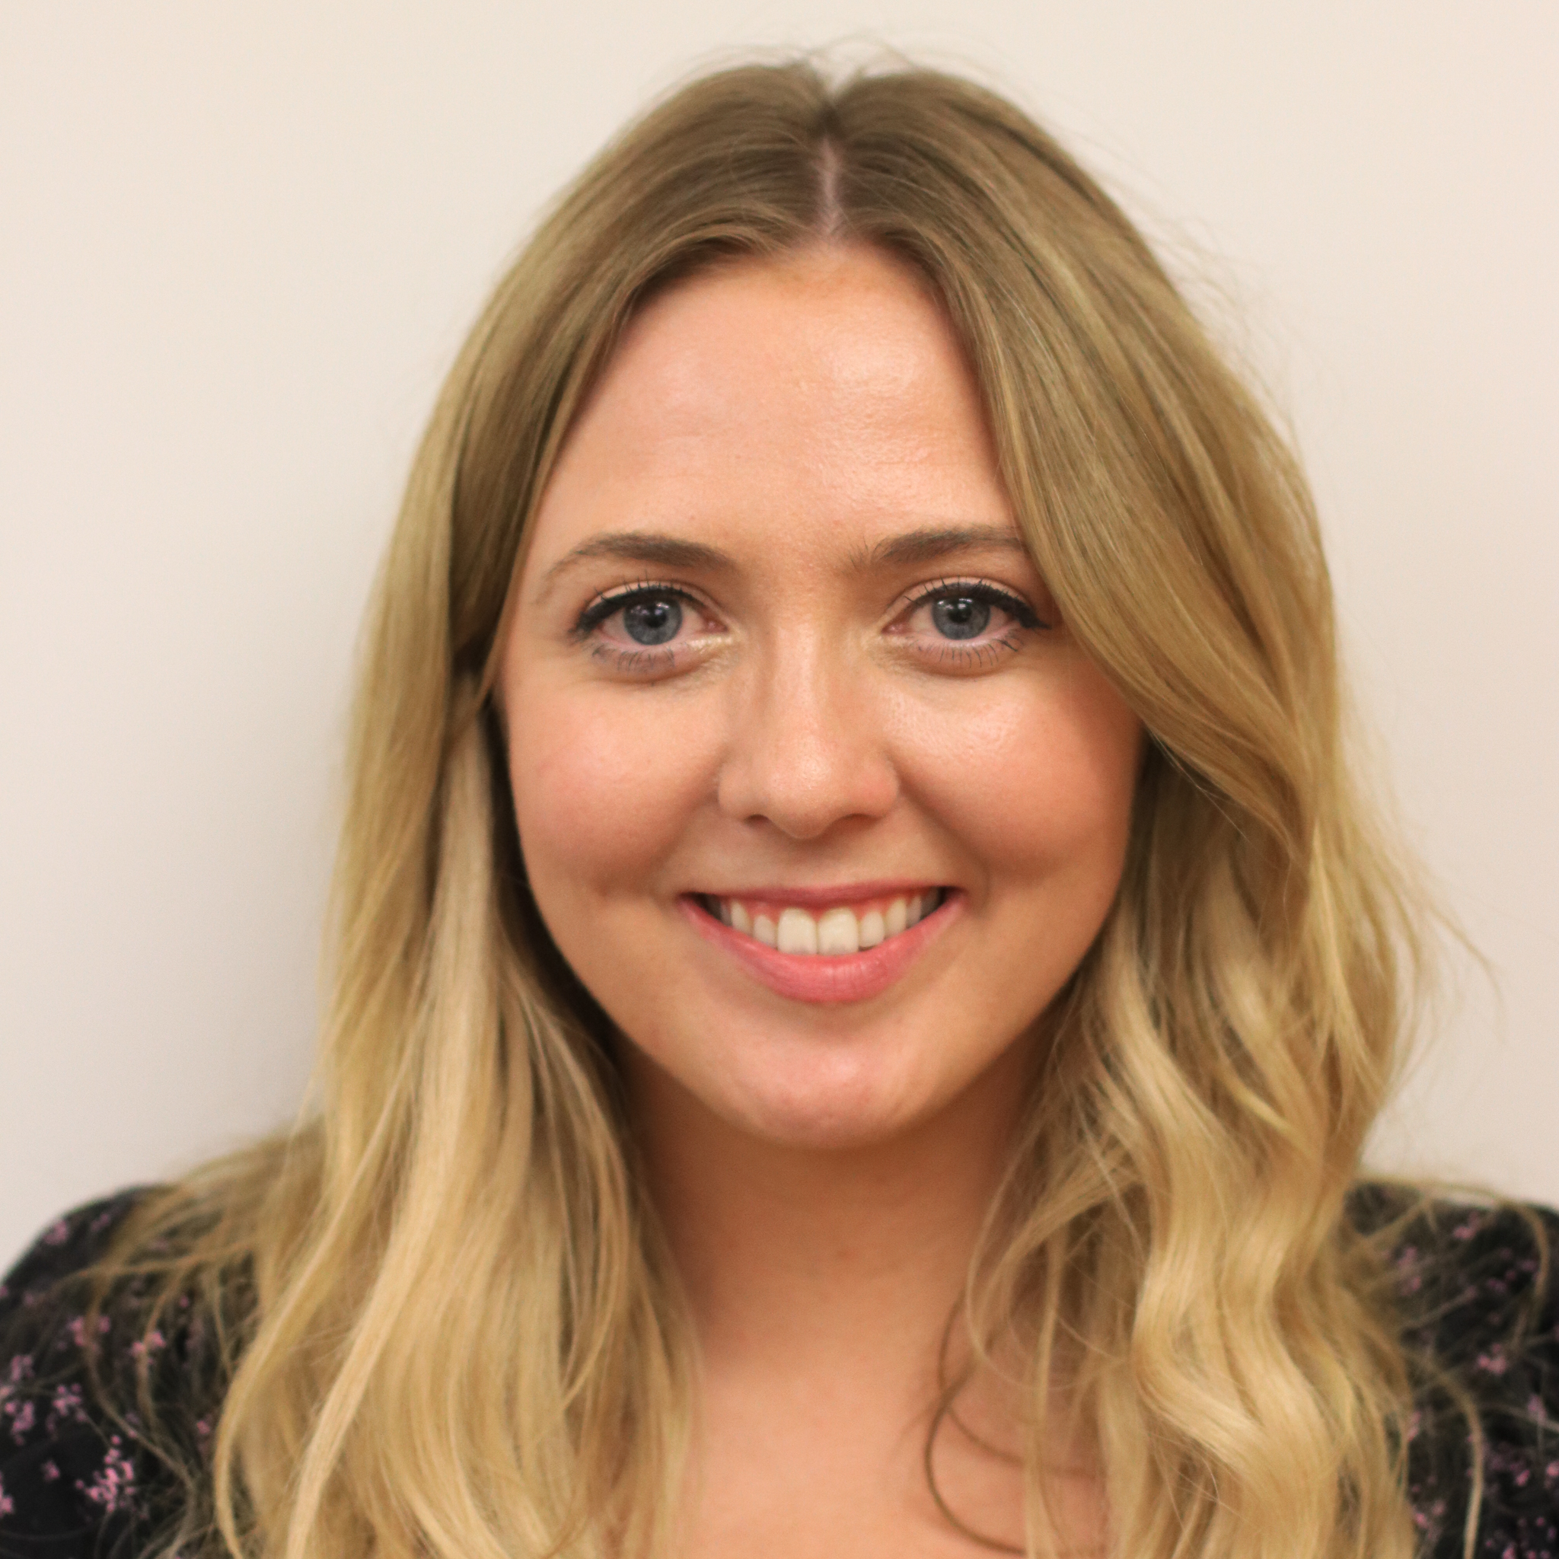
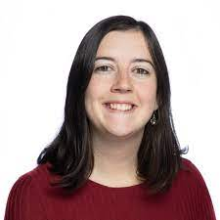


Dr Éadaoin Regan
Skills Centre Coordinator
Eadaoin.regan@ucc.ie
Dr Loretta Goff
Academic Integrity Education Officer​
l.goff@ucc.ie
Staff Training and Wellbeing

Slide 49
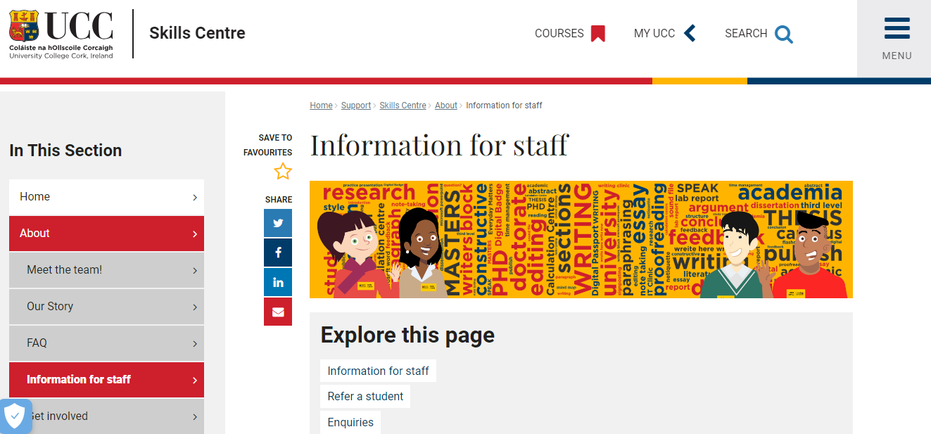
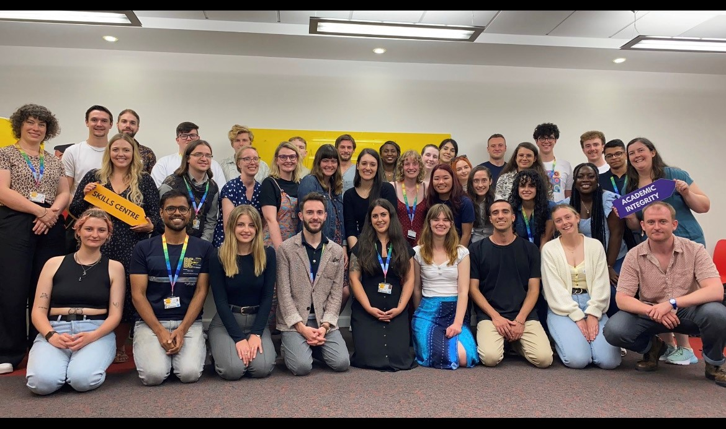
Who are we?
https://www.ucc.ie/en/skillscentre/about/informationforstaff/

Slide 50


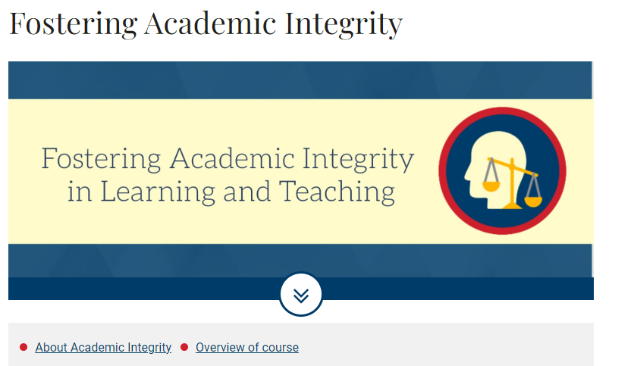
Digital Badges
Staff Wellbeing
Group Sessions
Microsoft Teams or in person
Any of our sessions are adaptable to staff perspective
Examples of previous sessions:
Staff Presentations – Crash Course
Making Feedback Work For You
Groupwork and Teamwork

Slide 51
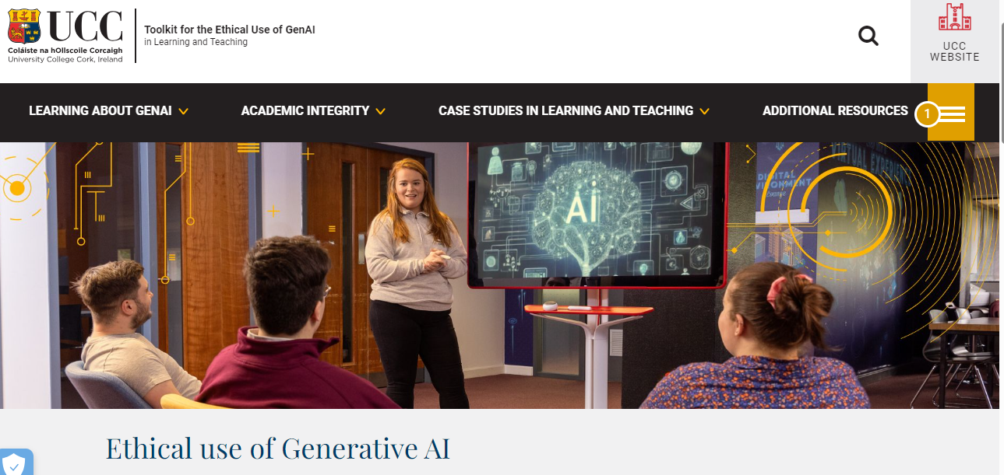
AI Toolkit
Toolkit for the Ethical use of GenAI | University College Cork (ucc.ie)

Slide 52

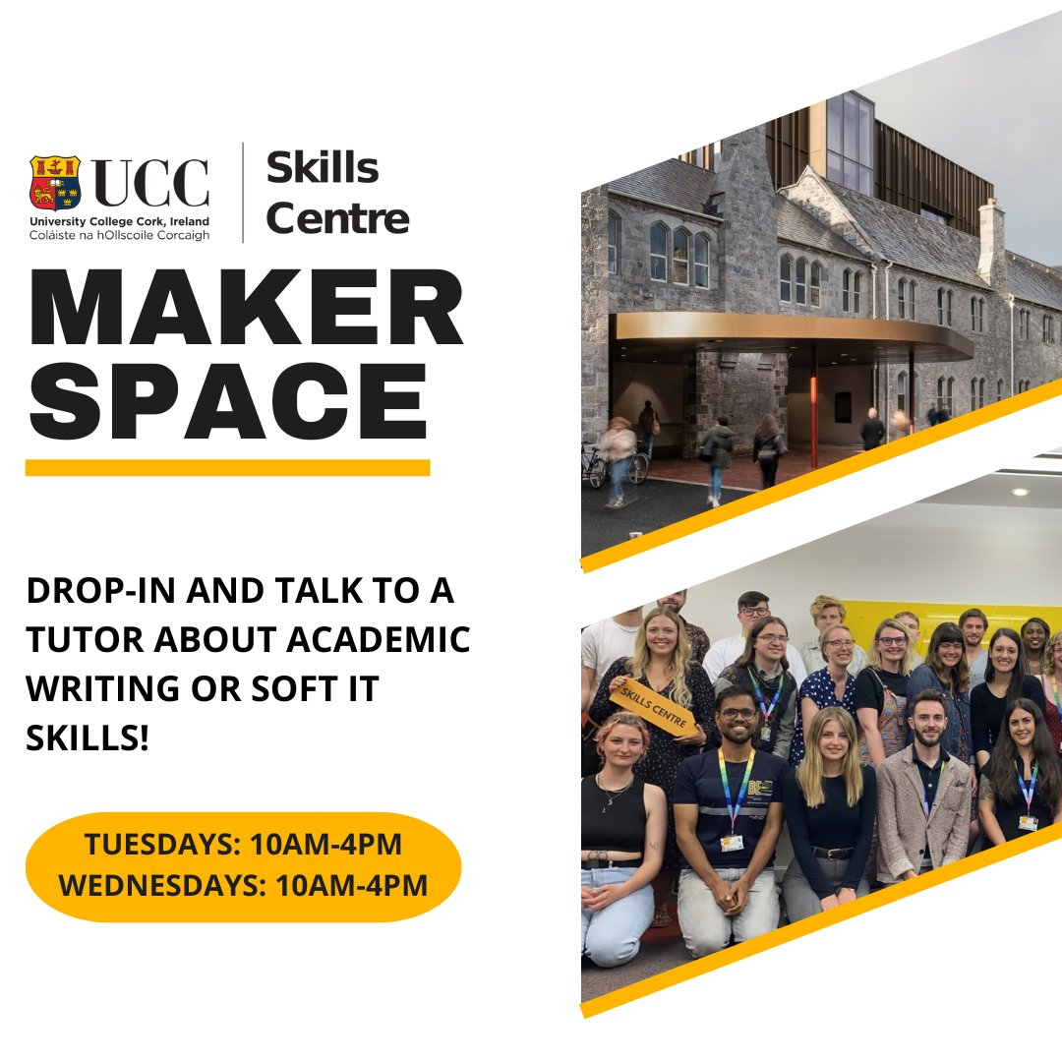

Slide 53



Office of Corporate & Legal Affairs
​Meet Your UCC Training Providers
Monday, 29 January 2024, 3 – 5pm via MS Teams

Slide 54
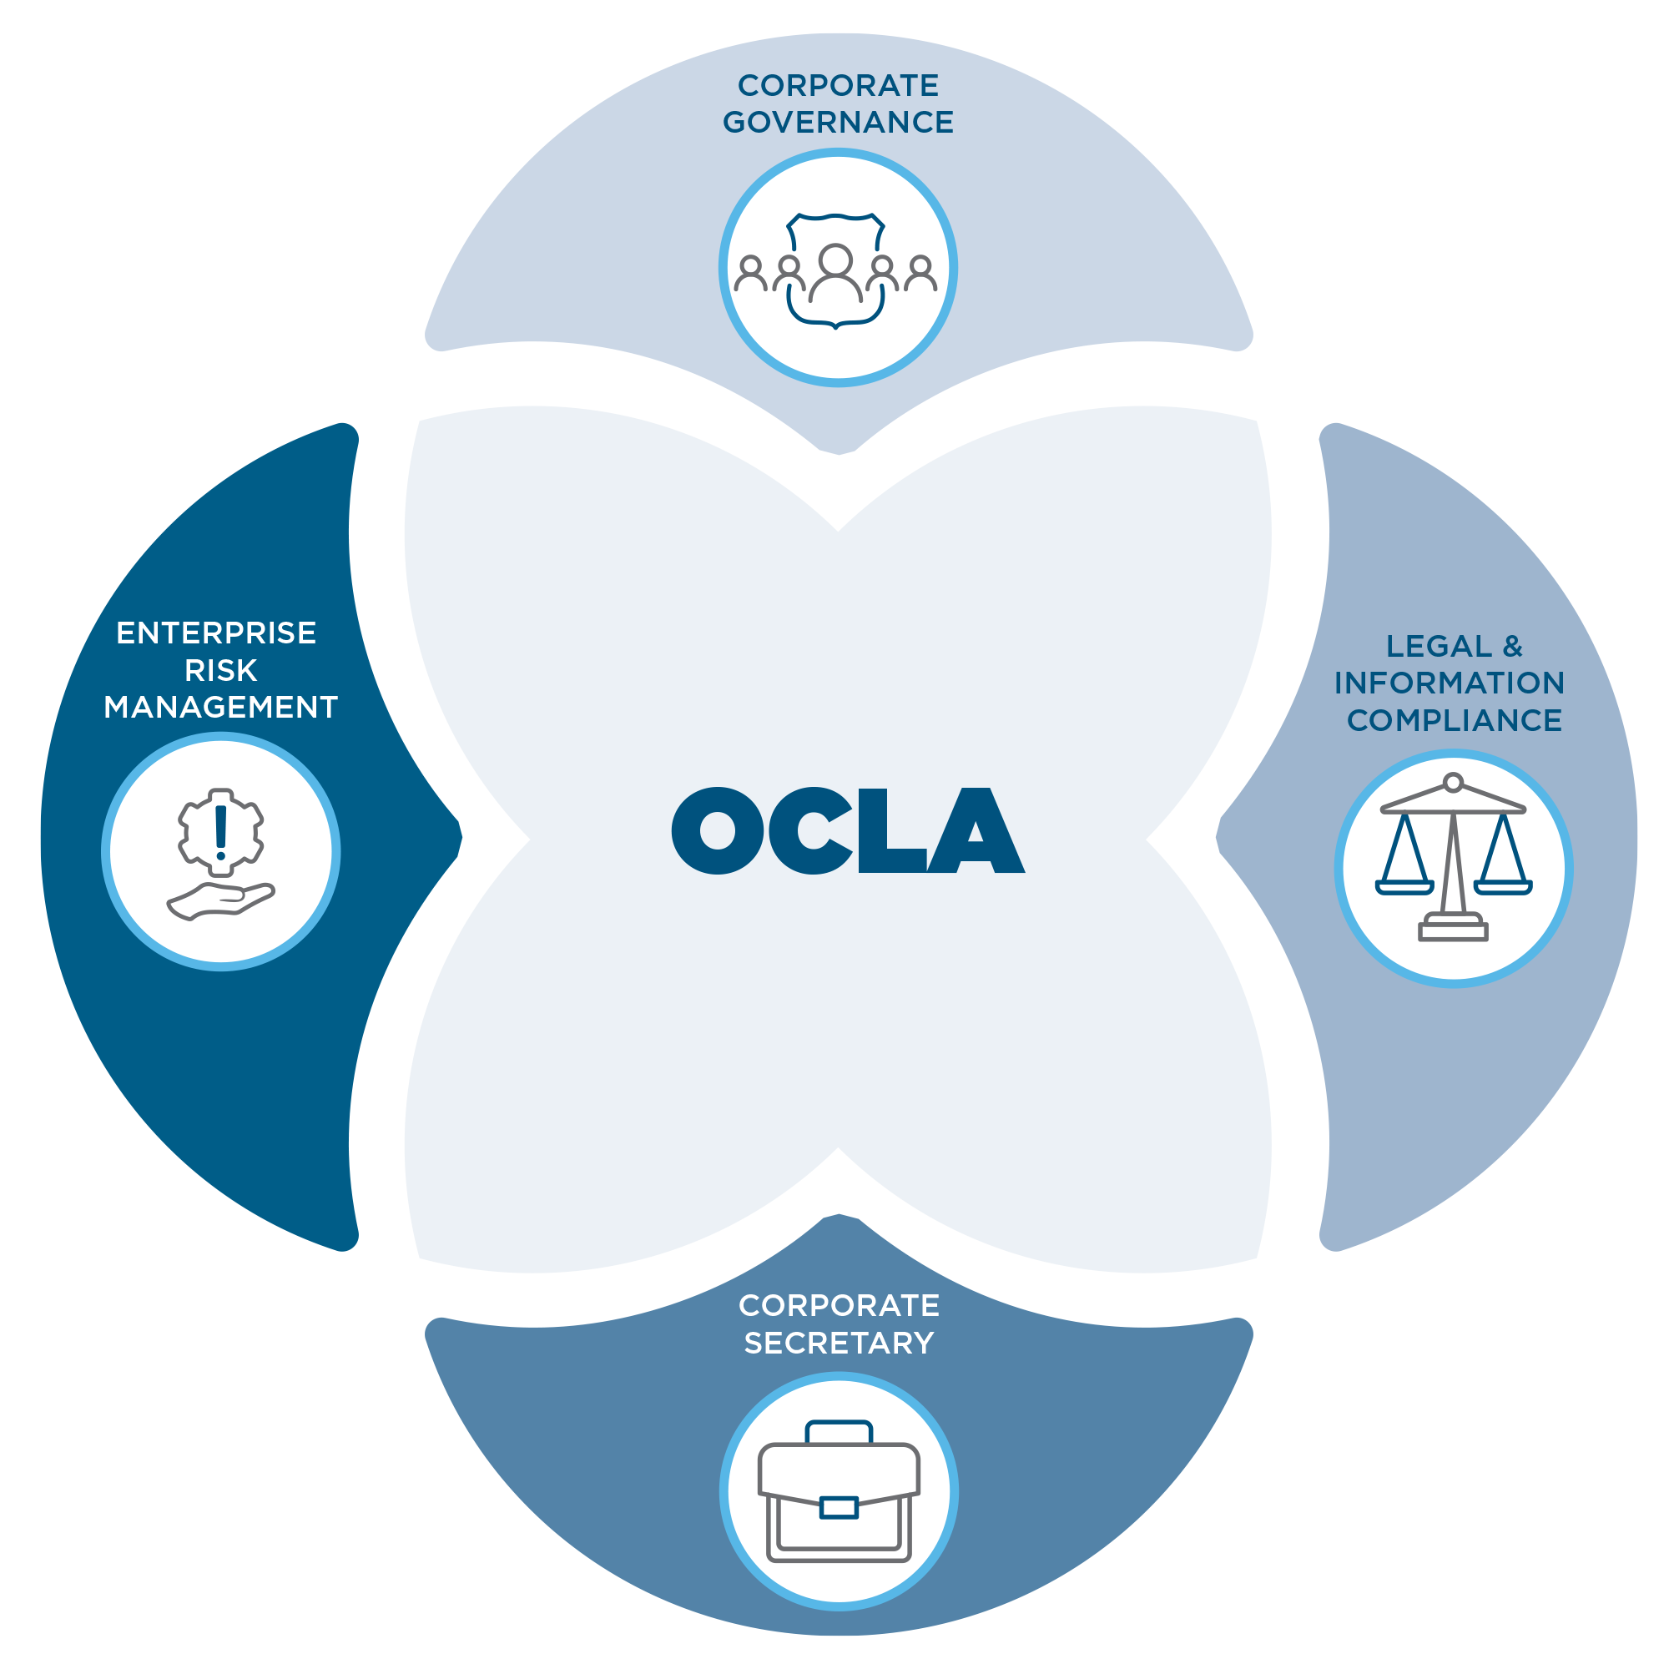
Who we are:
Office of Corporate and Legal Affairs
A highly committed, flexible and agile team of 29 specialists and support staff working together to deliver a comprehensive service portfolio across the functional pillars of Governance; Legal & Information Compliance and Enterprise Risk Management working in a cohesive and inter-related manner.
Our purpose is simple: ensuring good governance, helping enable sustained innovation and protecting the University’s reputation, all crucial cornerstones to UCC’s Securing Our Future strategy.
We are working to help the University achieve its strategic goals and realise its vision as set out in Sustaining Our Future 2023-2025 by providing trusted expertise, guidance and solutions for the benefit of the entire UCC community, underpinned by the institution's core values.
Encouraging everyone to see the value of early engagement with OCLA to work through the opportunities and risks that new activities bring; engaging with us at the onset of a project and seeing the development pathways.

Slide 55
Legal Training
The Legal Team provide training and guidance in a number of areas including:
Essentials of research contracts for contracts managers
Intellectual property management for commercialisation managers
State aid
Export control
Further information at: Legal Affairs
Contact Jonathan Hurley for details
Brief Overview
.
Legal & Information Compliance Training

Slide 56
Information Compliance Training
The Information Compliance Team provide training and guidance in a number of areas including:
Online training on the General Data Protection Regulation (GDPR)
Recorded information session on FOI and GDPR (approx. 1 hour). These are available at https://uccireland.sharepoint.com/sites/InformationCompliance
Further information on training options is available at: https://www.ucc.ie/en/ocla/comp/
Contact InfoCompliance@ucc.ie for details
Brief Overview
.
Legal & Information Compliance Training

Slide 57
Risk Management, Emergency Management & Business Continuity Planning
Brief Overview
Risk Management training to date is offered to leadership and teams in the following Functional Areas and units: Colleges, schools, research centres, professional services, subsidiaries and major projects.
Standard presentation, covering RM policy, Risk Register template, risk scoring criteria and risk maturity criteria is available on https://uccireland.sharepoint.com/sites/OCLAPolicies/SitePages/Risk-Management.aspx
Individual or small group consultations in advance of annual presentation to Enterprise Risk Management Committee
Training for Business Continuity Planning also provided – most recently specifically to prepare for possible cyber-attack (anytime) and potential power outages during Winter season 2022-23
.
Enterprise Risk Management Training

Slide 58
Enterprise Risk Management Training
ERM Function provides core training
UCC has a legal obligation to provide the information, instruction, training and supervision necessary to ensure, so far as is reasonably practicable, the safety, health, and welfare at work of employees.
What is statutory training?
Explicitly required by law, or
Required on the instruction of a statutory body (Health and Safety Authority) on the basis of specific legislation, for example, Safety, Health and Welfare at Work Act (2005) or
Required through the process of risk assessment or training needs analysis (TNA). That is where, through either of these processes, UCC deems training to be necessary to ensure, so far as is reasonably practicable, the safety, health and welfare at work of employees and others.
.
Brief Overview
Enterprise Risk Management Training

Slide 59
Health and Safety
Instructor Led Training (ILT)
In the past year, 120 instructor-led Health & Safety statutory training sessions have been delivered across campus to a total of 736 participants.
Manual Handling
First Aid
Health and Safety for Managers
Fire Extinguisher
Instructor Led Health and Safety Training can be booked through the Health and Safety Office Website.
Click on ‘Timetable’ to view upcoming courses and book a place.
Instructor Led Training (ILT) available:
We now have a subscription for 4000 employees to complete online training.
Display Screen Equipment
Fire Safety Awareness
Risk Assessment
Hazardous Substances
Asbestos Awareness
Hybrid Working
Lock Out Tag Out
Working at Height Essentials
Manual Handling Awareness
Brief Overview
Enterprise Risk Management Training
Centralised LMS
Online courses
Author/Policy Sign Off
Instructor Led Training records
Compliance Reporting

Slide 60
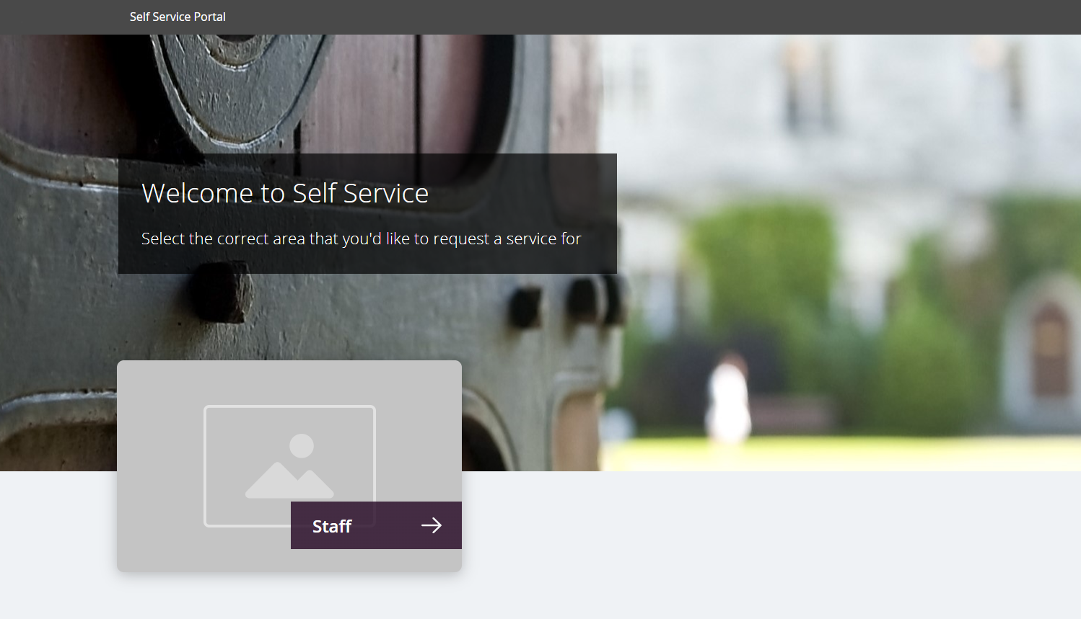
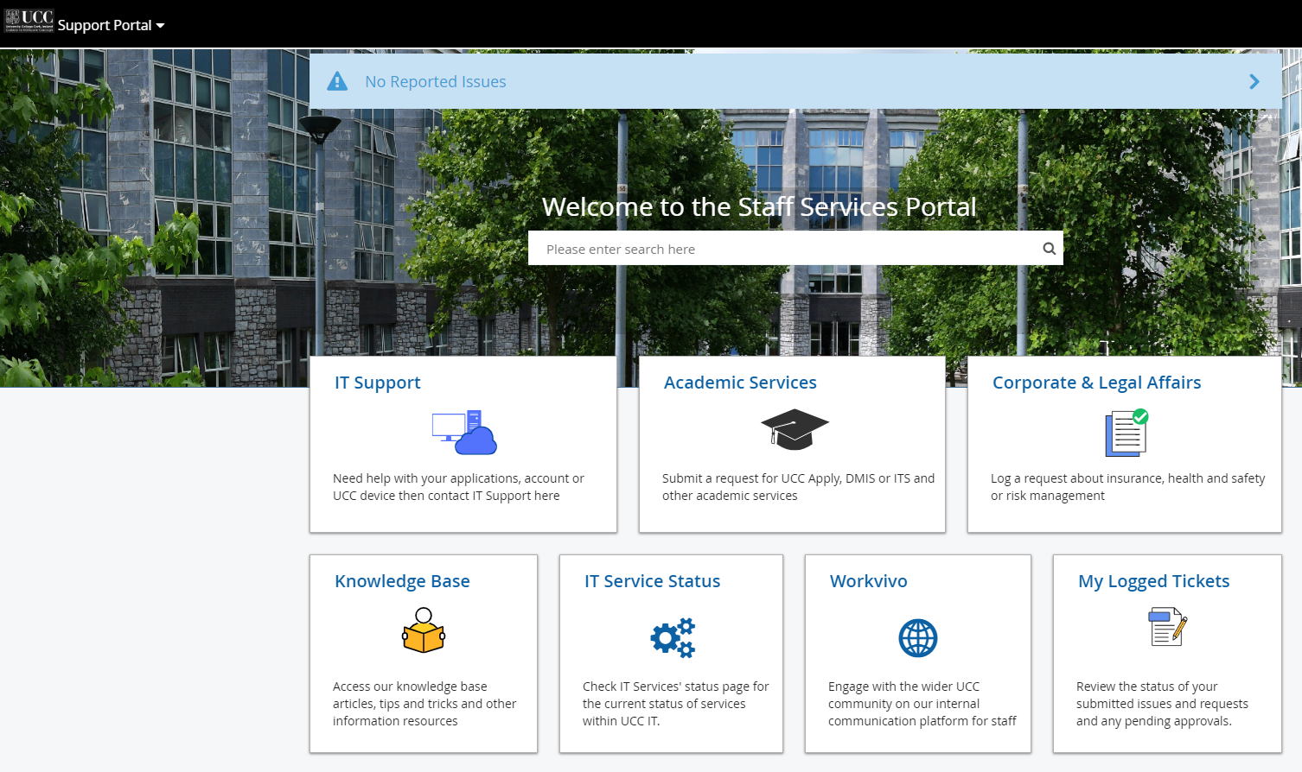
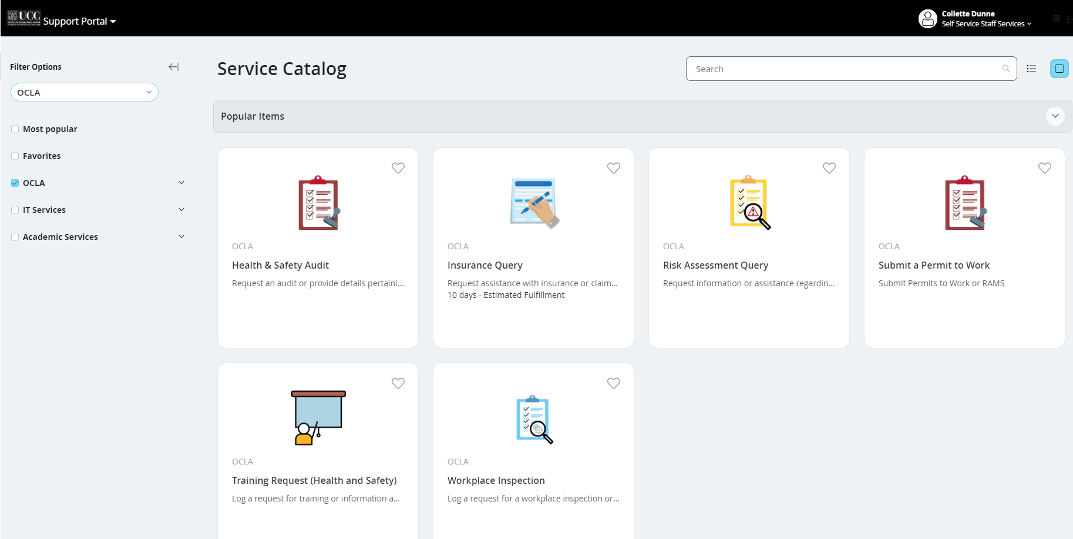
Who To Contact For More Information
New ERM Helpdesk which has replaced the health&safety mailbox All queries related to: Health and Safety Risk Management Emergency Management and Business Continuity Insurance and Claims https://portal.ucc.ie/ Or ERM@ucc.ie

Slide 61
Mary Kate O’Regan
HR Business Manager Research UCC
Marykate.oregan@ucc.ie

Slide 62

HR Excellence in Research
UCC successfully retained the HR Excellence in Research Award at the Award Renewal Phase for the second time in January 2021 making us the first University on the Island of Ireland to reach this level

Slide 63


Online sessions for Research Staff
1 hour
Every Friday
Competency Based
Open to all including PhD students
Online sessions for research staff

Slide 64
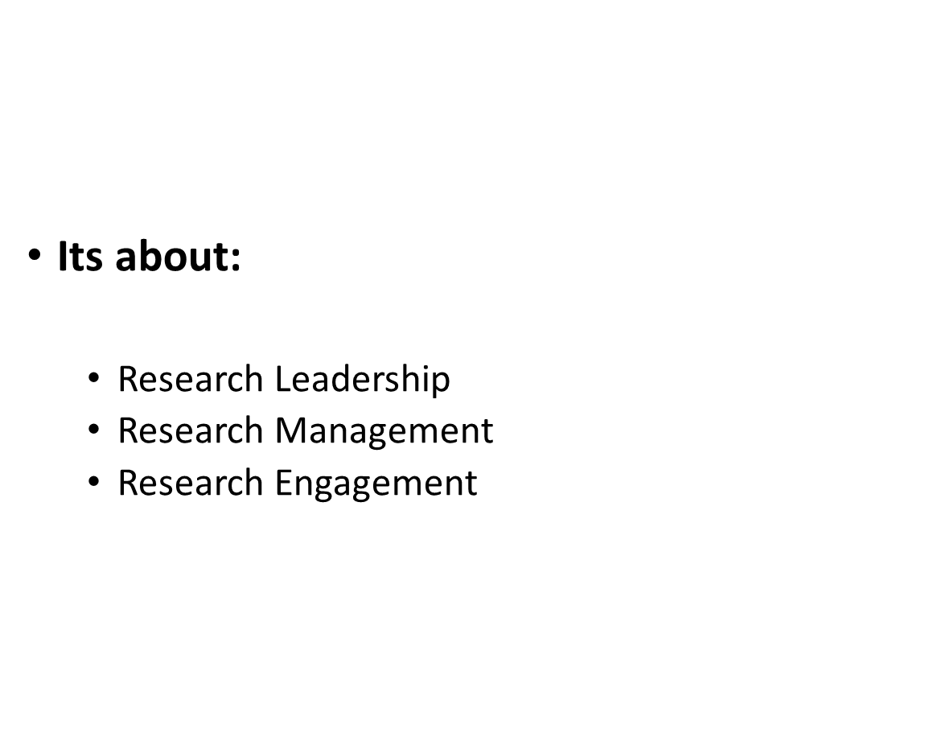
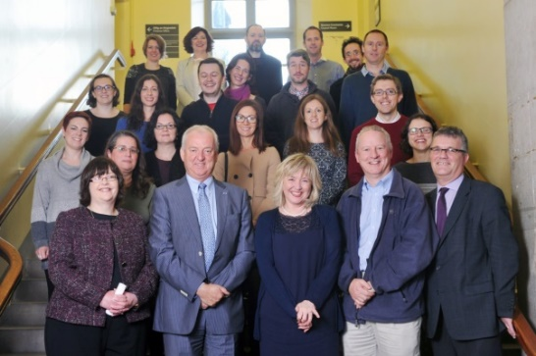
Professional Skills for Researcher Leaders
EC Charter & Code “..multi-faceted role as supervisors, mentors, career advisors, leaders project co-ordinators, managers or science communicators”
UCC is approved provider of
Professional Skills for Research Leaders.
Course aimed at Senior Post Docs and Research Fellows…Blended Learning
80 graduates received ILM Certificate of Endorsement so far….

Slide 65
PSRL - What's covered
Introduction
Developing and Consolidating your Research Career
Funding your Research
Managing a Research Team
Research Integrity
Communicating your Research

Slide 66

The Odyssey Programme 600 since July 2018
The Odyssey programme was designed to enable researchers R1 to R4
to adapt, integrate and expand on their existing expertise to prepare for the many diverse career choices ahead of them.
It also highlights the significant differences and/or advantages to the many workplace cultures that exist beyond academia.

Slide 67


EMAIL ETIQUETTE: PROFESSIONAL COMMUNICATION
LEARNING OUTCOMES:
Gain an understanding of how to tailor your emails and Teams messages to different target audiences in UCC.
You will know how to draft formal communications that are clear, effective, visually pleasing, and display your competence and professionalism.
You will understand the importance of tone, how to gauge your audience’s communication style, and their familiarity with emojis and slang.
Leave with some top tips that will help you build your reputation through on-point email communications

Slide 68

COMMITTEE AND MEETING TRAINING
This online training has been designed for both UCC students and staff to empower you to be open-minded and have the confidence to participate on committees and in meetings. The learning content includes training on agendas and minutes, committee structure, meeting etiquette, conflict resolution, and more. Training on various related skills such as time management, presentation skills and how to build confidence are also included.
Visit: ucc.ie/en/graduateattributes/committeemeetingtraining/

Slide 69

Notes:
.

Slide 70

Training & Development Opportunities

Slide 71

Training & Development Opportunities
Notes:
Workshops & Programmes – Difference
Applications for some e.g CL, digital badges
New Digital Badge – Continuing Steps, Professional skills
LD – First steps up to CL Level 1 & much in between

Slide 72
Overview of Wellbeing Training & Supports staffwellbeing@ucc.ie
Employee Assistance Programme
Occupational Health
Individual Wellbeing Consultations Available to All Staff
Wellbeing Support for Managers
Monthly Programme of Wellbeing Activities
Wellbeing Coaching
Wellbeing Training
Physical Wellbeing Programmes Available at the Mardyke
Digital Gym Open to All Staff
Wellbeing Workshops

Slide 73
Join Us
Sessions open for booking emailed to all staff every Monday
VISIT
Staff Wellbeing & Development Training webpage
Wellbeing webpage
Our Workvivo Site
Monthly Wellbeing Schedule via email
TO BOOK
UCC Staff: Book your place on our training courses via the 'My Training' tab on ESS (some exceptions)
Staff in UCC Subsidiaries: Book your place via email to traininganddevelopment@ucc.ie
All staff encouraged to participate in at least 2 programmes annually​

Slide 74


