Slide 1
Staff Wellbeing & Development at UCC
Dr Anne Gannon – October 2025

Slide 2
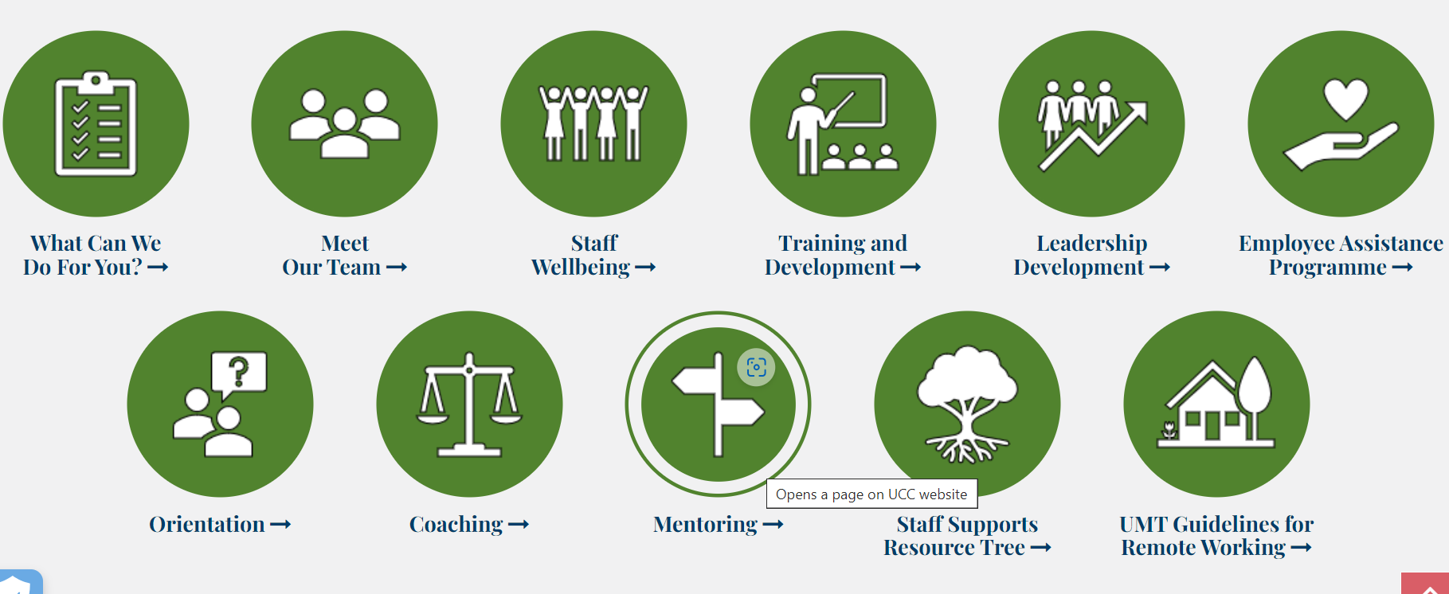
Training & Development Opportunities

Slide 3
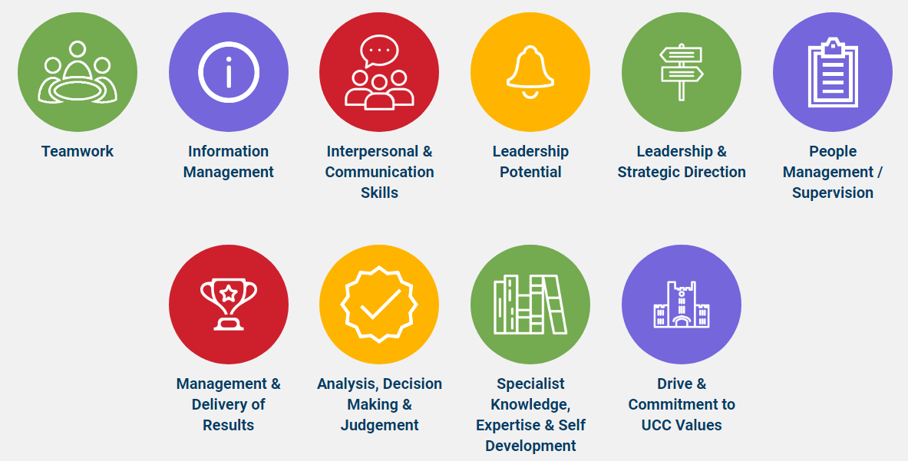
Our Training Workshops & Programmes
Notes:
Workshops & Programmes - Difference

Slide 4
Staff Professional Development (1)
Schedule of forthcoming programmes advertised every second Monday (email, Workvivo & website)
Once advertised, open for booking – ESS
Training & Development - full calendar of events
All staff encouraged to participate in at least 2 workshops annually
** UCC CPD Guidelines **

Slide 5
Staff Professional Development (2)
Onboarding For New Staff (Local Orientation Checklist)
Professional Skills Digital Badge
Tailored Team Sessions including Team Leadership Development
Professional & Career Development
Staff Fee Concession, Study & Exam Leave
University Staff Recognition Awards
Long Service Awards

Slide 6
Leadership & Management (1)
UCC/IMI Current Leaders 1 & 2 programmes
Aurora Programme
First Steps into Management Digital Badge
Continuing Steps Into Management Digital Badge
Successful Team Leader Digital Badge
Coaching & Mentoring (All)

Slide 7

Leadership & Management (2)
Managers' Insights Hub – info on internal topics, share best practices, foster discussion
Lead@UCC – 60 minute bite-size leadership topics and information
Manager's Toolkits – provide practical skills, suggestions and resources to effectively carry out your line management responsibilities
To access, email us directly
Notes:
Difficult conversations / Leading for Wellbeing / Local Orientation

Slide 8
Overview of Staff Wellbeing Supports
EAP Service & Occupational Health
Staff Wellbeing & HR Business Partners
Line Managers
Policy Framework

Slide 9
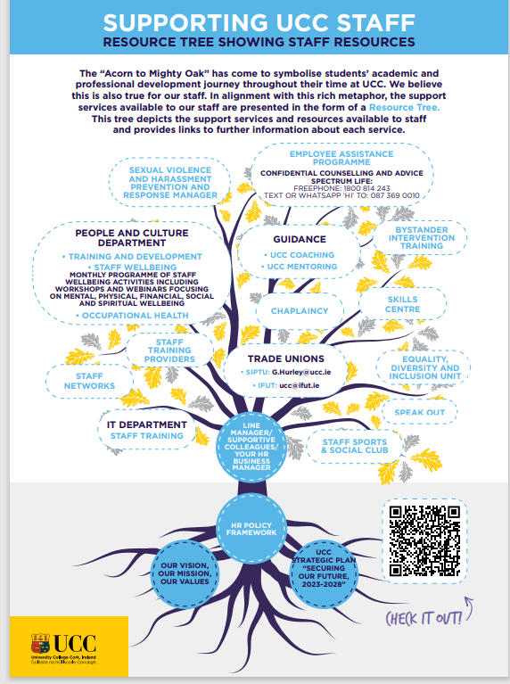
SupportTreeImagePDF.pdf
Notes:
SupportTreeImagePDF.pdf

