Slide 1
UCC Staff Fee Concession
Information Session
Mary Horgan
Friday, 22 May 2026

Slide 2
What we will look at
Introduction to Staff Fee Concession Policy
Staff undertaking study themselves
Pre 1992 staff & entitlements
Finance
Q&A

Slide 3
UCC Fee Concession Scheme
Two Programmes (undergrad & postgrad)
Programmes > internal or external to UCC?
Duration of your contract?
Relevance to role (external programmes only)?
In agreement with manager
Annual application form
Notes:
You as a staff member

Slide 4
CRITERIA
In UCC at least one year
Programme of study at least FETAC 7 or higher on the National Framework of Qualifications (NFQ)
** Current contract at least one year longer than end date of completion of programme **
Requires manager approval
Open to internal UCC & external programmes
External only if not available in UCC & required for role
Max of two programmes of study during employment at UCC
Notes:
Emphasise - relevance of the course to their role and also approval of head for both this and any revisions to working hours etc as these are often issues that arise for managers – you might wish to reference also the guidelines we developed last year on this

Slide 5
INTERNAL UCC PROGRAMME | EXTERNAL PROGRAMME
Full tuition fee covered Staff pays registration & capitation fee themselves Pro rata | 50% Tuition Fee Staff pays registration & capitation fee themselves Up to a max €5,000 over full duration of programme Pro rata
Fee paid annually upfront | Reimbursed on successful completion Masters & PhD only after each year
Manager approval | Manager approval Equivalent is not available in UCC Must be relevant to role

Slide 6
INTERNAL UCC PROGRAMME COST | EXTERNAL PROGRAMME COST
YOU pay: Postgraduate Research Reg. Fee PT - €412.50 / FT - €825.00 & Capitation fee - €70 Postgraduate Taught Reg. Fee PT - €412.50 / FT - €825.00 & Capitation fee - €210 Undergrad Capitation fee - €210 | YOU pay: Undergrad & Postgrad Pay full fee 50% reimbursement up to max €5,000 on successful completion
Notes:
Costs can change from year to year

Slide 7
How to pay my fees (UCC)
How Do I Pay My Fees? | University College Cork (ucc.ie)
In payment box of student portal, add reg. & capitation fees & insert amount
How to Make a Payment Online > Step by step
Go to MyStudentAdmin
Enter your student ID number & password & continue to login
Click on 'online registration’
Complete all steps from ‘regulations /data protection’
At ‘Payment of fees’ & insert relevant amount

Slide 8
How do I get reimbursed? (external)
External programme reimbursement >You pay upfront
On successful completion > Email Training & Development with
Completed external form
All receipts
Proof of successful completion

Slide 9
Staff Fee Concession Forms
Internal Programme form
External Programme Form
Staff Fee Concession Website
Email: traininganddevelopment@ucc.ie

Slide 10
Study Leave & Exam Leave
Study Leave
Max 2 programmes & 10 days each (Pro Rata)
Pre-approved by head & relevant to role
Exam Leave
Only if during work hours
Pre-approved by Head & relevant to role
FORMS
Study Leave
Exam Leave
EMAIL TO traininganddevelopment@ucc.ie

Slide 11
Part II - Pre 1992 Entitlement
Only applies to:
Full-time permanent on or before 30th September 1992
Full-time temporary on or before 30th September 1992 & subsequently appointed in a permanent capacity
Capitation Fee only
Children – living with &/or financially dependent on staff member
One undergrad & one postgrad
Universities = UCC, UCD, TCD, Maynooth University, University of Galway
50% Fee Payment (payable in two equal instalments)
Spouse of UCC staff member

Slide 12
Part II - Pre 1992 Entitlement Steps
Contact Training & Development to check your eligibility
Once beneficiary has received place, staff member makes online payment
Complete beneficiaries form available on Staff Fee Concession webpage
Email scanned form to Training & Development
Once approved by P&C, form with staff member cc’d to Una Barrett (Fees Office)
Fees Office will process
Must re-apply annually i.e. send form to Training & Development

Slide 13
Part II - How much do I pay?
Children of Staff Registering at UCC
Payment of Capitation fee - €210 due at registration
2. Children of Staff Registering at another NUI College
Pay Capitation/Student Levy Charge
Inform Fees Office of relevant College to invoice UCC Fees Office for Student Contribution Fee (Undergrad)
If postgrad - tuition fee less capitation fee
3. Staff Spouse
50% of total fee is payable
Can be paid in two instalments, half on registration & half by 31st January each year

Slide 14
Part II - How & when to pay UCC Fees
How Do I Pay My Fees? | University College Cork (ucc.ie)
In payment box of student portal, insert relevant fee
In Detail > How to Make a Payment Online
Registering and making your payment that is due at registration
Go to MyStudentAdmin
Enter your student ID number & password & continue to login
Click on 'online registration’
If you have already completed most of the registration steps during a previous log in, click directly on ‘payment of fees’
Otherwise, complete all steps beginning with ‘regulations /data protection’ & concluding with ‘payment of fees'
Follow instructions as advised when completing the payment from this point. You can change the amount that appears in the ‘amount to pay(EUR)’ box by clicking and entering the amount you wish to pay

Slide 15
FOR ALL - NOTE
Funded centrally NOT locally i.e. no cost implication for local unit
P&C - On receipt of form, will process & forward to Fees, cc’ing staff member.
Fees – Student must register before funding allocated. Funding allocated mid October in general.
During busy periods (mid-Sept.) & where an application is more involved, process may take longer
** HOWEVER simply ensure relevant fee is paid **
Processing of forms takes place on a continual process

Slide 16
Who to contact & for what?
Queries re eligibility, programmes & form
Training & Development / Mary Horgan
AND
Anything Financial
Una Barrett

Slide 17
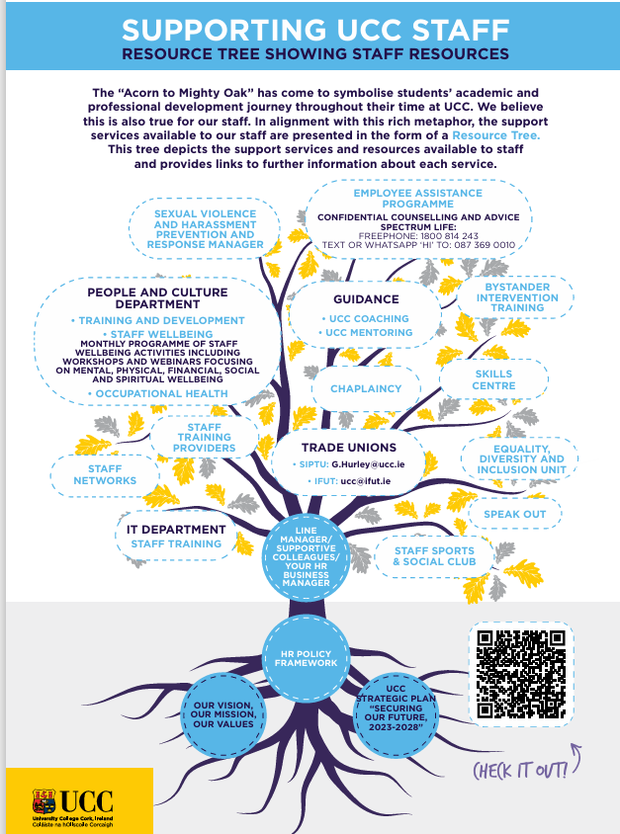

Slide 18


