Slide 1
Redeployment Policy
Mary Kate O’Regan HR Business Manager People and Culture UCC

Slide 2
Where is the policy?
Reassignment & Resignations
Transfers & Resignations | University College Cork
A to Z
Policies A-Z | University College Cork

Slide 3

UCC Redeployment Policy
What its about
Commitment to Permanent Staff
Redeployment Support
University College Cork’s Redeployment
Policy
Alignment with University Aims
Statutory Obligations

Slide 4
Redeployment Reasons – Permanent Staff
Organisational Restructuring
Redeployment Policy
Funding Stream Cessation

Slide 5
What the University wishes to provide
Maintaining Permanent Staff
University's Redeployment Policy
Suitable Alternative Employment
Provide Support

Slide 6
Best case scenario – Redeployment at local level
Head of Unit
Head of College
In the first instance local redeployment
Central Administration Head
Decisions will be made locally within Colleges or Central Administration.
People and Culture Business Manager
Employee Relations Section (if required)

Slide 7
The Sweet Spot for Redeployment
Mutually Beneficial Redeployment
Win-win for all parties
Employer Satisfaction
Employee Satisfaction
Meets organisational needs
Fulfills career aspirations

Slide 8
Redeployment if Role at a Lower Grade
4
Redeployment Register
Staff member can opt to remain on the redeployment register for future opportunities.
3
Role Redesign
Heads of unit redesign the role to align with the staff member's grade.
2
Maintain Pay Scale
Staff member continues on their original pay scale to its maximum. Ring Fenced.
1
Lower Pay Scale
Staff member moves to a role with a lower pay scale.

Slide 9
When local redeployment is not an option
Details Set Aside for Committee
Details Held by People and Culture
Employee Not Redeployed
The employee's details are set aside for the Redeployment Committee.
The employee's details are securely held by People and Culture.
The employee is not successfully redeployed.

Slide 10
So, what does the staff member do?
Notification by Line Manager
Contact P & C Business Partner
Manager informs staff of redeployment status
Staff seeks assistance from P & C partner
Redeployment Process for Permanent Staff
Completion of Role Matching Template
Registration on Redeployment Register
Staff fills out the role matching template
Staff registers on the redeployment list
Return Template to P & C
Priority Consideration for Vacancies
Staff submits the completed template
Staff receives priority for suitable roles
Support from Manager and P & C
Role Suitability Assessment
Staff receives ongoing support from manager and P & C
Redeployment Committee assesses role suitability

Slide 11
Employee Role Matching Template
Forms | University College Cork
Nature of Work
Career Development
Describes the tasks and responsibilities of the current role.
Qualifications
Outlines opportunities for training and career advancement.
Lists the educational and professional qualifications of the employee.
Work Environment
Skills
Describes the current work setting, such as academic or technical.
Highlights the skills such as project management and communication.
Grade and Pay
Experience
States the employee's grade and salary details.
Summarizes the employee's work history and achievements.
Responsibility Level
Aptitude
Defines the level of responsibility in the current role.
Assesses the potential for growth and success in new roles.
Working Arrangements
Specifies any flexibility needs in the work environment.

Slide 12
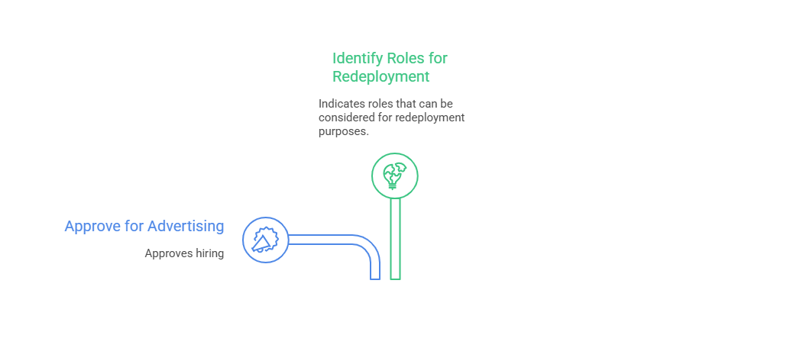
ULT Post Approval Committee

Slide 13
Redeployment Committee
Redeployment Committee Structure
Chairperson of the Committee
Head of Unit with the
available position for redeployment
People and Culture representatives

Slide 14

Role Matching Criteria based on job description and employees’ experience
Nature of Work
Ensures consistency with previous role
Qualifications
Verifies necessary skills and experience
Aptitude
Assesses adaptability and growth potential
Working Arrangements
Considers logistical aspects
Responsibility Level
Compares responsibility levels
Work Environment
Evaluates cultural fit
Career Development
Assesses growth opportunities

Slide 15
Suitability Scores out 35
Score Range
31-35 90 to 100%
27-30 80 - 90%
21-26 60 to 79%
14-20 40 to 59%
7-12
0-6
Suitability Category
Highly Suitable
Suitable
Marginally Suitable
Unsuitable
Highly Unsuitable
Not Suitable at all

Slide 16
This is it
Accept Offer
Appeal Process
Proceed with the redeployment offer as is.
Initiate the appeal process to challenge the redeployment decision.

Slide 17
Employee Appeals Process
1
Prepare the Appeal
Employee outlines grounds for appeal
2
Submit the Appeal
Appeal lodged with Chief People and Culture Officer
3
Consultation with Trade Unions
Chief People and Culture Officer consults with unions
4
Final Decision
Chief People and Culture Officer makes final decision
5
Communicate Outcome
Employee receives written outcome

Slide 18
So, what can a Manager do?
Redeployment Process Sequence
Initial Assessment
Support and Guidance
Employee Action
Determine if local redeployment is possible
Provide resources and information to the employee
Employee completes and submits necessary documents
Appeals Stage
Outcome
Review and Matching
Process moves to appeals if role is rejected
Employee accepts or rejects the proposed role
Committee reviews documents and matches roles

Slide 19
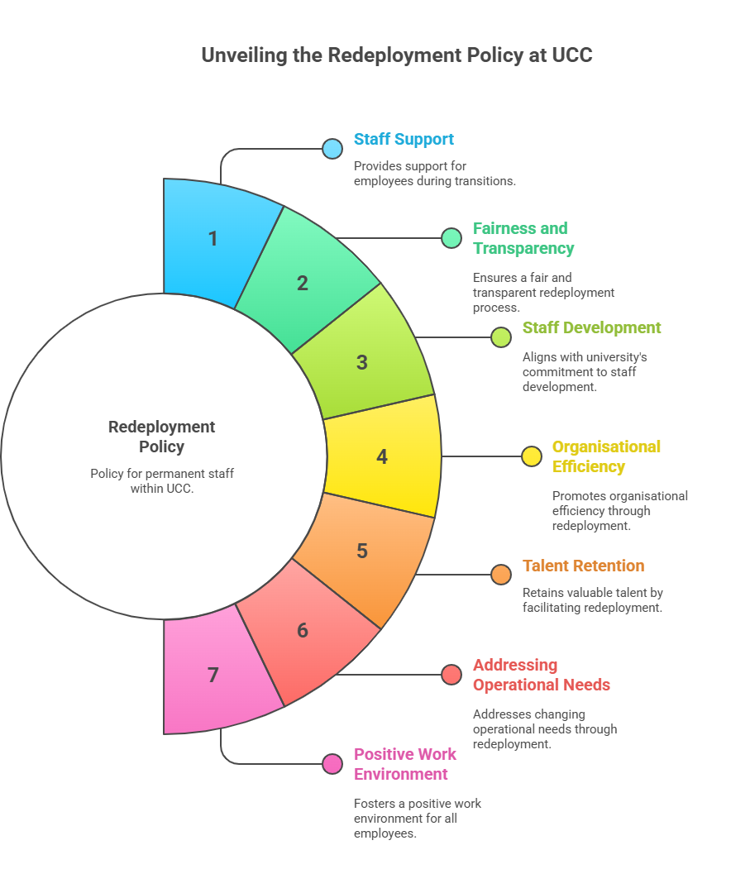
Thanks. Questions?

