Slide 1
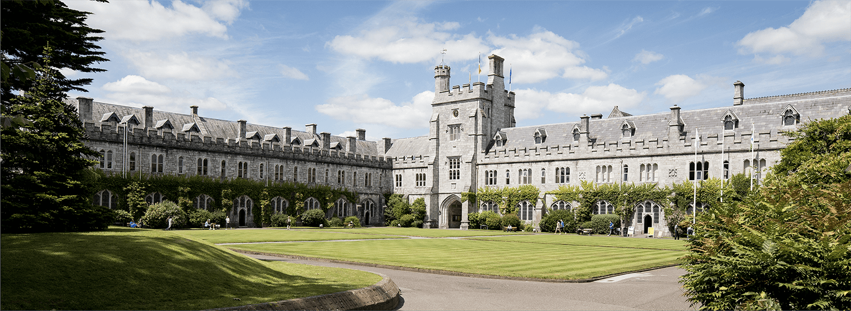
Marketing and Communications: Practical Steps for Managers
28 April 2025
University College Cork

Slide 2
Aims and Content of Presentation
What we know
How we are doing
Where we are going
How you can help
Questions and Discussion

Slide 3
Global Engagement –ambition and transformation
Media and Communications
Marketing and Brand Impact
Student Recruitment
International strategy and agent network
UNIC, Confucius Institute
Arts and Culture
Language Centre
University of Sanctuary

Slide 4
1. What we know

Slide 5
Brand and Reputation
Brand is the external presentation of the University – how we show ourselves to the world. Consistency and quality matter.
Our logo is a visual representation of this brand/who we are – linked to brand equity
Consistent and clear brand management makes a major difference to university rankings as well as wider reputation
An integrated approach to communications, marketing and recruitment is essential to enhance global reputation and impact
Key to a successful brand is
Leadership
A unified and consistent approach to implementation

Slide 6
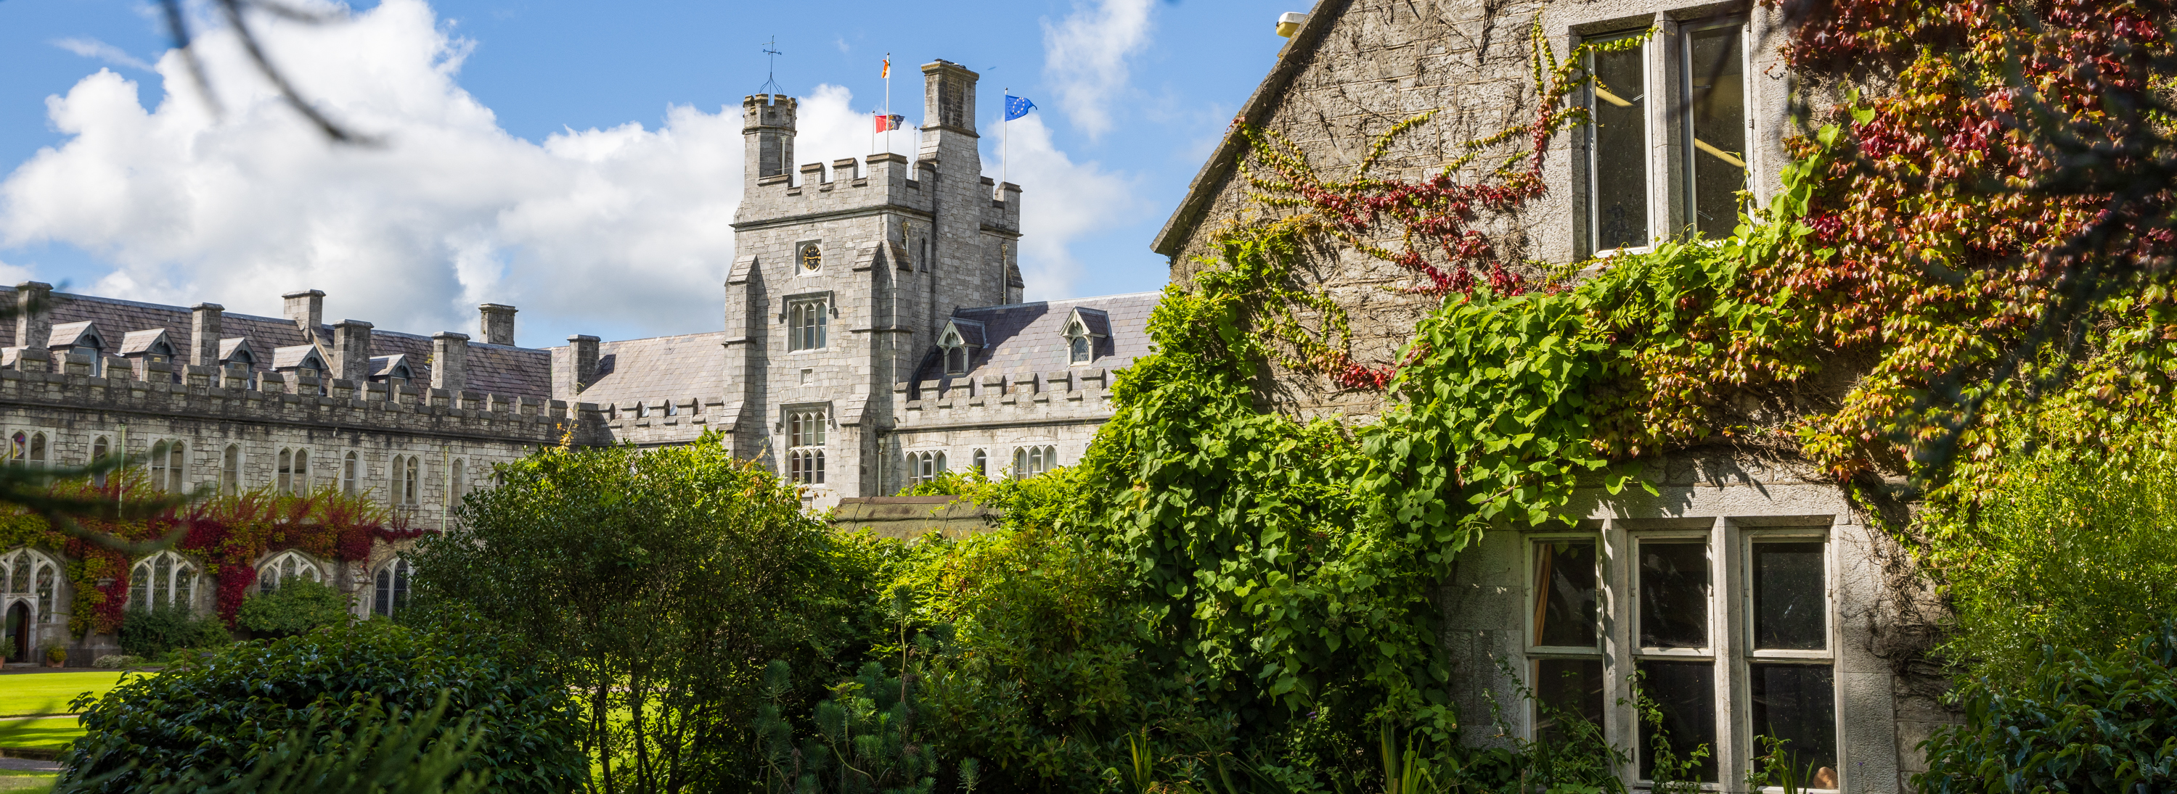
2. How we are doing

Slide 7
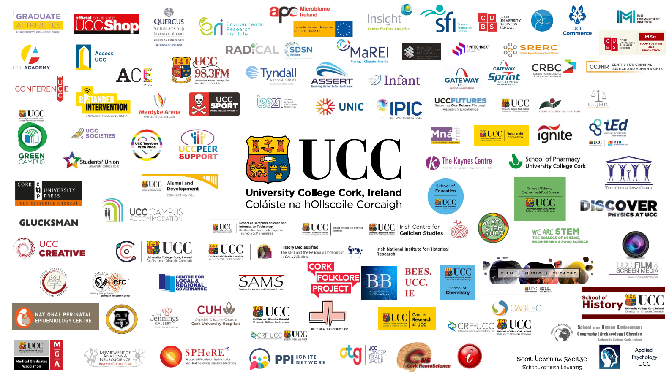
We are a diverse community from the inside out

Slide 8
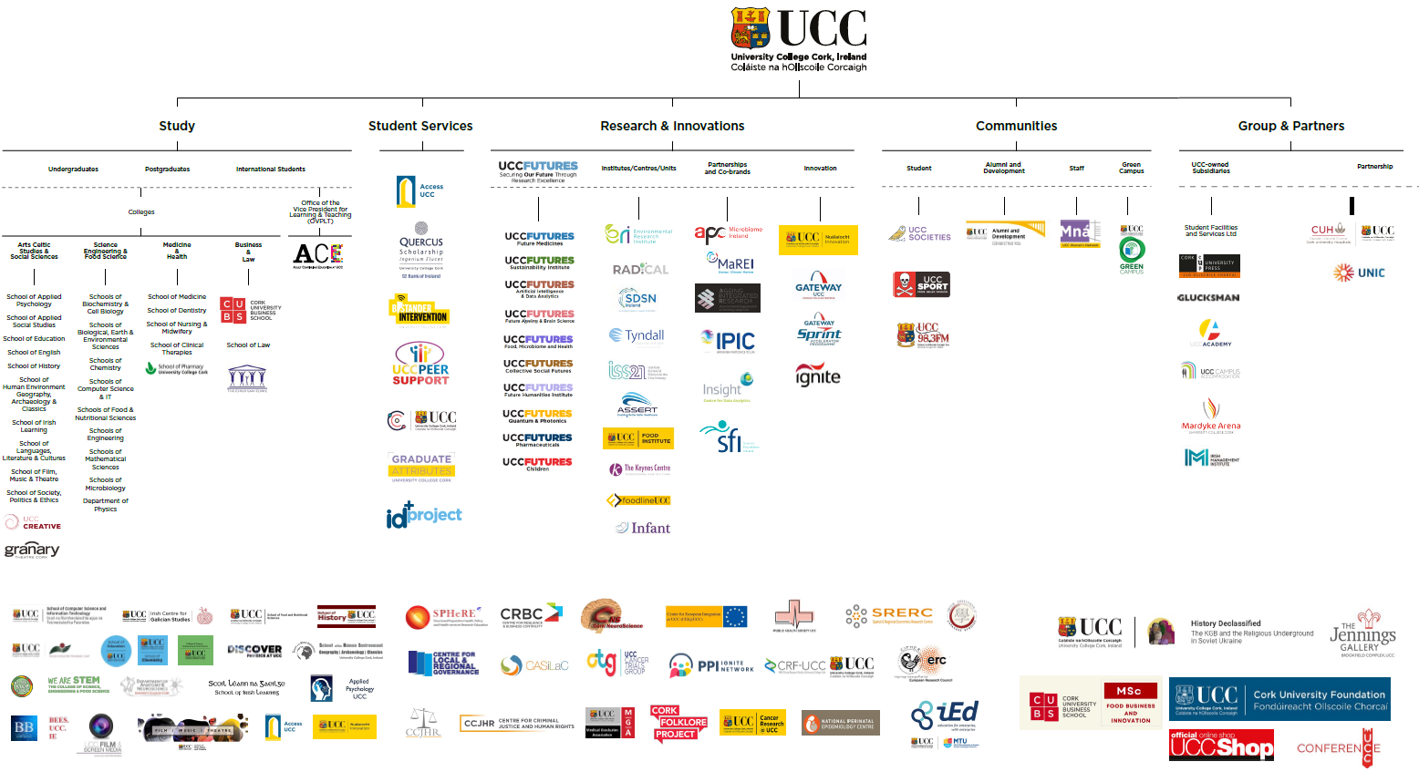
Our current brand architecture

Slide 9
Reviews and Observations
We have found:
Fragmentation, duplication and confusion in our brand
Multiple logos, sub brands and identities – often dominant over UCC
Use of acronyms and terms that are not easily understood
Externalising of our internal structures
Social media channel proliferation – diversifying voice
No clarity on our key strengths or messages
Reputation is suffering
But:
We have a very positive story to tell, if we can tell it with one voice

Slide 10
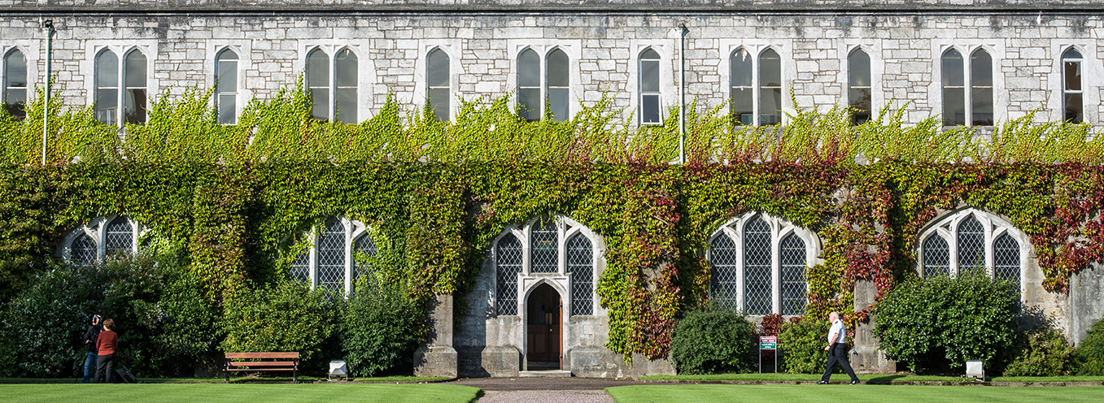
3. Where we are going

Slide 11
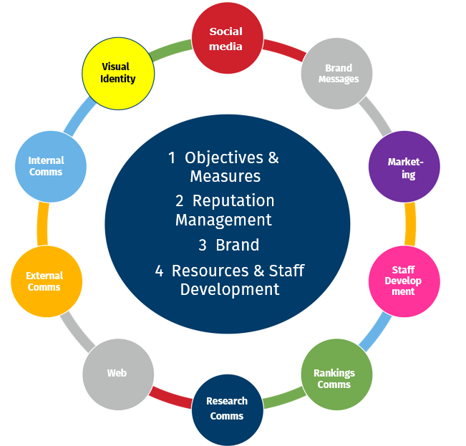
Communications, Marketing and Recruitment Plan
Integrated approach: Integrating communication, marketing and recruitment both centrally and across the University
One Team Approach: Harnessing the wealth of expertise and experience in CMR across the university for the benefit of the University. Working together as a team.
Strengthened professional leadership is required in key areas e.g. web, social media, student recruitment, Internal comms, external comms etc.
Staff Development: A programme of staff support and development to recognise and enhance our professional community

Slide 12
Approved Brand Architecture

Slide 13
Visual Identity Standards in development
Full version
Short version
Sharepoint: One stop shop for all resources, toolkits and templates
Training
Roll out from June

Slide 14
What will it look like when complete?
Single University brand – one Voice, One Identity
Strategic direction clear, measured performance
Our strengths clearly articulated and recognised
Improved reputation and rankings
Stronger financial performance
Sustainable and coherent brand
The University team will be
part of a shared vision, supported to deliver together, through professional leadership, taking pride in the University’s reputation

Slide 15
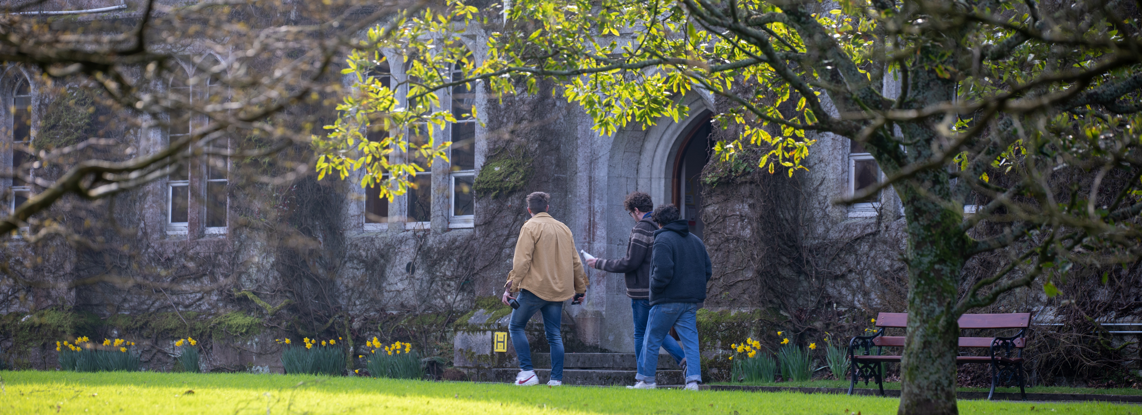
4. How you can help

Slide 16
As Managers in your area …
Your buy-in and active support for this change is essential
Cascade: Put the item on your management agenda to foster an interest in University reputation management – it is everyone’s responsibility
Discuss what the new approach means for your area? Your identity, your messaging, your resourcing, your plans
What activity needs to be revised, stopped, refreshed?
Communication: Talk (and listen) to your Marketing, Communications and Recruitment colleagues Questions? We can come and talk to you

Slide 17
As University Managers …
Engage with information, materials and training
Attend the marketing/communications/recruitment meetings
Champion the new approach across the University
Get involved centrally, where can you/your staff support?
Provide feedback on the process
Think University, think global, think reputation!

Slide 18
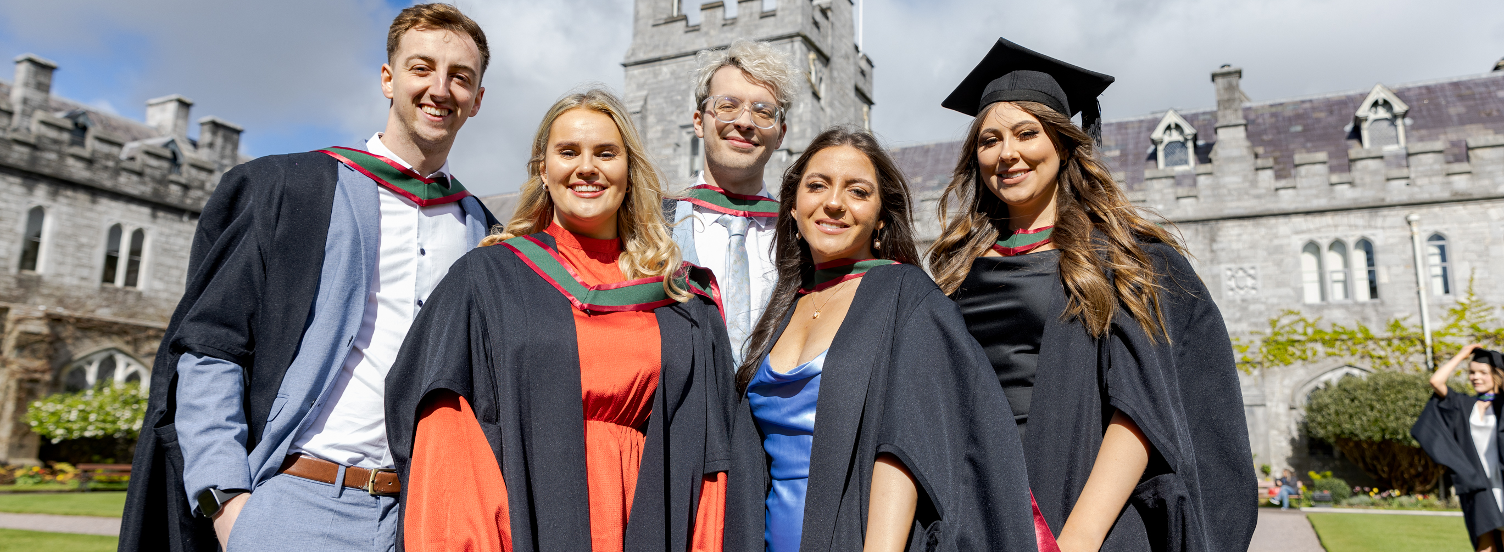
4. Questions and Discussion

