Slide 1
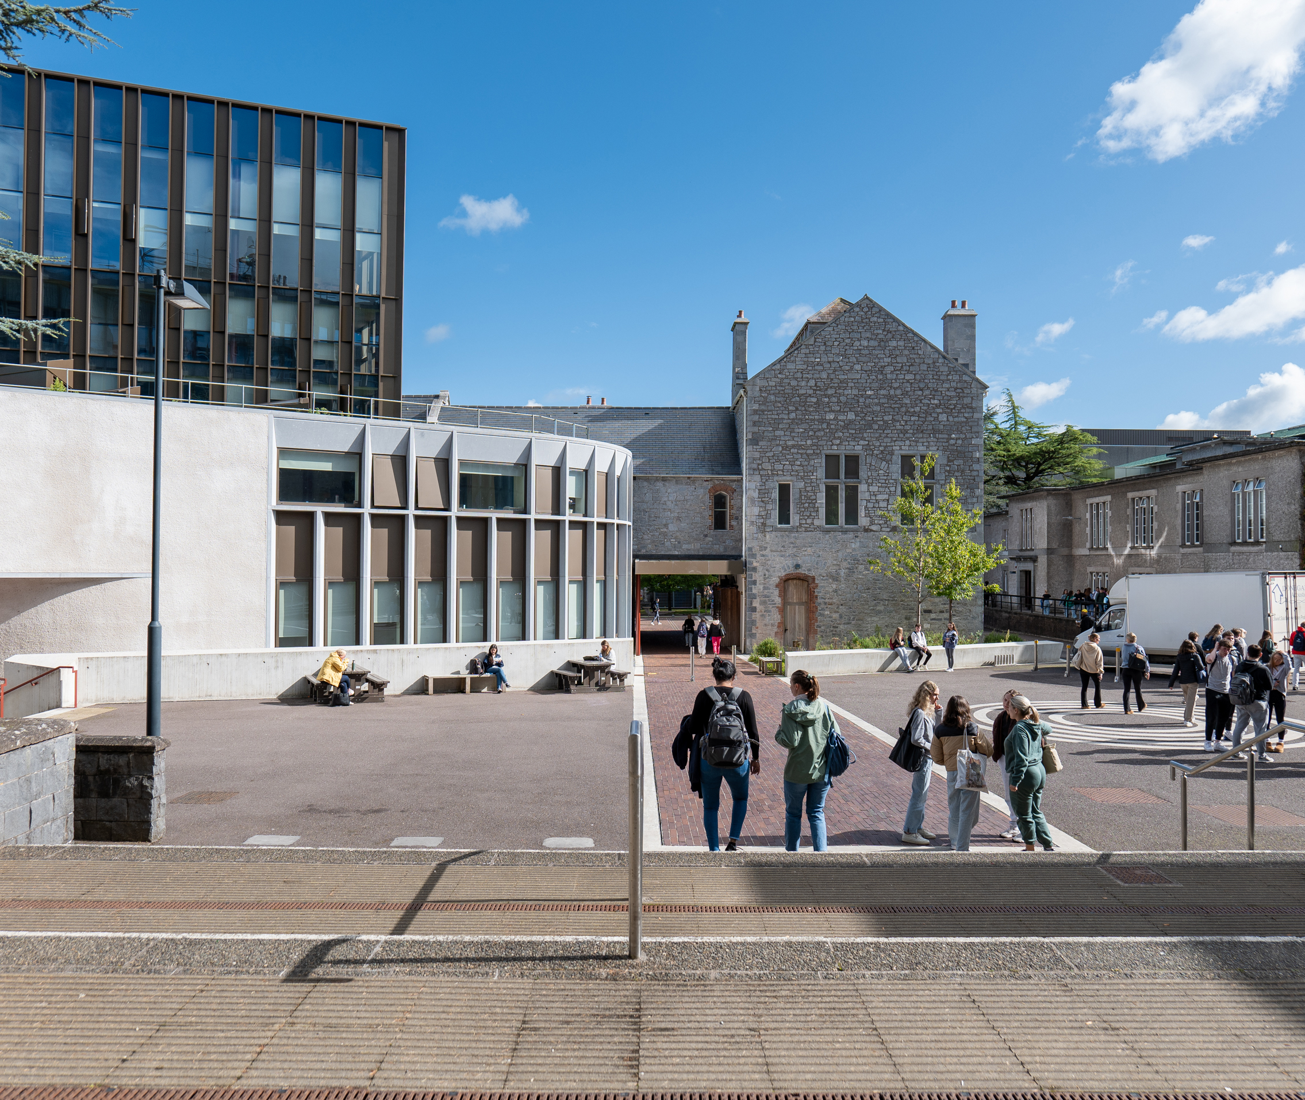
A Briefing on the Interim Admin Promotion Scheme 2025
Angela O’Donovan & Tracy Eagles
People & Culture Department 23rd April 2025

Slide 2
Admin Promotions - Things to Note
Applications are invited on a ‘call-basis’ with this call being the 1st under the Interim Scheme approved by ULT in November 2024.
Advance notice of a call issued week commencing 7th April 2025 with the official call on Friday 11th April 2025 opening the round for applications. Closing date for promotion up to Grade 6a: 15th May 2025.
Principle of a ‘readiness to apply’ approach.
Candidates are asked to apply when ready to apply with cognisance of the competencies for promotion.
Promotion to a higher grade is a recognition of strong performance and meaningful contribution in one’s current role. It is both a reward and an opportunity, acknowledging past achievements while signalling a step up to greater responsibility and expectation that comes with the higher grade. With promotion comes a clear opportunity to take on grade relevant duties, demonstrate enhanced leadership, and contribute strategically at a higher level. Promoted staff are encouraged to meet with their line manager to discuss opportunities for enhanced responsibilities and how best to support their continued growth and impact in the new grade.

Slide 3
Key Institutional Messages
You will find some key messages reflecting some important aspects to keep in mind right now:
AdminPromotionsKeyMessages2025220425.pdf
These messages relate to:
Stepping Up to Greater Responsibility upon promotion
Confidence with Digital Tools and Change
Thinking Globally
Empowering a Research-Intensive University
Operational Strength
Financial Awareness and Acumen
Values Led Behaviour

Slide 4
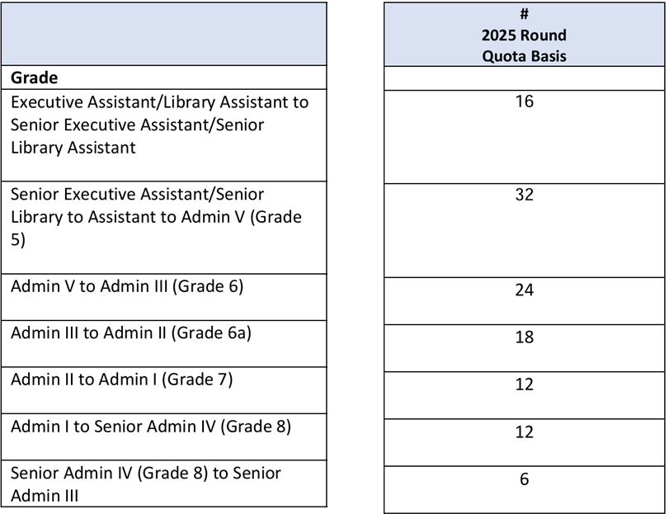
Number of Promotions

Slide 5
A Very Important Message!
This is an evidence- based promotion Scheme – there are no interviews.
The decision regarding promotion will be based on the strength of evidence in your application. Marks will be assigned by the relevant Administrative Promotions Board.
Strict word count limits: Please note the word count limits set out in the application. An application that exceeds these limits can be deemed void.

Slide 6
2 Boards

Slide 7
Promotion Boards
Boards will receive Scheme Training + EDIB Training

Slide 9
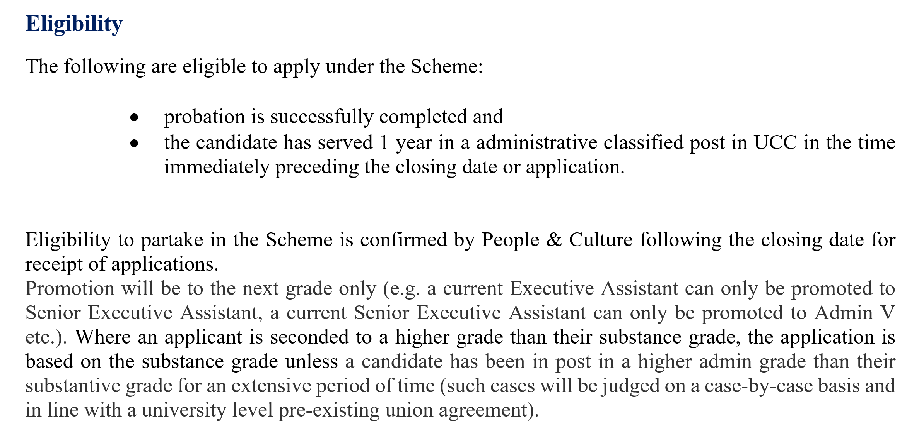
Candidate Eligibility Criteria
As at the closing date for application for Promotion

Slide 10
Competencies – current (non-revised) Competencies | University College Cork

Slide 11
Paperwork - 1 Stage Process
Application
Optional
Application Structured Template 5-6pages
Personal Circumstance Statement -Impact
Statutory Leave Form

Slide 13
Statutory Leave
In this Scheme, “Statutory Leave” refers to maternity leave, paternity leave, parental or adoption leave, carer’s leave and/or any other protected leave which may be provided for in legislation enacted by the State from time to time.
In assessing a candidate’s merit relative to their opportunity to accrue that merit. Consideration shall be given to the impact of Statutory Leave when assessing against the competency areas. Impact guided by the candidate.

Slide 14
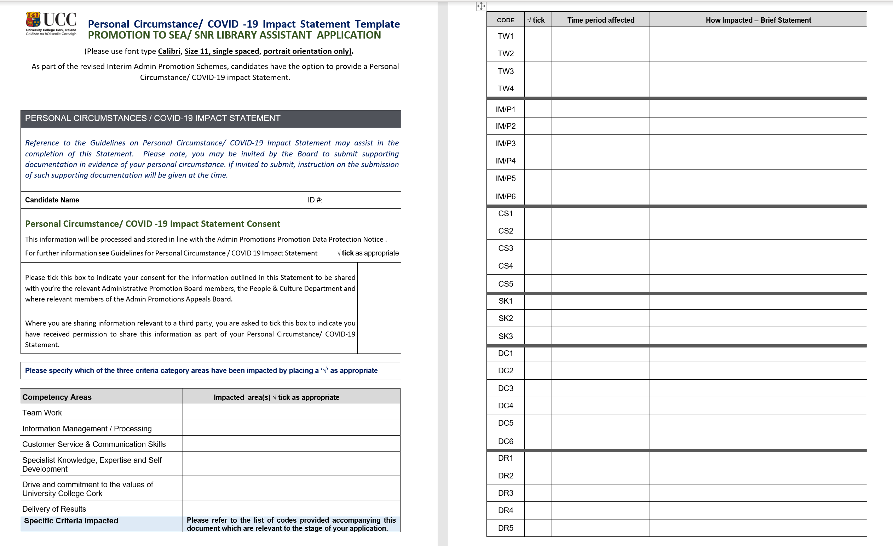

Slide 17
Candidate Feedback
Unsuccessful applicants will have the option to avail of a feedback session.
Requests for in person feedback shall be submitted to the Secretary of the Board within 20 business days of results of the outcome of the candidate’s application being notified to the candidate.
Appeals Board for Board 1 is Board 2
Appeals Board for Board 2 is an appointed Appeals Board – appointed by the Chief People & Culture Officer
Appeals must be submitted within 30 business days of the date of the candidate’s in-person feedback session.

Slide 18
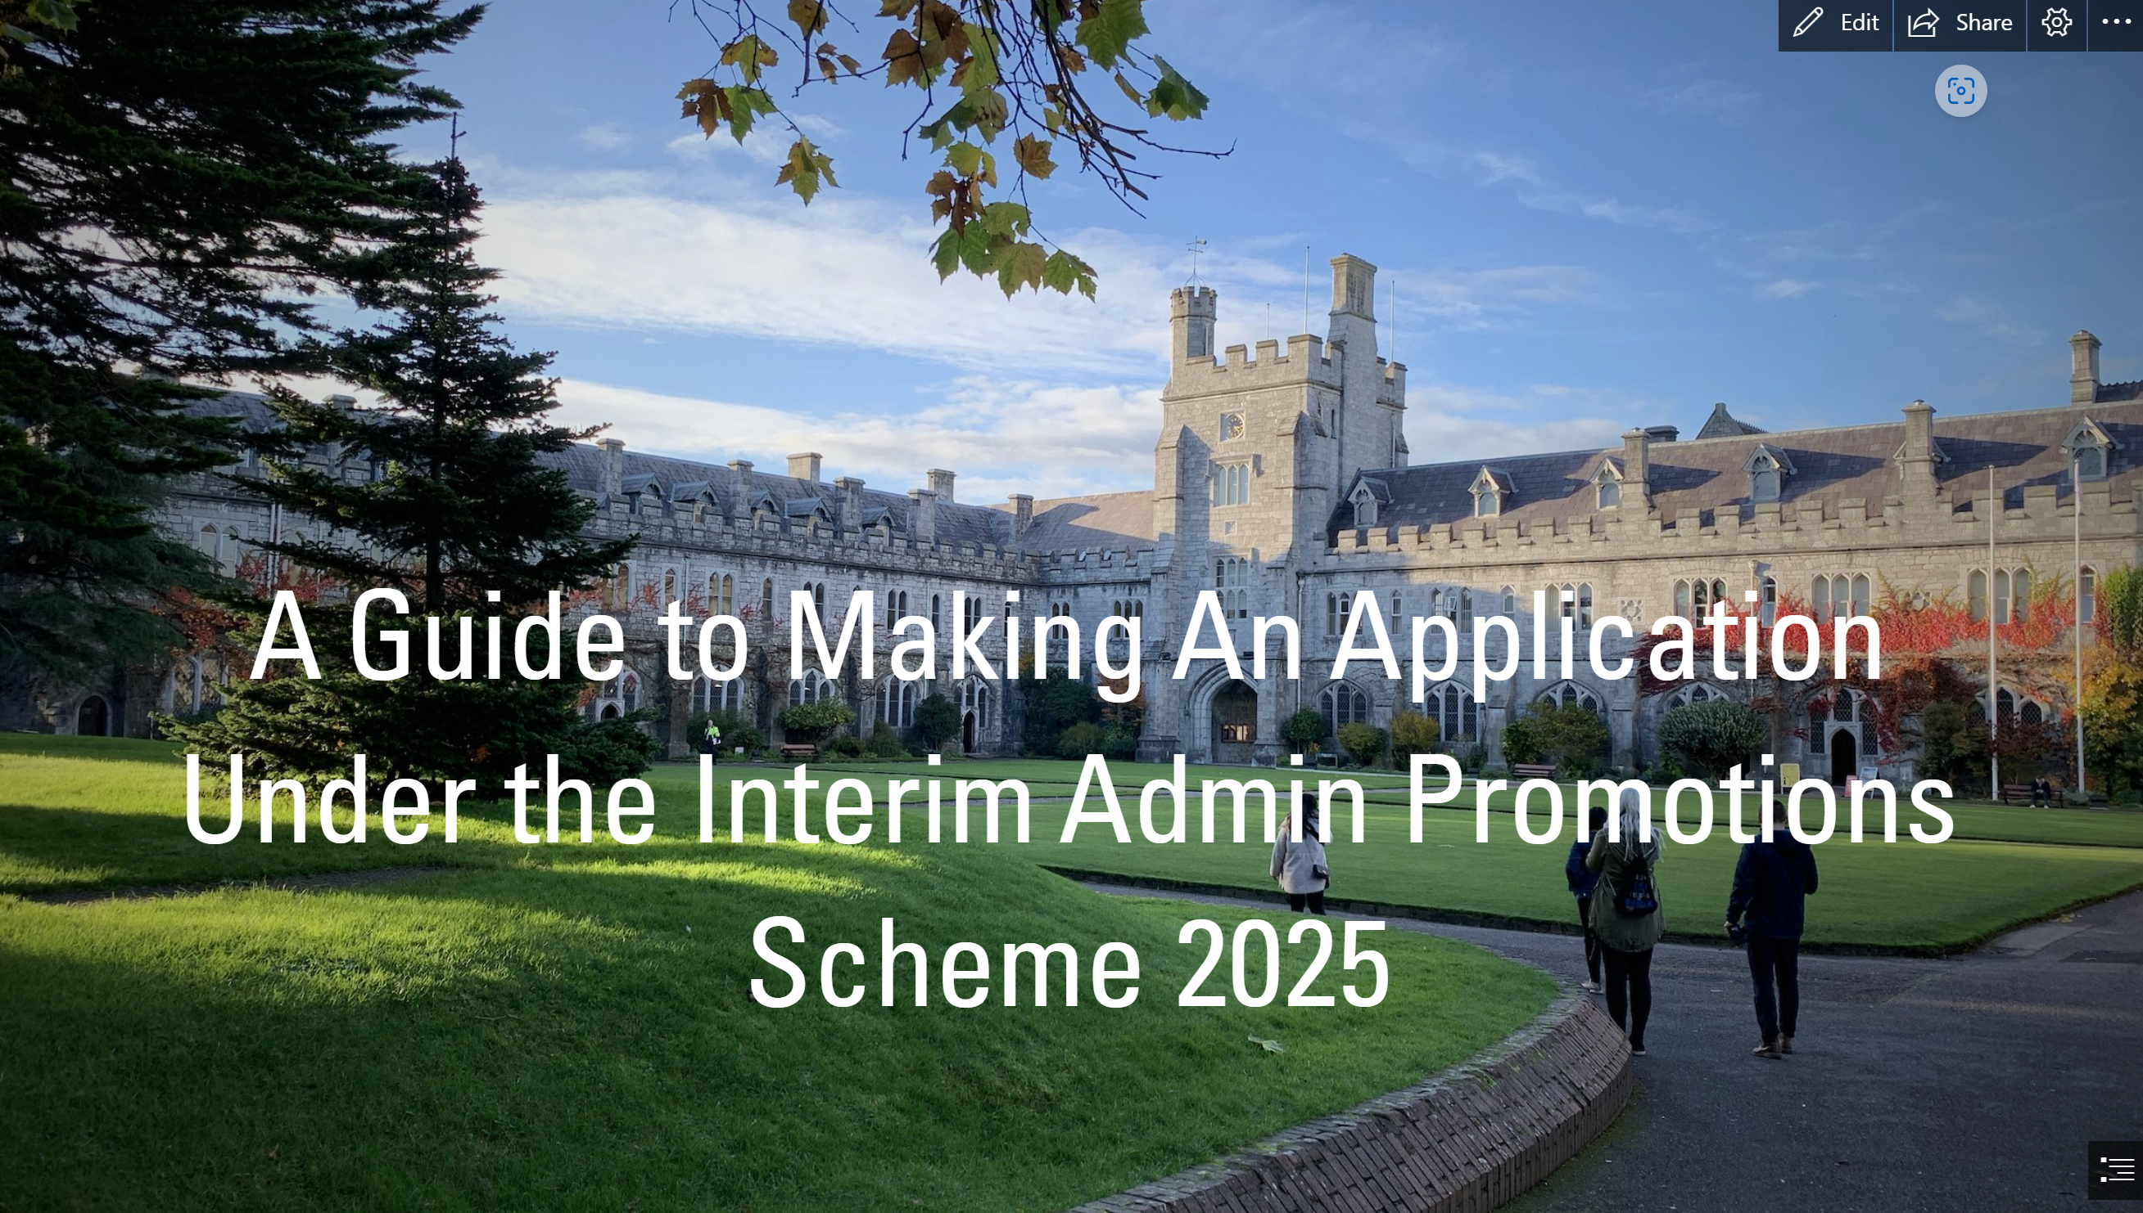
Supporting Guidelines

Slide 19
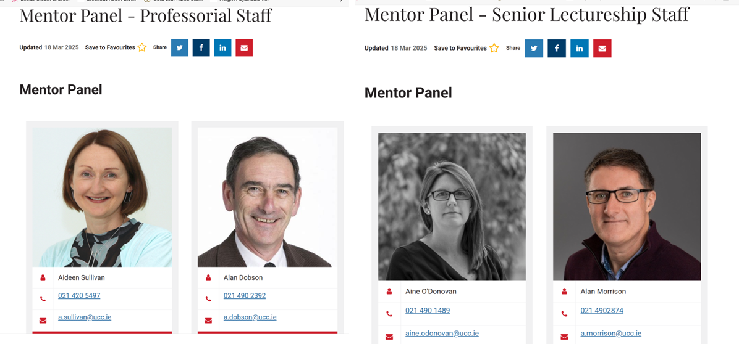
Admin Mentoring Panel will be set up akin to the Academic Mentoring Panel see below
Academic Mentoring | University College Cork

Slide 20
Documentation Relating to Promotion to Admin Promotions
Relevant paperwork will be located atAdmin Promotions | University College Cork or https://my.corehr.com/pls/coreportal_uccp/
Applications for both stages will be made via Employee Self Service (ESS).
Dedicated mailbox: adminpromotions@ucc.ie
Email w/c 7th April 2025 – Announcement issued launching the Interim Admin Promotions Scheme.
Briefing for Staff – recorded and available on Webpage also – 23rd April 2025
Closing Date for applications Board 1 (Grade SEA/Snr Library Ass up to Grade 6a) - 15th May 2025
Launch of call for applications for Board 2 – September 2025

