Slide 1

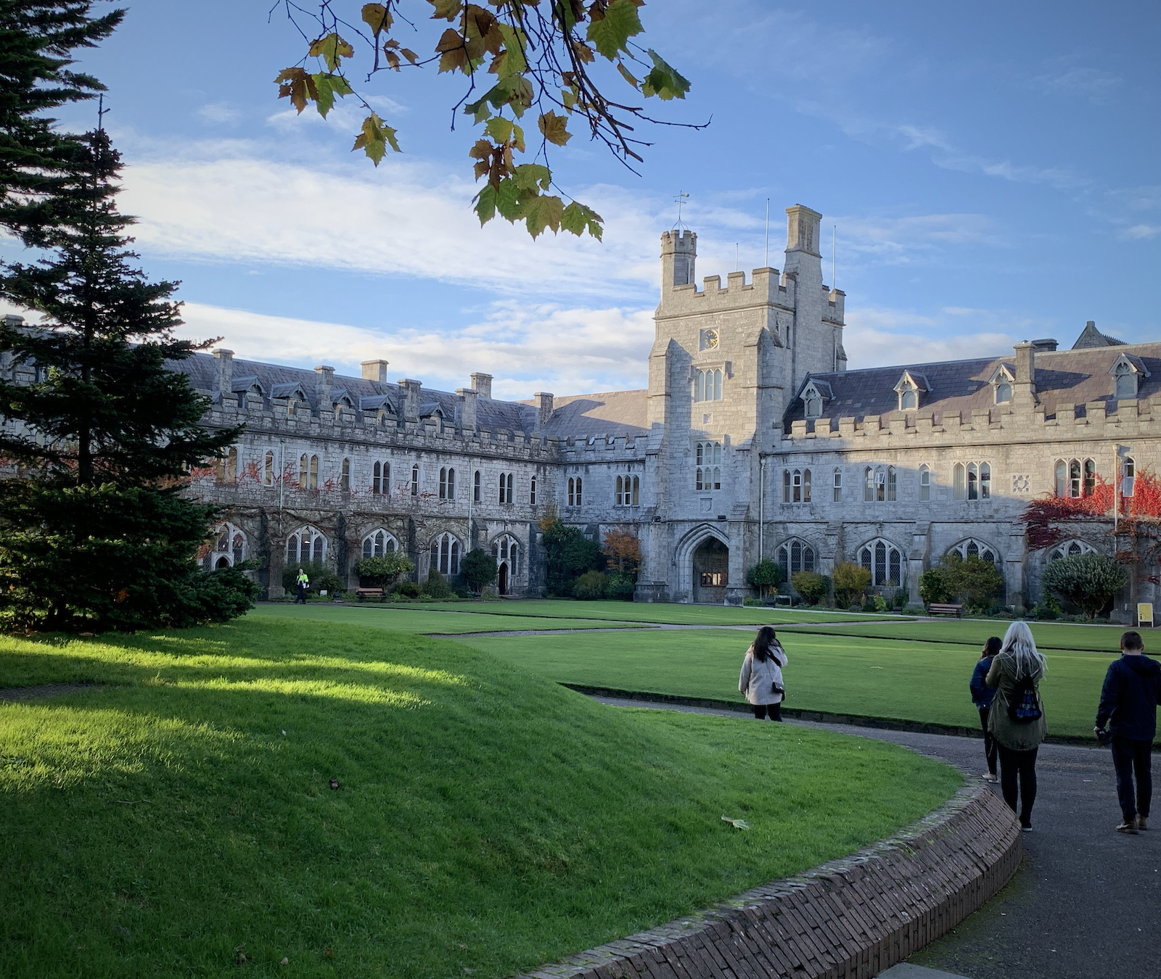

Promotion to Senior Lecturer Briefing
Prof Stephen Byrne
Deputy President & Registrar
Angela O’Donovan
Manager HR Strategy & OD 31st Jan & 1st Feb 2023

Slide 2

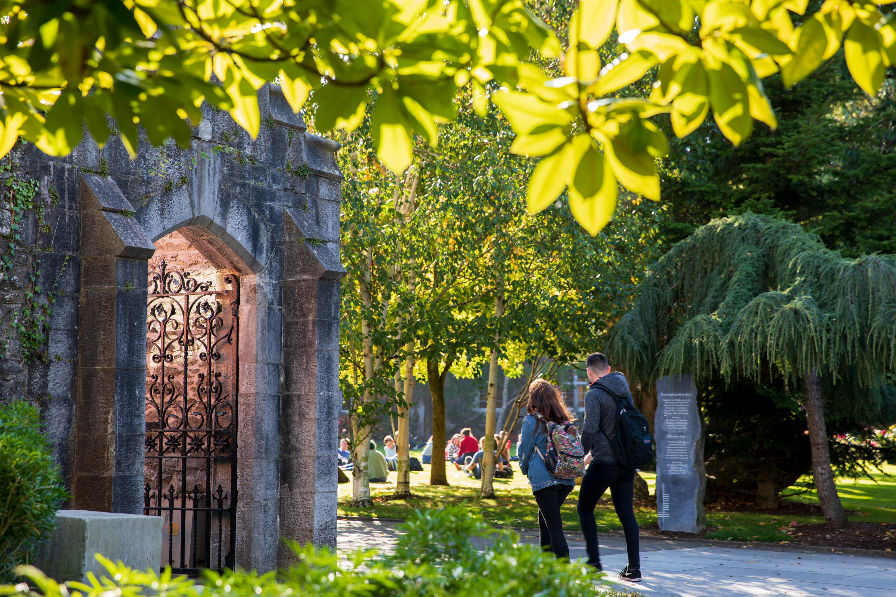
UCC 2022 Actions relating to Academic Progression & Promotion.
UCC 2022 - Delivering a Connected University
Pillar 4 Actions:
4.1.1 Conduct a rapid review of the architecture of the existing promotions schemes to ensure that they are aligned appropriately with UCC’s strategic goals and priorities, linked to performance. Streamline the processes for applicants and panel members alike.
4.1.2: Develop a clear regular timetable for a new promotions system based on both competitive and threshold progression, for staff who demonstrate sustained excellence.
4.1.3: UCC will establish a timeline and budgetary provision for a progression across the Bar programme.
4.1.4: In tandem with promotional opportunities, we will review and implement provision of academic titles in line with national and international best practice.

Slide 3
The Revised Promotion & Progression Processes:
Key Changes
Consistency in approach across progression & promotion schemes;
Streamlined processes;
Clearer and more appropriate eligibility criteria, structured in a manner that aids the candidate in evidencing and the Board in marking;
Introduction of the 2 stage application process across the three schemes (Stage 1 – Expression of Interest Stage and Stage 2 Full Application Stage);
Devolution of Stage 1 of the schemes to Colleges;
Incorporation of disciplinary norms via College input into the process;
Removal of references
Enhanced College participation in PAMB & promotion decision making inclusive of nomination of external reviewers;
Consideration of Statutory Leave, Personal Circumstance/ COVID impact;
Enhanced Feedback process.

Slide 4

Promotion to SL - Things to Note
Rolling Call i.e. moving from a ‘call issued/event’ approach to on-going application period based on a readiness to apply. New scheme launched 20th Jan 2023;
Published schedule of dates (3 years) - 2 sittings of the SL Board (Stage 2) per year;
Principle of last submission dates and readiness to make an application.

Slide 5
Eligibility Criteria
As at the closing date for application (Stage 1)
- All Lecturers holding a current appointment at UCC;
- Doctorate from a recognised institution (or equivalent evidence of high-level research achievement);
- Completed probation in post at UCC;
- Have at least three years continuous service as a Lecturer, two of which are in UCC.
Note:
- Period of Sabbatical Research Leave is counted as service (paid or unpaid);
- Secondments – assessed for eligibility on a case by case basis.
Waiting period for eligibility following an unsuccessful application at Stage 1:
- 12 month waiting period before re-submitting another application for promotion to SL.

Slide 6
Promotion to SL – A Two Stage Process
Two application periods per year: cycles
Apply any time, submitting your Stage 1 Expression of Interest application in recognition of the deadline for submitting a full application, if one was to be shortlisted.
Stage 2 (Full application) is by SL Promotions Board invite issued to successfully shortlisted candidates.
Apply to Stage 2 up to the 5pm on the last day of the cycle you wish to apply to (full application). The SL Board will meet twice a year to consider full applications submitted by shortlisted applicants within either the ‘June Cycle’ or November Cycle’
June Cycle - 1st August to 31st March November Cycle – 1st April to 31st July.
June Cycle
June Cycle
November Cycle

Slide 7
Key Apply by Dates
Stage 1 Submission dates
Stage 2 FULL Application Submission dates (BY INVITE ONLY)
Apply any time.
Note application will fall within either the June or November cycle.
Applications submitted with insufficient time before the end of a cycle may be deferred to a subsequent cycle.
6.1. Closing Dates and Notifications – note Stage 2:
If a candidate is notified of their shortlisting less than two months prior to the end of a cycle, the candidate may submit their full application within the cycle immediately following. Subsequent cycle submission only by exception and via Director of HR permission.
31st March 2023 – June Cycle
31st July 2023 – November Cycle
31st March 2024 – June Cycle
31st July 2024 – November Cycle
31st March 2025 – June Cycle
31st July 2025 – November Cycle

Slide 8
Working Example 1: application made in cycle 1 2023
Dr. Fitzpatrick makes an application on the 13th February 2023, falling within the June Cycle. Dr. Fitzpatrick’s application is successfully shortlisted by the College Level Board at its meeting on the 8th March 2023.
Dr. Fitzpatrick is invited by the SL Board to Stage 2 on the 10th March to make a full application by the deadline – 31st March 2023.
Dr. Fitzpatrick submits an application on the 31st March 2023 prior to the 5pm deadline.
As Dr. Fitzpatrick has been notified of the shortlisting outcome less than 2 months prior to the end of the cycle, Dr. Fitzpatrick could have chosen to submit the full application to the next SL Board sitting i.e. November 2023. Dr. Fitzpatrick decided to go ahead and submit to the June sitting of the SL Board in full knowledge of the notification period prior to application. In this example Dr. Fitzpatrick had three weeks from notification of shortlisting to the last submit by date within the June Cycle.

Slide 9
Working Example 2: application made in cycle 2 2023
Dr Khan makes an application on the 3rd April 2023, falling within the November Cycle. Dr. Khan’s application is successfully shortlisted by the College Level Board at its meeting on the 30th May 2023.
Dr. Khan is invited by the SL Board to Stage 2 i.e. to make a full application by 31st July 2023 for consideration at the November meeting of the SL Board.
Dr. Khan submits an application on the 7th July ahead of the 31st July 2023 deadline for consideration by the November sitting of the SL Board.

Slide 10
SL Promotion Boards
College Level Board Stage 1 Expression of Interest
Head of College
School Heads
Research & Innovation representative from the College*
Learning & Teaching representative from the College*
SL Board member in attendance i.e. not a Board member –for consistency across the Colleges.
Gender an Quorum requirements
Additional – None College Applicant/ ULT Representative provision
Independent from the SL Promotions Board
*if none available R&I and L&T offices nomination.
University Board Stage 2 Full Application
Senior Lecturer Promotions Board
Chaired by the Deputy President and Registrar
An academic nominee of the President (internal or external to UCC)
Eight academic members (Prof, Prof Scale 2 and SL) made up of two representatives from each of four Colleges – AC determined following consultation with the Colleges.
Independent Senior Academic from outside of UCC to oversee the process at Full Application Stage.
Gender an Quorum requirements

Slide 11
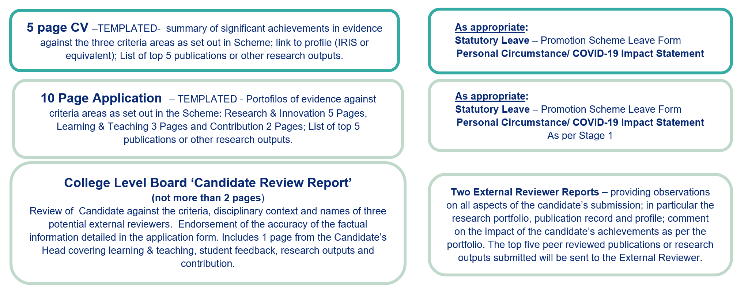
Paperwork
Stage 1: Expression of Interest to College Level Board
Stage 2: Full application to SL Promotions Board.

Slide 12
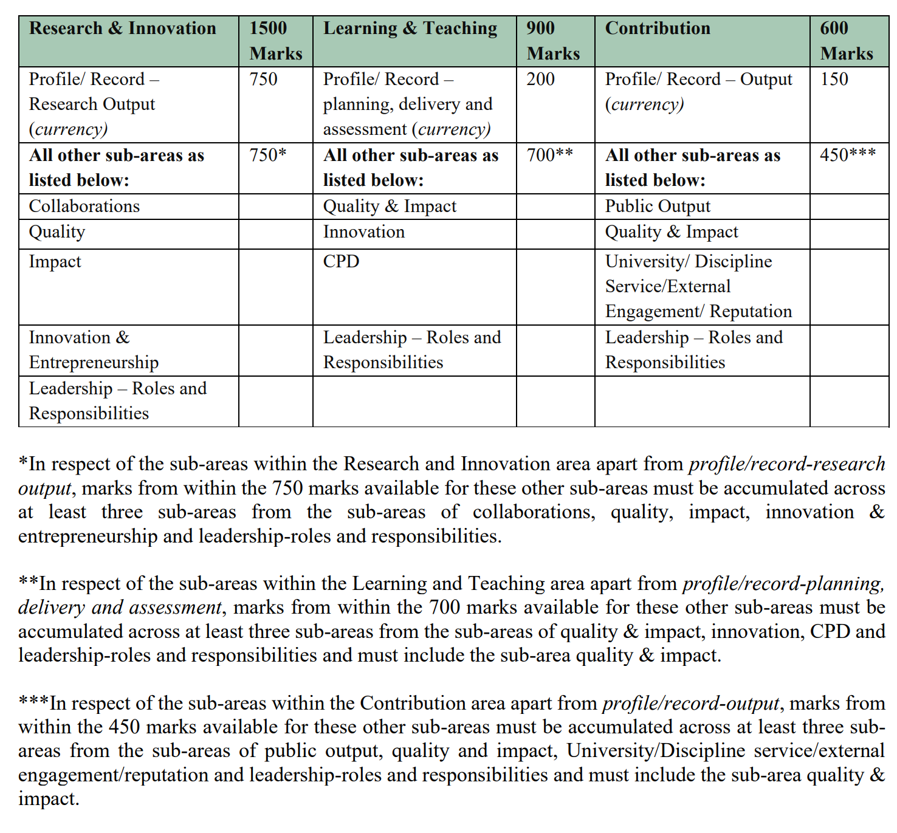
Assessment Criteria under Three Broad Areas
Criteria Areas, Sub-categories and associated marks at Stage 2.
To be promoted candidates must score:
900 out of 1500 marks in Research & Innovation
540 out of 900 marks in Learning & Teaching
360 out of 600 marks in Contribution to Academic Citizenship and Engagement.

Slide 13
Evidencing Criteria
When making an application for promotion to SL, Applicants should supply supporting evidence demonstrating their level of achievement across the range of areas set out in the Regulation for Promotion to SL;
Applicants need to present a prima facie case for promotion to SL.
To establish a prima facie case for promotion to SL, candidates must satisfy all of the essential criteria as set out in Appendix B of the ‘Regulation on Academic Promotions to Senior Lectureships’.
Evidence of meeting the criteria should be presented within the portfolio templates provided by HR. In compiling these portfolios candidates may wish to make reference to the indicative evidence as set out in Appendix C. Whilst not submitted with the application, the Board may, where needed in consideration of an application, request submission of such evidence to aid in its deliberations.
It is recognised, however, at full application stage that not all the activities and responsibilities in each section listed in Appendix C will be fulfilled by every applicant. Applicants should therefore articulate, supported by appropriate evidence, where they consider their major and minor contributions lie in each of the three Criteria Categories set out in the application.
In order to be promoted to SL, successful candidates will be expected to achieve at least a 900 out ogood’ level of performance under all three criteria categories: Learning and Teaching, Research and Innovation, and Contribution to Academic Citizenship and Engagement.

Slide 14
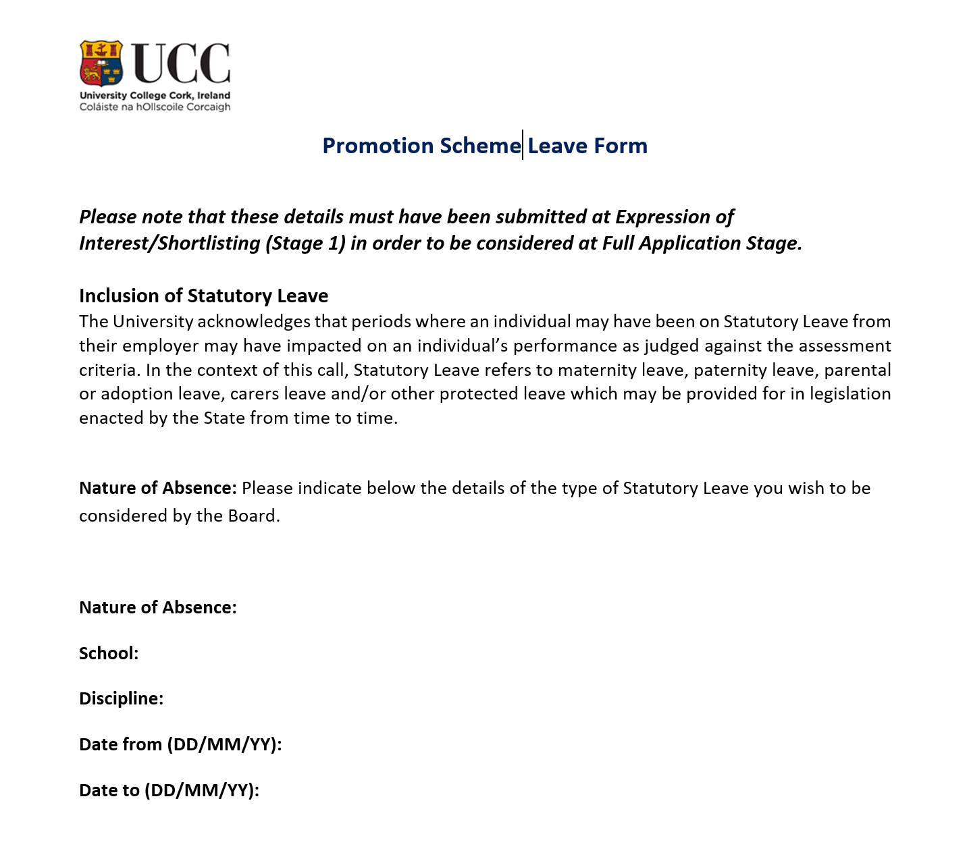
Statutory Leave
In this Scheme, “Statutory Leave” refers to maternity leave, paternity leave, parental or adoption leave, carer’s leave and/or any other protected leave which may be provided for in legislation enacted by the State from time to time.
In assessing a candidate’s merit relative to their opportunity to accrue that merit at shortlisting stage, consideration shall be given to the impact of Statutory Leave when assessing those essential criteria listed in Appendix B which are denoted with an asterisk *.
At full application stage, the impact of Statutory Leave will be considered when determining an appropriate score under those criteria listed in Appendix C which are denoted with an asterisk *.

Slide 15
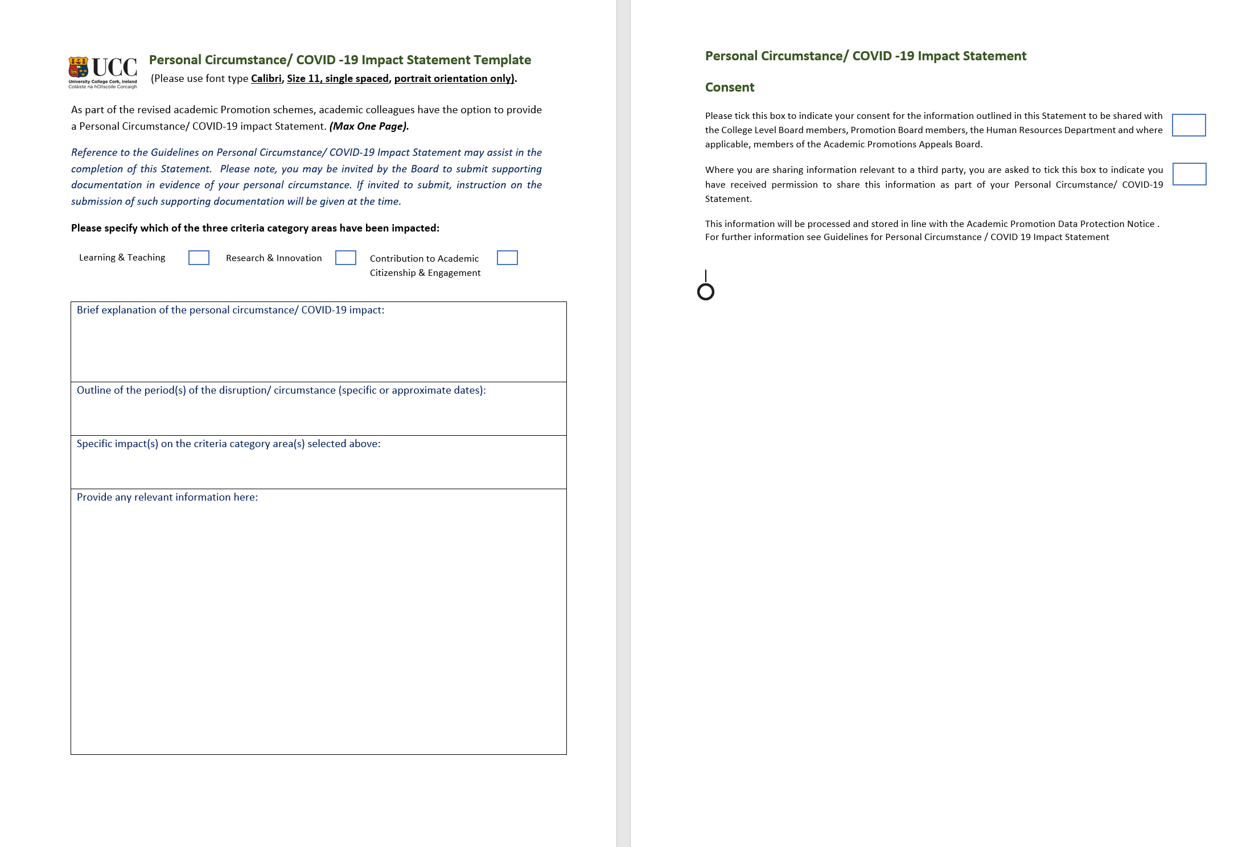

Slide 16
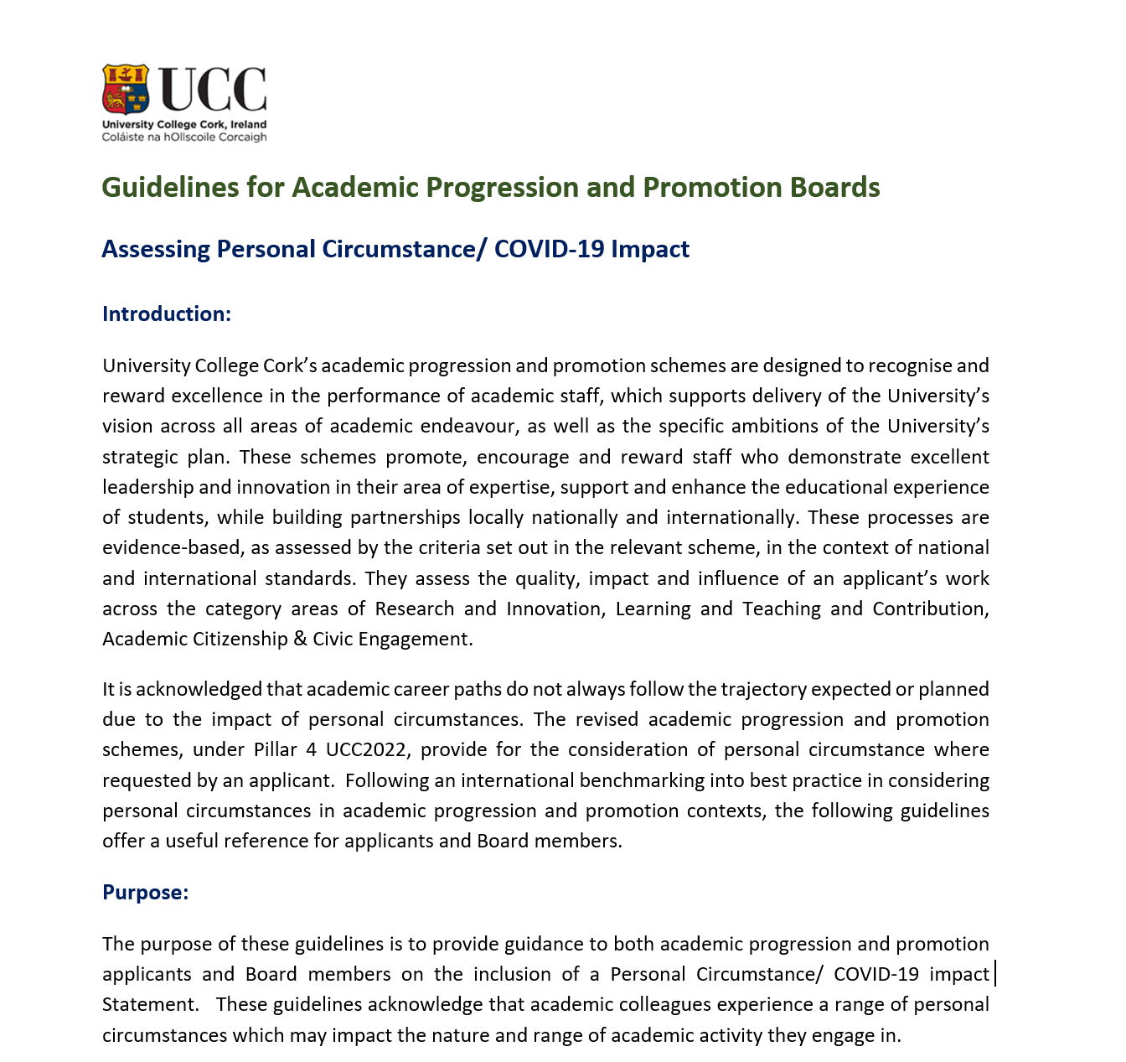
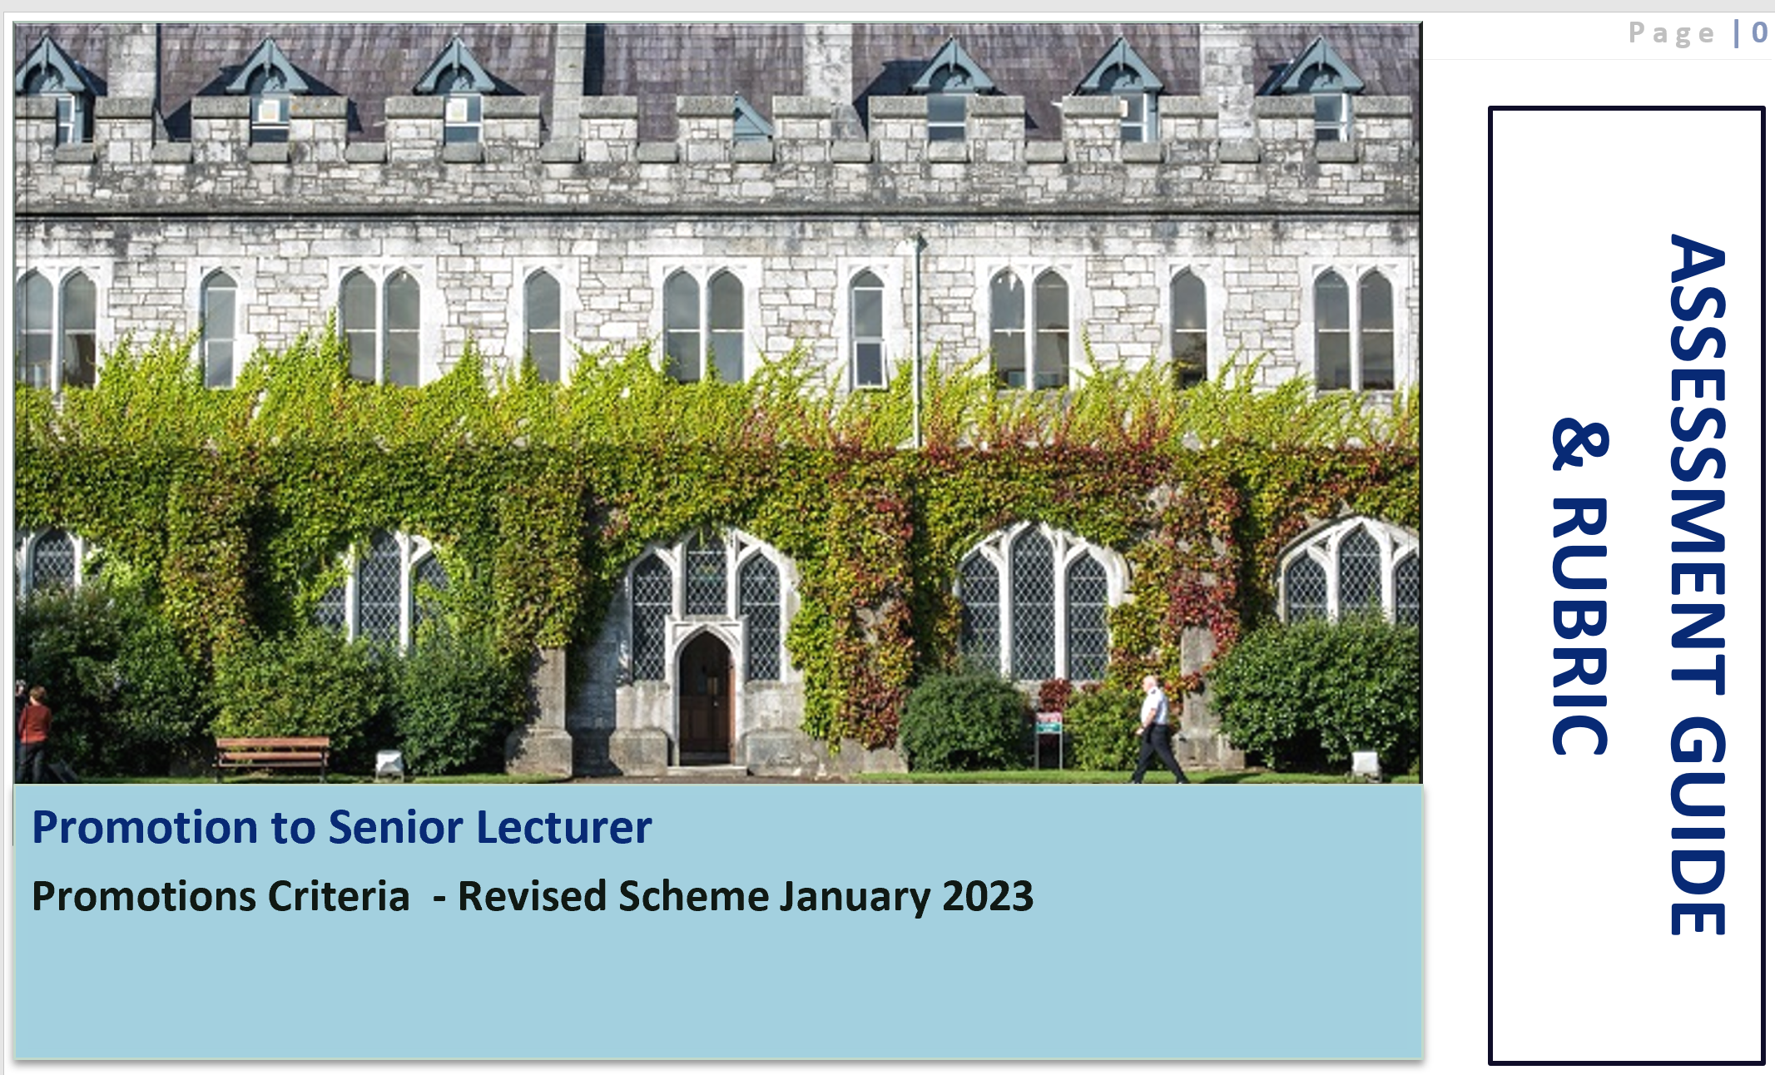
Supporting Guidelines

Slide 17
Feedback
At Stage 1 and Stage 2
Unsuccessful applicants at Stage 1 receive written feedback from the College Level Board with the option of requesting an in-person feedback session with their:
  Head of College as Chair of the College Level Board and
  Head of School.
Unsuccessful applicants at Stage 2 have the option to avail of an in person feedback session.
Requests for in person feedback (Stage 2) shall be submitted to the Secretary of the SL Board within 20 business days of results of the outcome of the candidate’s full application being notified to the candidate.
  Deputy President and Registrar (Chair of the SL Board for the purposes of assessing applications under this Regulation),
  their Head of College and
  their Head of School.

Slide 18
Making an Application
Please note if you ‘submit’ you cannot ‘un-submit’
Please note that the Regulation on Academic Promotions to Senior Lectureships and relevant paperwork is located at Promotion to Senior Lectureship | University College Cork (ucc.ie)or https://my.corehr.com/pls/coreportal_uccp/ Applications for both stages will be made via Employee Self Service (ESS), where applicable.
Please note there is a separate application per College on ESS. Please ensure you apply for the relevant College. Where you have a joint appointment across the Colleges, please make contact so it can be clarified which College you will apply under.
Dedicated mailbox for SL: slqueries@ucc.ie
Apply when ready to apply with cognisance of the deadlines set out for submission in the regulation!

