Slide 1
Briefing: New Scheme Promotion from Professor (Scale 2) to Full Professor (Scale 1)
Prof. Stephen Byrne Deputy President & Registrar & Angela O’Donovan – People & Culture
18th December 2025

Slide 2

Promotion to Professor Scale 1 - Things to Note
Applications are invited on a ‘call-basis’ with this call being the 1st under the new regulation approved by GA on the 15th April 2025.
Calls can be expected every two-years on a running cycle.
The official call will issue 18th December 2025 and will be open up for applications on that date. Closing date of Stage 1: 27th March 2026 (cognisant of the holiday period).
All revised schemes run to date (PAMB, SL, Prof Scale 2) encourage a ‘readiness to apply’ approach.

Slide 3
The Academic Rank of Promotion to Full Professor Scale 1
It is expected that those at Professor (Scale 2) have extensive academic experience, which is demonstrated through significant contributions in research, learning and teaching, as well as in contribution to their discipline and the University.
It is also expected that those at Professor (Scale 2) level engage in the advancement of knowledge, having a well-established and impactful reputation in their discipline at a national and international level leading to peer-reviewable outputs.
Full Professor represents academic achievement of the highest distinction. In addition to the expectations set out for the level of Professor (Scale 2), above, it is expected that those at full Professor level carry significant academic leadership responsibilities both nationally and internationally.
Full Professors are expected to have substantial academic experience, international reputation in their discipline, as well as being impactful in the advancement, application and dissemination of knowledge for the greater good of society and UCC.

Slide 4
Eligibility Criteria
As at the closing date for application for Promotion to Professor Full Scale 1 (Stage 1)
All Professor Scale 2 holding an appointment at UCC;
Have at least five years continuous service at the level of Professor Scale 2 (or service seconded to Full Professor level) at UCC, immediately prior to the date of application. If counting service from another institution three years services needs to be with UCC (equivalence of Prof Scale 2 looked for).
Note:
Period of Sabbatical Research Leave/ is counted as service (paid or unpaid).
Statutory Leave (Paid) is counted as service. Statutory Leave Form as part of the process can be used to reflect periods of paid and unpaid Statutory Leave.
Secondments – assessed for eligibility on a case-by-case basis.
*Please refer to the criteria outlined in the scheme which reflects the standard expected at Prof Scale 1 grade.
Eligibility to partake in the scheme is confirmed by People & Culture/Human Resources following the closing date for receipt of applications.

Slide 5
Professor Scale 2 Promotion Board Stage 1 (Shortlisting) & Stage 2 (Full Application)
Deputy President & Registrar (Chair)
An academic nominee of the President (who may be internal or external to the University)
Eight academic members – Professors*, made up of two representatives from each of the four colleges.
Two independent international external academics, as nominated by the President, one from each constituency pairing CACSSS/B&L and SEFS/M&H.
The regulation, in line with the other academic regulations, provides for process oversight by an External
Senior Academic.
The Board is in the process of being appointed, the membership of which will be posted on the P&C/HR Webpage.

Slide 6
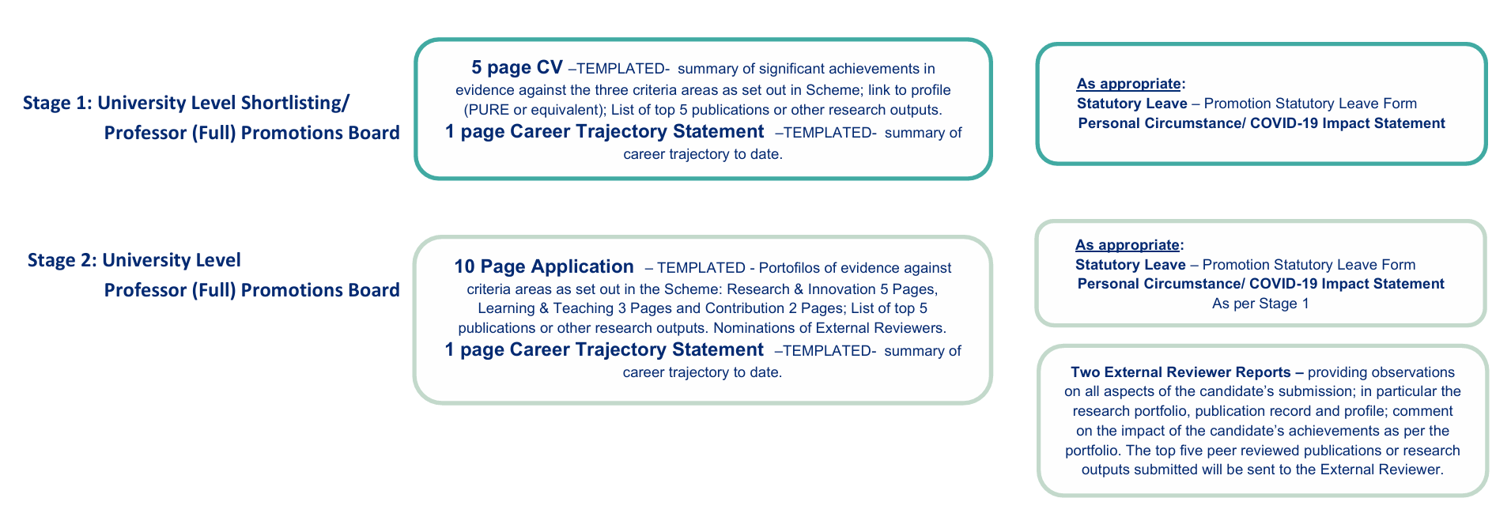
Paperwork

Slide 7
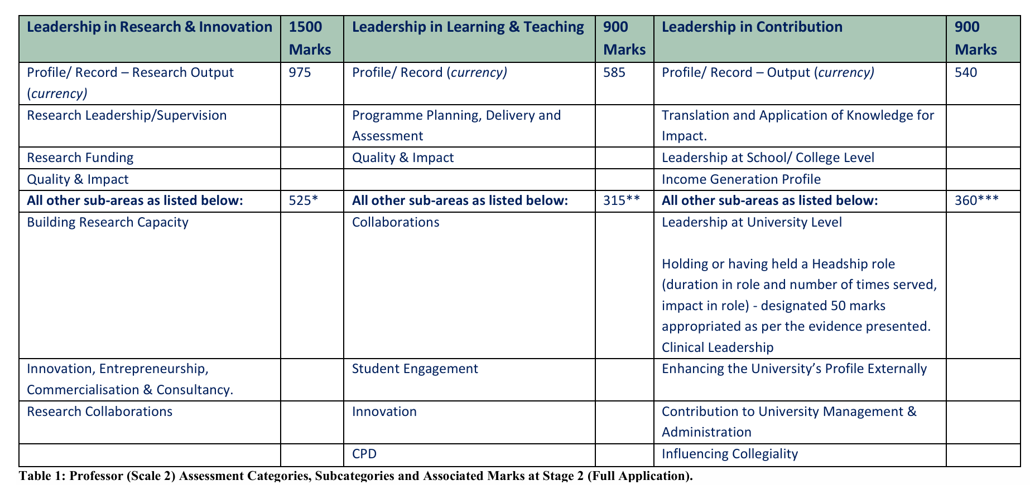
Assessment Criteria under Three Broad Areas Criteria Areas, Sub-categories and associated marks at Stage 2.

Slide 8
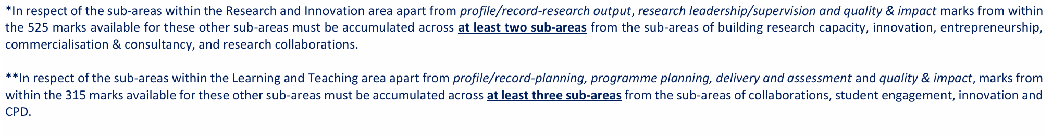
Required versus Choice Sub Areas

Slide 9
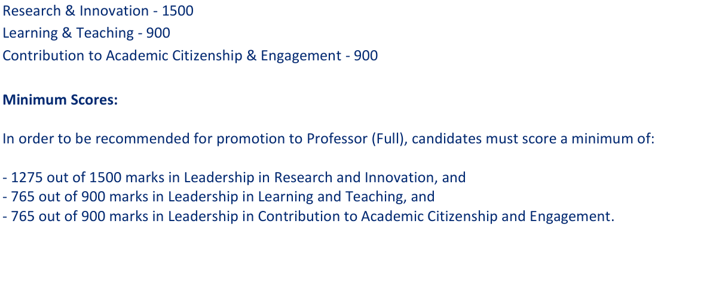
Mark Distribution & Minimum Scores

Slide 10
Evidencing Criteria
When making an application for promotion to Professor Scale 1, Applicants should supply supporting evidence demonstrating their level of achievement across the range of areas set out in the Regulation for Promotion to Prof Scale 1;
Applicants need to present a prima facie case for promotion to Professor Scale 1.
To establish a prima facie case for promotion to Professor Scale 1, candidates must satisfy all of the essential criteria as set out in Appendix B of the ‘Regulation on Academic Promotions to Professor Scale 1.
Evidence of meeting the criteria should be presented within the portfolio templates provided by People & Culture/HR. Whilst indicative evidence e.g. letters of commendation, grant letters, publisher’s contracts etc are not submitted with the application, the Board may, where needed in consideration of an application, request submission of such evidence to aid in its deliberations.
It is recognised, however, at full application stage that not all the activities and responsibilities in each section listed in Appendix C will be fulfilled by every applicant. Applicants should therefore articulate, supported by appropriate evidence, where they consider their major and minor contributions lie in each of the three Criteria Categories set out in the application.
At Stage 2 (Invited Full Application) in addition to the Essential Criteria outlined in Appendix B, candidates for promotion to Professor (Scale 1) are required to evidence a prima facie case for promotion across the categories listed. Timeframe of evidence – last 5 years up to the point of application to Stage 1.

Slide 11
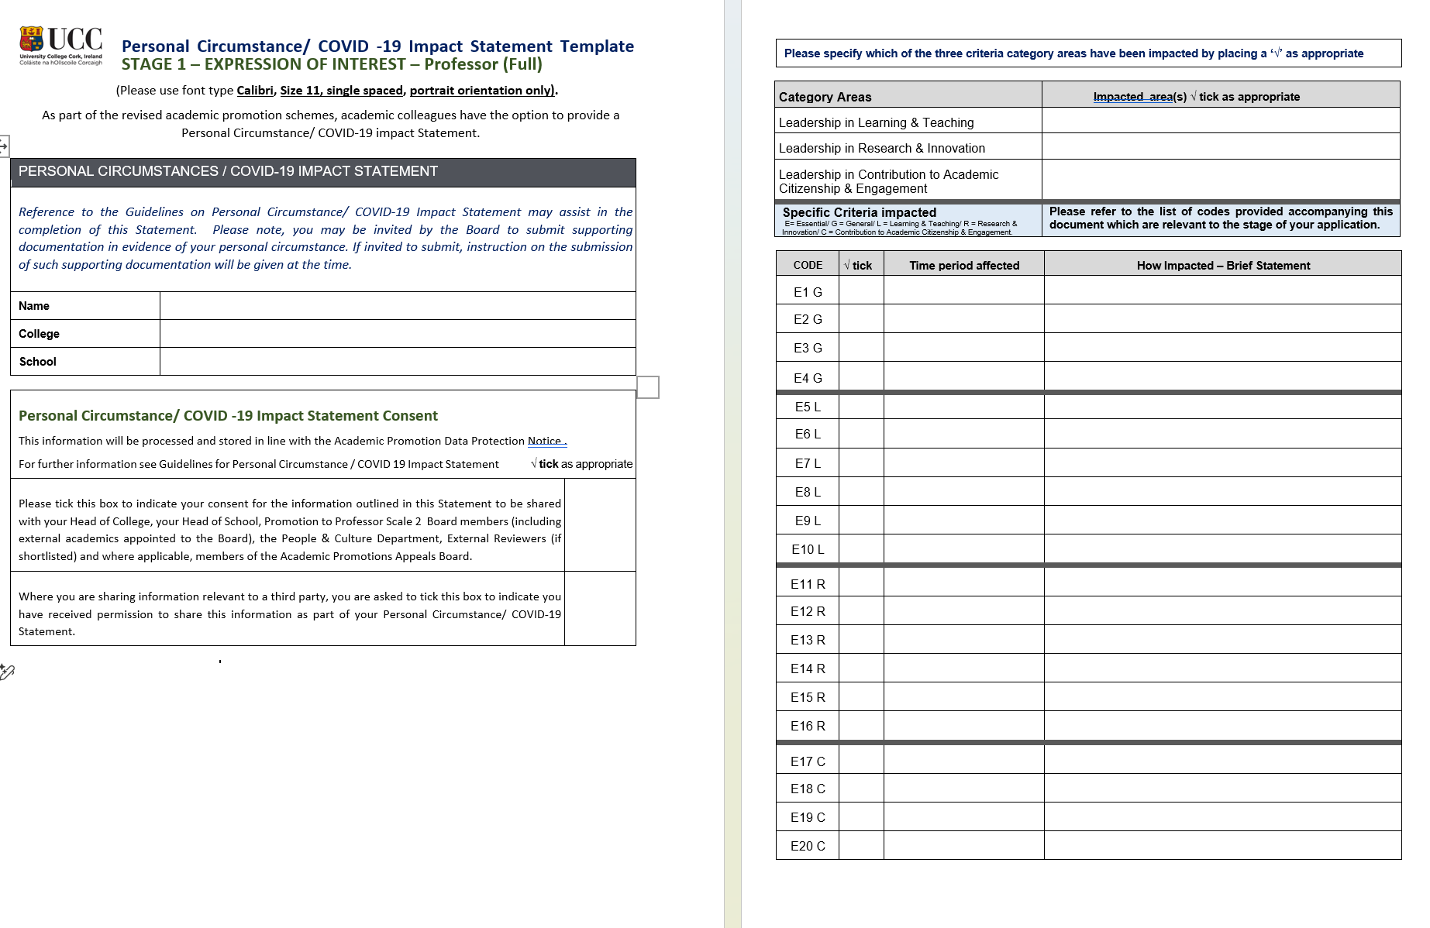

Slide 12
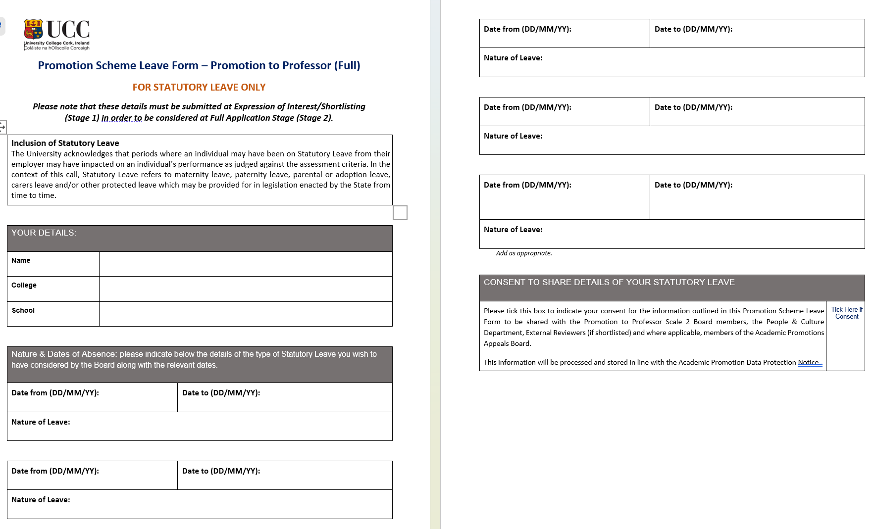
Statutory Leave
In this Scheme, “Statutory Leave” refers to maternity leave, paternity leave, parental or adoption leave, carer’s leave and/or any other protected leave which may be provided for in legislation enacted by the State from time to time.
In assessing a candidate’s merit relative to their opportunity to accrue that merit at shortlisting stage, consideration shall be given to the impact of Statutory Leave when assessing those essential criteria listed in Appendix B which are denoted with an asterisk *.
At full application stage, the impact of Statutory Leave will be considered when determining an appropriate score under those criteria listed in Appendix C which are denoted with an asterisk *.

Slide 13
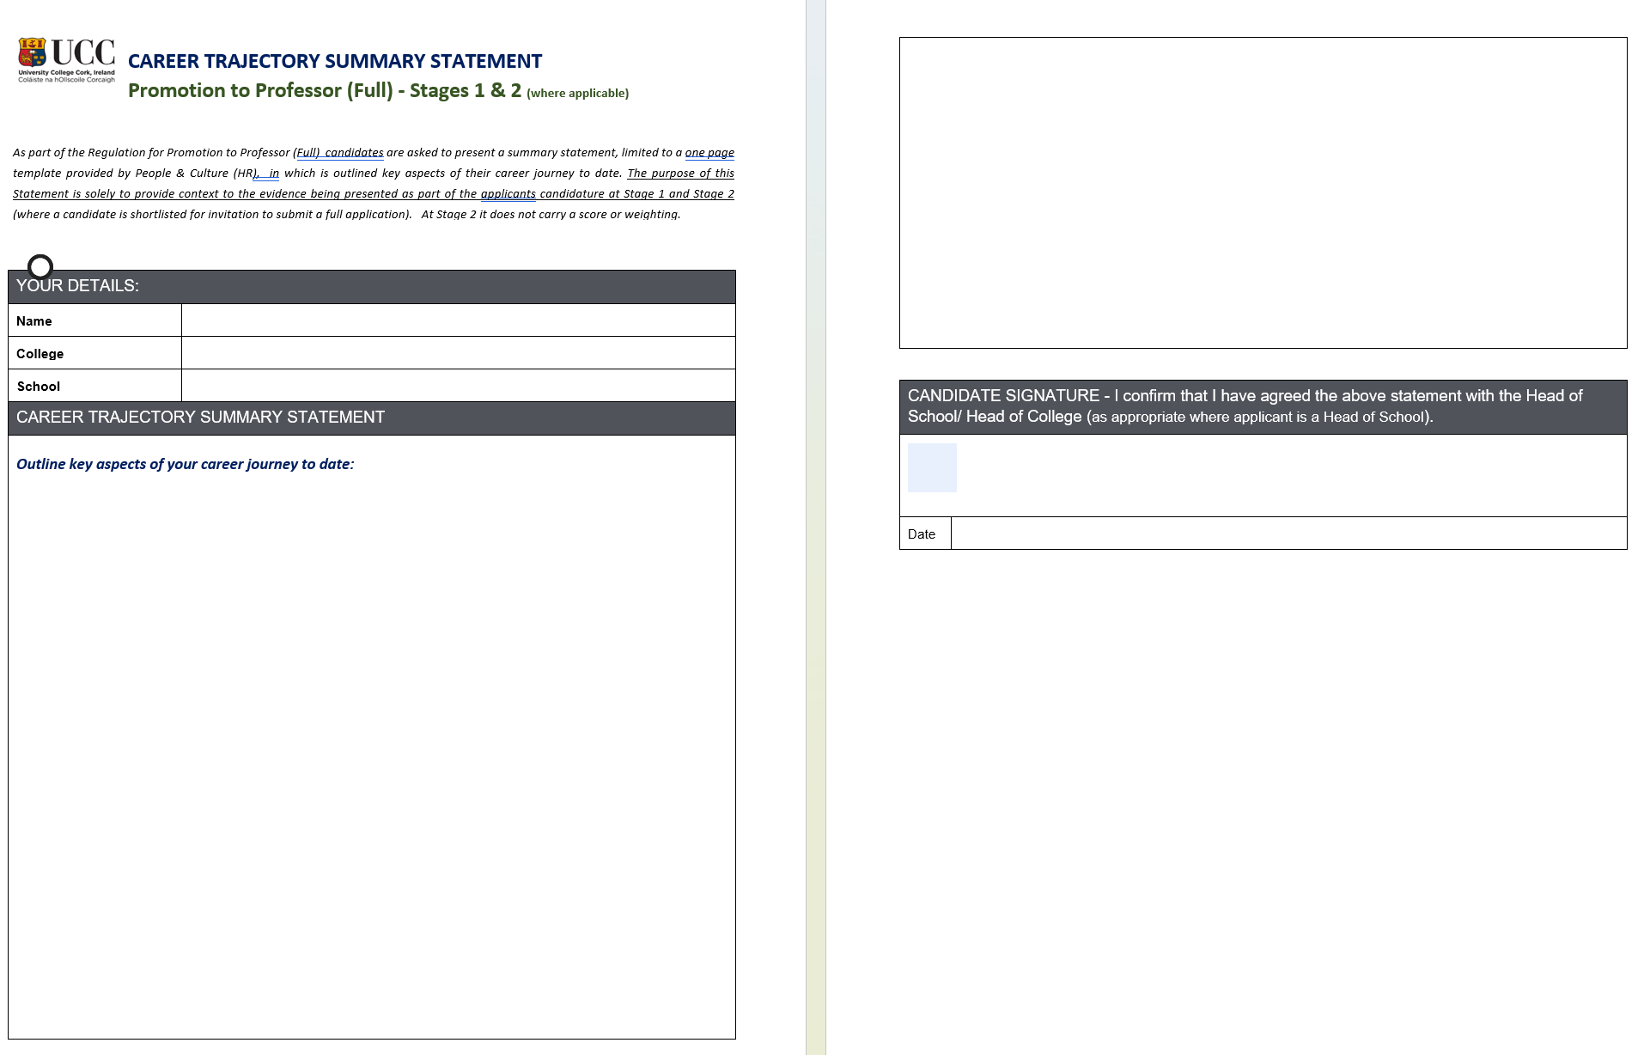

Slide 14
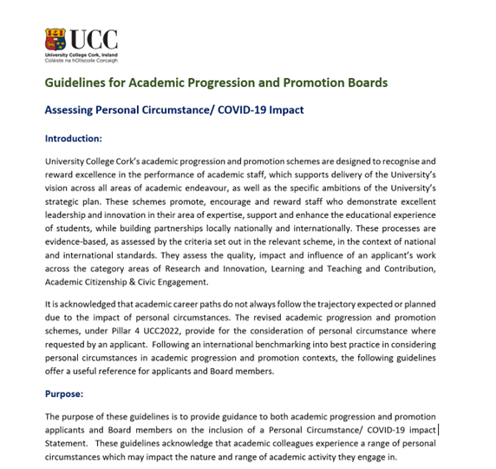
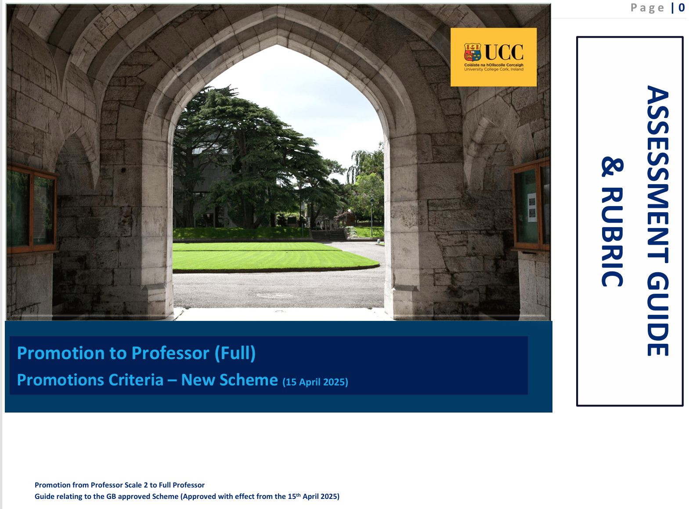
Supporting Guidelines

Slide 15
Feedback At Stage 2
Unsuccessful applicants at Stage 2 have the option to avail of an in-person feedback session.
Requests for in person feedback (Stage 2) shall be submitted to the Secretary of the Professor Scale 1 Board within 20 business days of results of the outcome of the candidate’s full application being notified to the candidate.
Deputy President and Registrar (Chair of the Prof Scale 1 Board for the purposes of assessing applications under this Regulation),
Candidate’s Head of College and
Candidate’s Head of School (where applicable)
Appeals must be submitted within thirty business days of the date of the candidate’s in-person feedback session.

Slide 16
Making an Application
Please note if you ‘submit’ you cannot ‘un-submit’
Please note that the Regulation on Academic Promotions to Professor (Full - Scale 1) and relevant paperwork is located at RegsPromotiontoFullProfPost.pdf or https://my.corehr.com/pls/coreportal_uccp/ Applications for both stages will be made via Employee Self Service (ESS), where applicable.
Dedicated mailbox: professor@ucc.ie
Closing Date: 27th March 2026 – 12 noon
Apply when ready to apply with cognisance of the criteria for promotion and the two-year call for applications.

