Slide 1
COMPLETION OF THE ANNUAL FUNCTIONAL AREA SAFETY REPORT

Slide 2
Objectives
To summarise what needs to be submitted as part of your Functional Area Annual Safety Return by 27th March 2020.
To offer guidance on how to complete the Return documents.
To identify sources of information which will assist in completion of the documents.

Slide 3
What do I need to return by the 27th March?
Functional Area Annual Safety Report (Microsoft Word document) *
Functional Area Training Needs Analysis Spreadsheet (Microsoft Excel document)
Functional Area Risk Assessment Summary (Microsoft Excel document)
Department Risk Reconciliation Workbook for each Department within the Functional Area (Microsoft Excel document)
Functional Area Self-Assessment KPI spreadsheet (Microsoft Excel document)
*Sections B are completed via the Functional Area Self-Assessment KPI spreadsheet (document 5 above) and do not need to be duplicated in the Functional Area Annual Safety Report Microsoft Word document.
All Materials are linked in the ASR webpage.

Slide 4
FA ASR Review
In accordance to the SHWW Act the necessary standard for full legal compliance is 100% and a corresponding 0% non-compliance exposure.
The UCC FA ASR KPI H&S management criteria reflects the same.
A nett ASR performance score of 80%+ is the required UCC and safety management systems standard for excellence in H&S management.
A pass standard is 70%.

Slide 5
FA ASR Review
Every department within a Functional Area must complete a proper Risk Assessment reconciliation report to assist the Head of Function to identify gaps and implement equal standard across the Functional Area.
In the past, insufficient number of risk assessments (RAs) are completed in certain schools/depts.
The Head of Function needs to review the risk assessment report submitted considering the gaps identified.

Slide 6
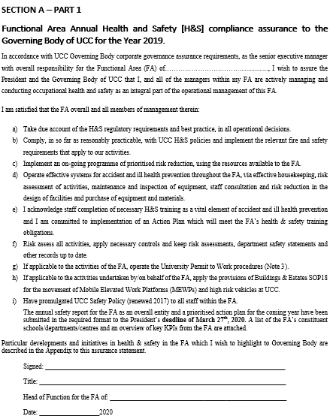
Section A.1
Head of Function Assurance.
To be signed by Head of Function (Deputy signature or p.p. signature not permitted).

Slide 7
FA Management Organisation Chart

Slide 8
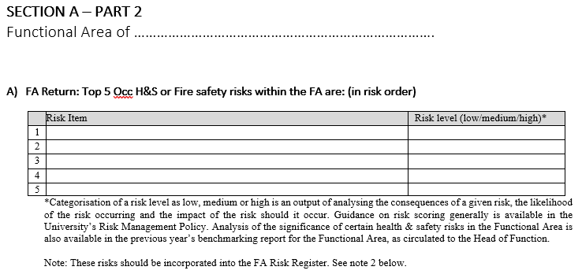
Section A
Functional Area of………………………………………… A)FA Return: Top 5 Occ H&S or Fire safety risks within the FA are: (in risk order)
Sources of Information:
For the purposes of a FA’s Risk Register, health & safety risks should be assessed using the impact and likelihood scoring contained in the University’s Risk Management Policy and such risks should be incorporated into functional area overall risk registers as appropriate.

Slide 9
Section A
B)FA Return: Top 5 Occ H&S or Fire Safety Risks within the FA are: (in risk order)
Source of Information:
Part B) – review previous year’s Functional Area feedback information (circulated Functional Area Benchmarking Feedback Report 2018)

Slide 10
Section A
C)FA Return: Top 5 Occ H&S risk reduction measures instituted within the FA in 2020, in relation to B above, were:
Source of Information:
Part C) – review Functional Area meeting notes re: Health & Safety

Slide 11
Section B
Section B is completed via the Functional Area Self-Assessment KPI spreadsheet and do not need to be duplicated in the Functional Area Annual Safety Report Microsoft Word document.

Slide 12
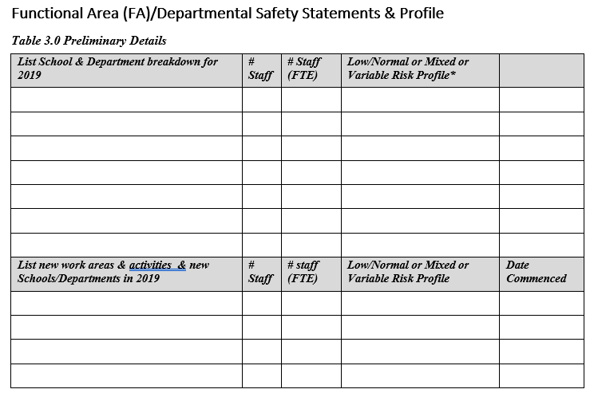
Section C
Functional Area (FA)/Departmental Safety Statements & Profile
List all the schools & departments within the area.
List all new work areas that have joined over the past year (2019)

Slide 13
Section C
Detail the status of each school/department safety statement and risk assessments.

Slide 14
Section D
Functional Area (F.A.) Emergency Responders Overview
Table D1.0 Responder Coverage
Table D1.1

Slide 15
Section D
Table D1.2 Departmental Emergency Responders (Supporting FA Details)
Table D1.3 Shared Emergency Responder Arrangements

Slide 16
Section D
Table D1.4 Biological Risks/Agents Risk Assessment (First Aider)

Slide 17
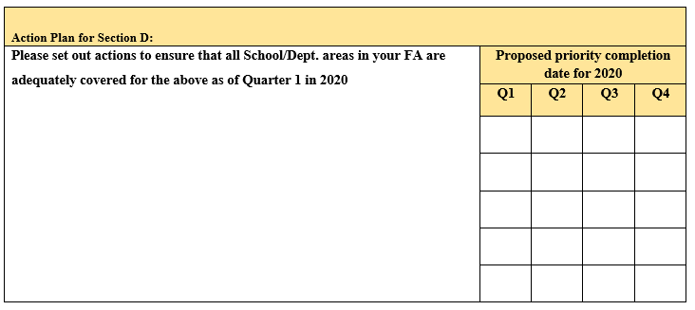
Section D
Table D1.5 Action Plan for Emergency Response

Slide 18
Section D
2. Functional Area (F.A.) Accident/Incidents/Dangerous Occurrences during 2019
Table D2.0
Table 8.1
Table D2.1

Slide 19
Section D
3. Key FA Metrics (2019 update)
Table D3.0 Staff Training
Please note all of below to be supported by an updated FA Excel electronic Health & Safety Training Matrix file format which is as forwarded to each Head of Functional Area. – See TNA requirements below. Utilise the TNA to extract these metrics. (Note: All staff must receive training)
TNA Requirements
 | Please confirm the following for all units across the FA in conjunction with the Training Matrix. | YES | NO | Note:
 | Have all current staff completed core occupational health & safety training? (MH, e-vdse) |  | N | Training completion dates must correlate with Training Needs Assessment spreadsheet.
B | Have all current staff completed core emergency training? ( Fire Extinguisher, Fire Drill, E-Learning Fire Safety) |  | N
c) | Have relevant staff completed other risk specific training relevant to their work? | Y
d) | Have all managerial & supervisory staff & PIs completed h&s management training?( Managing H&S, RA) |  | N

Slide 20
Section D
Identify new staff.
Identify staff who have retired / departed/ transferred.

Slide 21
Section D
Table D3.1 Departmental Safety Management
 | Yes | No | Supporting details | Actions required Y/N
Has the management of each School/Dept. completed a safety tour & housekeeping review of their department within the last 6- 12 months? ( at least 6 monthly for variable risk areas) |  | N | Provide dates | Provide detailed plan of dates of safety tours
Table D3.2 Risk Assessments*
RAs completed for Dept. work activities and places of work | Quantity
Total number of RAs that were updated after yearly review in 2018 | 40
b) Total number of RAs completed during 2018 for existing work activities & places of work, equipment and processes. | 10
c) Total number of RAs completed during 2018 - for new activities and new places of work or equipment or processes | 5
d) Updated total number of RAs now completed in the FA (as of 31st Dec 2018) – provide supporting School and Department summary (*) | 120
e) Total number of RAs yet to do - provide supporting School and Department details (*) | 24
Note: provide updated 2019 Risk Reconciliation summary and breakdown by units to support.

Slide 22
Section D
Table D3.4 FA Biological Research/Laser Safety
Table 9.5 FA Non completion
# of staff with NO H&S Training Completion History as of 31st December 2019 | # | Details
# of Depts. with NO RAs completed as of 31st December 2019 | # | Details
# of Depts. with NO H&S Training Completion History as of 31st Dec 2019 | # | Details
Table 9.6 FA Unresolved Risks
Unresolved H&S Risks as of 31st December 2019 | # | Details and actions currently taken ( including avoidance) | Current Risk Rating Level (based on RA)
Premises/Facilities related
Dept. systems of work, equipment or processes.

Slide 23
Section D
2019 Planned Completions
Detail the number of planned completions for 2020
Name of Training Course | Overall No. of FA staff who require training in 2020
Management Courses:
Managing Health & Safety for Heads of Function & Department Management (1day)
Control of Manual Handling & Fire Risks for Heads of Function & Department Management (supplementary course to the 1 day course above)
Core Courses:
Workstation Ergonomics VDU – online course
UCC Bespoke Fire Safety – online course
Manual Handling – Initial
Manual Handling – Refresher (completed within 3 years of initial training course)
Occupational First Aid Certificate
Occupational First Aid Refresher (to be completed within 2years to date of the certificate)
Fire Marshal
Use of Fire Extinguisher
Lab \ Chemical Related Courses
Specify each course (i.e. Chemical Spill Response etc.) - -
Other \ Specific courses
General Risk Assessment & Risk Controls Any \ other courses (general risk based etc. – please specify
OVERALL TOTAL FOR 2019:
2019 Training Profile: Management ____ Academic______ Admin_____ Technical ____Other____

Slide 24
2018 Training Needs Analysis
Reporting on training taken place from 2014 – 2019 (e.g. include VDU training which has taken place since January 2016)
Course | VDU | Manual Handling | Fire Drill | Fire Safety online | Use of Fire Ext. | Mgt H&S | Chem. Spill response | Fire Marshall | First Aid | R/A
Trained Staff % | 100% | 100% | 100% | 100% | 100% | 20% | 15% | 15% | 15% | 20%
Frequency | 3 yrs | 3 yrs | Annually | 3 yrs | 5 yrs | 5 yrs | 5 yrs | 5 yrs | 2 yrs | 5 yrs
Applicable to: | All staff | All staff | All staff | All staff | All staff | Mgrs & Supervisors and PI’s | Select | Select | Select | PI’s & Technical staff

Slide 25
2019 Training Needs Analysis
Please list all staff present in the Department/Unit regardless of training completed.
If a staff member has not completed a course. Please leave the cell blank.
If they are not required to complete the course or are exempt please put N/A in the cell.
Please date the course DD/MM/YYYY
Staff ID numbers are an important inclusion to distinguish individuals with the same name across the University. (This processing of personal data is provided for in the UCC Staff Data Protection Notice)

Slide 26
Functional Area Risk Assessment Summary
A Functional Area level overview of the data in the Department Risk Reconciliation Workbooks from the Departments in the Functional Area.
Take the Department total from the final tab of each Department’s Workbook.
Dept. RA 2019 Summary Sheet Risk Categories: | RA's Applicable | # OF RA'S CURRENTLY COMPLETED as of 31/12/19 | # OF RA'S STILL Required for Dept | # OF RA'S TO BE PRIORITISED IN 2019 | BALANCE # of RA to be closed out before activity occurs | # of Permits Issued by Department
PHYSICAL | 0 | 0 | 0 | 0 | 0 | 0
FIRE & FLAMMABLE | 0 | 0 | 0 | 0 | 0
ERGONOMIC/PSYCHOSOCIAL/HUMAN FACTOR | 0 | 0 | 0 | 0 | 0
EXPOSURE TO HAZARDOUS SUBSTANCES | 0 | 0 | 0 | 0 | 0
WORK WITH BIOLOGICAL AGENTS | 0 | 0 | 0 | 0 | 0
DEPARTMENT TOTAL | 0 | 0 | 0 | 0 | 0 | 0

