Slide 1
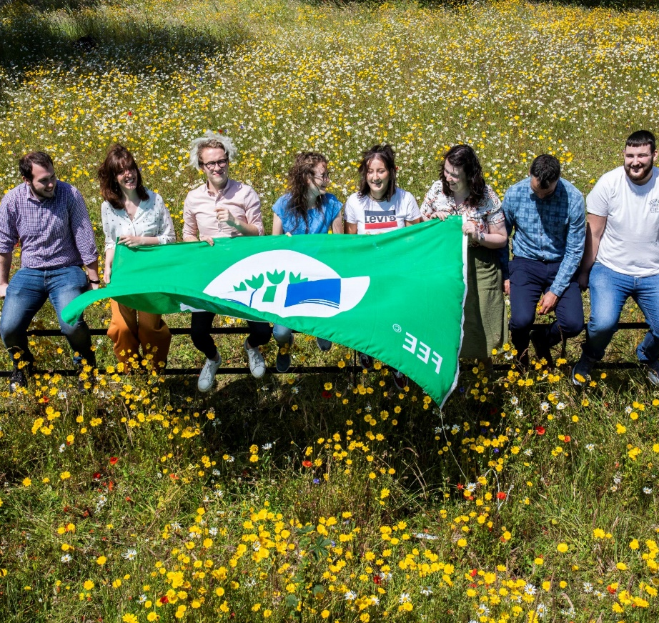
2023 Energy Management & Performance Review

Slide 2
Annual Energy Management Meeting Agenda

Slide 3
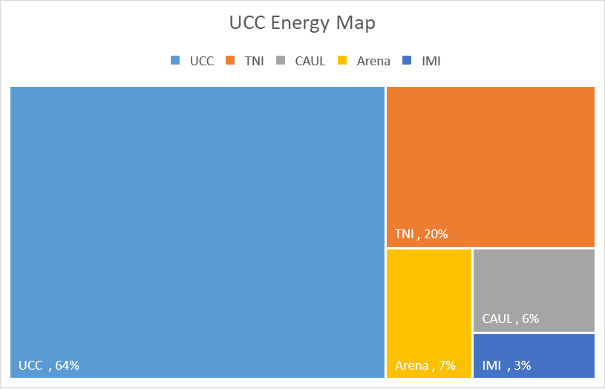
Context /Interested Parties
Approved Sept 2023 meeting.
Scope of Energy
Management System
EnMS applies to 64 % of
UCC's Energy Load.
TNI and Arena (27% )
operating certified EnMS systems.
CAUL / IMI ( 9%)
managed locally and remains a risk.

Slide 4
2023 Energy Performance Statement
Scope | 2023 | 2022 | 2018 Baseline
Electrical GWh | 18.16 | 19.12 | 20.14
Gas GWh | 18.3 | 18.7 | 23.05
Total GWh | 36.46 | 37.82 | 43.19
16 % Energy Reduction on 2018 Baseline. ( 7% when normalised)
4 % Energy Reduction on 2022.

Slide 5
UCC Electrical Performance
Key points
No significant changes in campus activities throughout 2023.
Electrical consumption showed a notable decrease, down by 5.5 % compared to the 2022 levels and 11% compared to the baseline of 2018.
Lowest annual electrical energy use since 2008. (COVID excluded)

Slide 6
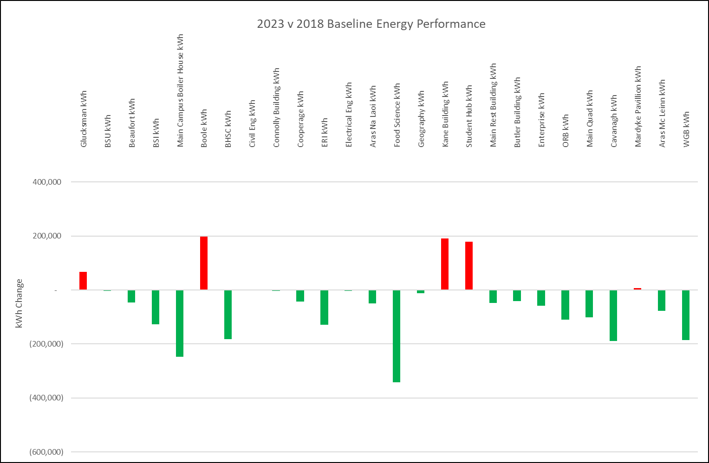
UCC Significant Electrical Users Performance
When compared to the 2018 baseline:
Boole up 200,000 kWh.
Kane up 190,000 kWh.
Hub building added 180,000 kWh
Despite the addition of these loads our overall electrical consumption is down 1,980,000 kWh from the baseline period.

Slide 7
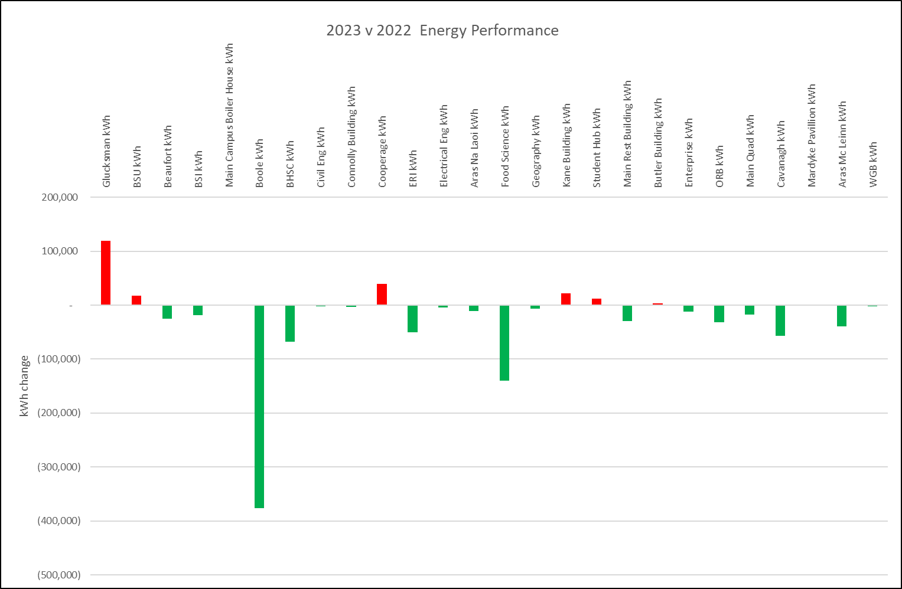
UCC Significant Electrical Users Performance
Consumption Increases:
Glucksman exhibition environmental controls and Café opening.
Cooperage increase due to research activities.
Kane increase due to ULV
Consumption Decreases:
Boole Ventilation Controls and reduced Christmas space openings.
Food Science – Reduced processing.

Slide 8
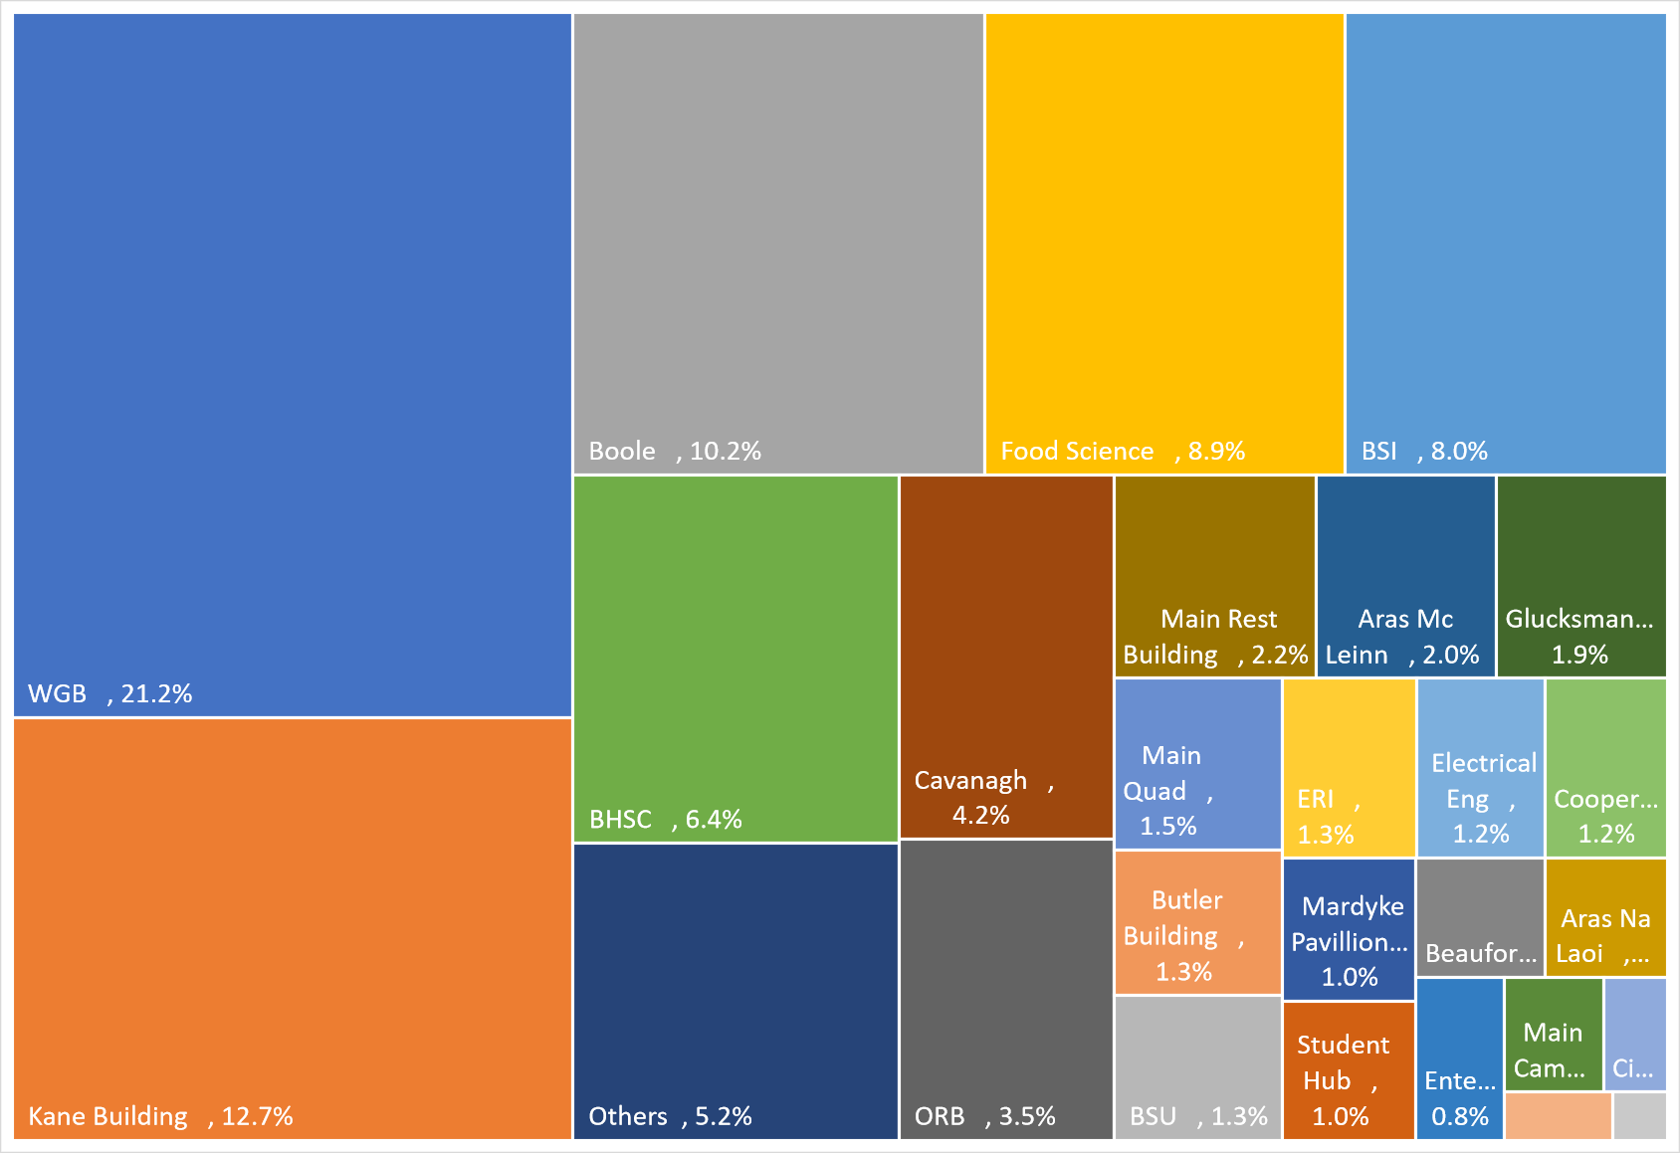
UCC Significant Electrical Users
14 buildings account for 85% of our annual electrical load.
94% of the electrical load is now actively monitored through real time metering platforms.

Slide 9
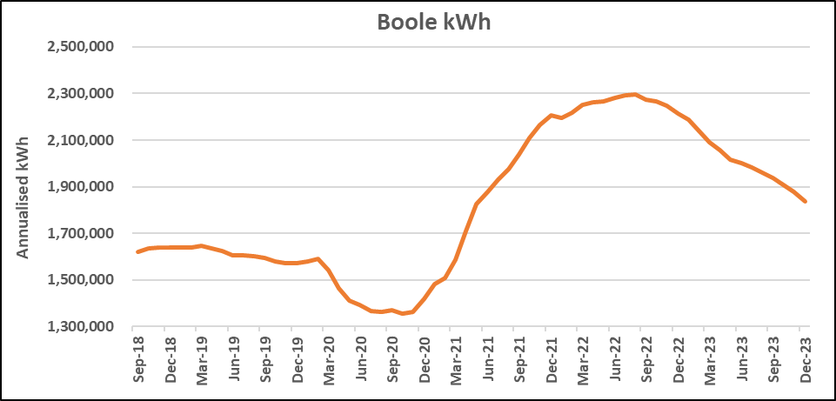
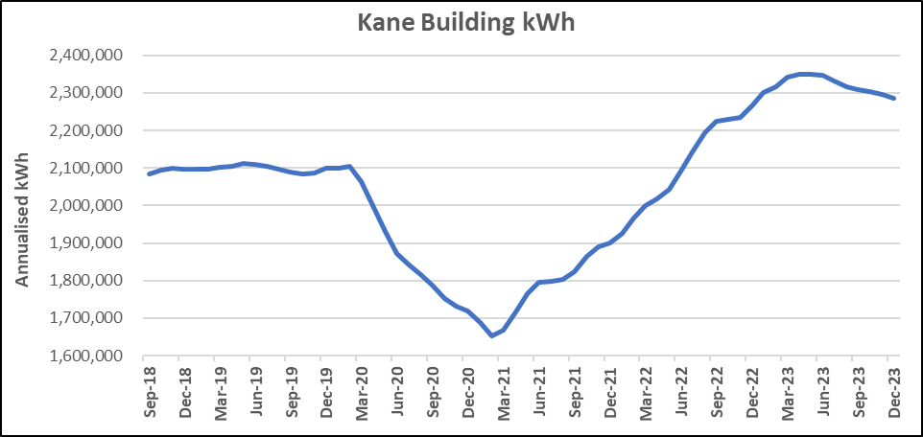
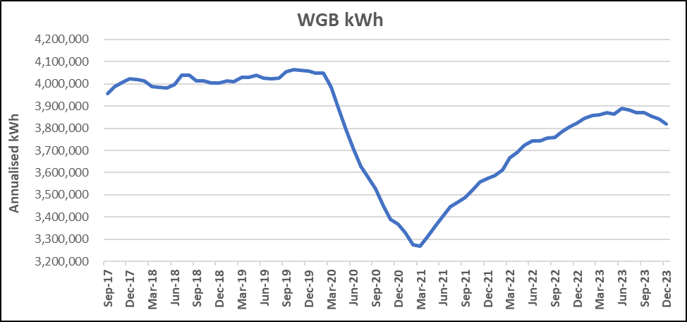
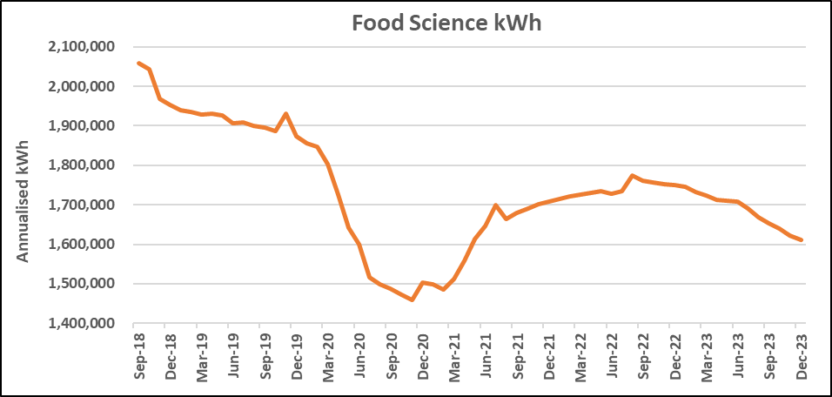
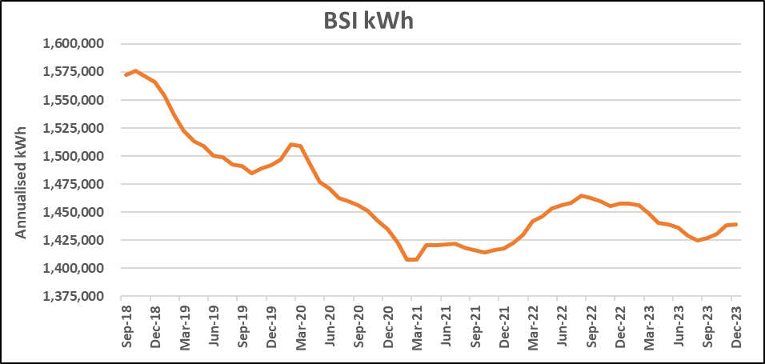
Focus on the top 5
Accounts for 60% of electrical consumption.
Building services account for 30-50% of the electrical load with the remaining 50-70% consumed by the activities within the building.
Electrical trends going in the right trajectory but the continued increase in research activity and growth poses a significant risk to energy reduction programs.

Slide 10
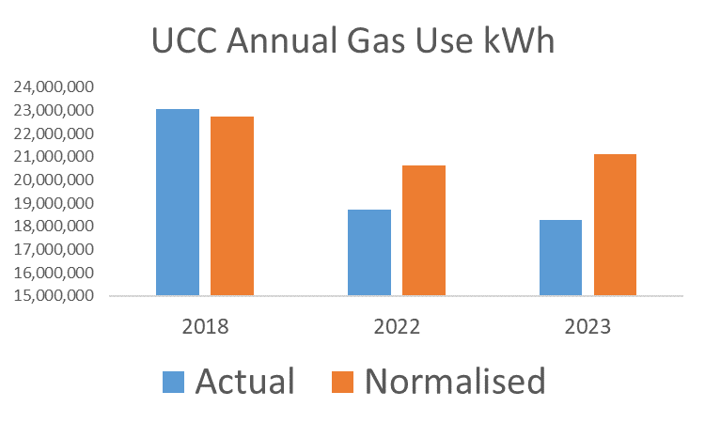
UCC Gas Performance
Key points
No significant changes in campus activities throughout 2023.
5% less HDD than 2022.
When normalised gas use is 5% below 2018 baseline.

Slide 11
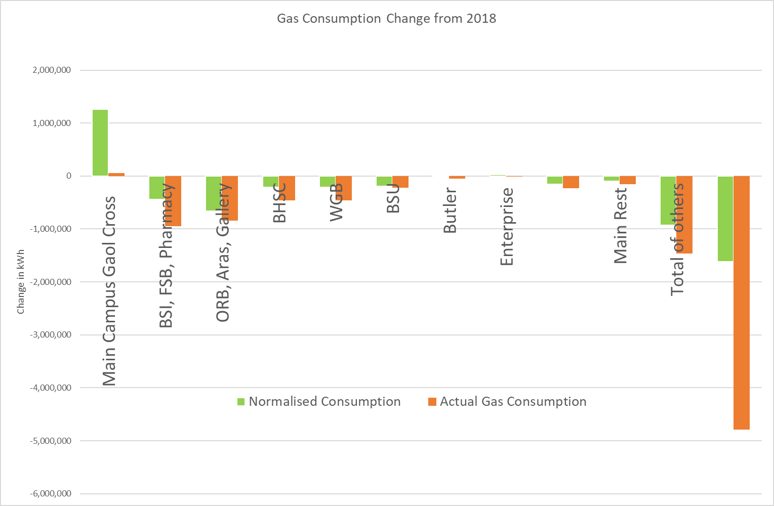
UCC Significant Gas Users Performance
.
Consumption Increases:
Glucksman exhibition environmental controls and Café opening.
Main Campus Steam increase due to ventilation protocols.
ERI - GSHP out of service.
Consumption Decreases:
ORB – Heat pump shifted 280,000 kWh.
Houses – Closer controls and time schedules.

Slide 12
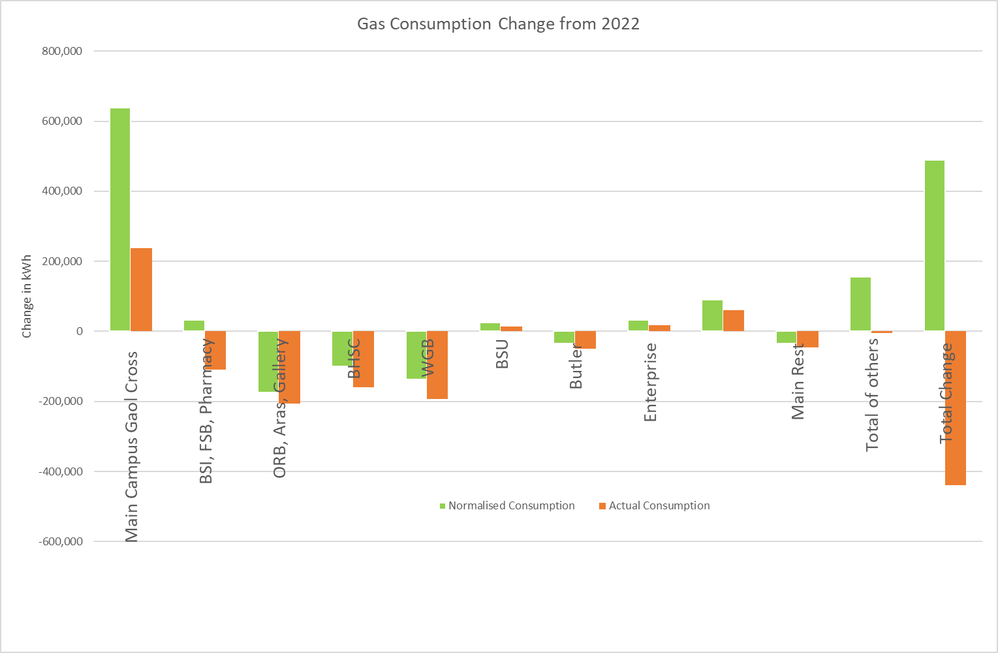
UCC Significant Gas Users Performance
When normalised for weather gas use was 489,000 kWh or 2% above expected use.
Increases
Glucksman café & added 110,000 kWh.
Main Campus running hours increase.
Deanrock added 85,000 kWh
Reductions
Food Science Block A 120,000 kWh saving.
Continuous management and optimisation
.

Slide 13
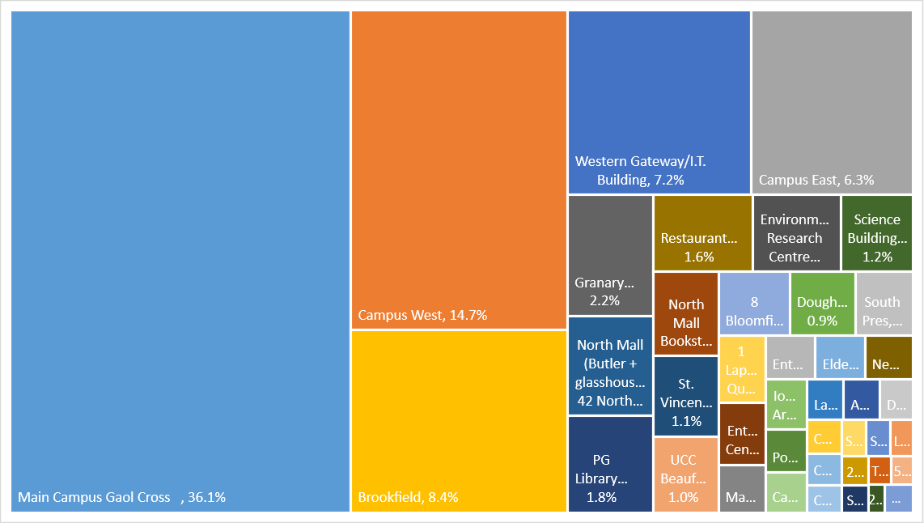
UCC Significant Gas Users
19 Buildings use 82% of our annual gas load.
Main Campus Steam dominates the demand.
84% of thermal load is now tracked via metering platform.

Slide 14
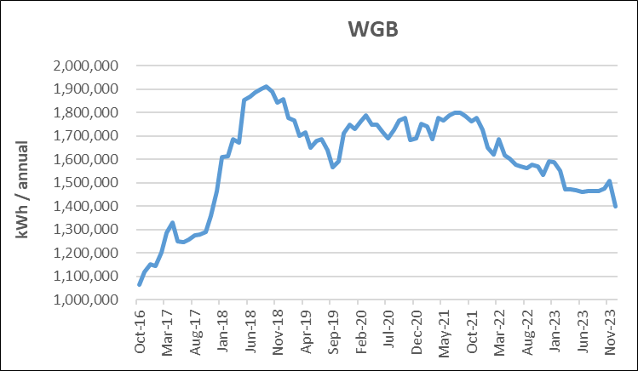
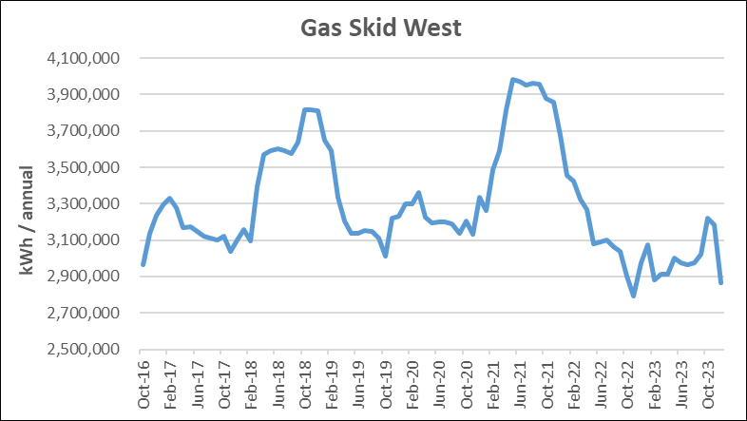
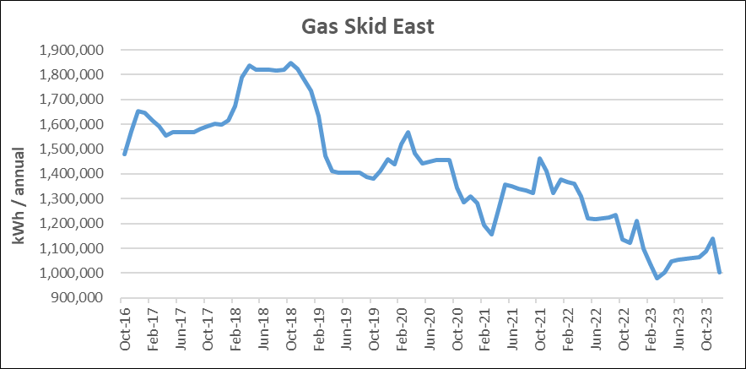
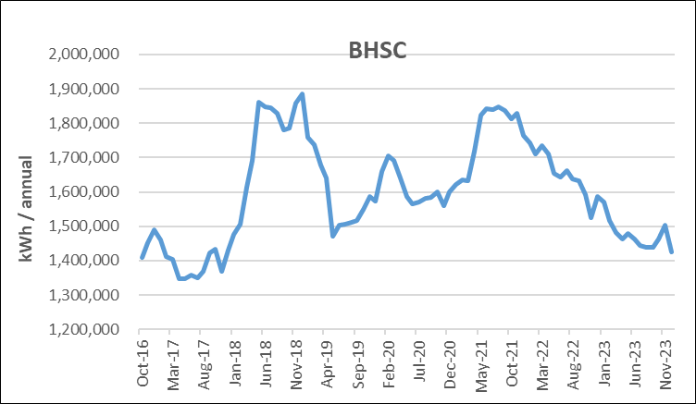
Focus on the top 5
Accounts for 73% of our gas consumption.
Control & system optimisations have delivered the most impact.
East Skid reductions achieved from ORB heat pump

Slide 15
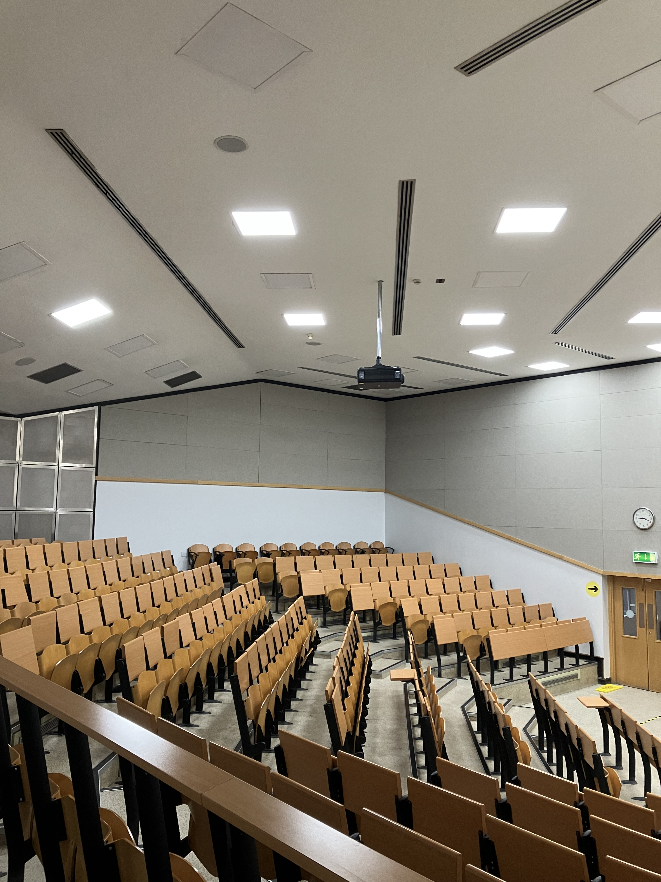
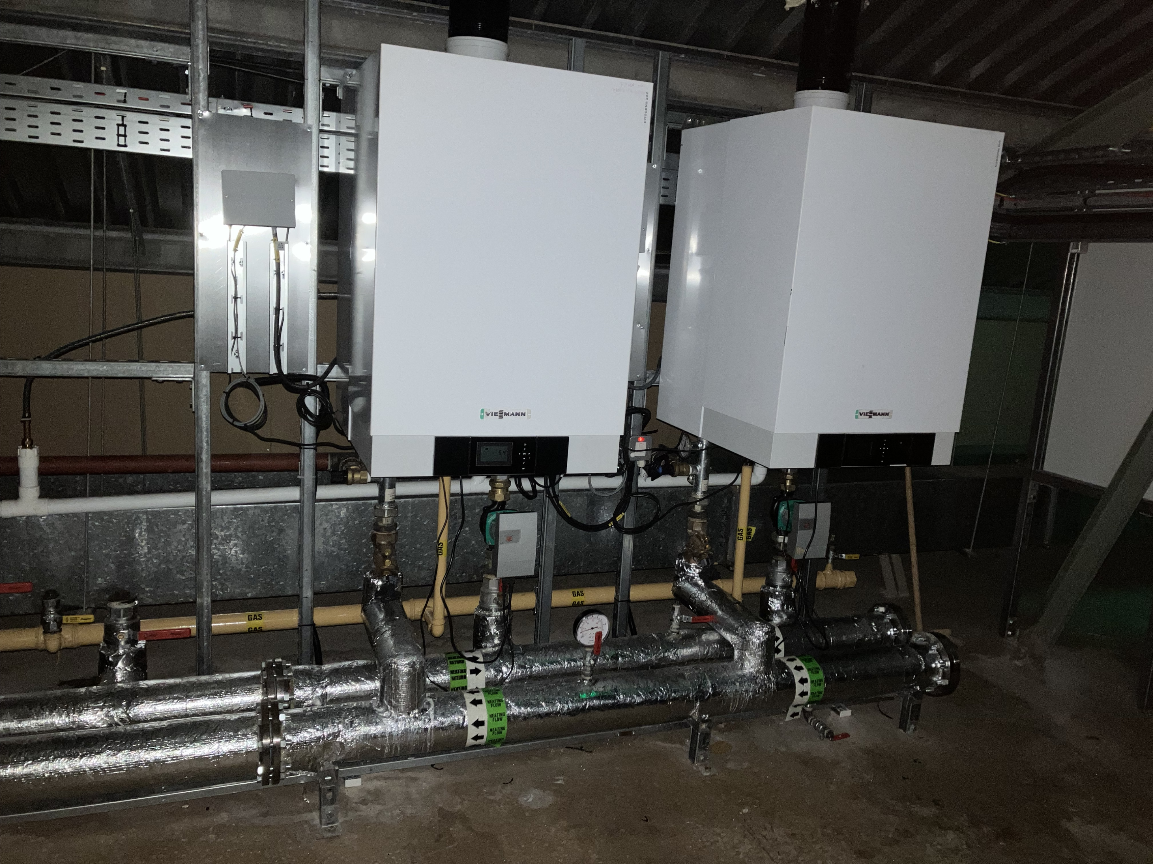
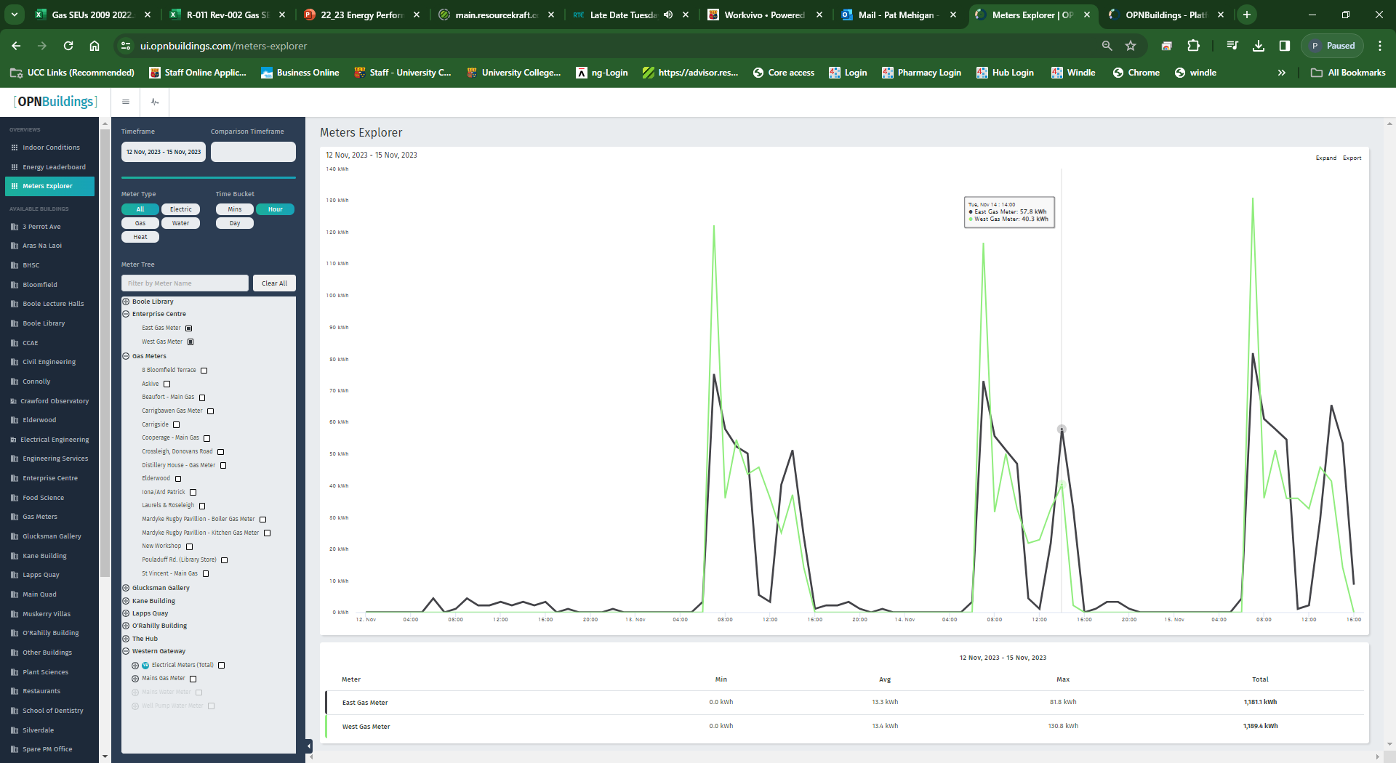
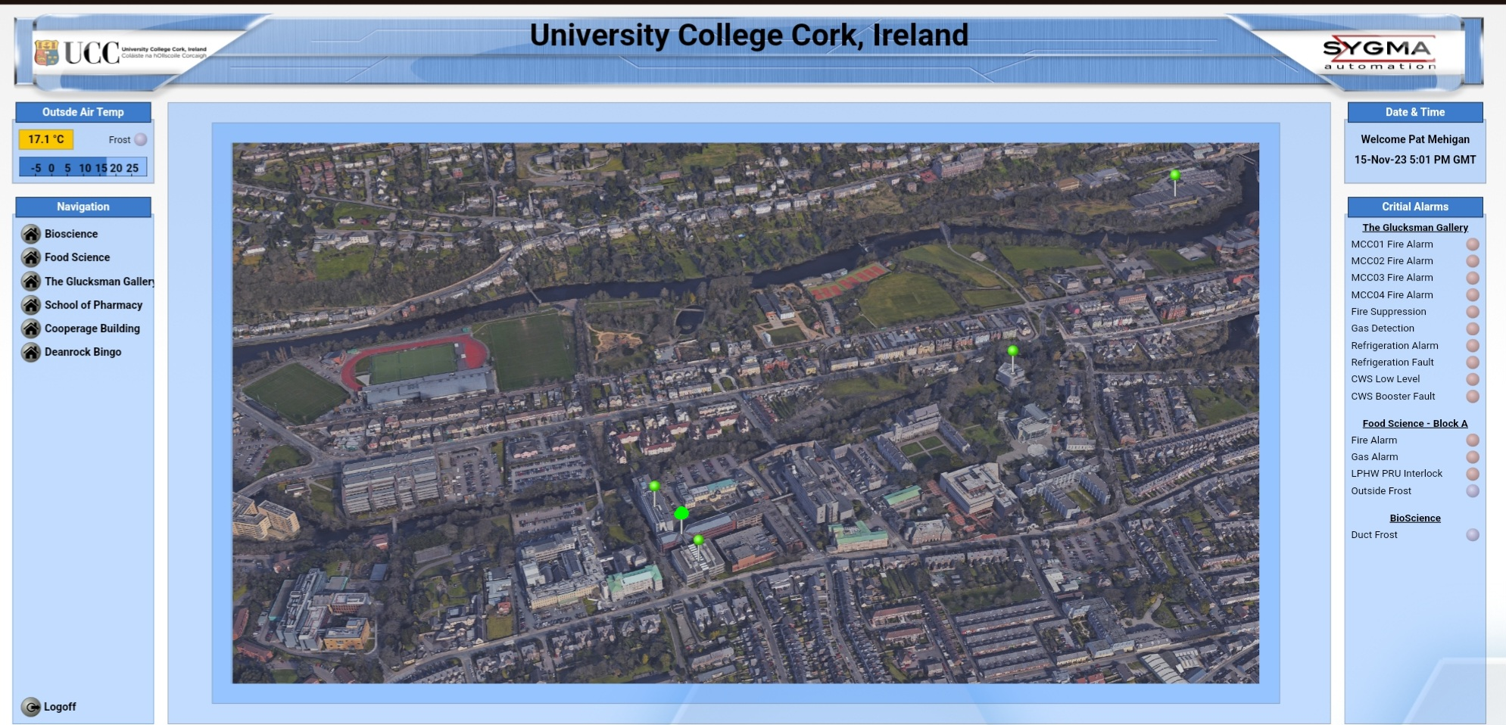
22 Energy Projects Completed
Food Science Boiler
Metering
Lighting Upgrades
Communications
Cooperage Controls

Slide 16
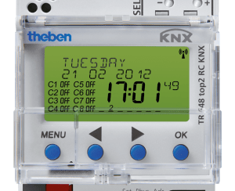
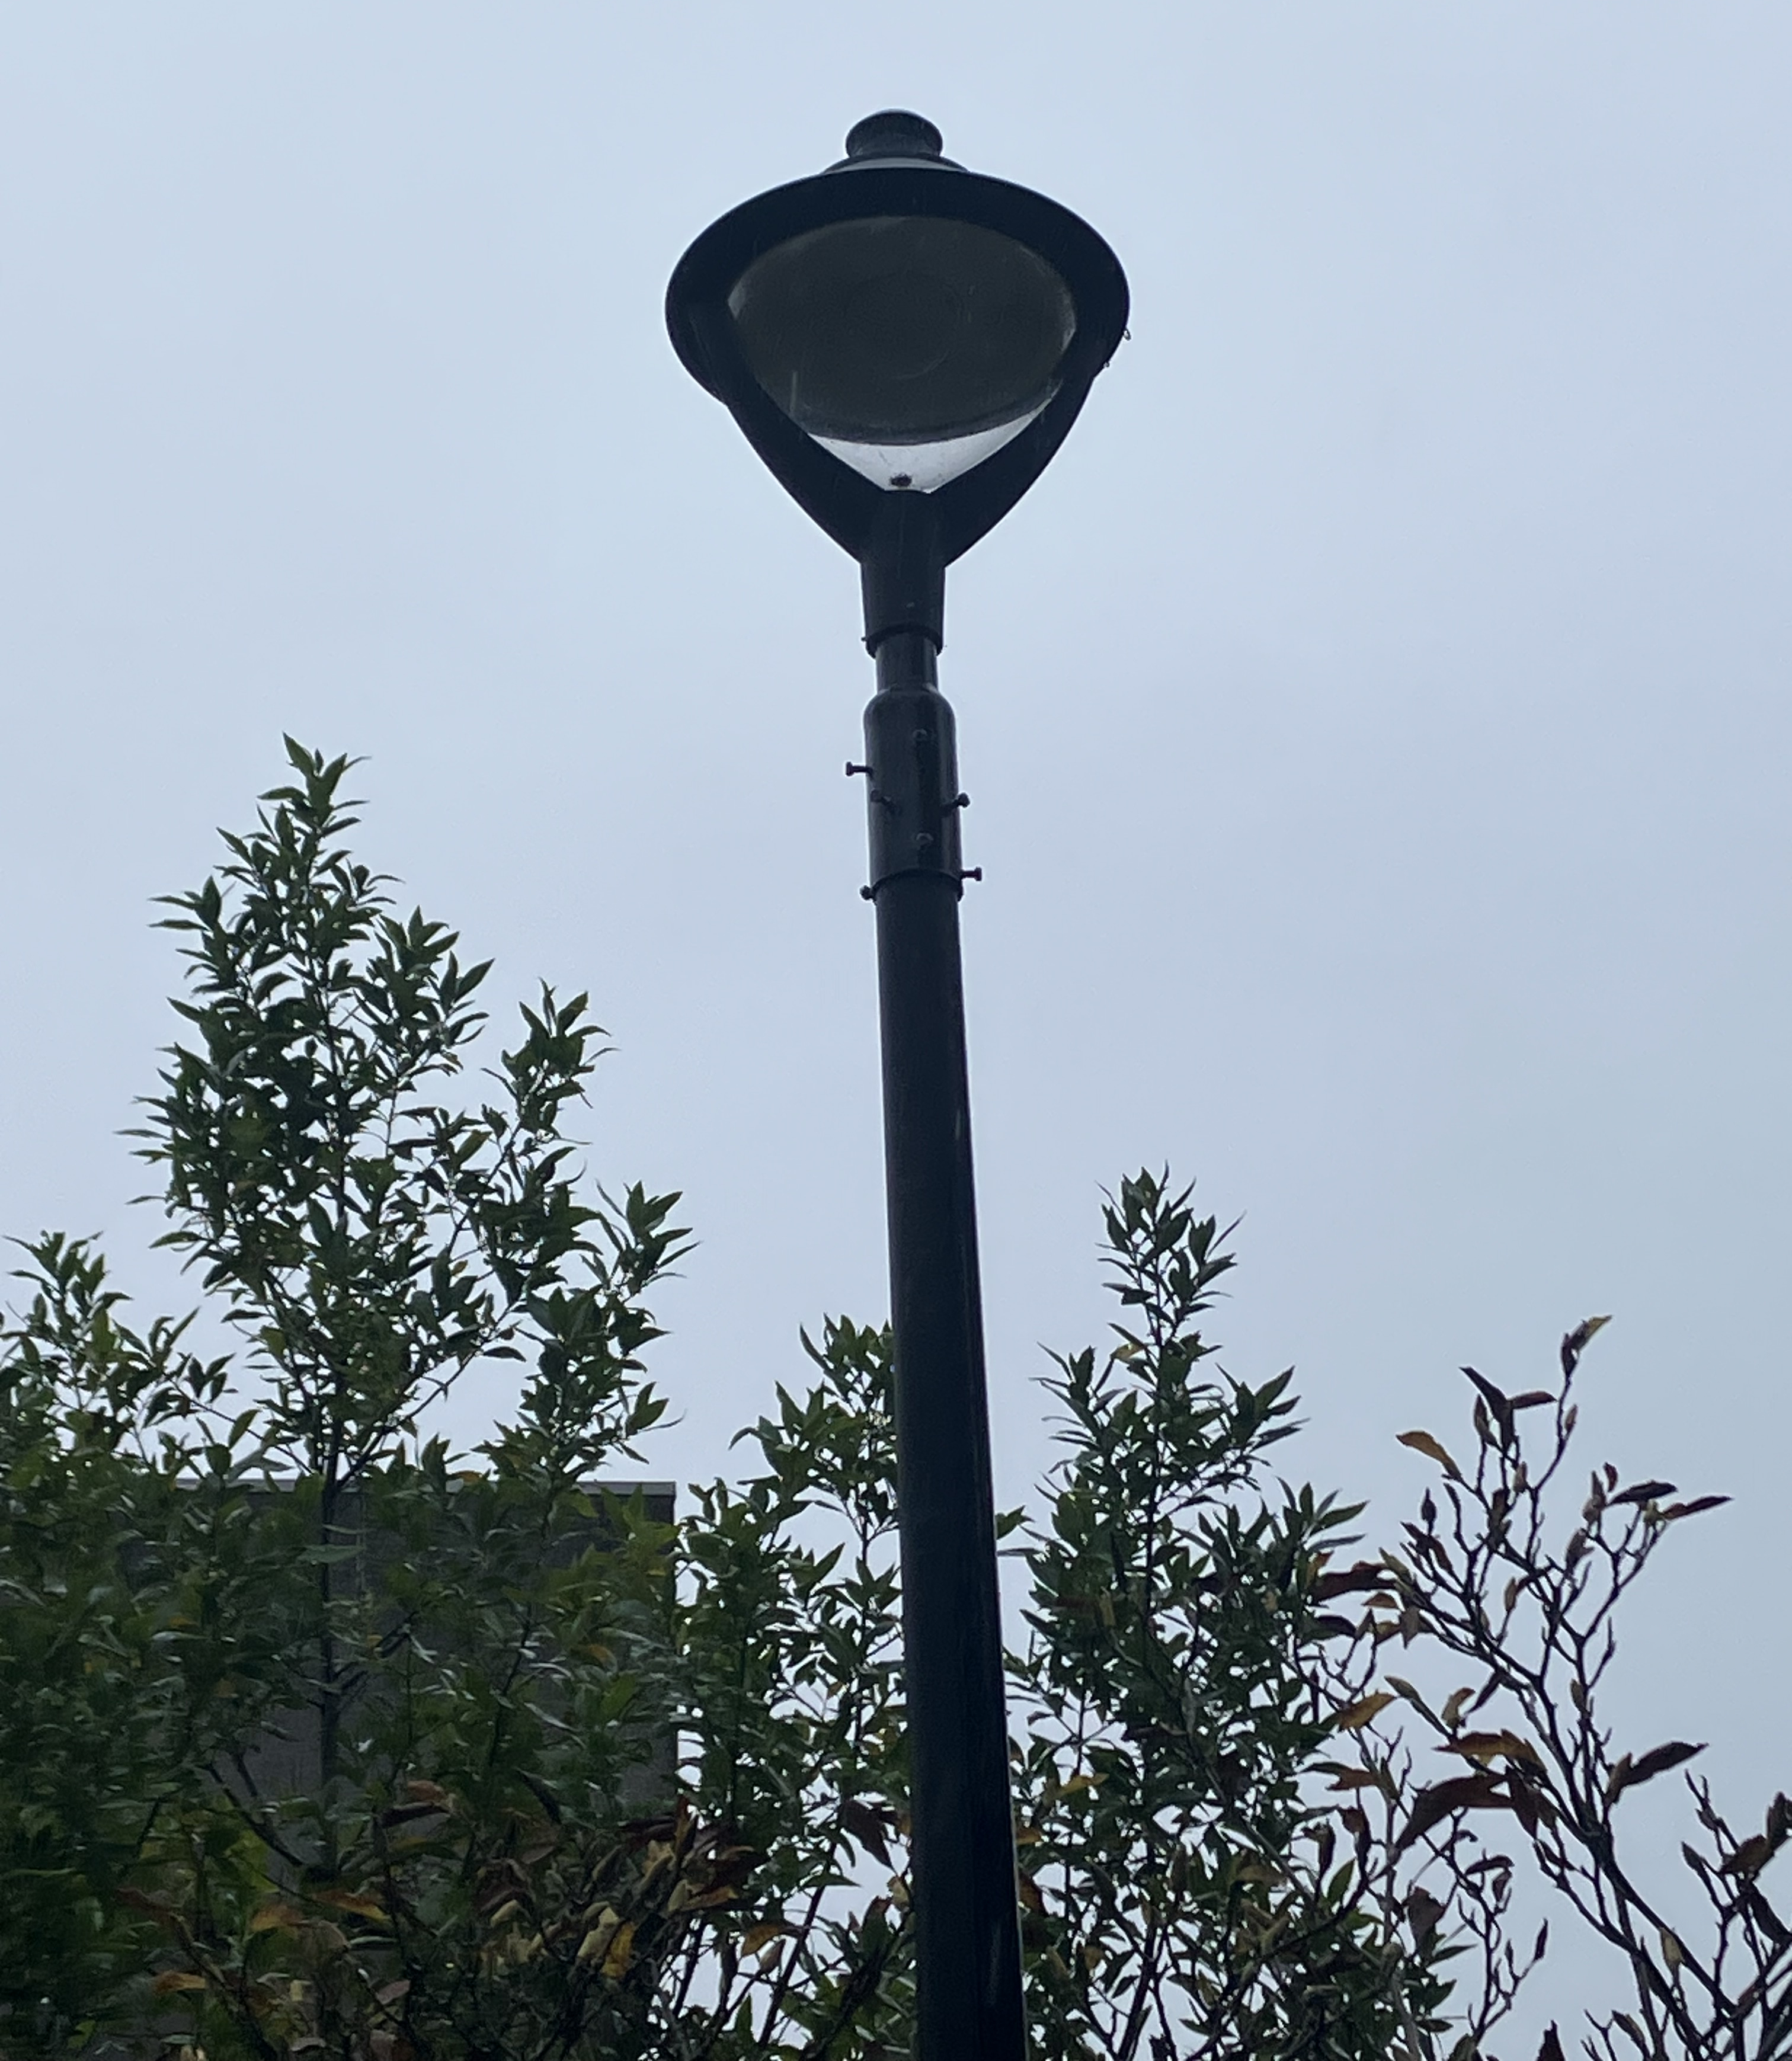
External Lighting Project
Design:
Replace existing external fittings with LED units, noting the dark sky / biodiversity goals of the University.
Fitting of astronomical timeclocks.
Construction:
All works undertaken by Eng Services Team.
Impact:
Significant reduction in light pollution.
Annual Energy savings of 44,000 kWh
Design and construction activities managed by in house Electrical team.

Slide 17
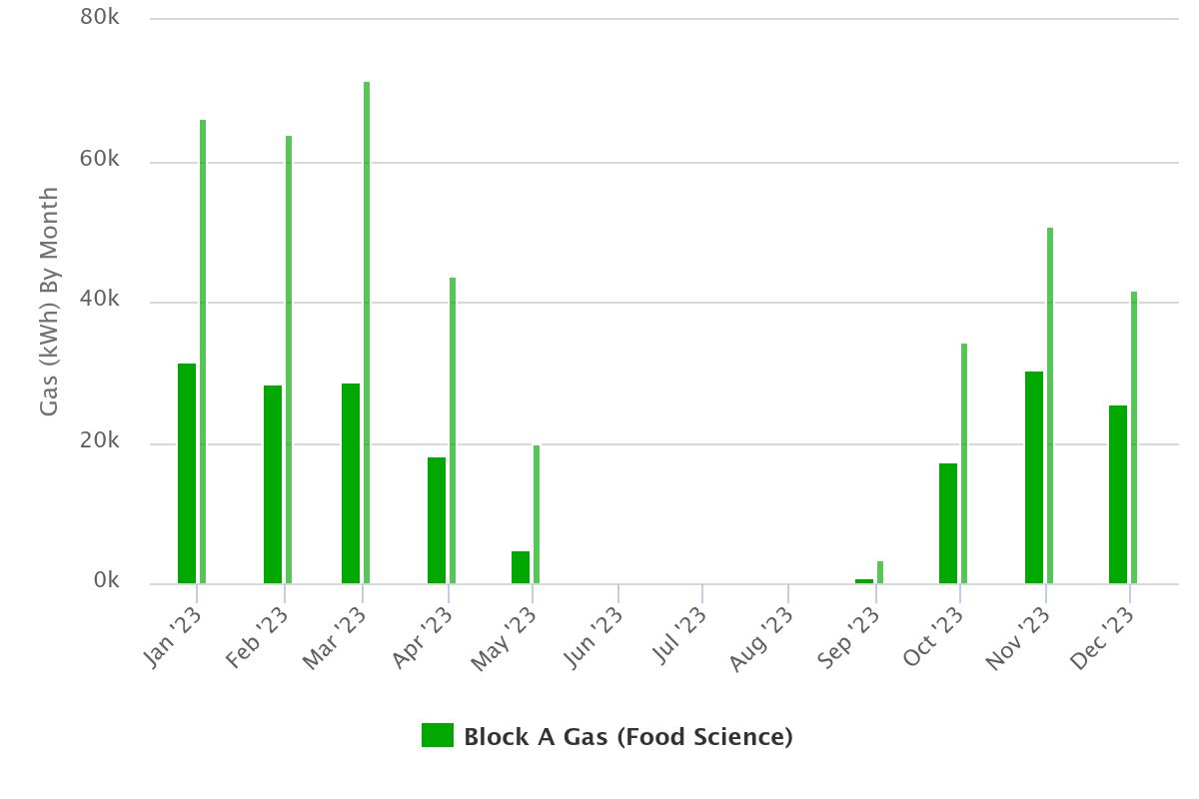
Food Science Boiler Block A
Design:
Replace existing single 750 kW atmospheric boiler with 2 off 136 kW gas unit.
BMS upgrade.
Future Connection for Heat Pump.
Construction:
Completed Autumn 2022
Impact:
45% reduction in gas use (180,000 kWh normalised)
570 TCO2 avoided over 15 years at a cost of €964 per T
Design by Powertherm under EEOS funds.
Construction by Minor Works team
2023 Monthly gas use compared to 2018 baseline

Slide 18
Controls Upgrade
Design:
Installation of Tridium Cloud Based BMS platform
Construction:
Completed Spring 2023
Impact:
Control and visibility of Ground Source Heat Pump
Continuous monitoring and optimisation of environmental conditions for Gallery.
Secure access and not connected to IT infrastructure.
Improved indoor environment.
Design Internally
Construction by Sygma Automation

Slide 19
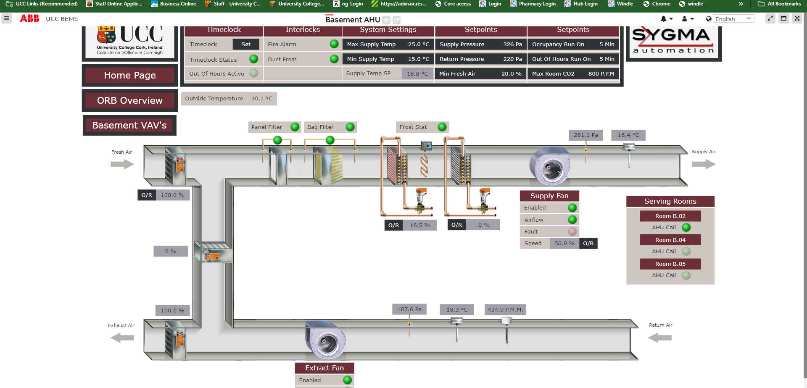
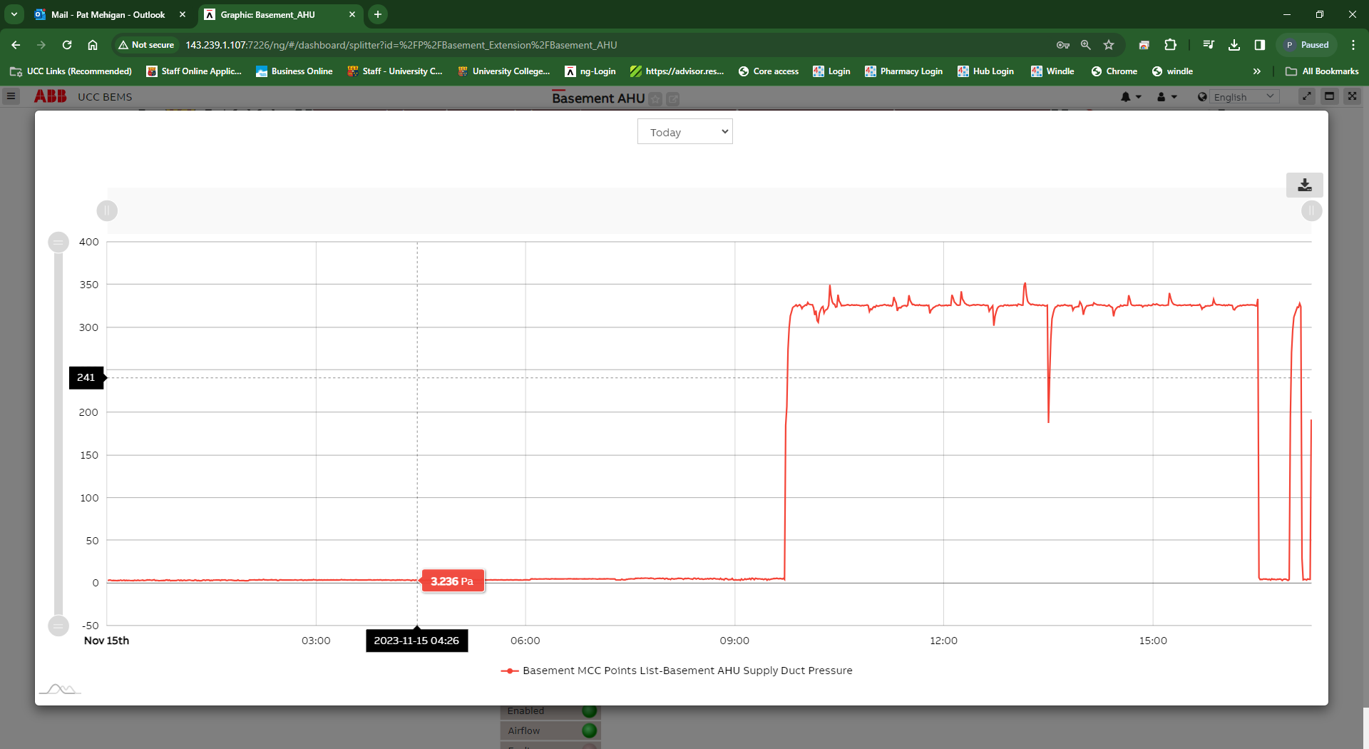
HVAC Upgrade
Design:
Presence and CO2 control for ORB HVAC Units including installation of VAV flow boxes to supply tempered air when required at the right location and volume.
Construction:
Completed Summer 2023
Impact:
Improved indoor environment.
Reduced heating load.
22,000 kWh reduction.
Design by Powertherm under EEOS funds.

Slide 20
2023 Audits / Non Conformities
Technical Audits completed in
Pharmacy
Internal Audits
Operational Controls. - 2 NC's noted.
System Audits – 10 OFI's noted.
7 closed.
3 in progress.

Slide 21
Resources & Effectiveness
Resources
Energy conservation projects continue to be supported and funded.
Devolved Grant - Used to replace EOL equipment with more energy efficient systems.
Continue to use grant aid / pathfinder programs and other innovative ways of funding projects.
Pathfinder €3.3 for Enterprise.
SEAI SSRH €105,000 grant aid.
Pathfinder 3 – Block B Retrofit – stage 1 approved.
BMS Foreperson Handover
Personnel Resources
Effectiveness
Continuous Improvement in Energy Performance.
24% reduction in absolute energy use.(2006-2008 baseline).
21% reduction in CO2 emissions (2016-18 baseline)

Slide 22
UCC Progress to 2030
Key Points
21% reduction in CO2 emissions against baseline 2016-18.
2030 Projects:
2 complete.
5 in construction.
2 in design.
3 scoped.
8 at concept stage.
5 yet to start.

