Slide 1
Dr. Eric Jensen – e.jensen@icorsa.org Senior Research Fellow and director of ICoRSA Policy Research Unit
@JensenWarwick

Slide 2
Professional Background
e.jensen@icorsa.org
Senior Research Fellow and director of ICoRSA Policy Research Unit
RRING.eu
GRRIP.eu
MUSICA-project.eu
@JensenWarwick

Slide 7
ICoRSA – International Consortium of Research Staff Associations
icorsa.org

Slide 8
RRING project (rring.eu)
Dr Eric Jensen, ICoRSA
e.jensen@icorsa.org
This project has received funding from the European Union’s Horizon 2020 research and innovation programme under grant agreement No 788503.

Slide 9
Overall aim:
Bring socially responsible research and innovation (RRI) into the linked up global world to promote mutual learning and collaboration
Achieved by:
Forming a global RRING community network
Developing and mobilising a global Open Access RRI knowledge base
Align RRI to the Sustainable Development Goals (SDGs) as a global common denominator
Bottom-up approach, learning from best practices in RRI
RRING acknowledges that each region of the world is advancing its own agenda on socially responsible research and innovation.

Slide 10
Defining RRI: Process Dimensions of Socially Responsible Research/Innovation (1/2)
Diverse & inclusive
Involve early a wide range of actors and publics in R&I practice, deliberation, and decision-making to yield more useful and higher quality knowledge. This strengths democracy and broadens sources of expertise, disciplines and perspectives.
Anticipative & reflective
Envision impacts and reflect on the underlying assumptions, values, and purposes to better understand how R&I shapes the future. This yields to valuable insights and increase our capacity to act on what we know.
As summarized by RRI Tools: rri-tools.eu/about-rri

Slide 11
Defining RRI: Process Dimensions of Socially Responsible Research/Innovation (2/2)
Open & transparent
Communicate in a balanced, meaningful way methods, results, conclusions, and implications to enable public scrutiny and dialogue. This benefits the visibility and understanding of R&I.
Responsive & adaptive to change
Be able to modify modes of thought and behaviour, overarching organizational structures, in response to changing circumstances, knowledge, and perspectives. This aligns action with the needs expressed by stakeholders and publics.
As summarized by RRI Tools: rri-tools.eu/about-rri

Slide 12
Defining RRI: EU RRI Policy Keys
The survey further integrates and addresses all six RRI policy keys:
Ethics
Gender Equality
Governance
Open Access
Public Engagement
Science Education
As summarized by RRI Tools: rri-tools.eu/about-rri

Slide 13
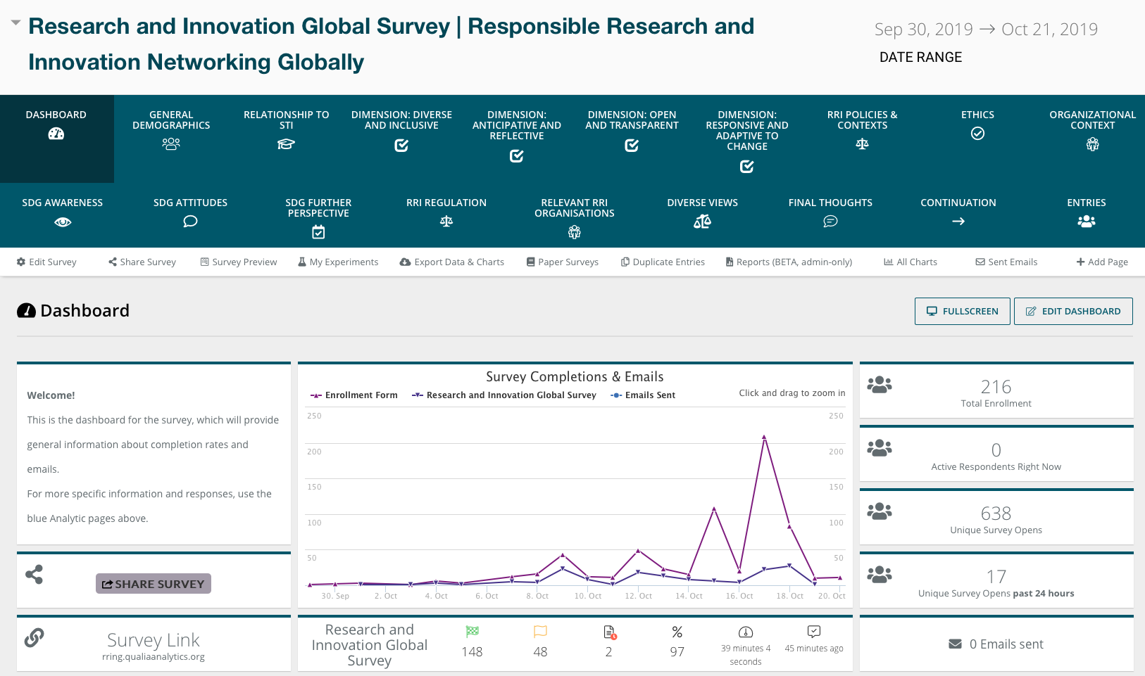
Global Survey of Researchers and Innovators
Surveys
Development of a survey, then two rounds of in-depth pilot testing and refinement

Slide 14
Survey Design Good Practice and Timeline
The survey was open from 1 October 2019 to 20 December 2019

Slide 15
Variables Covered Demographic Information
Age
Gender
Nationality
Native Language
Level of Education & Subject of Schooling
Location of Schooling & Professional Career
Time in current position of career

Slide 16
Variables Covered in Survey
General Science, tech and innovation fields :
Natural sciences, mathematics and statistics
Engineering and technology
Medical and health sciences
Agricultural sciences
Social sciences
Humanities
Respondents could further indicate sub-fields for each STI field e.g.: Mathematics, Computer and information sciences, Physical sciences, Chemical sciences, etc.
Work Sector, e.g. University/college, government agency, industry / commercial, etc.

Slide 17
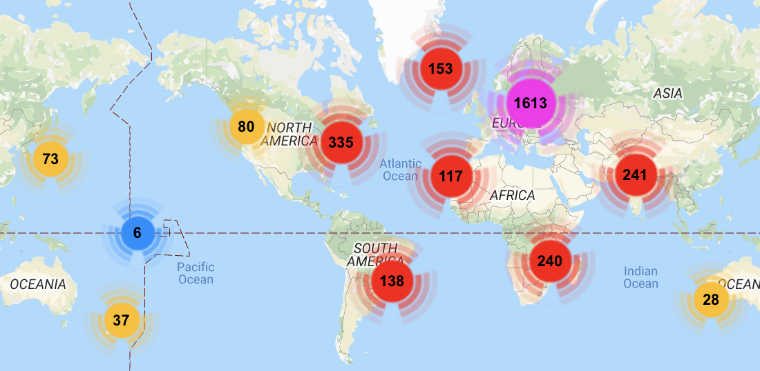
Global Survey of Researchers: Sample Overview
2198 responses with a completion rate of 70% or more
539 responses with a completion rate of 5+% (less than 70%)
Respondents on average took 33 minutes to complete the survey

Slide 18
The Five RRING World Regions for Analysis
European and North American States
Latin-American and Caribbean States
Asian and Pacific States
African States
Arab States
Defined following the UNESCO regions of the world

Slide 19
Open-ended responses about specific steps to implement socially responsible research
Content analysis: method for analysing open-ended data on the steps taken by respondents to address the different dimensions of social responsibility.
All open-ended responses were analyzed by two independent coders (analysts) to ensure reliability.

Slide 20
Content Analysis
The content analysis included:
A coding guide for each open-ended question, providing analysts with detailed descriptions on how to categorise certain responses
Calculating inter-coder reliability as a measure of agreement between analysts for each open-ended question

Slide 21
Sample Profile by UNESCO World Regions
For this analysis, results from India are displayed separately, although India data remains part of the UNESCO world region “Asian and Pacific States”.
Region | Total sample size* | Men | Women | Non-binary | Prefer not to say
African States | 239 | 133 | 87 | 0 | 5
Arab States | 237 | 116 | 89 | 0 | 0
Asian and Pacific States | 231 | 107 | 89 | 0 | 8
European and North American States | 1958 | 769 | 901 | 5 | 38
Latin-American and Caribbean States | 258 | 126 | 104 | 2 | 3
*n=3048, includes completion rates <5% and responses not answering the gender question

Slide 22
Sample Profile: Age
Distribution of Age
In what year were you born?
n=2428
[African=204, Arab=188, Asia & Pac=171, Eur & N. Am=1543, Lat. Am & Car=231, India=91]

Slide 23
Sample Profile: Highest Degree
Highest level of formal education completed
Which general subject area(s) do you hold degrees in (at or above the bachelor’s level)?
n=2630 [African=222, Arab=201, Asia & Pac=198, Eur & N. Am=1678, Lat. Am & Car=231, India=100]

Slide 24
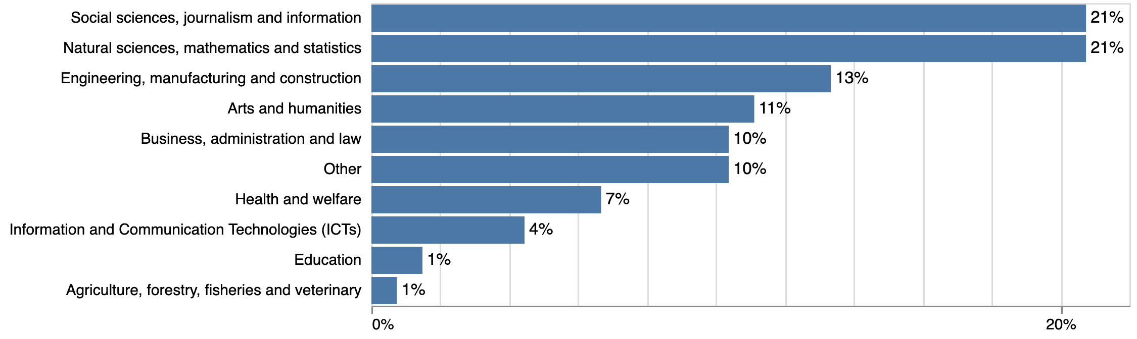
Sample Profile: Subject Area of Degree(s)
Which general subject area(s) do you hold degrees in
(at or above the bachelor’s level)?
f=135 This question allowed multiple choices for the same respondent

Slide 25
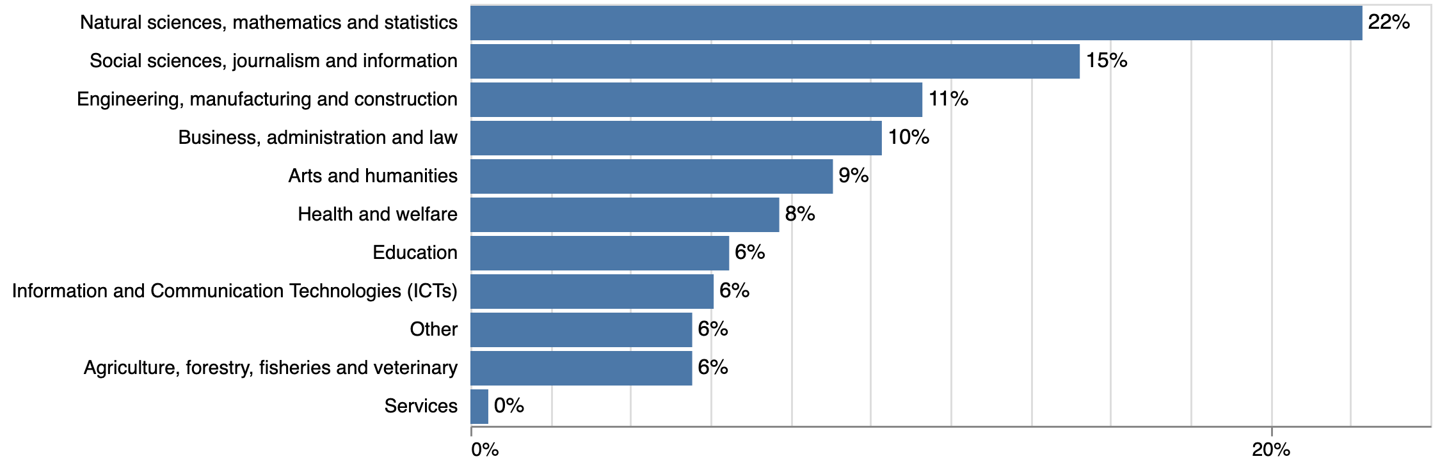
Sample Profile: Subject Area of Degree(s) – Worldwide
Which general subject area(s) do you hold degrees in
(at or above the bachelor’s level)?
f=3512 This question allowed multiple choices for the same respondent

Slide 27
Overall findings: Attitudes about SDGs
Respondents indicate relatively high levels of familiarity with the SDGs across world regions.
Attitudes about the SDGs are generally positive across world regions.

Slide 28
Results SDG Familiarity
How familiar are you with the UN Sustainable Development Goals?
n=2089 [African=187, Arab=155, Asia & Pac=156, Eur & N. Am=1316, Lat. Am & Car=200, India=75]
Overall lowest familiarity with UN SDGs in the US
41% of Latin American respondents are not at all familiar with the SDGs

Slide 29
Results Views on SDGs
Only displayed if respondent was at least “somewhat familiar” with the SDGs
Global- Top to bottom: n=1501; 1496; 1496; 1493; 1492; 1497

Slide 30
Results Views on SDGs
Only displayed if respondent was at least “somewhat familiar” with the SDGs
Global - Top to bottom: n=1493; 1493; 1491; 1491; 1494; 1491

Slide 31
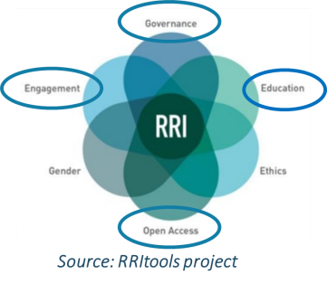
Alignment: RRI and SDGs
What are the connections between RRI and SDGs?
Can RRI be integrated within SDGs to establish a more global framework?

Slide 32
Overall findings: Attitudes about socially responsible research/innovation
Uniformly high ‘in principle’ agreement to wide range of socially responsible research/innovation (RRI) concepts
Indicates general attitudinal support, although specific way this translates into practice varies dramatically.

Slide 33
Direct mapping of some RRI dimensions onto SDGs

Slide 34
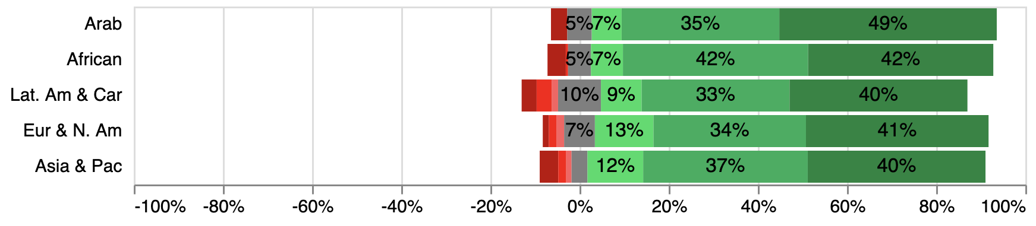
Results Diverse & Inclusive: Diverse Range
'It is important to involve individuals/organizations with a diverse range of perspectives and expertise when planning my research and innovation work.'
n=2194 [African=195, Arab=164, Asia & Pac=168, Eur & N. Am=1377, Lat. Am & Car=208, India=82]
Mostly similar distribution of agreement
India leading slightly with 55% strongly agreeing

Slide 35
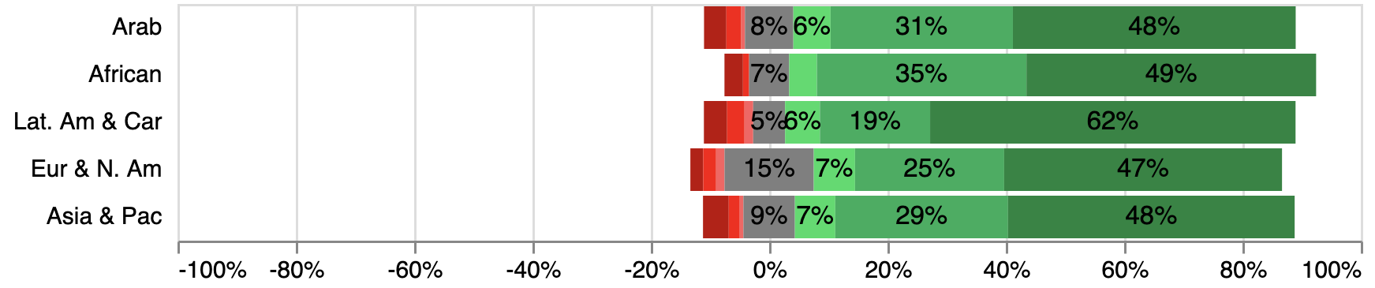
Results Diverse & Inclusive: Gender
'It is important to promote gender equality in my research and innovation work.'
n=2132 [African=192, Arab=159, Asia & Pac=161, Eur & N. Am=1333, Lat. Am & Car=204, India=83]
Mostly similar distribution of agreement
Latin America leading slightly with 60% strongly agreeing
Most neutral views in Europe and North America (15%)

Slide 36
Targets
5.1 End all forms of discrimination against all women and girls everywhere
5.2 Eliminate all forms of violence against all women and girls
5.3 Eliminate all harmful practices, such as child, early and forced marriage and female genital mutilation
5.4 Recognize and value unpaid care and domestic work through the provision of public services, infrastructure and social protection policies and the promotion of shared responsibility within the household and the family as nationally appropriate
5.5 Ensure women’s full and effective participation and equal opportunities for leadership at all levels of decision-making in political, economic and public life
5.6 Ensure universal access to sexual and reproductive health and reproductive rights 5.A Undertake reforms to give women equal rights to economic resources, as well as access to ownership and control over land and other forms of property, financial services, inheritance and natural resources, in accordance with national laws
5.B Enhance the use of enabling technology, in particular information and communications technology, to promote the empowerment of women
5.C Adopt and strengthen sound policies and enforceable legislation for the promotion of gender equality and the empowerment of all women and girls at all levels

Slide 37
Gender Equality Analysis (Global Survey)
Bottom line: Partial overlap with SDGs (focusing on professional research practices/policies)
Follow-up question “Please list the steps you have taken to promote gender equality in your research and innovation work.”

Slide 38
Gender Equality
Response Categories
GE1 – Non-specific, vague, platitude or virtue signalling (18% of participants)
Responses suggesting they promote or support gender equality without mentioning any practical steps.
Example: “Working on promoting gender in my work.”
GE2 – Gender equality in R&I, within academic environment (81% of participants)
Responses indicating they take practical steps to promote gender equality in R&I activities.
This category has two subcategories:

Slide 39
Gender Equality
Response Categories
Specific steps to enhance gender equality in R&I work
GE2.1.1 – Gender equality in R&I, within academic environment (general) (30% of participants)
Responses about promoting gender equality without providing specific steps.
Example: “My research topic has a gender element.”
GE2.1.2 – Gender equality in R&I, within academic environment (specific) (51% of participants)
Responses indicating specific steps taken to ensure gender equality.
Example: “I have sought to promote gender equality in hiring office admin staff, encouraging and promoting fellow women colleagues work in front of the higher management.”

Slide 40
Gender Equality
Overview of steps taken

Slide 41
Gender Equality
Response Categories
GE2.2.1 - Supporting female researchers’ publications, co-authorship, academic citations (2% of participants)
For example collaboration with female research partners and publication of a shared report.
Example: “Balance between women’s and men’s visibility in publications.”
GE2.2.2 – Integrating gender equality in research participant selection (5% of participants)
Selection processes and mechanisms such as representative samples.
Example: “Equal selection of the research participants by gender.”

Slide 42
Gender Equality
Response Categories
GE2.2.3 - Fostering gender equality in R&I teams (24% of participants)
Ensuring parity between men and women, and diverse gender representation in research teams.
Example: “I make sure my research team represents women and men equally.”
GE2.2.4 – Integrating gender as a substantive dimension/focus of R&I content/practice (13% of participants)
R&I focuses on addressing gender equality issues, e.g. pay gap.
Example: “My current research is focusing on discrimination against women working in the technology industry.”

Slide 43
Gender Equality
Response Categories
GE2.2.5 - Promotion/mentorship of female researchers (11% of participants)
Example: “I encouraged a female colleague to undertake a PhD, I will be on her supervisory panel in a mentoring role.”
GE2.2.6 – Promoting women in R&I decision-making roles and senior positions (6% of participants)
Example: “Drafted unprecedented number of women to selection panels of scientific grant applications.”

Slide 44
Gender Equality
Response Categories
GE2.2.7 - Ensuring gender equality in process of recruitment and selection of R&I staff (8% of participants)
Efforts making recruitment in R&I contexts fairer for, or less discriminatory against women.
Example: “When hiring ensure that both men and women have equal opportunity.”
GE2.2.8 – Promoting gender equality through delivering or attending training (8% of participants)
Example: “Promote gender equality in public lecture.”
GE2.2.9 - Participation in or engagement with equality committees (3% of participants)
Example: “Meet and discuss issues with Equality committee.”

Slide 45
Gender Equality
Response Categories
GE2.2.10 – Compliance with rules, regulations, and legal obligations (3% of participants)
Example: “Signed up to provisions of my university and EU policies on gender balance and equality.”
GE2.2.11 – Other gender equality promotion step taken (27% of participants)
Steps which do not belong to any of the above categories.
Example: “We use gender neutral language in our reports and in general.”
GE3 – Unclear/ Uncertain (2% of participants)

Slide 46
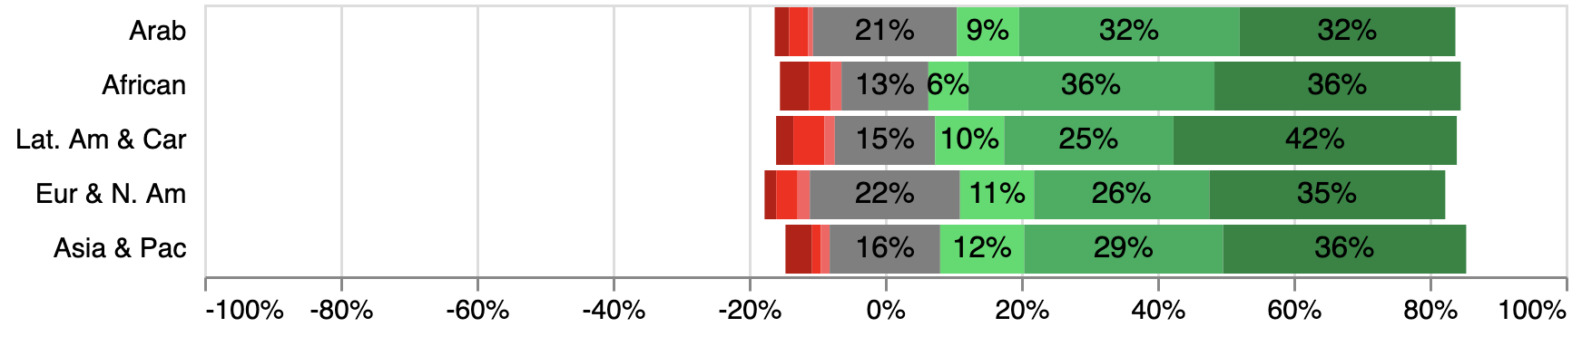
Results Diverse & Inclusive: Ethnic Minorities
'It is important to include ethnic minorities in my research and innovation work.'
n=2039 [African=188, Arab=142, Asia & Pac=154, Eur & N. Am=1278, Lat. Am & Car=197, India=80]
Overall sentiment leaning heavily on agreement
Latin America and Caribbean slightly with 42% strongly agreeing
Comparatively high percentages indicating a neutral view (13%-22%)

Slide 47
Targets:
10.1 By 2030, progressively achieve and sustain income growth of the bottom 40 per cent of the population at a rate higher than the national average
10.2 By 2030, empower and promote the social, economic and political inclusion of all, irrespective of age, sex, disability, race, ethnicity, origin, religion or economic or other status
10.3 Ensure equal opportunity and reduce inequalities of outcome, including by eliminating discriminatory laws, policies and practices and promoting appropriate legislation, policies and action in this regard
10.4 Adopt policies, especially fiscal, wage and social protection policies, and progressively achieve greater equality
10.5 Improve the regulation and monitoring of global financial markets and institutions and strengthen the implementation of such regulations

Slide 48
Targets:
10.6 Ensure enhanced representation and voice for developing countries in decision-making in global international economic and financial institutions in order to deliver more effective, credible, accountable and legitimate institutions
10.7 Facilitate orderly, safe, regular and responsible migration and mobility of people, including through the implementation of planned and well-managed migration policies
10.A Implement the principle of special and differential treatment for developing countries, in particular least developed countries, in accordance with World Trade Organization agreements
10.B Encourage official development assistance and financial flows, including foreign direct investment, to States where the need is greatest, in particular least developed countries, African countries, small island developing States and landlocked developing countries, in accordance with their national plans and programmes
10.C By 2030, reduce to less than 3 per cent the transaction costs of migrant remittances and eliminate remittance corridors with costs higher than 5 per cent

Slide 49
Ethnic diversity inclusion in R&I
Follow-up question
“Please list the steps you have taken to include ethnic minorities in your research and innovation work.”

Slide 50
Ethnic Minorities
Response Categories
EM1 – Non-specific, vague, platitude or virtue signaling (18% of participants)
Responses suggesting they promote or support racial/ethnic equality without mentioning any practical steps.
Example: “Racial/ethnic equality is my entire focus.”
EM2 – Racial/ethnic equality in R&I, within academic environment (78% of participants)
Responses indicating they take practical steps to promote or support racial/ethnic equality in R&I activities.
This category has two subcategories:

Slide 51
Ethnic Minorities Response Categories
Specific steps to enhance gender equality in R&I work
EM2.1.1 – Racial/ethnic equality within the R&I environment (general) (44% of participants)
Responses about promoting racial/ethnic equality without providing specific steps.
Example: “I involved various ethnic minorities in a new European project.”
EM2.1.2 – Racial/ethnic equality within the R&I environment (specific) (34% of participants)
Responses indicating specific steps taken to ensure gender equality.
Example: “Identify gaps and areas where ethnic minorities are underrepresented in the organization, research and learn best practices on racial/ethnic equality.”

Slide 52
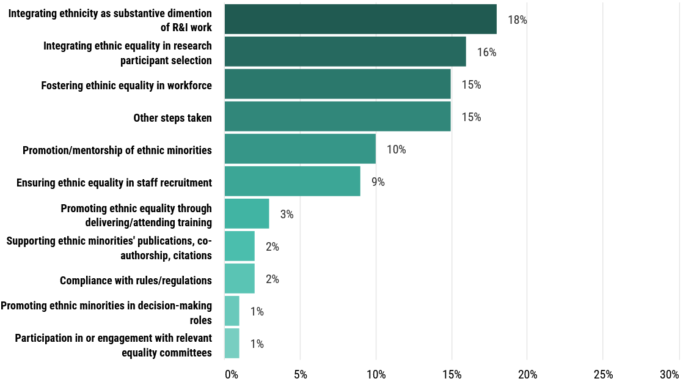
Ethnic Minorities
Overview of steps taken

Slide 53
Ethnic Minorities
Response Categories
EM2.2.1 - Supporting racial/ethnic minority researchers’ publications, co-authorship, academic citations (2% of participants)
For example collaborating with researchers from ethnic minority group and publication of a shared report.
Example: “I encouraged ethnic minority researchers to co-author two of my papers.”
EM2.2.2 – Integrating racial/ethnic equality in research participant selection (16% of participants).
Selection processes and mechanisms such as representative samples.
Example: “Ensuring the representation of minority research participants in the community.”

Slide 54
Ethnic Minorities
Response Categories
EM2.2.3 - Fostering racial/ethnic equality in R&I teams (15% of participants)
Ensuring the representation of ethnic minorities in research teams, and diverse racial representation in collaborations.
Example: ““I make sure that races/ethnicities are appropriately represented in my working groups.”
EM2.2.4 – Integrating race/ethnicity as a substantive dimension/focus of R&I content/practice (18% of participants)
Addressing race/ethnicity issues in research, e.g. xenophobia
Example: “Research I am working on focuses on integrating indigenous people’s needs and concerns in forest fire and haze management strategies.”

Slide 55
Ethnic Minorities
Response Categories
EM2.2.5 - Promotion/mentorship of ethnic minority researchers/innovators (10% of participants)
Example: “Support ethnic minority researchers to secure funding and industry linkages.”
EM2.2.6 – Promoting ethnic minorities in R&I decision-making roles and senior positions (1% of participants)
Example: “We promote staff according to certain diversity quotas, which include ethnic minorities.”

Slide 56
Ethnic Minorities Response Categories
EM2.2.7 - Ensuring racial/ethnic equality in process of recruitment and selection of R&I staff (9% of participants)
Efforts making recruitment in R&I contexts fairer for, or less discriminatory against ethnic minorities.
Example: “I intentionally hire people from different ethnic groups in all roles in my research center.”
EM2.2.8 – Promoting racial/ethnic equality through delivering or attending training (3% of participants)
Example: “I joined a course on diversity in research and innovation.”

Slide 57
Ethnic Minorities
Response Categories
EM2.2.9 - Participation in or engagement with equality committees (1% of participants)
Example: “Participation in institutional committees tasked with promoting racial/ethnic equality/inclusivity.”
EM2.2.10 – Compliance with rules, regulations, and legal obligations (2% of participants)
Example: “My department follows the institution’s rules on ethnic diversity when hiring new staff.”
EM2.2.11 - Other racial/ethnic equality promotion step taken (15% of participants)
This category was usually used for cases which had sufficient information to be coded for EM2 but insufficient information to code more precisely.

Slide 58
Ethnic Minorities
Response Categories
EM3 – Downplaying, minimising and excusing ethnic diversity issues in R&I (6% of participants)
Responses downplaying the necessity to address ethnic issues, or attributing a lower priority to them.
Example: “I agree it’s important but not at all costs.”

Slide 59
Apparent differences between steps taken for Ethnic Minorities & Gender Equality
Specific steps were indicated more frequently for Gender Equality than for Ethnic Diversity (51% vs 34%).
The proportion of virtue-signalling responses or platitudes was identical for both variables (18% each).

Slide 60
Comparison: steps taken for Ethnic Minorities & Gender Equality
Steps focusing on research participant selection (outward):
Ethnic Diversity (16%)
Gender Equality (5%)
Steps focusing on workforce composition (inward):
Ethnic Diversity (15%)
Gender Equality (24%)

Slide 61
Preliminary conclusions: Direct mapping RRI/SDGs
SDGs more comprehensive in principle and practice than RRI
This should mean that directly mapped RRI dimensions can be folded into the SDG framework
Ideally, this will be an opportunity to enrich the relatively thin and insufficiently impact-oriented conceptualisations within RRI

Slide 62
Most RRI dimensions = Underpinning factors that enable successful delivery of SDGs

Slide 63
RRI contributes to effectiveness and sustainability of research and innovation, which in turn contributes to SDGs

Slide 65
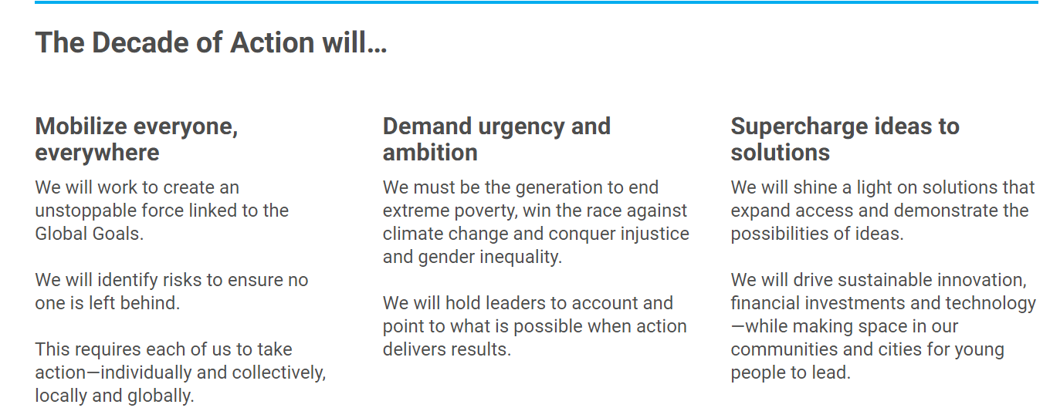

Slide 66
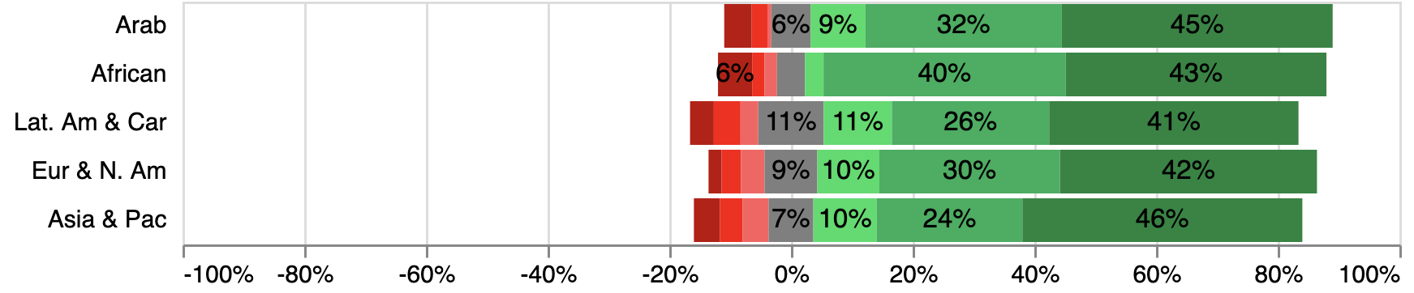
Results – Researchers’ views on socially responsible research dimensions Anticipative & Reflective: Societal Concerns
'It is important to ensure that the way I do my research and innovation work does not cause concerns for society.'
n=2113 [African=196, Arab=155, Asia & Pac=163, Eur & N. Am=1314, Lat. Am & Car=205]
Overall sentiment leaning heavily on agreement
Africa has highest combined “strongly agree” and “agree” percentage (83%)
Overall distribution of agreement is similar across regions

Slide 67
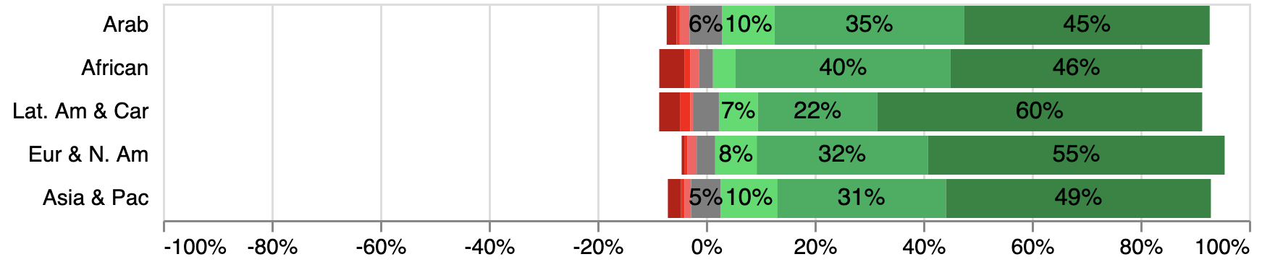
Results – Researchers’ views on socially responsible research dimensions Open and Transparent:
R&I Methods and Processes
'It is important to make my research and innovation methods/processes open and transparent.'
Overall sentiment leaning heavily on agreement
Latin America leading slightly with 60% strongly agreeing
n=2194
Notes:
[African=192, Arab=166, Asia & Pac=164, Eur & N. Am=1374, Lat. Am & Car=209]

Slide 68
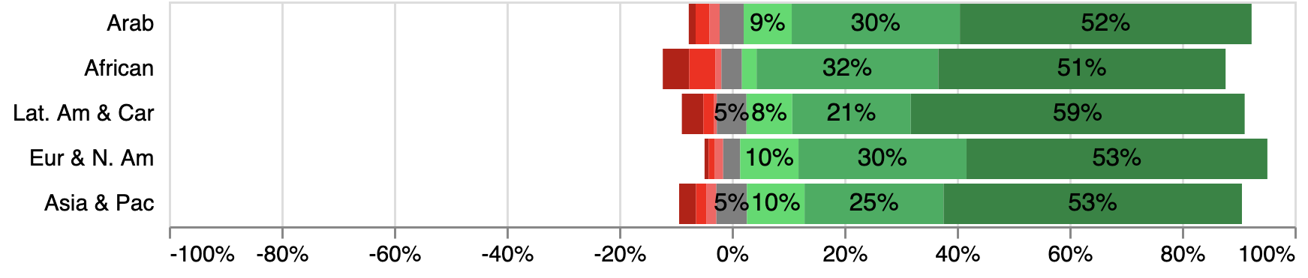
Results – Researchers’ views on socially responsible research dimensions Open and Transparent:
Public Accessibility
'It is important to make the results of my research and innovations work accessible to as wide a public as possible.'
Overall sentiment leaning heavily on agreement
Highest combined disagreement to the statement across African regions
Overall distribution of agreement is similar across regions
n=2175
Notes:
[African=192, Arab=164, Asia & Pac=166, Eur & N. Am=1360, Lat. Am & Car=209]

Slide 69
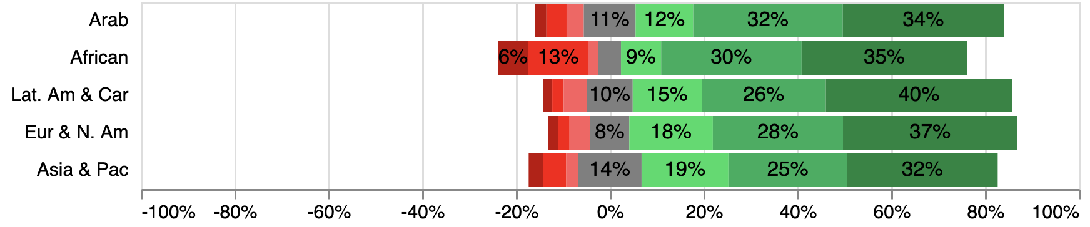
Results – Researchers’ views on socially responsible research dimensions Open and Transparent:
Open Data
'It is important to make data from my research and innovation activities freely available to the public.'
Overall sentiment leaning heavily on agreement
Highest combined disagreement to the statement across African regions
Overall distribution of agreement is very similar across regions
Notes:
n=2113 [African=187, Arab=163, Asia & Pac=162, Eur & N. Am=1319, Lat. Am & Car=204]

Slide 70
Results – Researchers’ views on socially responsible research dimensions Responsive & Adaptive:
Societal Needs
'Research and innovation should address societal needs.'
n=2224 [African=193, Arab=164, Asia & Pac=171, Eur & N. Am=1400, Lat. Am & Car=210, India=86]
Overall sentiment leaning heavily on agreement
Highest combined disagreement to the statement across Latin American regions
India leading with 66% strongly agreeing

Slide 71
Results – Researchers’ views on socially responsible research dimensions Ethics
'Ethical principles guide my research and innovation work.'
Overall sentiment leaning heavily on strong agreement
Arab States leading with 65% strongly agreeing
Notes:
n=2047 [African=184, Arab=159, Asia & Pac=156, Eur & N. Am=1274, Lat. Am & Car=197]

Slide 72
Next Steps: Connecting the dots between RRI and SDGs
1 - Qualitative data from the survey research:
Quantitative part: Have you taken any steps in the last 12 months to support this concept?
Qualitative part: If yes, which steps have you taken?
2 - Qualitative interview data
---------------------------------------------------------------------------
Follow us to be notified when our research findings are published!
rring.eu/newsletters | @RRING_PROJECT

Slide 73
Connecting the dots between RRI and SDGs
Qualitative Interviews research
113 full-length interviews
Conducted by a combination of project partners and subcontractors across the five geographical world regions
Qualitative content analysis completed and write-up underway

Slide 74
Connecting the dots between RRI and SDGs Qualitative Interviews (global)
Region | Country | n | Domain coverage |  |  |  | Stakeholder type coverage
 |  |  | Energy | Waste | ICT | Bioeconomy | RPO | RFO | Industry | CSO | Policy bodies
Europe and North America | UK | 8 | ✔ | ✔ | ✔ | ✔ | ✔ | ✔ | ✔ | ✔ | ✔
 | Italy | 5 | ✔ | ✔ | ✔ | ✔ | ✔ |  | ✔ |  | ✔
 | USA | 5 | ✔ |  |  | ✔ | ✔ | ✔
 | Serbia | 6 | ✔ | ✔ | ✔ | ✔ | ✔ |  | ✔ | ✔
Sub-Saharan Africa | Botswana | 3 | ✔ | ✔ | ✔ | ✔ | ✔ | ✔
 | Malawi | 8 | ✔ | ✔ | ✔ | ✔ | ✔ | ✔ | ✔ | ✔
 | South Africa | 10 | ✔ | ✔ | ✔ | ✔ | ✔ | ✔ |  | ✔ | ✔
Asia | India | 6 | ✔ | ✔ | ✔ | ✔ | ✔ | ✔ | ✔ | ✔ | ✔
 | Singapore | 2 | ✔ |  | ✔ |  | ✔ |  |  |  | ✔
 | Japan | 5 | ✔ | ✔ | ✔ | ✔ | ✔ | ✔
Latin America and the Caribbean | Uruguay | 5 | ✔ | ✔ | ✔ | ✔ |  | ✔ |  |  | ✔
 | Bolivia | 9 | ✔ | ✔ | ✔ | ✔ | ✔ |  | ✔ | ✔ | ✔
 | Brazil | 7 | ✔ | ✔ | ✔ | ✔ | ✔ | ✔ | ✔ | ✔ | ✔
Arab World | Egypt | 10 | ✔ | ✔ | ✔ | ✔ | ✔ | ✔ | ✔ | ✔ | ✔
 | Morocco | 11 | ✔ | ✔ | ✔ | ✔ | ✔ |  | ✔ | ✔ | ✔
 | Israel | 5 | ✔ | ✔ | ✔ | ✔ | ✔ |  | ✔
 | Jordan | 8 | ✔ | ✔ | ✔ | ✔ | ✔ | ✔ | ✔ | ✔
=Country-wise distribution of interviews conducted with details

Slide 75
Stay tuned! Project finishes end of April 2021
Follow us to be notified when our research findings are published!
rring.eu/newsletters
@RRING_PROJECT

Slide 76
Dr. Eric Jensen – e.jensen@icorsa.org Senior Research Fellow and director of ICoRSA Policy Research Unit
@JensenWarwick

