Slide 1

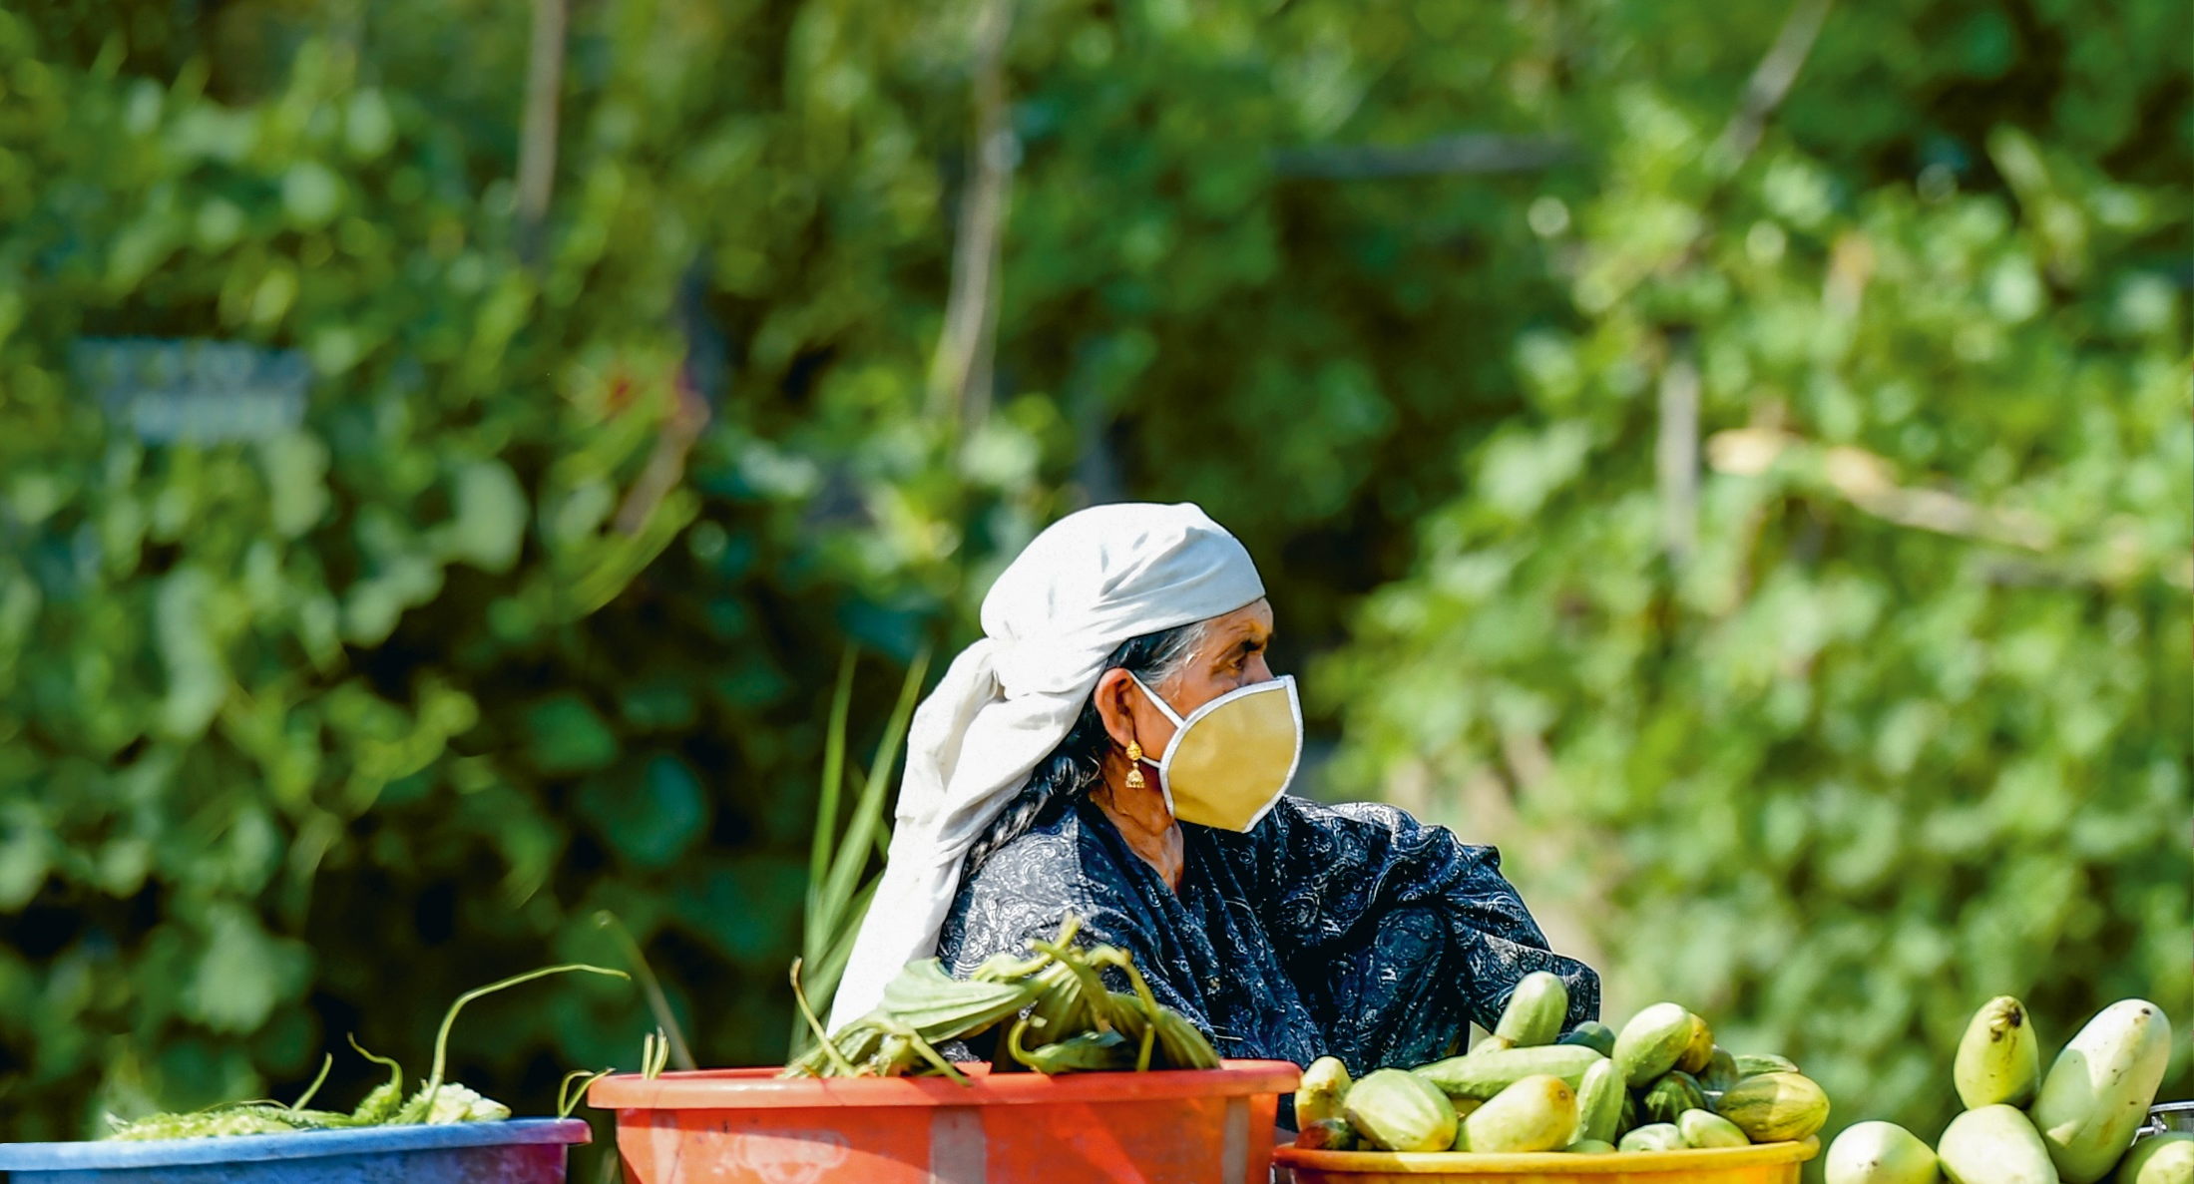

2020
GLOBAL HUNGER INDEX
ONE DECADE TO ZERO HUNGER
LINKING HEALTH AND SUSTAINABLE FOOD SYSTEMS

Slide 2
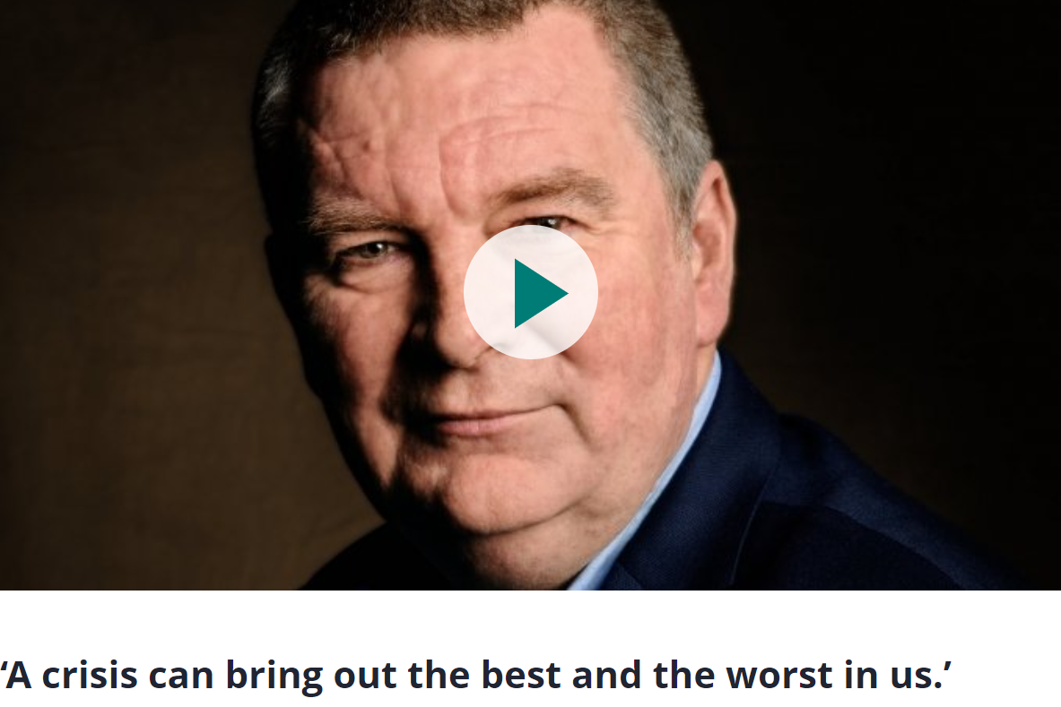
2020
GLOBAL HUNGER INDEX
ONE DECADE TO ZERO HUNGER
LINKING HEALTH AND SUSTAINABLE FOOD SYSTEMS

Slide 3
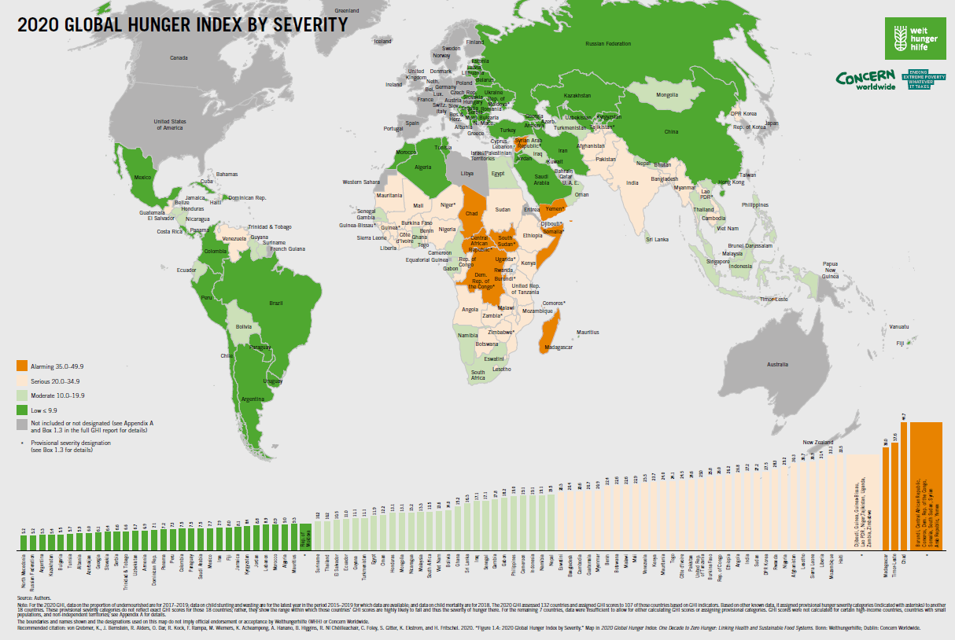

Slide 4
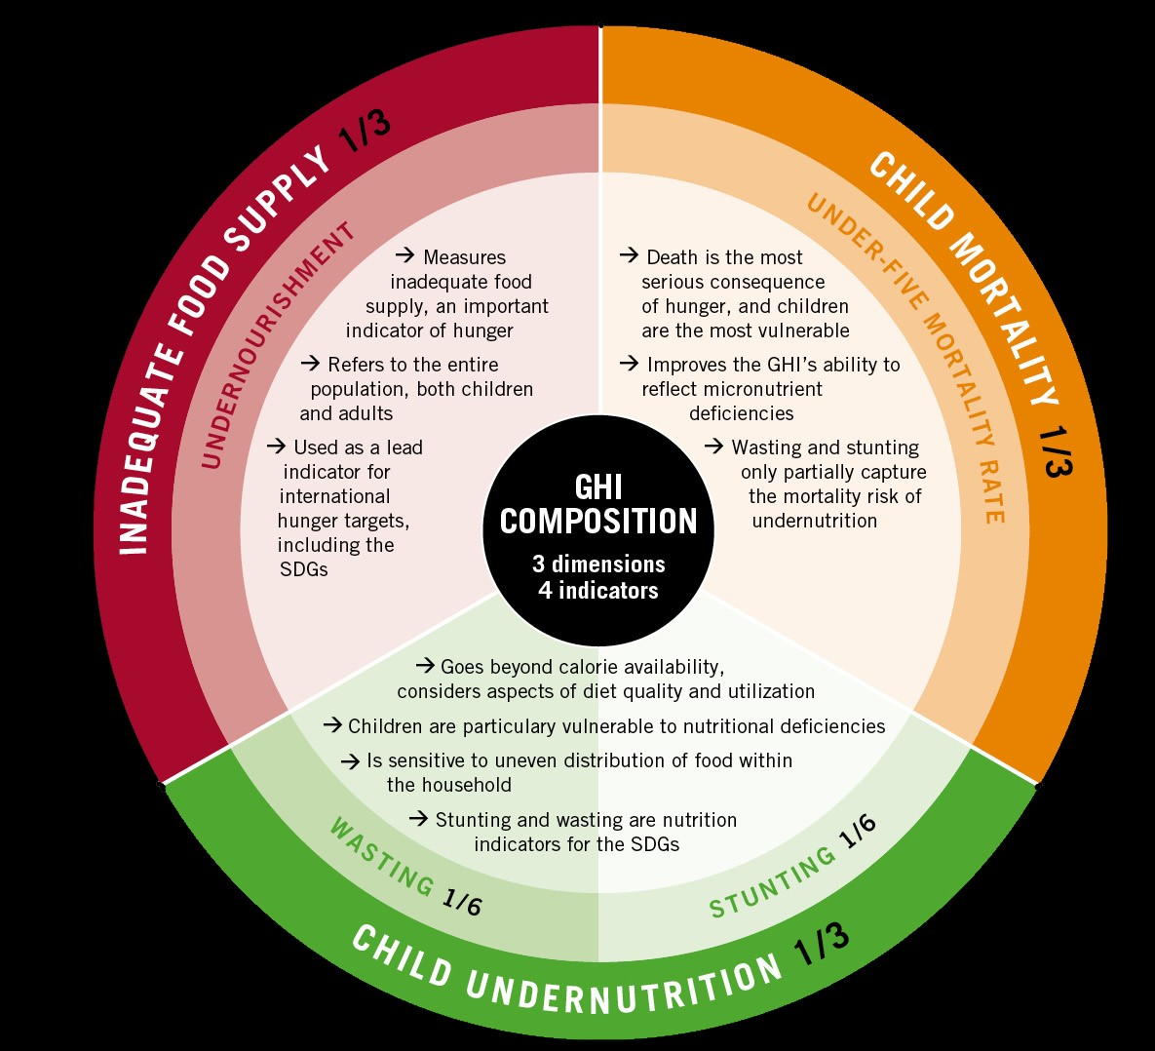
COMPONENTS
GHI MEASURES THREE
DIMENSIONS
and
FOUR
OF HUNGER
Notes:
INADEQUATE FOOD SUPPLY: Percentage of population that is undernourished
CHILD UNDERNUTRITION:
Percentage of children under 5 years old suffering from WASTING
(low weight-for-height)
Percentage of children under 5 years old suffering from STUNTING
(low height-for-age)
CHILD MORTALITY: Percentage of children who die before the age of 5
The standardized scores for the four indicators are aggregated to calculate the GHI score for each country.
Increase in GHI scores = hunger situation is worsening; decrease = improved situation

Slide 5
UNDERNOURISHMENT IN CHILDREN
HEALTHY
WASTED
STUNTED
Low weight-for-height
Low height-for-age

Slide 6
GHI SEVERITY SCALE
≤ 9.9
low
10.0-19.9
moderate
20.0-34.9
serious
35.0-49.9
alarming
≥ 50.0
extremely alarming
0
10
20
35
50
The minimum score is zero and the maximum score is 100.
In practice, neither of these extremes is reached.

Slide 7
NUMBER OF COUNTRIES IN EACH LEVEL OF GHI SEVERITY SCALE
≤ 9.9
low
10.0-19.9
moderate
20.0-34.9
serious
35.0-49.9
alarming
≥ 50.0
extremely alarming
0
10
20
35
50
48
26
40
11
0
countries
countries
countries
countries
countries
Note: Of the tallies of countries listed, 1 was provisionally categorized as low, 9 were provisionally categorized as serious, and 8 were provisionally categorized as alarming.

Slide 8
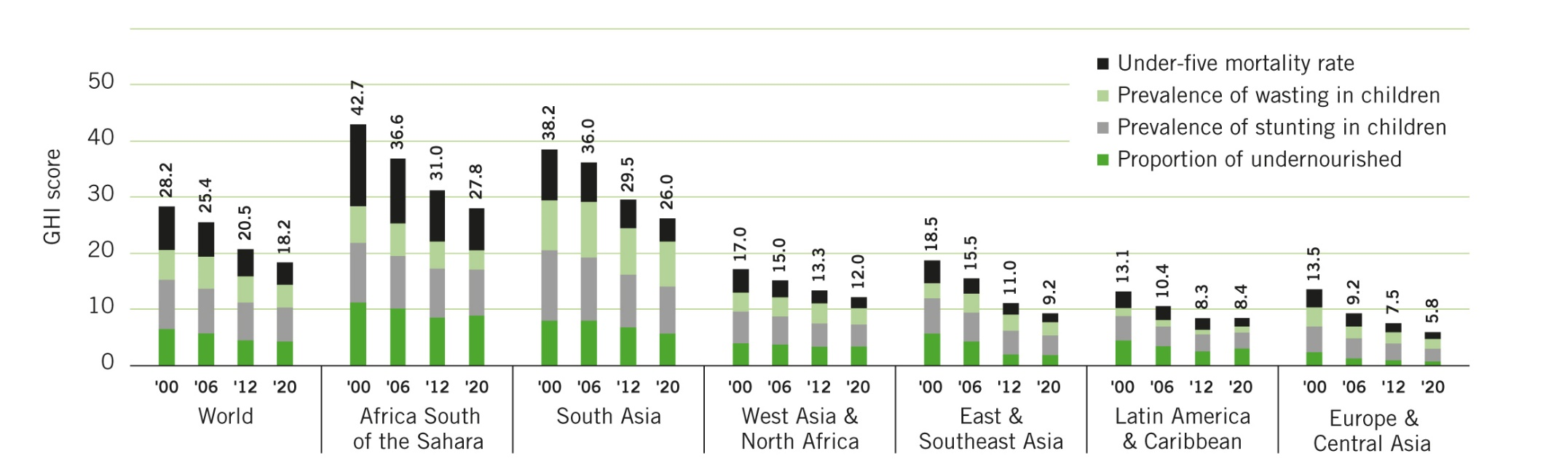
GLOBAL AND REGIONAL SCORES
WITH CONTRIBUTIONS BY COMPONENTS

Slide 9
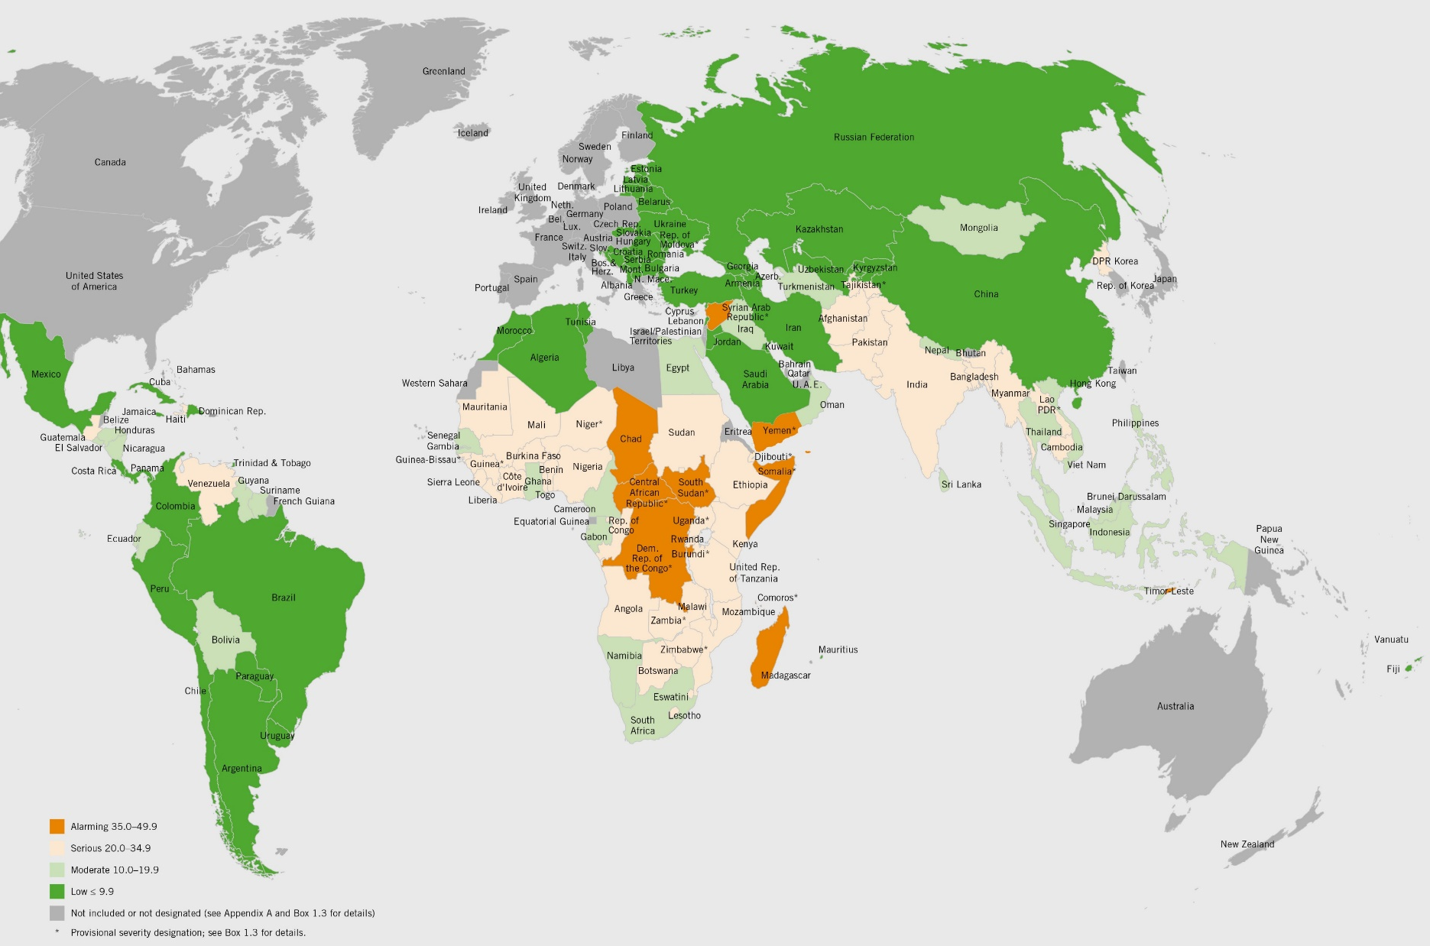
GLOBAL HUNGER INDEX 2020 BY SEVERITY
9

Slide 10
Impact on
Global Poverty
Source: IFPRI

Slide 11
COVID 19 is turning back the clock
2010
2019
2020
9 years
54m
Wasted
(very thin)
Children
under 5 years old
9 months
54m
Wasted
(very thin)
Children
under 5 years old
47m
Wasted
(very thin)
Children
under 5 years old
Headey et al. Lancet 2020

Slide 12
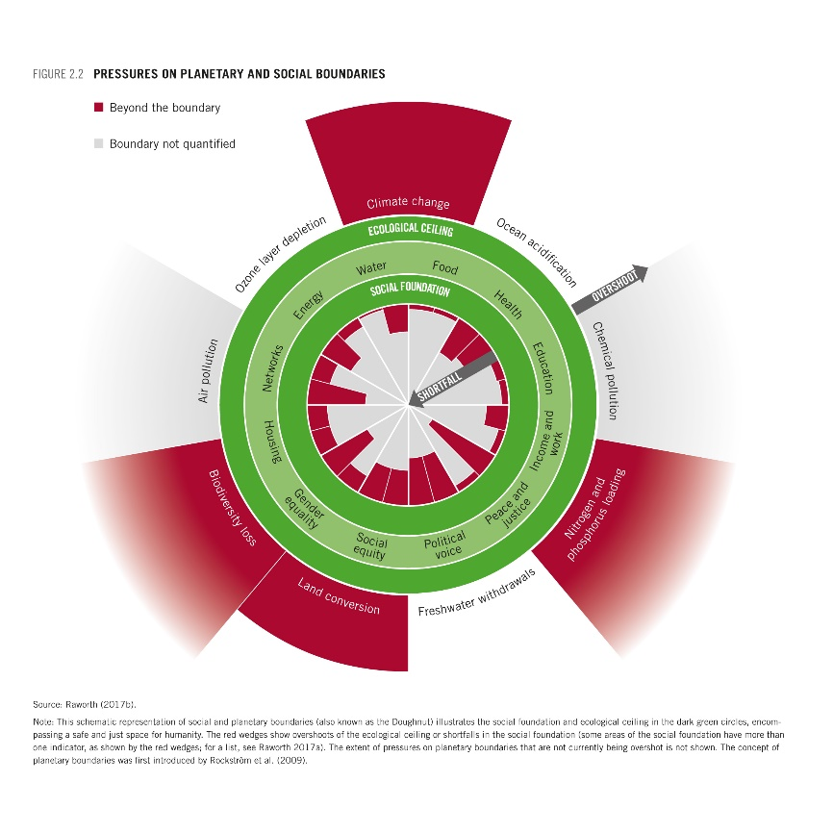
ONE HEALTH, ZERO HUNGER
Essay by Robyn Alders, Osman Dar, Richard Kock and Francesco Rampa , Chatham House
Our current global food system is posing health hazards to humans and the environment and has a big part to play in the rise of emerging infectious diseases such as covid-19. The huge increase in intensive livestock production has caused an immense loss of biodiversity and contributes to the rise of emerging infectious diseases such as COVID-19. Land use change, intensive agriculture, large-scale livestock production, and other practices have led to agroecological degradation, destroyed habitats, and contributed to climate change. Our food systems contribute 21–37 percent of total net human-caused greenhouse gas emissions and account for 70 percent of freshwater use.

Slide 13
A NEW TERM BUT AN OLD CONCEPT
WHAT IS
ONE HEALTH?

Slide 14
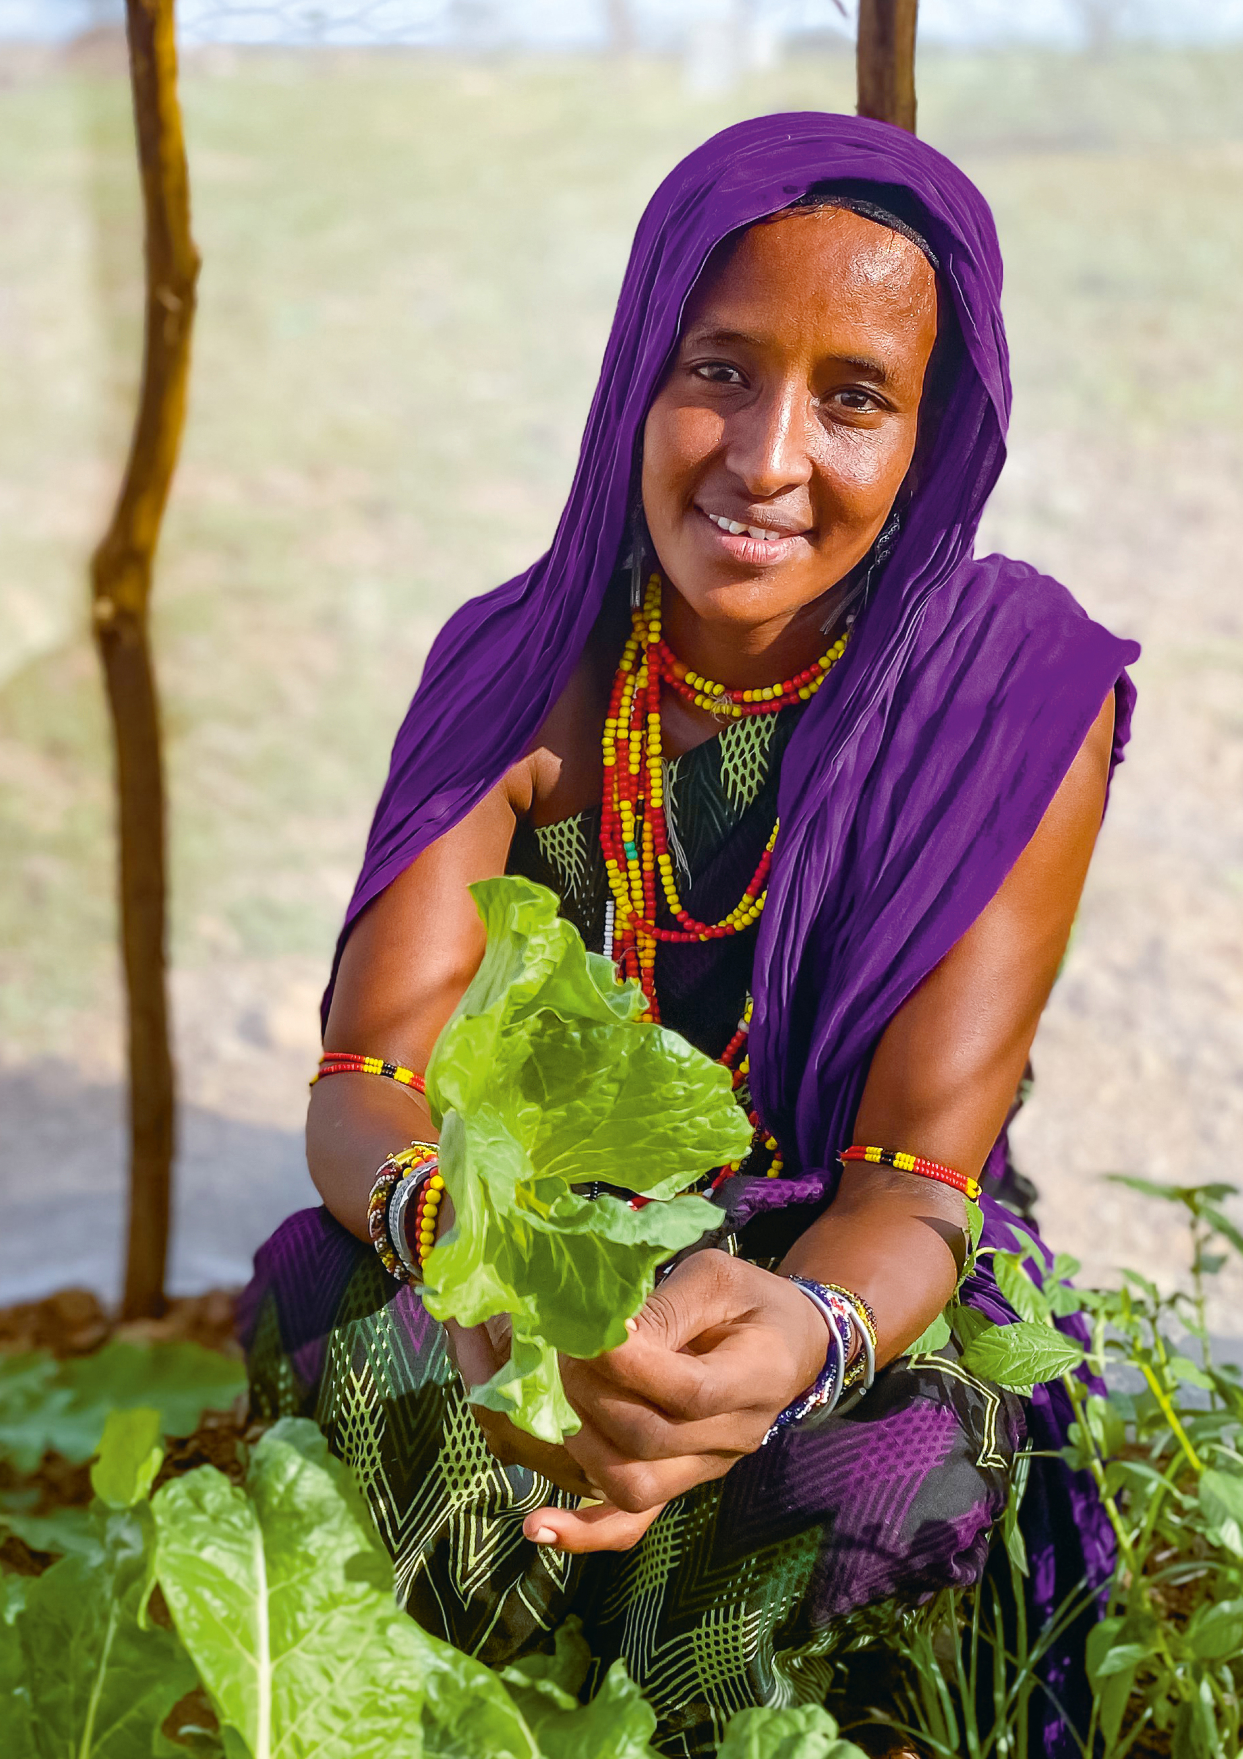
1. Make food systems work better for people and the planet
Support smallholder farmers in improving sustainability, diversification and market access
Strengthen local and regional food markets
Price food not only according to its weight and volume, promote sound biosecurity practices
Promote, develop, and implement circular food economies
2. Improve how food systems are governed
Hold food system actors legally accountable for respecting human rights and protecting the environment
Ensure security of land tenure
Strengthen and incentivize local and participatory governance
3. Strengthen international cooperation and regulations
Reduce trade inequities, such as nontariff barriers, align trade and development policies
Strengthen existing human rights-based multilateral mechanisms and international standards
Reinforce commitments to equitable and sustainable development, use opportunities such as UN Food Systems Summit
POLICY RECOMMENDATIONS

Slide 15
2030 Agri-Food Strategy European Green Deal AU-EU Summit COP-26 Nutrition for Growth UN Food Systems Summit
2021
OPPORTUNITIES

Slide 16

A crisis can bring out the best and the worst in us. We can choose a different future. The future is not written…
Dr Mike Ryan, Executive Director WHO Emergencies Programme
16th October 2020

