Slide 1
Study abroad
A semester or year abroad during your 3rd year of your UCC degree

Slide 2
Study Abroad Introduction
EU & Non-EU Exchange programme
Spend a semester or academic year abroad at one of
UCC’s partner institutions
Study similar subjects abroad
Sit normal examinations abroad
Full recognition – not a gap year/semester

Slide 3
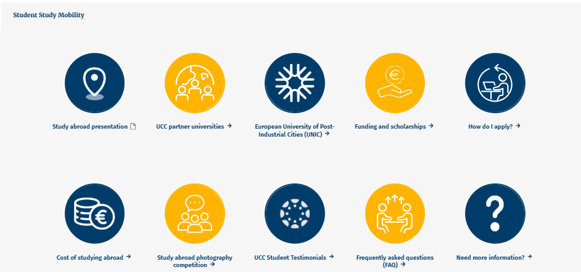
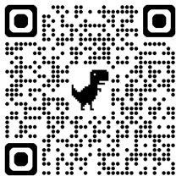
GO ABROAD WITH UCC WEBSITE

Slide 4



Things to consider
One semester or Full Academic Year
International pathway- mandatory year abroad
Not all UCC degree programmes offer study abroad as an option
Exchange availability
We have a limited number of places at each partner university. Students should consider a number of different partner universities
Host university
Campus, modules, language of instruction, city, country
Cost
Europe
outside the EU
Adapting abroad
Willing to step outside your comfort zone so you can grow, learn from new cultures, and build confidence in a completely new environment
Positive attitude
staying optimistic helps you remain motivated, confident, and resilient throughout the journey

Slide 5
What steps do I need to take?
Step 1
Attend study abroad information sessions (1st semester of your 2nd year)
Information Sessions will be announced on our website https://www.ucc.ie/en/international/goabroadwithucc/ or via email if we are presenting directly to your degree programme
If you cannot attend/miss the session, please contact the International Office
Check our website for updates: https://www.ucc.ie/en/international/goabroadwithucc/
Step 2
Submit a study abroad application- https://www.ucc.ie/en/international/goabroadwithucc/
Students will either be applying to the International Office OR their academic coordinator
Details provided at information sessions
Application deadlines will vary depending on your degree programme
Step 3
Your application will be reviewed by the International Office and your UCC department
If you have applied to the International Office, your application is reviewed after your 1st semester of 2nd year results are released
Step 4
Notification to all students about the outcome of their application (mid-late February)

Slide 6
UCC Partner Universities
When reviewing UCC’s partner universities:
Check if the partner institution has an exchange agreement with your specific degree programme or subject area.
If the university operates under a “university-wide agreement,” you must ensure that it offers modules that are suitable for your UCC degree.
Full list of partner universities: https://www.ucc.ie/en/international/goabroadwithucc/uccpartneruniversities/
What you need to know!
The list of partner universities and available modules may change at any time.
Placement at a specific university cannot be guaranteed for any student.
Each partner university has a limited number of exchange places.
Places at high-demand (popular) universities are highly competitive.
You must include several partner university choices in your application, as we cannot guarantee your top preference due to demand, academic results, and availability.
Studying a language at UCC: If you are studying a language as part of your degree, you are required to complete your year abroad in a country where that language is spoken.
You can only study at UCC’s exchange partner universities (no exceptions)
BComm students: There is a cap on the number of BComm students who can study abroad each year. Please see the link for more details: https://www.ucc.ie/en/international/goabroadwithucc/uccpartneruniversities/#additional-information

Slide 7
Minimum Grade Requirements
For some degree programmes, your department may have set minimum grade requirements to ensure that applicants have the academic foundation and skills needed to succeed in a foreign education system, helping them handle the coursework, adapt to different teaching styles, and meet the standards expected in their chosen field of study.
It is important to review this now in 1st year
Click here for further information about minimum grade requirements https://www.ucc.ie/en/international/goabroadwithucc/howdoiapply/#minimum-grade-requirements
For example:
Applying to study outside of the EU (Australia, Canada, USA and Singapore)
*Your department may have additional or requirements subject to higher grades (Physics, School of BEES etc)
Students must achieve a minimum of:
60% grade average in 1st year and
60% grade average in 1st semester of 2nd year

Slide 8
Modules
While abroad, you are ‘replacing’ your UCC modules that your classmates back home are taking.
*This is only relevant to students that will be missing 3rd year modules at UCC while abroad.
It is extremely important that you research the module offerings for the universities you are interested in.
Go to UCC Programme Calendar: https://reg.ucc.ie/curriculum/calendar/live/
Search for your degree and click on the relevant one
Click on Programme requirements
Check what modules you should be taking during 3rd year
You will need to ensure that the universities you plan on applying for offer these modules.
You will need to speak with your academic coordinator about your modules in semester 1 of your 2nd year
Mandatory year abroad: Your coordinator will speak with you about their academic requirements

Slide 9
University of California system (9 locations)
Only students of high honours standard (1.1 - first class honours) are selected to participate in this programme.
Your UCC grades from 1st year will be reviewed.
One semester only (depending on the circumstances, a full year maybe possible)
Limited UCC subject areas available (email mb.murphy@ucc.ie to check)
Step 1: UCC Application
Deadline to apply to the UCC International Office: early December each year
Online form
Statement of support from academic coordinator (or lecturer)
Personal statement
Step 2:
If successful, the UCC International Office will provide further details

Slide 10
Erasmus+ Programme=Studying in Europe
Funding
Students who study in the EU are eligible for Erasmus funding
approx. €330-€385 per month(depending on country of destination)
Students are not charged tuition/registration fees at the host institution
Travel Grant - €309 for most
partner cities
(some may be €395)
Koc, Turkey - €1,188)
Erasmus documentation information sessions in March
SUSI + possible additional Erasmus funding €250 per month
Travel Grant calculated based on distance (once off payment)
Financial information is subject to change

Slide 11
Cost of studying abroad
Tuition Fees at host university
You are not paying tuition fees to the host university
You must pay your normal UCC fees (when registering for 3rd year)
All other expenses
Students are responsible for all other costs such as insurance, flights, visa’s, housing, orientations, meal plans etc
Outside the EU
No funding or scholarships available for students studying outside the EU
Host university will request evidence of finances for visa paperwork (March/April)
Email mb.murphy@ucc.ie if you have any questions
Example of finances required by host university (subject to change)
Francis Marion University, South Carolina ( $12,000 per semester estimated cost of living)
Suffolk University, Boston ($22,000 per semester estimated cost of living)
Canada: $20,635 for the full academic year (visa requirement) (Subject to change)

Slide 12
How do I apply?
Step 1- Research
Go to the Go abroad with UCC website
https://www.ucc.ie/en/international/goabroadwithucc/
Step 2- Apply
Complete the online application (available on our website in semester 1 of your 2nd year)
Some students will be applying to their departments directly and not the International Office
Information on application process will be provided in those information sessions
No late applications accepted
Step 3- Result
Wait for an email notification on the outcome of your application
This will be AFTER your semester 1 of 2nd year results are released (mid-late February)
Notification to all students will take place from late February to early March
Please note, unfortunetly not all students will be offered a place due to various factors which will be communicated to you

Slide 13
If I am offered a place studying abroad- What happens next?
You will be nominated to the host university by UCC’s International Office
Receive application instructions from the host university
Attend MANDATORY information sessions hosted by UCC
Host University application
Examples of supporting documents:
UCC Transcript of Records
Erasmus Learning Agreement / Study Plan (Module Selection Form)
Copy of Passport (must be in date for your study abroad period- if expiring, renew NOW!
Copy of European Health Insurance Card
Reference Letter / Nomination Letter
US and Canada: Proof of finances paperwork
When do I apply to the host university?
When you get application instructions from the host university (March/April)
When do I apply for my visa (if I need one)
When you have received your official acceptance from the host university, they will provide you with the relevant visa paperwork.
Please be mindful of visa application/appointment obligations if you are going abroad during the summer (J1’s etc)

Slide 14


Check out our FAQ section
https://www.ucc.ie/en/international/goabroadwithucc/frequentlyaskedquestionsfaq/

Slide 15
Study Abroad canvas page
Application procedures, Accommodation and Living,
Finance, Wellbeing,
Visa and Immigration, Insurance, Pre-departure
Survival tips from returned UCC students
..and more!
Link will be emailed to students

Slide 16
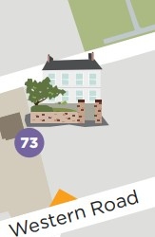
Erasmus partners(Europe)
Clare Murphy & Joanne Heffernan Email: studyabroad@ucc.ie
Contact
non-European partners
Mary-Bríd Murphy
Email: mb.murphy@ucc.ie
International Office Roseleigh, Western Road Monday-Friday
(9am-1pm and 2pm-5pm)

