Slide 1
School of Applied Social Studies
B.Soc.Sc.
Youth and Community Work
Information Session
2025-26

Slide 2
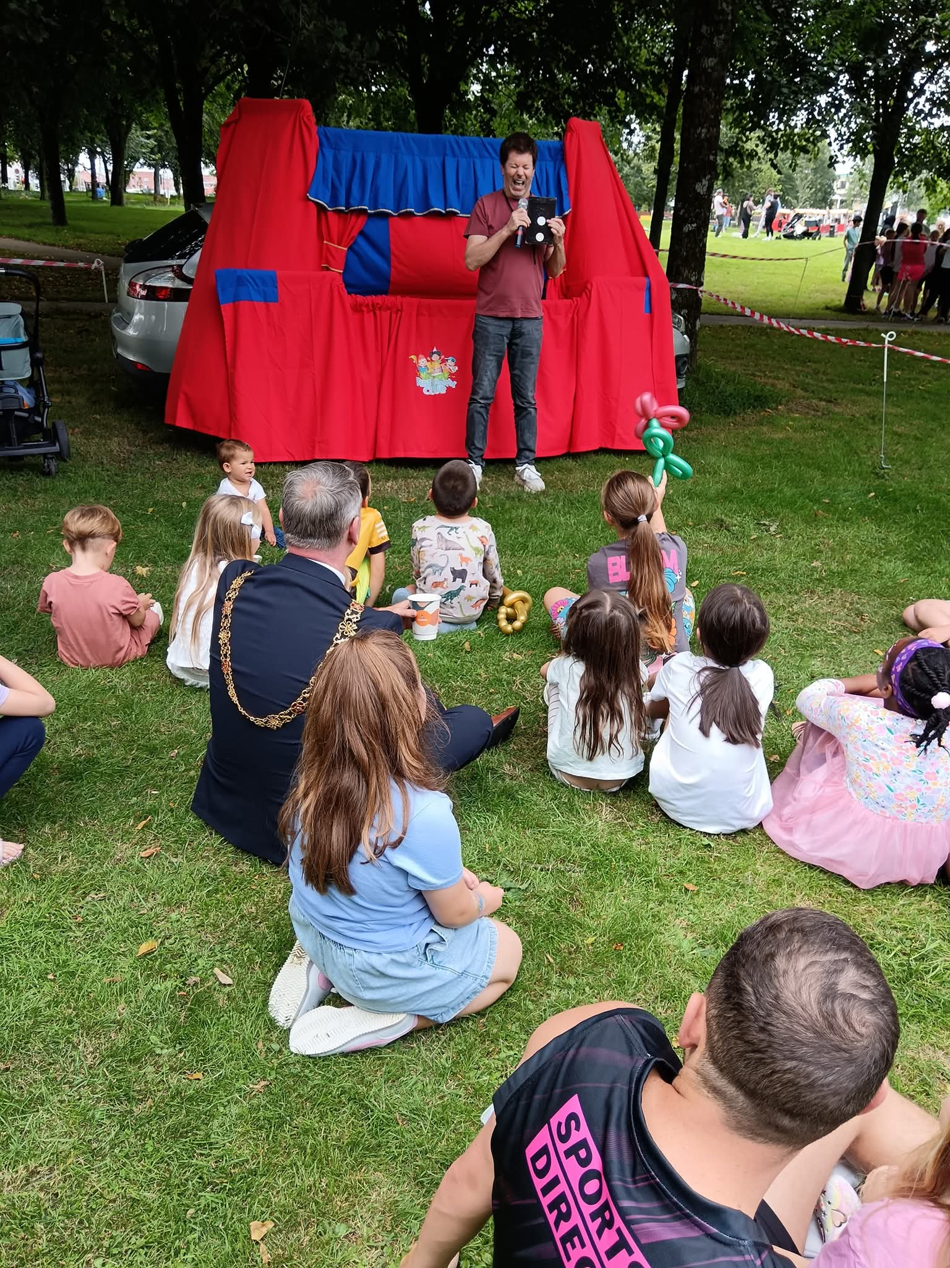
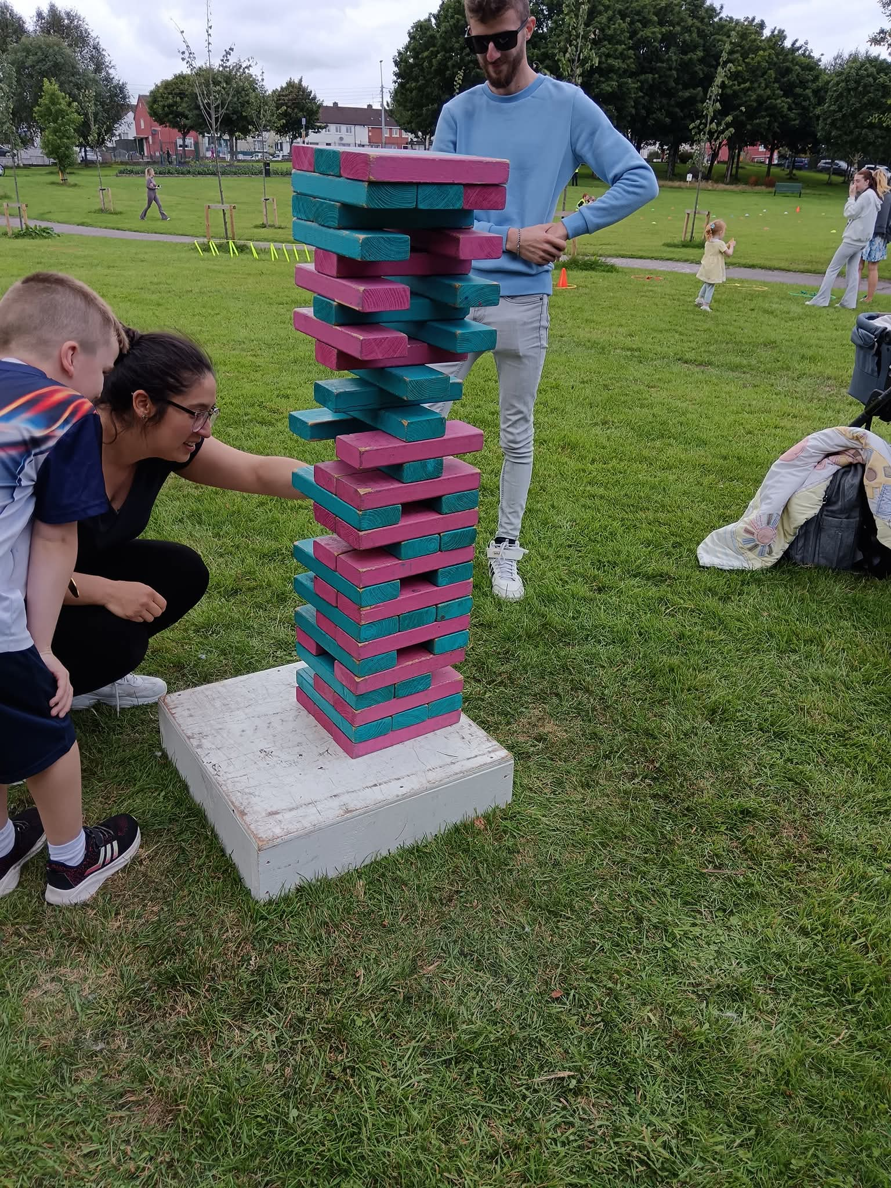
BSocSc Youth and Community Work CK114, School of Applied Social Studies
Programme duration: 3 years
Professionally accredited by NSETS (North/South Education and Training Standards Committee for Youth Work)
Offers a degree and professional accreditation in Youth Work.
Photos: Cork City Partnership

Slide 3
People who are interested in making Irish society a more just society.
People who are interested in what happens in their community and who are actively involved in their community.
People who enjoy working with young people and who believe that by working with young people you can help them to help themselves.
People who are interested in groups which are struggling for rights and equality.
People who want further education and a professional training in youth and community work.
Who is this degree for?

Slide 4
Course Objectives
Prepare students who take part in the course for employment and/or enhanced roles as volunteers in a range of youth and community work contexts.
Value participants' prior experience and enhance this by engaging them in a process of learning which will facilitate their personal development and growth, contribute to their professional development as youth and community workers and increase their knowledge and skills bases.
Provide the opportunities and resources for each student to ensure the integration of theory and practice.
Provide, through negotiation, a range of fieldwork placements which will both enhance the skills development of the student and development of the agency as part of the on-going training process.
Provide a framework for political and social analysis with which to explore the tensions and realities of youth and community work as an area of professional practice.
Locate the practice of the students within an international context, by examining issues and practices in youth and community work internationally.
Notes:
Welfare state – the governance of economic security for citizens of that state

Slide 5
BYCW: Year 1 Modules 60 credits in total in Year 1
SS1101 | Introduction to Youth & Community Work (10 credits)
SS1104 | Principles and Practice of Youth and Community Work (10 credits)
SS1130 | Contemporary Issues in Youth and Community Work (5 credits)
SS1105 | Social Policy 1 (10 credits)
SS1102 | Social Analysis 1 (10 credits)
SS1154 | Informal and Global Education in a Youth and Community Work Setting (5 credits)
SS1107 | Level 1 Professional Placement (10 credits)
Year 1 Modules
https://www.ucc.ie/admin/registrar/modules/
Notes:
Social Analysis - examines the nature of sociology, to think conceptually about the systems and structures of society.
Social policy - actions that affect the well-being of members of a society through the distribution of and access to goods and resources in that society.

Slide 6
Principles of Youth and Community Work which inform the course
Youth and Community Work is about working with people. The course, thus, aims to develop particular skills in the youth and community worker as an educator which will facilitate them to work alongside and with people rather than for them.
As youth and community workers, core skills of enabling and facilitating are seen as crucial in working with communities, allowing the worker to be of service to the community and those in it.
Notes:
Creative dialogue – sharing experiences

Slide 7
About the Course
How is the degree delivered?
Full-time course
3 years duration
2 consecutive days per week at lectures
2 days/16 hours per week on placement
Same model for years 1 & 2; Year 3 has 10-week block placement
Course Curriculum
Year 1 – 7 Subjects/Modules
4 Subjects/Modules at a time
Building from one year to the next
Support Consistent individual and group academic and placement tutorial support.

Slide 8

Application Process
Four entry routes:
Leaving Certificate
QQI FET
Mature Student
ACE
All applications are made online through the CAO (Central Applications Office)
Apply through the CAO by February 1st 2026 – CAO Code CK114 and get CAO number – www.cao.ie

Slide 9
Entry Requirements (all applicants)
All applicants should have relevant and verifiable experience, either paid or voluntary in the youth/community/voluntary sector. This can include experience as a participant.
Knowledge of social issues and youth and community work, and a readiness to undertake professional training in youth and community work.
You will be invited to attend an information session (in April/May) if you satisfy the minimum entry requirements for the programme.

Slide 10
CK114 BSocSc Youth & Community Work
Leaving Cert CAO process:
Must satisfy minumum entry requirements and achieve the CAO points for the programme.
Study of Social Science combined with Youth and Community Work
Notes:
At least six subjects must be presented. Minimum grade H5 in two subjects and minimum grade O6/H7 in four other subjects. English and Irish are requirements for all programmes . Applicants will need to meet the following minimum entry requirements:
English Irish Other LanguageO6/H7O6/H7O6/H7
India, Sri Lanka, Belarus, Romania, Ukraine, Kenya, Ghana, and South Africa.

Slide 11
Leaving Cert Applicants
Minimum NUI requirements of 6 subjects at Leaving Certificate, with minimum grades of 2H5 and 4 O6/H7.
English, Irish and another language must be presented.

Slide 12
QQI FET Entry Route
Successful applicants must achieve Distinctions* (i.e. 80% or greater) in 4 modules in their final results (8 modules successfully completed)
List of eligible QQI Programmes here. Applicants who have completed any of these are eligible to apply through the QQI FET route https://www.ucc.ie/en/study/undergrad/fetac/acsss/

Slide 13
Mature Entry Route
MATURE: As a mature applicant you must be over 23 years by 1st January 2026
Provide a Statement of Interest
MSE – Mature Student Evaluation
Notes:
Written English - is to assess your ability to communicate effectively in writing.
and Reasoning in the Humanities and Social Sciences (multiple-choice);

Slide 14
ACE Entry Route
Exemption from the MSE
Successful applicants must have successfully completed an ACE Diploma from the approved list here https://www.ucc.ie/en/ck114/#section4
Applicants who are successful in gaining a place on the course through the ACE route (DYCW) may also qualify to be exempted from one 10 credit module on the programme (SS1101 – An Introduction to Youth & Community Work)

Slide 15
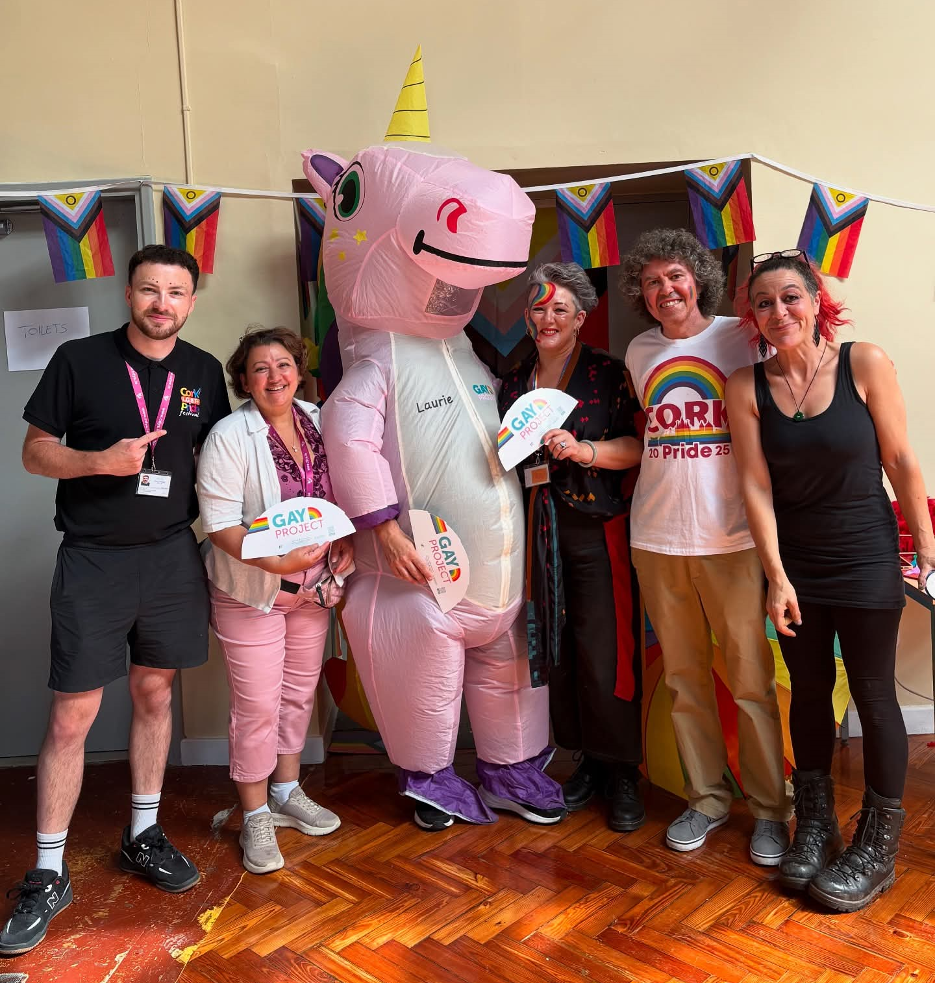

CAREERS
Mainstream Youth Work e.g. Foróige
Special Project Youth Work – UBU Your Place Your Space Projects
Garda Youth Diversion Projects
Community Development
Community Based Drug and Alcohol Projects e.g. Tabor Lodge
Schools Completion Programmes
Family Resource Centres
Community Arts
Youth/Community Mental Health e.g. Jigsaw
HSE Health Promotion
Homeless Agencies e.g. SIMON, Vincent de Paul
SOLAS Local Training Initiatives
Sustainability and Environmental Awareness related projects
Local government
Photo: The Hut Youth Project, CDYS Youth Work Ireland

Slide 16
Postgraduate Routes
Within the School
Masters in Social Policy (MSocSc) (Online also)
MSocSc Social Policy and Social Justice Online
Master of Social Science in Research (by Portfolio) (MSocSc)
Post Graduate Diploma in Social Work Studies
Masters of Social Work
Masters in Voluntary and Community Sector Management (MSocSc)
Outside the School
BYCW graduates have gone on to undertake postgraduate study in areas such as social policy, law, counselling, criminology, sociology, migration studies, women’s studies, planning and sustainable development, media studies, psychology and life coaching.

Slide 17
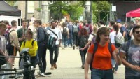
Ger Interview 1 with UCC Students – YouTube
Mature Student Testimonial

Slide 18

Graduate Testimonials
What did you find most rewarding about doing the degree?
Liz
Working with different groups of people for each of the placements was particularly rewarding and allowed me the opportunity to apply what I was learning academically to how I engaged with people and their organisations.
Darcy
I love the fact that it's both placement and lectures weekly. The classes are engaging and there's room for plenty of discussions, your life experience is highly valued in UCC.

Slide 19
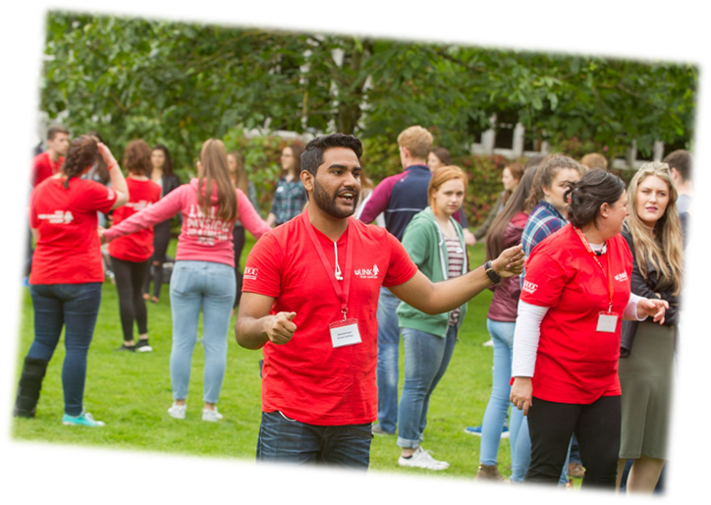
Graduate Testimonials
Where are they now?
Megan
I am working in my dream job where I get to work with the most amazing and inspiring young people and children every day. I love getting to know the children and young people I work with and learn something new from them every day.
Cian
Coming from a family that has fostered for the past number of years has also driven me towards this kind of a career. The staff on the course have helped me to overcome the barrier of working with young people around my own age and use it to my advantage. The lecturers and tutors have been a great help

Slide 20
Thank you!
Any Questions?
Programme Queries to:
youthandcommunitywork@ucc.ie
Webpage:
https://www.ucc.ie/en/ck114/
X: @BsocscW

