Slide 1
The mortgage that’s right for you
Marcelle McAuliffe
Bank of Ireland UCC

Slide 2
This is what I’ll be talking about this evening
This is what I’ll be talking about today
What Bank of Ireland looks for when assessing a mortgage application
The key steps to a mortgage application
The cost of a mortgage and how much can you borrow
The Mortgage offering from Bank of Ireland

Slide 3
Preparing to take on your mortgage
Two key things to consider before you apply for a mortgage
1. Your track record
Regular savings is key: Show how you have built up your deposit by saving regularly
Rent paid: Be able to show a record (through your bank account) of rent paid on a regular basis
Day to day finances: Show how you have managed your day to day finances for a period of time, i.e.
Your current account operates in credit or within its overdraft
You pay as many bills as possibly by direct debit to avoid missing payments
2. If you can afford the mortgage
Remember additional costs such as legal and valuation fees
Have you other borrowings? Existing debt will reduce the amount you can borrow
Will you have money left each month to live comfortably after you have paid your mortgage?
… even if rates increase?
We are keen to see that you can afford to take on a mortgage and still have enough money left to enjoy your new home.
Notes:
3
3
3

Slide 4
5 key steps to the Mortgage Process
Step 1: Complete Mortgage Application
Step 2: Offer Letter issues
Step 3: Providing the documentation
Step 4: Home Insurance & Life Assurance
Step 5: Getting the funds – and your keys…

Slide 5
What will a mortgage cost and how much can I borrow?
Mortgage monthly repayment examples
Mortgage Amount | 35 years | 30 years
€100,000 | €474 | €508
€150,000 | €708 | €759
€200,000 | €944 | €1,011
Average monthly rent in ROI: €960.00
(+8.2% in previous 12 months)
Daft.ie Q1 2015
Above repayments are based on our highest variable rate of 4.50% (4.6% Annual percentage Rate (APR) for Loan to Value (LTV) over 80%).
Repayments are even lower with our fixed rate options
and for mortgages with lower LTV
Factors that can influence the amount you can borrow
Level of regular dependable income
History of regular savings and/or rent payments
Financial track record and other financial commitments
Deposit saved
The cost or type of property sought.
Remember to allow for additional costs such as legal fees, valuation and surveyors costs, life and fire cover, stamp duty, etc., and that variable rates can increase.
Ask a Bank of Ireland Mortgage Adviser how much you can borrow for your mortgage

Slide 6
We have a mortgage to suit every need…
First Time Buyer
Mover
Equity Release
Buy To Let
Choice of competitive fixed / variable rates
LTV (Loan to Value) up to 90%* with terms up to 35 years
LTV up to 80%*
Negative Equity solution and Starter (5 year) Tracker for Mover **
Borrow from €10,000 up to 80% LTV*
LTV up to 70%*
25 year terms
1 year and 5 year Interest-only options (depending on LTV)
* Maximum mortgage is generally 3.5 times gross annual income and 80% of the property value (90% of the property value up to €220,000 for First Time Buyers, 70% of the full property value for Buy to Let) but these limits may vary.
** Our Negative equity and Starter (5 year) Tracker for Mover features are for existing Bank of Ireland mortgage customers only.
There are lending criteria and terms and conditions, and security and insurance are required. In general mortgage terms up to maximum age 70 are available.

Slide 7
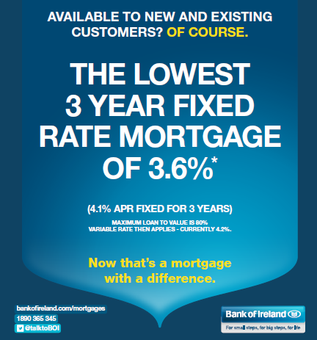
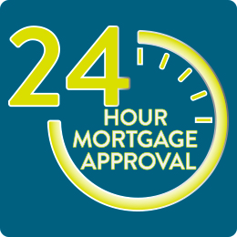
… and a mortgage offering that’s second to none
New 2% Cashback offer for all mortgage segments
Best 3-year fixed rate 3.6% (LTV up to 80%)
Only 10 year fixed from 4.2%
All rate options available to new and existing customers
A great package for investors
2% Cashback
Lowest Buy to Let fixed rates (lowest variable up to 50% LTV)
Interest-only options 5 year (up to 50% LTV) and 1 year (over 50% LTV)
More than 250 branches
Mobile mortgage managers
House Hunter approval
Real approval in 24 hours – not just approval in principle
Approvals last 12 months – (based on House Hunter mortgage approval lasting 6 mths and mortgage offer for a suitable property lasting a further 6 mths)
Solutions for Movers with a tracker or in negative equity*
Flexi-options in the life of the mortgage
Payment holidays, skip a month (or 2), Overpayments, Twin rate option, change repayment date
2
Offer on drawdowns from 3rd June to 31st Dec 2015. The Bank may seek refund if the mortgage is repaid within 5 years.
* BoI Mortgage Customers only

Slide 8
Next Steps
Talk to us today – we have qualified mortgage advisers here who can answer any questions
Or ask for an appointment with a mortgage adviser in any of our branches
We’d be delighted to help you every step on the road to your new home!

Slide 9
Legal information
Warning: If you do not keep up your repayments you may lose your home.
Warning: You may have to pay charges if you pay off a fixed–rate loan early.
Warning: If you do not meet the repayments on your loan, your account will go into arrears. This may affect your credit rating, which may limit your ability to access credit in the future.
Warning: The cost of your monthly repayments may increase.
Warning: The entire amount that you have borrowed will still be outstanding at the end of the interest-only period.
Valuation
The Bank requires that you arrange a valuation of the property (or properties) offered as security, carried out by a valuer acceptable to the Bank. You will need to pay the valuation fee direct to the valuer. You need to agree that fee with the valuer (you should expect to pay a fee of €150 to €250 plus VAT but this can vary). If we withdraw the loan offer we may refund this fee.
Legal fees
You will need to pay legal fees to your own solicitor, which you need to agree with him or her as part of your own arrangement. This does not include costs associated with the Bank’s legal investigation of title for the purpose of the Mortgage.
Arrears - Interest Surcharge
If you do not pay us a repayment instalment or other sum of money by the date you are due to pay it, we may charge you a default interest rate of 0.5% per month or part of a month (which is 6% per year) on the unpaid sum. This default interest is added to normal interest. We do not charge borrowers default interest when they are in a Mortgage Arrears Resolution Process under the Central Bank’s Code of Conduct on Mortgage Arrears and are co-operating reasonably and honestly with us.
Repaying your Mortgage early
If you repay your Mortgage early when you are on a variable rate of interest, we charge no redemption fee. If you repay your Mortgage early when you are on a fixed rate of interest, or change to another rate within your fixed rate period, you may have to pay an additional funding fee.
This funding fee is compensation for the additional interest expense that the bank may incur as a result of a customer breaking their fixed rate contract. If there is no additional interest expense incurred by the Bank no compensation will be required.
This is how the funding fee compensation is calculated – it is equal to “C” where: C = A x (R%-R1%) x D ÷ 365, and
“A” = the amount repaid early (or the amount which is changed from the fixed rate to a new rate) averaged from the date of early repayment (or rate change) to the
end of the fixed rate period to allow for scheduled repayments (if there are any) and interest charges.
“R%” = the annual percentage interest rate which was the cost to us of funding an amount equal to “A” for the originally intended fixed rate period.
“R1%”= the annual percentage interest rate available to us for a deposit of an amount equal to “A” for a period equal to “D”.
“D” = the number of days from the date of early repayment (or rate change) to the end of the fixed period.
Here is a worked example: “Amount” = €250,000, “R” = 5 %, “R1” = 3%, “D” = 2 years or 730 days.
C = 250,000 x (5%-3%) x 730 ÷ 365
So, C = 250,000 x 2% x 730 $÷$365,
C = €10,000
A typical variable rate mortgage of €100,000 over 20 years costs €623.20 per month (Annual Percentage Rate (APR) 4.4%). The cost of your monthly repayments may increase. A 1% interest rate rise will increase this repayment to €677.55 (APR 5.4%). This is an increase of €54.35 per month. Information correct as at 1st June 2015.

Slide 10
Thank you
Bank of Ireland Mortgage Bank trading as Bank of Ireland Mortgages and The Mortgage Store is regulated by the Central Bank of Ireland.

