Slide 1
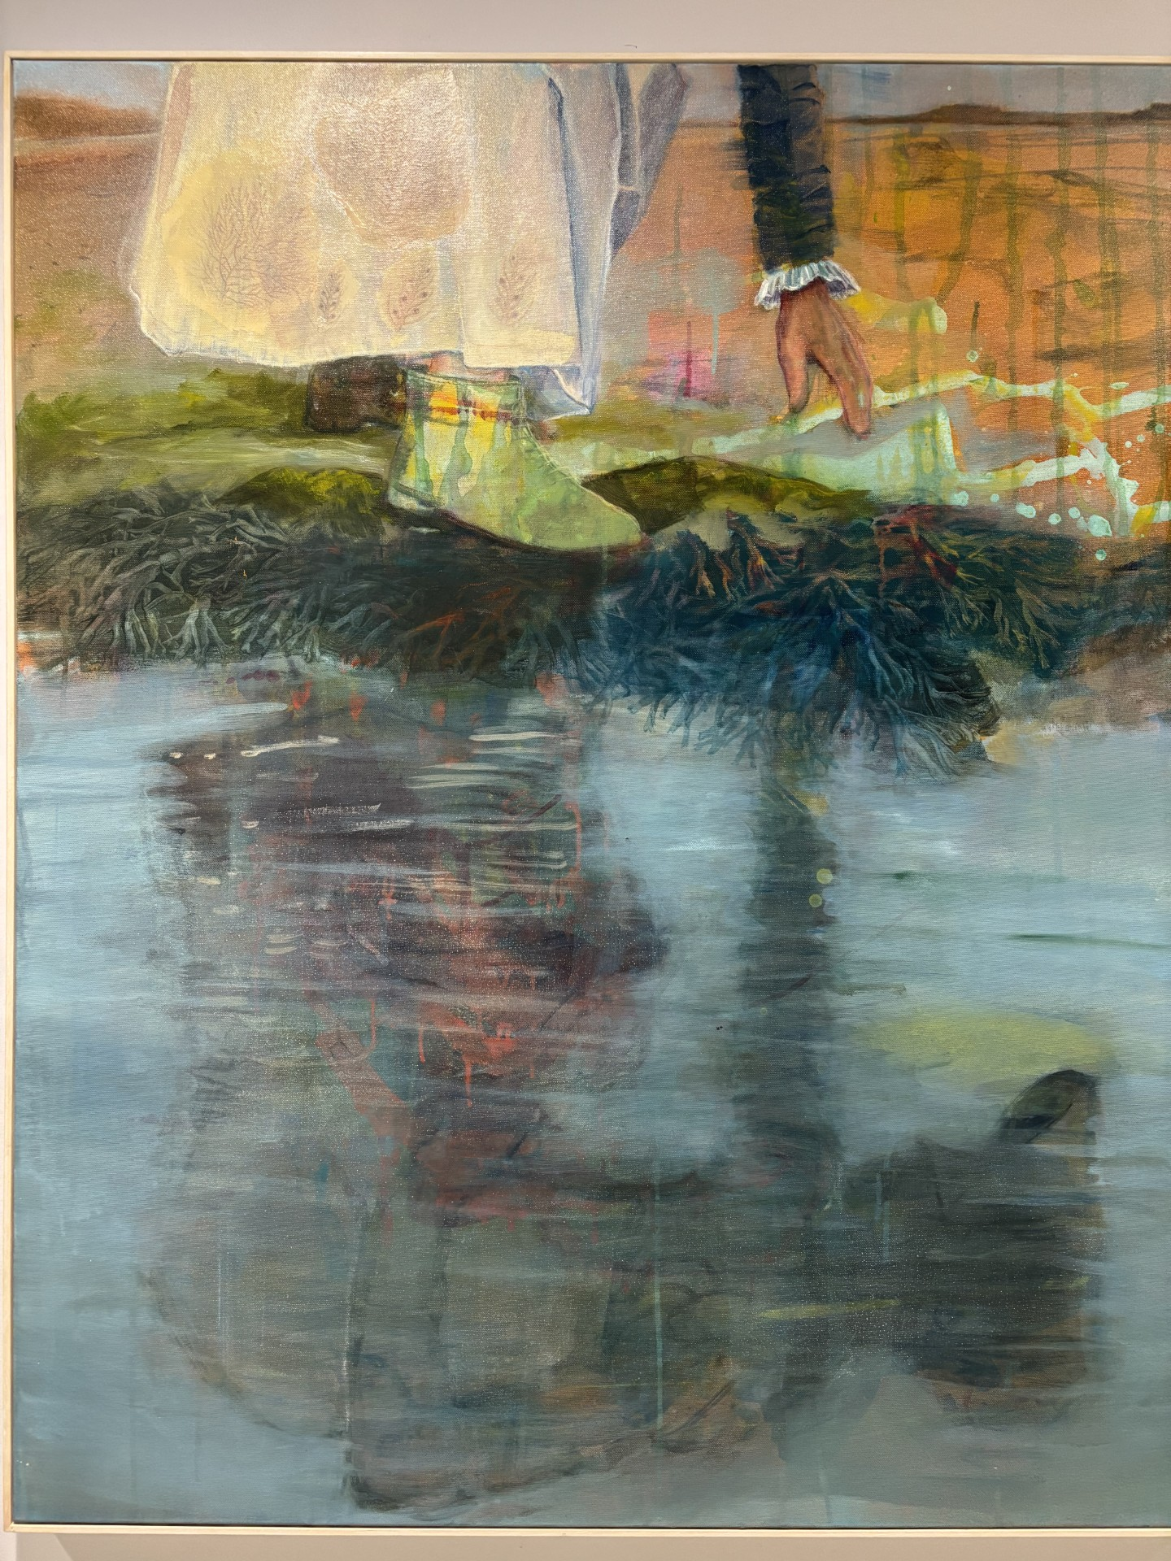

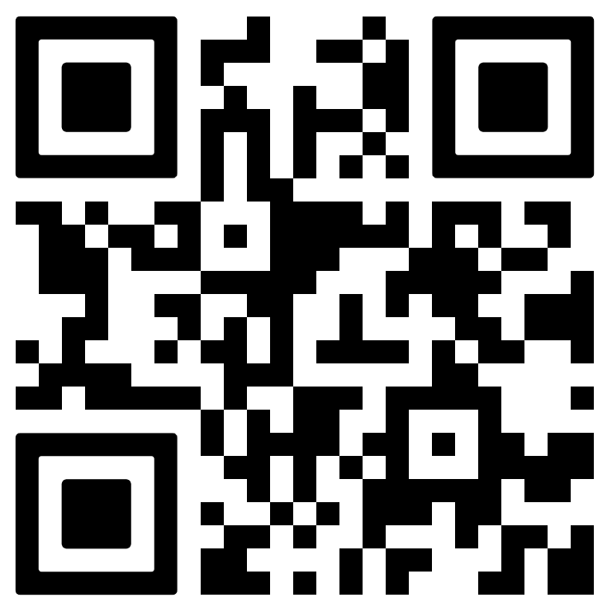

ELLEN HUTCHINS
BUILDING
OPEN MORNING
Saturday 7th February
10.30 – 12.30 PM
Drop in for free and join us as we explore the life and work of Ireland’s first female botanist.
Enjoy science and arts activities for adults and children aged 6 and above—perfect for families, nature lovers, history enthusiasts, or anyone looking for a fun day out!
First floor Sustainability Institute
Ellen Hutchins Building,
Lee Road,
T23 XE10
For more information about the Open Morning, scan this QR code.

