Slide 1
Statistical Spatio-Temporal Modelling with SPDEs
2026 STOCHASTICA Colloquium
Geir-Arne Fuglstad
Department of Mathematical Sciences

Slide 2

DIScover
Started in 2022 as the large interdisciplinary project IMod
The big ambition is uniting deterministic, stochastic and data-driven methods
Involves (S)PDEs, numerical analysis, and statistics
¹https://www.ntnu.edu/imf/discover

Slide 3
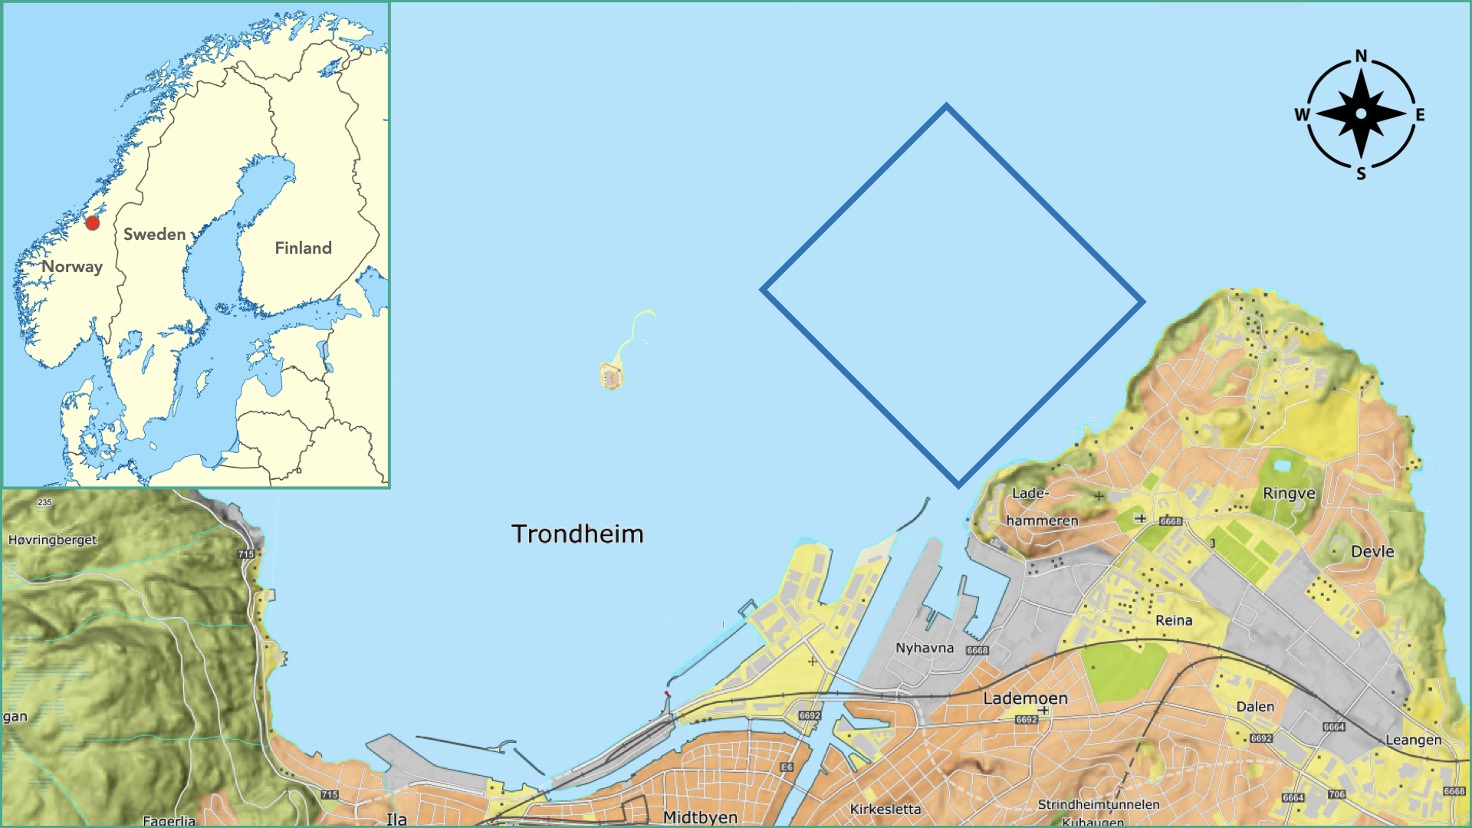
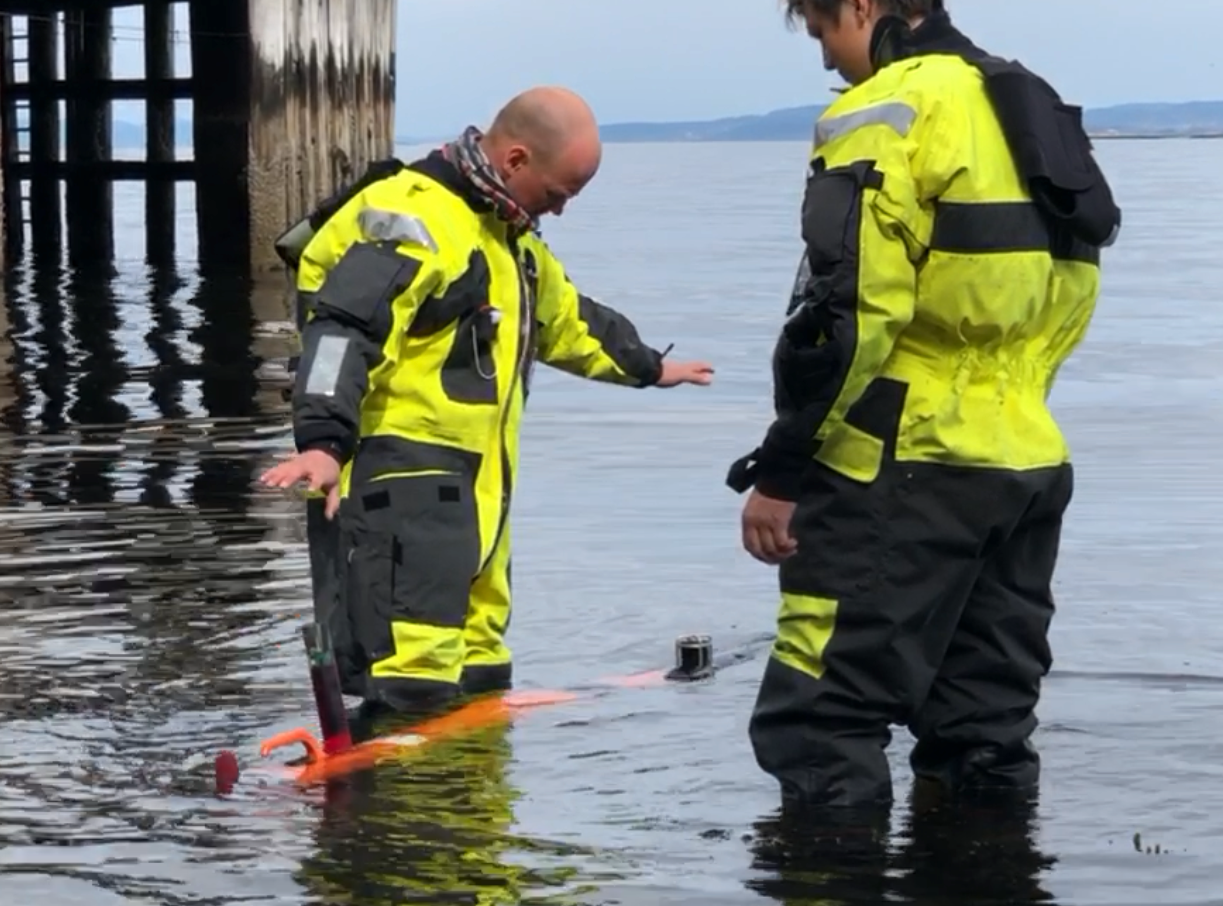
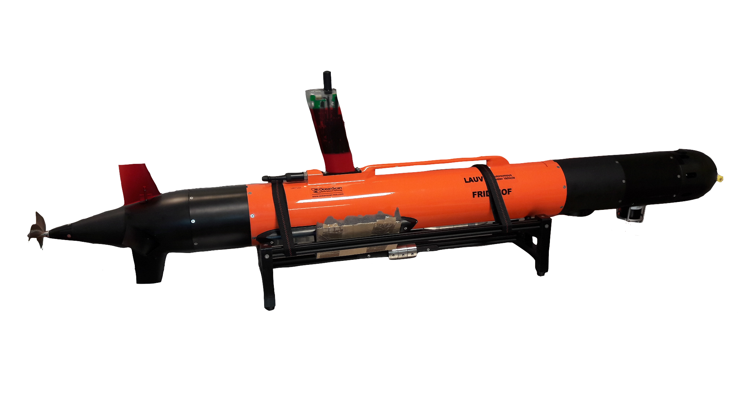
Motivating application
Autonomous sampling of the ocean using autonomous underwater vehicles (AUVs)
Collaboration with Marine Sciences and Oceanography (MASCOT²)
Test application was mapping a freshwater plume in Trondheim
a) Test location
b) AUV
c) AUV in water
²https://wiki.math.ntnu.no/mascot

Slide 4
Scope
I exclude:
Decision problem: where to go next
Path planning: how the AUV will get there
And focus on:
Decision support: Real-time map (of salinity) with uncertainty based on measurements collected by the AUV

Slide 5
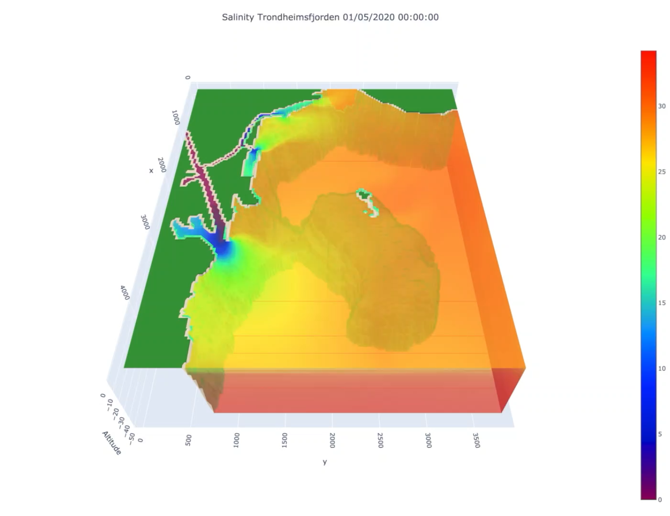
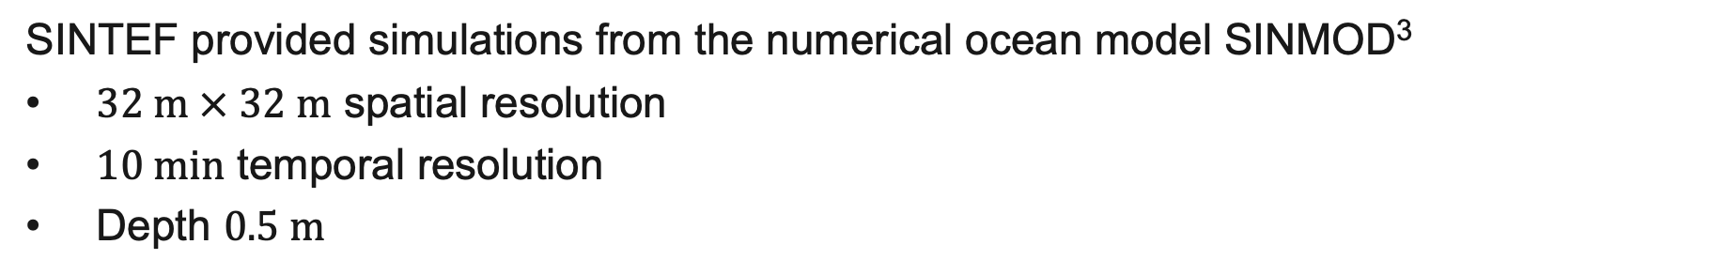
Training data
SINTEF provided simulations from the numerical ocean model SINMOD³
$32 m × 32 m$ spatial resolution
$10 min$ temporal resolution
Depth $0.5 m$
Two steps:
Learn general properties from simulations offline
Predict using learned properties and AUV measurements in real-time
³https://www.sintef.no/en/software/sinmod/
Salinity

Slide 6
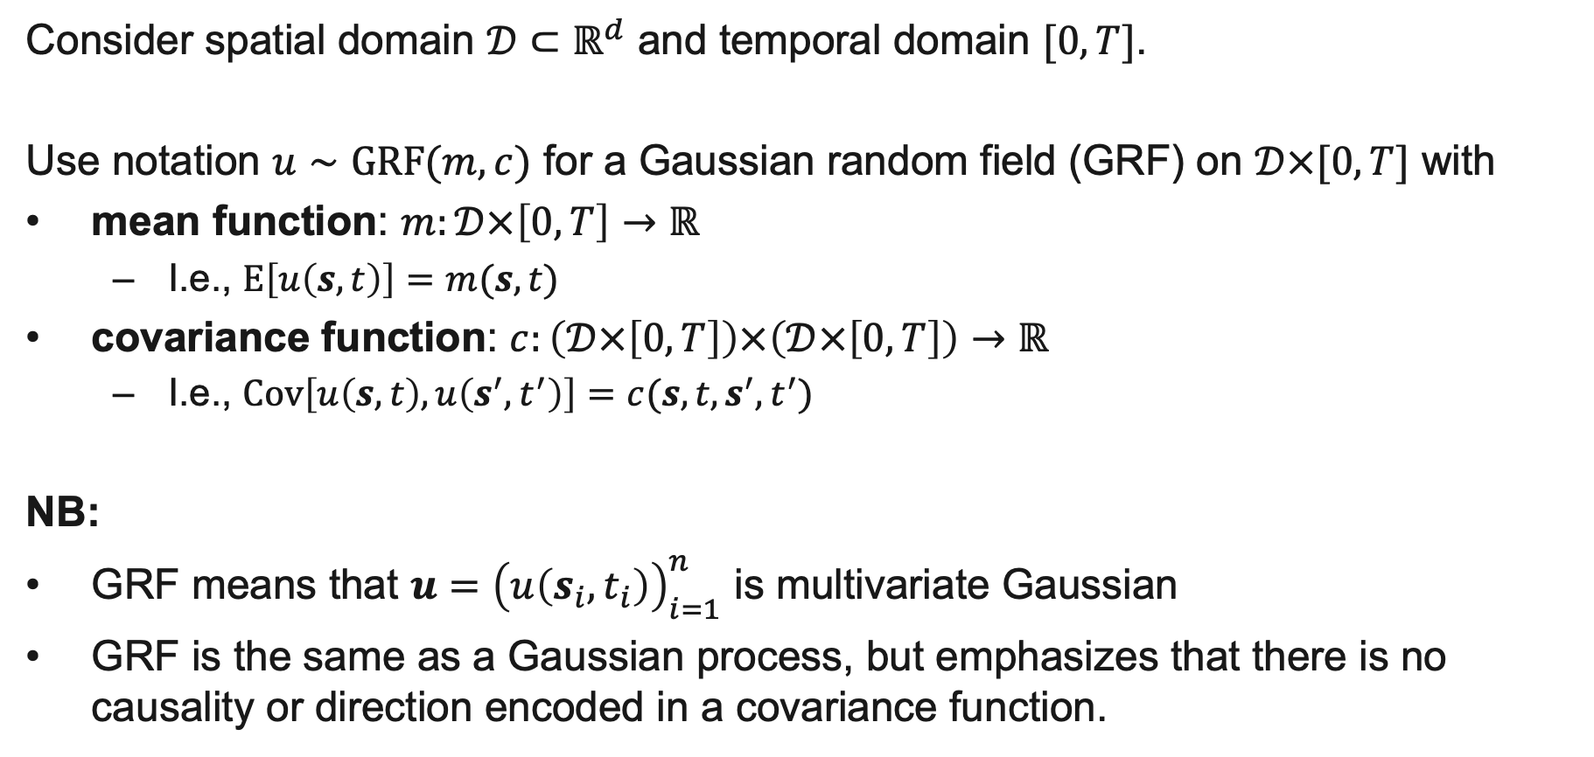
Tool of choice
Consider spatial domain $𝒟⊂ℝ^{d}$ and temporal domain $[0,T]$.
Use notation $u∼GRF(m,c)$ for a Gaussian random field (GRF) on $𝒟×[0,T]$ with
mean function: $m:𝒟×\left[0,T\right]→ℝ$
  I.e., $E\left[u\left(s,t\right)\right]=m(s,t)$
covariance function: $c:\left(𝒟×\left[0,T\right]\right)×\left(𝒟×\left[0,T\right]\right)→ℝ$
  I.e., $Cov\left[u\left(s,t\right),u\left(s^{′},t^{′}\right)\right]=c(s,t,s^{′},t^{′})$
NB:
GRF means that $u={\left(u\left(s_{i},t_{i}\right)\right)}_{i=1}^{n}$ is multivariate Gaussian
GRF is the same as a Gaussian process, but emphasizes that there is no causality or direction encoded in a covariance function.

Slide 7
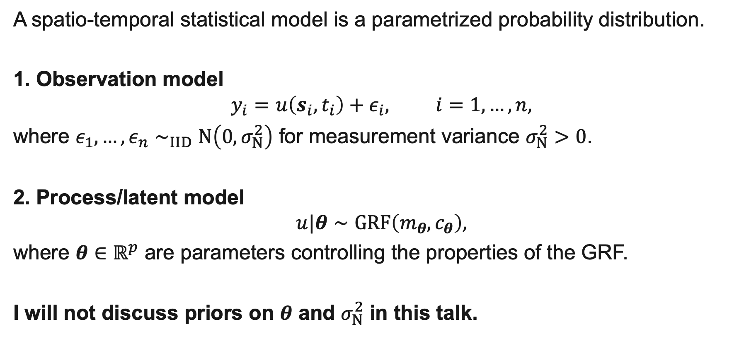
Statistical model
A spatio-temporal statistical model is a parametrized probability distribution.
1. Observation model
$$y_{i}=u\left(s_{i},t_{i}\right)+ε_{i}, i=1,…,n,$$
where $ε_{1},…,ε_{n}∼_{IID}N\left(0,σ_{N}^{2}\right)$ for measurement variance $σ_{N}^{2}>0$.
2. Process/latent model
$$u|θ∼GRF\left(m_{θ},c_{θ}\right),$$
where $θ∈ℝ^{p}$ are parameters controlling the properties of the GRF.
I will not discuss priors on $θ$ and $σ_{N}^{2}$ in this talk.

Slide 8
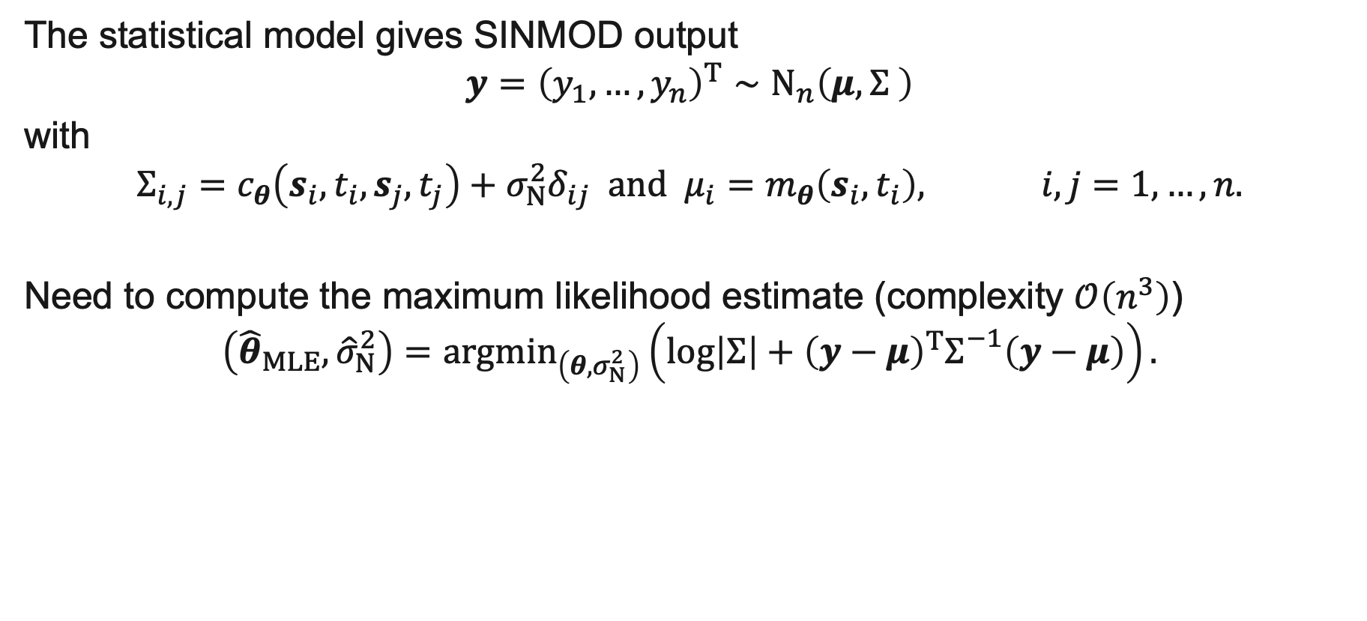
Offline task
The statistical model gives SINMOD output
$$y={\left(y_{1},…,y_{n}\right)}^{T}∼N_{n}\left(μ,Σ \right)$$
with
$$Σ_{i,j}=c_{θ}\left(s_{i},t_{i},s_{j},t_{j}\right)+σ_{N}^{2}δ_{ij} and μ_{i}=m_{θ}\left(s_{i},t_{i}\right), i,j=1,…,n.$$
Need to compute the maximum likelihood estimate (complexity $𝒪\left(n^{3}\right)$)
$$\left({\hat{θ}}_{MLE},{\hat{σ}}_{N}^{2}\right)={argmin}_{\left(θ,σ_{N}^{2}\right)}\left(log\left|Σ\right|+{\left(y−μ\right)}^{T}Σ_{}^{−1}\left(y−μ\right)\right).$$

Slide 9
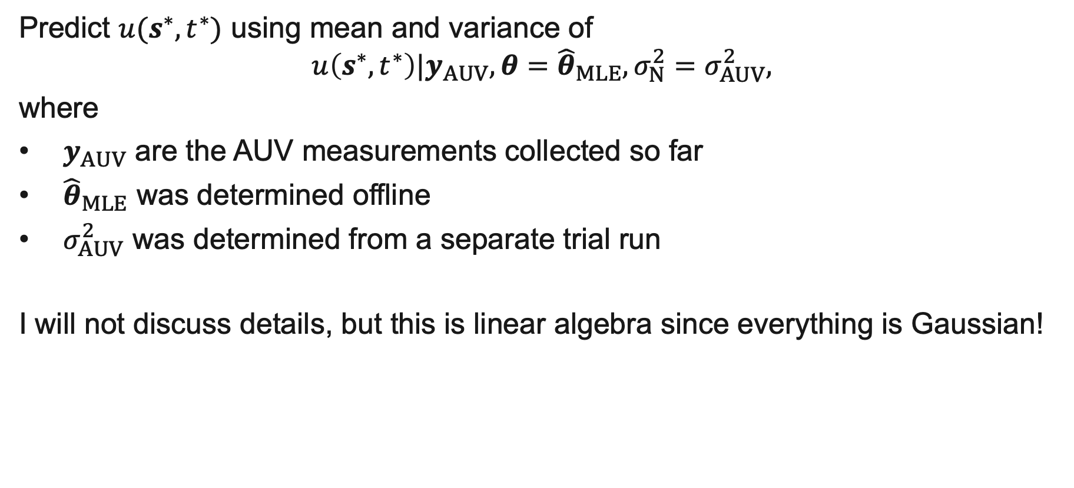
Real-time task
Predict $u(s^{∗},t^{∗})$ using mean and variance of
$$u\left(s^{∗},t^{∗}\right)|y_{AUV},θ={\hat{θ}}_{MLE},σ_{N}^{2}=σ_{AUV}^{2},$$
where
$y_{AUV}$ are the AUV measurements collected so far
${\hat{θ}}_{MLE}$ was determined offline
$σ_{AUV}^{2}$ was determined from a separate trial run
I will not discuss details, but this is linear algebra since everything is Gaussian!

Slide 10
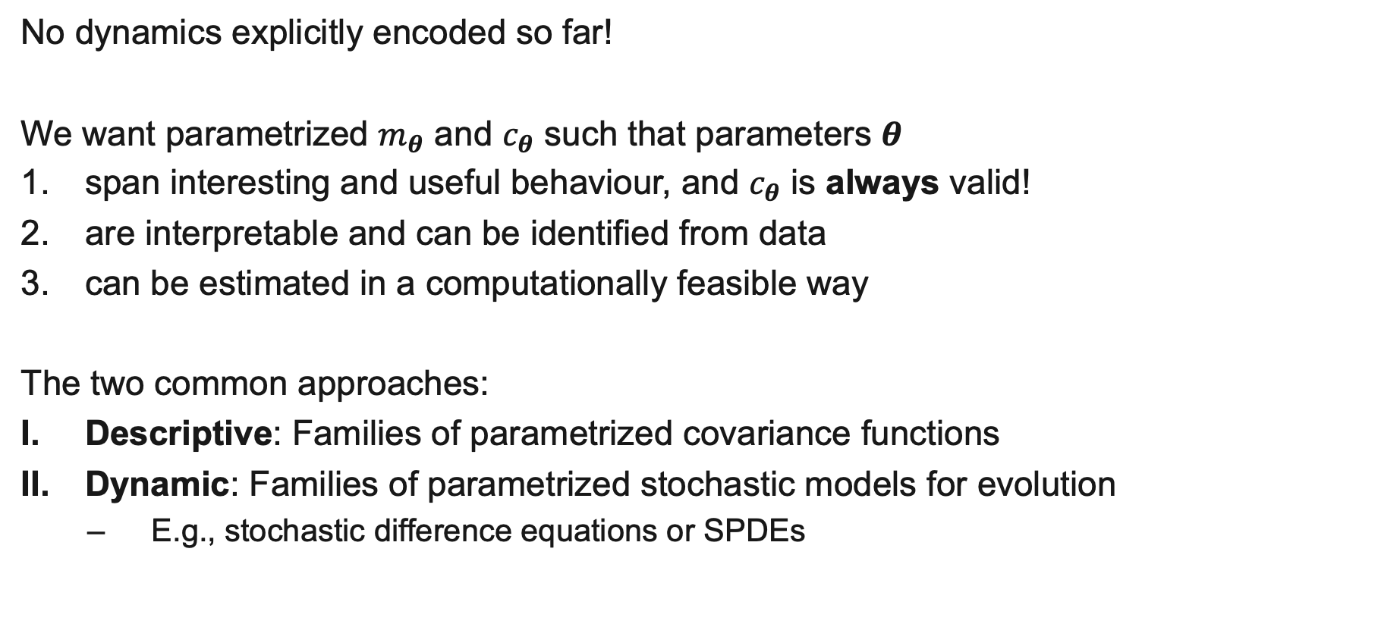
Parametrization
No dynamics explicitly encoded so far!
We want parametrized $m_{θ}$ and $c_{θ}$ such that parameters $θ$
span interesting and useful behaviour, and $c_{θ}$ is always valid!
are interpretable and can be identified from data
can be estimated in a computationally feasible way
The two common approaches:
Descriptive: Families of parametrized covariance functions
Dynamic: Families of parametrized stochastic models for evolution
  E.g., stochastic difference equations or SPDEs

Slide 11
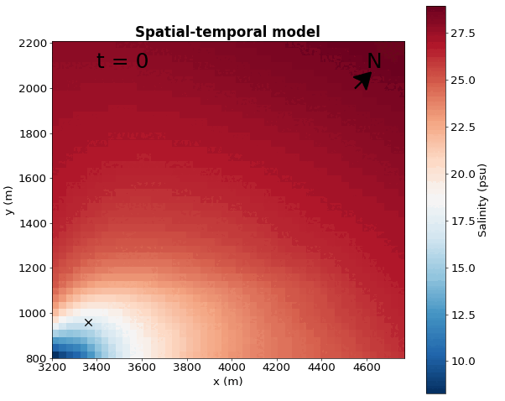
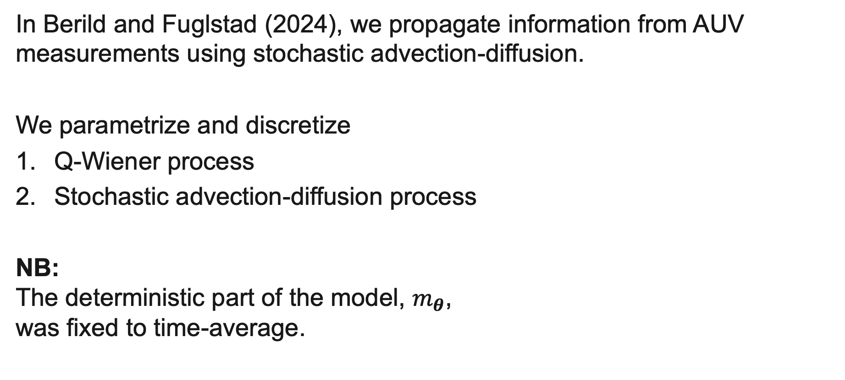
Our approach
In Berild and Fuglstad (2024), we propagate information from AUV measurements using stochastic advection-diffusion.
We parametrize and discretize
Q-Wiener process
Stochastic advection-diffusion process
NB:
The deterministic part of the model, $m_{θ}$,
was fixed to time-average.

Slide 12
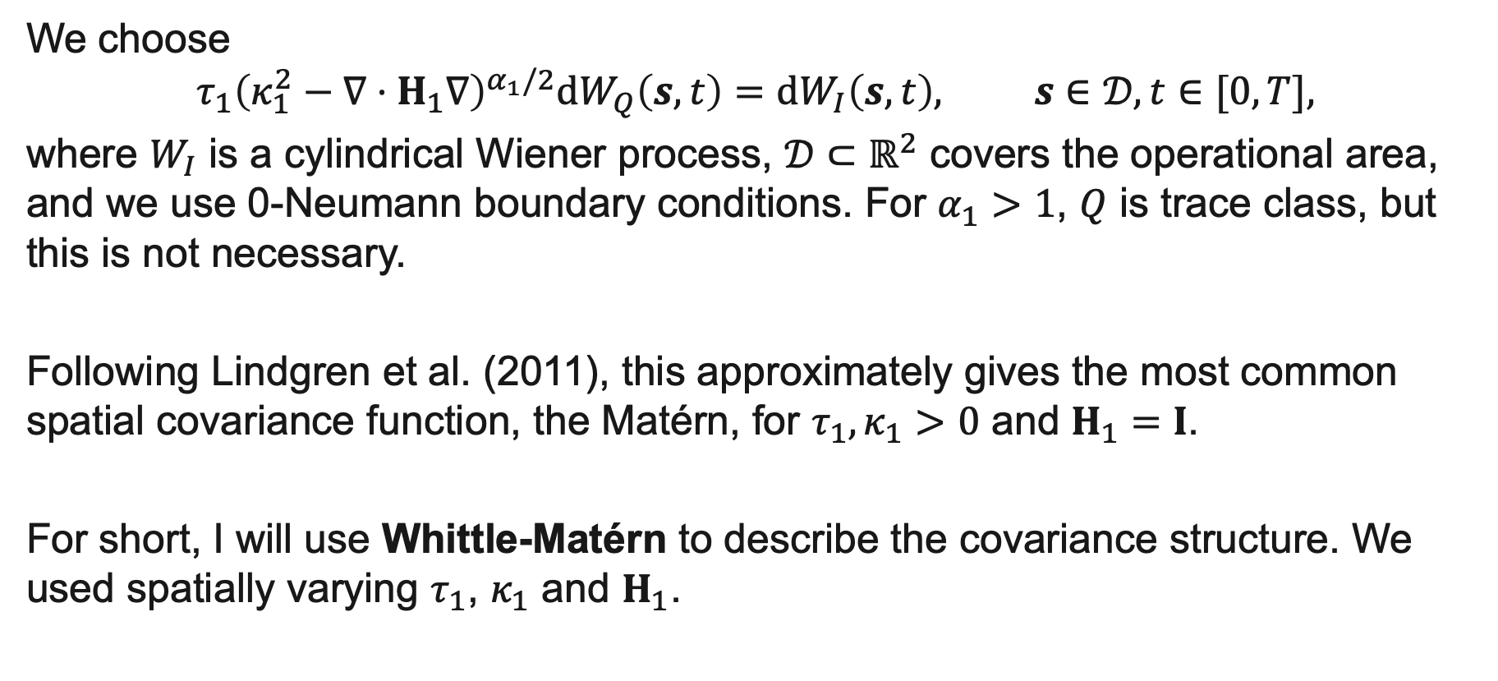
Q-Wiener process
We choose
$$τ_{1}{\left(κ_{1}^{2}−∇⋅H_{1}∇\right)}^{α_{1}/2}{dW}_{Q}\left(s,t\right)=dW_{I}\left(s,t\right), s∈𝒟,t∈[0,T],$$
where $W_{I}$ is a cylindrical Wiener process, $𝒟⊂ℝ^{2}$ covers the operational area, and we use 0-Neumann boundary conditions. For $α_{1}>1$, $Q$ is trace class, but this is not necessary.
Following Lindgren et al. (2011), this approximately gives the most common spatial covariance function, the Matérn, for $τ_{1},κ_{1}>0$ and $H_{1}=I$.
For short, I will use Whittle-Matérn to describe the covariance structure. We used spatially varying $τ_{1}$, $κ_{1}$ and $H_{1}$.

Slide 13
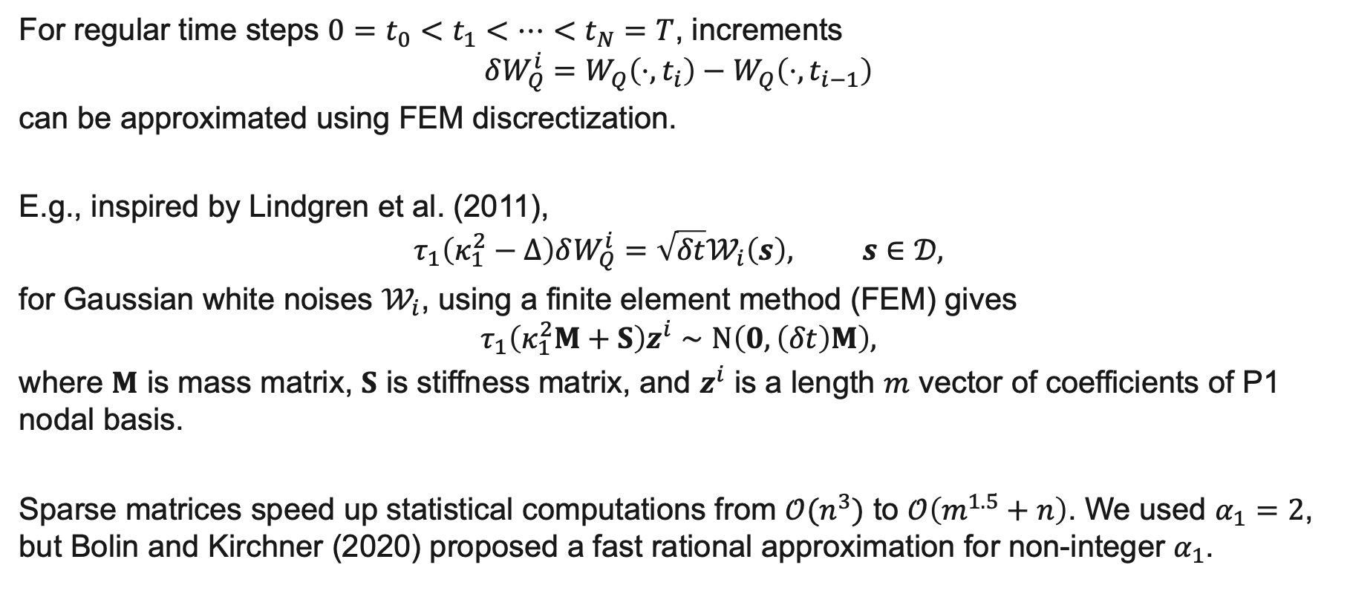
Discretization
For regular time steps $0=t_{0}<t_{1}<⋯<t_{N}=T$, increments
$$δW_{Q}^{i}=W_{Q}\left(⋅,t_{i}\right)−W_{Q}\left(⋅,t_{i−1}\right)$$
can be approximated using FEM discrectization.
E.g., inspired by Lindgren et al. (2011),
$$τ_{1}\left(κ_{1}^{2}−Δ\right)δW_{Q}^{i}=\sqrt{δt}𝒲_{i}\left(s\right), s∈𝒟,$$
for Gaussian white noises $𝒲_{i}$, using a finite element method (FEM) gives
$$τ_{1}\left(κ_{1}^{2}M+S\right)z^{i}∼N\left(0,\left(δt\right)M\right),$$
where $M$ is mass matrix, $S$ is stiffness matrix, and $z^{i}$ is a length $m$ vector of coefficients of P1 nodal basis.
Sparse matrices speed up statistical computations from $𝒪(n^{3})$ to $𝒪\left(m^{1.5}+n\right)$. We used $α_{1}=2$, but Bolin and Kirchner (2020) proposed a fast rational approximation for non-integer $α_{1}$.

Slide 14
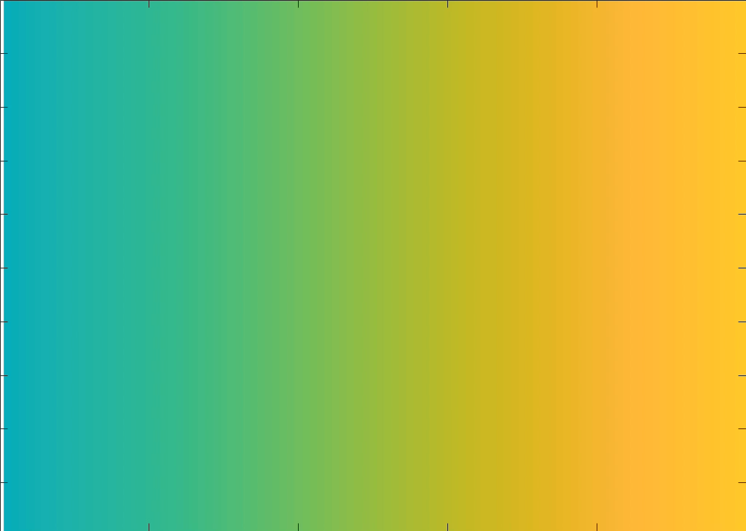
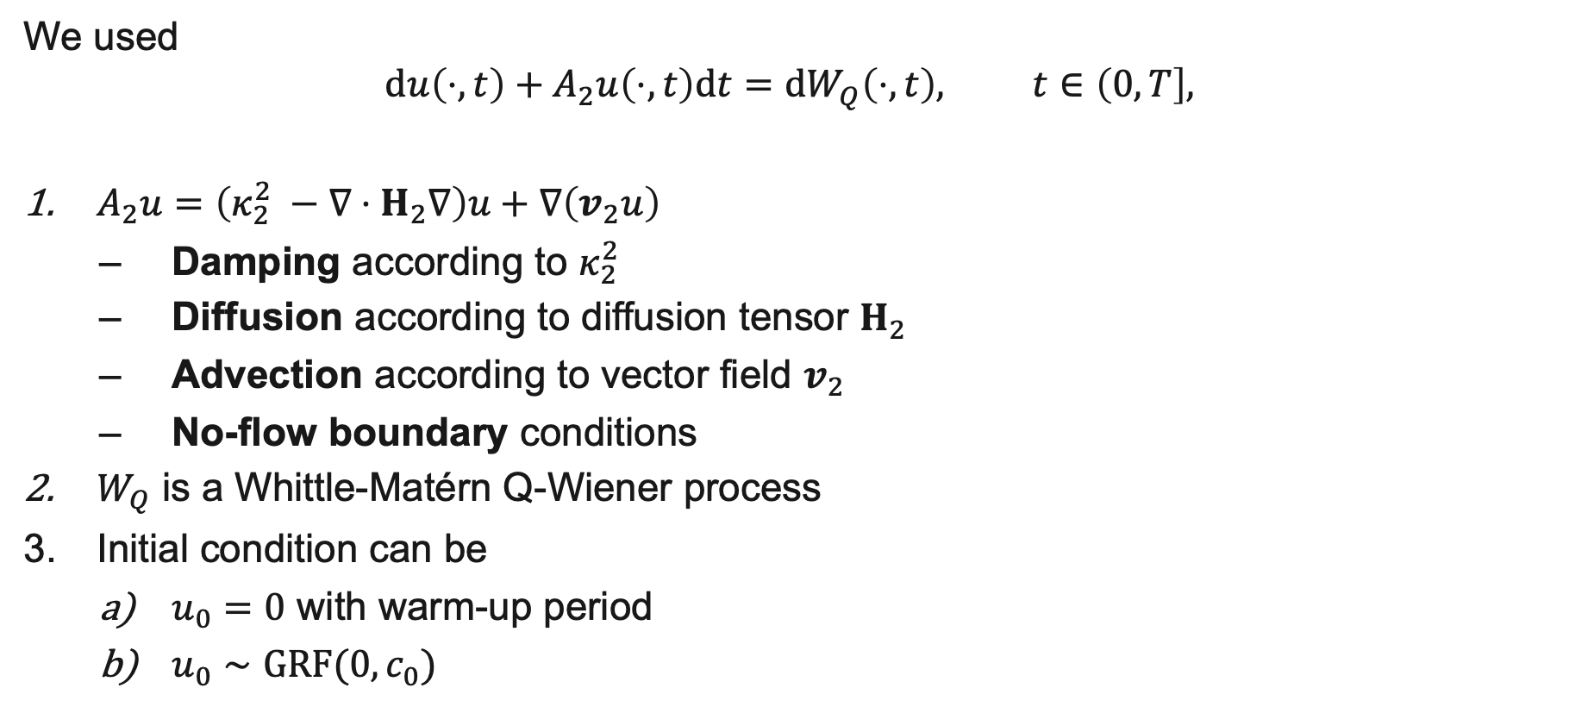
Advection-Diffusion
We used
$$du\left(⋅,t\right)+A_{2}u\left(⋅,t\right)dt={dW}_{Q}\left(⋅,t\right), t∈\left(0,T\right],$$
$A_{2}u=\left(κ_{2}^{2} −∇⋅H_{2}∇\right)u+∇\left(v_{2}u\right)$
  Damping according to $κ_{2}^{2}$
  Diffusion according to diffusion tensor $H_{2}$
  Advection according to vector field $v_{2}$
  No-flow boundary conditions
$W_{Q}$ is a Whittle-Matérn Q-Wiener process
Initial condition can be
  $u_{0}=0$ with warm-up period
  $u_{0}∼GRF(0,c_{0})$

Slide 15
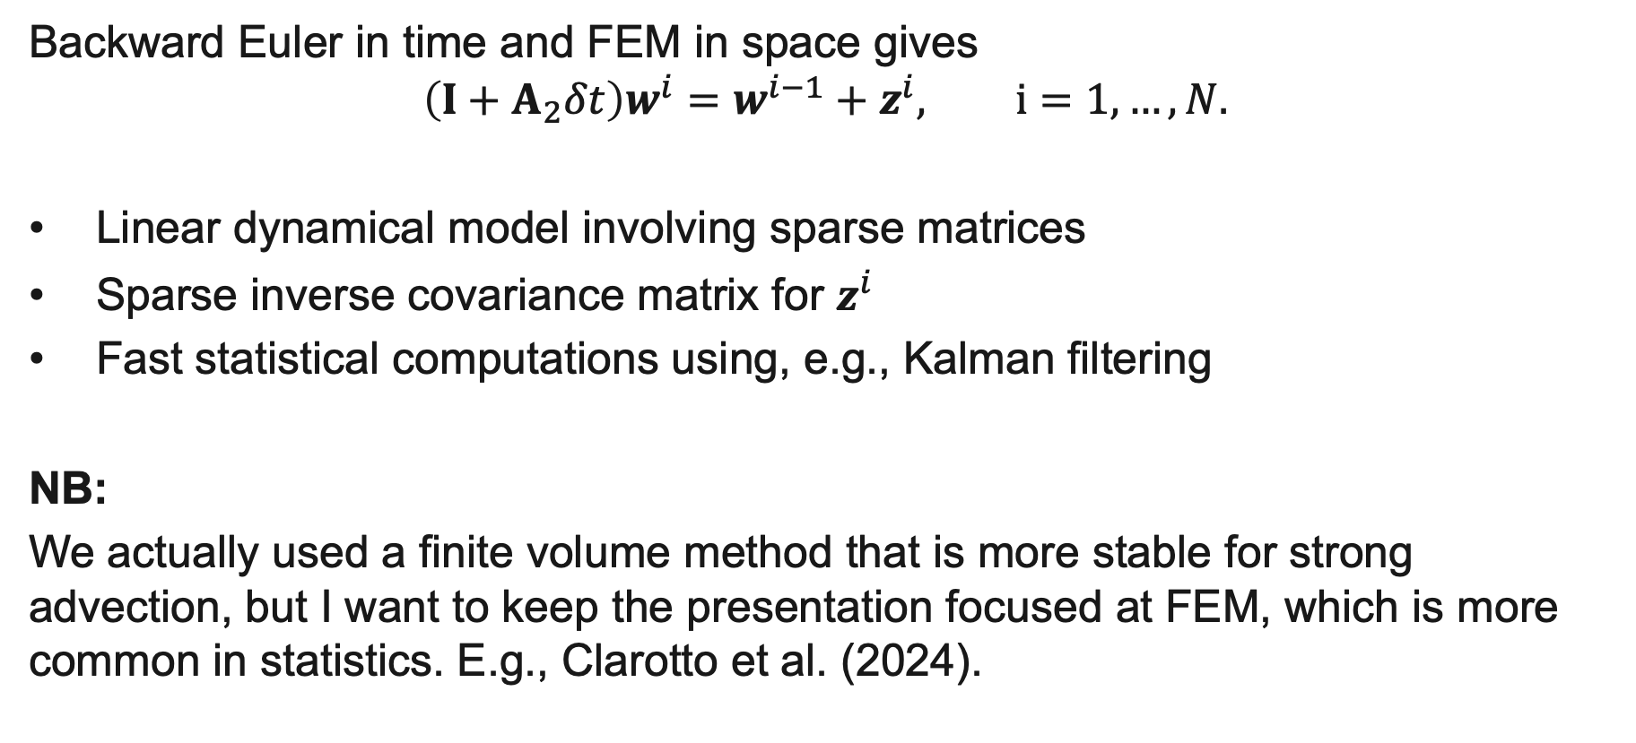
Discretization
Backward Euler in time and FEM in space gives
$$\left(I+A_{2}δt\right)w^{i}=w^{i−1}+z^{i}, i=1, …,N.$$
Linear dynamical model involving sparse matrices
Sparse inverse covariance matrix for $z^{i}$
Fast statistical computations using, e.g., Kalman filtering
NB:
We actually used a finite volume method that is more stable for strong advection, but I want to keep the presentation focused at FEM, which is more common in statistics. E.g., Clarotto et al. (2024).

Slide 16
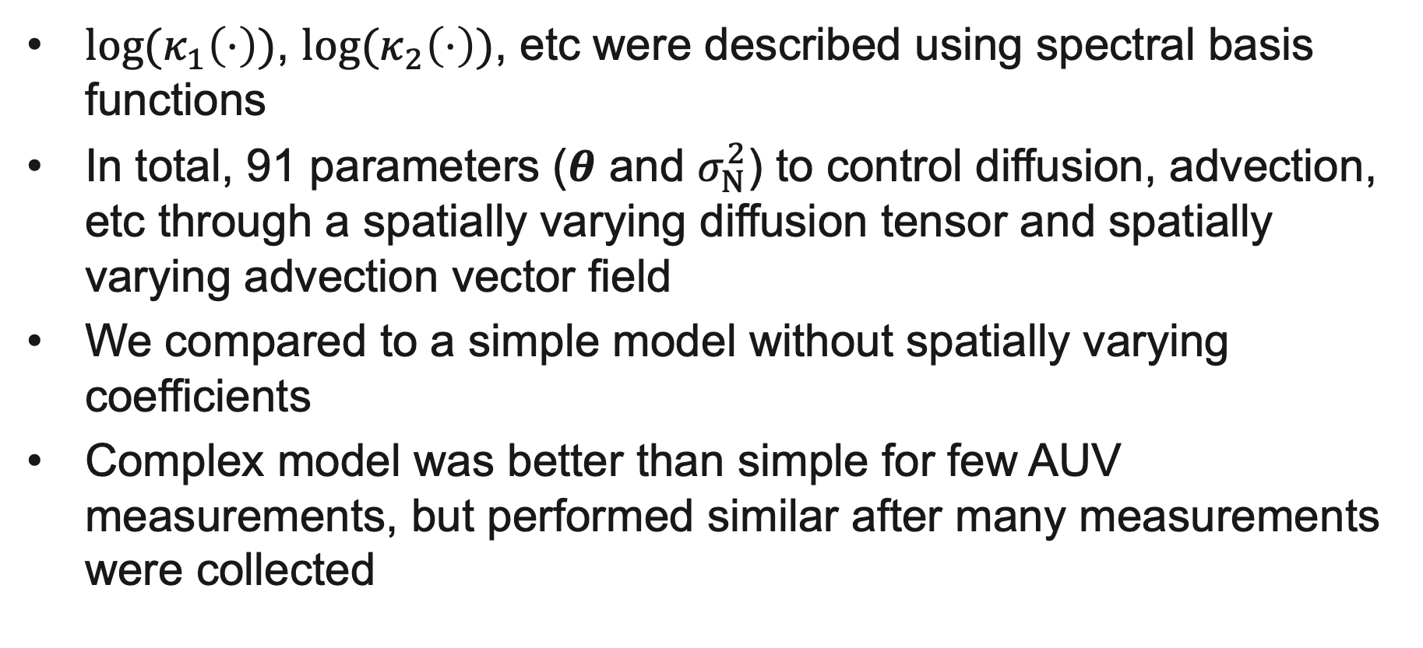
Short summary of results
$log⁡(κ_{1}\left(⋅\right))$, $log⁡(κ_{2}\left(⋅\right))$, etc were described using spectral basis functions
In total, 91 parameters ($θ$ and $σ_{N}^{2}$) to control diffusion, advection, etc through a spatially varying diffusion tensor and spatially varying advection vector field
We compared to a simple model without spatially varying coefficients
Complex model was better than simple for few AUV measurements, but performed similar after many measurements were collected

Slide 17
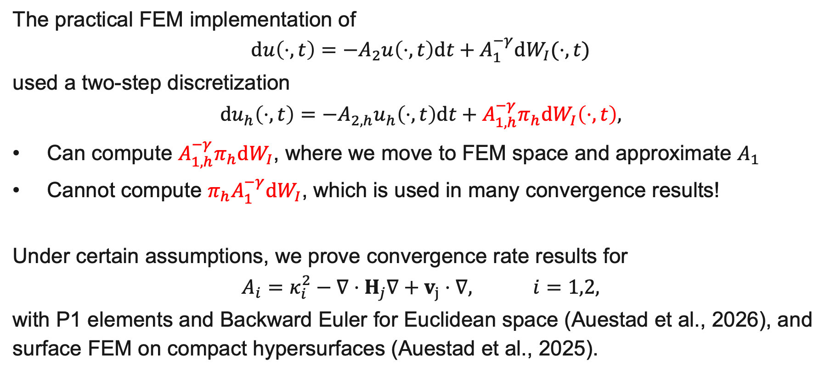
Numerical analysis
The practical FEM implementation of
$$du\left(⋅,t\right)=−A_{2}u\left(⋅,t\right)dt+A_{1}^{−γ}dW_{I}(⋅,t)$$
used a two-step discretization
$$du_{h}\left(⋅,t\right)=−A_{2,h}u_{h}\left(⋅,t\right)dt+A_{1,h}^{−γ}π_{h}dW_{I}\left(⋅,t\right),$$
Can compute $A_{1,h}^{−γ}π_{h}dW_{I}$, where we move to FEM space and approximate $A_{1}$
Cannot compute $π_{h}A_{1}^{−γ}dW_{I}$, which is used in many convergence results!
Under certain assumptions, we prove convergence rate results for
$$A_{i}=κ_{i}^{2}−∇⋅H_{j}∇+v_{j}⋅∇, i=1,2,$$
with P1 elements and Backward Euler for Euclidean space (Auestad et al., 2026), and surface FEM on compact hypersurfaces (Auestad et al., 2025).

Slide 18
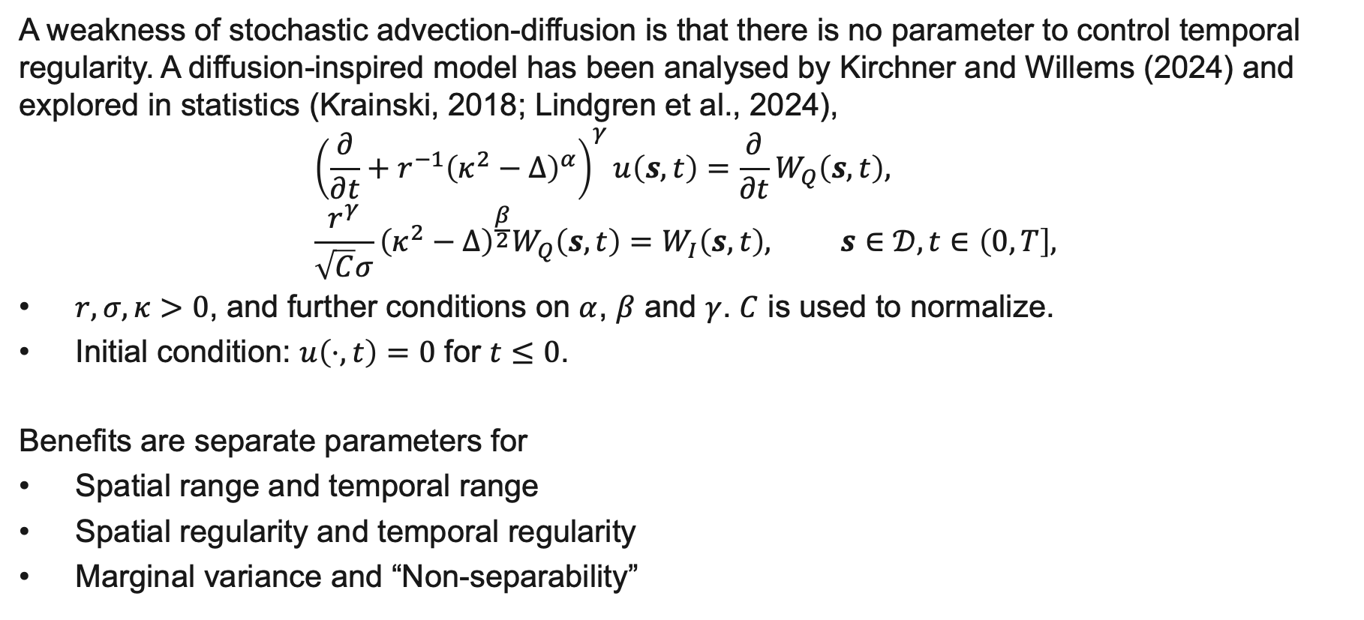
Space-time fractional
A weakness of stochastic advection-diffusion is that there is no parameter to control temporal regularity. A diffusion-inspired model has been analysed by Kirchner and Willems (2024) and explored in statistics (Krainski, 2018; Lindgren et al., 2024),
$${\left(\frac{∂}{∂t}+r^{−1}{\left(κ^{2}−Δ\right)}^{α}\right)}^{γ}u\left(s,t\right)=\frac{∂}{∂t}W_{Q}\left(s,t\right), \\ \frac{r^{γ}}{\sqrt{C}σ}{\left(κ^{2}−Δ\right)}^{\frac{β}{2}}W_{Q}\left(s,t\right)=W_{I}\left(s,t\right), s∈𝒟, t∈\left(0,T\right],$$
$r,σ,κ>0$, and further conditions on $α$, $β$ and $γ$. $C$ is used to normalize.
Initial condition: $u\left(⋅,t\right)=0$ for $t≤0$.
Benefits are separate parameters for
Spatial range and temporal range
Spatial regularity and temporal regularity
Marginal variance and “Non-separability”

Slide 19
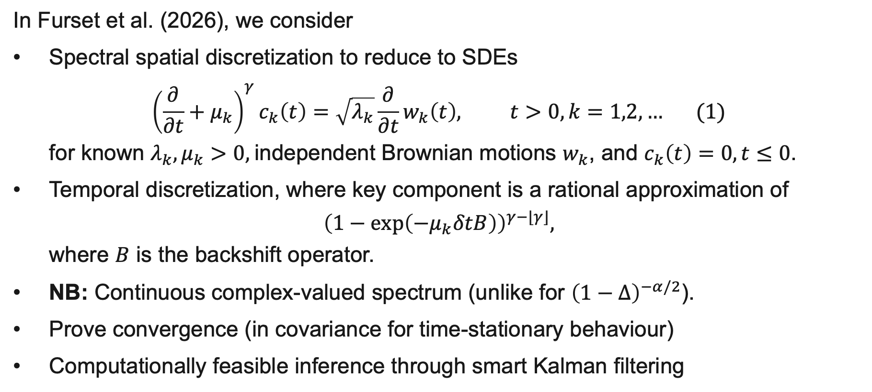
Synergy
In Furset et al. (2026), we consider
Spectral spatial discretization to reduce to SDEs
${\left(\frac{∂}{∂t}+μ_{k}\right)}^{γ}c_{k}\left(t\right)=\sqrt{λ_{k}}\frac{∂}{∂t}w_{k}\left(t\right), t>0,k=1,2,… (1)$
for known $λ_{k},μ_{k}>0,$independent Brownian motions $w_{k}$, and $c_{k}\left(t\right)=0, t≤0$.
Temporal discretization, where key component is a rational approximation of
${\left(1−\exp\left(−μ_{k}δtB\right)\right)}^{γ−⌊γ⌋},$
where $B$ is the backshift operator.
NB: Continuous complex-valued spectrum (unlike for ${\left(1−Δ\right)}^{−α/2}$).
Prove convergence (in covariance for time-stationary behaviour)
Computationally feasible inference through smart Kalman filtering

Slide 20
Summary and discussion
Typically, data is sparse in space and time
We need to be able to estimate parameters and to predict
Predictions including uncertainty is essensial
Collaboration between mathematics and statistics has lead to new approaches and results for fractional SPDEs in space and space-time
Much development of spatio-temporal statistical models is being held back by computational feasibility.

Slide 21
References
Auestad, Ø.S., Fuglstad, G.-A., and Lang, A. (2025). Surface finite element approximation of parabolic SPDEs with Whittle--Matérn noise. arXiv:2510.08443.
Auestad, Ø.S., Fuglstad, G.-A., Jakobsen, E.R., and Lang, A. (2026). Finite element approximation of parabolic SPDEs with Whittle–Matérn noise, ESAIM: M2AN, 60(4):1805—1827.
Berild, M.O., and Fuglstad, G.-A. (2024). Non-stationary spatio-temporal modeling using the stochastic advection–diffusion equation, Spatial Statistics, 64:100867.
Bolin, D., and Kirchner, K. (2020). The Rational SPDE Approach for Gaussian Random Fields With General Smoothness, Journal of Computational and Graphical Statistics, 29(2):274—285
Clarotto, L., Allard, D., Romary, T., and Desassis, N. (2024). The SPDE approach for spatio-temporal datasets with advection and diffusion, Spatial Statistics, 62:100847.
Furset, S.K., Fuglstad, G.-A., and Jakobsen, E.R. (2026). ARMA approximation of a Non-separable Spatio-Temporal Model with Fractional Smoothnesses in Space and Time. arXiv:2604.26535.
Kirchner, K., and Willems, J. (2024). Regularity theory for a new class of fractional parabolic stochastic evolution equations, Stochastics and Partial Differential Equations: Analysis and Computations, 12:1805—1854.
Krainski, E. (2018). Statistical Analysis of Space-time Data: New Models and Applications. PhD thesis 2018:093, NTNU.
Lindgren, F., Rue, H., Lindström, J. (2011). An explicit link between Gaussian fields and Gaussian Markov random fields: the stochastic partial differential equation approach, JRSS: Series B, 73(4):423—498.
Lindgren, F., Bakka, H., Bolin, D., Krainski, E., and Rue, H. (2024). A diffusion-based spatio-temporal extension of Gaussian Matérn fields, SORT, 48(1):3—66.

