Slide 1
Empowering Video Players in Cellular:
Throughput Prediction from Radio Network Measurements
MMSYS’19
Darijo Raca*, Ahmed H. Zahran, Cormac J. Sreenan
University College Cork, Ireland
Rakesh K. Sinha, Emir Halepovic, Rittwik Jana, Vijay Gopalakrishnan, Balagangadhar Bathula, Matteo Varvello^{Ϯ}
AT&T Labs – Research ^{Ϯ}Brave Software
This publication has emanated from research conducted with the financial support of Science Foundation Ireland (SFI) under Grant Number 13/IA/1892.
All presented information does neither reflect nor imply an actual business case for AT&T and associated companies.
They are generalized data used to assess performance of the algorithms only.

Slide 2


Mobile Environment
Highly challenging environment: frequent throughput variations
Negative impact on user Quality of Experience (QoE)
Low Quality¹
Re-Buffering¹
    1. Big Buck Bunny (https://peach.blender.org/)

Slide 3
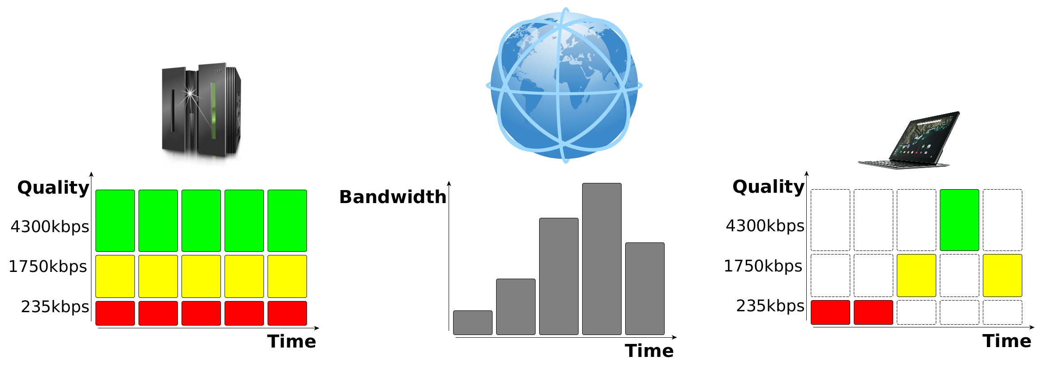
Background: Adaptive Streaming
ADAPT TO NETWORK CONDITIONS
GOAL: MAXIMIZE USER QoE

Slide 4

Motivation 1/2
Most of the algorithms rely on bandwidth estimate (arithmetic, harmonic or EWMA)
Idea: Improve accuracy of Estimator
  Leverage additional information about channel (SNR, CQI…)
Request
HAS Video Player
Download

Slide 5
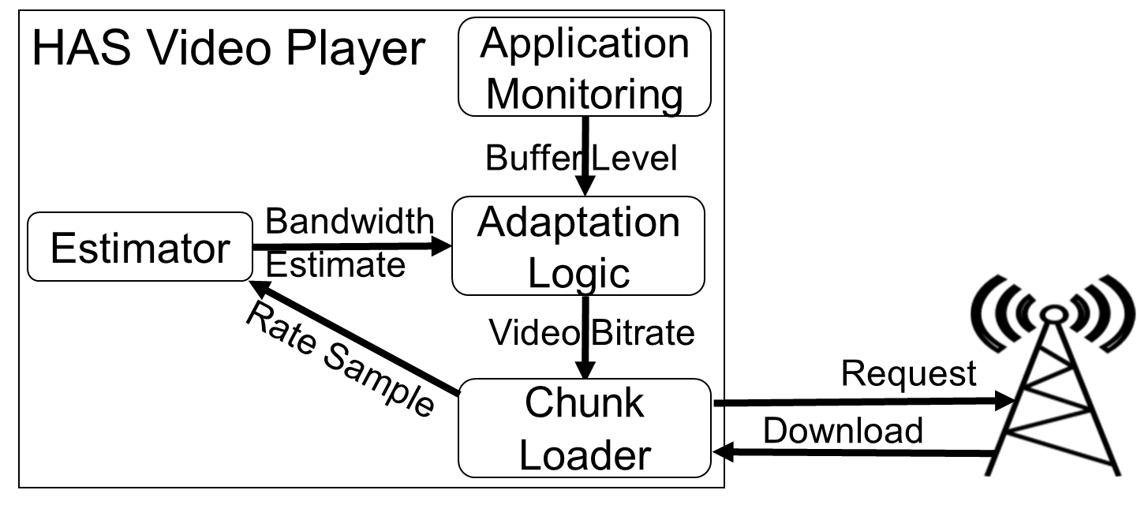
Motivation 1/2
Most of the algorithms rely on bandwidth estimate (arithmetic, harmonic or EWMA)
Idea: Improve accuracy of Estimator
  Leverage additional information about channel (SNR, CQI…)

Slide 6
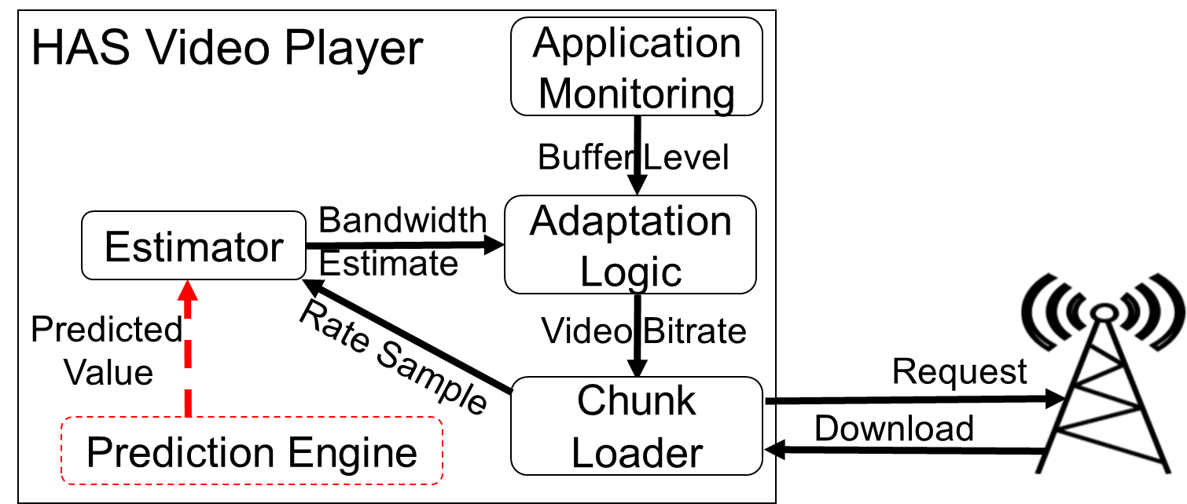
Motivation 1/2
Most of the algorithms rely on bandwidth estimate (arithmetic, harmonic or EWMA)
Idea: Improve accuracy of Estimator
  Leverage additional information about channel (SNR, CQI…)

Slide 7
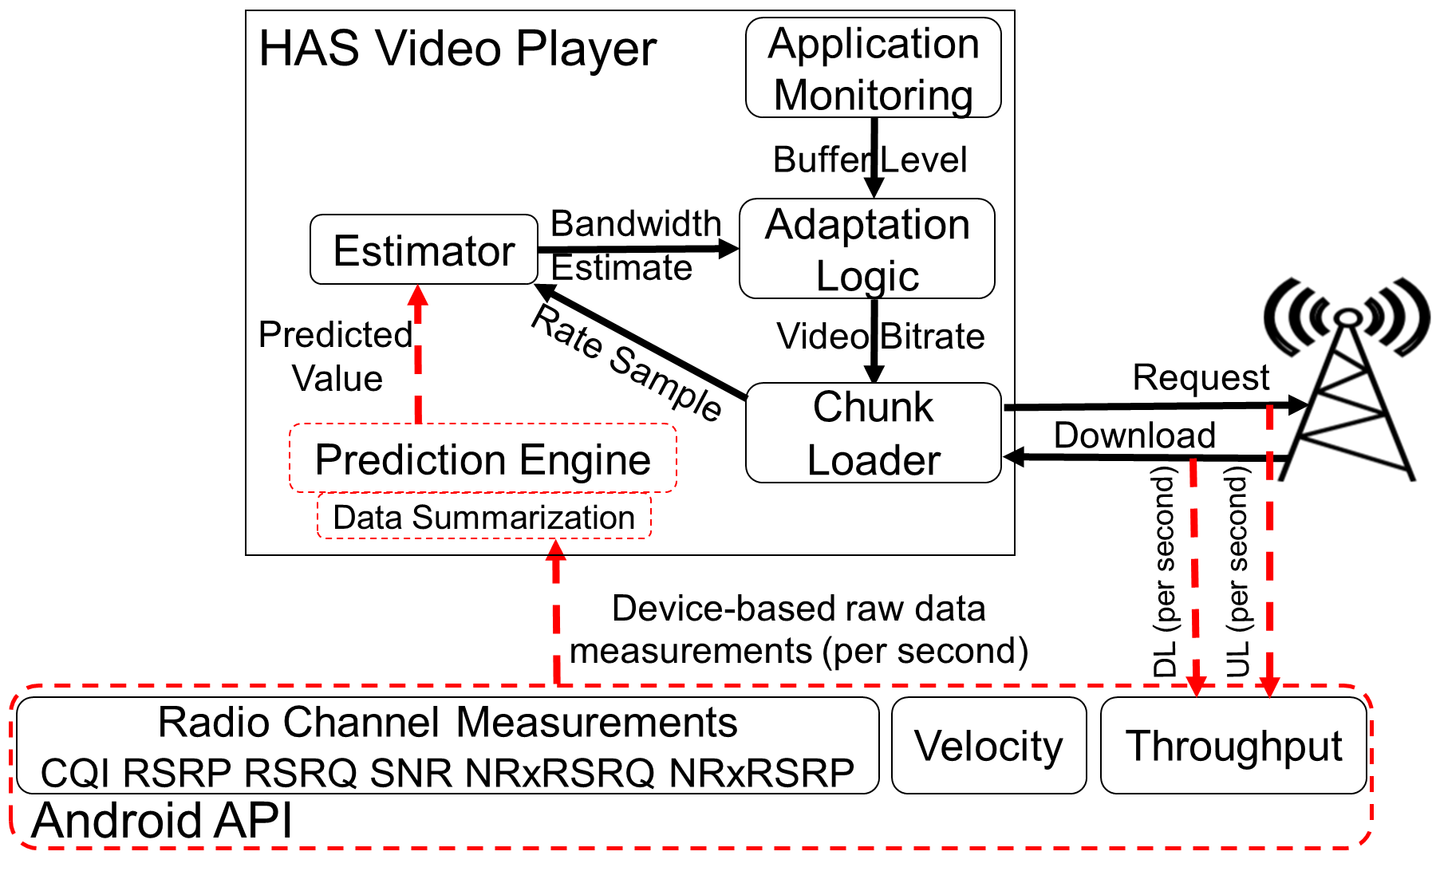
Motivation 1/2
Most of the algorithms rely on bandwidth estimate (arithmetic, harmonic or EWMA)
Idea: Improve accuracy of Estimator
  Leverage additional information about channel (SNR, CQI…)

Slide 8
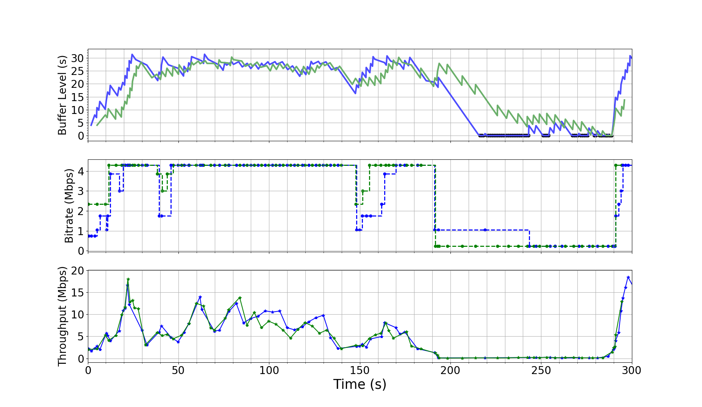
Motivation 2/2
Idea: improve accuracy of Estimator
  Leverage additional information about channel characteristics (SNR, CQI…)
  Use machine learning approach to predict future throughput values
Video Stall
Green Player starts at a higher quality (with prediction)
Blue Player starts with lower bitrate (relies on classical bw estimation)
Green Player recognizes the level of drop in bandwidth more accurately
  switches to the lowest quality quickly.
Buffer underrun is cut by 90% compared to blue player

Slide 9
Related Work
Throughput prediction
  Non-machine learning approaches
    Improving TCP performances in cellular networks
    Active and passive measurements for throughput prediction (sending short packets and using CQI values respectively)
  Machine learning approaches
    Improving TCP performance over short horizons
Application specific
  Non-machine learning approaches
    Design of prediction-aware HAS algorithms
    Combination of physical-and application-level information for HAS algorithm design
  Machine learning approaches
    Use of reinforcement learning approach for HAS algorithm

Slide 10
Throughput Prediction via ML 1/2
What streaming algorithm needs?
  Predicted average throughput for the decision for next streaming quality (in addition to buffer application state…)
Methodology
  Use historical data (past throughput, channel information) as input to Machine Learning algorithm
  Algorithm outputs predicted throughput
  ML algorithm: Random Forest
How to represent history of each metric?
  Quantile approach: estimate distribution of historical data by percentiles
  Raw approach: use samples directly as input

Slide 11
Throughput Prediction via ML 2/2
Notation:
  Fx – average throughput over x seconds in future (horizon)
  Px – past y seconds of historical data (history)
Accuracy metrics:
  Ratio of the difference between actual and predicted throughput and actual throughput (percent error)
Data
  We use publicly available 4G dataset (over 150 traces)
  Dataset provides channel information collected through OS API: CQI, RSRP, RSRQ, SNR, RSRP and RSRQ from neighbouring base stations
  Five mobility patterns: static, pedestrian, bus, car and highway

Slide 12
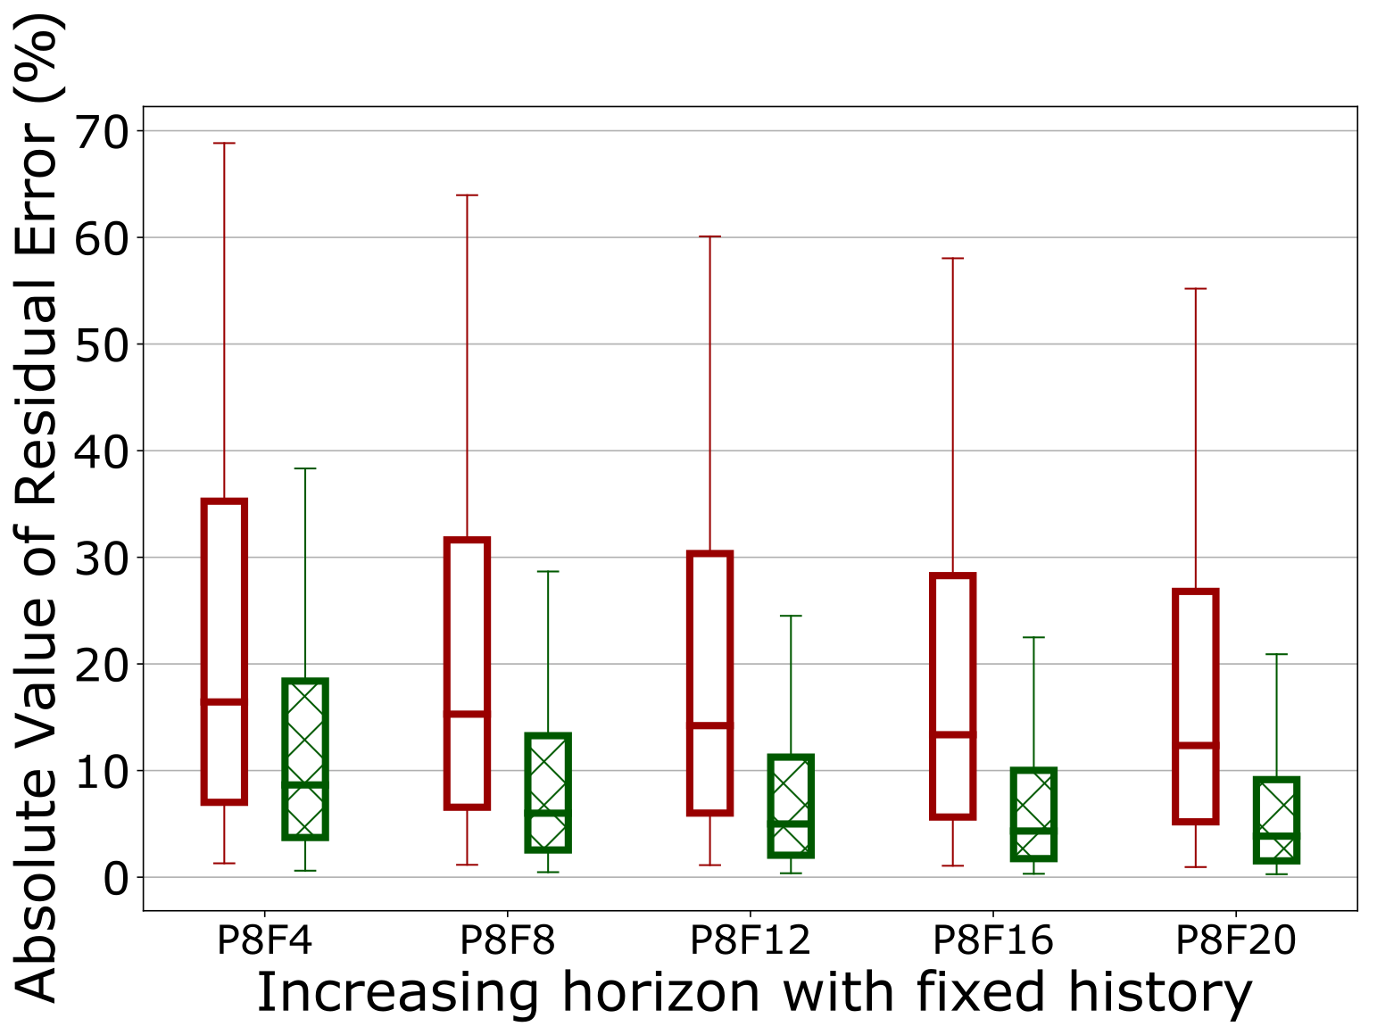
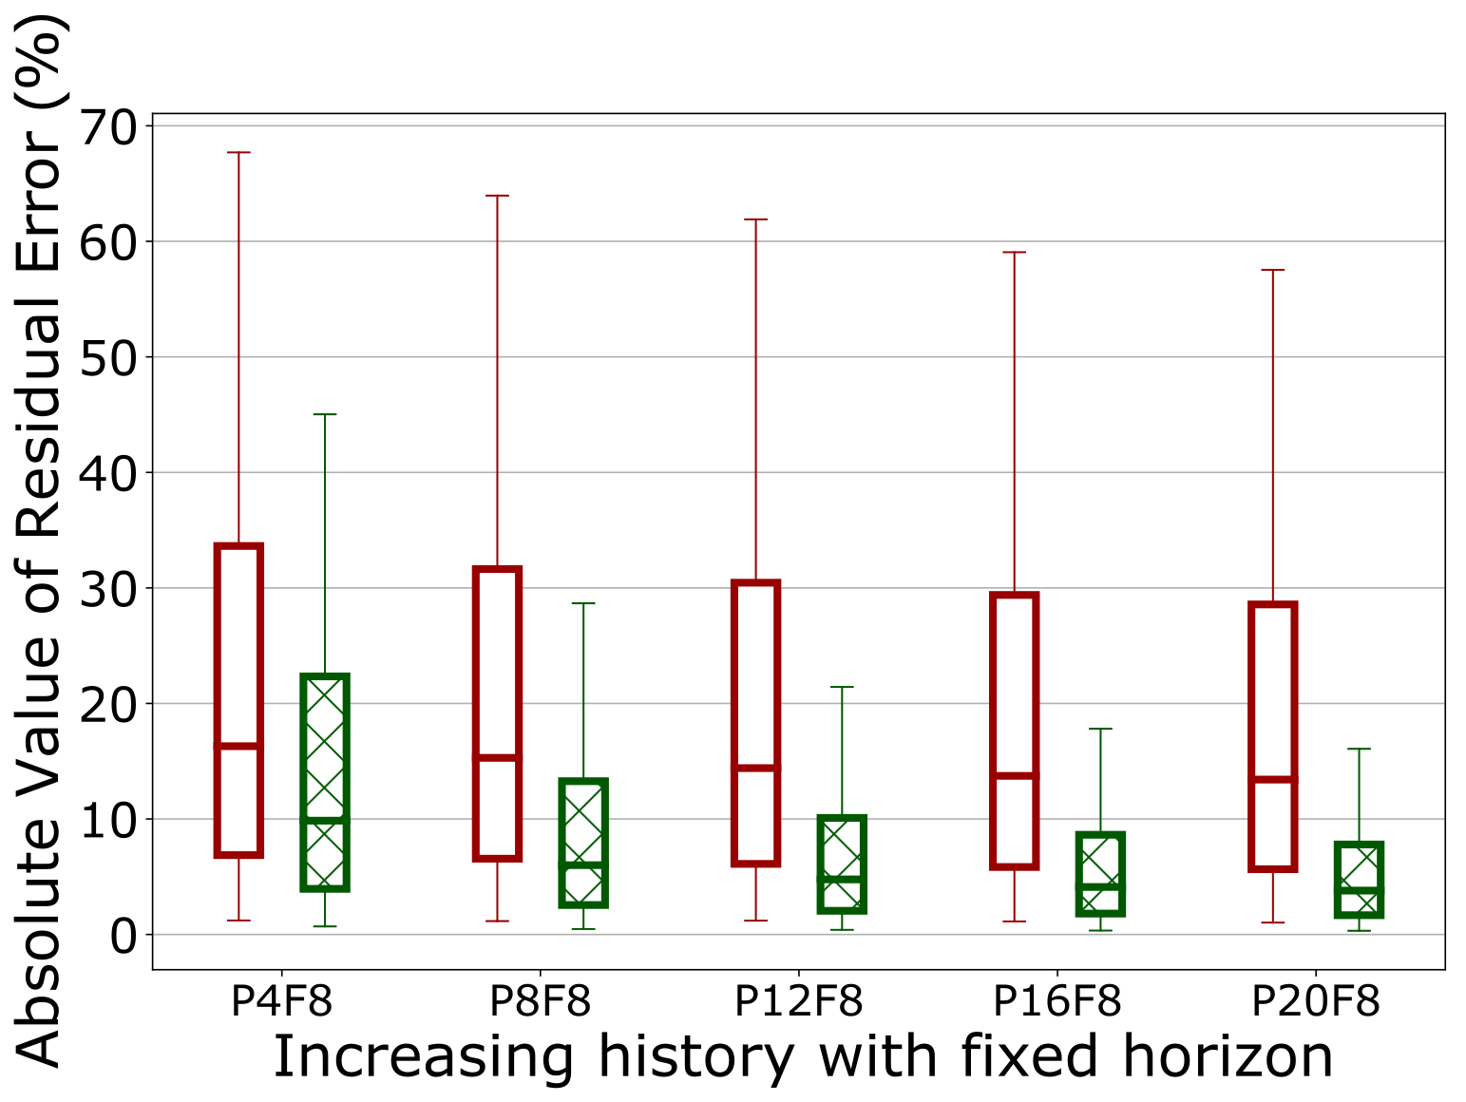
Throughput Prediction - Results
Quantile achieves higher prediction accuracy than raw approach across all scenarios
Prediction accuracy improves with increasing horizon and history window

Slide 13
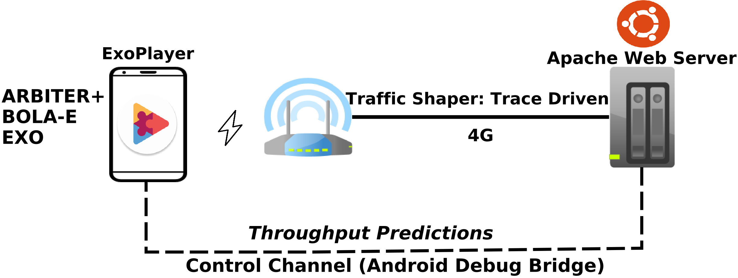
Video Player with Throughput Prediction
Testbed
iVID Video dataset, ten bitrates: 235 – 4300 kbps, 4- and 8-second chunks
Evaluated horizon: 12 – 32 seconds, history window: 20-seconds
Bandwidth traces characteristics:
Type | Avg (kbps) | Std (min – max, kbps)
Low-variable traces | 1656 | 1591 - 1166
High-variable traces | 4451 | 4010 - 6447
2. A.H. Zahran, D. Raca, C.J. Sreenan. ARBITER+: Adaptive Rate-Based InTElligent HTTP StReaming Algorithm for Mobile Networks. IEEE Transactions on Mobile Computing. April 2018
3. Kevin Spiteri, Ramesh Sitaraman, and Daniel Sparacio. 2018. From theory to practice: improving bitrate adaptation in the DASH reference player. In Proceedings of the 9th ACM Multimedia Systems Conference (MMSys '18)
4. Exo: Google default implementation in ExoPlayer library: https://github.com/google/ExoPlayer
5. Jason J. Quinlan, Ahmed H. Zahran, and Cormac J. Sreenan. 2016. Datasets for AVC (H.264) and HEVC (H.265) evaluation of dynamic adaptive streaming over HTTP (DASH). In Proceedings of the 7th International Conference on Multimedia Systems (MMSys '16)

Slide 14
Video Player with Throughput Prediction
EVALUATION METRICS
Metric | Summary
Bitrate | Average bitrate
Stability | Measure of quality level changes
Stalls_{num} | Average number of stalls
Stalls_{dur} | Average stall duration
QoE | Geometric mean of Clay³ and Yao⁴ Video QoE Models
    6. J. De Vriendt, D. De Vleeschauwer, and D. Robinson. 2013. ‘Model for estimating QoE of video delivered using HTTP adaptive streaming’. In 2013 IFIP/IEEE International Symposium on Integrated Network Management (IM 2013)
    7. Y. Liu, S. Dey, F. Ulupinar, M. Luby, and Y. Mao,. 2015 ‘Deriving and Validating User Experience Model for DASH Video Streaming’. IEEE Transactions on Broadcasting

Slide 15
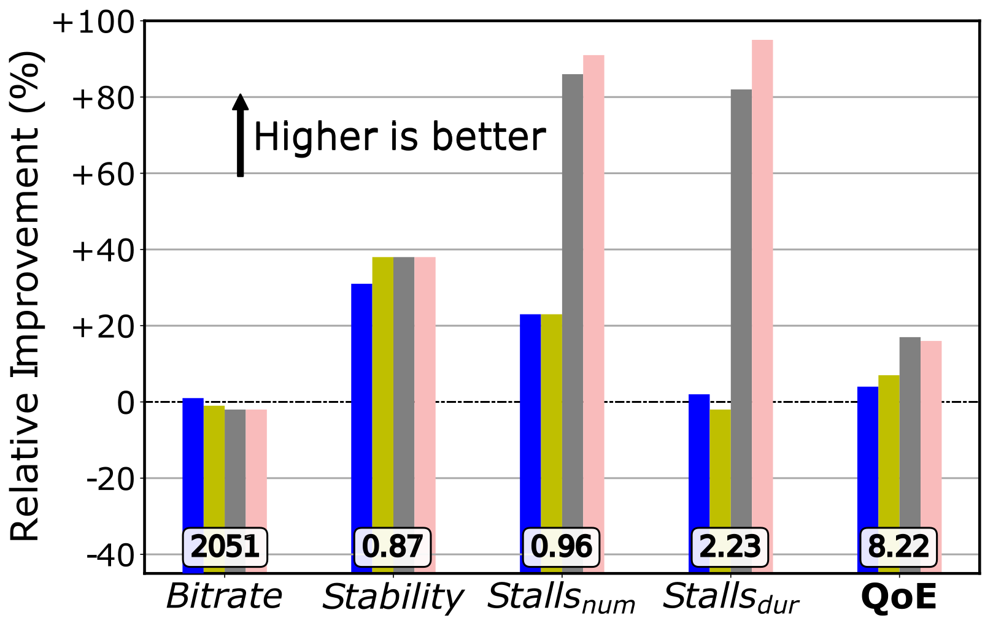
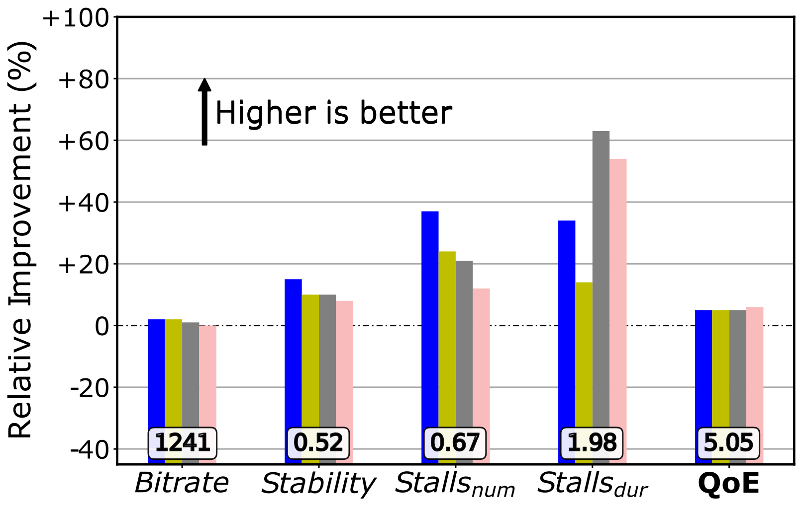
Video Player with Throughput Prediction
Results
ARBITER+, 4-second chunk duration
BOLA-E, 4-second chunk duration
Prediction enables all algorithms to reduce/eliminate stalls, improve switching stability and average stability
Overall, QoE improves by 8% - 27%
Similar conclusion holds for 8-second chunks

Slide 16
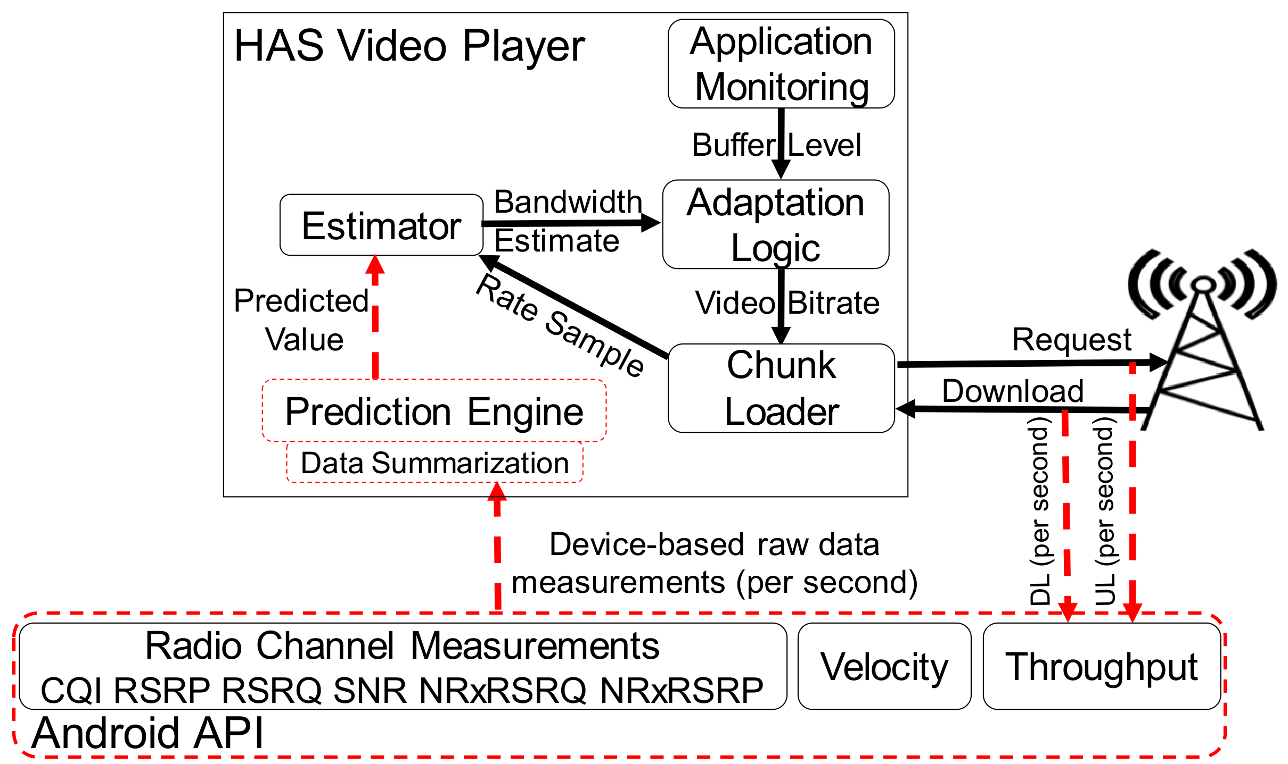
Real Time Prediction
Prediction engine implemented in real device as a part of ExoPlayer
  Android telephony class -> channel measurement collection
  Weka ML framework-> Random Forest model running on device
Methodology
  Two phones running concurrently (ExoPlayer default algorithm)
  56 tests (static and mobile)
  Horizon: 20-seconds, History: 20-seconds

Slide 17
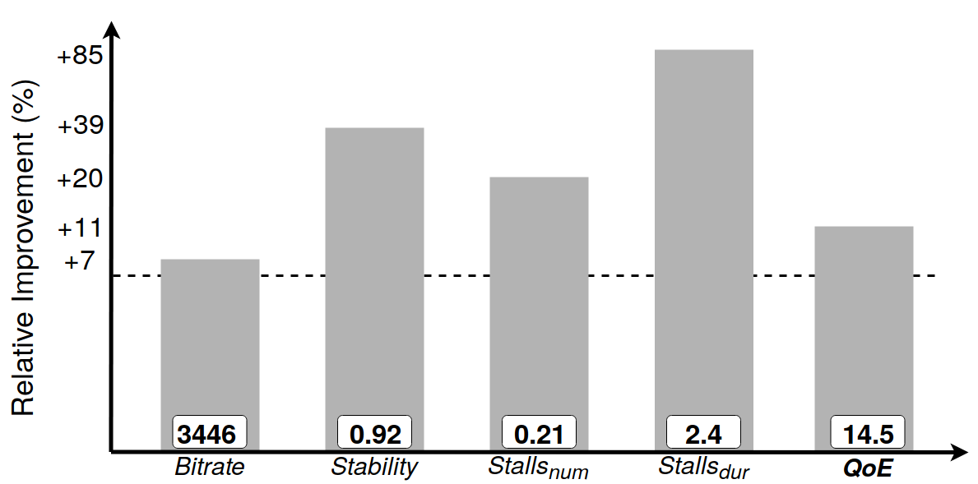
Real Time Prediction - Results
Prediction improves all QoE metrics
Overall, QoE improves by 11%

Slide 18
Conclusion
  We present a thorough quantitative study of throughput prediction in a real cellular network
  We combine machine learning techniques with radio channel metrics
  We introduce novel quantile abstraction technique allowing us to achieve low throughput prediction errors
  Having more accurate predictions allow us to improve performance of three adaptation algorithms.
  Prediction reduces stalls by up to 85%, and bitrate switching by up to 40%

Slide 19
Future Work
  Design adaptation algorithms to take advantage of highly accurate throughput predictor
  Possible model improvement by deriving optimal high-level features
  Enhancing model with network metrics
  Device vs. in network prediction

Slide 20
  Questions?
  Darijo Raca
  d.raca@cs.ucc.ie

