Slide 1
SMASH: a Supervised Machine Learning Approach to Adaptive Video Streaming over HTTP
Yusuf Sani, Darijo Raca, Jason J. Quinlan, Cormac J. Sreenan
School of Computer Science and Information Technology University College Cork, Cork, Ireland

Slide 2
Outline
Introduction
Motivation
Data Generation
Feature Selection
Model Training
Performance Evaluation
Conclusion

Slide 3
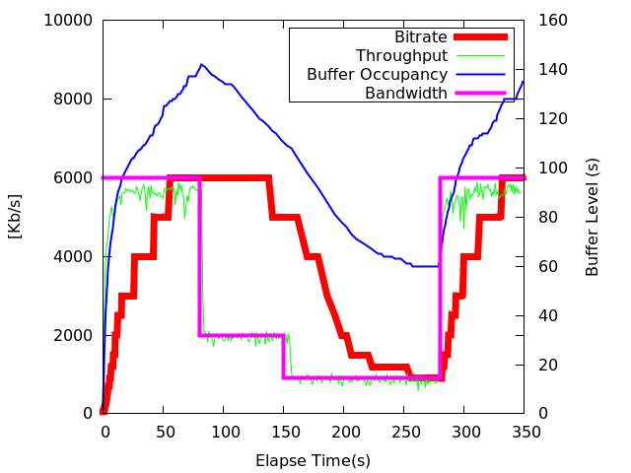
Introduction
HTTP-based Adaptive
Streaming
Adaptive Bitrate Selection (ABR)
Algorithms
Heuristic based: BBA-2[1], Arbiter+[2]
Machine Learning-based: Pensive[3]

Slide 4
Motivation
Heuristic-based approach is based on a fixed set of rules the do not generalized well.
The first group ML-based ABRs dynamically reconfigure the parameters of an existing algorithms.
The second set of schemes rely on trained predictive ABR, however a several studies have found them to be sensitive to: reward function, network traces, video representation used in training.

Slide 5
Hypothesis/Methodology
A simple and effective ABR module can be built by training a predictive model, using a large collection data generated from streaming several state-of-the-art ABRs, with each of the ABR used, optimised to serve a specific streaming context.
Empirical experiments based on heterogeneous wireless technology network traces

Slide 6

Data Generation
Technology | Number of Traces | Mode
3G | 30 | Static, Pedestrian, Bus, Car, Tram, Train
4G | 25 | Static, Pedestrian, Bus, Car, Train
WiFi | 5 | Pedestrian, Static
Rate Base | Buffer Base | Hybrid
Minimum rate | BBA-2 | Arbiter+
Median rate | Elastic | Conventional
Exoplayer Default | Logistic | BOLA

Slide 7
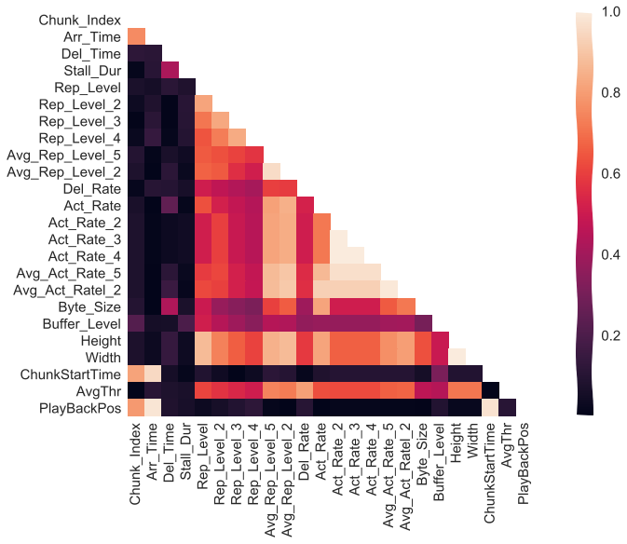
Feature Selection
Features correlation matrix
Rep_Level_1
Avg_Rep_Level_5
Del_rate
Act_rate_1
Act_rate_2
Byte_size
Buffer_Level
Avg_throughput
Mutual Information score

Slide 8
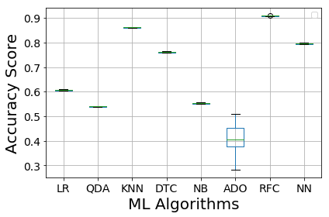
Model Selection
Logistic Regression (LR)
Quadratic Discriminant Analysis (QDA)
K-Nearest Neighbors (KNN)
Decision Tree Classifier (DTC)
Gaussian Naive Bayes (NB)
Ada Boost Classifier (ADO)
Random Forest Classifier (RFC)
Multi-layered perceptron (NN)
RFC
Notes:
.

Slide 9
Result
4g
3g
Wifi
SMASH outperforming the state-of-the-art players.

Slide 10
Conclusion
We present a Supervised Machine learning approach to Adaptive Streaming over HTTP (SMASH).
The results validate our hypothesis, that is, the best way to generalise the performance of an ABR algorithm is for a predictive model to learn the method of streaming from many high performing ABR schemes.

Slide 11
Refence
T. Huang, R. Johari, N. McKeown, M. Trunnell, and M. Watson, “A Buffer-based Approach to Rate Adaptation: Evidence from a Large Video Streaming Service,” in 2014 ACM Conference on SIGCOMM
A. H. Zahran, D. Raca, and C. J. Sreenan, “ARBITER+: Adaptive RateBased InTElligent HTTP StReaming Algorithm for Mobile Networks,” IEEE Transactions on Mobile Computing
H. Mao, R. Netravali, and M. Alizadeh, “Neural Adaptive Video Streaming with Pensieve,” in Proceedings of the Conference of the ACM Special Interest Group on Data Communication.

Slide 12
Thank you
Yusuf Sani, Darijo Raca, Jason J. Quinlan, Cormac J. SreenanSchool of Computer
Mobile and Internet Systems Laboratory (https://www.ucc.ie/en/misl/)
Science and Information TechnologyUniversity College Cork, Cork, Ireland
{ys8, d.raca, j.quinlan, cjs}@cs.ucc.ie}
This publication has emanated from research conducted with the financial support of Science Foundation Ireland under Grant 13/IA/1892, acknowledges the support of SFI Grant 13/RC/2077 and also SFI Grant 18/IF/6354

