Slide 1
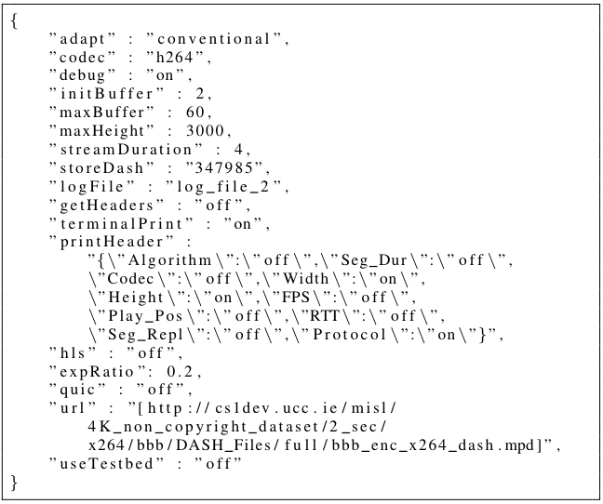
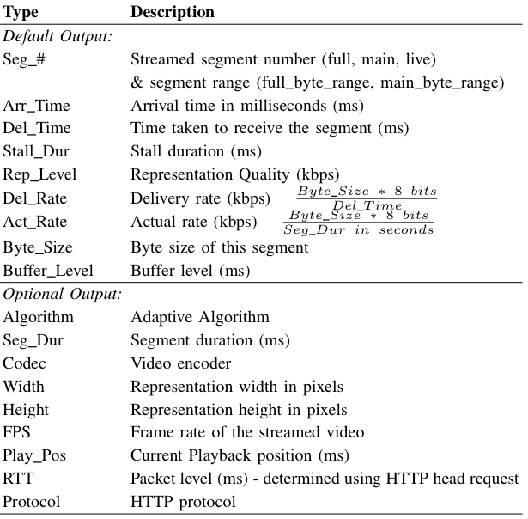
goDASH - GO accelerated HAS
framework for rapid prototyping
Darijo Raca, Maëlle Manifacier, Jason J. Quinlan
Summary
Example Configuration File
A modular, dynamic and easily configurable infrastructure for headless streaming of HTTP Adaptive Streaming (HAS) video content, implemented in golang, an open-source programming language supported by Google.
Contribution: goDASH has the ability to stream HAS content without decoding actual video (headless player). This results in low memory requirements and the ability to run multiple players in a large-scale-based evaluation setup. goDASH comes complete with numerous state-of-the-art HAS algorithms.
goDASH supports two transportation protocols TCP and QUIC. The QUIC protocol is a relatively new protocol with the promise of performance improvement over the widely used TCP.
goDASH
Open-Source Real-Time headless HAS video streaming, with options such as:
Inbuilt adaptation algorithms such as - Hybrid: Arbiter+ [7] and Elastic [6], Buffer Based: Logistic [3] and BBA [4], and Rate Based: Conventional [19], Average, Progressive, Geometric and Exponential
Video codec support: H264, H265, VP9 and AV1
Supported DASH profiles: full, main, live, full_byte_range and main_byte_range
Header information extraction for all segments
Video streaming using the TCP/QUIC protocols
Configuration file input selection option
Debug/Logging to output files
Other options include: maximum stream buffer in seconds, initial number of segments to download before stream starts (start up phase), maximum height resolution to stream
goDASH comes complete with its own testbed framework, known as goDASHbed. This framework uses the Mininet virtual environment to serve video content locally (which allows setting security certificates), including set up of https certs
Support for experiments with heterogeneous traffic
Trace Output Format
Sample goDASH output shown below
Further information and build instructions for goDASH/goDASHbed are available at http://cs1dev.ucc.ie/misl/goDASH/
j.quinlan@cs.ucc.ie Computer Science & Information Technology, UCC, Ireland
This publication has emanated from research conducted with the
financial support of Science Foundation Ireland under Grant 13/IA/1892,
and acknowledges the support of SFI Grant 13/RC/2077

