Slide 1
Food Systems and Policy Pathways for Equal Population Nutrition in Europe: FOODPATH
Janas Harrington – University College Cork - Ireland
September 19th, 2024
j.harrington@ucc.ie
https://www.ucc.ie/en/foodpath/
HealthEquity kick-off – FOODPATH

Slide 2
Consortium
Name | Research Institution | Country
Dr Janas Harrington | UCC | Ireland
Prof Maartje Poelman | WUR | The Netherlands
Prof Piotr Romaniuk | SUM | Poland
Dr Stefanie Vandevejvere | SSc | Belgium
Prof Daniel Moro | UCSC | Italy
Prof Gulsah Kaner | IKCU | Türkiye
Dr Sanne Djojosoeparto | WUR | NL
Prof Greet Cardon | UG | Belguim
Prof Carlijn Kamphuis | UU | NL

Slide 3
FOODPATH will work across different sectors
Public Sector
Private Sector
Community
Public Sector
Private Sector
Community
Public Sector
Private Sector

Slide 4
Project description/aims
Shortly explain background, aims and research methodology of your project, including description and access to the target group and co-creation approaches (indication: 2-4 slides)
The overarching aim of FOODPATH is to identify and understand the societal, commercial and political determinants and mechanisms of food-related inequalities, and to provide solutions which have the potential to break through the cycles maintaining unhealthy dietary behaviours and food related inequalities in Europe.

Slide 5
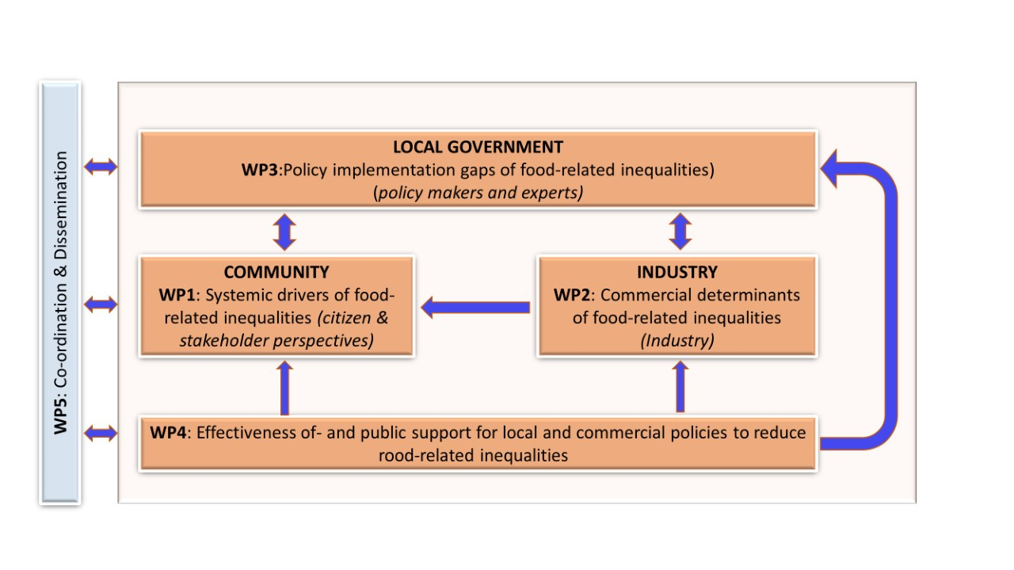
Project description
5 inter-related workpackages:
Work package 1: Systemic drivers of food-related inequalities-a citizen & key stakeholder perspective
Work Package 2: Commercial Determinants of food-related inequalities
Work Package 3:Policy mapping to identify policy implementation gaps to address food-related inequalities in European cities
Work Package 4: Effectiveness and public support for local and commercial policies to reduce food-related inequalities in European countries
Work package 5:Co-ordination and Dissemination

Slide 6
Research Questions
What are the systemic drivers, barriers and enabling factors of healthy and unhealthy dietary behaviours among disadvantaged communities? (WP1)
What are systemic leverage points to reduce food-related inequalities from a citizen/social domain perspective? (WP1)
How do commercial interests influence food-related inequalities and what are systemic commercial leverage points for change to reduce food-related inequalities? (WP2)
What are the policy gaps and priorities actions needed to improve food environments and to reduce inequalities in selected European cities? (WP3)
To what extent do sugar-sweetened beverages (SSB) tax schemes lead to product reformulation; how do these schemes impact socioeconomic inequalities; to understand the public support for policies and actions to enhance healthy diets and to =investigate whether support differs across socioeconomic position? (WP4)

Slide 7
Expected impact
Describe potential impact of expected results for public health including socio-economic health aspects
(indication: 1 slide)
Over arching question to be answered:
Which societal, commercial and political determinants of diet-related behaviour have the potential to break through the cycles maintaining unhealthy dietary behaviours among people living in socioeconomically disadvantaged circumstances and which solutions are recommended to reduce socioeconomic inequalities in diet?

Slide 8
Expected impact
Describe potential impact of expected results for public health including socio-economic health aspects
(indication: 1 slide)
Through a public health, and equity lens we will comprehensively study the systemic drivers, barriers and enablers of healthy and unhealthy dietary behaviours among disadvantaged communities, in relation to governmental and private sector food environment policies/practices and public support, which impact both positively and negatively on dietary behaviours and health equity
Engage with citizens and key stakeholders (including policy makers) to identify priorities and make recommendations for leverage points for change to improve and enhance equitable access to health and sustainable food for all
FOODPATH will develop targeted approaches to identify the systemic drivers of food-related inequalities from the citizen and stakeholder perspective and will identify systemic leverage points to reduce food-related inequalities.

Slide 9
Expected impact
WP1
WP2
A report will be developed for each country, which includes:
The stakeholder power-analysis;
An action plan, including actions, policies and interventions that match with the identified leverage points and systems-map (4 countries)
Cross-country comparison
SEP differences in food industry practices on food environments;
Outline the extent to which company practices are targeting lower SES populations across countries
Overview of the corporate political activities of the food industry targeting lower SES populations across countries
WP3
WP4
What are the policy gaps and priorities actions needed to improve food environments and to reduce inequalities in selected European cities?
impact of local level food environment policies on food-related inequalities observed in disadvantaged groups
Local (City) Food Policy Mapping (Context Analysis)
Identify implementation gaps and priority action areas for the local food environment 3-4 countries
To what extent do SSB tax schemes lead to product reformulation, and how does that impact socioeconomic inequalities in dietary intakes
Public Support for political and commercial actions and policies to reduce food-related socioeconomic inequalities

Slide 10
Involvement of Stakeholders and dissemination
“..to generate upstream change, all actors in society have a role to play in the transition towards healthier and sustainable population diets and a reduction in socioeconomic inequalities in diet and health.”
Stakeholder involvement will be integral to the FOODPATH work plan and at each stage of the research. Across all WPs stakeholders from across the system will be identified and consulted and will be actively involved with the research.

Slide 11
Involvement of Stakeholders and dissemination
Citizens, with an emphasis on those living in more disadvantaged communities (Group Model Building WP1); (Consumer survey DCE, WP4)
Industry actors (WP2)
Policy makers (local and national) (WP3); Community Stakeholder Power Analysis (WP1); Community and inter-agency consultation workshops (WP3)
public discourse debates, dissemination workshops and expert meetings will be organized to ensure the appropriate stakeholders are targeted. Key stakeholders in local and national agencies and key community members will be involved to ensure the uptake of future policy implementation.

Slide 12
Dissemination
Modal Approach
Papers: high-profile international peer-reviewed publications.
People: person engagement, public discourse debates, dissemination workshops
Place: local, national and international networking with researchers/stakeholders to exchange information, cross-fertilises for future international research projects a
Policy: engaging with key stakeholders in local and national agencies tasked with the remit for policy implementation

Slide 13
Responsible Research and Innovation approaches
Research Integrity Training (compulsory in UCC)
Ethical Considerations
Active participation in the project by stakeholders across the food system:
Group Model Building-vulnerable communities; Community consultations
Stakeholder Power Analysis
Upstream focus, a move away from individual/victim blaming
Industry play-book: strategies to target low SEP
Industry
Industry play book-strategies to target low SEP communities

Slide 14
Potential synergies with other HealthEquity projects
YAHEE – Young adults in health-enhancing equitable environments (Collaborating on GMB sessions, a joint training session on Sept 6th, 2024)
IMPAQT- IMproving Physical Activity policies and their impact on health eQuiTy (Sibling projects, both stemmed from PEN)
Very open to collaboration and discussions with other projects
Other Potential Synergies:
Business Impact Assessment on Obesity and Population Nutrition in Belgium and France
Business Impact Assessment on Obesity and Population Nutrition, as well as environmental sustainability in Belgium, Ireland and Portugal
Document analysis and limited set of interviews on the corporate political activities of food industry umbrella organisations in Belgium, Norway, Slovenia, Ireland

Slide 15
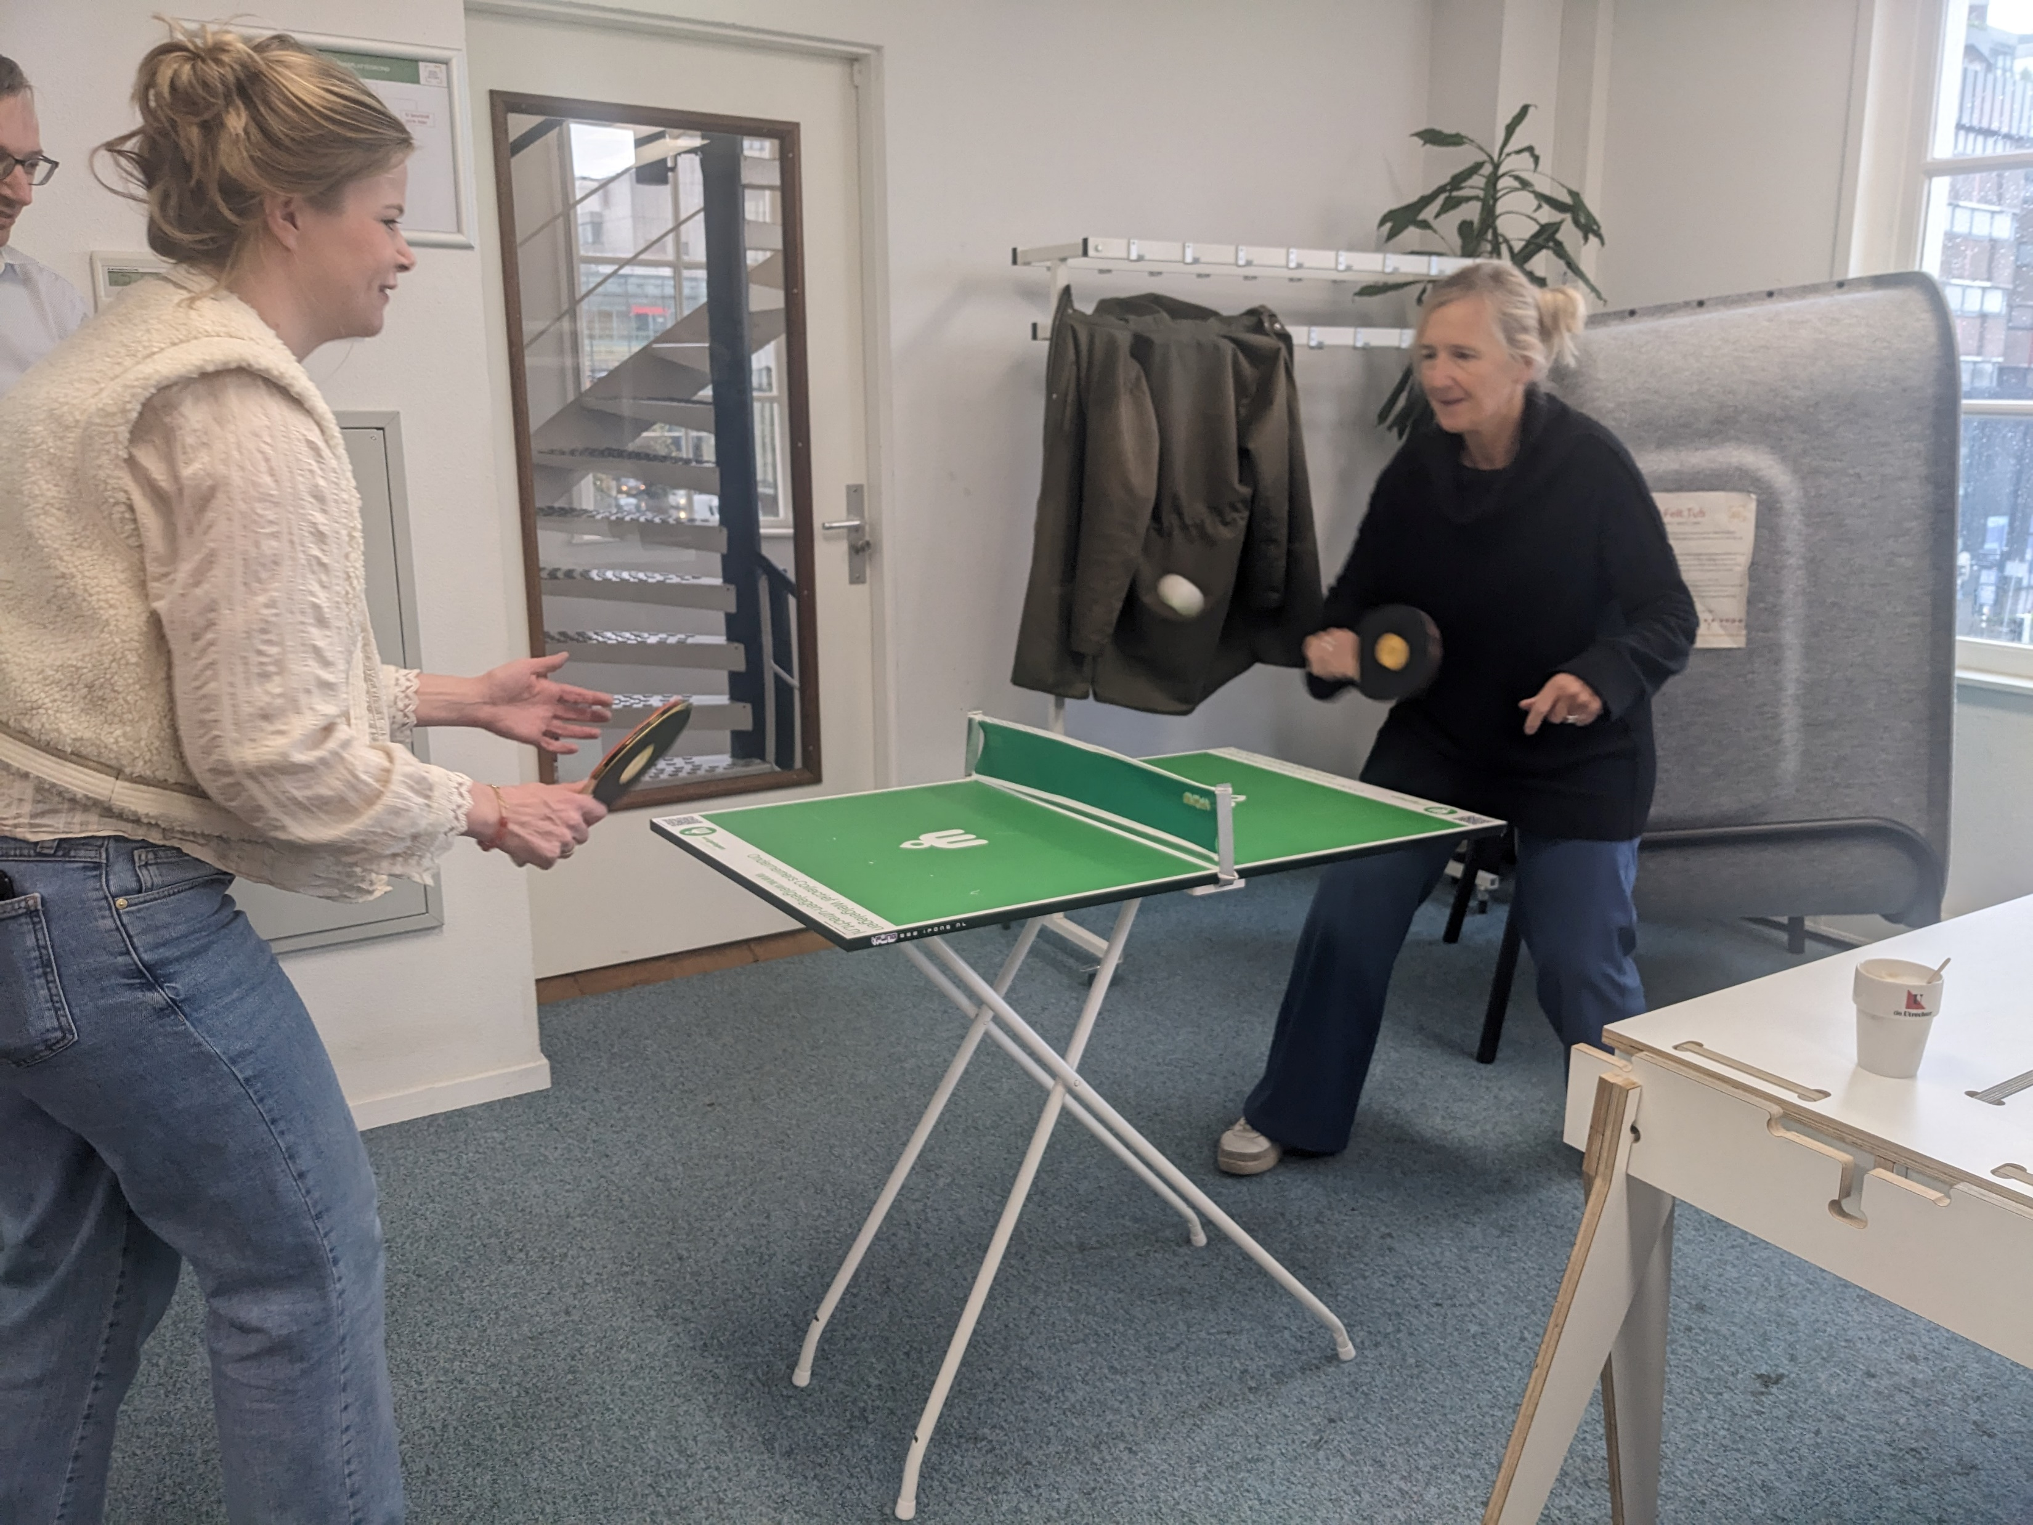
Thank you
FOODPATH Consortium
FOODPATH-IMPACT Kick-Off meeting, Utrecht, April 2024
https://www.ucc.ie/en/foodpath/
Partner
Contact data

