Slide 1
Energy Policy and Modelling Group, UCC
Engineers Ireland Wi-Fi
Network: EI-Guest
Password: Engineersguest
Research Showcase Event 2025
15/12/2025
Engineers Ireland, Clyde Road, Dublin 4.

Slide 2

Introduction - Brian Ó Gallachóir
Engineers Ireland Wi-Fi
Network Name: EI-Guest
Password: Engineersguest

Slide 3

Introduction - Brian Ó Gallachóir
Session 1: Climate Action
Session 2: Energy Security
Join Slido to engage and ask
Enter Code 2338920
Code: 2338920
Engineers Ireland Wi-Fi
Network: EI-Guest
Password: Engineersguest

Slide 4























Funders

Slide 5
Engineers Ireland Wi-Fi
Network: EI-Guest
Password: Engineersguest
Opening Keynote
Denis Naughton
Former Minister of Department of Climate, Energy and the Environment

Slide 6
Session 1 Climate Action
Chaired by Dr Jeanne Moore
Policy Analyst at National Economic and Social Council
Including the following presentations
Will we remain within Ireland’s 1st Carbon Budget? By Prof Brian Ó Gallachóir
A Marginal Abatement Cost Curve for Ireland by Dr Tomás Mac Uidhir
Beyond Net-Zero by Dr Róisín Moriarty
Why we're still ignoring the physics of climate change by Professor Hannah Daly

Slide 7
Will we remain within Ireland’s 1st Carbon Budget? Prof Brian Ó Gallachóir
Engineers Ireland Wi-Fi
Network: EI-Guest
Password: Engineersguest

Slide 8
Indicative Pathway to Meet Ireland's Statutory Carbon Budgets (Fig 2 CCAC 2021 CB Report 2021)

Slide 9
… zooming in on Carbon Budget 1

Slide 10
… adding in EPA GHG emissions 2021-2024

Slide 11
… adding in estimates for GHG emissions 2025
Estimated Cumulative GHG Emissions 2021-2025
2021-2024 | 2025 | Basis | Cumulative GHG (Mt CO_{2eq}) 2021-2025 | Carbon Budget 1 | Gap to CB1 (Mt CO_{2eq}) | Gap to CB1
243 + | 61 | EPA WEM | 304 | 295 | 9 | 3%
 | 58 | EPA WAM | 301 |  | 6 | 2%
 | 58 | =2024 | 301 |  | 6 | 2%
 | 54 | =2* H1 2025 | 297 |  | 2 | 1%
Notes:
EPA’s GHG emissions estimate for 2024 was 741 kt higher than twice the estimates for the first half of 2024.

Slide 12
What about sectoral emissions ceilings?
Sectors | Sectoral Emissions Ceiling 2021-2025 | Estimated Cumulative Emissions 2021-2025 | Sectoral Emissions Ceiling Exceedance | Emissions Reduction 2018 - 2024
Electricity | 40 | 40 | 0 | 32%
Transport | 54 | 58 | 4 | 5%
Buildings (Residential) | 29 | 29 | 0 | 20%
Buildings (Commercial and Public) | 7 | 7 | 0 | 4%
Industry | 30 | 32 | 2 | 14%
Agriculture | 106 | 105 | -1 | 5%
Other | 9 | 9 | 0 | 20%
Ireland’s total GHG emissions reduced by 12% in the period 2018-2024
Population grew by 10%, economy grew by 30%.

Slide 13
So where do we stand now?
Ireland’s carbon budgets and sectoral emissions ceilings are achievable
Political leadership, strong governance framework, supportive policies and societal mobilisation have all played important roles
There is a delicate balance between these four dimensions
The most significant progress has been in electricity and buildings
System inertia challenges in transport and agriculture are significant
We can achieve the next carbon budget but that does not mean we will.

Slide 14
A Marginal Abatement Cost Curve for Ireland Dr Tomás Mac Uidhir
Engineers Ireland Wi-Fi
Network: EI-Guest
Password: Engineersguest

Slide 15
Motivation
What about the next 25 years?
Ireland needs to make informed choices about how best to reduce emissions across the whole economy.
Decision confidence depends on clear evidence regarding the technologies and measures available, their costs, and their mitigation potential.
Notes:
To provide clear data on technologies, costs, and impacts to inform Ireland’s carbon budget decisions.

Slide 16

What is a Marginal Abatement Cost Curve (MACC)?
200
100
€/tCO₂
0
tCO₂
-100
-200
Abatement Measures
Notes:
What is a MACC? Original Text: Meeting our legally binding carbon budgets will require Ireland to make informed choices about how best to reduce emissions across the whole economy. Good decisions depend on clear evidence: which technologies and measures are available, what they cost, and how much they can contribute to lowering emissions.
The integrated Marginal Abatement Cost Curve (iMACC), developed using the TIMES-Ireland Model (TIM), provides this kind of evidence in a structured way.
Unlike conventional cost curves, which consider measures in isolation, the iMACC sits within a full energy system model. This allows it to capture interactions across electricity, heat, transport, and industry, while ensuring results are consistent with Ireland’s legally-binding carbon budgets.
Not every possible option is shown. Instead, only the measures that TIM identifies as part of the least-cost, carbon budget compliant pathway are included. This ensures that the iMACC highlights not just what could be done in theory, but what makes sense in practice under emissions constraints.
By combining robust modelling with a transparent step-by-step process, the iMACC provides a clearer picture of cost-effective deployment pathways for Ireland’s energy transition. It is designed to be a tool for policy and decision-making. We invite stakeholders to engage with the methods, assumptions, and results presented here: to test them, challenge them, and to help shape the co-development of a tool that is transparent, credible, and useful for Ireland’s policy process.
“the challenge is no longer to identify low-cost opportunities, but to avoid all emissions at the lowest cost possible” – world bank

Slide 17
What is a Marginal Abatement Cost Curve (MACC)?
200
Average cost per tonne abated
100
€/tCO₂
0
tCO₂
-100
CO₂ reduction
-200
Notes:
What is a MACC? Original Text: Meeting our legally binding carbon budgets will require Ireland to make informed choices about how best to reduce emissions across the whole economy. Good decisions depend on clear evidence: which technologies and measures are available, what they cost, and how much they can contribute to lowering emissions.
The integrated Marginal Abatement Cost Curve (iMACC), developed using the TIMES-Ireland Model (TIM), provides this kind of evidence in a structured way.
Unlike conventional cost curves, which consider measures in isolation, the iMACC sits within a full energy system model. This allows it to capture interactions across electricity, heat, transport, and industry, while ensuring results are consistent with Ireland’s legally-binding carbon budgets.
Not every possible option is shown. Instead, only the measures that TIM identifies as part of the least-cost, carbon budget compliant pathway are included. This ensures that the iMACC highlights not just what could be done in theory, but what makes sense in practice under emissions constraints.
By combining robust modelling with a transparent step-by-step process, the iMACC provides a clearer picture of cost-effective deployment pathways for Ireland’s energy transition. It is designed to be a tool for policy and decision-making. We invite stakeholders to engage with the methods, assumptions, and results presented here: to test them, challenge them, and to help shape the co-development of a tool that is transparent, credible, and useful for Ireland’s policy process.
“the challenge is no longer to identify low-cost opportunities, but to avoid all emissions at the lowest cost possible” – world bank

Slide 18
Scenario selection
Baseline: disable all technologies
Notes:
1. the model runs with all measures available too it 2. This outlines the optimal deployment of individual measures (in this case BEV) 3. We create a baseline scenario where all technologies are disabled (to get cost/emissions) 4. Run the baseline again with forced deployment of the desired technology (again BEVs) in this case to get the difference in cost/emissions 5. Calculate the MAC of the measure ....

Slide 19
Scenario selection
Baseline: disable all technologies
Mitigation: enable all technologies and set a carbon budget e.g. 300 MtCO2eq
Identify optimal deployment of individual technologies, consistent with Carbon Budget constraint.
Re-enable technologies one-by-one
Compare relative costs and emissions between baseline and mitigation scenario
Notes:
1. the model runs with all measures available too it 2. This outlines the optimal deployment of individual measures (in this case BEV) 3. We create a baseline scenario where all technologies are disabled (to get cost/emissions) 4. Run the baseline again with forced deployment of the desired technology (again BEVs) in this case to get the difference in cost/emissions 5. Calculate the MAC of the measure ....

Slide 20

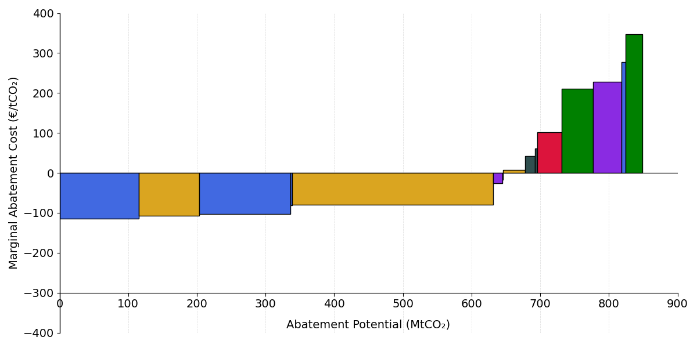
iMACC: Cumulative cost and abatement, €/${tCO}_{2}$
Transport
Services
Industry
Residential
Electricity Supply
Biofuels
Solar replacing Natural Gas (10 GW*)
District Heating - Services
On-shore Wind replacing Natural Gas (8.8 GW*)
Off-shore Wind replacing Natural Gas (17 GW*)
Battery Electric Vehicle (BEV) (3.7 Million*)
Heat Pumps Services
Electrification Industry
Biogas
(5.7* TWh)
Hybrid Electric Trucks (11,000*)
Battery Electric Buses (42,000*)
Plug-in Hybrid Vehicles (PHEV)
Retrofit & Heat Pumps - Residential
District Heating - Residential
Battery Electric Trucks (792,000*)
Biofuel Blend - Transport
*Total deployment by 2050
Notes:
Explain why low deployment and low mitigation potential for hybrid electric trucks and hybrid cars (because the model sees very little role for them as “transition measures”

Slide 21
iMACC: Sensitivity (Grid & Charging)
Transport
Services
Industry
Residential
Electricity Supply
Biofuels
On-shore Wind replacing Natural Gas (8.8 GW*)
Solar replacing Natural Gas (10 GW*)
Off-shore Wind replacing Natural Gas (17 GW*)
Battery Electric Vehicle (BEV) (3.7 Million*)
Biogas
(5.7* TWh)
Battery Electric Trucks (792,000*)
Biofuel Blend - Transport
*Total deployment by 2050
Notes:
Explain why low deployment and low mitigation potential for hybrid electric trucks and hybrid cars (because the model sees very little role for them as “transition measures”

Slide 22
iMACC: Sensitivity (Low Gas & High Biofuel price)
Transport
Services
Industry
Residential
Electricity Supply
Biofuels
On-shore Wind replacing Natural Gas (8.8 GW*)
Solar replacing Natural Gas (10 GW*)
Off-shore Wind replacing Natural Gas (17 GW*)
Battery Electric Vehicle (BEV) (3.7 Million*)
Biogas
(5.7* TWh)
Renewables become relatively expensive in a scenario with historically low gas prices, or if biofuels are more expensive than anticipated
Battery Electric Trucks (792,000*)
Biofuel Blend - Transport
*Total deployment by 2050
Notes:
Explain why low deployment and low mitigation potential for hybrid electric trucks and hybrid cars (because the model sees very little role for them as “transition measures”

Slide 23
iMACC: Sensitivity (Compliance)
Transport
Services
Industry
Residential
Electricity Supply
Biofuels
Range of compliance costs assessed by IFAC:
€80-300/tCO₂
*Total deployment by 2050
Notes:
Explain why low deployment and low mitigation potential for hybrid electric trucks and hybrid cars (because the model sees very little role for them as “transition measures”

Slide 24
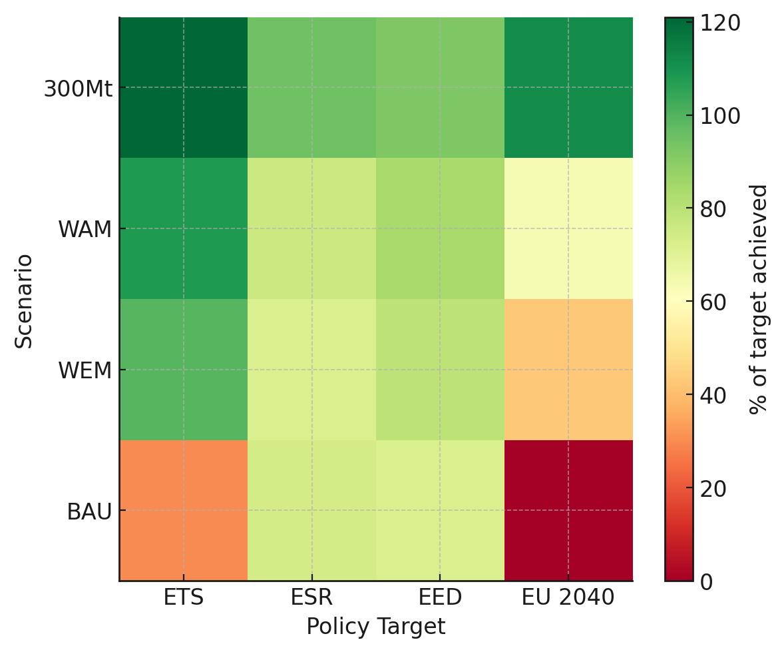
iMACC: Sensitivity (Compliance)
Over-achievement of EU policy target
Under-achievement of EU policy target
ESR target assumes Agriculture sector meets WAM EPA trajectory
WEM and WAM scenarios are derived from EPA modelling
Notes:
Explain why low deployment and low mitigation potential for hybrid electric trucks and hybrid cars (because the model sees very little role for them as “transition measures”

Slide 25
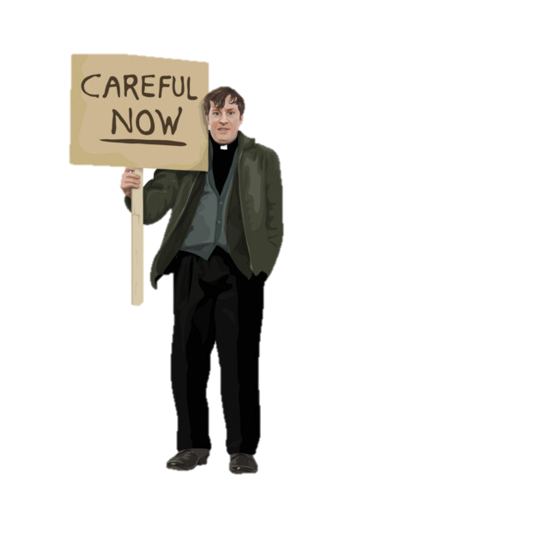
Conclusions and Key Takeaways
Conclusions
Transparent, flexible, replicable
Cost-effective mitigation is met through renewable electricity, and electrifying end uses. These are critical to remain within carbon budget shown.
We are moving in the right direction but not fast enough, placing 2050 targets at risk.
Realising full savings requires needs rapid scaling of all these measures e.g. All New car sales electric by 2029.
The largest measures are already economical, but face barriers.
Easy to model – hard to do!
Simple communication tool but cannot inform:
What barriers & how to remove them?
Who pays? Who benefits?
Complexity within measures
Non-economic benefits & costs
-> not a policy design tool
MACC is typically used to inform incremental change, where there are a large range of choices and a long planning horizon
the challenge is no longer to identify low-cost opportunities, but to avoid all emissions at the lowest cost possible.
Risk that sensitivity is confused with uncertainty and delays action

Slide 26
Beyond Net-Zero Dr Róisín Moriarty
Engineers Ireland Wi-Fi
Network: EI-Guest
Password: Engineersguest

Slide 27
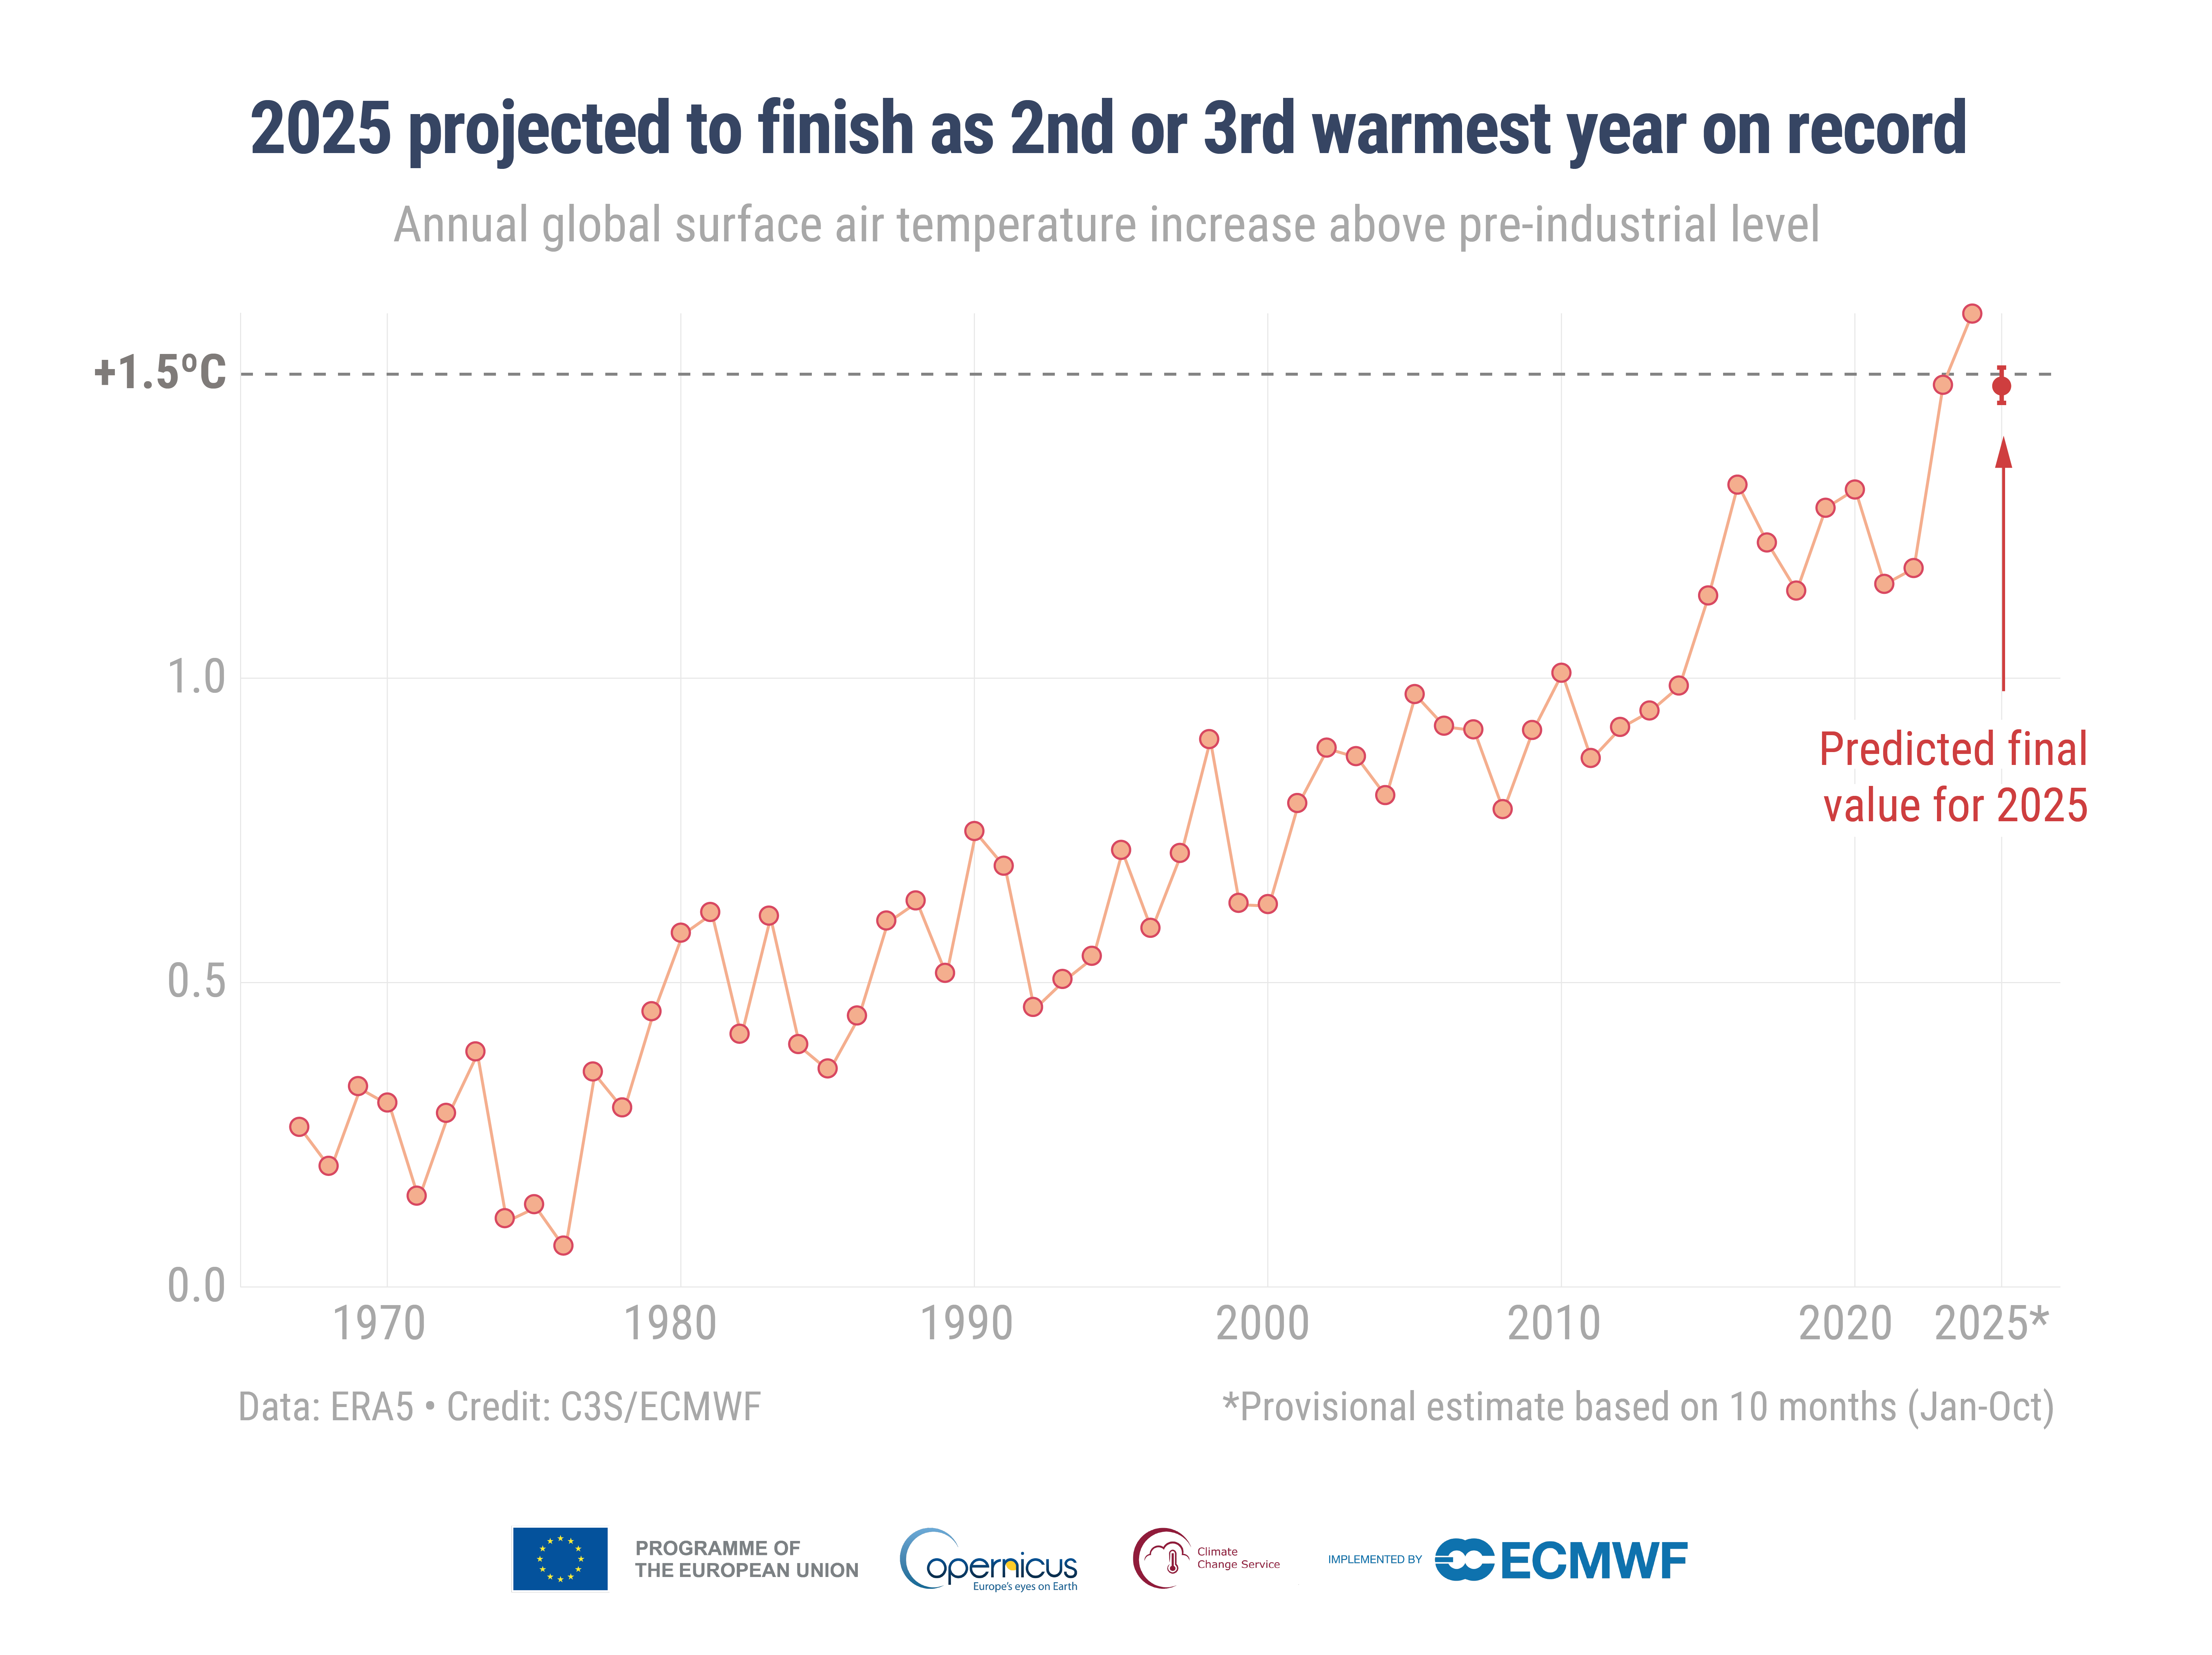
Copernicus / ECMWF
Notes:
[slide 1 - Temperature]
Depending on the definition of 1.5 degrees of global warming we are at or will soon be at 1.5 degrees of global warming.
[2015 Paris Agreement goal of keeping warming well-below 2C and ideally 1.5C “refers to a long-term average over two decades”]

Slide 28
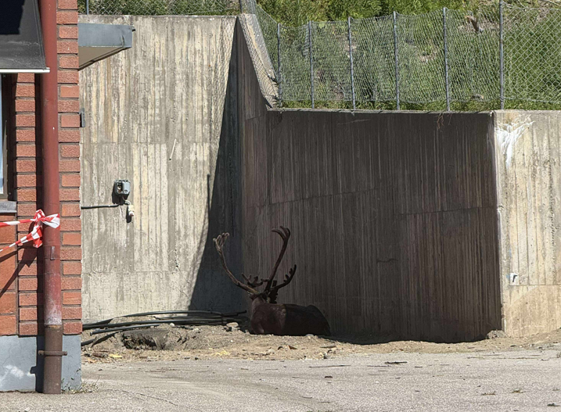

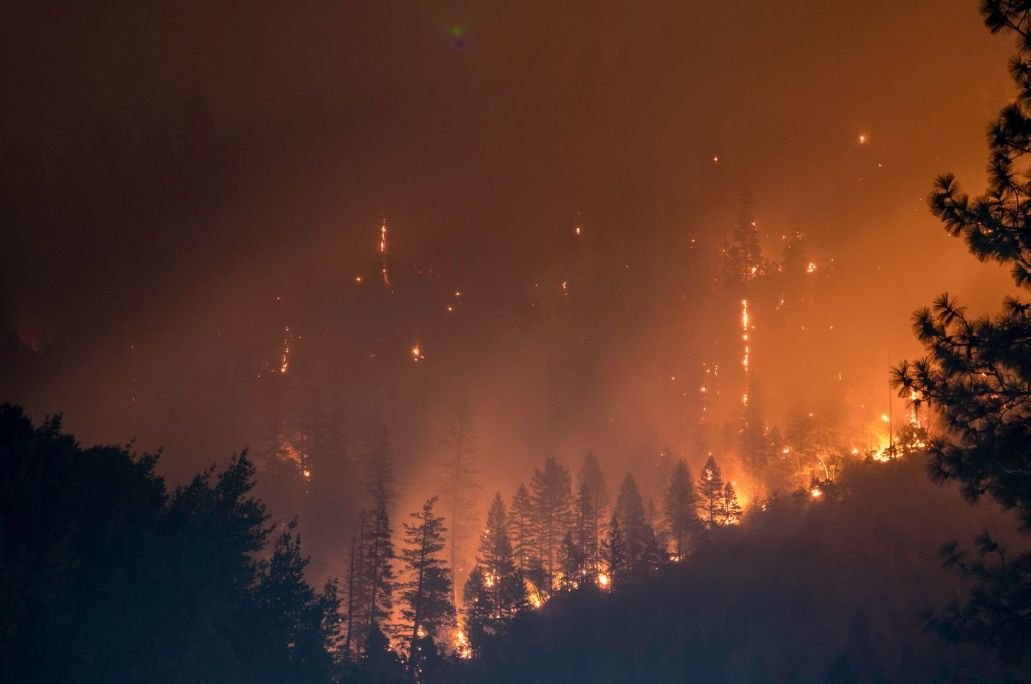
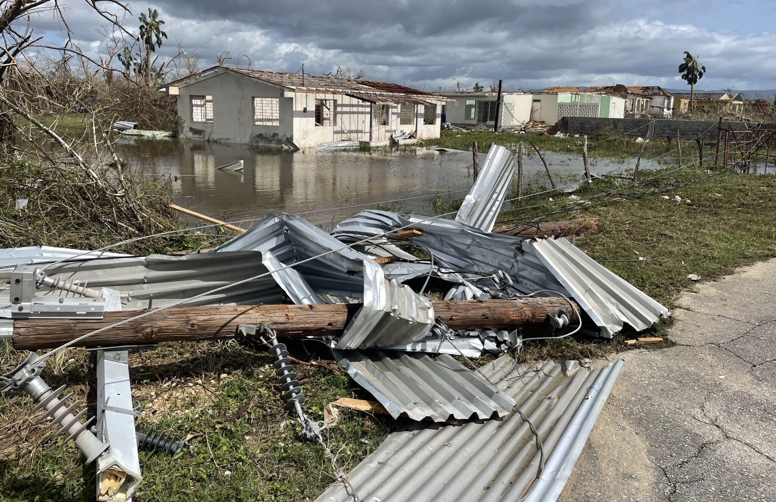
International impacts
World Weather Attribution
Notes:
[slide 2 – Impacts: internationally]
We already experiencing severe climate change impacts, more severe than the scientific evidence that informed the Paris Agreement suggested ten years ago.
We look at the news and we can see rainfall is getting heavier, flooding more widespread, hurricanes more intense, there is more extreme heat and longer heatwaves,
AND extreme fire weather conditions leading to more wildfires.

Slide 29



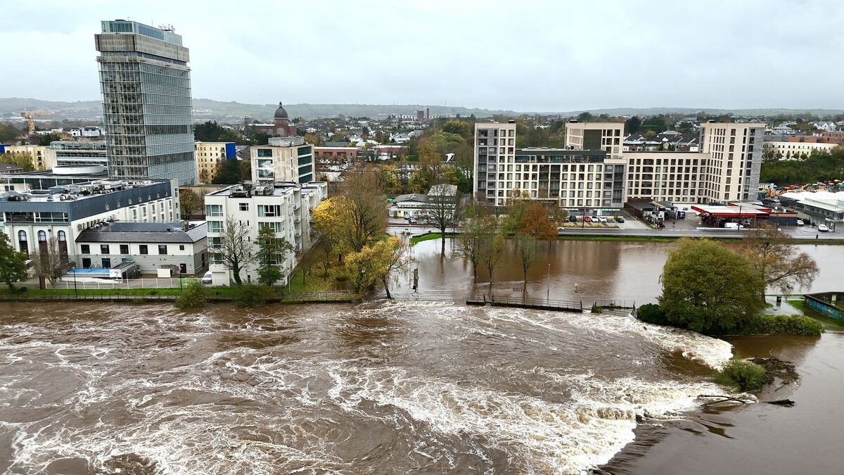
National impacts
World Weather Attribution
Notes:
Closer to home, storms in Ireland are more severe, rainfall is heavier, flooding is widespread
AND periods of hot weather are getting hotter, longer and more regular.
All these events impact people, nature, the built environment and the economy.

Slide 30
Paris Agreement
Article 2.1(a) Holding the increase in the global average temperature to well below 2°C above pre-industrial levels and pursuing efforts to limit the temperature increase to 1.5°C above pre-industrial levels, recognizing that this would significantly reduce the risks and impacts of climate change;
Article 4.3 Each Party's successive nationally determined contribution will represent a progression beyond the Party's then current nationally determined contribution and reflect its highest possible ambition, reflecting its common but differentiated responsibilities and respective capabilities, in the light of different national circumstances.
Paris Agreement 2015

Slide 31
ICJ: Advisory Opinion
Paragraph 224. As a general matter, the Court notes that while the Paris Agreement provides for limiting the global average temperature increase to well below 2°C above pre-industrial levels as a goal and 1.5°C as an additional effort, 1.5°C has become the scientifically based consensus target under the Paris Agreement.
Paragraph 242. Second, a party’s NDCs must reflect “its highest possible ambition”. While this term is not defined in the Paris Agreement, the Court considers that the level of ambition to be reflected in a party’s NDCs has not been left entirely to the discretion of the parties. The provision, when interpreted in its context and in light of its object and purpose and the customary obligation to prevent significant harm to the environment, reveals that the content of a party’s NDCs must, in fulfilment of its obligations under the Paris Agreement, be capable of making an adequate contribution to the achievement of the temperature goal. …
ICJ 2025

Slide 32
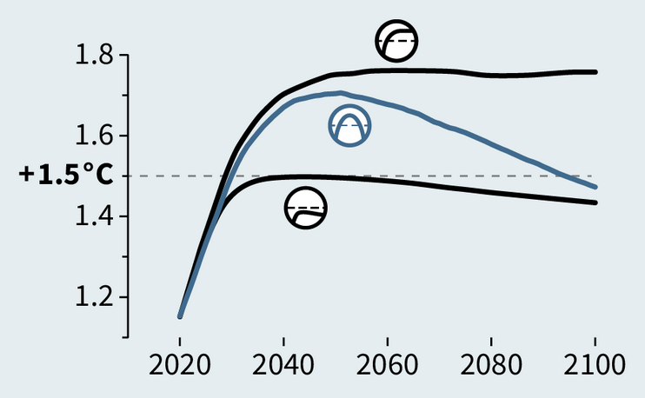
Keeping 1.5°C in reach
Geden & Reisinger 2025

Slide 33
Keeping 1.5°C in reach
Geden & Reisinger 2025

Slide 34
Keeping 1.5°C in reach
Temperature overshoot
> peak warming asap
> limit amount of time above 1.5°C
Geden & Reisinger 2025

Slide 35
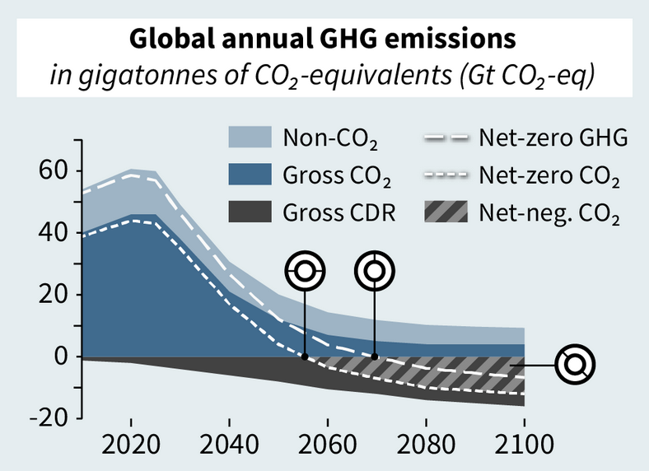
Keeping 1.5°C in reach
To halt global warming
> global net CO₂ emissions reach zero
Subsequent decline in global warming needs
> net negative CO₂ emissions
> total removals is greater than residual emissions of all long-lived GHGs
> Reducing CH₄ would limit peak warming
NZ CO₂
NZ GHG
Net-negative
Geden & Reisinger 2025

Slide 36
Keeping 1.5°C in reach
To halt global warming
> global net CO₂ emissions reach zero
Subsequent decline in global warming
> net negative CO₂ emissions
> total removals is greater than residual emissions of all long-lived GHGs
> Reducing CH₄ would limit peak warming
NZ CO₂
NZ GHG
GOAL
Net-negative
Geden & Reisinger 2025

Slide 37
Overshoot of the 1.5 degree global temperature goal means that net-zero has become a milestone, on the way to sustained net-negative emissions, rather than the endpoint.
Geden & Reisinger 2025

Slide 38
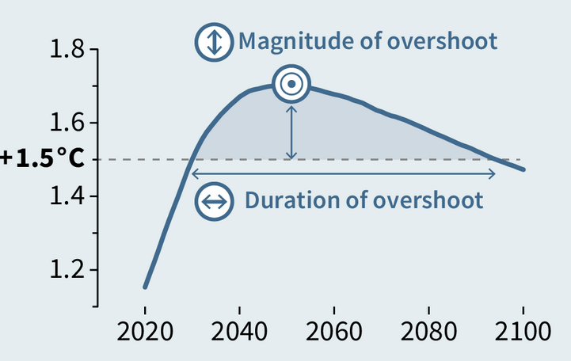
What we do now matters!
ICJ Advisory Opinion
> far reaching legal and political consequences for at national level
> states have legal obligations under the Paris Agreement
> in principle can be held liable if adequate action is not taken
Near-term GHG reductions
> reducing CO₂ emissions to net-zero asap on the way to net-negative
> substantial reductions in CH₄ emissions contribute to limiting peak warming

Slide 39
Why we're still ignoring the physics of climate change Professor Hannah Daly
Engineers Ireland Wi-Fi
Network: EI-Guest
Password: Engineersguest

Slide 40
Ireland’s emissions: Planned path vs. legal and physical limits
CB1
Average annual reduction since 2021: 3.5%
Carbon budget-compatible
GHG pathways
Start in 2025 → 8% annual reductions
2-year delay → 10% annual reductions
4-year delay → 15% annual reductions
6-year delay → 25% annual reductions
8-year delay → 80% annual reductions

Slide 41

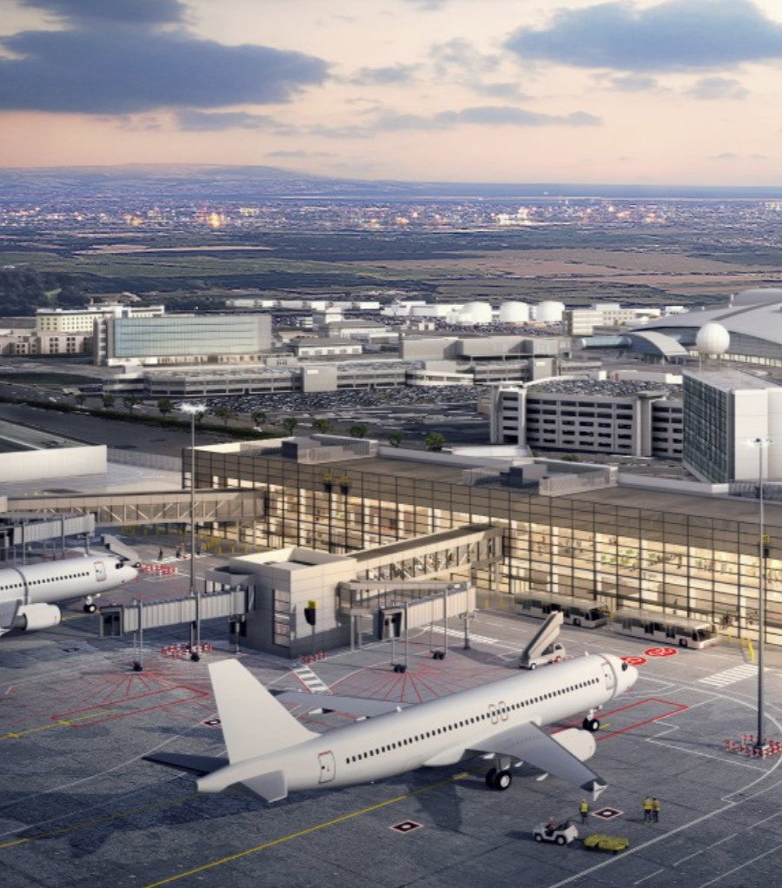
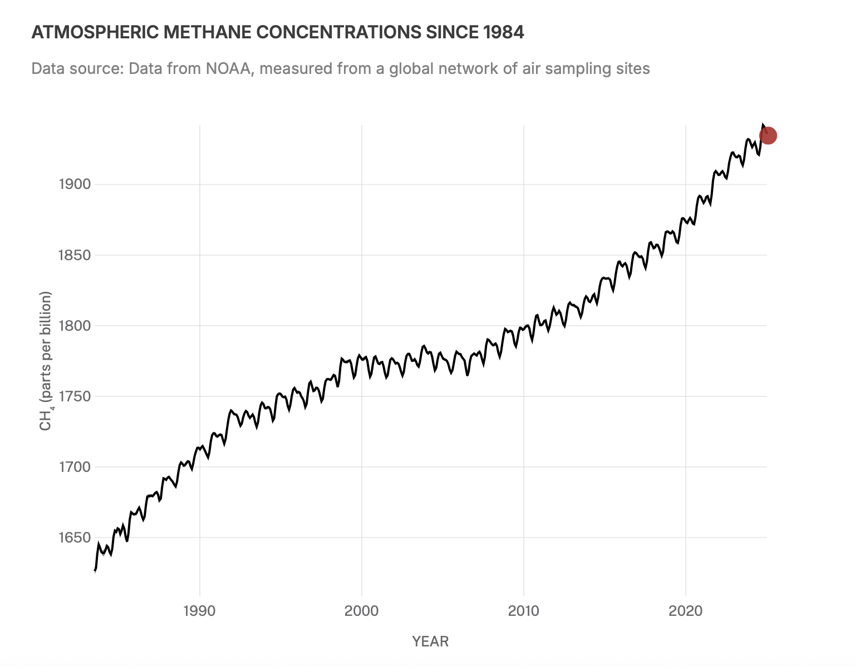
Where we are ignoring the physics
Data centres & gas lock-in
Airport expansion & emissions
“No additional warming” hiding warming

Slide 42


Slide 43

Panel Discussion
Session 1: Climate Action
Chair: Dr Jeanne Moore
Policy Analyst at National Economic and Social Council
Panel Members
Prof Brian Ó Gallachóir
Dr Tomas Mac Uidhir
Dr Róisín Moriarty
Prof Hannah Daly
Join at Slido.com
Code: 2338920
Engineers Ireland Wi-Fi
Network: EI-Guest
Password: Engineersguest

Slide 44
Engineers Ireland Wi-Fi
Network: EI-Guest
Password: Engineersguest
Short Break (20 mins)

Slide 45
Session 2 Energy Security
Chaired by Dr Ellen Diskin
Head of Net Zero Strategy & Sustainability at ESB Customer Solutions
Including the following presentations
Energy Transition system Readiness by Dr Fionn Rogan
Electricity Pricing by Dr Paul Deane
Exploring Energy Justice in Ireland by Jeanne Spillane
Community Benefit Funding and Ireland's Energy Transition by Dr Evan Boyle

Slide 46
Energy Transition System Readiness Dr Fionn Rogan
Engineers Ireland Wi-Fi
Network: EI-Guest
Password: Engineersguest

Slide 47
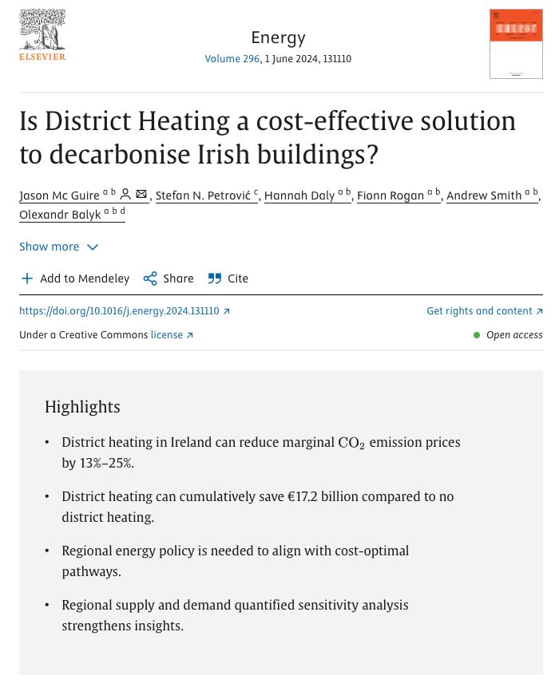

Is it feasible?

Slide 48
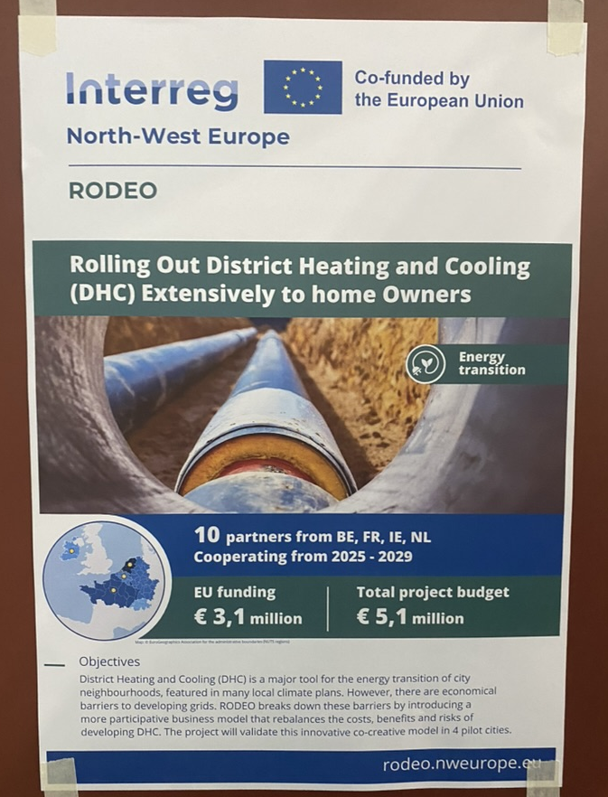
What are the non-technical factors impacting roll-out of District Heating?

Slide 49

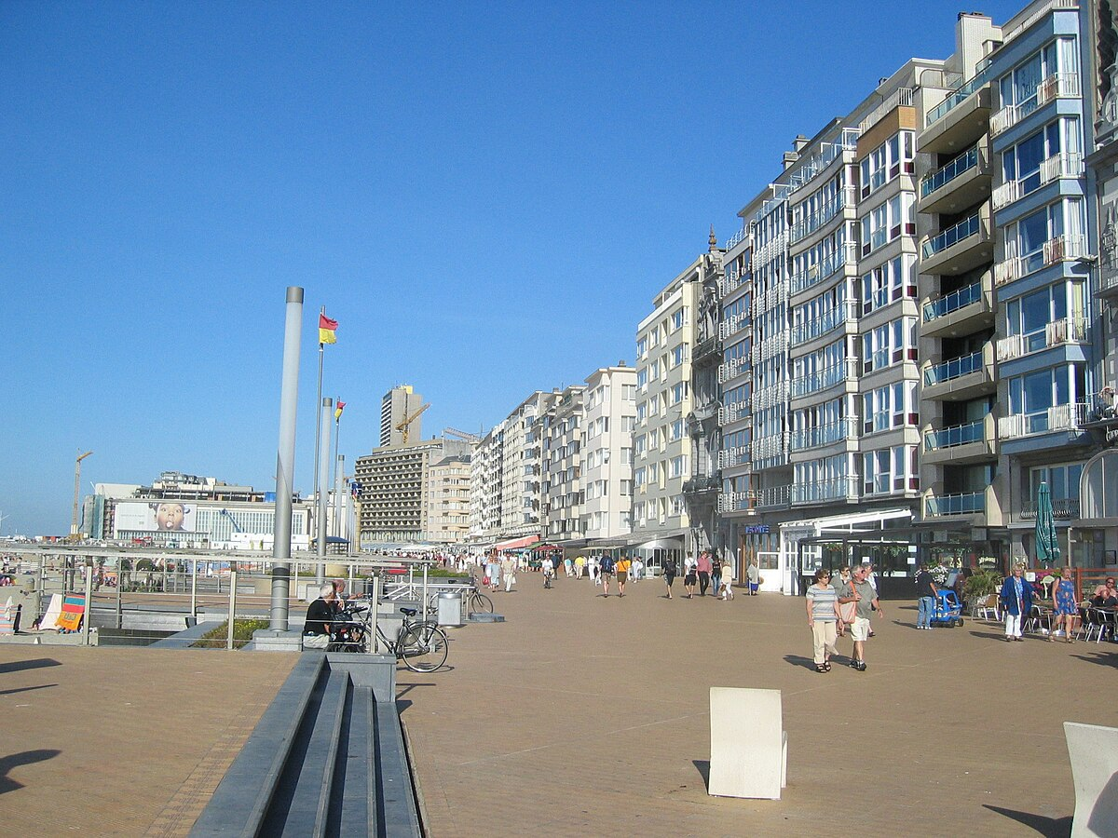
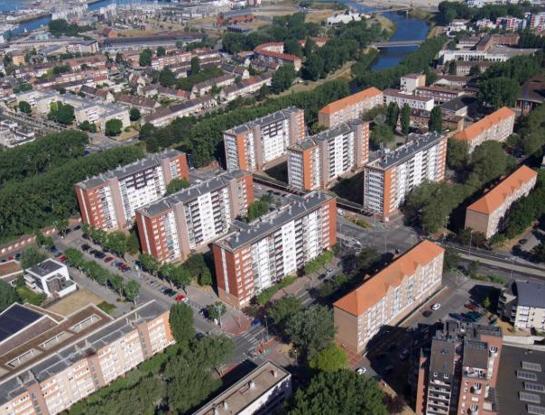
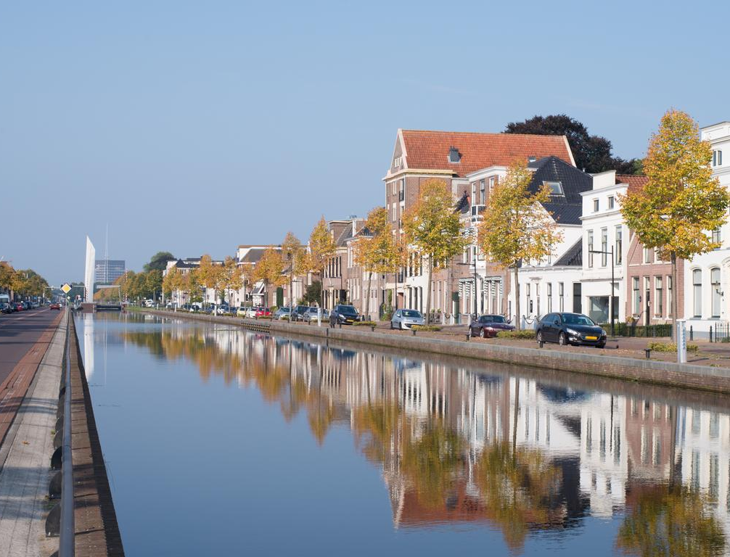
Rolling Out District Heating & Cooling (DHC) Extensively to home Owners [RODEO]
Project Partner Meeting, 25-27th Nov
Dublin, Ireland
Oostende, Belgium
Oostende, Belgium
Dunkerque, France
Assen, Netherlands

Slide 50
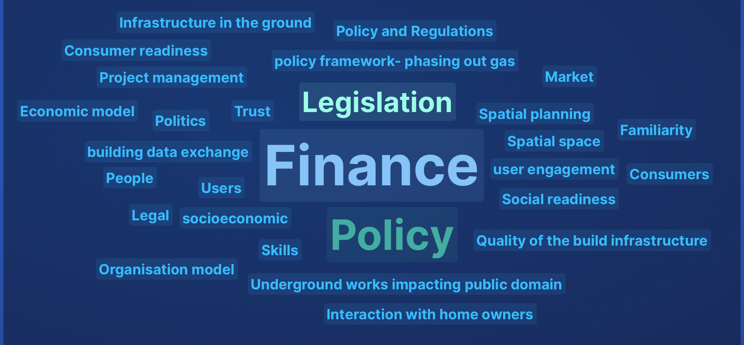
What are the non-technical factors impacting roll-out of District Heating? [RODEO PROJECT]

Slide 51
What are the non-technical factors impacting roll-out of District Heating? [DATA INSIGHTS]
Non-technical factors
Workshop
&
Innovation Journeys Framework*
District Heating System Readiness
*Source: (Grubb, McDowall & Drummond, 2017)

Slide 52
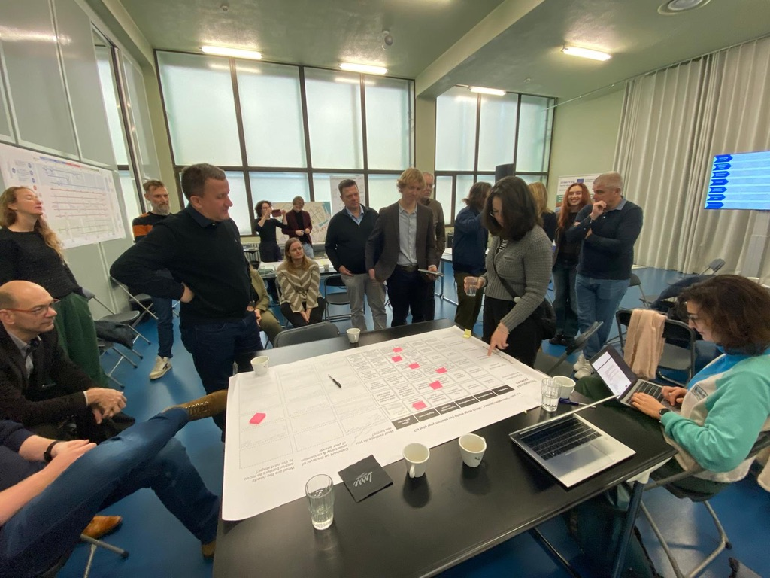
What are the non-technical factors impacting roll-out of District Heating? [WORKSHOP]

Slide 53
Technology Journey
Invention
Development
User Demand & Practices
Demand poorly understood
Potential market defined
Organisation & Supply Chain
One or two individuals
Venture or new unit
Demonstration
Commercialisation
Deployment
Wide Diffusion
Finances
Regulatory Environment
Institutionalisation
Demand created in first niche markets
Niche markets & practices established
Expanding beyond niche market, new practices expanding
Well defined user demand & practices established
First outsiders/entrepreneurs
Recruit/train specialists, develop supply chain
Grow operational staff & production capacity
Mature company or independent division
Speculative public/ internal funding
Targeted internal funds/project specific public grants
Targeted internal funds, project grants, angel or VC investors
1st sales, internal funds, project grants, angel/VC investor
First profits, first commercial debt and equity investment
Neutral or negative
Neutral or negative
Neutral regulation, minor amendments to mitigate negative aspects
Targeted positive additions or amendments
Broad positive additions, amendments or removals
Fully adapted regulatory environmental & market structure
Research teams, lone visionaries
Specialist technology institutions
1st technology associations, new civil service experts
Growing associations, dedicated government units
Infrastructure
Established associations, new governance responsibilities
Established associated, integrated governance responsibilities
Negative or neutral physical infrastructure
Infrastructure implications identified
1st moves away from negative physical infrastructure
Piggybacking on existing/first investments in new infrastructure
Broad repurposing of existing/installation of new infrastructure
Physical infrastructure fully repurposed, replaced or supplemented
Balance sheet, commercial equity & lenders

Slide 54
Technology Journey
Invention
Development
User Demand & Practices
Demand poorly understood
Potential market defined
Organisation & Supply Chain
One or two individuals
Venture or new unit
Demonstration
Commercialisation
Deployment
Wide Diffusion
Finances
Regulatory Environment
Institutionalisation
Demand created in first niche markets
Niche markets & practices established
Expanding beyond niche market, new practices expanding
Well defined user demand & practices established
First outsiders/entrepreneurs
Recruit/train specialists, develop supply chain
Grow operational staff & production capacity
Mature company or independent division
Speculative public/ internal funding
Targeted internal funds/project specific public grants
Targeted internal funds, project grants, angel or VC investors
1st sales, internal funds, project grants, angel/VC investor
First profits, first commercial debt and equity investment
Neutral or negative
Neutral or negative
Neutral regulation, minor amendments to mitigate negative aspects
Targeted positive additions or amendments
Broad positive additions, amendments or removals
Fully adapted regulatory environmental & market structure
Research teams, lone visionaries
Specialist technology institutions
1st technology associations, new civil service experts
Growing associations, dedicated government units
Infrastructure
Established associations, new governance responsibilities
Established associated, integrated governance responsibilities
Negative or neutral physical infrastructure
Infrastructure implications identified
1st moves away from negative physical infrastructure
Piggybacking on existing/first investments in new infrastructure
Broad repurposing of existing/installation of new infrastructure
Physical infrastructure fully repurposed, replaced or supplemented
Balance sheet, commercial equity & lenders
Notes:
Dublin

Slide 55
Technology Journey
Invention
Development
User Demand & Practices
Demand poorly understood
Potential market defined
Organisation & Supply Chain
One or two individuals
Venture or new unit
Demonstration
Commercialisation
Deployment
Wide Diffusion
Finances
Regulatory Environment
Institutionalisation
Demand created in first niche markets
Niche markets & practices established
Expanding beyond niche market, new practices expanding
Well defined user demand & practices established
First outsiders/entrepreneurs
Recruit/train specialists, develop supply chain
Grow operational staff & production capacity
Mature company or independent division
Speculative public/ internal funding
Targeted internal funds/project specific public grants
Targeted internal funds, project grants, angel or VC investors
1st sales, internal funds, project grants, angel/VC investor
First profits, first commercial debt and equity investment
Neutral or negative
Neutral or negative
Neutral regulation, minor amendments to mitigate negative aspects
Targeted positive additions or amendments
Broad positive additions, amendments or removals
Fully adapted regulatory environmental & market structure
Research teams, lone visionaries
Specialist technology institutions
1st technology associations, new civil service experts
Growing associations, dedicated government units
Infrastructure
Established associations, new governance responsibilities
Established associated, integrated governance responsibilities
Negative or neutral physical infrastructure
Infrastructure implications identified
1st moves away from negative physical infrastructure
Piggybacking on existing/first investments in new infrastructure
Broad repurposing of existing/installation of new infrastructure
Physical infrastructure fully repurposed, replaced or supplemented
Balance sheet, commercial equity & lenders
Notes:
Assen

Slide 56
Is it feasible?
See you at Energy Transition System Readiness Workshop!

Slide 57
Electricity pricing Dr Paul Deane
Engineers Ireland Wi-Fi
Network: EI-Guest
Password: Engineersguest

Slide 58
Electricity bills in Ireland are higher than other EU countries because:
it costs more to make electricity in Ireland and
it also costs more to move it around

Slide 59
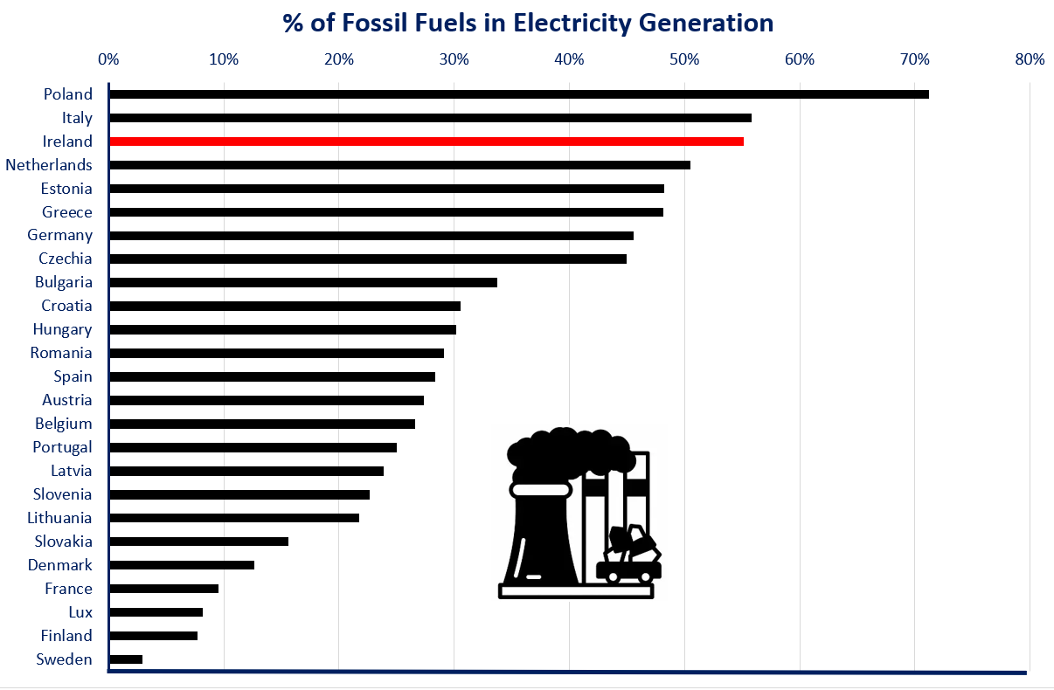
2023 Data

Slide 60
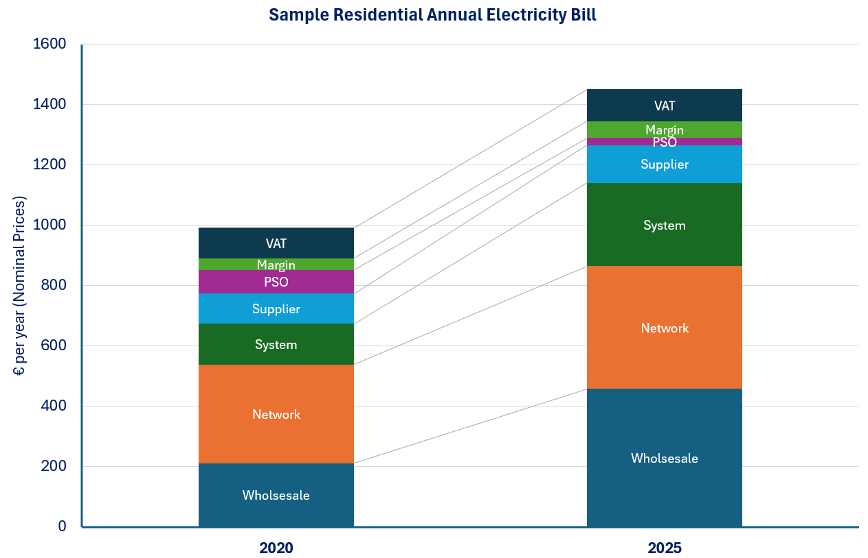
2020 2025

Slide 61
Question we asked for 2030
“Will the cost of suppling electricity to the market increase or decrease if we have more renewables”
We looked at an 80% RES-E Scenario
We looked at an 68% RES-E Scenario
We looked at an 54% RES-E Scenario
2024 Commodity Prices are assumed for all scenarios
Electricity demand is the same for all scenarios

Slide 62
 | 2024 40% RES-E | 54% RES-E | 68% RES-E | 80% RES-E
Annual Wholesale System Price (€/MWh) (A) | 108 | 105 | 81 | 54
Estimated Top requirement (€/MWh) (B) | - | 4 | 18 | 45
Resulting Energy Supply Price (€/MWh) (A+B) | 108 | 109 | 99 | 99

Slide 63
Commentary on Future Electricity Prices
Looking to the future, there is little evidence to suggest that residential electricity prices will be significantly lower than today.
The narrative that electricity will be ‘cheap’ in the future as we move to a renewable system creates a false expectation because it overlooks the fact that as the cost of generating electricity reduces (likely to levels similar to today’s wholesale price), the costs of moving greater volumes of electricity will increase to finance extra network infrastructure.
Policymakers instead should focus on the natural characteristic of a well-planned renewable system which can deliver affordable, clean, and secure electricity in contrast to cheap, polluting, and volatile power prices.

Slide 64
Exploring Energy Justice in Ireland Jeanne Spillane
Engineers Ireland Wi-Fi
Network: EI-Guest
Password: Engineersguest
Notes:
Paul talked about affordability – people and fairness
Minister Naughten mentioned this morning the dangers of people feeling unheard or unseen, while Jeanne talked about building societal understanding and support
Equity increases social acceptance and social licence

Slide 65
Exploring Energy Justice in Ireland
Background
Extensive literature on energy poverty in Ireland, though definition and measurement are still contested
Just Transition enjoys a growing focus in the Irish policy landscape
Limited exploration of energy justice in an Irish context
Notes:
The Irish government has set up a National Energy Affordability Taskforce and an Energy Poverty Action Plan Steering Group to ensure a whole of Government effort to support people in or at risk of energy poverty.
The Irish government established the Just Transition Commission which has promised to take a justice-based lens to climate action, taking into account factors such as poverty and affordability
Limited exploration of energy justice in an Irish context
The energy transition is inevitable, a just energy transition is not.

Slide 66
Energy Justice
“combines a social science perspective on energy (policy) with a natural science perspective (systems) and takes a whole systems approach to question how the positive and negative impacts of the energy transition are distributed, and those affected are recognised and included.”
Source: Jenkins, K. et al. (2016) https://doi.org/10.1016/j.erss.2015.10.004

Slide 67
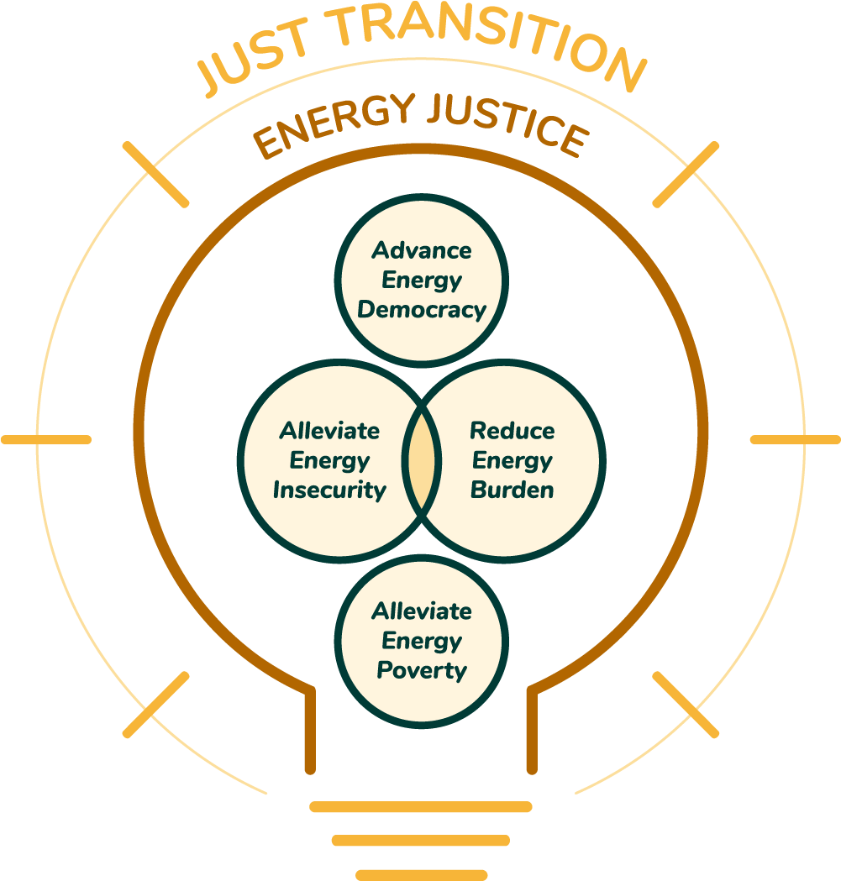
Notes:
Key to energy justice is the recognition of the interconnectedness between energy access, social justice, and environmental sustainability.
Energy Justice can encompass other areas of advocacy including “energy democracy”, “energy communities” or “energy equity”, some of which are well explored in an Irish context. Just Transition traditionally had a jobs focus, but more recently it has been proposed to expand this to unite climate, energy and environmental justice to assess where injustices will emerge and how they should be tackled.

Slide 68
Benefits of Solar
Making lives better in tangible ways
Reduced Energy Bills
FIT payments
When paired with battery – can improve flexibility and resilience
Improved Air Quality
Help Reduce Emissions
Notes:
So the idea of energy justice is a bit academic, right – what does it mean for people everyday? How can people benefit and contribute. Let's take domestic solar PV as an example.
Covering rooftops across the planet with solar panels could deliver almost 2/3 of current global power consumption and almost completely replace fossil fuel-based electricity. This could actually help lower global temperatures by up to 0.13 degrees.
National capacity has expanded to 2.1 GW, supported by over 155,000 rooftop installations across homes, farms and businesses. national target of 8 GW by 2030.
Benefits at individual and societal level

Slide 69
Energy Justice Implications
National support schemes for those in energy poverty in Ireland don’t include solar PV
Grant for solar PV – must own home and high initial cost
Explore
Socioeconomic implications
Geographical implications
Notes:
As Paul mentioned, Ireland has some of the highest energy costs in Europe.
ESRI at one point in recent years estimated over 29% of households in Ireland were experiencing energy poverty, with a risk of that rising to 43 percent.
Support schemes, including Warmer Homes Scheme, for those in energy poverty in Ireland don’t include solar PV

Slide 70
Methodology
Mixed methods research
Quantitative - merged three datasets
CSO SAPS data
Pobal Deprivation Index
SEAI data on Solar Installations from LACAP database
Notes:
CSO and Pobal Data from 2022 census, SEAI data is more recent

Slide 71
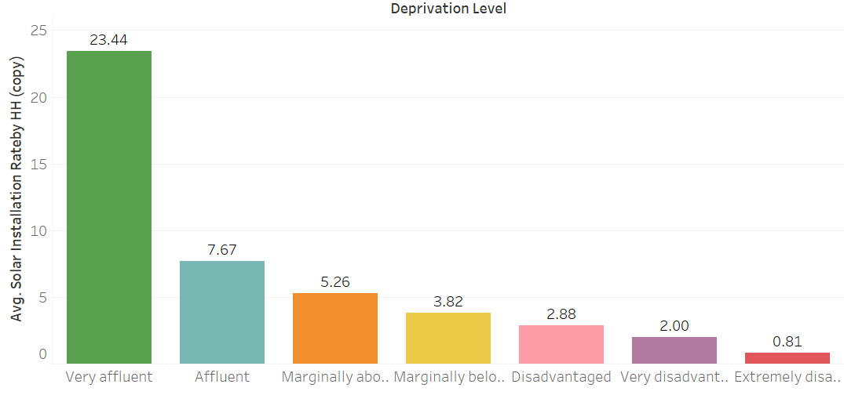
Average Rate of Solar Installation by Household by Deprivation Level Nationally
Solar Installation Rate
Deprivation Level (Pobal Deprivation Index)
Notes:
The average rate of solar installation by deprivation level by county – at a national level, the trend is stark.

Slide 72
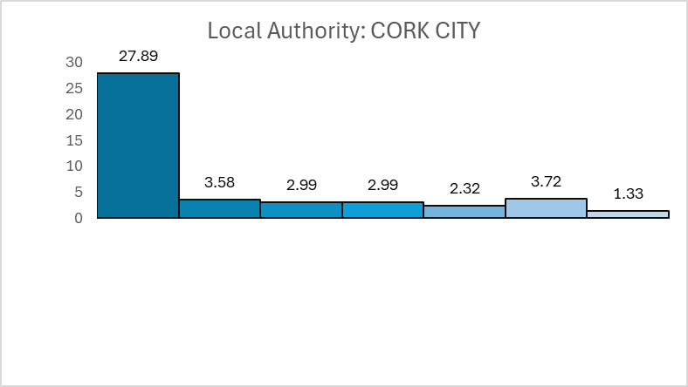
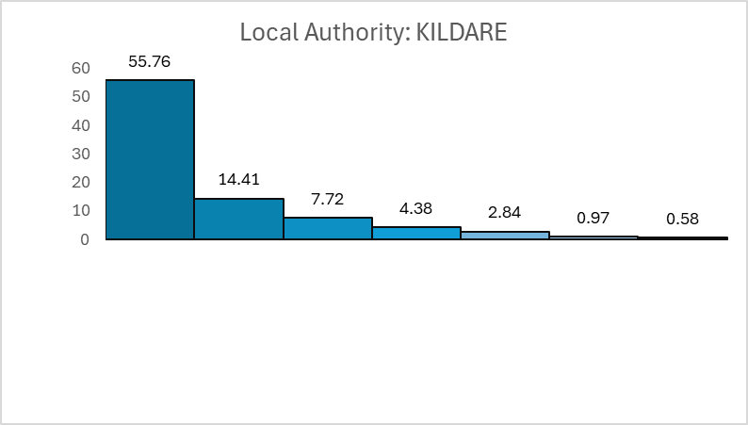
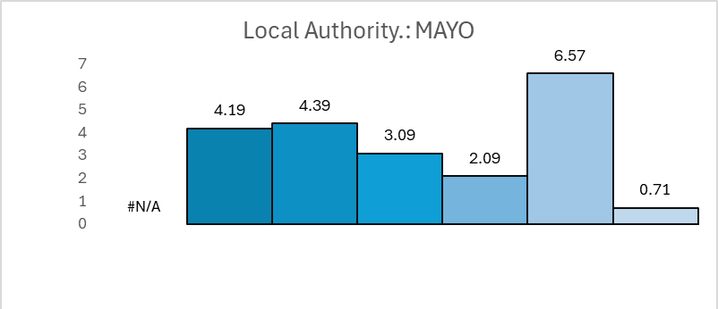
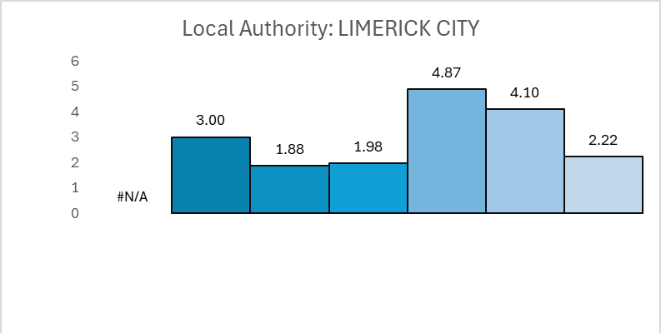
Average Rate of Solar Installation by Household by Deprivation Level By County
Solar Installation Rate
Deprivation Level (Pobal Deprivation Index)
Notes:
As you can see, there’s a wide variation between different local authorities. Household numbers and deprivation levels are taken from the 2022 census, while solar installations are more recent figures.

Slide 73
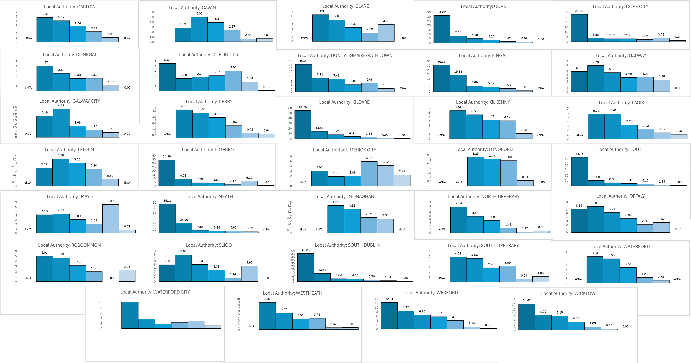
Average Rate of Solar Installation by Household by Deprivation Level By County
Solar Installation Rate
Deprivation Level (Pobal Deprivation Index)
Notes:
That’s a lot of charts! No need to worry about detail – more to illustrate the wide variation that exists at county level. Like the previous one, these charts show the average rate of solar installation by deprivation level but at a county level.
Please note, the scale of solar PV installation (Y axis) varies by county.
Some total figures by way of example – Dublin City has 6362 Very affluent HHs, and 2299 Extremely disadvantaged; Dun Laoghaire/ Rathdown has 3162 VA and 0 ED; Limerick City has 0 VA and 1937 ED

Slide 74
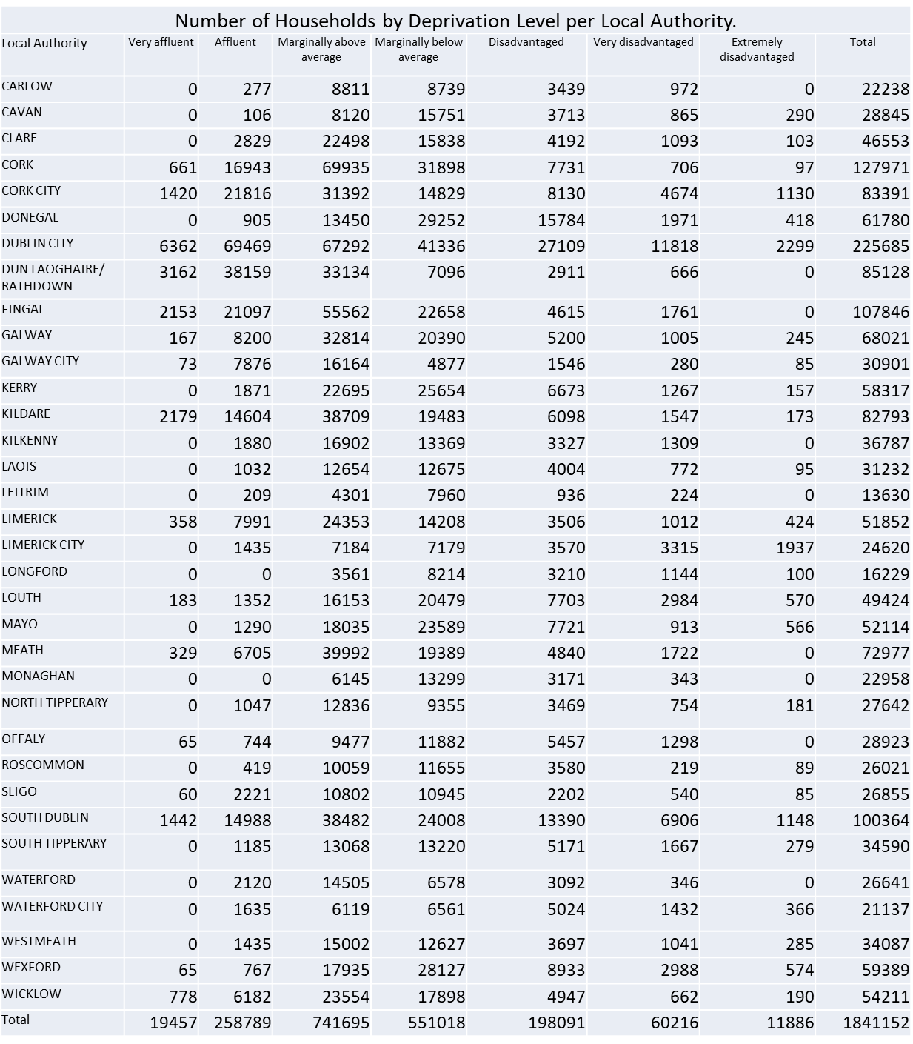

Slide 75
Main Findings
National figures show a clear negative correlation between levels of deprivation and domestic solar installations
More variation at a local level
Next Steps – explore this variation
Qualitative Approach
Interviewing key stakeholders working at county and regional levels
Exploring perspectives on local and regional policies and processes that may help explain the discrepancies
Are local level actions helping improve energy justice?

Slide 76


Connect With Me :
Questions or
Comments?
Please Get In Touch!

Slide 77
Community Benefit Funding and Ireland's Energy Transition Dr Evan Boyle
Engineers Ireland Wi-Fi
Network: EI-Guest
Password: Engineersguest

Slide 78
The Opportunity Ahead
If Ireland is to address the delays in infrastructure development, it is crucial to ensure that the community benefits from renewable energy projects are both substantial and meaningful. This could lead to new engagement opportunities, such as fostering trust, equity, and community capacity to meet Ireland's energy and sustainability goals. The transfer of €1 billion to communities over the 15-year lifetime of projects within 2030 targets has transformative potential.
Projected RESS Community Benefit Funding from 2030 Targets
 | Target by 2030 GW installed | GW currently installed | GW installed from 2025 | MWh per annum | Total CBF over 15 years
Solar PV | 8 | 1.8 | 6.2 | 5,974,320 | €179,229,600
Onshore Wind | 9 | 5 | 4 | 10,512,000 | €315,360,000
Offshore Wind | 5 | 0 | 5 | 17,520,000 | €525,600,000
Total CBF over 15-year lifetime of projects |  |  |  |  | €1,020,189,600

Slide 79
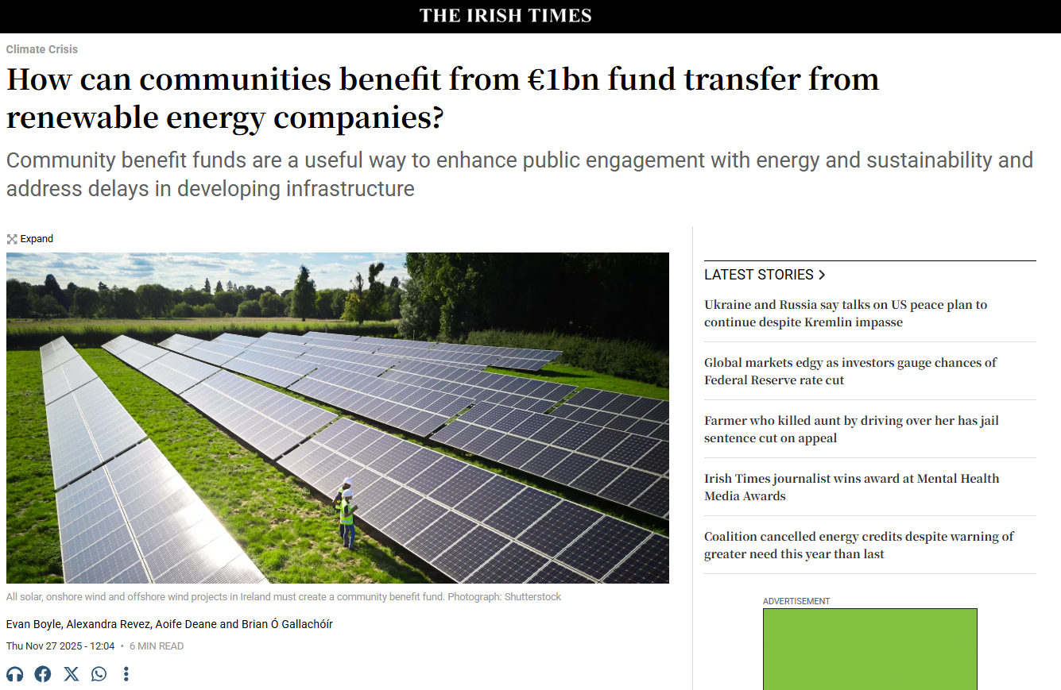

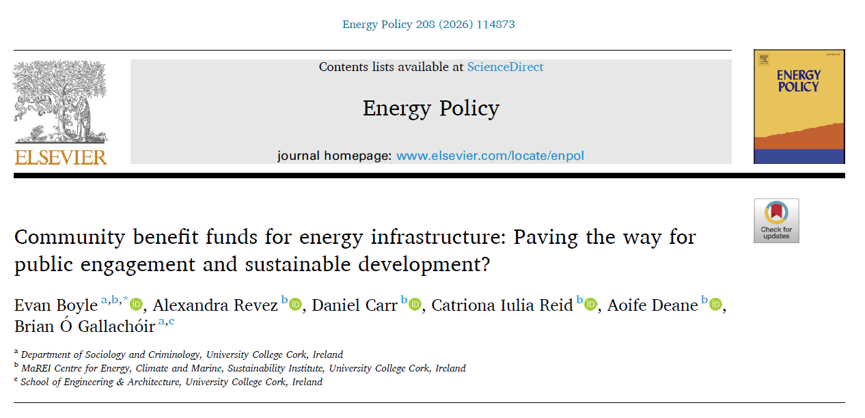
The Research
Examined and enhanced how communities engage with electricity‑grid development and community benefit funds to better align local participation with sustainability goals.

Slide 80
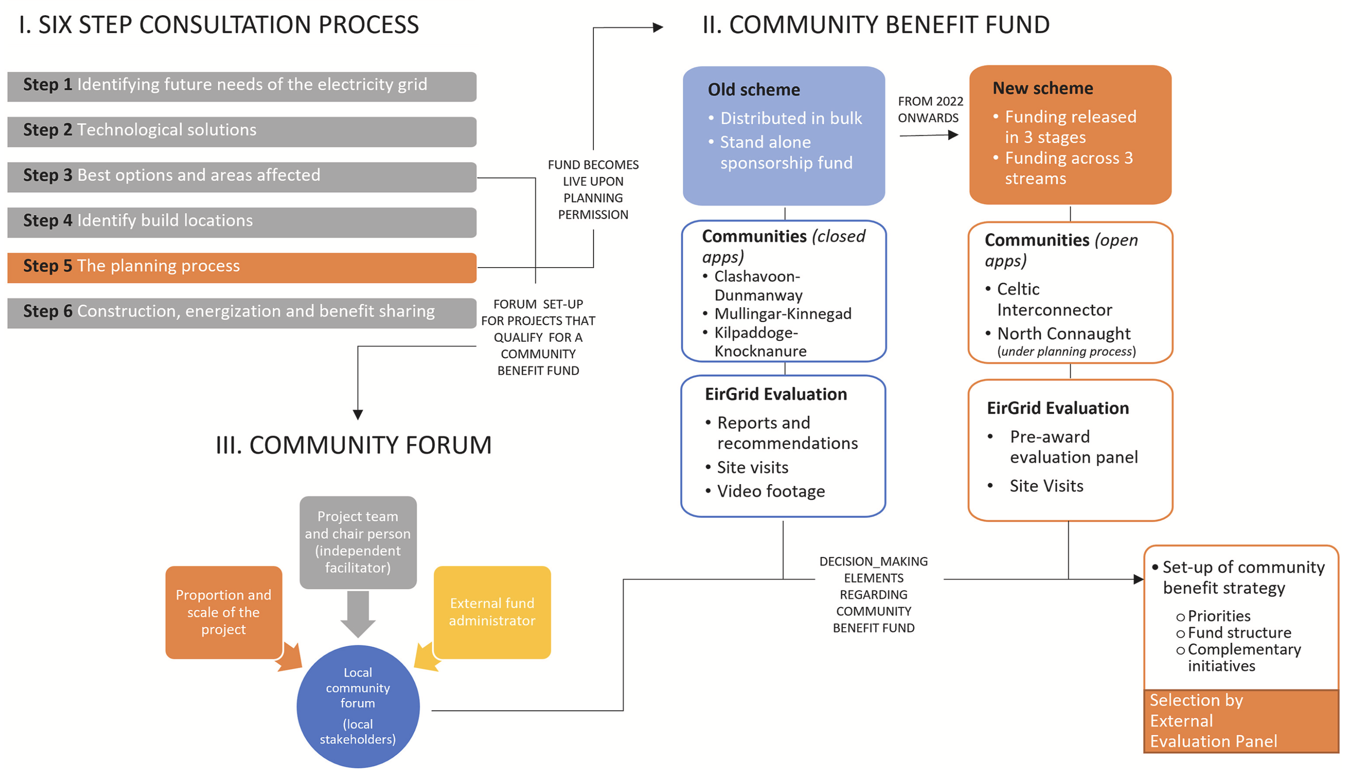
Insights from EirGrid’s Approach

Slide 81
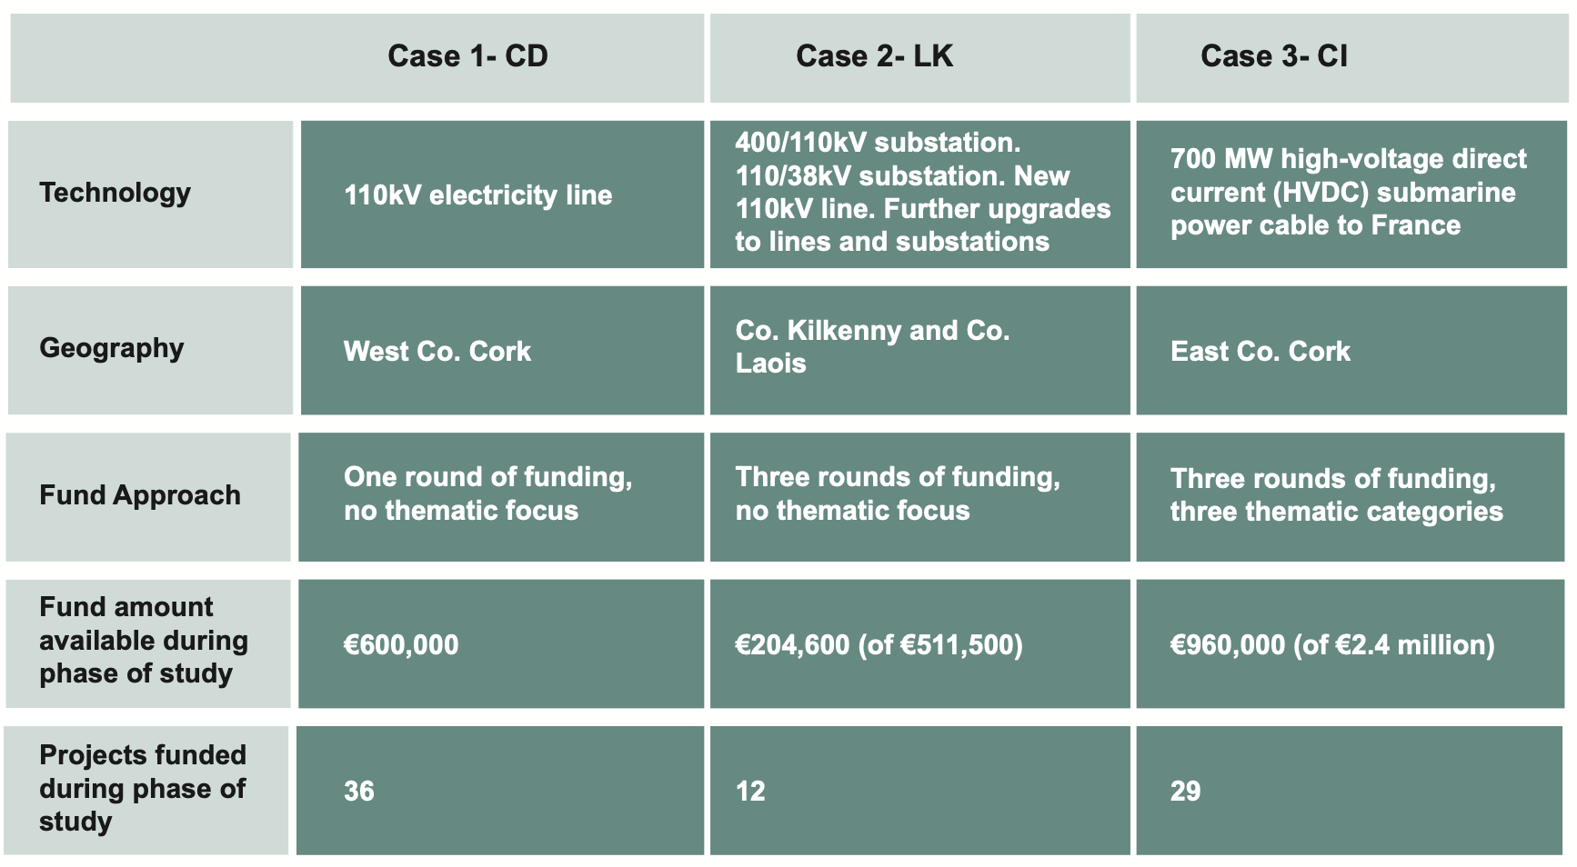
Insights from EirGrid’s Approach
Connecting community benefit funding to broader sustainability goals can create shared advantages.
More supports need for communities to build their capacity, including administrative, legal and financial advice alongside knowledge related to the energy transition under way.
Community forums play an important role as a type of public participation approach that includes local stakeholders, such as sports organisations, volunteer groups, and community councils.
Community sentiment highlighted the important role of expert fund administration in supporting groups through the process.
An internationally recognised approach by EirGrid, with early engagement and a flexible approach to working with communities to support them in delivering local projects.

Slide 82
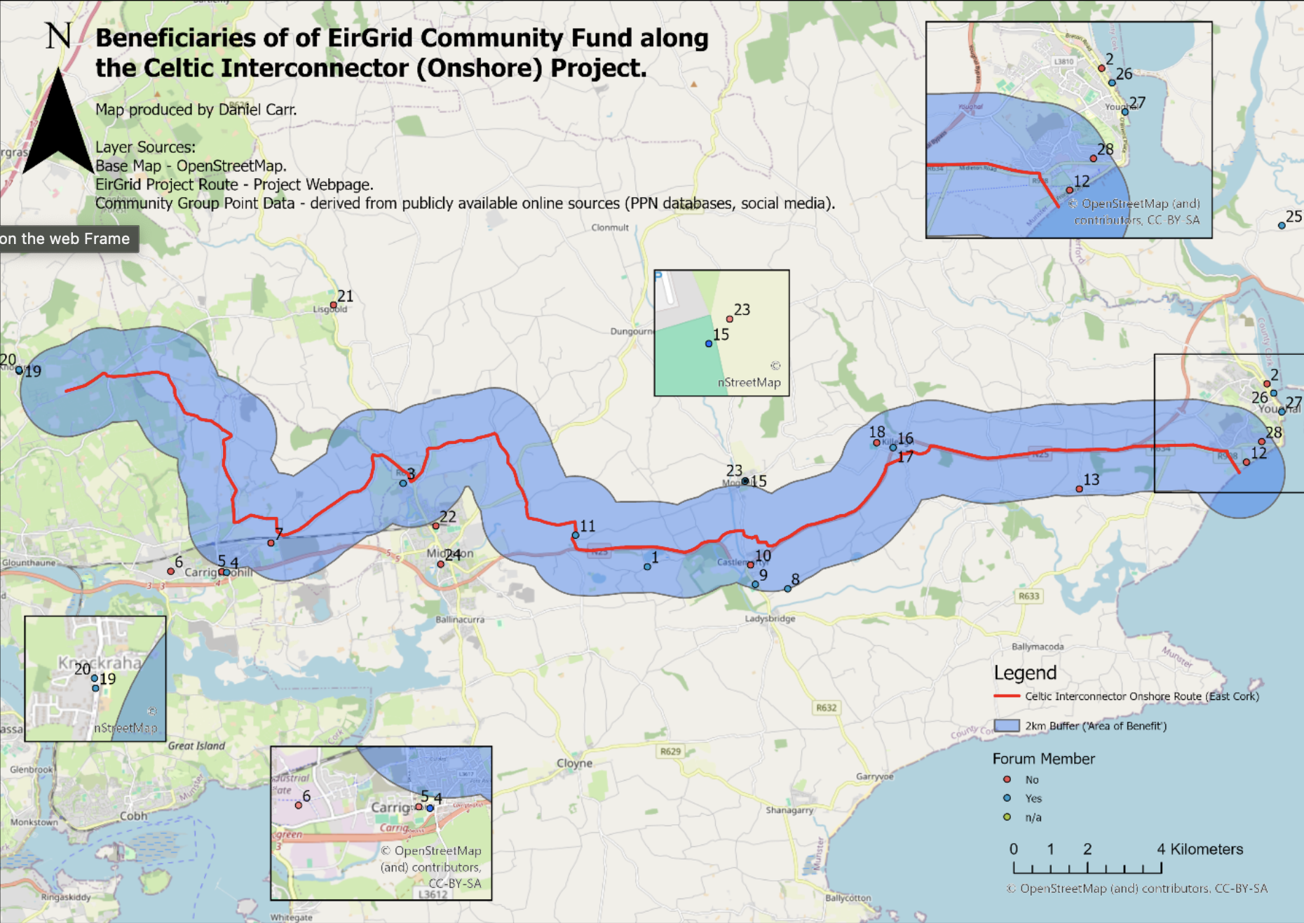

Doesn’t readily copy and paste to RESS
Defining what a “community” is for offshore wind not as clear cut as for grid upgrades
Fishing is the most clearly impacted industry, but the potential for opposition from residents with a view of these new structures should not be underestimated.
Potential for one “impacted” community to receive funding over another may raise serious concerns around fairness and equity, particularly in light of the coastal adaptation challenges which the country will face in the years to come
Timely learnings are now available based on the approach adopted by EirGrid in terms of the role of community forums to distribute the funds, but also in involving the communities in decision-making processes.
co-ordinated tracking, monitoring and evaluation of the impacts of community benefit funds to inform policy and practice over the next decade is needed.

Slide 83
Our Policy Recommendations
Aligning community benefit funding with wider sustainability objectives represents an opportunity for co-benefits, however, capacity building is needed which should not be led by individual developers alone.
The establishment of long-term needs analyses for communities located close to infrastructure may support alignment of CBF and wider objectives.
The development of a network of communities at different stages of accessing and implementing funding can support capacity building.
Developers should be supported through guidance in relation to best practice on community benefit funding and encouraged to work cross-organisationally to maximise the impact of funds.
Fund administration has a major role to play in the administration of funds in developing infrastructure needed for the energy transition. Best practice informed approaches should be implemented and support provided to create more service providers.
If capacity is not built in relation to sustainability and biodiversity at the community level, funding should not be ringfenced for such initiatives and instead remain open to community objectives.

Slide 84
Panel Discussion
Session 2: Energy Security
Chair: Dr Ellen Diskin
Head of Net Zero Strategy & Sustainability at ESB Customer Solutions
Panel Members
Dr Fionn Rogan
Dr Paul Deane
Dr Evan Boyle
Jeanne Spillane
Join at Slido.com
EPMG
Engineers Ireland Wi-Fi
Network: EI-Guest
Password: Engineersguest

Slide 85

Feedback Survey
Engineers Ireland Wi-Fi
Network: EI-Guest
Password: Engineersguest
Please complete this short feedback form so we can incorporate feedback received for next year’s event!

Slide 86
Poster Pitches

Slide 87
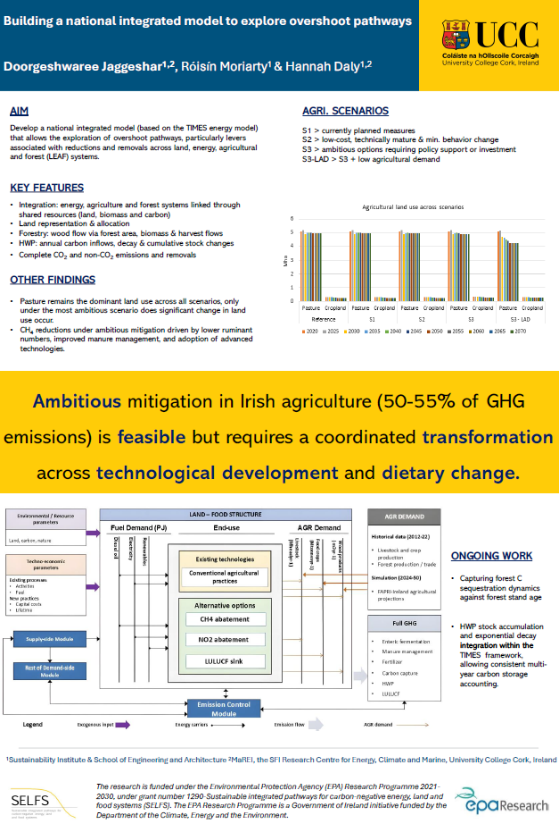

Building a national integrated model to explore overshoot pathways
Neha Jaggeshar

Slide 88
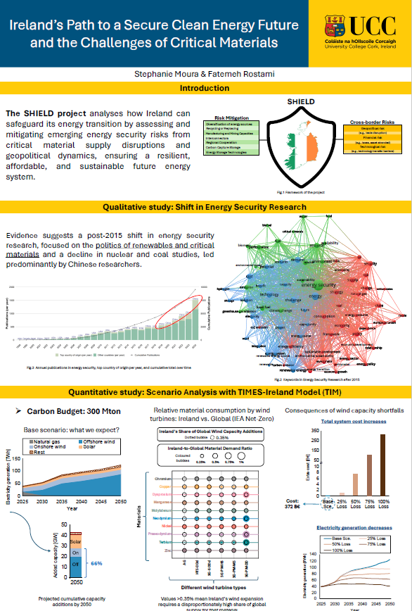


Ireland’s Path to a Secure Clean Energy Future and the Challenges of Critical Materials
Dr. Stephanie Moura
Dr. Fatemeh Rostami

Slide 89


Journeys Toward Rural Sustainability in the Dingle Peninsula
Dr Alexandra Revez

Slide 90
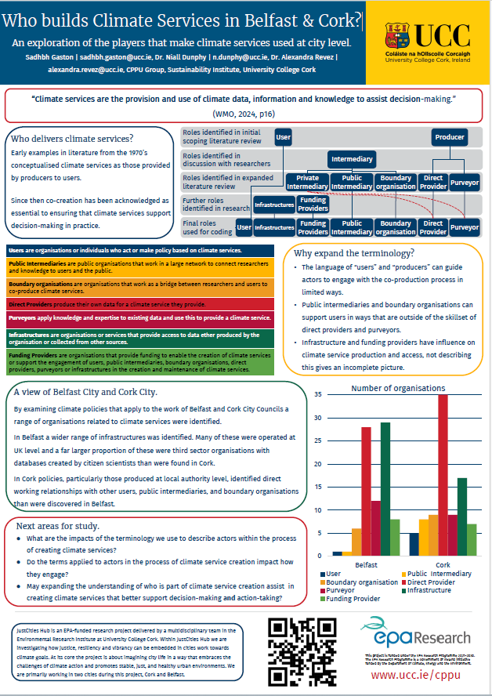

Who builds Climate Services in Belfast & Cork?
Sadhbh Gaston

Slide 91
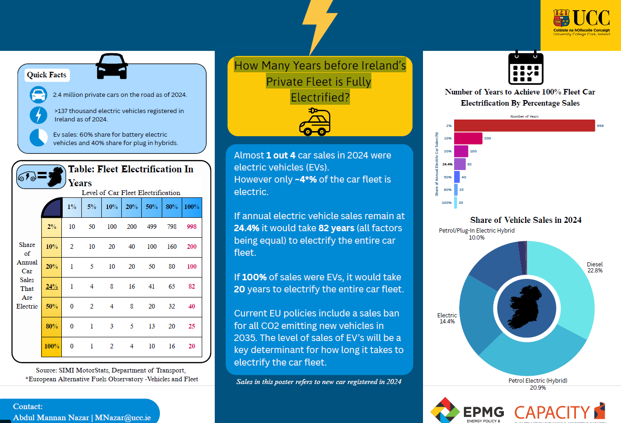

How Many Years before Ireland’s
Private Fleet is Fully
Electrified?
Mannan Nazar

Slide 92
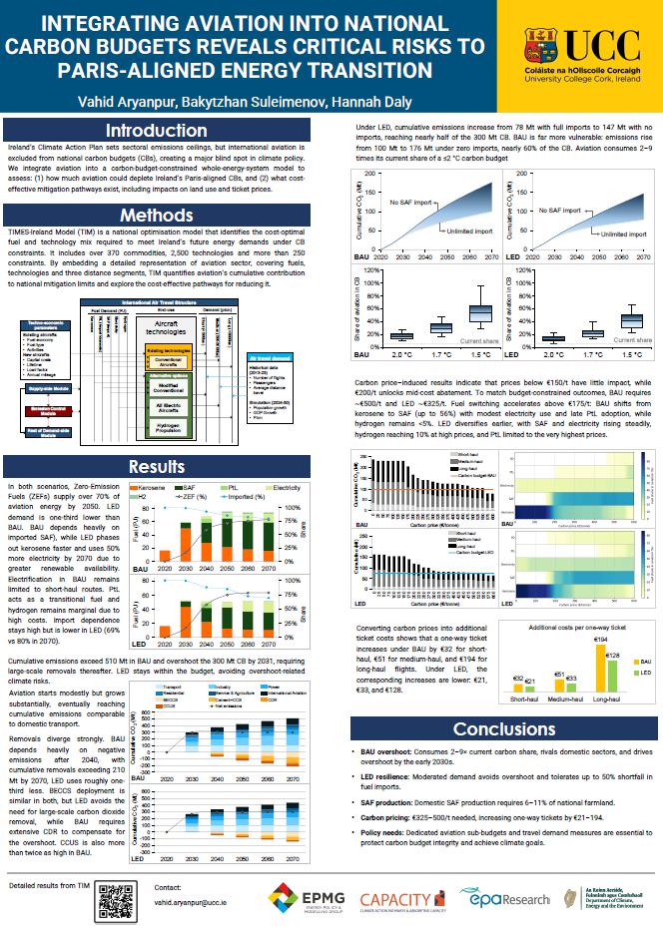

Integrating Aviation into National Carbon Budgets Reveals Critical Risk to Paris-Aligned Energy Transition
Dr Vahid Aryanpur

Slide 93
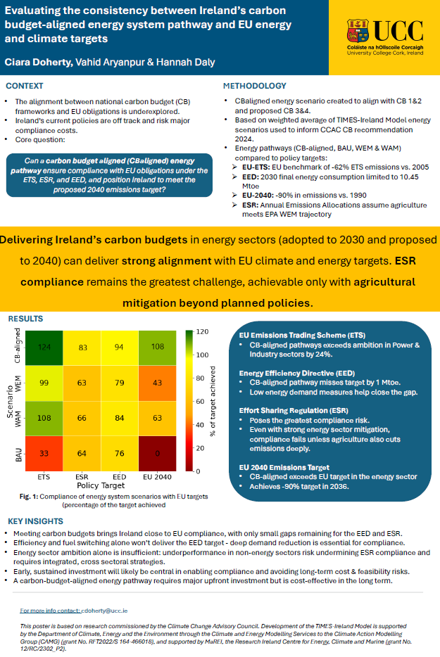

Evaluating the consistency between Ireland’s carbon budget-aligned energy system pathway and EU energy and climate targets
Ciara Doherty

Slide 94
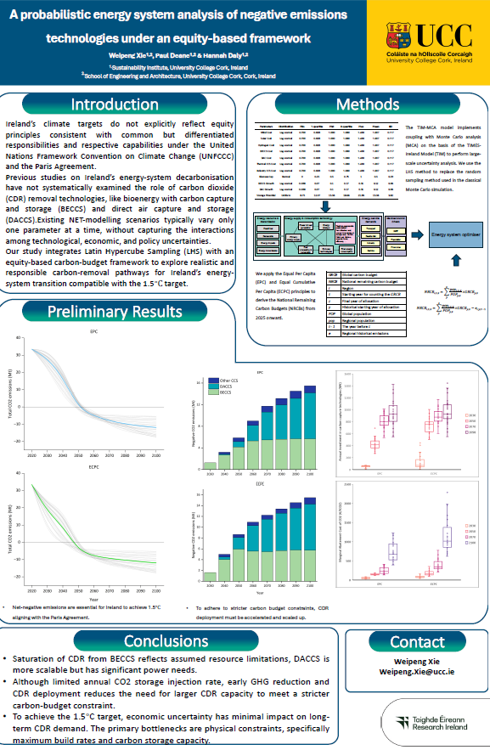

A probabilistic energy system analysis of negative emissions technologies in deep decarbonisation pathways
Weipeng Xie

Slide 95
Closing Keynote
Eamon Ryan
Former Minister Department of Climate, Energy and the Environment and Department of Transport

Slide 96

Thank you all for attending, participating and engaging with us.
Wishing you all a happy and restful holiday season
See you at next years event!

